Slide 1

Intelligent E-Commerce Analytics: Fraud Detection and Insights through Machine Learning
Anurag Jaipal Rathore
x23271302

Slide 2
Introduction
Classification is a technique of supervised learning technique whereby an algorithm learns from the labeled data to classify unknown data into given classes.
Regression is another machine learning algorithm that is implemented to classify dependent variables into a category based on their input variables.
The project focuses on text analysis which is crucial where customer feedbacks are assessed with a view of classifying it as either positive, negative, or even neutral.
Cluster analysis involves sorting similar data based on a distance or similarity measure. One of the methods used in unsupervised learning, K-Means Clustering.
Notes:
The essential aspect of increasing profitability and cost control in today’s intense business environment is the understanding of customer behavior and the prevention of fraudulent activities. The main aim of the project is to use different data mining and machine learning methods to solve several problems that may concern business organizations, such as customer rating issues, cost estimation, fraud identification, and sentiment classification. Thus, this work is invaluable for improving fraud detection and analysis of customer behavior to improve customers’ financial situation and improve their overall satisfaction.

Slide 3
Research Objectives and Questions
Objectives
To assess customer ratings and related characteristics regarding entities and put them into certain categories.
To predict cost values using customer ratings as well as any other numerical value that may be associated with an item.
To analyze sentiment and categorize the customer reviews to gain an understanding of them.
To cluster transactions to discover possible anomalies in terms of temporal patterns.
To identify correlations within or between the attributes of transactions for improved fraud identification.
Research Questions
Research Question 1: What are the main variables involved in the determination of the nature of customer ratings?
Research Question 2: How can regression modeling improve cost prediction results?
Research Question 3: What influences the difference in the sentiment of customer feedback concerning different product categories?
Research Question 4: Which clusters suggest high-risk or suspicious behavior?
Research Question 5: Which transaction attributes have been identified as relevant to the presence of fraud most of the time?
Notes:
The purpose of evaluating customer ratings and similar attributes is to segment entities about customers’ preferences, opinions, and actions. Business organizations are in a position to discover patterns that associate ratings generated by customers with attributes of products or services including quality, services offered, and prices. The objective involves making estimates of cost using data such as customer ratings together with other quantitative data like price, quantity, or features. The idea of this research objective is to employ methods of sentiment analysis to categorize customer feedback into positive, negative, or neutral sentiments. This approach is helpful since it may help businesses achieve greater insight into the perceived value their products or services have to customers. The purpose of this objective relates to the identification of time-related patterns in transaction grouping to identify symptoms of anomalous behavior. Holders of business can therefore use the temporal analysis of transactions to detect the outliers, do fraud detection, and more importantly comprehend the customer purchasing pattern over the period, thus enhancing the decision and risk management. One of the essential objectives is because it focuses on intra and inter-attribute dependencies of attributes like location, amount, time, and customer history in order to find out co-relation which may indicate fraud.

Slide 4
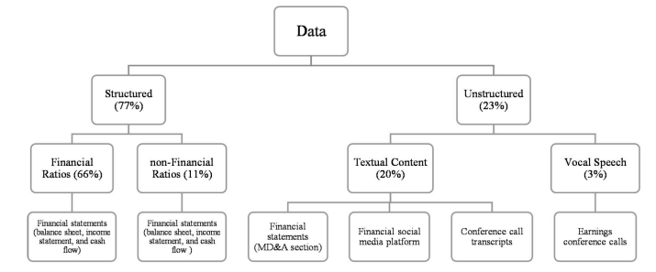
Related Work
Naive Bayes considers each feature to be independent of others, enabling it to process even large-scale sets in real quick time.
Linear Regression has been successfully applied for cost value predictions based on customer ratings based on the regression analysis for analyzing customer sentiment.
Sentiment analysis, particularly through Naive Bayes and Random Forest, is one of the most common applications in product or service feedback analysis.
Transaction data normally consist of such parameters as transaction amount, time, and place characteristics of customer behavior
Notes:
The study critically reviews the related literature about the application of machine learning models including Naive Bayes, Random Forest, Linear Regression, and K-Nearest Neighbors for detecting customer sentiment, predicting costs, and analyzing transactional data. The two classification models are established for analysing purposes like Naive Bayes, and Random Forest.Naive Bayes is simple and efficient, it can be very useful for sentiment analysis in customer reviews, particularly when data is of high dimensionality. Naive Bayes considers each feature to be independent of others thereby, enabling it to process even large-scale sets in real quick time. The essential limitation is in the assumption of feature independence, which may not be granted for real-world customer review datasets. The ensemble learning method known as the Random Forest application aggregating outputs of several decision trees is believed to be among the most powerful models for classification tasks, especially with structured data focused on customer ratings or transaction attributes. Random Forest models can be very expensive as the number of decision trees grows and are usually considered less interpretable compared to simpler models, which may reduce their utility in some business contexts where model interpretability is paramount. Although Linear Regression has been successfully applied for cost value predictions based on customer ratings based on the regression analysis for analysing customer sentiment. K-Nearest Neighbors (KNN)-Regression Model K-Nearest Neighbors is another well-known regression model that finds its perfect application in predicting continuous values where relationships among features are complex and nonlinear. KNN works by averaging out the results of the nearest neighbors in the feature space and is thus very good at capturing any sort of local pattern. KNN is a non-parametric technique and thereby Linear Regression, assumes less about the data.

Slide 5
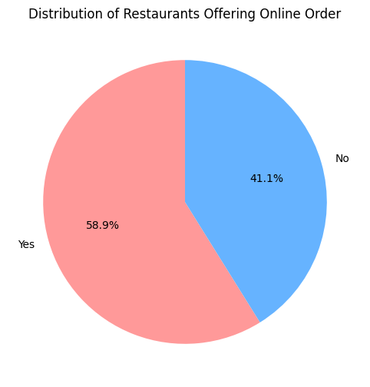
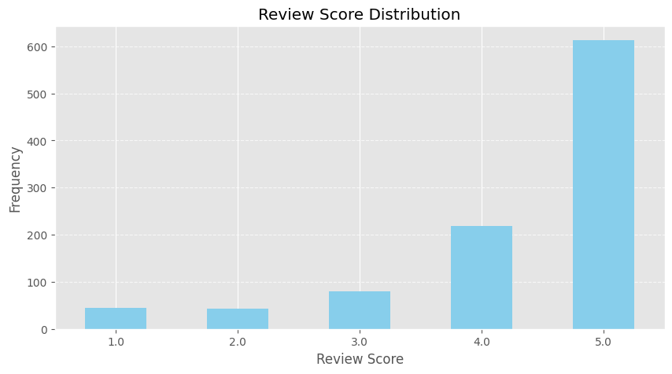
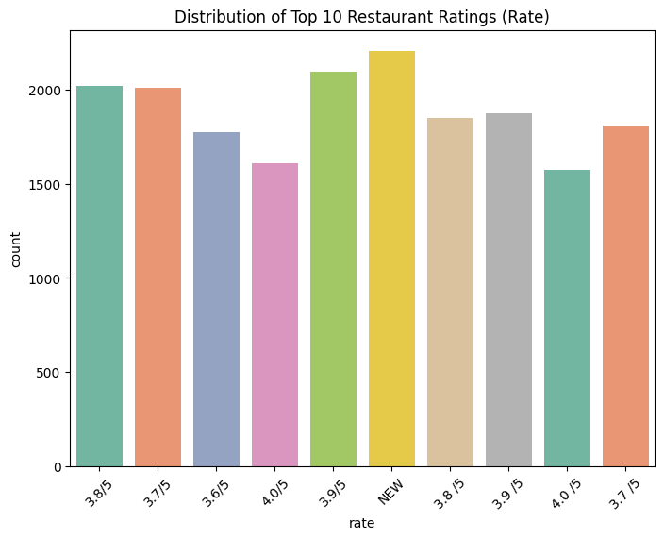
Data Mining Methodology
CRISP-DM approach has been used for the analysis of data mining by following the research question.
The classification phase involves predictive models, like Random Forest and Naive Bayes, being applied to data that has been categorized with predefined labels.
The regression task is to predict a rating of restaurants using continuous variables of the same set of features.
The target variable for this is fraud or non-fraud labels of transactions.
Notes:
The Amazon Books Reviews dataset is credited to Kaggle and presents customer reviews for various books listed on Amazon. Indeed, this dataset is made up of unstructured textual materials, including full reviews of the books, ratings, and metadata about the books. Some of the important attributes in the dataset include review text, rating, book title, and author. The use of this dataset was majorly associated with text analysis preprocessing, sentiment analysis, and topic modeling.
The Zomato Restaurant Data is available in Kaggle; the dataset shows minute details of various restaurants listed in Zomato based on their ratings, location, type of cuisine, average cost, number of votes received, etc. The following dataset has been used for classification and regression analyses.
The classification task is to predict the rating category, i.e., bins of ratings like 1-2, 2-3, 3-4, and 4-5, based on features regarding restaurant type, location, and average cost for two people. The regression task was to predict a rating of restaurants using continuous variables of the same set of features.
The Online Payment Fraud Detection dataset was also retrieved from Kaggle. It includes transactional data regarding online payments, such as transaction amount, kind of payment, and user activity. The target variable for this is fraud or non-fraud labels of transactions. This dataset has been used to carry out unsupervised machine learning techniques, such as clustering, on transactions to track down unusual patterns that show fraud.

Slide 6
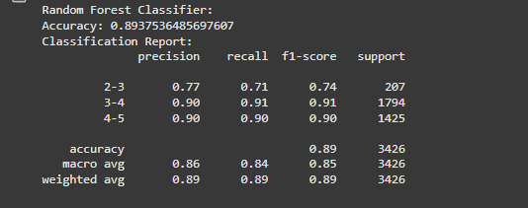
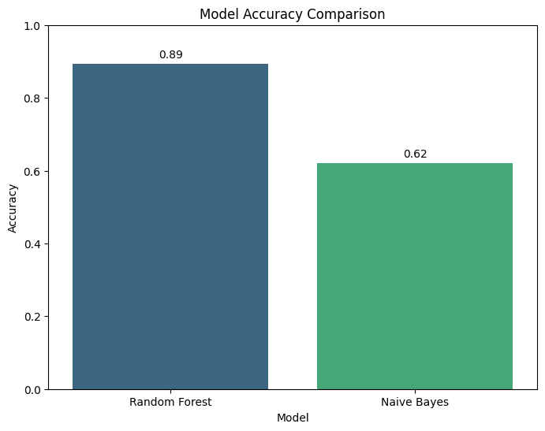
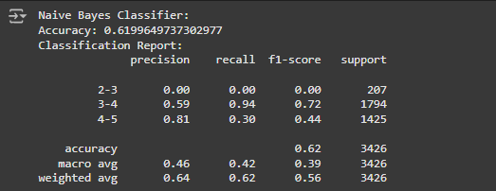
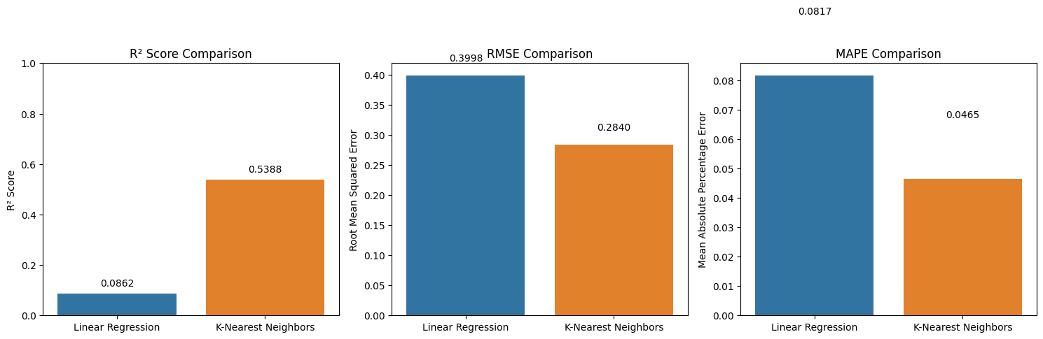
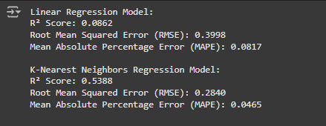
Classification and Regression
The Classification Report of Random Forest Classifier by precision, recall, f1-score, and support of different classes involved in the classification
The Naive Bayes Classifier report gears up by showing the same performance metrics as the report for the Random Forest Classifier.
Model Accuracy Comparison shows the general accuracy of the models Random Forest and Naive Bayes are compared.
Comparison of two regression models such as the Linear Regression and the other one is K-Nearest Neighbors. the validity of the data, after which it divides it into a training set and a testing set.
Notes:
The Classification Report of Random Forest Classifier by precision, recall, f1-score, and support of different classes involved in the classification. These can all provide insight into how well the model is performing in predicting the right target classes. Confusion Matrix of Random Forest Classifier performs the model on correctly and incorrectly classified instances of the test dataset. It is a matrix that will help in determining the specific reasons behind the model's poor or good performance. The Naive Bayes Classifier report gears up by showing the same performance metrics as the report for the Random Forest Classifier. This allows a comparison directly of the capability of the two models against each other. Confusion Matrix of Naive Bayes shows the performance of the Naive Bayes Classifier. Comparing the confusion matrices may help suggest the relative strengths and weaknesses of the two models. Model Accuracy Comparison shows the general accuracy of the models Random Forest and Naive Bayes are compared. This may lead to easier detection as to which model has outperformed the other and make an educated decision on which model best fits based on accuracy rate. Comparison of two regression models such as the Linear Regression and the other one is K-Nearest Neighbors. the validity of the data, after which it divides it into a training set and a testing set. The models are then trained and evaluated on test data using three performance metrics such as 𝑅2 Score, Root Mean Squared Error, and Mean Absolute Percentage Error.

Slide 7
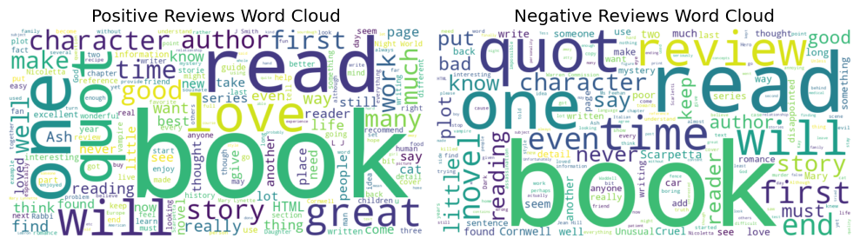
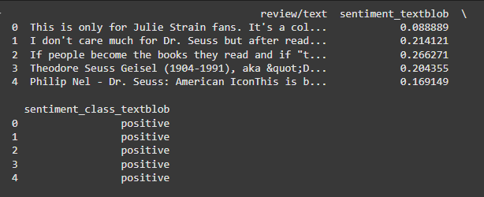
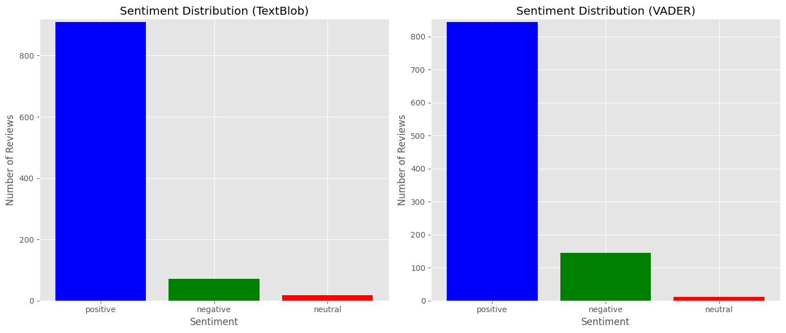
Text Analysis
The Word Cloud for Positive and Negative Reviews presents the most recurring word usage within positive and negative reviews.
The result of Sentiment Analysis shows the review text is classified into positive or negative.
The distribution of sentiment scores for both text blob and VADER sentiment analysis techniques.
K-means Clustering (PCA) shows the principal component analysis and the data has been clustered.
Notes:
The Word Cloud for Positive and Negative Reviews presents the most recurring word usage within positive and negative reviews. Insight will be achieved into the sentiment customers have reflected through review texts. The result of Sentiment Analysis shows the review text is classified into positive or negative. The general trend of the reviews summarized and to proceed further in understanding the hidden trend. The distribution of sentiment scores for both text blob and VADER sentiment analysis techniques. It shall probably give an idea about the consistency and distinction between these two areas of sentiment analysis. K-means Clustering (PCA) shows the principal component analysis and the data has been clustered. The presence of subgroups or segments within the data could be useful in further analysis and subsequent decisions. The Frequency Itemsets represent the support for different transaction types, providing a quantitative view toward the assessment of the relative frequency of diverse transaction categories within the dataset.

Slide 8
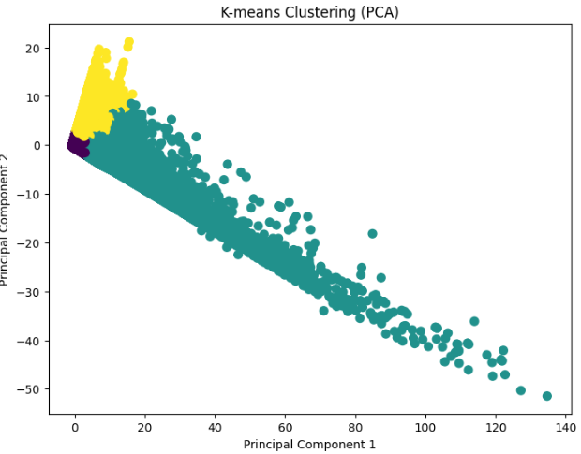

Clustering and Apriori Algorithm
K-means Clustering (PCA) shows the principal component analysis and the data has been clustered.
The Frequency itemset represent the support for different transaction types, providing a quantitative view toward the assessment of the relative frequency of diverse transaction categories within the dataset.
The prevailing trends in the transactions where an analysis needs to be done regarding striking trends or imbalances.
The presence of subgroups or segments within the data could be useful in further analysis and subsequent decisions.
Notes:
The Frequency Itemsets represent the support for different transaction types, providing a quantitative view toward the assessment of the relative frequency of diverse transaction categories within the dataset. The information can be useful in assessing the prevailing trends in the transactions where an analysis needs to be done regarding striking trends or imbalances. K-means Clustering (PCA) shows the principal component analysis and the data has been clustered. The presence of subgroups or segments within the data could be useful in further analysis and subsequent decisions.

Slide 9
Evaluation of methodology
Random Forest appears preferable for usage because it can better recognize various properties of data by means of combining results obtained through several decision trees.
Naive Bayes tends to work well particularly when using the assumption of independence is reasonable best.
Linear Regression is used when dependent variables are continuous; it offers interpretations of the importance of these variables to the dependent variable.
KNN is great when using regression problems since the nature of problems changes and it can be useful in cases when the connection between variables is not linear.
Notes:
Linear Regression: The research design involves straight-line relationships among variables or in some cases simply to find the minimum of the sum of squared residual. Linear Regression is used when dependent variables are continuous; it offers interpretations of the importance of these variables to the dependent variable.
K-Nearest Neighbors (KNN): In its functionality, similar to any non-parametric model, KNN employs the average cases of the K-nearest data as its prediction. KNN is great when using regression problems since the nature of problems changes and it can be useful in cases when the connection between variables is not linear.
Unsupervised Machine Learning and Association Rule Mining
K-means Clustering: K-means clustering classified the data into three clusters. The first step in the choice of the methodology was data scaling through StandardScaler to bring the dataset to a normal scale. The quality of cluster formation was assessed based on the losses Within-Cluster Sum of Squared Errors (WSSSE) for compactness, and the Davies-Bouldin index, according to the overall performance.

Slide 10
Performance Measures
The simplest measure to calculate which involves the number of correct predictions over the actual prediction done.
The accuracy rate of actual positive prediction, recall demonstrates well all positive data are identified and the F1-score works as a balance between Precision and Recall values.
The Receiving Operating Characteristic curve and its globalization, the AUC is used when comparing models at various thresholds.
Standard error of mean estimates the mean square error or the typical magnitude of the variant from the mean of the data set used in the model.
Notes:
Classification Models
Random Forest and Naïve Bayes are mostly applied to classification forms of problems, meaning that these two algorithms are used in cases where the variable to be predicted must belong to some particular category [21]. The performance of these models is typically measured using:
Accuracy: The simplest measure to calculate which involves the number of correct predictions over the actual prediction done.
Precision, Recall, and F1-Score: The latter is more helpful when working with imbalanced classes of data sets. Precision calculates the accuracy rate of actual positive prediction, Recall demonstrates how well all positive data are identified and the F1-score works as a balance between Precision and Recall values.
Confusion Matrix: Breaking down of true positive, false positive, true negatives, and false negative results offering better evaluation in classifying problems as opposed to the accuracy measure.
ROC-AUC: The Receiving Operating Characteristic curve and its globalization, the AUC is used when comparing models at various thresholds.
Evaluation Metrics
R²: The extent of the dependent variable variation that can be explained by the independent variables giving a measure of model fitness.
RMSE (Root Mean Squared Error): Standard error of mean estimates the mean square error or the typical magnitude of the variant from the mean of the data set used in the model and is highly interpretable because it comes in the same unit as the target variable.
MAPE (Mean Absolute Percentage Error): MAPE is expressed in percentage defines prediction accuracy, and makes the comparison with other models as a way of measuring how far off from the correct values the predictions are, in percentage.

Slide 11
Conclusion and Future Work
Classification models such as Random Forest and Naive Bayes are measured by performing metrics such as accuracy, precision, recall, and regression models such as Linear Regression and KNN are reflected by R².
No attention paid to factors outside the tests, constraints to extend the findings to other groups and populations.
The Random Forest algorithm practices a good amount of prediction accuracy, but it is not so suitable from the business perspective.
Future work is able to improve the current algorithm and apply it in real-time, especially for those applications like fraud detection that need large amounts of computing.
Notes:
Different data sets of restaurant rating, books, review and fraud transactions are exampled for classification, regression and unsupervised learning. It overlaps data preprocessing techniques like missing values handling, or distribution visualizations. Classification models such as Random Forest and Naive Bayes are measured by performing metrics such as accuracy, precision, recall, and regression models such as Linear Regression and KNN are reflected by R². Other forms of conventional methods such as K-means clustering method and Apriori for association rule mining are also experimented. The outcomes returned the findings concerning model efficiency, clubs and the sentiment portrayed by respondents, which are helpful in decision-making. The study implies various types of machine learning models including Naive Bayes, Random Forest, Linear Regression, and KNN models, Apriori method proves they can be used to analyse customer sentiments, forecast costs, and identify fraud. Some of the drawbacks like ambiguity of interpretation of models like Random Forest and time complexity of KNN make the need for more interpretable and efficient such models. Reducing class imbalance in fraud detection and integration of multi-models for improved results will again increase the probability of accurate results and decisions made by the business organization.

Slide 12
References
[1] Ashtiani, M.N. and Raahemi, B., 2021. Intelligent fraud detection in financial statements using machine learning and data mining: a systematic literature review. Ieee Access, 10, pp.72504-72525.
[2] Ishaq, A., Sadiq, S., Umer, M., Ullah, S., Mirjalili, S., Rupapara, V. and Nappi, M., 2021. Improving the prediction of heart failure patients’ survival using SMOTE and effective data mining techniques. IEEE access, 9, pp.39707-39716.
[3] Shi, Y., Sun, F., Zuo, H. and Peng, F., 2023. Analysis of learning behavior characteristics and prediction of learning effect for improving college students’ information literacy based on machine learning. IEEE Access, 11, pp.50447-50461.
[4] Bujang, S.D.A., Selamat, A., Ibrahim, R., Krejcar, O., Herrera-Viedma, E., Fujita, H. and Ghani, N.A.M., 2021. Multiclass prediction model for student grade prediction using machine learning. Ieee Access, 9, pp.95608-95621.
[5] Asthana, P., Mishra, S., Gupta, N., Derawi, M. and Kumar, A., 2023. Prediction of student’s performance with learning coefficients using regression based machine learning models. IEEE Access.
[6] Vispute, S.R. and Saini, M.L., 2022. Performance Analysis of Soil Health Classifiers Using Data Analytics Tools and Techniques for Best Model and Tool Selection. Int. J. Online Biomed. Eng., 18(10), pp.169-189.

Slide 13
Thank You

