Slide 1

Chandigarh University
Ppt
on
Railway Reservation System
Submitted by :
Anurag Saini
19bcs2078
Cse-14/A

Slide 2
Railway Reservation System
This project is all about the booking of the seats for the railways.
When user book his/her ticket then he/she will get the Ticket number.
And by using that Ticket number he/she can also check the details of the ticket.
User can see the details for the trains.
And also able to see the list of reserved seats in a train.
Now lets talk about the interfaces in the brief :-

Slide 3
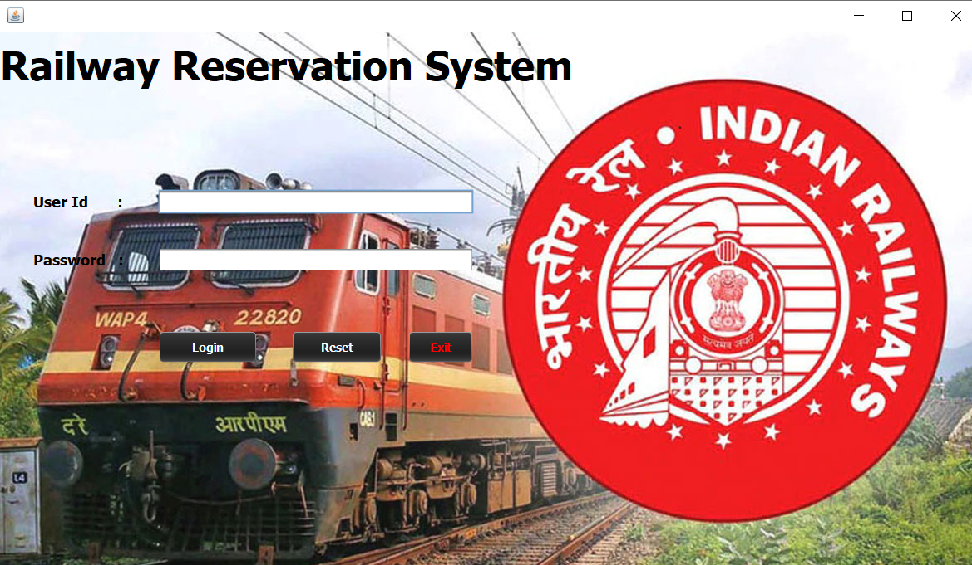
Login Interface
This page contains the columns of id and password.
User have to fill the authorized id and password.
When user fill the correct id and password the page will shift to next interface named as Option page.
If the password filled by the user is wrong then the system will give an error message of ‘Invalid id or password’.

Slide 4
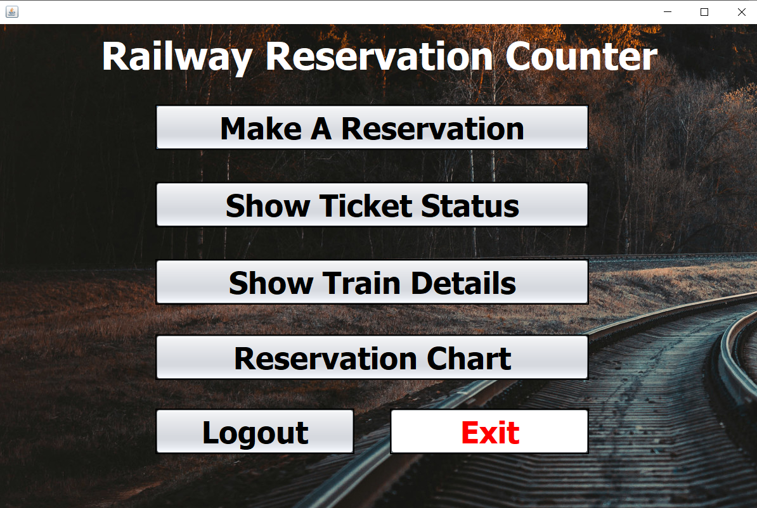
Option page
This page contains the several button as the options.
By clicking on that option user will shift to that page according to the clicks.
Logout button is also available if user want to go back to login interface.
Exit button on this page shut down the program.

Slide 5
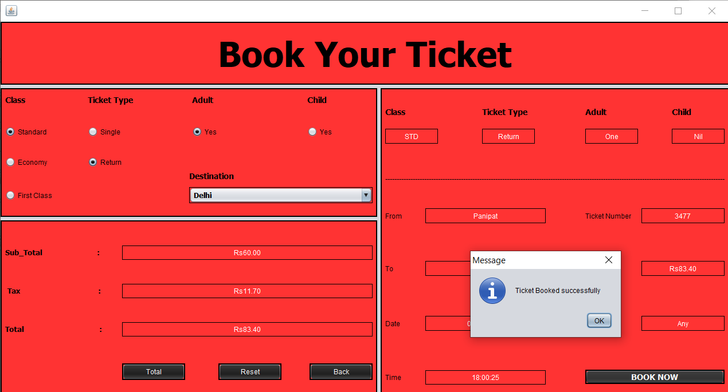
Booking Page
On this page there are several radio buttons.
On selecting the radio buttons according to the user need, when user press the total button then it will show the necessary details.
Then now pressing the button of book now the data will gets saved in the MySQL database.

Slide 6
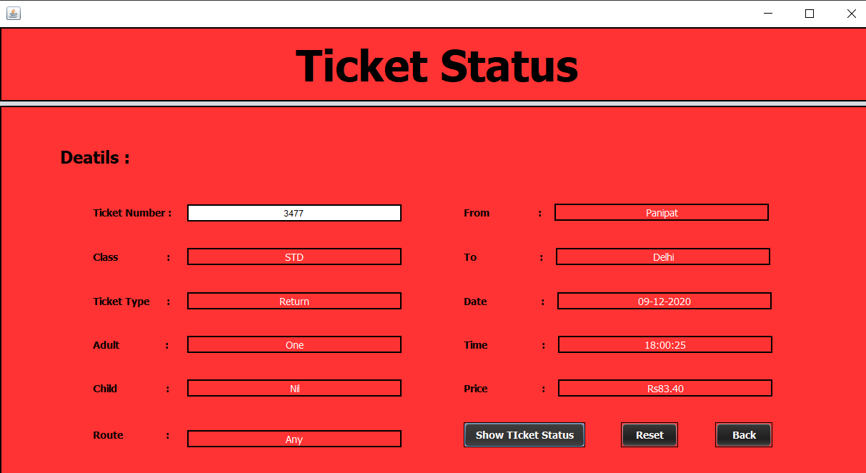
Status page
This page shows all details about the seat reserved for the railways.
When the user enter his/her ticket number on this page and click on the ‘Show Ticket Status’ button then it will show all the details about the Ticket reserved in the database.
This page retrieves the data from MySQL database and put it in the appropriate columns.

Slide 7
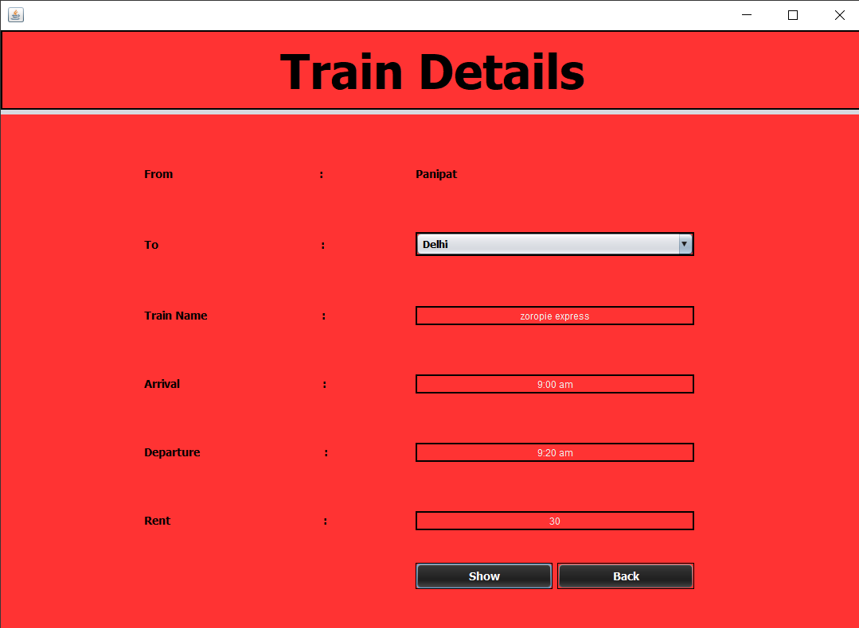
Train Details page
This page tells you about the details of the train.
On selecting the destination and then clicking on the show button it will show the trains details like arrival and departure time, train name, rent for the fair etc.

Slide 8
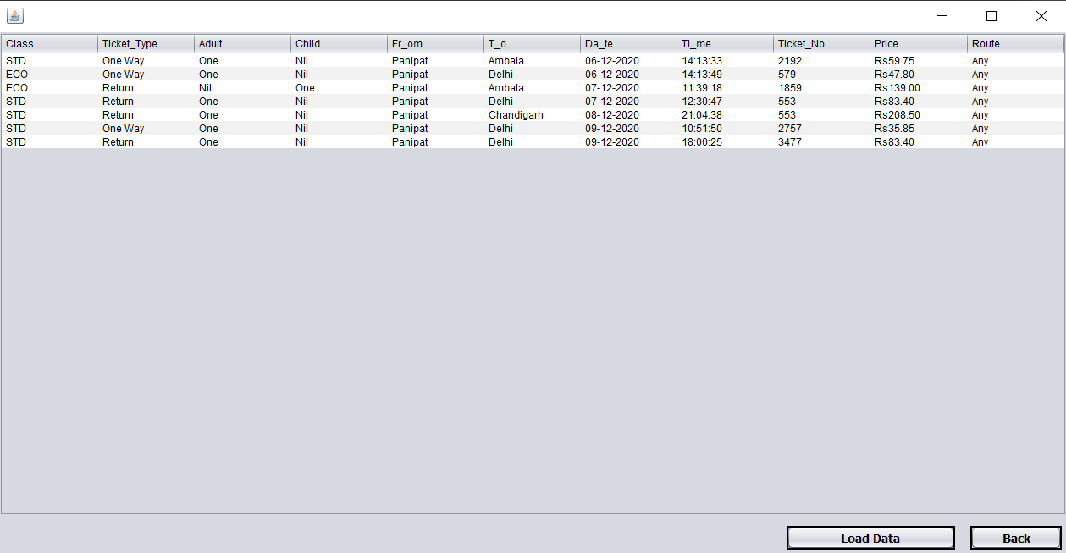
Reservation Table page
In this page we can see the details of the reserved seats.
On clicking the load data button the table will retrieve the data from the MySQL database and show it in the proper order.
In this page we import a package named Dbutils.
And for using this package we have to import a library ‘rs2xml’.

Slide 9
Thankyou

