Slide 1
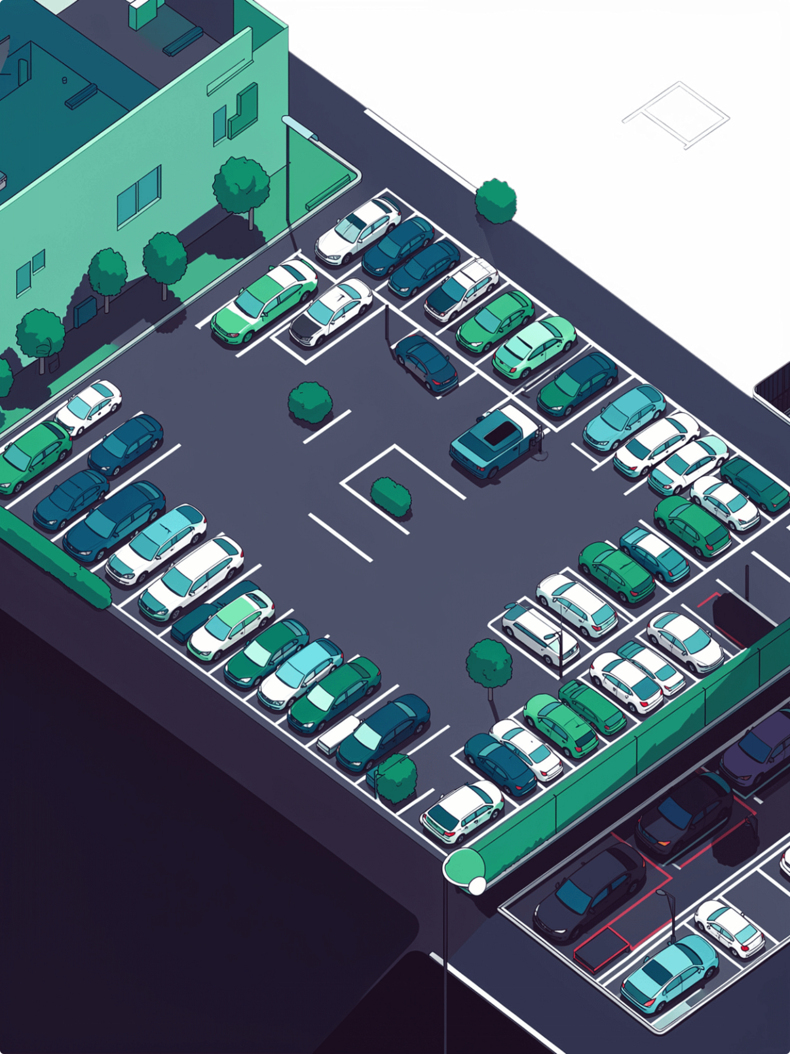
Real-Time Smart Parking Management System with IoT-Based Vehicle Slot Detection and Availability Monitoring
An IoT-enabled system designed to detect vehicle occupancy and monitor parking-slot availability in real time — improving parking efficiency and reducing the time drivers spend searching for available spaces.
SURISETTY DINESH 323129520018

Slide 2

Problem Statement
Finding available parking spaces in crowded urban areas is a major challenge. Traditional parking systems depend heavily on manual monitoring, leaving drivers to search without guidance.
There is a clear need for an intelligent system that automatically detects vehicle occupancy and provides real-time parking information.
Parking Difficulties Contribute To
Traffic Congestion
Vehicles circling for open spots block traffic flow
Fuel Wastage
Unnecessary driving burns extra fuel
Increased Travel Time
Drivers lose valuable time searching
Inefficient Space Use
Available slots go undetected and unused

Slide 3
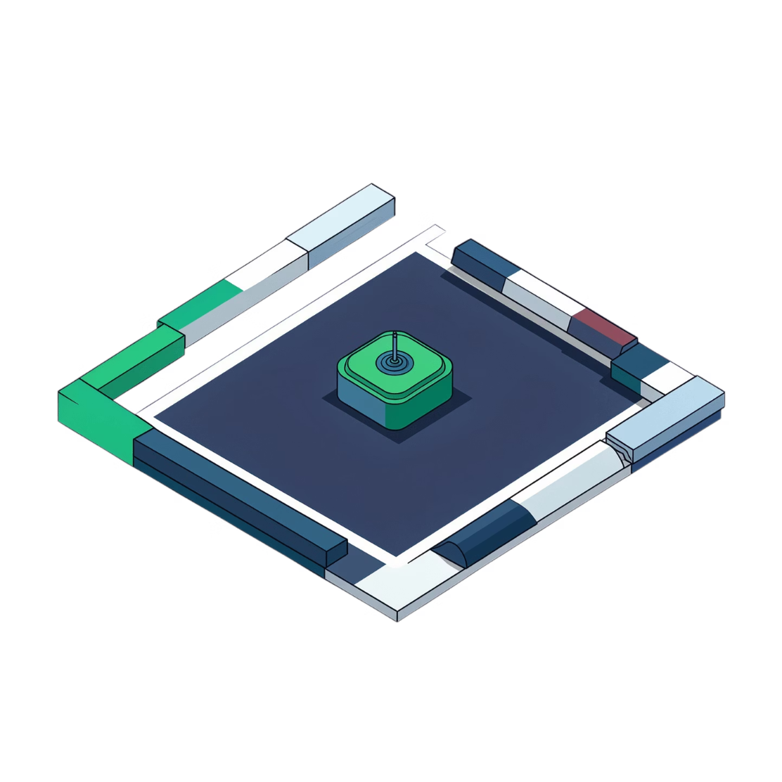
Proposed Solution
Real-Time Smart Parking Management System
The proposed system uses IoT-based vehicle-slot detection to continuously monitor parking spaces, identifying whether individual slots are occupied or vacant.
Continuous Monitoring
Centralized Platform
Dual Audience
Parking spaces are monitored at all times without manual intervention
Parking information is updated in real time through a centralized monitoring platform
Useful information delivered to both drivers and parking administrators

Slide 4

Objectives
Automatic Detection
Automatically detect vehicle presence in individual parking slots and monitor availability continuously
Reduce Search Time
Reduce parking search time for drivers and minimize unnecessary traffic movement and fuel consumption
Improve Utilization
Improve utilization of available parking spaces and help administrators monitor and optimize operations
Smart City Support
Support efficient smart-city infrastructure with scalable, real-time parking information

Slide 5
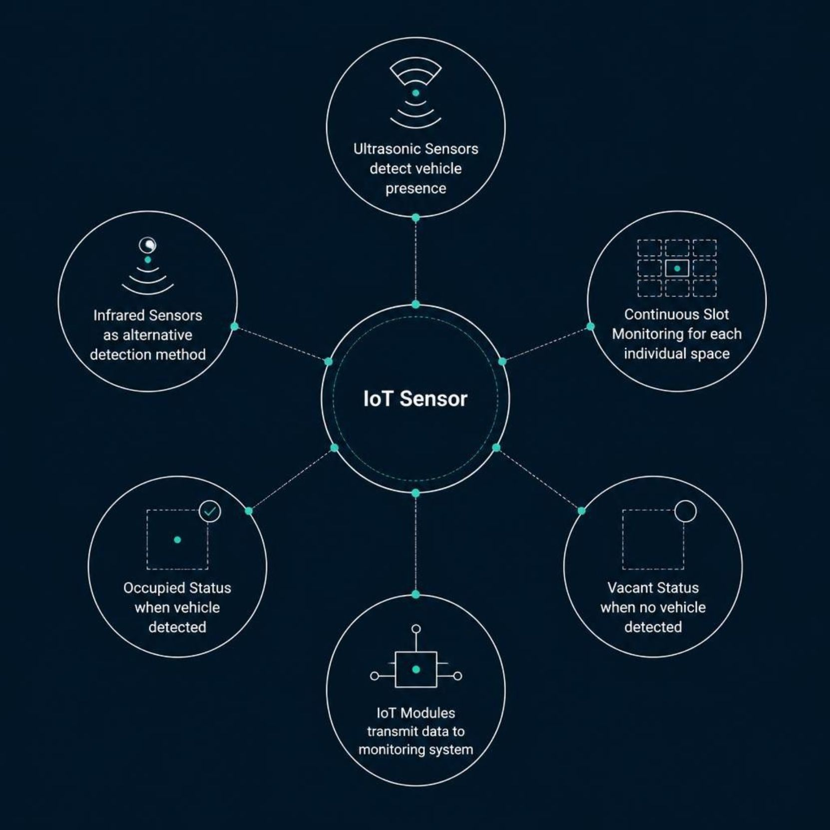
IoT-Based Slot Detection
IoT plays a central role in the system. Ultrasonic sensors or infrared sensors are deployed to detect vehicle presence at each individual parking slot.
Sensors continuously monitor individual parking slots
A slot is identified as occupied when a vehicle is detected
A slot is identified as vacant when no vehicle is detected
IoT communication modules transmit sensor information to the monitoring system
Continuous sensor monitoring enables real-time availability updates across the entire parking facility.

Slide 6
System Components and Working
Major Components
Step-by-Step Working Process
01
02
Sensors Monitor Slots
Vehicle Presence Detected
Parking-Slot Sensors
Sensors monitor individual parking slots continuously
Occupancy status is determined for each slot
03
04
Data Transmitted
Information Processed
IoT Communication Modules
Sensor data is transmitted through IoT communication modules
Parking information is processed and stored in the database
05
06
Cloud Updates Availability
Dashboard Displays Status
The cloud-based system updates slot availability in real time
Occupied and vacant slots are shown on the live dashboard
Cloud-Based Monitoring
07
Decisions Made
Drivers and administrators use updated information for parking decisions
Parking Database
User / Admin Interface
Real-Time Alert Mechanism

