Slide 1




ReACT-TTC: Capacity-Aware Resource Reassignment in Shared Cyber-Physical Systems
Presenter: Anurag Satpathy
Anurag Satpathy*, Arindam Khanda*, Chittaranjan Swain#, and Sajal K. Das*
*CReWMaN Lab, Missouri University of Science and Technology, USA
#Indian Institute of Information Technology and Management, Gwalior
Email: {anurag.satpathy, akkcm, sdas}@mst.edu and cswain@iiitm.ac.in
This work was supported by the NSF grants: OAC-2104078 (CANDY), ECCS-2319995 (SOTERIA), PFI-2431990, and SaTC-2030624 (TAURUS).

Slide 2
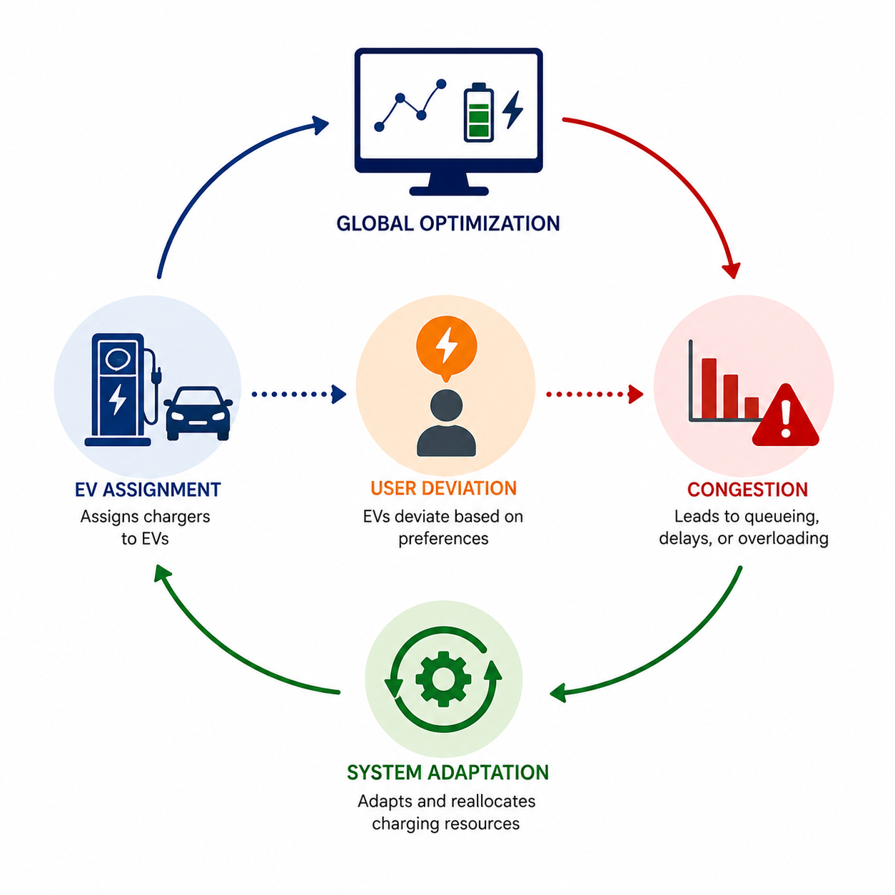
Table of Contents
Introduction
Proposed Top Trading Cycle based Reassignment Framework
Theoretical Analysis
Experimental Results
Conclusion

Slide 3
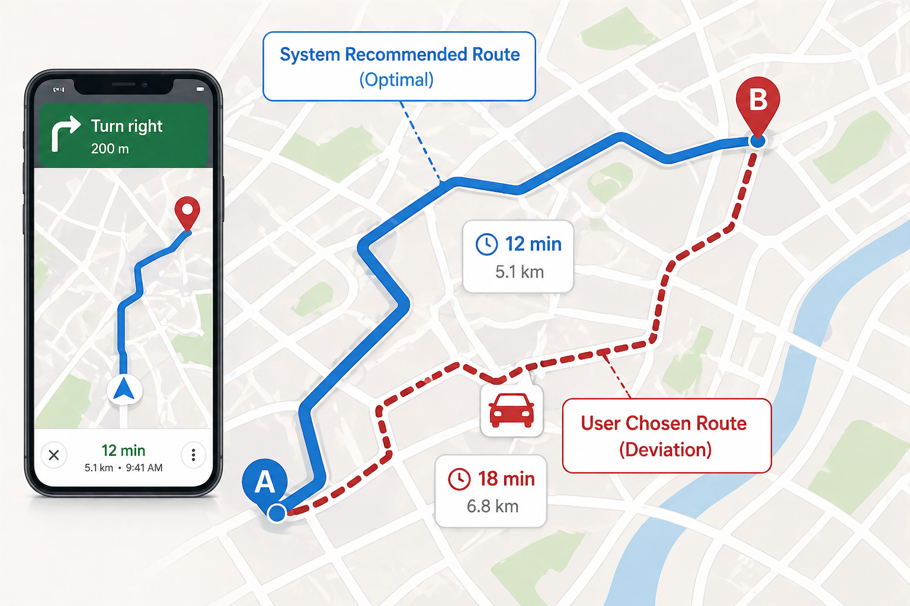
Motivation: Instances of Deviation in Transportation CPS
Stats: 30-60% users override navigation recommendation [1].
Reasons: Familiar routes, avoiding tolls, perceived traffic inaccuracies, safety concerns, scenic preference.
[1] Djavadian, S. et al. Empirical evaluation of drivers’ route choice behavioral responses to social navigation. TRR, 2014.

Slide 4
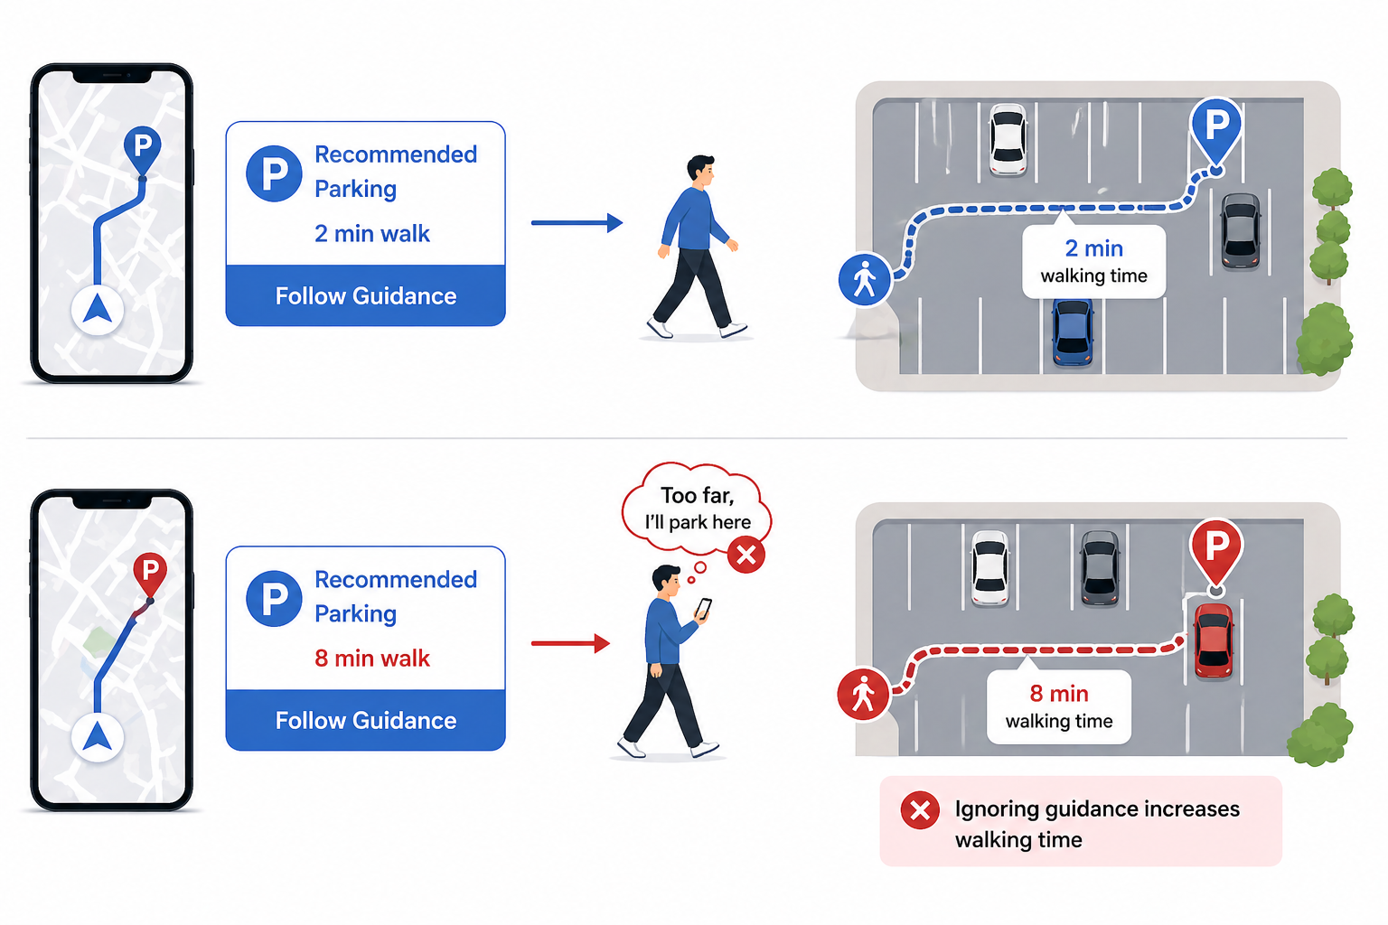
Motivation: Instances of Deviation in Transportation CPS
Stats: 15-35% of users override parking recommendations [2]
Reasons: Perceived parking difficulty, safety concerns, proximity preference, prior parking experience.
Stats: 30-60% users override navigation recommendation [1].
Reasons: Familiar routes, avoiding tolls, perceived traffic inaccuracies, safety concerns, scenic preference.
[1] Djavadian, S. et al. Empirical evaluation of drivers’ route choice behavioral responses to social navigation. TRR, 2014.
[2] Ji, Y. et al. Understanding drivers’ perspective on parking guidance information. IET ITS, 2014.

Slide 5
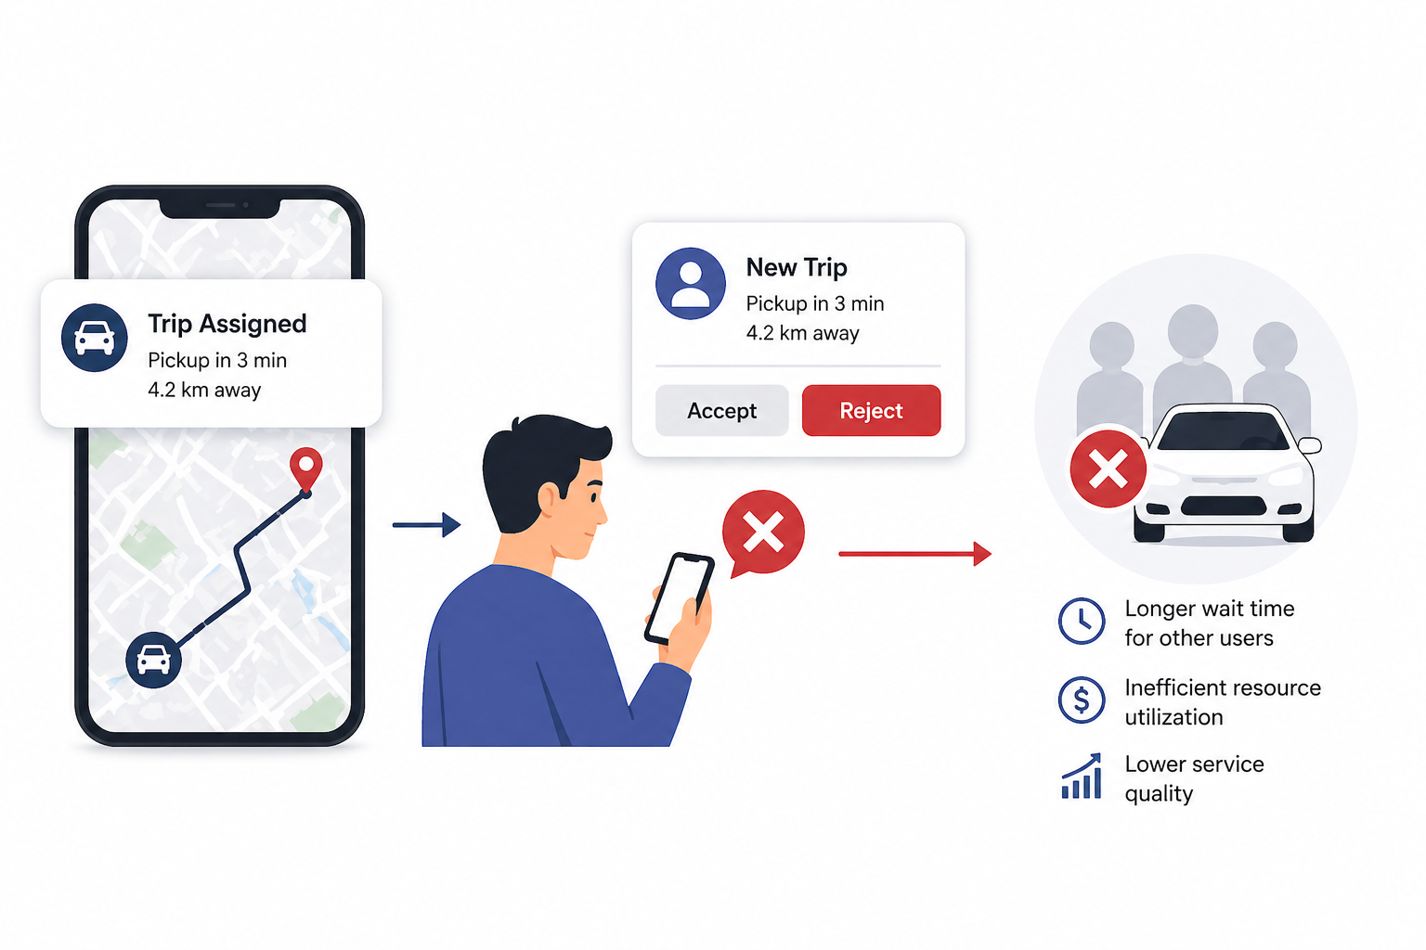
Motivation: Instances of Deviation in Transportation CPS
Stats: 15-35% of users override parking recommendations [2]
Reasons: Perceived parking difficulty, safety concerns, proximity preference, prior parking experience.
Stats: 30-60% users override navigation recommendation [1].
Reasons: Familiar routes, avoiding tolls, perceived traffic inaccuracies, safety concerns, scenic preference.
Stats: 20-40% of users override ride-hailing recommendations [3].
Reasons: Surge pricing, driver distrust, long pickup times, preference for alternate routes or platforms.
[1] Djavadian, S. et al. Empirical evaluation of drivers’ route choice behavioral responses to social navigation. TRR, 2014.
[2] Ji, Y. et al. Understanding drivers’ perspective on parking guidance information. IET ITS, 2014.
[3] Ashkrof, P. et al. Implications of drivers’ ride acceptance decisions on ride-sourcing operations. TR Part A, 2025.

Slide 6
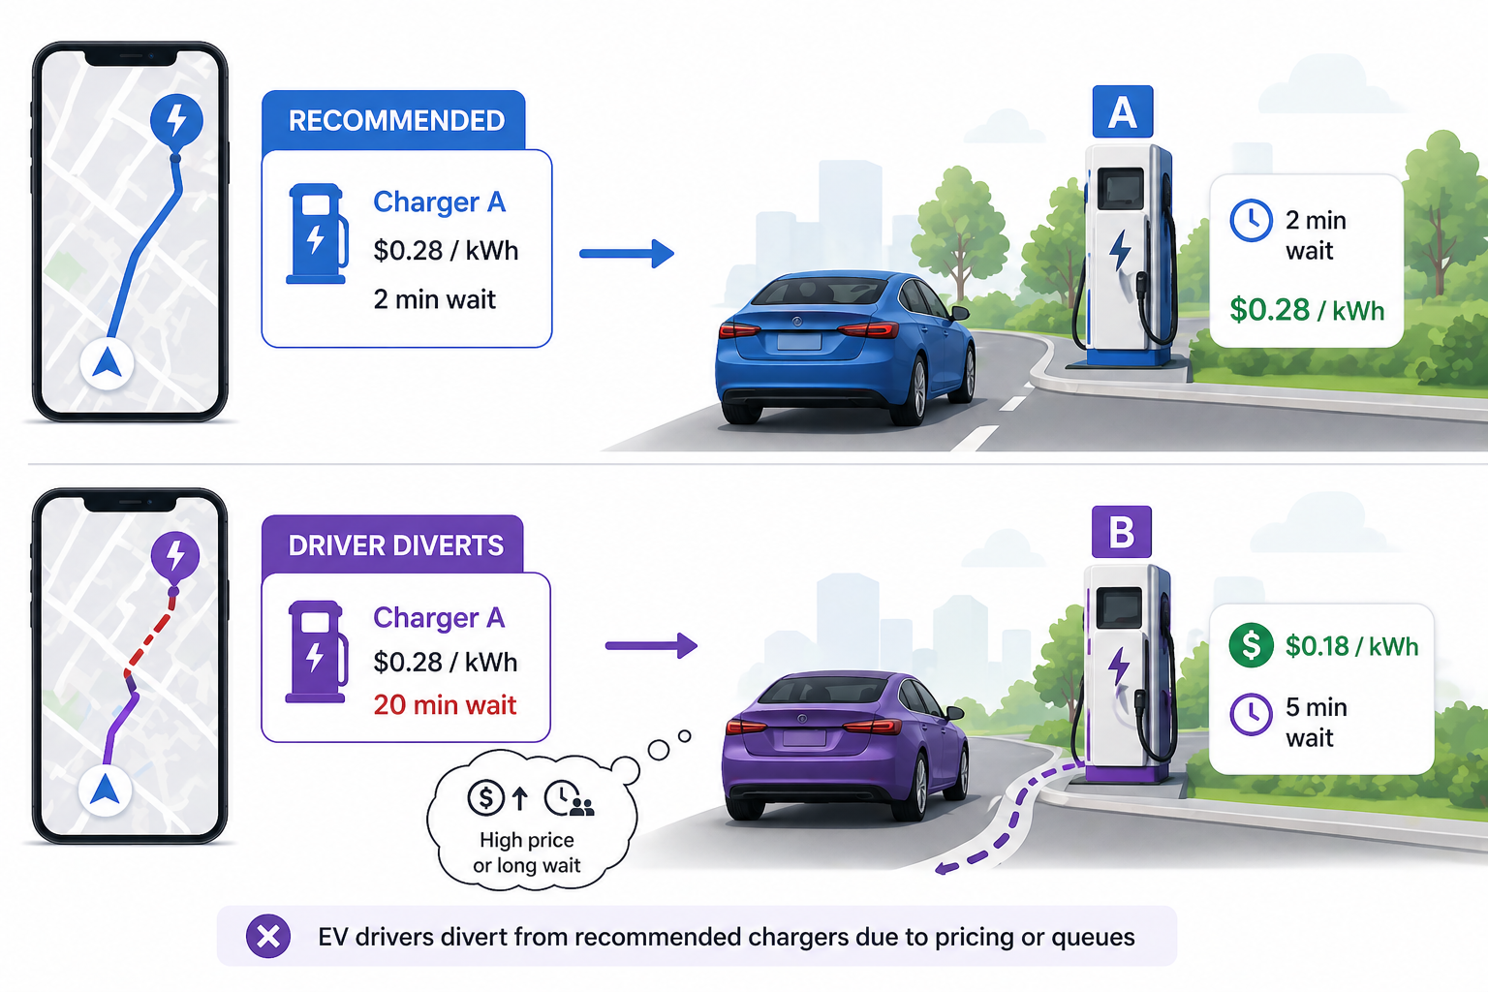
Motivation: Instances of Deviation in Transportation CPS
Stats: 15-35% of users override parking recommendations [2]
Reasons: Perceived parking difficulty, safety concerns, proximity preference, prior parking experience.
Stats: 30-60% users override navigation recommendation [1].
Reasons: Familiar routes, avoiding tolls, perceived traffic inaccuracies, safety concerns, scenic preference.
Stats: 25-50% of users override charging recommendations [4]
Reasons: Queue anxiety, charger reliability concerns, pricing differences, and battery range uncertainty.
Stats: 20-40% of users override ride-hailing recommendations [3].
Reasons: Surge pricing, driver distrust, long pickup times, preference for alternate routes or platforms.
[1] Djavadian, S. et al. Empirical evaluation of drivers’ route choice behavioral responses to social navigation. TRR, 2014.
[2] Ji, Y. et al. Understanding drivers’ perspective on parking guidance information. IET ITS, 2014.
[3] Ashkrof, P. et al. Implications of drivers’ ride acceptance decisions on ride-sourcing operations. TR Part A, 2025.
[4] Alinia, B. et al. Online EV charging scheduling with on-arrival commitment. IEEE T-ITS, 2019.

Slide 7
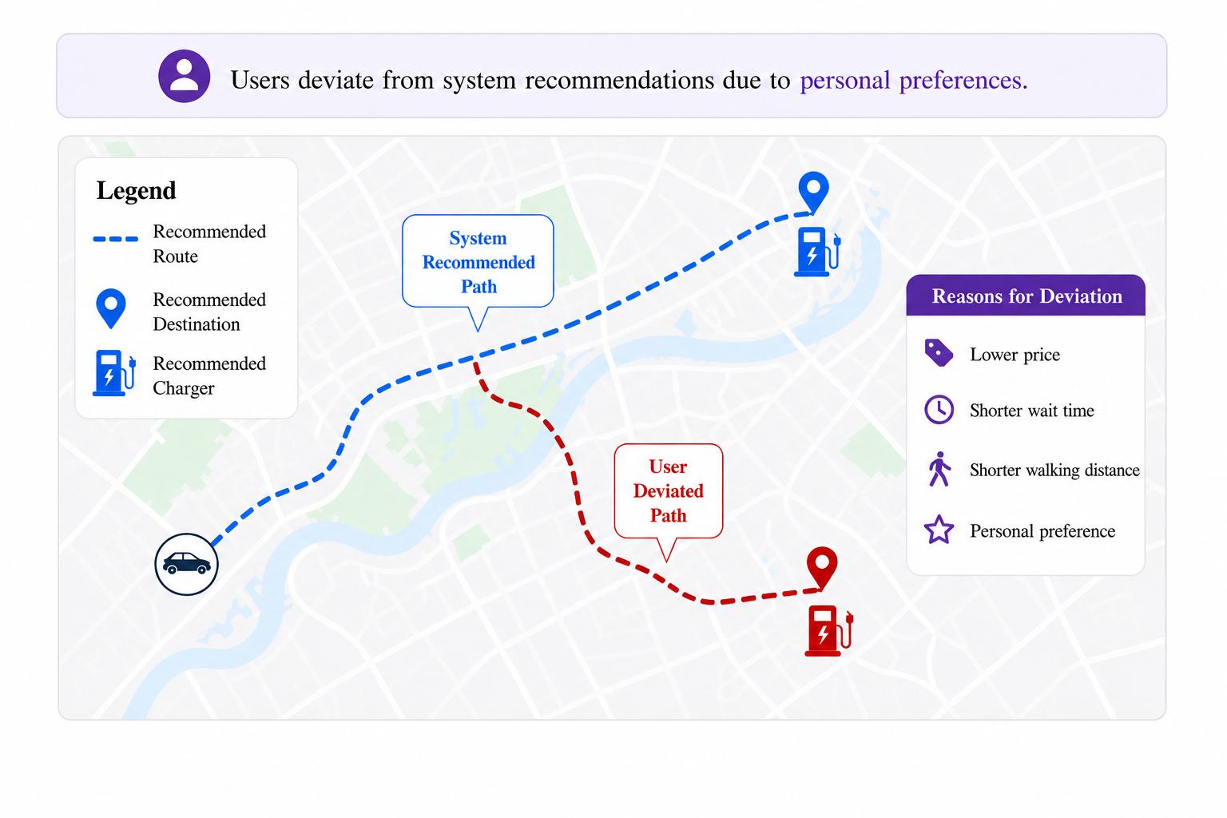
Why Deviation is a Problem?
Takeaway: For a EV charging, users may be non-compliant and deviate from the recommended charging option.

Slide 8
Why Deviation is a Problem?
Research Challenges:
Disrupts the user satisfaction.
Large scale re-computation triggers.
Takeaway: For a EV charging, users may be non-compliant and deviate from the recommended charging option.

Slide 9
Related Works and Gaps in the Literature
Refs | Non- Compliance | Post-deviation Reassignment | Capacity Considerations | Core Stability | Pareto- Optimality
[5] | Yes | No | No | No | No
[6] | Yes | No | Yes | No | No
[7] | No | No | Yes | No | No
[8] | No | No | Yes | No | No
[9] | No | No | No | Yes | Yes
Our | Yes | Yes | Yes | Yes | Yes
Takeaway: None of the existing solutions jointly addresses deviation, capacity considerations, core-stability pareto-optimality together.
[5] Kerkman, K. et al. Car drivers’ compliance with route advice and willingness to choose socially desirable routes. TRR, 2012.
[6] Ashkrof, P. et al. Implications of drivers’ ride acceptance decisions on ride-sourcing operations. TR Part A, 2025.
[7] Alinia, B. et al. Online EV charging scheduling wit]h on-arrival commitment. IEEE T-ITS, 2019.
[8] Liu, X. et al. Energy consumption minimization for delay-sensitive data collection in UAV-assisted WSN. IEEE Sensors J., 2025.
[9] Morrill, T., Roth, A.E. Top trading cycles. J. Math. Econ., 2024.

Slide 10
What is Top Trading Cycle and Why is it Used?
What is TTC?
Preference-driven resource exchange mechanism.
Resolves allocations through cyclic trades (mutual exchanges).
Produces pareto-efficient, individually rational, strategyproof, and stable exchanges.
The TTC based exchange is performed for atomic resources.

Slide 11
What is Top Trading Cycle and Why is it Used?
What is TTC?
Preference-driven resource exchange mechanism.
Resolves allocations through cyclic trades (mutual exchanges).
Produces pareto-efficient, individually rational, strategyproof, and stable exchanges.
The TTC based exchange is performed for atomic resources.
Why TTC?
Naturally adapts to user deviations without impacting the complaint ones.
Enables lightweight reassignment without full recomputation from scratch.
Preserves properties such as pareto-efficiency, individual rationality, stability, and strategyproof reassignment.
Handles non-compliance with mutually beneficial trades.

Slide 12
Our Contributions
We extend classical Top Trading Cycle (TTC) extending it to a multi-quota setting and propose a post-deviation reassignment policy, i.e., ReACT-TTC.
It allows preference-driven exchanges under non-compliance and can handle unassigned/co-assigned capacity efficiently.
We integrate prospect-theoretic preferences to model realistic user satisfaction.
We theoretically prove Pareto optimality, individual rationality, core stability and strategy proofness for ReACT-TTC.
ReACT-TTC on a one shot post-deviation EV charger reassignment problem on average improves user satisfaction 43%.

Slide 13
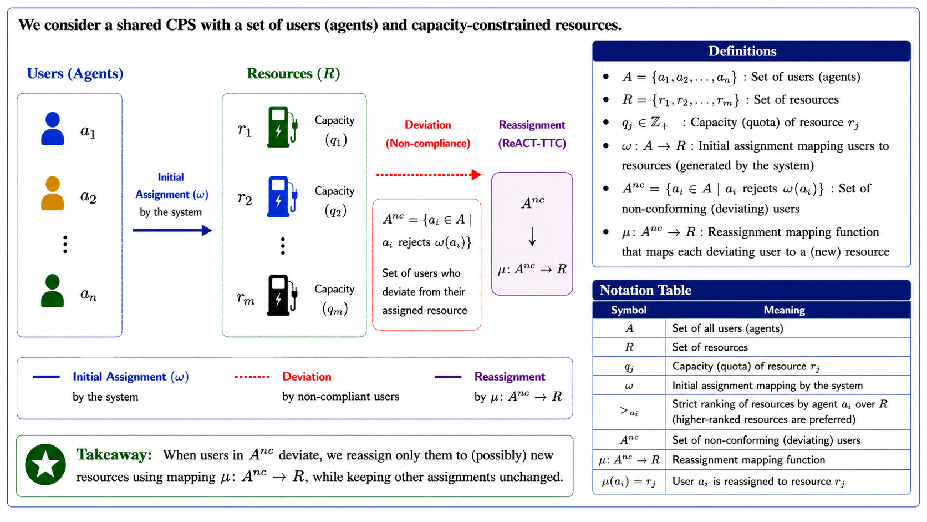
System Model

Slide 14
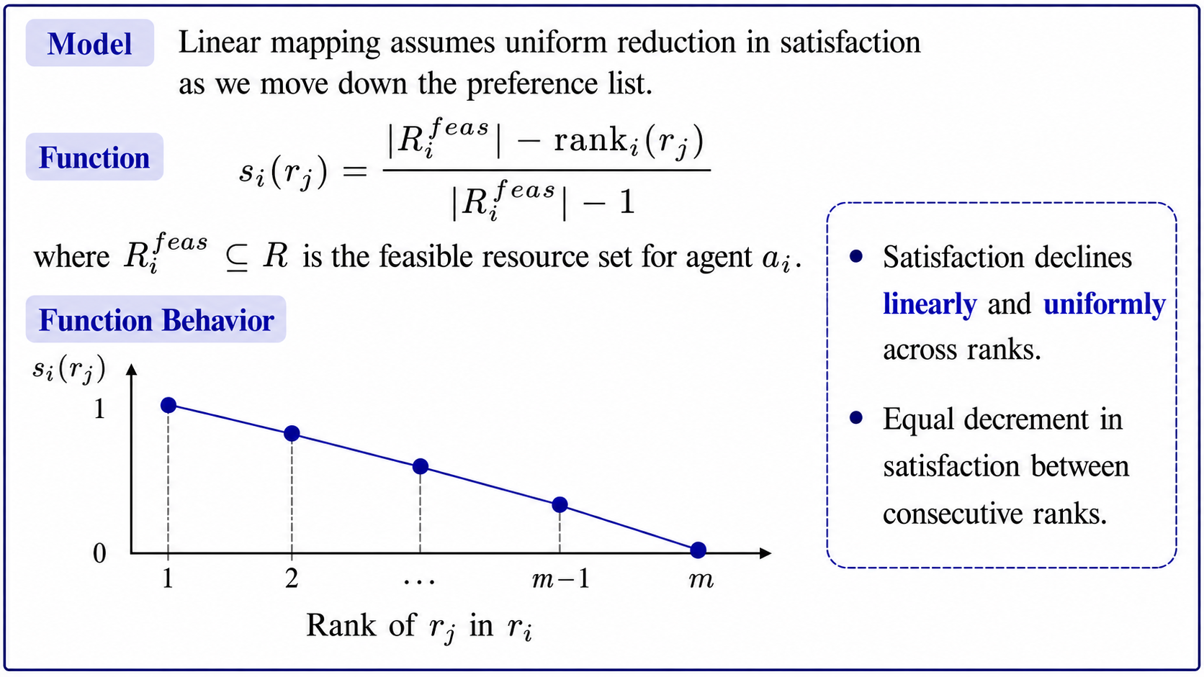
Mapping User Preference to Satisfaction

Slide 15
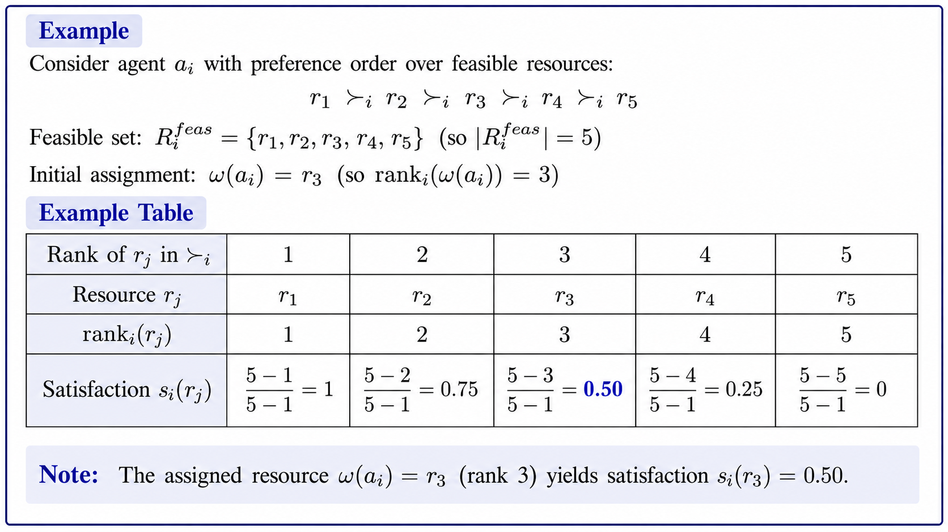
Mapping User Preference to Satisfaction
Takeaway: Linear satisfaction assumes uniform sensitivity across ranks and is reference-blind to an agent’s initial allocation or expectation.

Slide 16
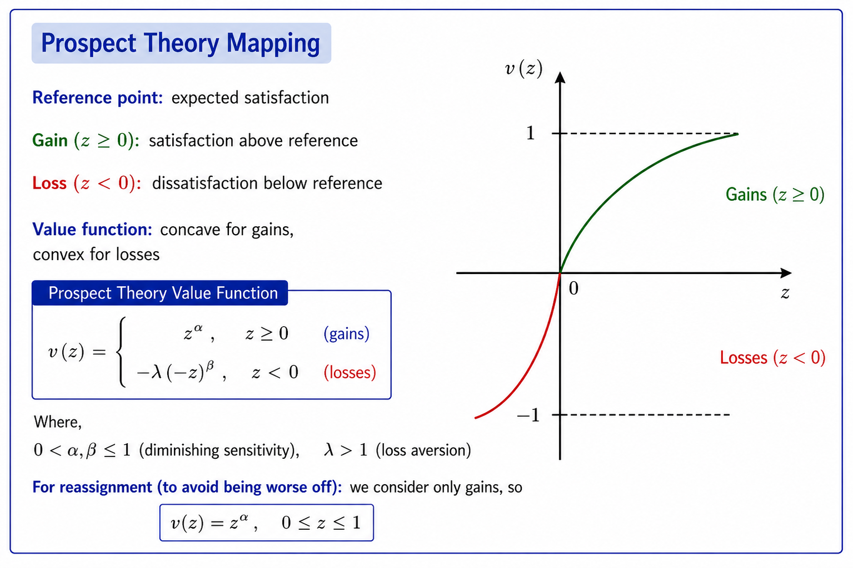
Mapping User Preference to Satisfaction

Slide 17
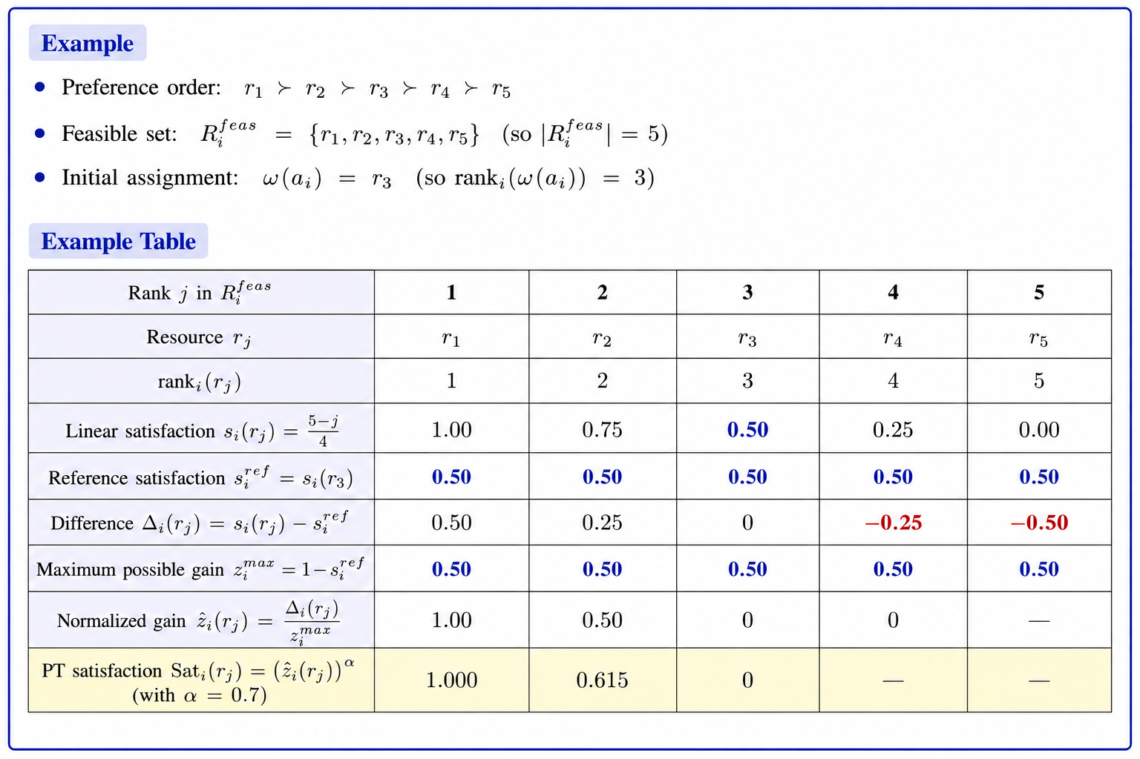
Mapping User Preference to Satisfaction

Slide 18
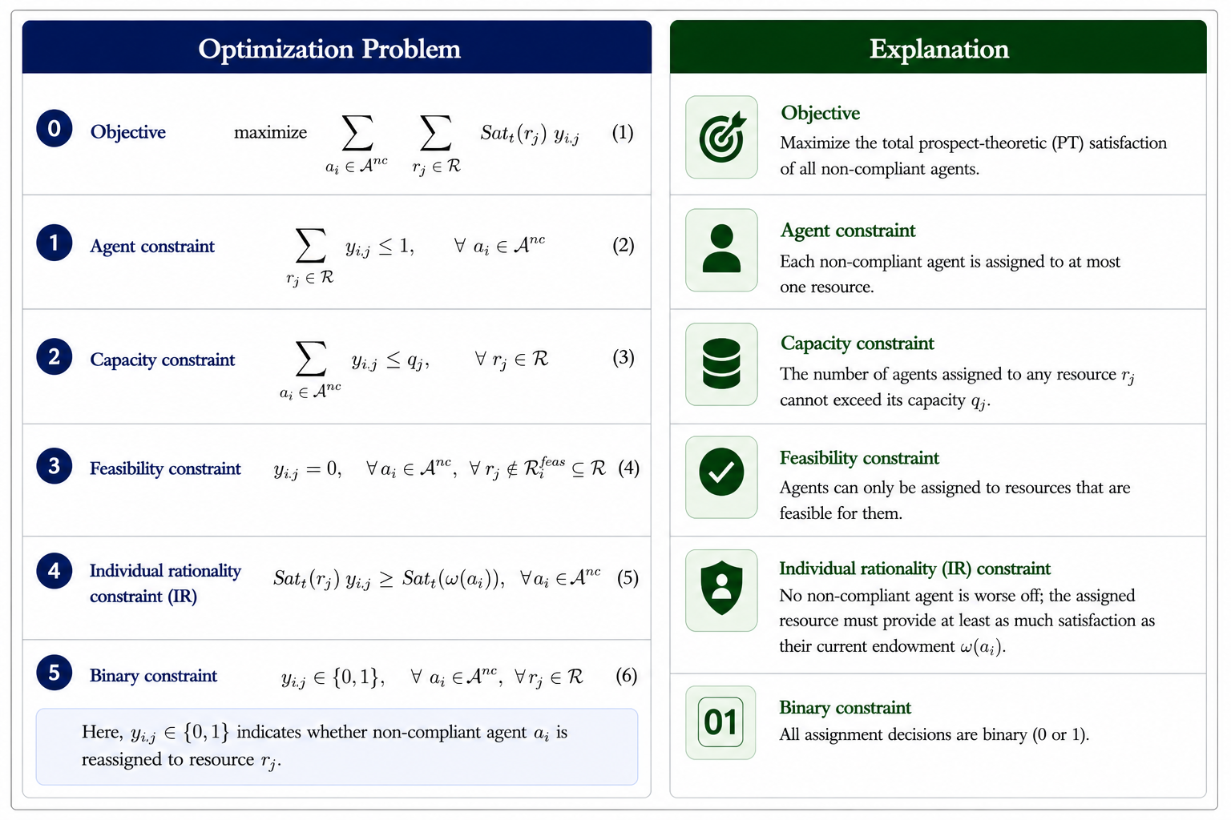
Problem Formulation
Objective
Maximize the total satisfaction of all non-compliant agents
Agent Constraint
Each non-compliant agent is assigned to at most one resource
Capacity Constraint
The number of agents assigned to any resource cannot exceed its capacity
Feasibility Constraint
Agents can only be assigned to resources that are feasible for them
Individual Rationality Constraint
No non-compliant agent is worse off. The assigned resource must provide at least as much satisfaction as their current endowment
Decision Variable
All assigned decisions are binary

Slide 19
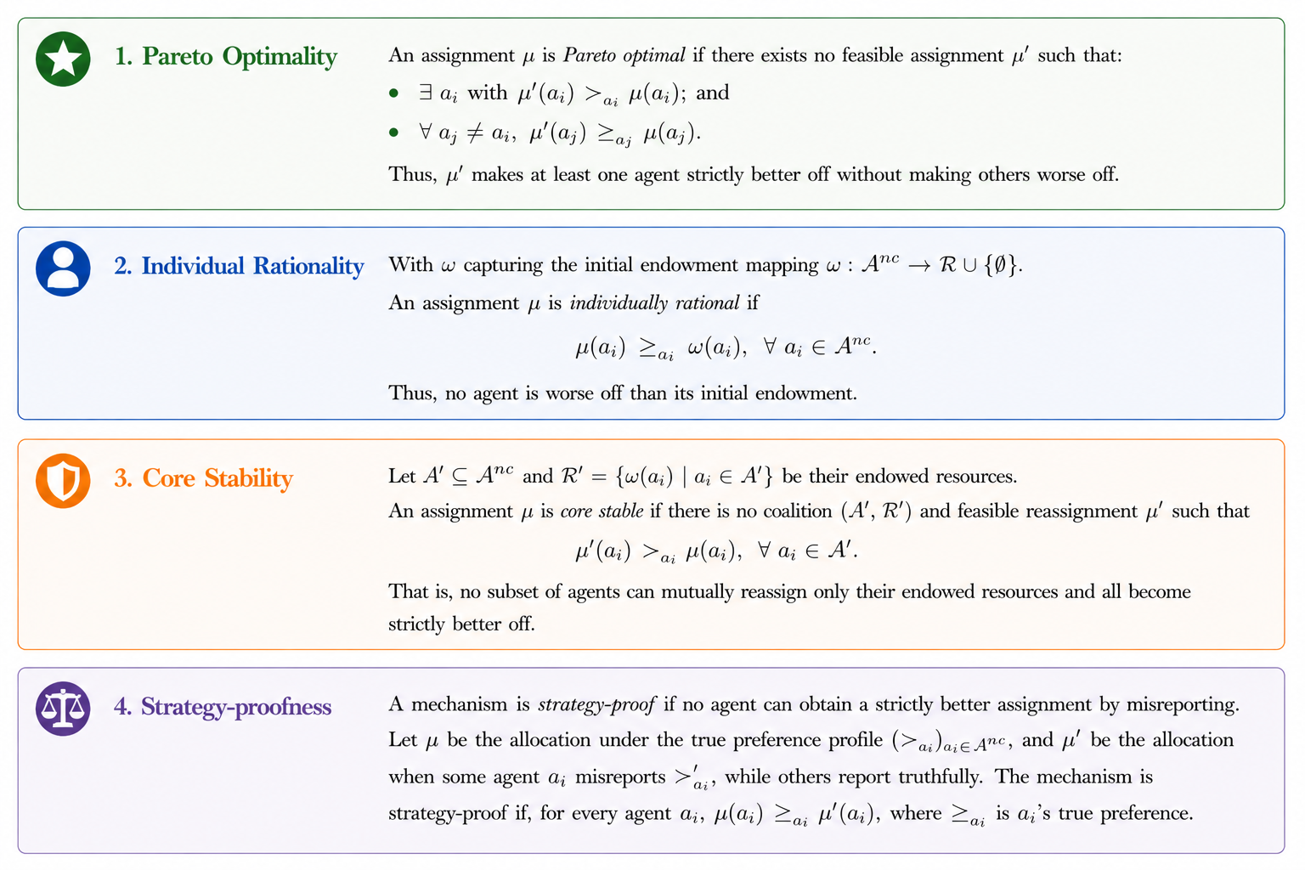
Desirable Solution Properties

Slide 20
Classical Top Trading Cycle (Working Procedure)
Step 1: Directed Graph Construction
Step 2: Cycle Detection
Step 3: Cycle Resolution

Slide 21
Potential Solution:Top Trading Cycle (Working Example)
Agents A = {a₁, a₂, a₃} and the resource set R = {r_{1,} r₂, r₃} with q_{j} = 1, ∀ r_{j} ϵ R
Agent | ѡ(a_{i}) | P(a_{i})
a₁ | r₁ | r₂ > r₁ > r₃
a₂ | r₂ | r₁ > r₂ > r₃
a₃ | r₃ | r₃ > r₁ > r₂
Resource (r_{j}) | Quota (q_{j})
r₁ | 1
r₂ | 1
r₃ | 1

Slide 22
Solving the Classical TTC
Step 1: Directed Graph Construction
Agent | ѡ(a_{i}) | P(a_{i})
a₁ | r₁ | r₂ > r₁ > r₃
a₂ | r₂ | r₁ > r₂ > r₃
a₃ | r₃ | r₃ > r₁ > r₂
Resource | q_{j}
r₁ | 1
r₂ | 1
r₃ | 1
r₂
a₁
a₂

Slide 23

Solving the Classical TTC
Step 1: Directed Graph Construction
r₂
Agent | ѡ(a_{i}) | P(a_{i})
a₁ | r₁ | r₂ > r₁ > r₃
a₂ | r₂ | r₁ > r₂ > r₃
a₃ | r₃ | r₃ > r₁ > r₂
Resource | q_{j}
r₁ | 1
r₂ | 1
r₃ | 1
a₁
a₂
r₂
a₁
a₂
r₁

Slide 24
Solving the Classical TTC
r₂
Step 1: Directed Graph Construction
Agent | ѡ(a_{i}) | P(a_{i})
a₁ | r₁ | r₂ > r₁ > r₃
a₂ | r₂ | r₁ > r₂ > r₃
a₃ | r₃ | r₃ > r₁ > r₂
Resource | q_{j}
r₁ | 1
r₂ | 1
r₃ | 1
a₁
a₂
r₃
r₂
r₂
a₃
a₁
a₂
a₁
a₂
r₁
r₁
Takeaway: In a finite directed graph with exactly one outgoing edge per vertex, repeatedly following edges must eventually revisit a vertex, which forms a directed cycle.

Slide 25
Solving the Classical TTC
Steps 2 and 3: Cycle Detection and Resolution
Agent | ѡ(a_{i}) | P(a_{i})
a₁ | r₁ | r₂ > r₁ > r₃
a₂ | r₂ | r₁ > r₂ > r₃
a₃ | r₃ | r₃ > r₁ > r₂
r₃
r₃
r₂
r₂
a₁
a₂
a₁
a₂
a₃
a₃
Resource | q_{j}
r₁ | 1
r₂ | 1
r₃ | 1
r₁
r₁
Cycle 1
Cycle 2
Resolution: (1) First cycle: Assign a₃→ r₃ (2) Second cycle: Assign a₁→ r₂ and a₂→ r₁
Detection: We have two cycles (1) a₁→ a₂→ a₁ and (2) a₃→ a₃

Slide 26
Alternative Example: Failure of TTC
Step 1: Directed Graph Construction
r₂
Agent | ѡ(a_{i}) | P(a_{i})
a₁ | r₁ | r₂ > r₁ > r₃
a₂ | r₂ | r₁ > r₂ > r₃
a₃ | r₃ | r₂ > r₁ > r₃
Resource | q_{j}
r₁ | 2
r₂ | 1
r₃ | 1
a₁
a₂
r₁
a₃

Slide 27
Alternative Example: Failure of TTC
Step 1: Directed Graph Construction
r₂
r₂
r₃
Agent | ѡ(a_{i}) | P(a_{i})
a₁ | r₁ | r₂ > r₁ > r₃
a₂ | r₂ | r₁ > r₂ > r₃
a₃ | r₃ | r₂ > r₁ > r₃
Resource | q_{j}
r₁ | 2
r₂ | 1
r₃ | 1
a₁
a₂
a₁
a₂
r₁
a₃
r₁
a₃
a₃
Resolution: Assign a₁→ r₂ , a₂→ r₁, and a₃→ r₃

Slide 28
Alternative Example: Failure of TTC
Step 1: Directed Graph Construction
r₂
r₂
r₃
Agent | ѡ(a_{i}) | P(a_{i})
a₁ | r₁ | r₂ > r₁ > r₃
a₂ | r₂ | r₁ > r₂ > r₃
a₃ | r₃ | r₂ > r₁ > r₃
Resource | q_{j}
r₁ | 2
r₂ | 1
r₃ | 1
a₁
a₂
a₁
a₂
r₁
a₃
r₁
a₃
a₃
Resolution: Assign a₁→ r₂ , a₂→ r₁, and a₃→ r₃
Agent | ѡ(a_{i}) | P(a_{i})
a₁ | r₁ | r₂ > r₁ > r₃
a₂ | r₂ | r₁ > r₂ > r₃
a₃ | r₃ | r₂ > r₁ > r₃
Resource | q_{j}
r₁ | 2 1
r₂ | 1
r₃ | 1
Question: Is this pareto-efficient?

Slide 29
ReACT-TTC Based Modified TTC
r₁
r₂
Case A: The case of co-ownership.
Agent | ѡ(a_{i}) | P(a_{i})
a₁ | r₁ | r₃> r₁ > r₂
a₂ | r₂ | r₁ > r₂ > r₃
a₃ | r₃ | r₂ > r₁ > r₃
a₄ | r₂ | r₃ > r₁ > r₂
ѡ(a_{i}) | q_{j}
r₁ | 1
r₂ | 2
r₃ | 1
a₂
a₄
a₁
C₁
C₂
a₃
r₃
Takeaway: How do we resolve the cycles considering that a₃ is the overlapping vertex? Different resolution process can impact the satisfaction of agents incident on the common vertex.

Slide 30
Different Resolution Order Leading to Different Aggregate Satisfaction?
r₁
r₂
r₁
r₂
Agent | ѡ(a_{i}) | P(a_{i})
a₁ | r₁ | r₃> r₁ > r₂
a₂ | r₂ | r₁ > r₂ > r₃
a₃ | r₃ | r₂ > r₁ > r₃
a₄ | r₂ | r₃ > r₁ > r₂
r₂
a₁
a₂
a₄
a₁
a₂
a₂
C₁
C₂
r₃
a₃
Case A: Shorter Cycle Resolution (0, 0, 1, 1)
ѡ(a_{i}) | q_{j}
r₁ | 1
r₂ | 2
r₃ | 1

Slide 31
Different Resolution Order Leading to Different Aggregate Satisfaction?
r₁
r₂
r₁
r₂
Agent | ѡ(a_{i}) | P(a_{i})
a₁ | r₁ | r₃> r₁ > r₂
a₂ | r₂ | r₁ > r₂ > r₃
a₃ | r₃ | r₂ > r₁ > r₃
a₄ | r₂ | r₃ > r₁ > r₂
r₂
a₁
a₂
a₄
a₁
a₂
a₂
C₁
C₂
r₃
a₃
Case A: Shorter Cycle Resolution (0, 0, 1, 1)
r₁
r₂
ѡ(a_{i}) | q_{j}
r₁ | 1
r₂ | 2
r₃ | 1
r₂
a₁
a₂
a₄
a₄
C₁
C₂
a₃
Case A: Longer Cycle Resolution (1, 1, 1, 0)
r₃

Slide 32
Hypothesis: Does the longer cycle resolution lead to higher aggregate satisfaction?

Slide 33
Hypothesis Invalidation: Counter Example
r₁
r₂
Agent | ѡ(a_{i}) | P(a_{i})
a₁ | r₁ | r₃> r₂ > r₁
a₂ | r₂ | r₁ > r₂ > r₃
a₃ | r₃ | r₂ > r₁ > r₃
a₄ | r₂ | r₃ > r₂> r₁
Resource | q_{j}
r₁ | 1
r₂ | 2
r₃ | 1
a₂
a₄
a₁
C₁
C₂
a₃
r₃
Takeaway: We have slightly updated the preferences of the agents (a₁ and a₄) having an incoming edge to the common vertex (a₃).

Slide 34
Hypothesis Invalidation: Counter Example
r₁
r₂
Agent | ѡ(a_{i}) | P(a_{i})
a₁ | r₁ | r₃> r₂ > r₁
a₂ | r₂ | r₁ > r₂ > r₃
a₃ | r₃ | r₂ > r₁ > r₃
a₄ | r₂ | r₃ > r₂> r₁
r₁
r₂
a₁
a₂
a₄
a₁
a₂
C₁
C₂
r₃
a₃
Case A: Shorter cycle resolution (0.71, 1, 1, 1)
Resource | q_{j}
r₁ | 1
r₂ | 2
r₃ | 1

Slide 35
Hypothesis Invalidation: Counter Example
r₁
r₂
Agent | ѡ(a_{i}) | P(a_{i})
a₁ | r₁ | r₃> r₂ > r₁
a₂ | r₂ | r₁ > r₂ > r₃
a₃ | r₃ | r₂ > r₁ > r₃
a₄ | r₂ | r₃ > r₂> r₁
r₁
r₂
a₁
a₂
a₄
a₁
a₂
C₁
C₂
r₃
a₃
Case A: Shorter cycle resolution (0.71, 1, 1, 1)
Resource | q_{j}
r₁ | 1
r₂ | 2
r₃ | 1
r₁
r₂
r₂
a₁
a₂
a₄
a₄
C₁
C₂
r₃
a₃
Case A: Longer cycle resolution (1, 1, 1, 0)

Slide 36
Heuristic: Which cycle to resolve First?
r₁
r₂
The overlapping vertex a₃ always achieves the same satisfaction.
Then who get impacted the most?
Immediate predecessor a₁ and a₄.
These agents are resolved in a later rounds of TTC, reducing their satisfaction.
This satisfaction reduction is captured as satisfaction loss (δ).
Heuristic: Resolve cycles that has a higher (δ), therefore maximizing the satisfaction.
a₂
a₄
a₁
C₁
δ = 0.5
δ = 0.7
C₂
a₃
r₃

Slide 37
ReACT-TTC Based Modified TTC
Case B: The case of no ownership.
r₁
r₂
Agent | ѡ(a_{i}) | P(a_{i})
a₁ | r₁ | r₂> r₁ > r₃> r₄
a₂ | r₂ | r₁ > r₂ > r₃> r₄
a₃ | r₃ | r₁ > r₄ > r₂> r₃
a₄ | r₂ | r₄ > r₃ > r₁ > r₂
a₅ | r₄ | r₃ > r₂ > r₄ > r₁
Resource | q_{j}
r₁ | 2
r₂ | 2
r₃ | 1
r₄ | 1
a₂
a₄
a₁
a₃
a₅
r₃
r₄
Takeaway: The resource r₁ has capacity of two, and has only one owner, i.e., a₁, so agents like a₂ and a₃ point to both, however as the unowned resource has no preference it does not point to any agent and hence it does not form cycles.

Slide 38
ReACT-TTC Based Modified TTC: Resolving Chains
Agent | ѡ(a_{i}) | P(a_{i})
a₁ | r₁ | r₂> r₁ > r₃> r₄
a₂ | r₂ | r₁ > r₂ > r₃> r₄
a₃ | r₃ | r₁ > r₄ > r₂> r₃
a₄ | r₂ | r₄ > r₃ > r₁ > r₂
a₅ | r₄ | r₃ > r₂ > r₄ > r₁
r₁
r₂
r₁
r₂
a₁
a₂
a₄
a₄
C₁
Resolve C₁
C₂
a₃
a₅
a₃
a₅
Resource | q_{j}
r₁ | 2
r₂ | 2
r₃ | 1
r₄ | 1
r₃
r₄
r₃
r₄
Takeaway: Any order of cycle resolution will lead to a chain ending at the virtual node at r₁. We resolve it by adding a virtual edge to the chain with the highest satisfaction loss (δ) forming a cycle.

Slide 39
ReACT-TTC: Classical Vs Modified TTC
Property | Classical TTC | React-TTC
Ownership Structure | One-to-one ownership | Co-ownership allowed
Outgoing Edge per Agent | Single outgoing edge | Multiple outgoing edge
Cycle Structure | Disjoint cycles | Overlapping cycles possible
Unowned Capacity Handling | No concept of empty slots | Representation of unused capacity
Assignment Resolution | Only cycles | Complete and incomplete cycles
Resolution Order | Order not critical | Satisfaction loss-based priority

Slide 40
Theoretical Analysis
Theorem 1 (Termination): ReACT-TTC terminates after a finite number of rounds and returns a feasible assignment.
Theorem 2 (Individual rationality): ReACT-TTC outcome 𝜇 is individually rational: for every agent 𝑎_{𝑖}, 𝜇(𝑎_{𝑖} ) ≽ 𝜔(𝑎_{𝑖} ).
Theorem 3 (Pareto Optimality): The outcome of ReACT-TTC i.e., 𝜇, is always Pareto optimal.
Theorem 4 (Core Stability): ReACT-TTC outcome 𝜇 is in the core, implying no coalition A′ ⊆ A^{nc} can reassign its initially endowments so that every member of A′ is strictly better than under 𝜇.
Theorem 5 (Strategy-Proofness): ReACT-TTC is individually strategy-proof under strict preferences. For any agent 𝑎_{𝑖} , holding all other reports fixed, truthful reporting yields an allocation that is at least as good for 𝑎_{𝑖} (in its true preference order) as the allocation obtained under any misreport.
Note: The detailed version and the proofs for the same can be found in the full version of the paper.

Slide 41
ReACT-TTC Algorithm
r₂
r₁
r₂
r₁
r₂
r₁
a₂
a₄
a₁
a₂
a₄
a₁
C₁
C₁
δ = 0.7
a₃
a₃
a₅
a₃
r₃
r₄
r₃
r₃
Step 1: Directed Graph Construction
Step 2: Complete Cycle Detection and Resolution
Step 3: In-complete Cycle Detection and Resolution
Repeat the process till there an unprocessed agent

Slide 42
Experimental Setup
Dataset: JD Logistics distribution network in Beijing [10]
Baseline Algorithms
V2VDisCS [11]
DAA [12]
SMEVCA [13]
Distributed charge sharing via stable matching on bipartite graphs
Charger assignment driven by deferred acceptance algorithm
Subscription-driven SLA frameworks (PCD, PCG) for charger assignment
[10] Zheng, Z. et al. Hybrid Memetic Search for Electric Vehicle Routing with Time Windows, Simultaneous Pickup-Delivery, and Partial Recharges. arXiv, 2024.
[11] Chatterjee, P. et al. V2VDisCS: Vehicle-to-Vehicle Distributed Charge Sharing in Intelligent Transportation Systems. IEEE T-ITS, 2025.
[12] Akter, M. et al. MOVE: Matching Game for Partial Offloading in Vehicular Edge Computing. IEEE ICC, 2024.
[13] Khanda, A. et al. SMEVCA: Stable Matching-Based EV Charging Assignment in Subscription-Based Models. ICDCN, 2025.

Slide 43
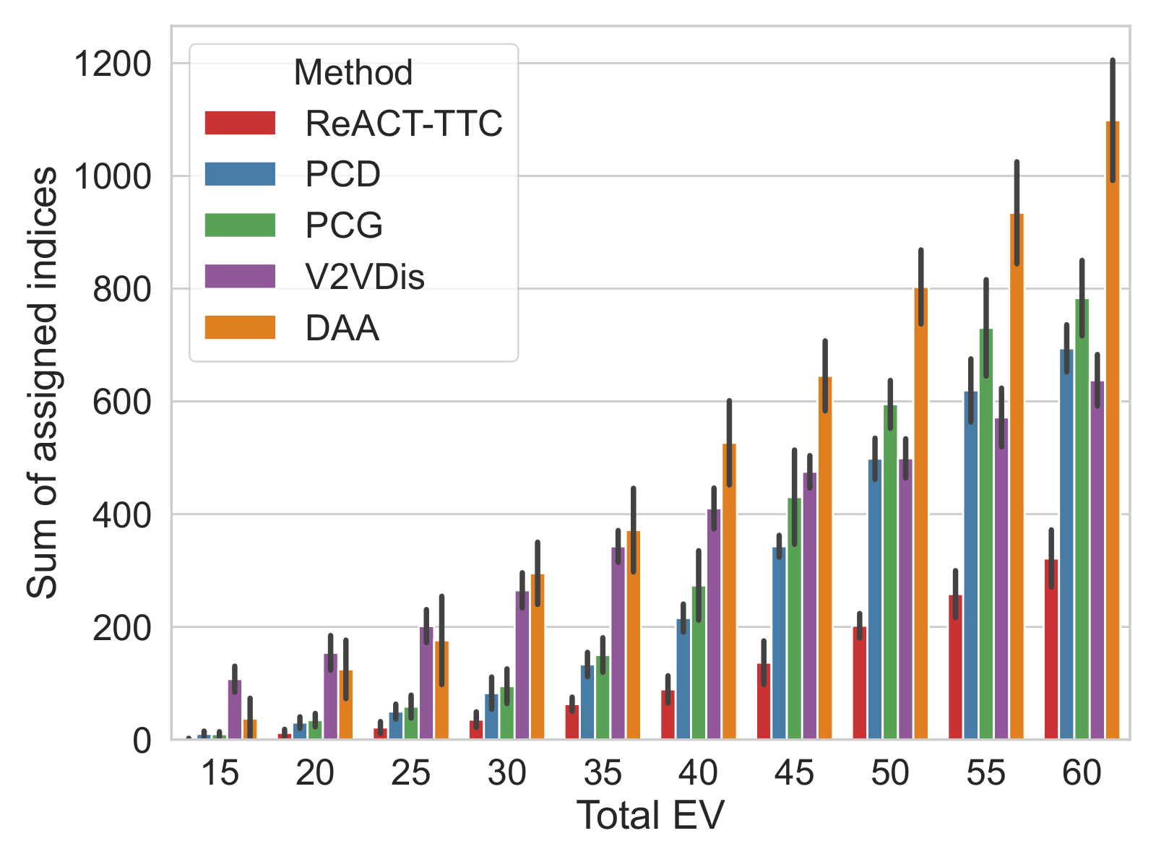
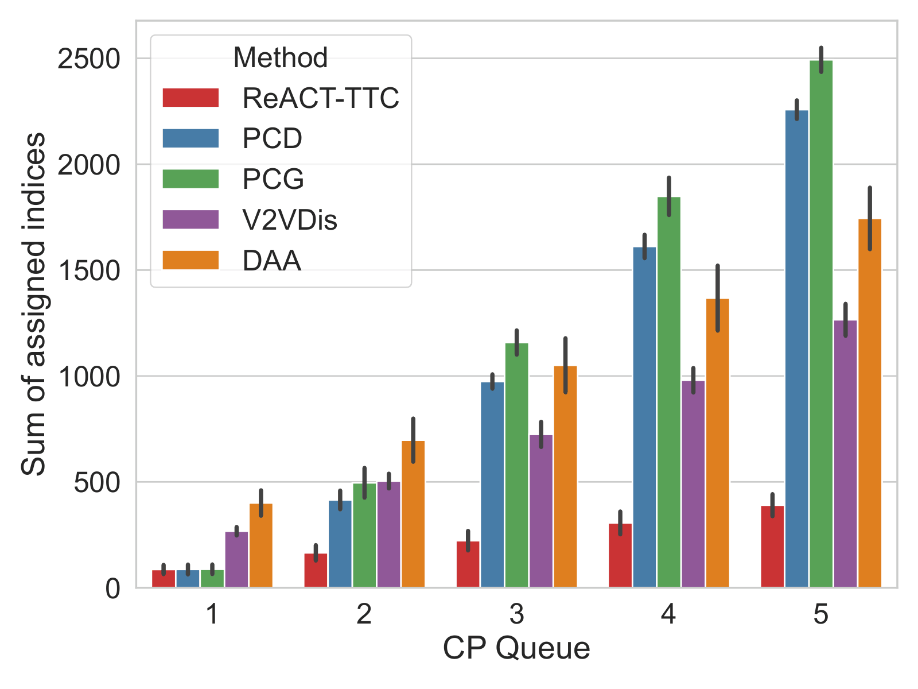
Experimental Results
Assigned Index Sum: Measures the aggregate rank of allocations for non-compliant agents (Lower is better)
ReACT-TTC achieves the lowest aggregate rank sum.

Slide 44
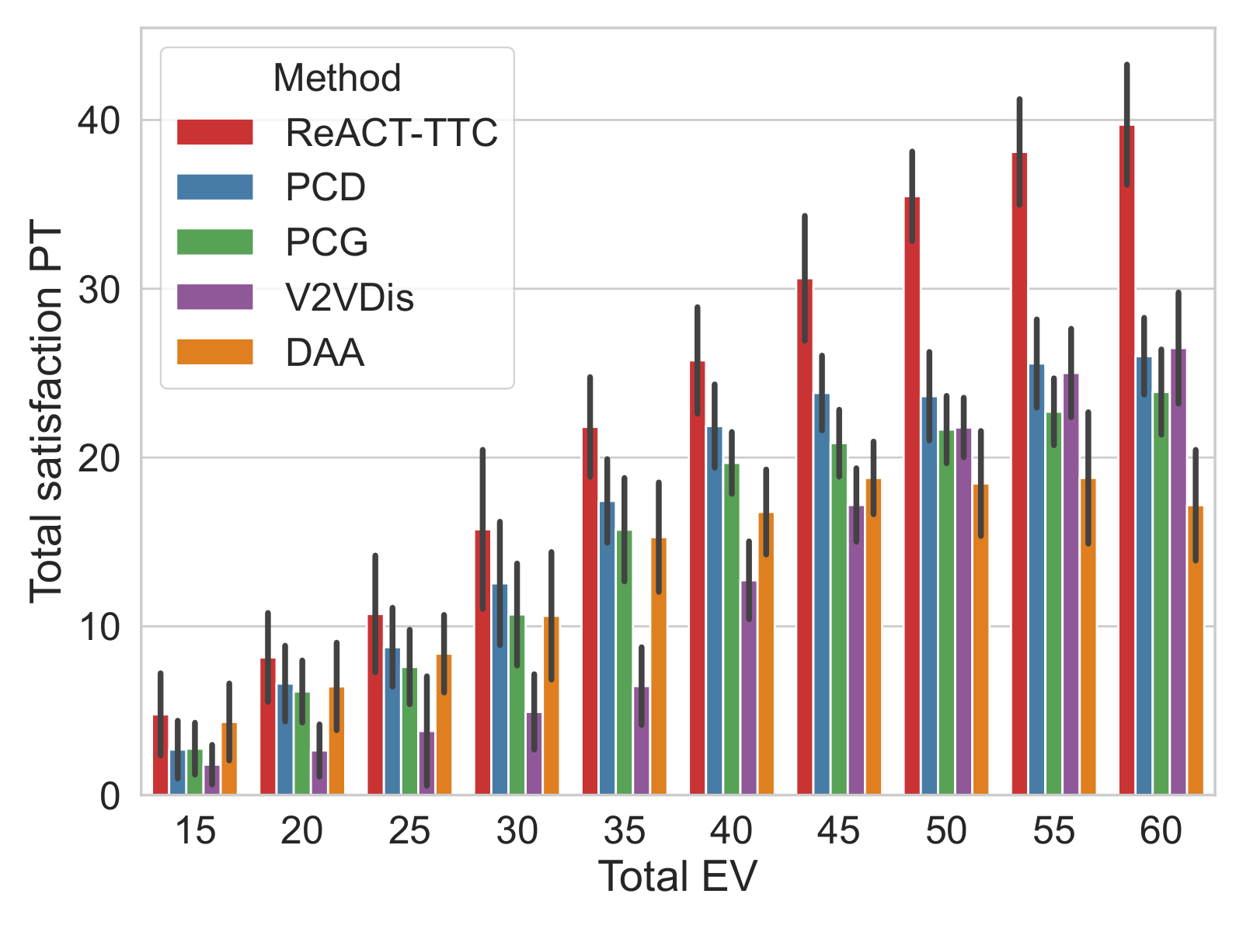
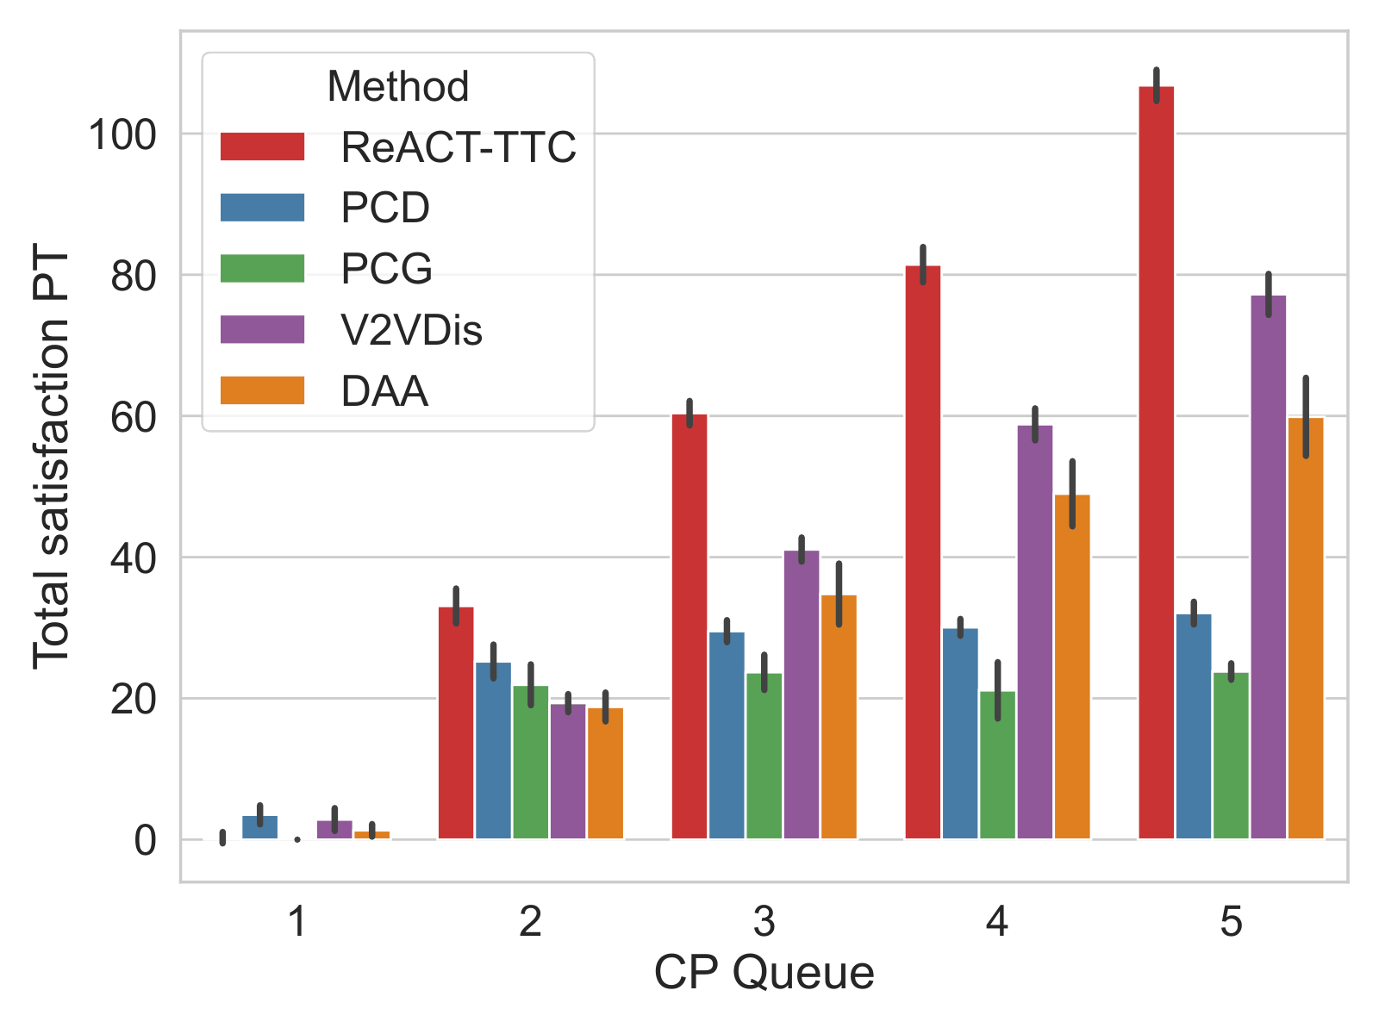
Experimental Results
Assigned Index Sum: Measures the aggregate rank of allocations for non-compliant agents (Lower is better)
PT-Satisfaction: Measures PT- satisfaction relative to the user’s initial endowment or reference point (Higher is better)
ReACT-TTC achieves the lowest aggregate rank sum.
ReACT-TTC attains the highest scores.
Users are never worse off than their starting state.

Slide 45
Conclusions
ReACT-TTC extends classical TTC to multi-quota CPS under non-compliance.
It allows preference-driven exchanges in many-to-one settings and can handle unassigned capacity efficiently.
ReACT-TTC models realistic user satisfaction by integrating prospect-theoretic preferences.
ReACT-TTC guarantees Pareto optimality, individual rationality, core stability and strategy proofness.
Our experimental analysis on real EV charging data shows that ReACT-TTC improves user satisfaction 43% on average.
Future Directions
Parallel cycle detection to make ReACT-TTC scalable.
Cross domain evaluation: compute task allocation and UAV bandwidth sharing.

Slide 46

Thank You

