Slide 1

Seasonal Agriculture
Performance Analysis
Student Name: Anurag Shah
College: [Your College Name]
AICTE STU ID: [Your STU ID]

Slide 2

PROBLEM STATEMENT
• Agricultural performance varies across Kharif, Rabi and Zaid seasons.
• Weather, soil conditions, irrigation and farming practices may influence outcomes.
• Raw agricultural data does not clearly reveal seasonal patterns and differences.
• Data analysis is required to identify meaningful trends, relationships and unusual variations.
PROBLEM STATEMENT
Agricultural Data → Seasonal Analysis → Insights → Better Planning

Slide 3
PROJECT DESCRIPTION
• Objective: analyze agricultural performance across seasons and identify meaningful patterns, relationships and differences.
• Dataset: 4,000 records × 28 variables covering crop, location, environment, inputs, irrigation, production and economics.
• Analysis: data cleaning, seasonal comparison, crop analysis, resource analysis, statistical testing and visualization.
Raw Dataset → Cleaning → EDA → Seasonal Comparison
Statistical Analysis → Insights → Recommendations

Slide 4

WHO ARE THE END USERS?
Farmers
Compare seasonal crop performance and resource use.
Agricultural Planners
Use seasonal patterns for planning priorities.
Researchers
Study crop, environmental and resource relationships.
Agricultural Organizations
Support evidence-based production and resource planning.

Slide 5

TECHNOLOGY USED
• Python
• Pandas — data preparation and aggregation
• NumPy — numerical processing
• SciPy — statistical tests
• Matplotlib — visualization
• Jupyter Notebook — reproducible analysis
• CSV — source dataset
• Exploratory Data Analysis
• Descriptive statistics
• Correlation analysis
• Kruskal–Wallis test
• One-way ANOVA

Slide 6
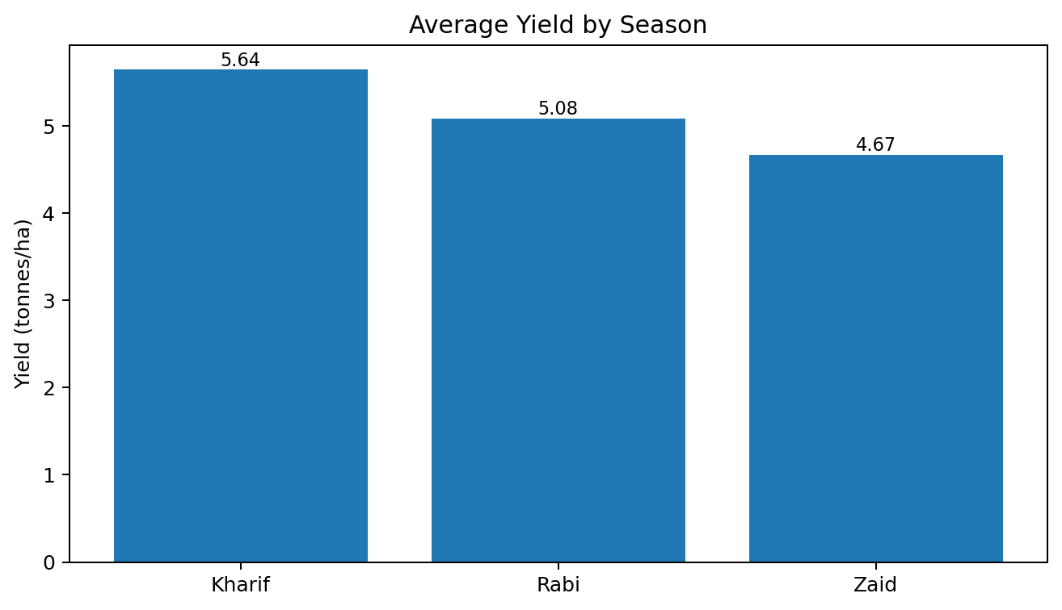
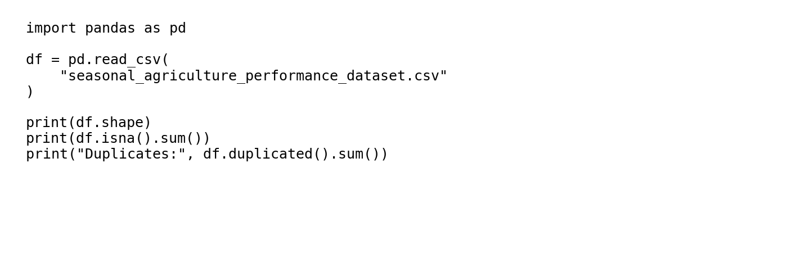
RESULTS — DATASET & DATA PREPARATION
[Add screen shots of your code ]
• 4,000 agricultural records and 28 variables.
• Three seasons: Kharif, Rabi and Zaid.
• 120 missing cells occur in rainfall, soil moisture and yield.
• No duplicate rows were detected.
• Cleaning and validation were completed before analysis.

Slide 7
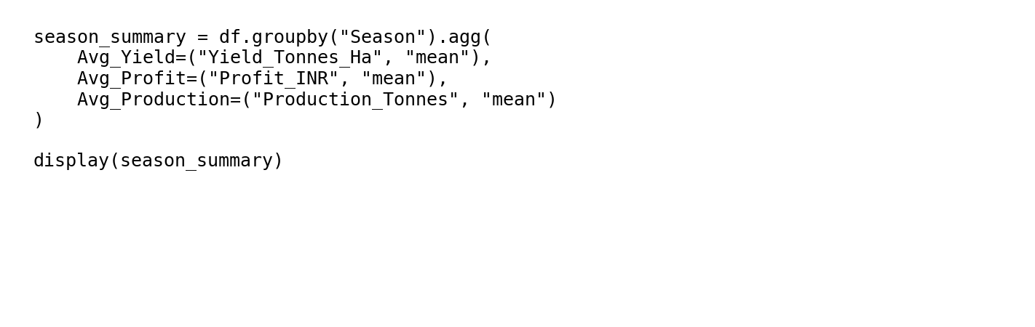
RESULTS — SEASONAL PERFORMANCE
[Add screen shots of your code ]
• Kharif average yield: 5.64 t/ha.
• Rabi average yield: 5.08 t/ha.
• Zaid average yield: 4.67 t/ha.
• Kharif average profit is highest: ₹178,915/farm.
• Seasonal averages should be interpreted with crop composition.

Slide 8
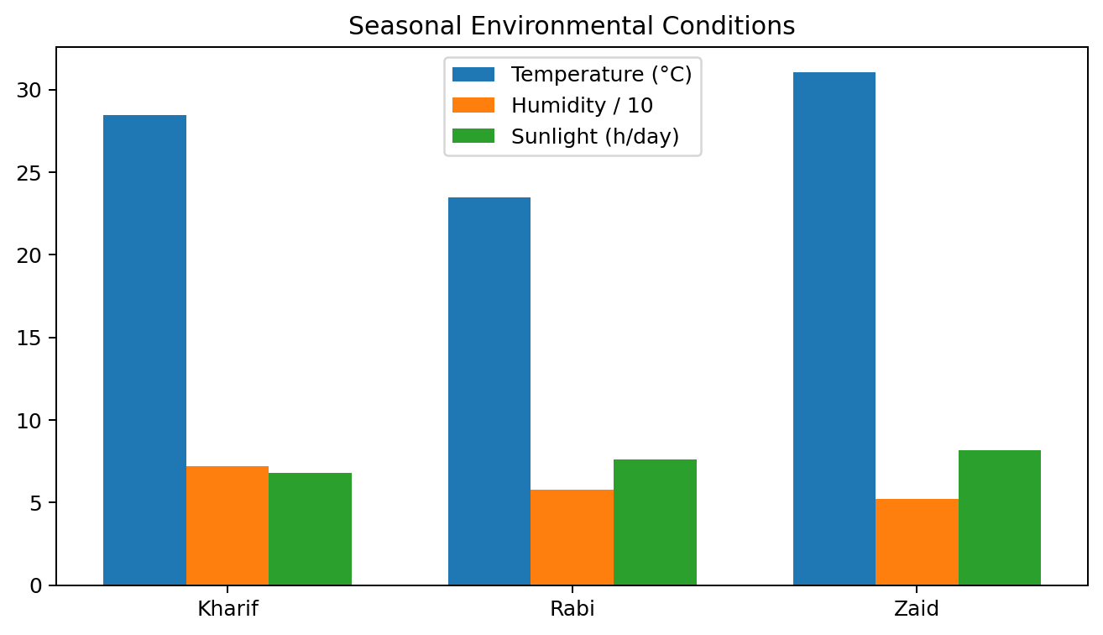
RESULTS — SEASONAL ENVIRONMENTAL CONDITIONS
[Add screen shots of your code ]
• Average rainfall: Kharif 852 mm.
• Average rainfall: Rabi 436 mm.
• Average rainfall: Zaid 299 mm.
• Average temperature is highest in Zaid: 31.0 °C.
• Observed disease/pest risk is highest in Kharif: 54.5%.

Slide 9
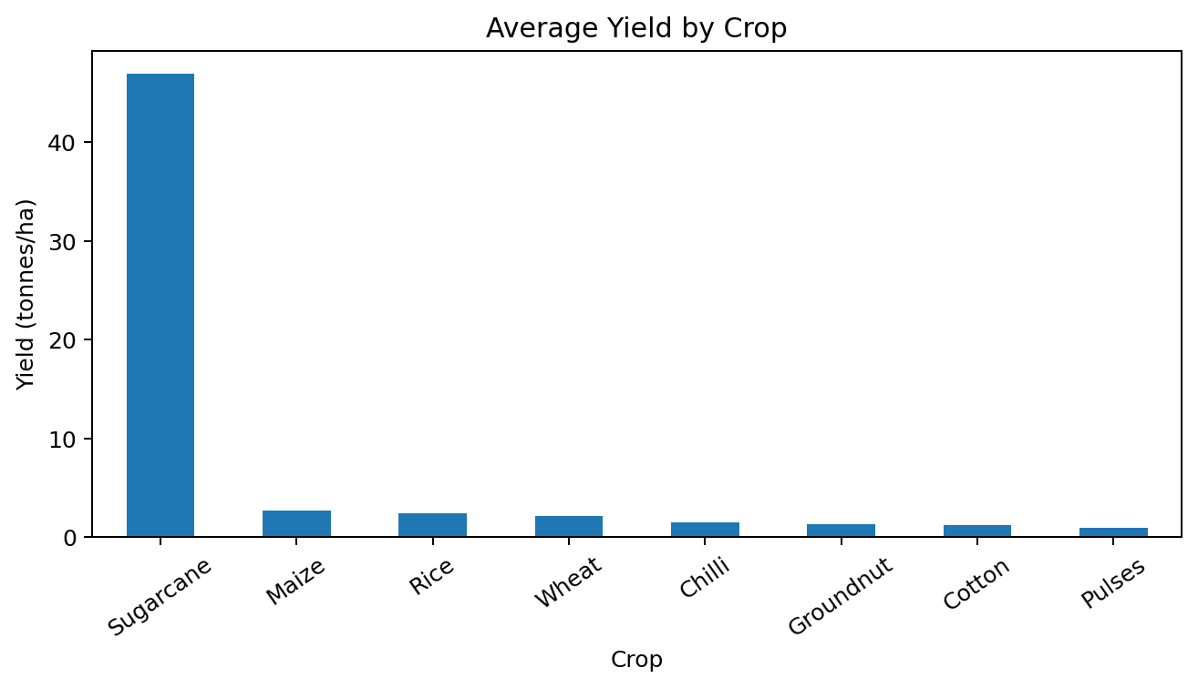
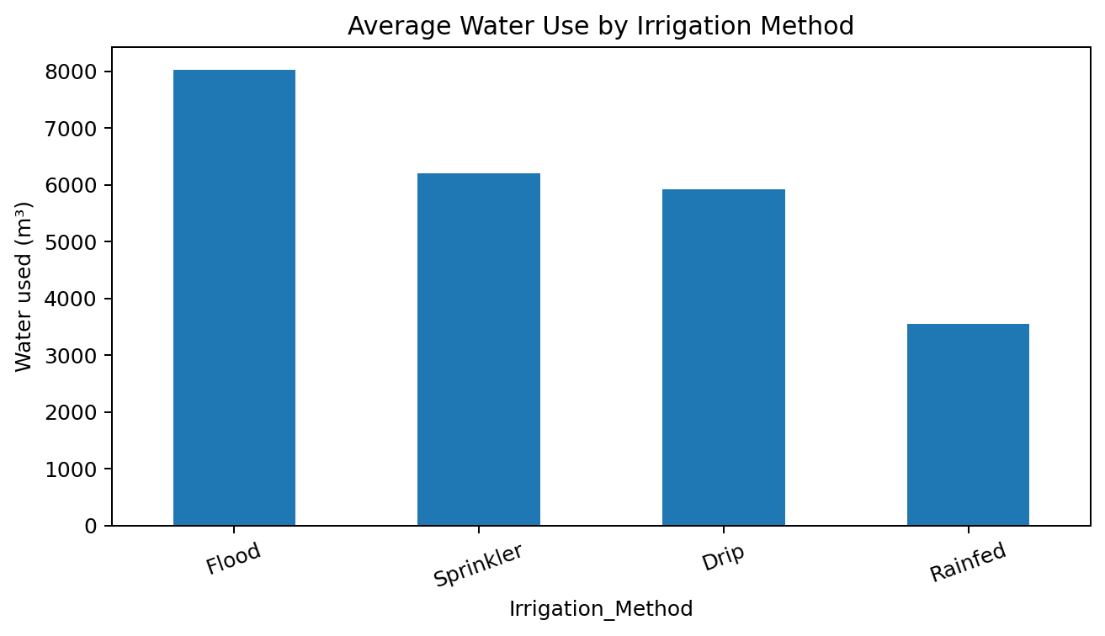
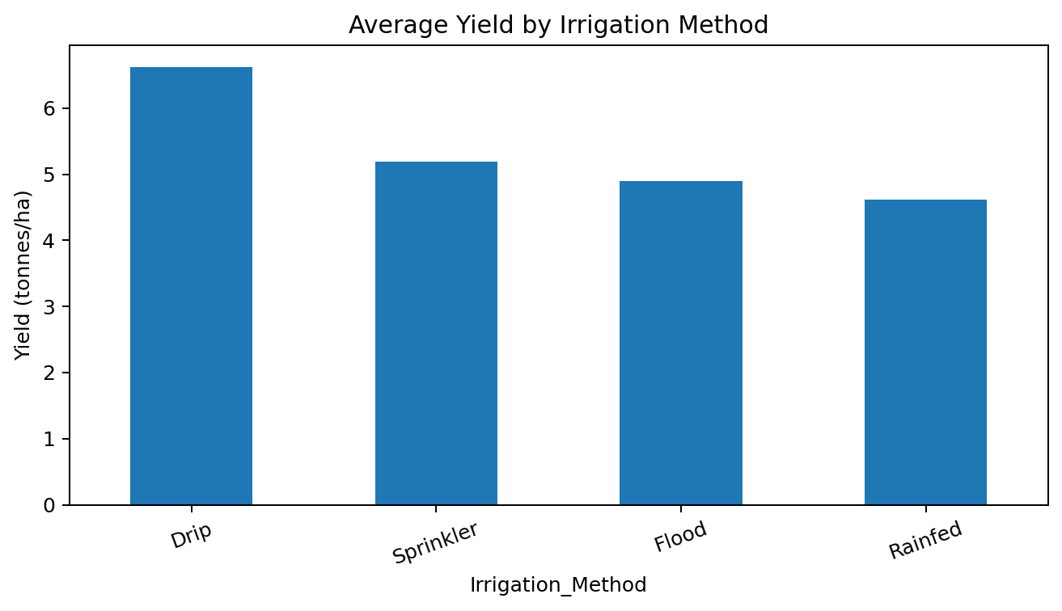
RESULTS — CROP & RESOURCE ANALYSIS
[Add screen shots of your code ]
Crop performance varies substantially; irrigation methods also differ in average water use.

Slide 10
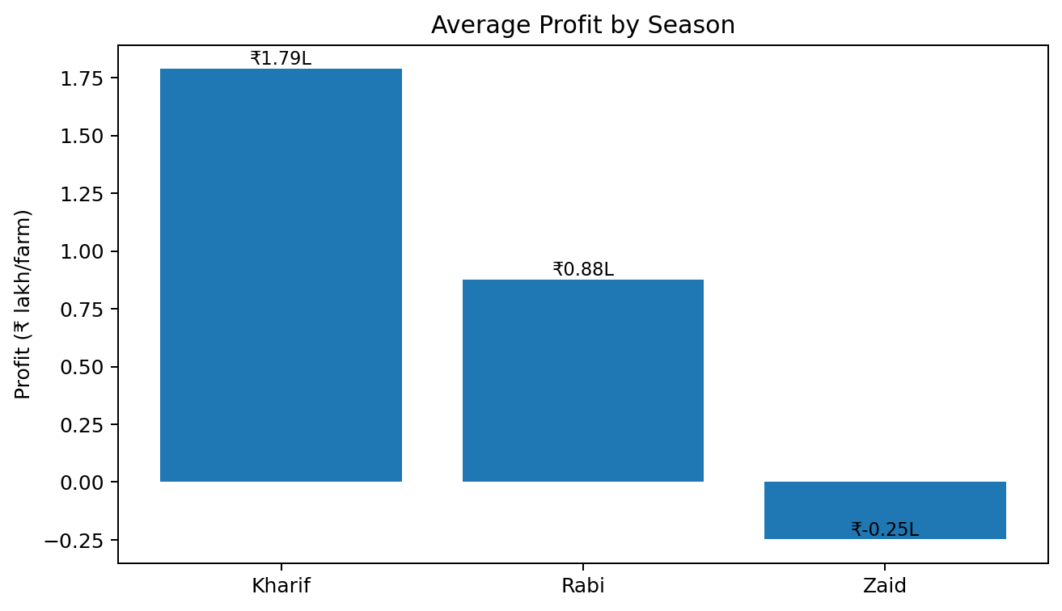
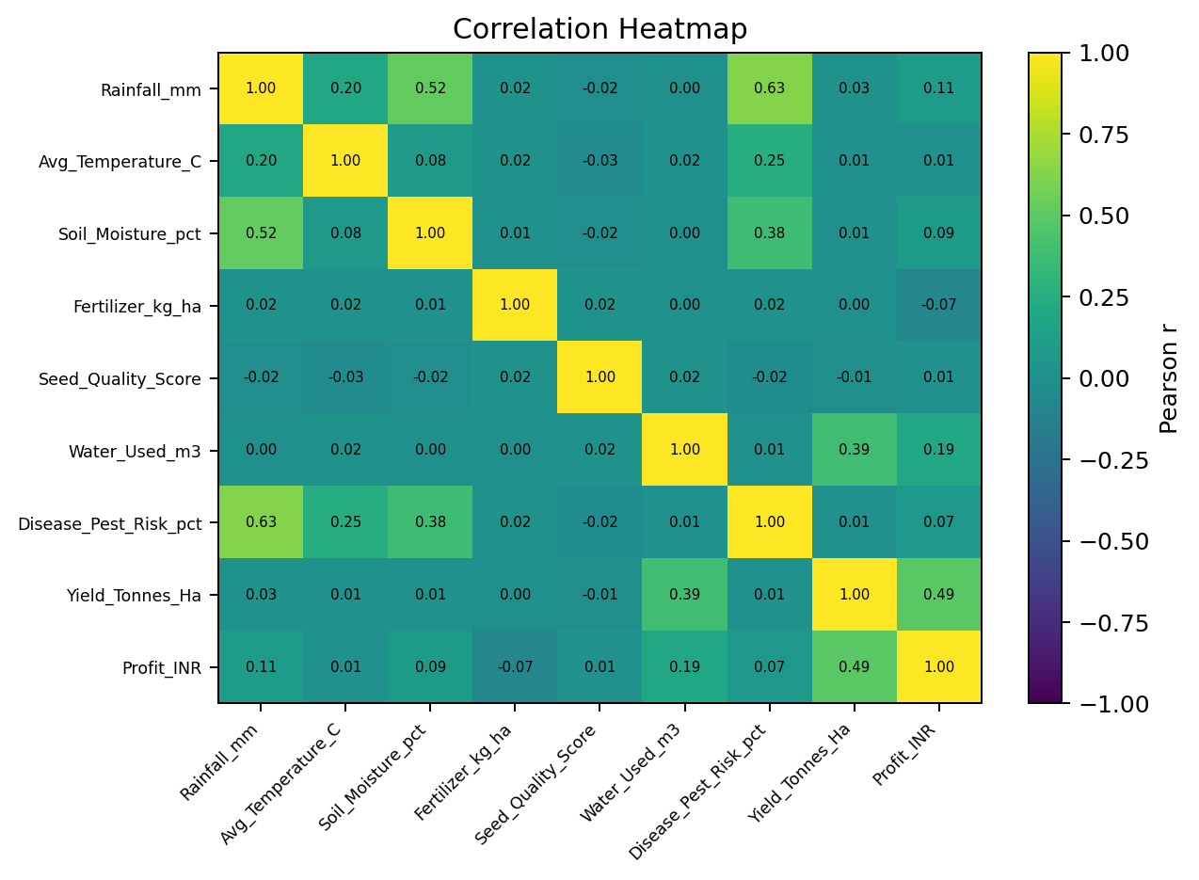
RESULTS — ECONOMIC & STATISTICAL ANALYSIS
[Add screen shots of your code ]
Kruskal–Wallis (yield): H = 68.60, p < 0.001
One-way ANOVA (yield): F = 1.46, p = 0.233
Statistical results should be interpreted alongside crop mix and distribution shape.

Slide 11
FUTURE SCOPE
• Develop crop-specific seasonal benchmarks.
• Add multi-year data to study trends and climate variability.
• Build predictive models for yield, profit and disease/pest risk after validation.
• Integrate real-time weather and market-price data.
• Develop an interactive dashboard for filtering by season, crop, region and irrigation.
• Add longitudinal farm-level data to support stronger causal analysis.

Slide 12
GITHUB LINK
GitHub Repository
[Create repository and paste link here]
Recommended repository contents:
• Jupyter Notebook
• Dataset / cleaned dataset
• Charts / figures
• README.md
• requirements.txt

Slide 13
VOIS COURSE COMPLETION CERTIFICATE
Course: Data Visualization
Attach the official VOIS course completion certificate here after completion.

Slide 14
Thank you
Questions & Discussion

