Slide 1





CE331 GROUP PROJECT
SURVEYING AND MAPPING OF GI LAB AND ACES BUILDING
Course Instructor
Prof. Salil Goel
Members:
Anurag Sharma(230174)
Awnish Kumar(230250)
Himanshu Dugar (230472)
Siddharth Jaiswal(231005)
Subhankar Sutradhar(231042)
Teaching Assistant
Shivangi Sinha
Tutor
Jamil Mahmood
Tuesday Group 7

Slide 2
ACKNOWLEDGEMENT
We would like to express our heartfelt gratitude towards our Instructor,
Prof. Salil Goel, for giving us the opportunity to learn about the field of
Geoinformatics, in class as well as on-site. We would also like to express our heartfelt thanks to our Teaching Assistants and Tutors, whose guidance and support helped us navigate each step of this project. We’re also deeply appreciative of the lab staff, who were always there to help us with equipment and logistics, keeping everything running smoothly and allowing us to focus on our work. And, of course, a big thank you to our fellow lab members working alongside you made this project not only productive but also genuinely enjoyable.

Slide 3
INTRODUCTION
This project and its presentation is an integral part of the Principles of Geoinformatics course (CE331)
• Significance: A hands-on end-to-end experience where we apply concepts taught in class and procedures taught in the laboratory sessions.
• This project involves all necessary steps for map-making, including setting up a control network, levelling, traversing, feature observations, and finally collating all the collected data into a map of the area allotted to us.

Slide 4
OBJECTIVES
• Apply principles taught in class: Followed the steps of map-making taught in class from scratch.
• Gain hands-on experience with geoinformatics tools and software, including Auto-level, Total Station, and QGIS.
• Data Processing: Learn to analyze and interpret geospatial data, including traversal, and report the Quality of Work of the data collected.
• Create detailed and precise maps.

Slide 5
METHODOLOGY
Reconnaissance
Levelling
Traversing
Feature Mapping
Creation of Map

Slide 6
Week 1- Reconnaissance
We began by exploring the assigned area, After some careful searching we have identified five change points and marked them with paint
Week 3 & 4 - Travesing
We spent two weeks doing travesing to measure the angles and distances between the control points
WORK-FLOW
Week 2- Leveling
We used an auto level to carry out leveling on the five Change Points , taking the benchmark near the GI lab for our reference
Week 5 & 6- Feature Mapping
In the final two weeks, we worked on feature mapping at all the five CP carefuly marking the locations of trees, lamps, electric poles and the buliding to create a clear and infromative map.

Slide 7
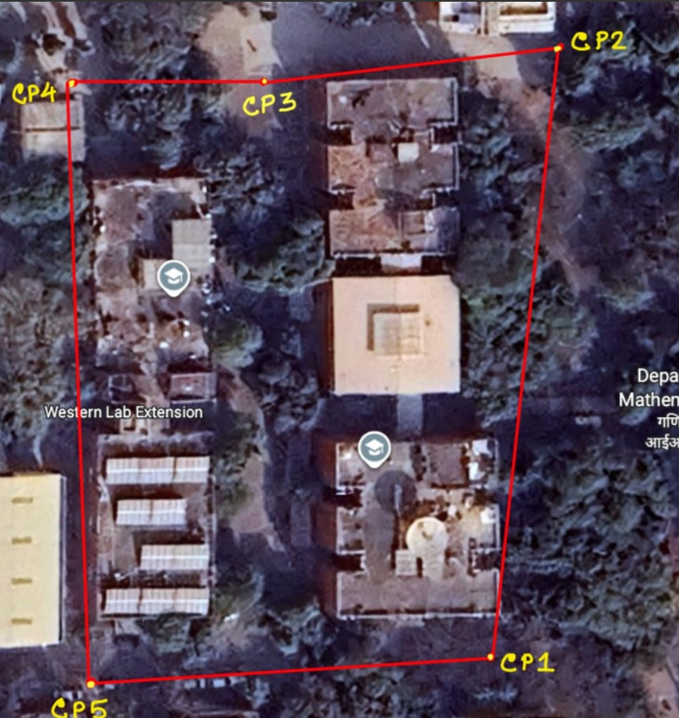
Reconnaissance
Before establishing our control network, we explored the survey area.
This helped us in setting up control points at the most suitable locations, considering
• Features in the area
• Inter-visibility
• Points being open to the sky
We finalized 5 control points, all necessary for plotting the various features present in the area, including trees and infrastructure.

Slide 8
Levelling
Before starting the detailed survey, we conducted levelling to determine the relative heights of different points in the area.
This process helped us establish a benchmark and maintain accuracy in plotting the terrain profile.
Key Steps:
  Selected a benchmark (BM) near the GI lab.
  Performed levelling to transfer the RLs (Reduced Levels) to all control points.
  Ensured proper back sight and fore sight readings for error minimization.
  Applied arithmetical checks to verify the accuracy of observations.
Outcome:
A precise elevation network was established, ensuring reliable height data for contouring and mapping.

Slide 9
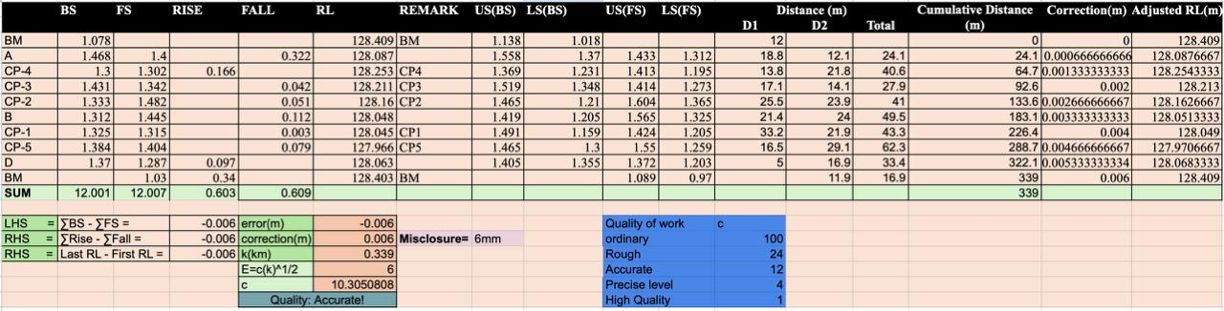
Data Sheet

Slide 10
TRAVERSING
Traversing was carried out to measure the angles and distances between control points for accurate mapping of the area.
Procedure:
  The Total Station was centred and levelled precisely at each change point.
  Bipod and prism were used to take observations between consecutive points.
  Horizontal angles along with horizontal distances were recorded.
  Data was processed to compute coordinates and ensure closing error checks.
Outcome:
An accurate traverse framework was established, forming the base for detailed feature plotting and contour generation.

Slide 11
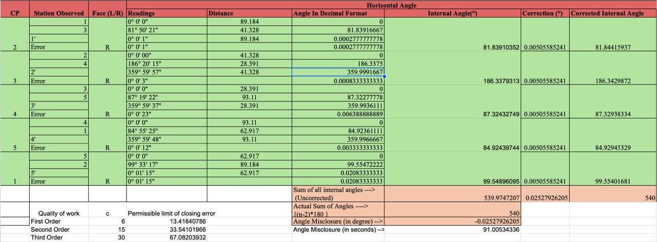
Data Sheet

Slide 12
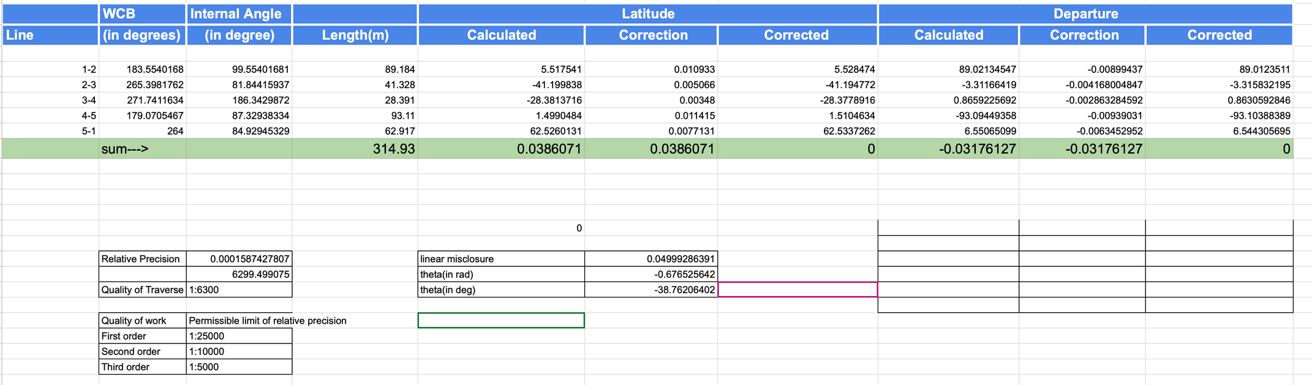
Data Sheet

Slide 13
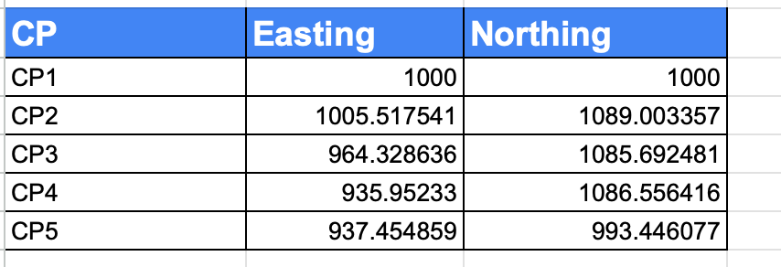
Data Sheet

Slide 14
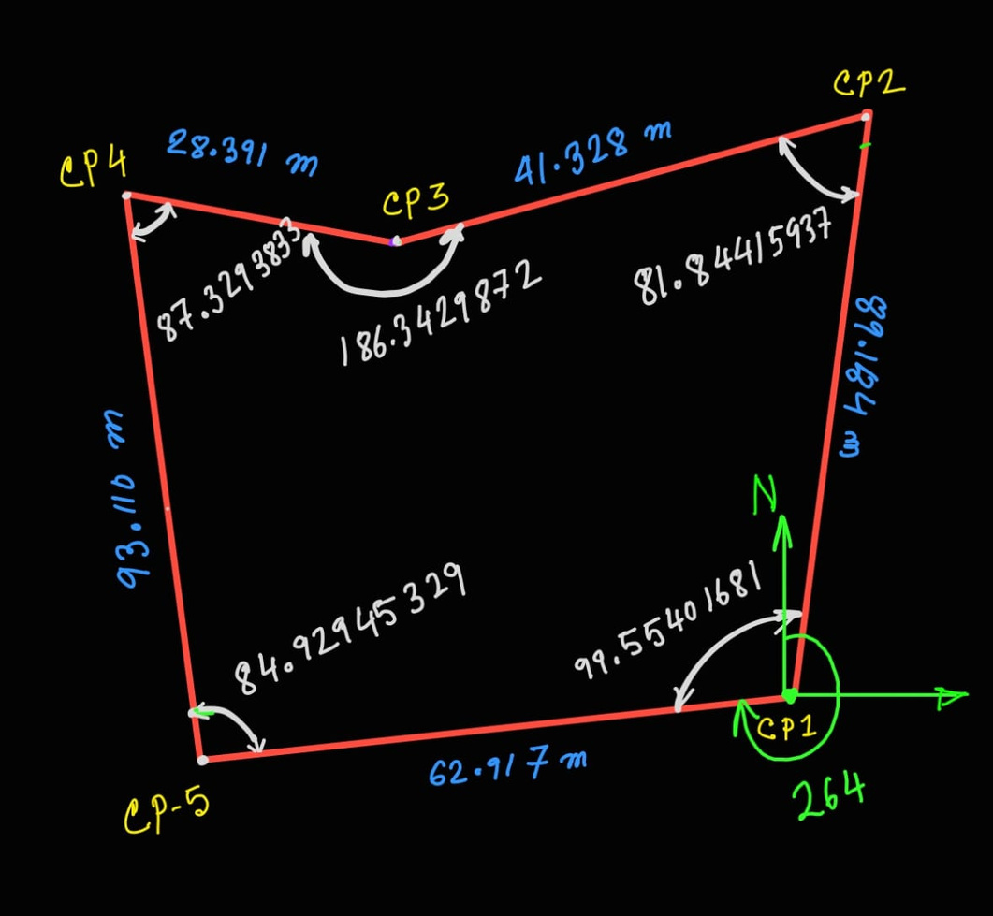

Slide 15
Feature Mapping
Feature mapping was conducted to record and locate all important details within the survey area.
Procedure:
  The Total Station was centred and levelled accurately at each station.
  Using a bipod and prism, we measured the coordinates of key features.
  Mapped features included trees, roads, manholes, electric poles, and buildings.
  All observations were stored electronically for processing and plotting in mapping software.
Outcome:
A detailed topographic map was generated, showing both natural and man-made features with high positional accuracy.

Slide 16
Creation of Map
Finally map is created on QGIS Software
Procedure
  The survey observations collected using the Total Station were first exported and organized.
  The collected point data was imported into QGIS software.
  Separate vector layers (point, line, and polygon) were created to represent different features on the map.
  Each feature was assigned proper symbology and labels (e.g., buildings, water tanks, roads, trees, electric poles, manholes).
  Contour lines were added to represent elevation differences across the site.
  The Layout Manager was used to design the final map.
Outcome:
A clear and accurate topographic map of the GI Lab and ACES Building area was successfully generated using QGIS.

Slide 17
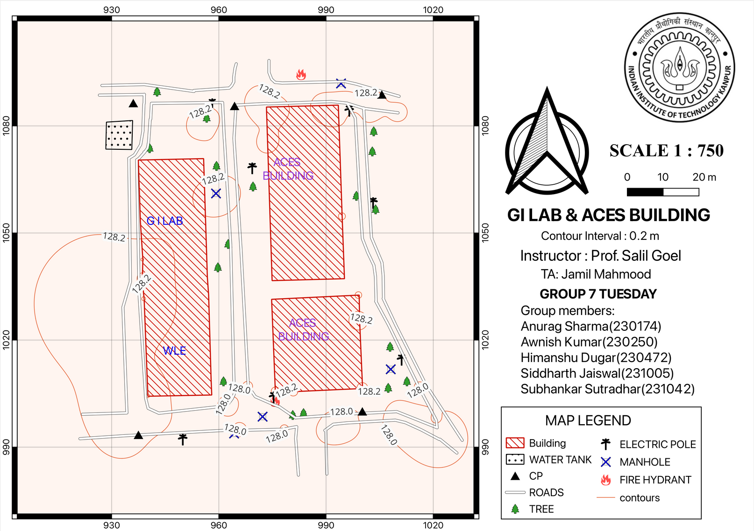
Final Map

Slide 18
Conclusion
Key Takeaways
  Result: A detailed map of the GI Lab, ACES Building, and their surrounding areas.
  Gained practical experience in:
    Setting up and operating surveying instruments.
    Recording and processing field observations.
    Handling real-world constraints in data collection.
    Understanding the complete survey-to-map workflow.
Challenges Encountered
  In lab 2 Control points (CPs) were erased due to rain and vehicle movement.
  Difficulty in centring and levelling at one CP because of loose soil conditions.
  Vehicles parked at control points interrupted traversing and levelling.
  Vehicle movement interrupts the reading of total station.

Slide 19
THANK YOU

Slide 20
Referencing
All the references used in preparing this ppt. are as follows:
  maps.google.com
  Lab reports of CE331
  QGIS software for map making.
  Lecture notes by Professor Salil Goel.

