Slide 1

PROJECT :- FAKE NEWS DETECTION USING LOGISTIC REGRESSION
DEPARTMENT OF MATHEMATICS, BIOINFORMATICS, AND COMPUTER APPLICATIONS
MAULANA AZAD NATIONAL INSTITUTE OF TECHNOLOGY
Minor Project(CA-406)
PRESENTED BY :-
AMIT MONDAL-2320403226 ANURAG SHARMA-2320403227
(MCA-IV)
GUIDED BY :-
Dr. AMIT BHAGAT

Slide 2
Content
Introduction
Project Objective
Model
Workflow
Implementation
References
Conclusion

Slide 3
What is fake news ?
Fake news refers to false or misleading information presented as real news. It is intentionally created to deceive people, influence opinions, or generate profits. Fake news spreads easily on social media and can have serious consequences, such as misinformation in politics, health, and finance.

Slide 4
How Fake News Spreads
Social Media – Fake news spreads quickly on platforms like Facebook, Twitter, and WhatsApp.
Bots & Trolls – Automated accounts and paid individuals spread fake news to manipulate opinions.
Poor Fact-Checking – People share information without verifying its authenticity.

Slide 5
Why Fake News is Dangerous
Affects Public Opinion – Can mislead voters and impact elections.
Harms Health – Spreads false medical advice (e.g., fake COVID-19 cures).
Economic Losses – Affects stock markets and businesses.
Social Division – Creates hatred, fear, or panic among people.

Slide 6
Objective
To develop a machine learning model that can automatically classify news articles as real or fake using logistic regression, helping to reduce the spread of misinformation through text-based analysis.

Slide 7
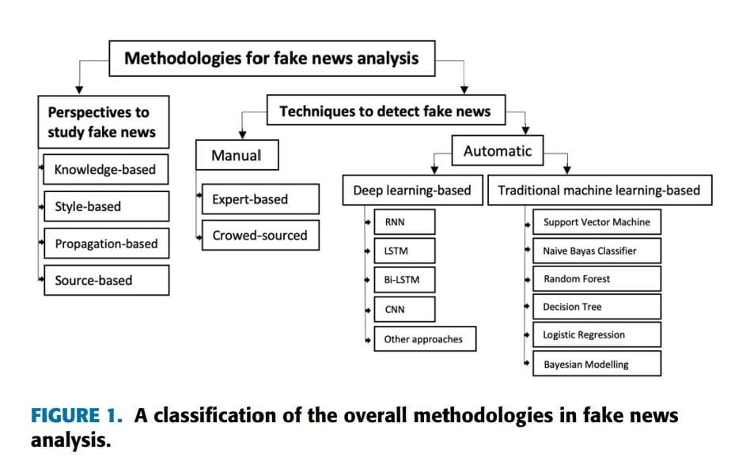

Slide 8
Model construction
Traditional Machine Learning-Based model is trained using extracted features.
Algorithms used:
Naive Bays
Random Forest
Decision Tree
Logistic Regression

Slide 9

Naive Bayes Model
A probabilistic classifier based on Bayes' Theorem.
Assumes that features (e.g., words, sources, clickbait) are independent given the class label.
Works well for text classification tasks like Fake News Detection.
Prediction Interpretation:
Computes P(Fake | Features) and P(Real | Features) using
conditional probabilities.
Chooses the label with the highest probability.
Mathematical Formula (Bayes' Theorem):

Slide 10
Decision Tree
A tree-based model that makes decisions based on feature-based rules.
Splits data into branches based on key features like headline words, source reliability, and content sentiment.
Leaf nodes provide final classification (Fake or Real).
Prediction Interpretation:
Follows Yes/No questions to classify news as Fake (0) or Real (1).
Example:
Does the headline contain clickbait words? (Yes → Fake, No → Next check)
Is the source credible? (Yes → Real, No → Fake)

Slide 11
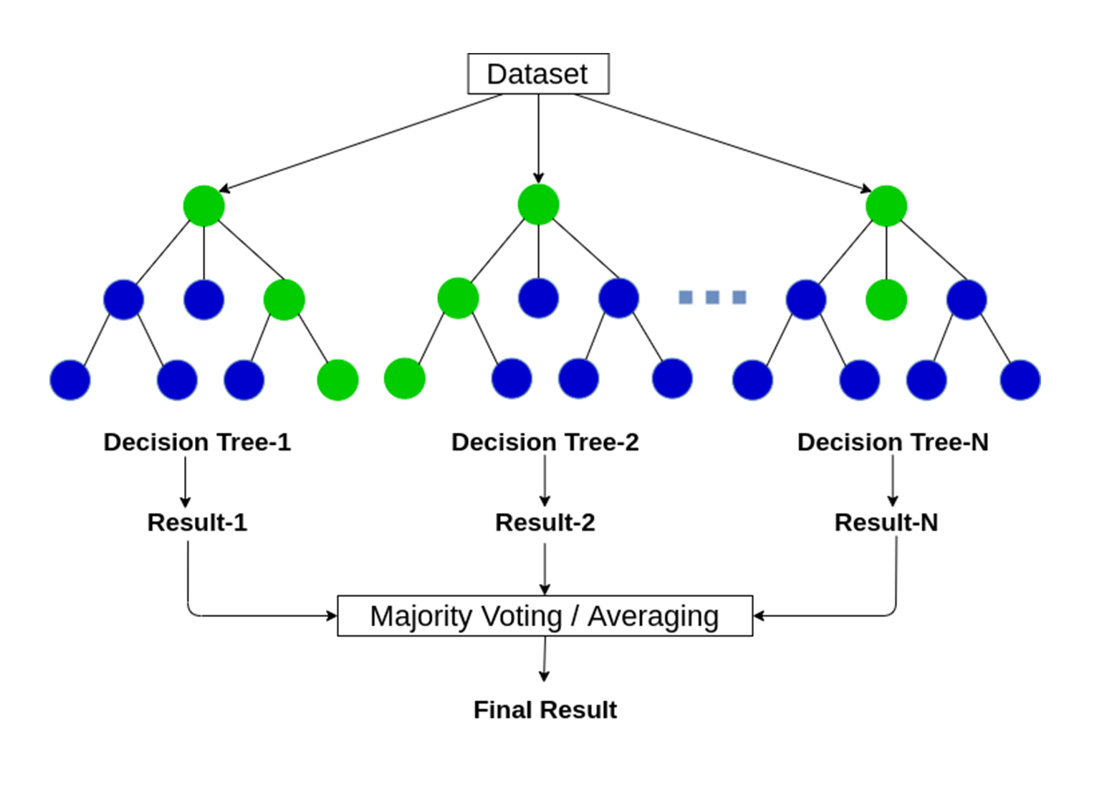
Random Forest
A supervised learning algorithm used for classification & regression.
It is an ensemble method that combines multiple Decision Trees to improve accuracy.
Works by majority voting in classification tasks (like Fake news prediction).
Step-by-Step Process: Creates multiple Decision Trees from random subsets of the dataset. Each tree makes a prediction (Fake news : Yes (0) or No (1)). Final Prediction = Majority Voting (most common result among all trees).
Example :- Tree 1 predicts: Not Fake news (1) Tree 2 predicts: Fake news (0) Tree 3 predicts: Fake news (0) Final Prediction: Fake news (0) (Majority Vote)
This reduces the risk of overfitting seen in a single Decision Tree!

Slide 12
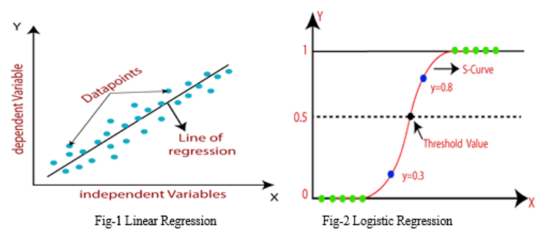
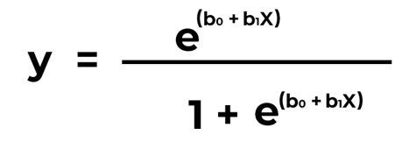
Logistic Regression
A supervised learning algorithm used for classification problems.
Predicts the probability of an event occurring (e.g., Fake News: Yes (0) / No (1)).
Uses the Sigmoid function to convert predictions into a probability between 0 and 1.
Prediction Interpretation: If P ≥ 0.5 → Predicts Fake News (0). If P < 0.5 → Predicts Not Fake News (1).
Mathematical Formula :

Slide 13
Fake News Detection Using Logistic Regression
Why Logistic Regression?
Suitable for binary classification problems like real vs. fake news
Fast and efficient to train on large datasets
Produces interpretable results, making it easier to understand model decisions
Works well with text feature extraction methods like TF-IDF.

Slide 14
Fake News Detection Workflow
Data Collection - Gather news articles, tweets, etc.
Preprocessing - Clean text, remove stop words.
Feature Extraction - Convert text to numerical data.
Model Training - Train ML or DL models.
Prediction - Classify news as fake or real.
Evaluation - Measure accuracy using metrics.

Slide 15
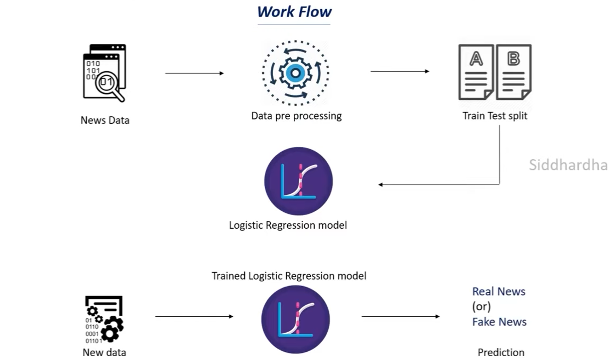
Fake News Detection Workflow Diagram

Slide 16
Introduction to datasets
A dataset is a collection of data used to train and test machine learning models.
In fake news detection, the dataset contains news articles, headlines, and related metadata labeled as fake or real.
Dataset Used: Kaggle Fake News Dataset.
Number of Records: ~10,000–24,000+ news articles.
Number of Features: Text content, Title, subject, date, etc.

Slide 17
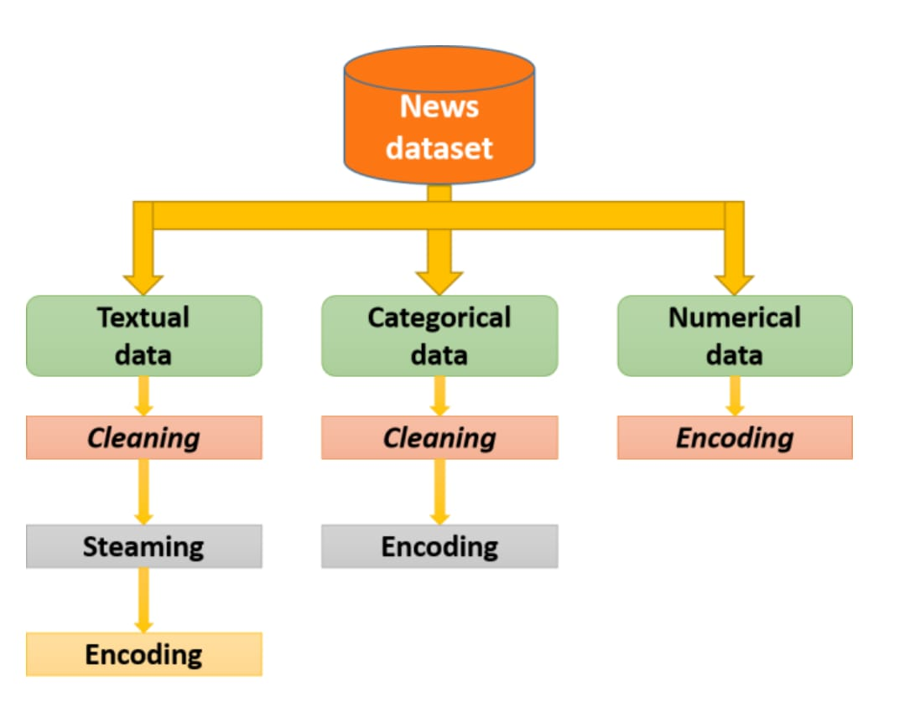
Data Preprocessing
Cleans and prepares text for analysis by:
Removing stop words, special characters, and punctuation.
Converting text to lowercase.
Performing stemming or lemmatization.

Slide 18
Feature Extraction
1). TF-IDF (Term Frequency-Inverse Document Frequency) Converts text into numerical form based on word importance. Filters common words and highlights key terms.
2). Word Embeddings Represents words as dense vectors, capturing meaning & context. Used for deep learning models.
Splitting into training and testing data
Training Data – Used to train the model.
Testing Data – Used to evaluate model accuracy.

Slide 19
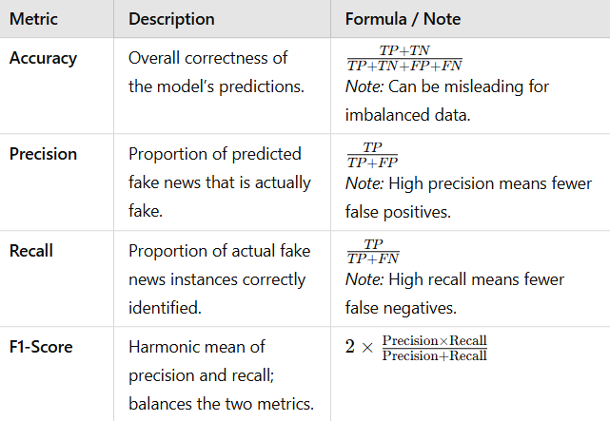
Prediction and Evaluation

Slide 20
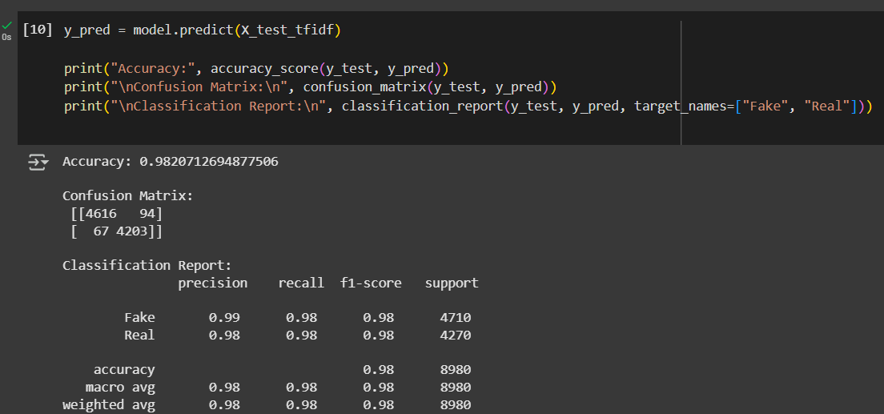

Slide 21
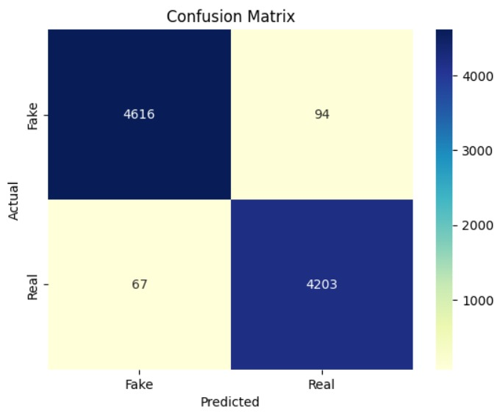

Slide 22
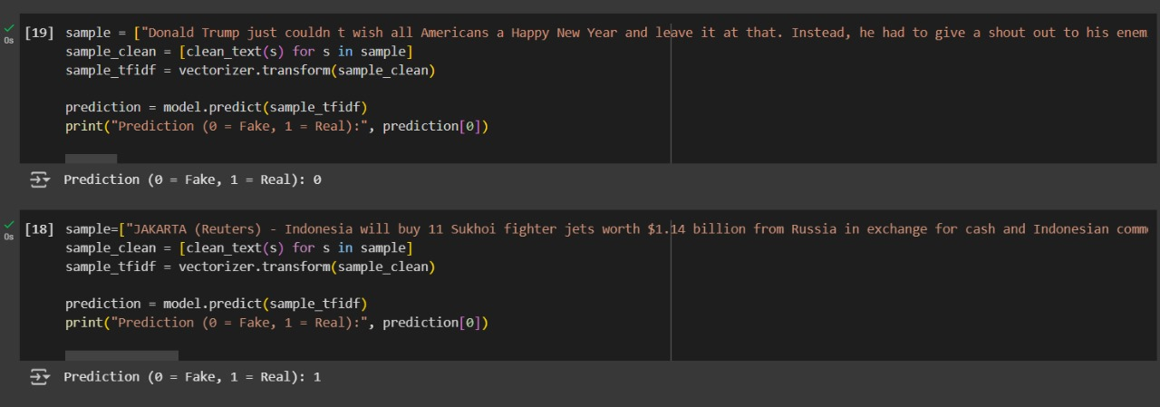
Classification Output

Slide 23
Conclusion
We choose Logistic Regression for fake news detection because it is simple, fast, and effective for binary classification problems like real vs. fake news. It works well with text-based features like TF-IDF, requires less computational power, and provides clear decision boundaries. This makes it easy to train, interpret, and deploy while still achieving good accuracy.

Slide 24
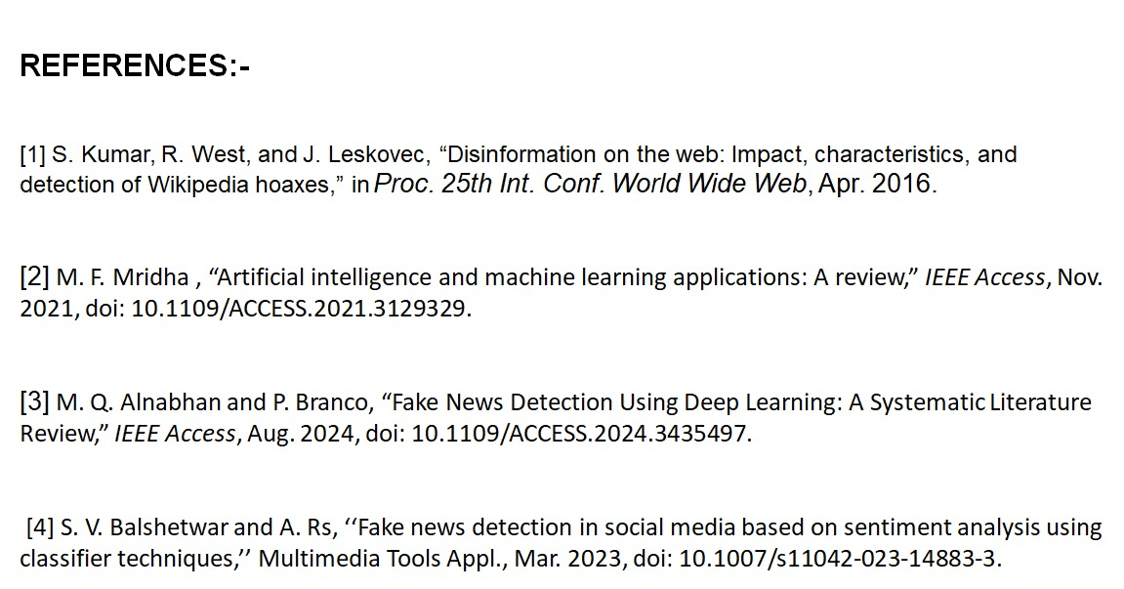

Slide 25
Thank you

