Slide 1
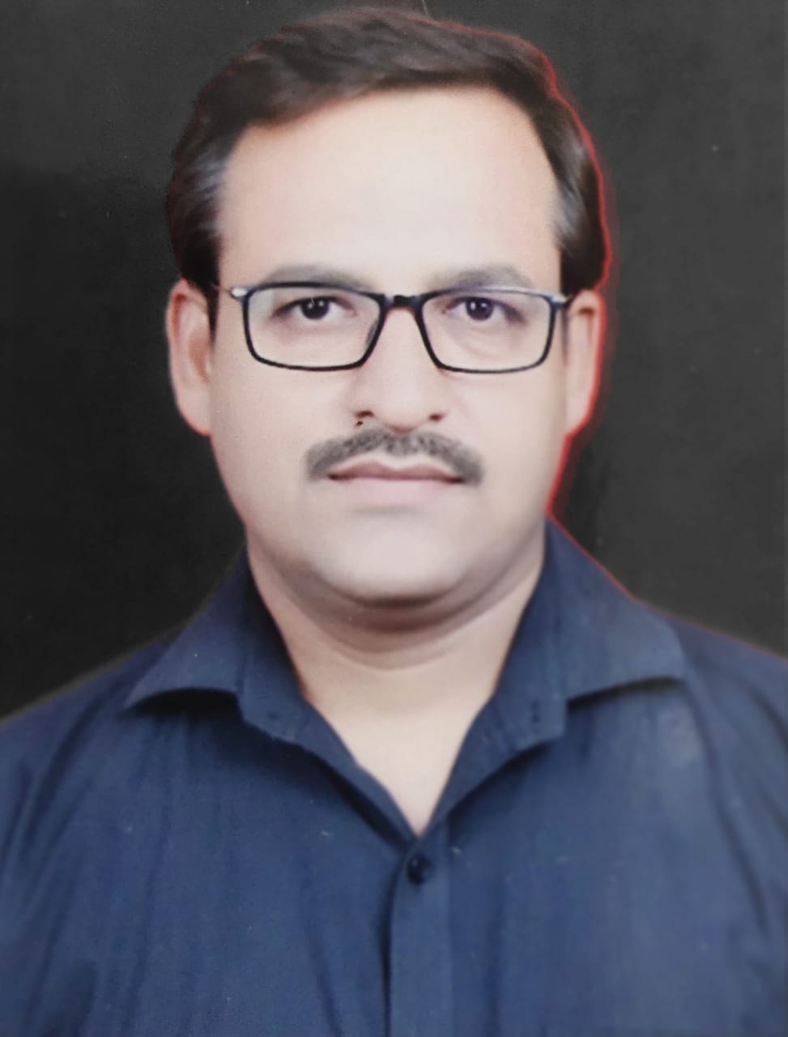

QUESTION TAG
By Ashutosh Tripathi

Slide 2

PRACTICE SET 1
He is late this morning, isn’t he ?
2. The hotel was quite good, wasn’t it?
3. She cooks well, doesn’t she?
4. You can’t tell the difference, can you?
5. They always sleep after lunch, don’t they?
6. You’re coming with us, aren’t you?
7. Mary plays football, doesn’t she?
8. You didn’t have any lessons this morning, did you?
9. Ann is on holiday, isn’t she?
10. The students see it everyday, don’t they?

Slide 3
PRACTICE SET 2
11) Let us dance together, shall we? 12) Switch on the radio, won’t you?
13) Don’t open the window, will you?
14) The sofa set was not strong enough, was it?
15) We did our homework, didn’t we?
16) I am not going to write it, am I?
17) I did not see her yesterday, did I?
18) Somebody knocked at the door, didn’t they?
19) This man always disturbed me, didn’t he?
20) I am a bit early, aren’t I?

