Slide 1
Fortification learning to help detecting abuse in financial exchange description
By Anuraj Bose,
22MCB0011

Slide 2
CONTENTS
Objective
Introduction
Literature Survey
Proposed Work
Experiments and Results
Case Studies and Success Stories
Summary and Future Scope
References

Slide 3
Objective
Technology has been used in targeted forms of domestic and family harassment, and there are challenges to detect, respond to, and deal with this type of abuse..
To prevent this kind of harassment into digital payment section

Slide 4
Introduction
• Welcome to the presentation on "Detection of Abuse in Payment Platforms (Paytm/Google Pay) Using Machine Learning."
• Overview of the rising importance of secure and abuse-free payment platforms.
• Introduce the role of machine learning in automating the detection process and ensuring user safety.

Slide 5
Understanding Abuse in Payment Platforms
• Define abuse in the context of payment platforms.
• Examples of abuse, such as fraudulent transactions, identity theft, phishing attacks, and money laundering.
• Emphasize the financial risks and consequences associated with abuse for users and the platform itself.

Slide 6
Challenges in Detecting Financial Transaction Abuse
• Complexity of financial data and patterns: Financial transactions involve various parameters and complex relationships, making it challenging to identify abusive patterns.
• Evolving tactics and techniques: Fraudsters continually adapt and employ new strategies, making it difficult for traditional rule-based systems to keep up.
• High volume of transactions: The sheer number of transactions makes manual detection inefficient and time-consuming.
• Limitations of traditional approaches: Rule-based systems often fail to detect sophisticated abuse, requiring more advanced methods.

Slide 7
Role of Machine Learning in Detection
• Machine learning enables the automation of abuse detection through the analysis of vast amounts of data.
• Key advantages of using machine learning include:
◦ Ability to process and analyze large volumes of data quickly.
◦ Identification of complex patterns and anomalies that may indicate abuse.
◦ Continuous learning and adaptation to evolving fraud tactics.

Slide 8
Data Preparation and Feature Engineering
• Data preprocessing is crucial for effective machine learning.
• Feature engineering involves creating relevant features from raw transaction data.
• Common features used in abuse detection include transaction amount, frequency, time, and geographical information.
• Incorporating external data sources, such as watchlists and historical fraud data, enhances detection accuracy..

Slide 9
Supervised Learning Algorithms
• Supervised learning algorithms use labeled datasets to learn patterns and make predictions.
• Decision trees, random forests, and gradient boosting algorithms are commonly used for abuse detection.
• Support Vector Machines (SVM) and Neural Networks (NN) excel at capturing complex relationships in the data.
• The training process involves feeding labeled data into the algorithms to enable them to generalize patterns.

Slide 10
Unsupervised Learning Algorithms
• Unsupervised learning algorithms are valuable for detecting unknown patterns and anomalies.
• Clustering algorithms like k-means and DBSCAN group transactions based on similarity, allowing identification of unusual clusters.
• Anomaly detection algorithms like Isolation Forest and Local Outlier Factor detect transactions that deviate significantly from normal behavior.
• Unsupervised learning is especially useful for detecting novel abuse techniques and identifying emerging fraud patterns.

Slide 11
Ensemble Methods and Model Evaluation
• Ensemble methods combine multiple models to improve detection accuracy.
• Bagging, boosting, and stacking techniques are commonly used to build robust models.
• Ensemble methods reduce overfitting and increase generalization capability.
• Model evaluation involves metrics such as precision, recall, F1-score, and receiver operating characteristic (ROC) curve analysis.

Slide 12
Literature Survey
Author & Year | Adopted Scheme | Features | Challenges
PenzeyMoog, Eva, and Danielle C Slakoff., 2021 | Smart Home Device Abuse, Changes in typical banking patterns. Erratic or unusual banking transactions. Frequent large withdrawals. | Reductant the mode of accuracy | Excess Training time Comparison between machine learning algorithms
AK. Varadharajul u, Y Ma, 2021 | Data Mining algorithms for a feature based customer review process model with engineering informatics approach | Detect 97% of the tweets that contain racist comments High Performance | Indicates that J48 is the beat classifier with highest accuracy and Simple K- mean is used for a smaller number of cluster when compared with other techniques.

Slide 13
Literature Survey
Author & Year | Adopted Scheme | Features | Challenges
Zampieri, Marcos, Shervin Malmasi, Preslav Nakov, Sara Rosenthal, Noura Farra, and Ritesh Kumar, 2019 | Offensive language identification, Automatic categorization of offense Types, Offense target identification | Reductant the mode of accuracy | Excess Training time Comparison between machine learning algorithms
Kircaburun K, Alhabash S, Tosuntaş ŞB, Griffiths MD, 2020-2018 | Uses and gratifications of problematic social media use among university students: a simultaneous examination of the big five of personality traits, social media platforms, and social media use motives | Real time detection Prevention of adverse effects | More of big five of personality traits, social media platforms, and social media use motives

Slide 14
Literature Survey
Author & Year | Adopted Scheme | Features | Challenges
Islam et al. 2020 | An automated detection of social media posts relating to cyberbullying by taking into account the two properties BoW and TF-IDF, along with SVM and four other machine learning algorithm | High precision High Accuracy Better Performance | No consideration for languages other than english
Barskar, A., & Phulre, A, 2017 | Opinion mining of twitter data using Hadoop and Apache Pig. | Hadoop Flowbased system | More resources are not working simetiniously

Slide 15
Real-Time Monitoring and Alert Generation
• Emphasize the importance of real-time monitoring in payment platforms.
• Machine learning models continuously analyze incoming transactions for suspicious activities.
• Prompt generation of alerts and notifications for potential abuse cases.
• Integration with existing platform infrastructure for seamless detection and response.

Slide 16
Problem Statement
•Technology-assisted abuse in banking payment systems presents a new set of difficulties, such as the sensitive nature of the subject and the potential for harm.
Unlike message boards messages that may be
readily removed or banned, bank transactions are unable to
defend. The transactions "life-span"has become substantially longer.
Transaction details features, Simple text features need to use in the today’s modern payment method texts.

Slide 17
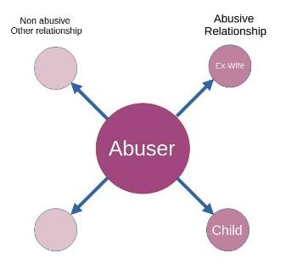
Proposed System
Tue 24 Jun, Today
YOU WIN... Hope your proud.....Killed your kids dad..... have a great life.... mines been over for 2 years
YOU WIN... Hope your proud.....Killed your kids dad..... have a great life.... mines been over for 2 years
₹12,000
Tue 23 Jun, Yesterday
IM FIRST........................ HAPPY 16th
₹5600
BIRTHDAY............................BUT left LAST
₹2300
Figure 1:Some abusers frightening many different kinds of victims.
In the present case, the communications in between the abuser and
his kid have been considered on their own in our dataset from the
abuser's relationships with his ex-wife.

Slide 18
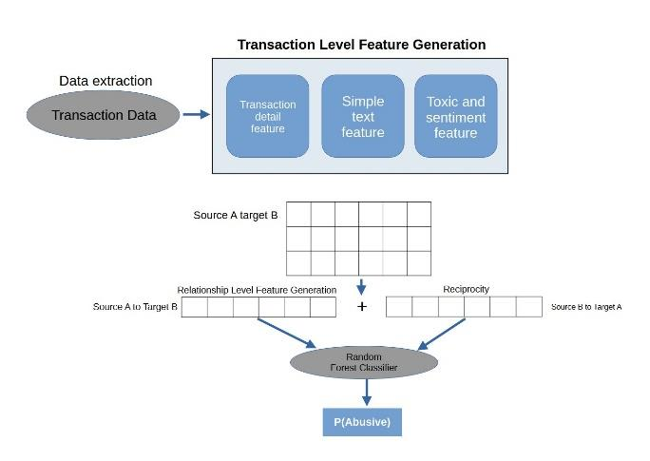
Proposed System
Figure 2 brief explanation of the architecture of the system's components. The unstructured information has been turned into three sets of traits, ranging which are subsequently incorporated in accordance with their relationship intensities. The final model inc.

Slide 19
Proposed Preprocessing Techniques
1) Transaction-level feature generation: creating appropriate features from each single transaction description (Section V-A)
2) Relationship-level feature generation: aggregating these features on each relationship (sender-recipient pair) in order to detect abusive customers, not just individual abusive transactions (Section V-B)
3) Incorporating reciprocity information: generating features related to the replies a potential victim might have sent (Section V-C)
4) Training a machine learning model to predict the labels: Random Forest model was used to classify relationships as either highly abusive or non-abusive

Slide 20
Proposed Preprocessing Techniques
Transaction-level feature generation:
Transaction details features (TRX)
Simple text features (ST)
Emotion, Toxicity and Sentiment features (ETS)

Slide 21
Proposed Preprocessing Techniques
Relationship level feature generation:
The above-mentioned features were calculated for every transaction. Because our prediction task focus is on relationships, we need to aggregate the information from all the transactions between a sender and a receiver.

Slide 22
Proposed Preprocessing Techniques
Aggregation | Features
Maximum | Every sentimental element
Minimum, Maximum, Median | Length of transactions, number of words, the longest word length, proportion of word breaks to the message description length
Sum | All the toxicity features
Mean | All the emotion features, transaction amount, number of lower case words, number of upper case words, number of mixed case words, number of punctuation found
Table 1 : TYPE OF AGGREGATION FOR FEATURES

Slide 23
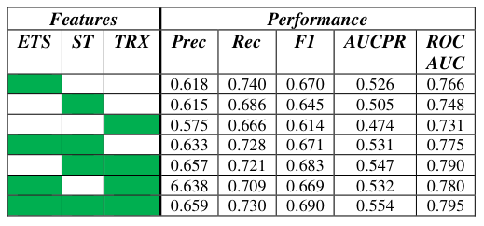
Experiment and Results
Table 2 Emotion, toxicity, and sentiment (ETS), simple text (ST),
and transaction (TRX) feature combinations: experimental results.

Slide 24

Experiment and Results
Table 3 : EXPERIMENTAL Performance Included RECIPROCITY PROVIDED TO THE most effective MODEL INCLUDING EMOTION, TOXICITY, AND
SENTIMENT (ETS), SIMPLE TEXT (ST), AND Payment
(TRX) Characteristics.

Slide 25
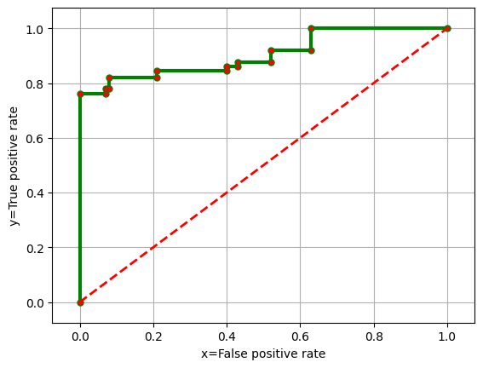
Experiment and Results
Figure 3 : The ROC curve (green line) for the group of fifty
situations the fact that have the highest corresponding
probabilities of the out-of-sample set being present, as calculated
using our best model (ETS+ST+TRX) + reciprocity

Slide 26
Summary & Future Scope
This paper outlines a new problem related to harassment and abuse in the financial services' domain.
It explores models with different feature sets and measures their performance in a real-life scenario.
The best performing model is a supervised model trained on a variety of features. Potential improvements include better foreign language coverage, use of several months conversation history, and use of BERT embeddings.

Slide 27
Case Studies and Success Stories
• Showcase real-world examples of Paytm/Google Pay or similar platforms employing machine learning for abuse detection.
• Highlight the effectiveness of machine learning in preventing financial losses and protecting users.
• Discuss the impact of machine learning on reducing false positives and enhancing platform

Slide 28
Conclusion
• Recap the key points discussed throughout the presentation.
• Emphasize the significance of machine learning in detecting abuse in financial transactions.
• Encourage further exploration and adoption of machine learning techniques in financial institutions.

Slide 29
REFERENCES
1. Social, We Are. "Social Media Users Pass the 4.5 Billion Mark."Retrieved September23(2021):
2021, https://wearesocial.com/au/blog/2021/10/social-media-users-pass-the-4-5-billion-mark/
2. Dragiewicz, Molly, Bridget Harris, Delanie Woodlock, Michael, Salter, Helen Easton, Angela Lynch, Helen Campbell, Jhan Leach,and
Lulu Milne. "Domestic Violence and Communication Technology: Survivor Experiences of Intrusion, Surveillance, and
Identity Crime." (2019).
3. Fiolet, Renee, Cynthia Brown, Molly Wellington, Karen Bentley, and Kelsey Hegarty. "Exploring the Impact of Technology-Facilitated Abuse and Its Relationship with Domestic Violence: A Qualitative Study on Experts’ Perceptions." Global qualitative nursing research 8 (2021): 23333936211028176.
4. Flynn, ASHER, Anastasia Powell, and Sophie Hindes. Technology- Facilitated Abuse: A Survey of Support Services Stakeholders. ANROWS Research Report, 2021.
5. "Preventing Misuse and Criminal Communication through Payment
Text Fields." Accessed 9 Dec 2021, https://www.austrac.gov.au/business/how-comply-guidance-and-
resources/guidance-resources/payment-text-fields.
6. Leontjeva, Anna, Genevieve Richards, Kaavya Sriskandaraja, Jessica Perchman, and Luiz Pizzato. "Detection of Abuse in Financial Transaction Descriptions Using Machine Learning." arXiv preprint arXiv:2303.08016 (2023)
7. UOL. "Homem ´E Preso Suspeito De Fazer S´Erie De Pix De Centavos Com Ameac¸as `a Ex." Last modified 20-06-2022, 2022. https://noticias.uol.com.br/cotidiano/ultimasnoticias/2022/06/20/homem-e-preso-suspeito-de-fazer-pix-comameacas-a-ex.htm.

Slide 30
Questions

Slide 31
Thank You

