Slide 1


EASYSEARCH
Cohort:
Anuraj Sinha
Lahari Pampati
Bhavya Mounika
Guided By: Abhinandan

Slide 2

AGENDA
Problem Statement​
Approach & Solution ​
Challenges​
Takeaways​
Different Opinion​
​

Slide 3
PROBLEM STATEMENT
An Interface should be built to add and manage the address database.
UI should be created for searching & adding the address to the database.
The Search should be auto-complete based on the records on the database, and it should be similar. The result should be with the top five similar addresses.
Enable an option to add multiple address in one request through a csv file that has each address per row.
Every address before it gets added should be validated against Map my India.

Slide 4
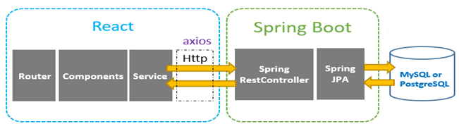
APPROACH TO THE PROJECT
A user should register himself or login to the website to use the search service.
Once logged in, the user will be able to search addresses in 2 ways: Type address and Upload a CSV file to search single or multiple addresses.
The user can type the address in the search bar, while a drop-down of similar searches is given from MapMyIndia.
So, the user can select an address and click on add button to add it to the database.
Or the user can also upload a CSV file that has single or multiple addresses to add to the database.

Slide 5
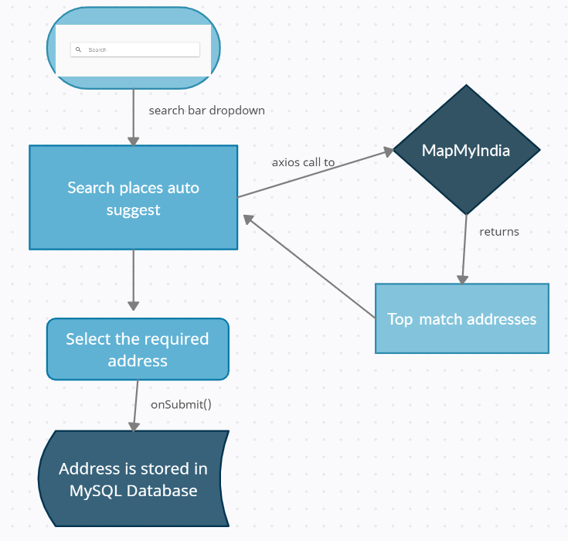

Slide 6
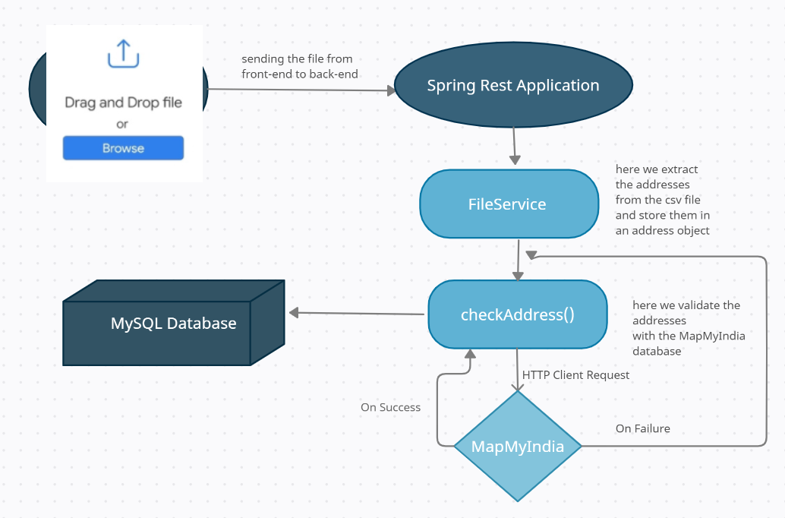

Slide 7
CHALLENGES & SOLUTIONS
The hurdle was using the CSS and Bootstrap for the application as it was our first time using these components.
Connecting with MapMyIndia, as it’s a 3rd party Api it was a bit challenging in the beginning.

Slide 8

TAKEAWAYS
Learnt connecting with the 3rd party apis which helped us understand a new concept.
Explored technologies like React and Spring boot and made us confident to work.
The best part was connecting the backend and the frontend and the e2e application flow.

Slide 9
ANOTHER APPROACH
We can use the concept of Cache Server to improve the performance.
We can use different technology stack for implementation.

