Slide 1
Explainable AI for Chest Disease Diagnosis: A Grad-CAM Enhanced EfficientNetV2S Approach
By Anuranj VV
Under the Supervision of
Prasad Anumula
Founder and Director
Risk Guard Enterprise Solutions Hyderabad

Slide 2
Introduction
This project focuses on classifying chest diseases like Pneumonia and COVID-19, pose serious health risks and need early, accurate diagnosis.
Chest X-rays are widely used due to their affordability and accessibility, but manual Interpretation is prone to errors and variability.
The model was trained on a balanced chest X-ray dataset created using images from Kaggle and other public repositories.
Traditional CNNs often miss subtle features, and this project uses EfficientNetV2S with Grad-CAM for accuracy and interpretability.
Notes:
Deep learning models (CNNs) automate diagnosis, improving consistency, but need explainability for clinical trust and adoption.
Subtle features in medical imaging (like chest X-rays) refer to very small, faint, or barely visible abnormalities that can indicate the early stages of a disease but are easy to miss—even for trained doctors or basic AI models.
Examples of subtle features in chest X-rays:
Mild opacities or haziness in the lungs (early sign of pneumonia)
Tiny infiltrates or lesions (possible infection or damage)
Faint shadows or texture changes that could hint at COVID-19
These features are:
Low in contrast (blend with surrounding tissue)
Not easily distinguishable without enhancement or advanced models
Important for early diagnosis, but can be overlooked by traditional CNNs or the human eye
Why is manual interpretation prone to errors and variability?
Human fatigue or oversight can lead to missed signs.
Subjectivity: Different doctors might interpret the same X-ray differently.
Subtle features may not be easily visible or distinguishable.
It takes time and may not be feasible for large volumes of images.
That’s why AI-assisted diagnosis is being developed—to reduce errors, speed up the process, and bring consistency across diagnoses.

Slide 3
Materials and Methods
Image Preprocessing: CLAHE is used to enhance local contrast in chest X-rays, improving the visibility of subtle disease features.
Feature Extraction: EfficientNetV2S, a pretrained lightweight CNN, extracts deep hierarchical features from enhanced images using transfer learning.
Classification: A custom dense neural network classifies X-rays into Pneumonia, COVID-19.
Explainability: Grad-CAM generates visual heatmaps highlighting the lung regions influencing the model's decision, supporting clinical trust.
Notes:
Contrast Limited Histogram Adaptive Equalisation

Slide 4
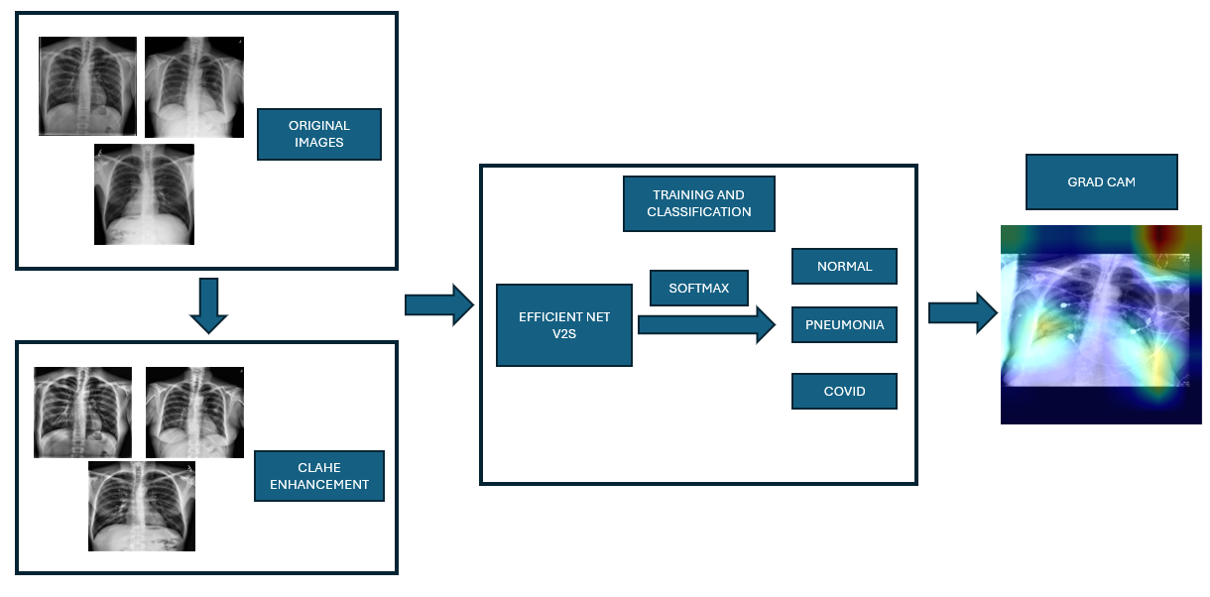
Materials and Methods

Slide 5
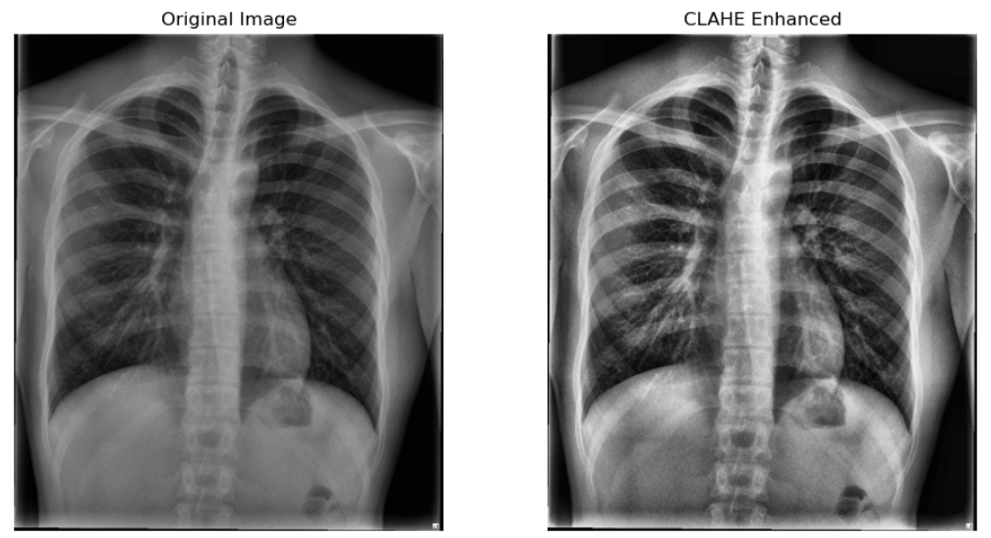
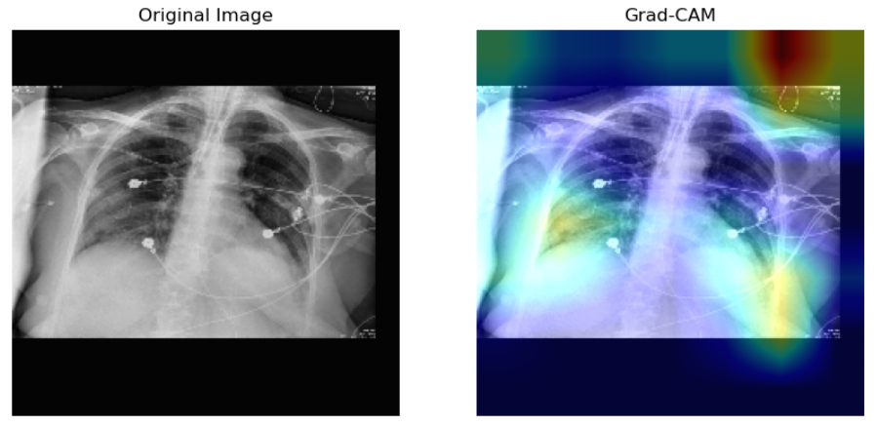
Image Enhancement & Explainability
CLAHE – Contrast Enhancement
Enhances local contrast in X-ray images using adaptive histogram equalization.
Reveals fine lung details like opacities and infiltrates.
Preserves features while suppressing noise and avoiding over-enhancement.
Grad-CAM – Model Interpretability
Generates heatmaps showing which regions influenced the model’s prediction.
Builds clinical trust by visually confirming disease focus areas.
Useful for error analysis and validating correct decision paths.
Notes:
The working of CLAHE (Contrast Limited Adaptive Histogram Equalization) can be described as an enhancement technique that improves the contrast of images, especially useful for medical or low-light images.
🔍 What is CLAHE?
CLAHE stands for:
Contrast Limited Adaptive Histogram Equalization.
It is an advanced form of histogram equalization, applied locally in small regions (called tiles) instead of the entire image.
⚙️ Step-by-Step Working of CLAHE:
Divide the image into tiles:
The image is split into small, equal-sized blocks (e.g., 8x8 regions).
Histogram equalization is performed independently on each tile.
This improves local contrast.
Clip the histogram (Contrast Limiting):
Before equalization, CLAHE clips the histogram at a predefined threshold (clip limit).
This prevents over-amplification of noise in uniform or flat regions.
Any excess pixels (beyond the clip limit) are redistributed across all histogram bins.
Equalize each tile:
For each tile, CLAHE maps the pixel intensities using its local histogram to improve local detail.
Bilinear Interpolation:
To avoid tile boundaries being visible, CLAHE applies bilinear interpolation between adjacent tiles.
This ensures smooth transitions across tile edges.
Reconstruct the enhanced image:
All the equalized tiles are combined using interpolation to produce the final contrast-enhanced image.
💡 Why Use CLAHE?
Works well for non-uniform lighting conditions.
Enhances features in medical images like X-rays, MRIs.
Reduces noise amplification (unlike standard histogram equalization).
✅ Summary:
CLAHE enhances local contrast while limiting noise amplification by:
Operating on small regions (tiles),
Clipping histograms,
Applying smooth interpolation.
Tracks how the model's output changes with respect to the feature maps.
Uses these gradients to compute a weighted average over channels.
Generates a class-specific 2D heatmap showing which regions were important for that class.
block6e_add is a convolutional feature map in the EfficientNetV2S architecture.
It's one of the later layers, so it has high-level features but still retains some spatial information—making it a good choice for Grad-CAM.

Slide 6
EfficientNetV2S Over Traditional CNN
Compound scaling - Unlike traditional CNNs that scale depth, width, or resolution separately, EfficientNetV2S uses compound scaling.
Detects subtle features more effectively with fewer parameters to achieve better generalization.
It is optimized for speed, making it practical for real-time clinical environments where quick decisions matter
Lightweight and effective for transfer learning on medical data.
Notes:
Compound Scaling is a method used to make Convolutional Neural Networks (CNNs) larger and more powerful in a balanced and efficient way by scaling:
Depth – number of layers (more reasoning)
Width – number of channels per layer (more features)
Resolution – size of input images (finer details)
Instead of increasing just one of them, compound scaling increases all three together using a fixed set of ratios.
🔷 Why Not Scale Only One?
📏 Only Depth → May overfit, slow training
📐 Only Width → May miss hierarchical patterns
🖼️ Only Resolution → More memory needed, less efficient
📌 Problem: Scaling one dimension causes imbalance. ✅ Solution: Compound scaling maintains harmony.
Real-World Analogy
Imagine you want to upgrade a camera:
You increase lens clarity (resolution)
Use better processor (depth)
Improve color sensors (width)
Doing all together gives balanced improvements, rather than just using a higher megapixel camera with a weak processor.
Input Layer- (224,224, 3) : Resized and normalized chest X-ray image
EfficientNetV2S (Base) Pretrained on ImageNet(7,7,1280) :Extracts hierarchical features (edges, textures, shapes)
GlobalAveragePooling2D-(1280,) :Averages spatial dimensions into a feature vector
Batch Normalization-(1280,) :Stabilizes and accelerates training by normalizing feature distributions
Dense Layer (128 units, ReLU, L2) (128,) :Learns non-linear high-level feature representations with L2 regularization
Batch Normalization - (128,) :Further normalizes activations after dense layer
Dropout Layer (rate=0.3)-(128,) : Randomly drops 30% of units to reduce overfitting
Output Layer (3 units, SoftMax) (3,) :Produces class-probability scores for: Pneumonia, COVID-19, and Normal

Slide 7
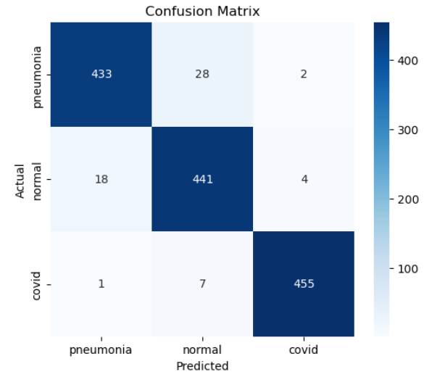
Results and Plots
The model achieved 95.68% validation accuracy, correctly predicting most chest X-ray cases across all three classes.
Some pneumonia cases (28) were predicted as normal, and a few normal cases (18) as pneumonia.
COVID-19 Detection is Highly Reliable: 455 out of 463 COVID-19 images were correctly classified.
The strong diagonal pattern in the confusion matrix shows the model is consistently accurate in identifying actual conditions.

Slide 8
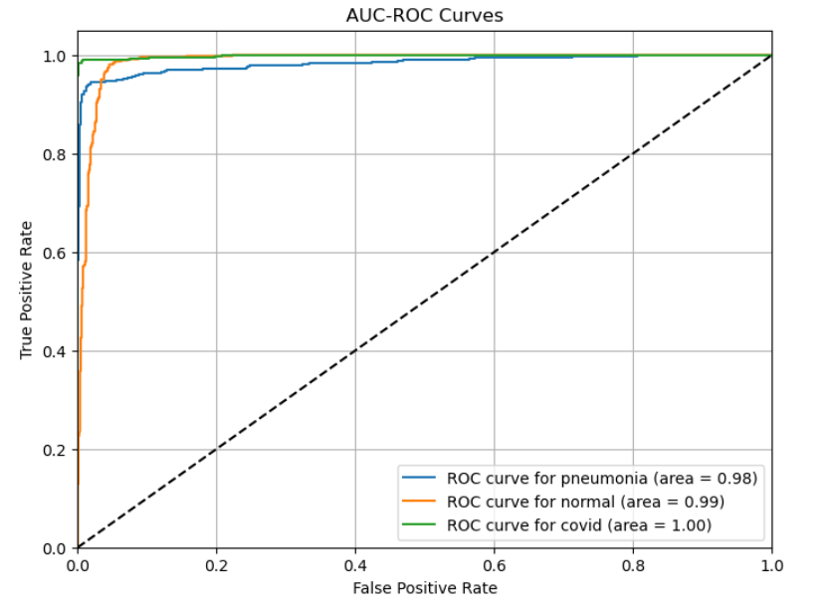
Results and Plots
The model shows excellent class separation with AUC scores of 0.98 (Pneumonia), 0.99 (Normal), and 1.00 (COVID-19), indicating robust diagnostic performance.
All ROC curves are close to the top-left corner, showing high sensitivity and low false positives.
High precision and recall values across all three classes, with F1-scores ranging from 0.94 to 0.98, indicating balanced and reliable predictions.
The model performs especially well for COVID-19, achieving 0.99 precision and 0.98 recall.
 | Precision | Recall | F1-Score
Pneumonia | 0.96 | 0.94 | 0.95
Normal | 0.93 | 0.95 | 0.94
Covid-19 | 0.99 | 0.98 | 0.98
Notes:
All ROC curves are close to the top-left corner, showing high sensitivity (true positive rate) and low false positives.
Each colored line in the plot shows how well the model can separate one specific class from the others.
Blue Line – Pneumonia (AUC = 0.98):
Shows how well the model can distinguish pneumonia from non-pneumonia (i.e., COVID or normal).
The AUC of 0.98 means it's very good.
Orange Line – Normal (AUC = 0.99):
Shows how well the model can identify normal cases vs pneumonia or COVID.
AUC of 0.99 = excellent.
Green Line – COVID (AUC = 1.00):
Model is perfect at distinguishing COVID cases from the rest (AUC = 1.00 = ideal).
📈 What ROC Curve Shows:
X-axis (False Positive Rate - FPR): Proportion of negatives incorrectly classified as positives.
Y-axis (True Positive Rate - TPR): Proportion of actual positives correctly classified.
A perfect model hugs the top-left corner.
The dashed line (diagonal) represents a random guess (AUC = 0.5).
✅ How to Interpret:
All three lines are close to the top-left = excellent performance.
AUC (Area Under Curve) values:
1.00 = Perfect
0.90–0.99 = Excellent
0.80–0.89 = Good
So here:
COVID detection is perfect
Normal and Pneumonia detection are near-perfect

Slide 9
Conclusion
This work presents a reliable and explainable deep learning system for classifying chest X-rays into COVID-19, Pneumonia, and Normal using CLAHE, EfficientNetV2S, and Grad-CAM.
The model achieved high accuracy (95.68%) and AUC (0.9884), proving its effectiveness in real-world diagnosis.
Grad-CAM visualizations enhance trust by showing disease-relevant regions.
The system offers a strong foundation for AI-assisted medical diagnosis.

Slide 10
Future Works
Explore alternative preprocessing techniques and denoising methods to enhance image clarity.
Test other deep learning models or create hybrid/ensemble models for better performance.
Expand the dataset with more diverse data and patient information.
Use advanced explainability tools like SHAP, LIME, or attention maps for deeper model insights.

Slide 11
Acknowledgement
I, Anuranj VV, hereby declare that the project report titled “Explainable AI for Chest Disease Diagnosis: A Grad-CAM Enhanced EfficientNetV2S Approach” is the result of the work carried out by me during my internship at Risk Guard Enterprise Solutions, Hyderabad,I would like to express my sincere gratitude to my supervisor, Prasad Anumula, for his invaluable guidance, support, and encouragement throughout the course of my project. His vast knowledge and constant motivation were instrumental in the successful completion of my work. I would also like to extend my appreciation to the entire team for creating a positive and collaborative work environment.

