Slide 1
Horizontal Pod Autoscaler Simulator
A DevOps project demonstrating how modern cloud systems automatically scale applications based on workload
using simplified visualization
By-
Anureet Kaur
23FE10CSE00304
To-
Dr. Dibakar Sinha

Slide 2
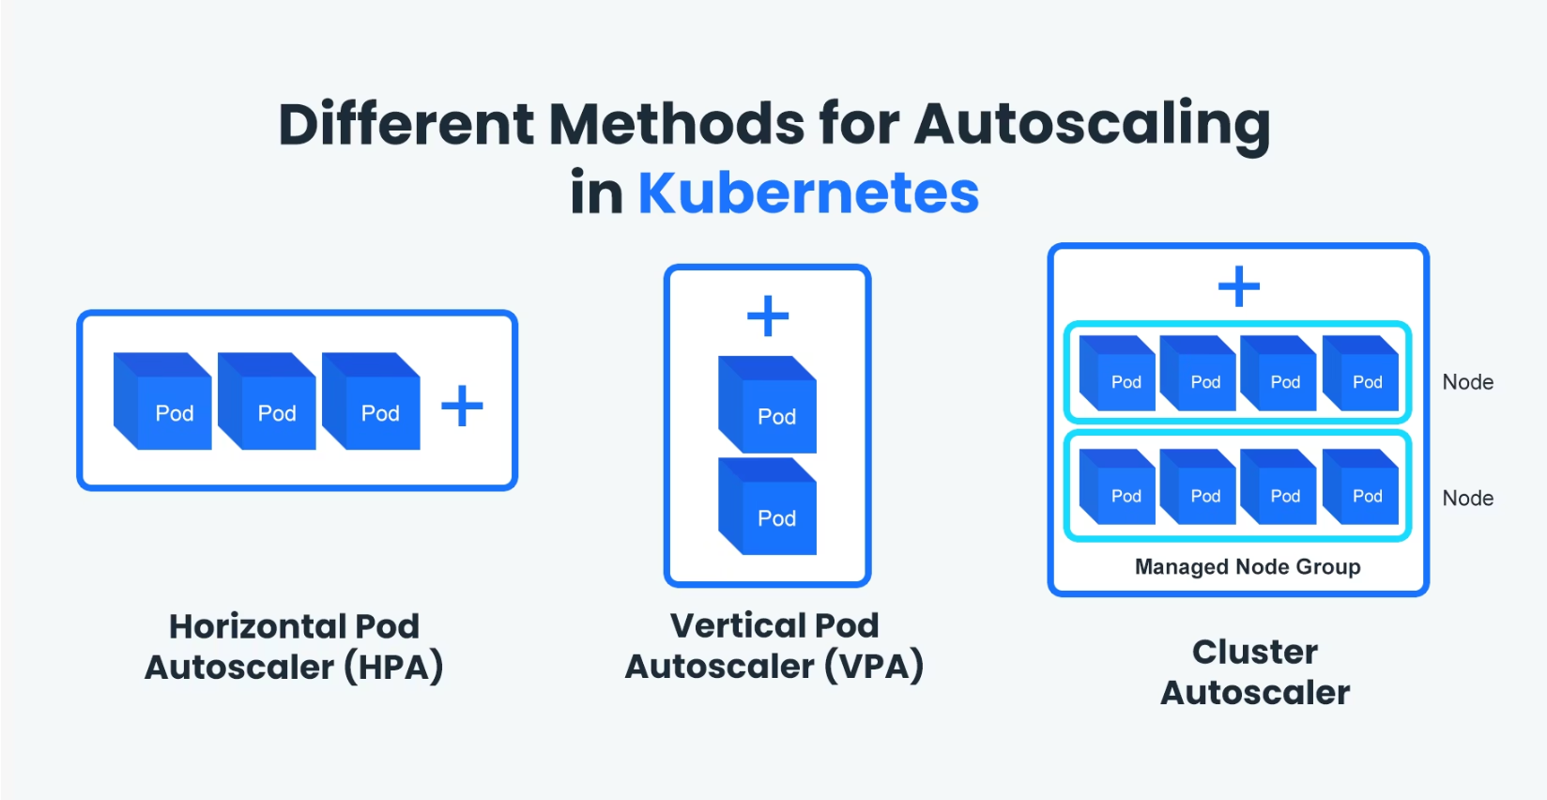
What Is Horizontal Pod Autoscaler?
In real-world environments, Kubernetes uses the Horizontal Pod Autoscaler (HPA) to monitor CPU usage of application pods and dynamically adjust the number of running instances. This project replicates that behavior in a simplified and visual way using a frontend dashboard and Docker-based backend.
The main idea is to simulate how systems handle varying traffic without requiring a full Kubernetes setup. Instead of setting up heavy infrastructure, this project focuses on implementing the core autoscaling logic and visualizing it clearly.

Slide 3




System Architecture
The system is divided into two main parts that work together to simulate autoscaling behavior.
Frontend Dashboard
Backend Engine
Built using HTML, CSS, and JavaScript
Built using Node.js and Express
Interactive CPU usage slider
Automatic traffic mode
Real-time visualization
Processes scaling requests
Executes Docker commands
Manages containers

Slide 4
The Core Formula
The system uses a formula inspired by Kubernetes HPA to calculate the desired number of pods:
Target CPU
Current CPU
Scaling Effect
Set around 50% as the ideal usage level
Real-time CPU usage measurement
Pods increase or decrease proportionally
If CPU usage increases, the number of required pods increases proportionally. If CPU usage decreases, the system reduces the number of pods accordingly.

Slide 5



Stability Range Mechanism
To make the system stable and avoid unnecessary scaling, a stability range is defined between 30% and 70% CPU usage. When the CPU lies within this range, no scaling is performed.
This prevents frequent scaling operations and mimics real-world system stability mechanisms. The system only takes action when CPU usage goes outside this safe zone, ensuring smooth and efficient operation.
Below 30%
30-70%
Above 70%
System scales down
No action taken
System scales up

Slide 6

Auto Traffic Mode
An important feature of the project is the Auto Traffic Mode, which simulates real-world fluctuating workloads. Instead of manually adjusting the CPU slider, this mode generates random CPU values at regular intervals, allowing the system to demonstrate dynamic scaling behavior automatically.
This feature creates realistic scenarios where the system must continuously adapt to changing conditions, just like in production environments.

Slide 7



Visual Dashboard Components
Pod Representations
Scaling Logs
Usage Charts
Visual containers showing active pods in the system
Real-time record of all scaling operations and decisions
Graphs displaying CPU usage and pod count over time
These components help users understand how the system responds to changes in load through clear, interactive visualization.

Slide 8
Technology Stack
Frontend
Backend
Container
HTML
CSS
JavaScript
Node.js
Express
Docker API
Docker
Container management
Real-time scaling

Slide 9
Design Decisions & Trade-offs
Why Docker Instead of Kubernetes?
Key Limitations
Running Kubernetes locally requires high CPU, memory, and disk resources, and can lead to system instability. By using Docker, the project achieves a lightweight and reliable way to demonstrate autoscaling while still maintaining real container behavior.
Does not use real container-level metrics like Kubernetes
Runs locally to allow Docker access
Simplified CPU simulation

Slide 10
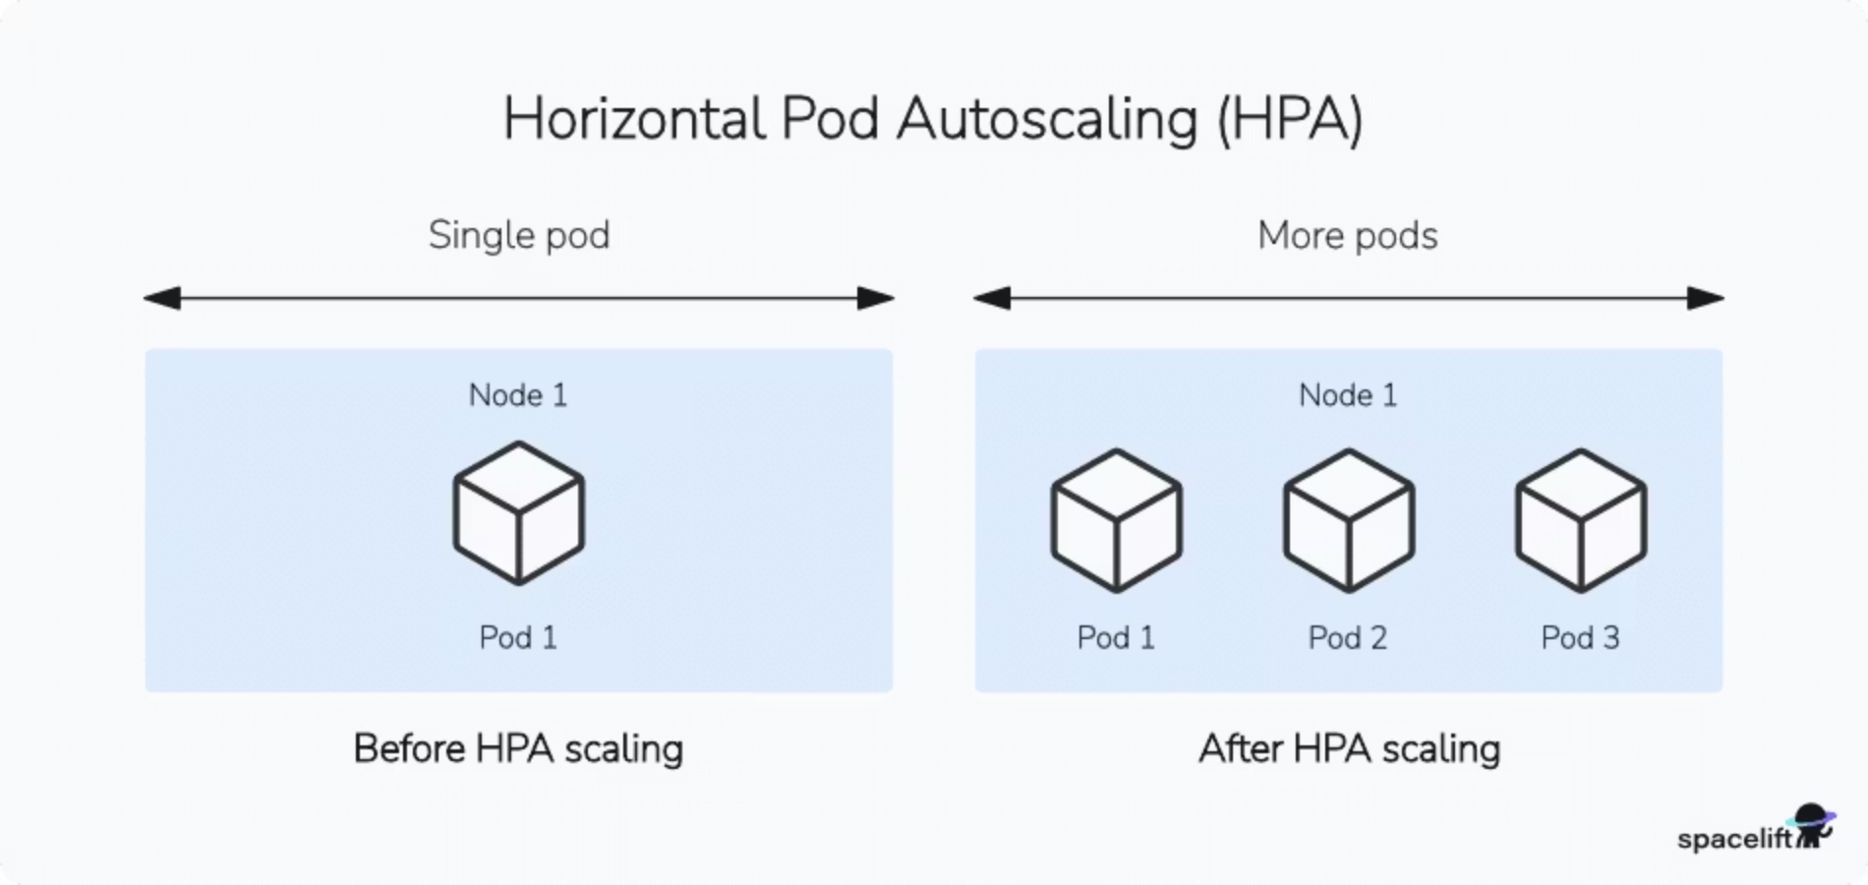
Future Extensions & Conclusion
01
02
Deploy to Cloud Platforms
Connect to Kubernetes Cluster
Run on AWS, Azure, or GCP infrastructure
Enable production-level simulation
This project bridges the gap between theoretical concepts of autoscaling and practical implementation. It provides a clear and interactive way to understand how modern systems automatically scale to handle varying workloads efficiently, making complex DevOps concepts accessible to learners and practitioners.

