Slide 1
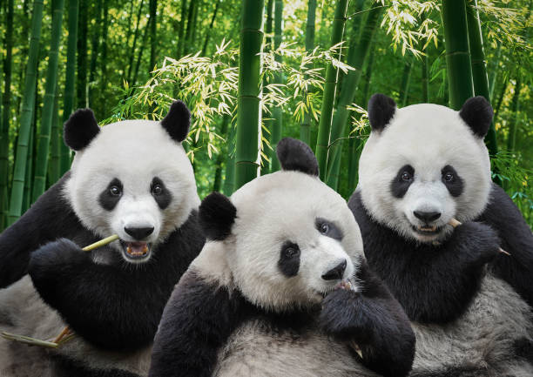
Milestone 2: Team „Pandaas“
Members: Adarsh Panda, Abriti Chakraborty, Anushree Rege
Dataset: Average Task Value
Main Research Question
Does the brain react differently to rewards depending on the contextual value of the task?
Step | Authors’ Pipeline | Our Planned Pipeline
Filtering | 0.1–40 Hz bandpass | 1–30 Hz (to reduce slow drifts & muscle noise)
Referencing | Average reference | Mastoid reference (or average — to test robustness)
Artifact Removal | ICA for eye blinks & saccades | ICA + automatic rejection (autoreject)
Epoching | -200 to 800 ms | Same window, but different baseline (we test −100 ms)
Baseline Correction | -200 to 0 ms | -100 to 0 ms (our variation)
ERP Component Focus | FRN & P300 | FRN only (simplified analysis)
Statistics | Regression analysis | Simple difference-wave first + regression
Analysis: fill in only as far as already possible

Slide 2
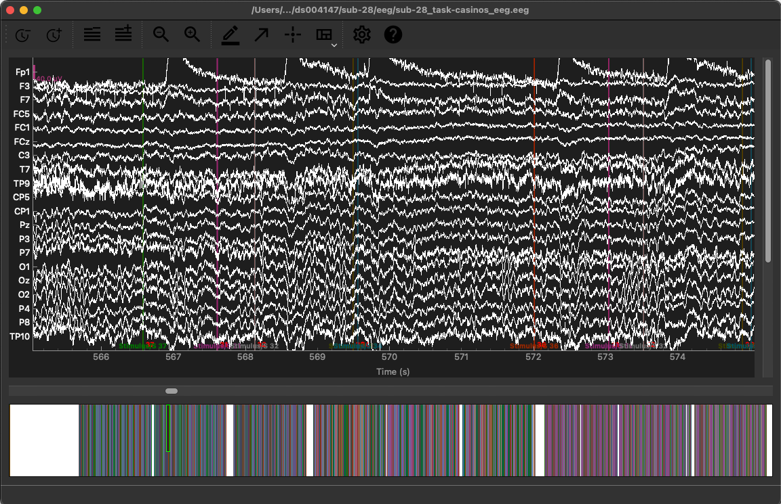
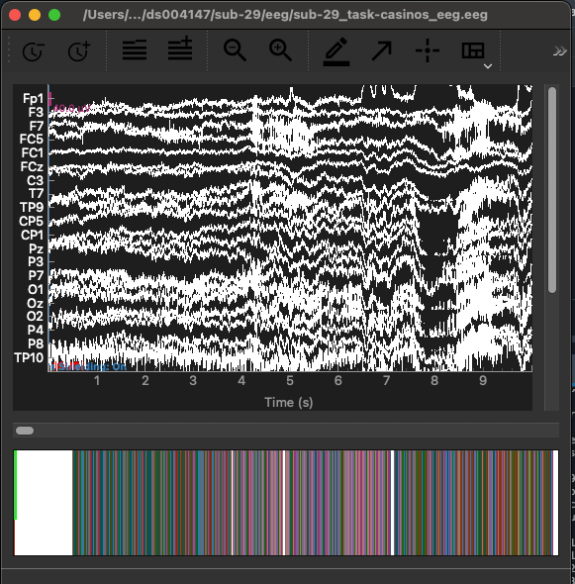
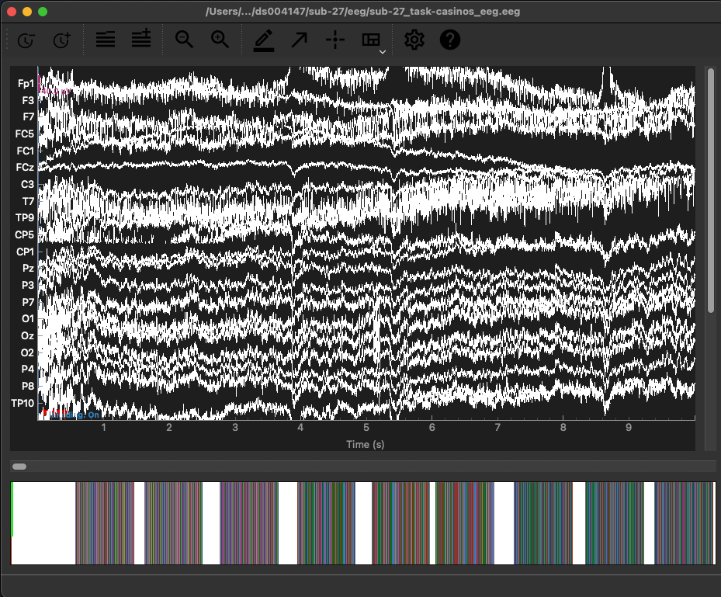
3. Data
Subject-28
Subject-29
Subject-27

Slide 3
Corrected pipeline
Step | Authors' Pipeline | My Updated Pipeline | Why
Filtering | 0.1–40 Hz | 0.1–30 Hz | Keeps low-frequency P300 & removes high muscle noise
Referencing | Average reference | Average reference (justified) | No mastoid electrodes present; average improves ERP stability
Statistics | Regression-based TRF modelling | Start with simple ERP difference waves | TRF is complex; our goal is robustness, not full reproduction

