Slide 1

Milestone 3: Team „Pandaas“
Members: Adarsh Panda, Abriti Chakraborty, Anushree Rege
Dataset: Average Task Value
Main Research Question
How does reward-related feedback influence neural responses as measured through event-related potentials (ERPs)?
Pipeline Processing (Author‘s vs. Mine)
Step | Authors' Pipeline | My Improved Pipeline | Changes Highlighted
Data Import | BrainVision files (vhdr, vmrk, eeg) | Same | —
Initial Filtering | 0.1–40 Hz band-pass filter | 0.1–30 Hz band-pass filter | Stricter filtering to remove slow drifts + muscle noise. Preserves P300 low frequencies
Down sampling | Optional | Not applied (yet) | —
Referencing | Average reference | Average reference | No mastoids, Average is standard and stable
Artifact Removal | ICA + EOG channels | ICA using pseudo-EOG (Fp1) | Different method due to missing EOG sensors
Blink Detection | find_bads_eog | Correlation-based detection using Fp1 | Adapted approach
Epoching | −200 to 800 ms | Same | Standard FRN/P300 window
Baseline | -200 to 0 ms | -200 to 0 ms | Works well with 0.1 Hz filter
Output | TRF Regression | ERP difference first | TRF too complex for reproduction; professor correction
Analysis: fill in only as far as already possible

Slide 2
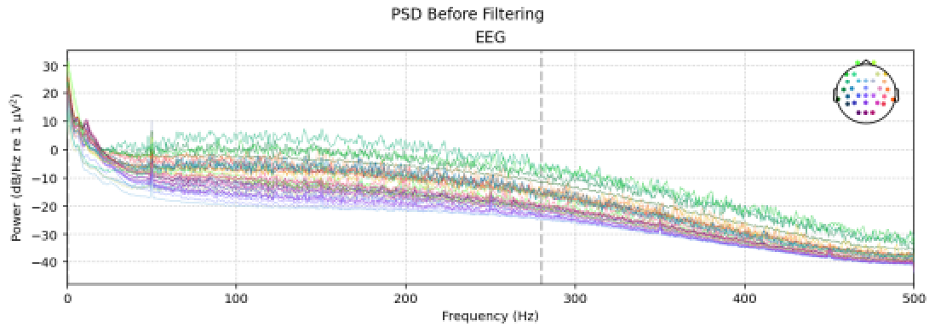
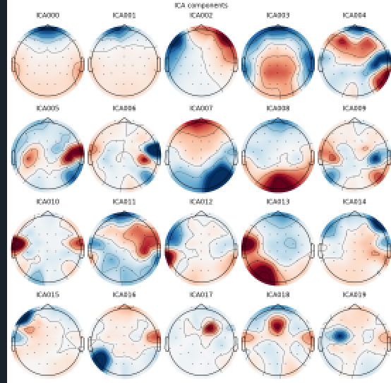
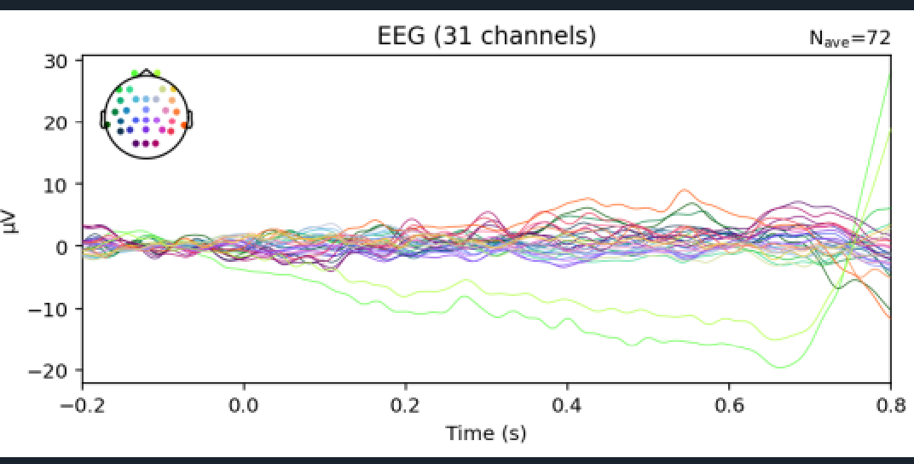
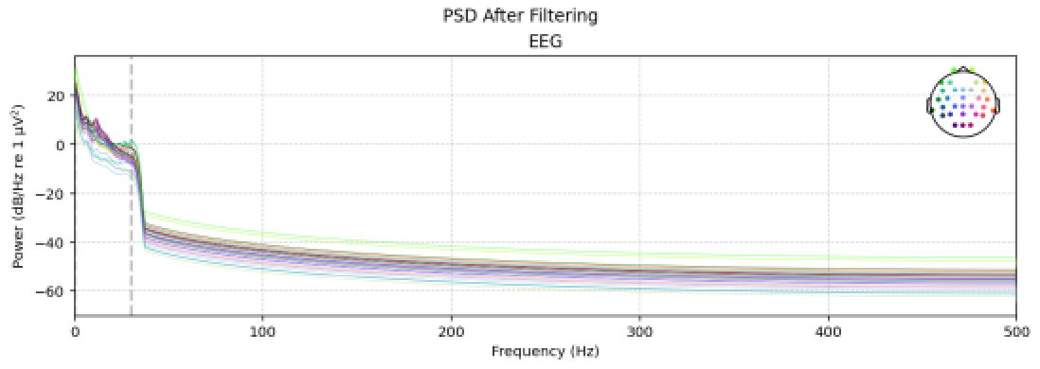
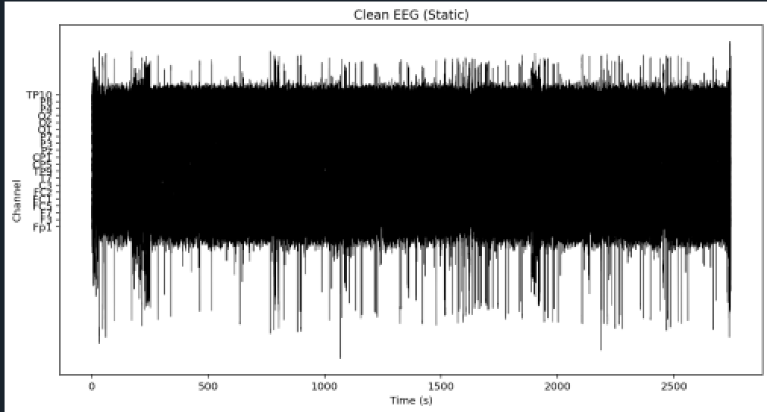
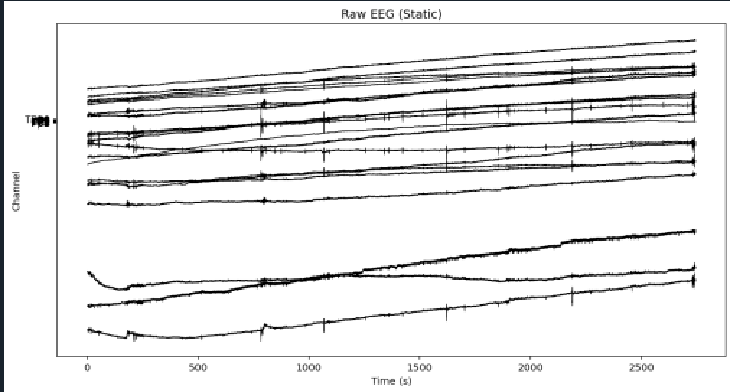
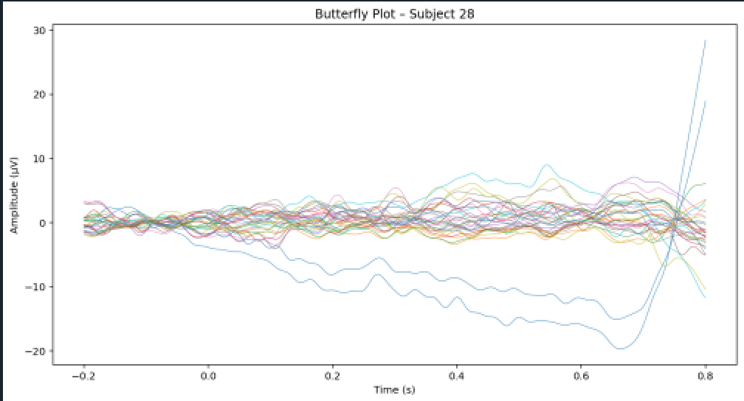
3. Data
Power Spectral Density (PSD) Before Filtering – Raw EEG
Power Spectral Density (PSD) After 0.1–30 Hz Filtering
ICA Component Topographies – Subject 28
Event-Related Potential (ERP) – Subject 28
Channel-wise variability in the evoked responses.
Clean EEG After ICA & Filtering
Raw EEG (Static Plot)
CA Component Topographies – Subject 28

