Slide 1

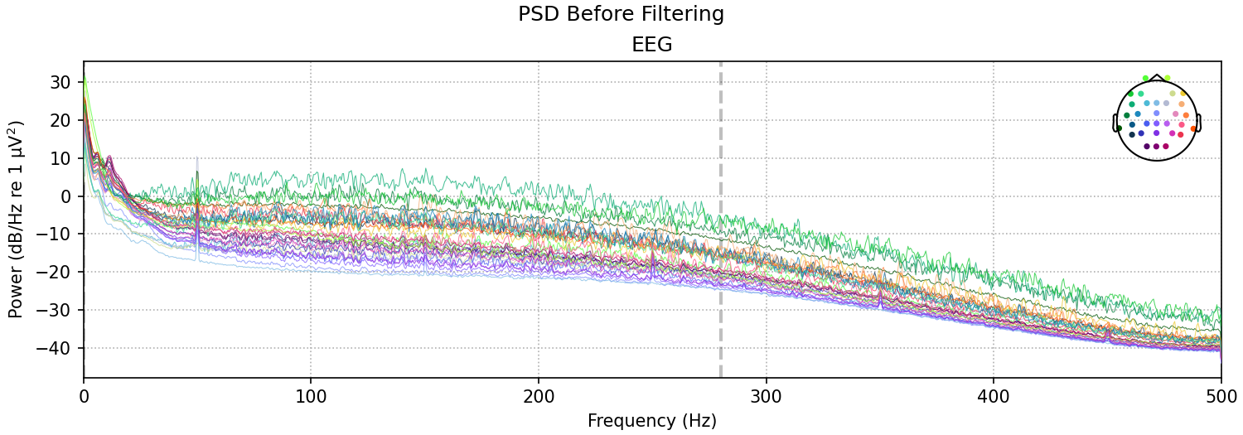
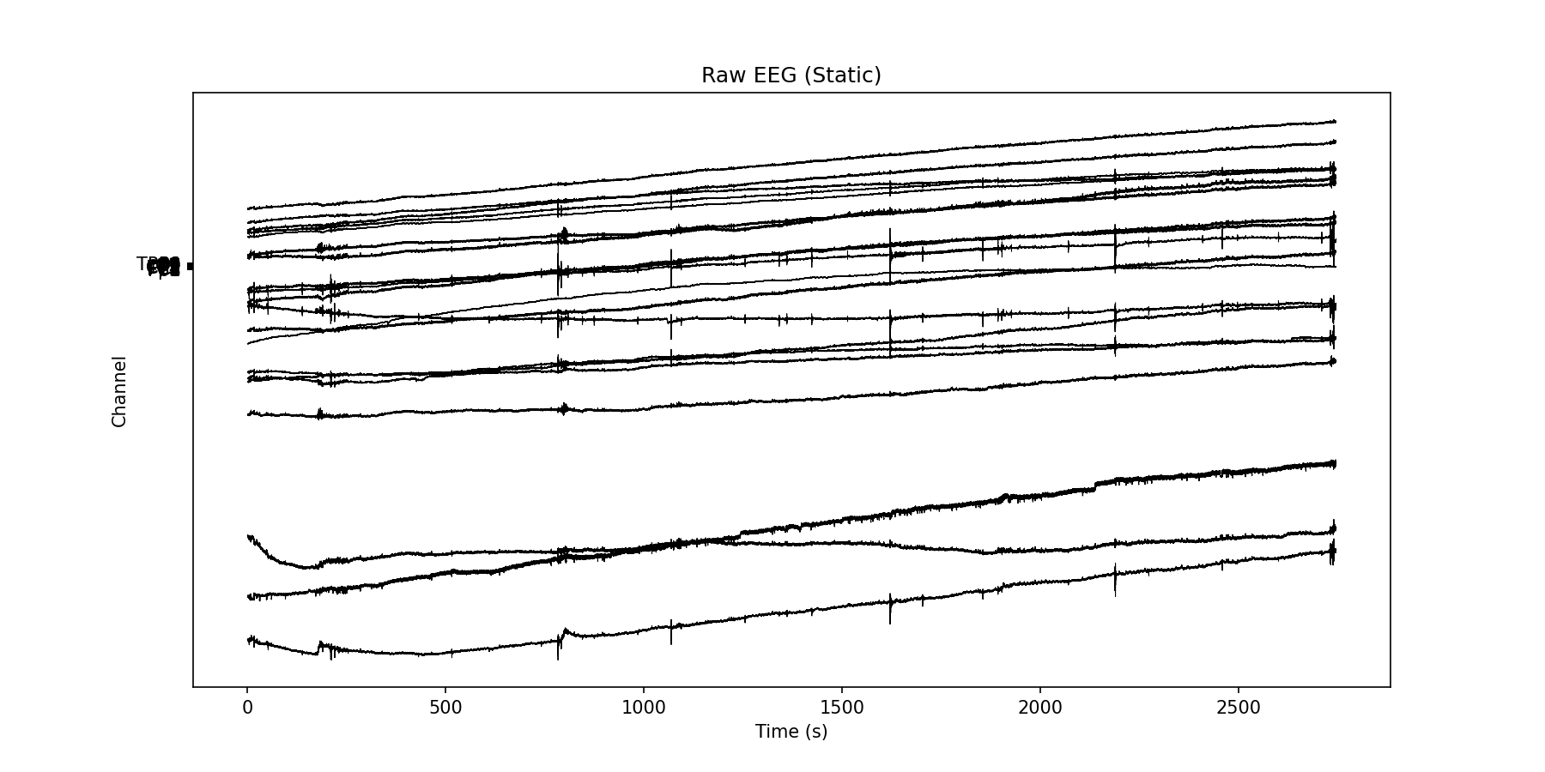
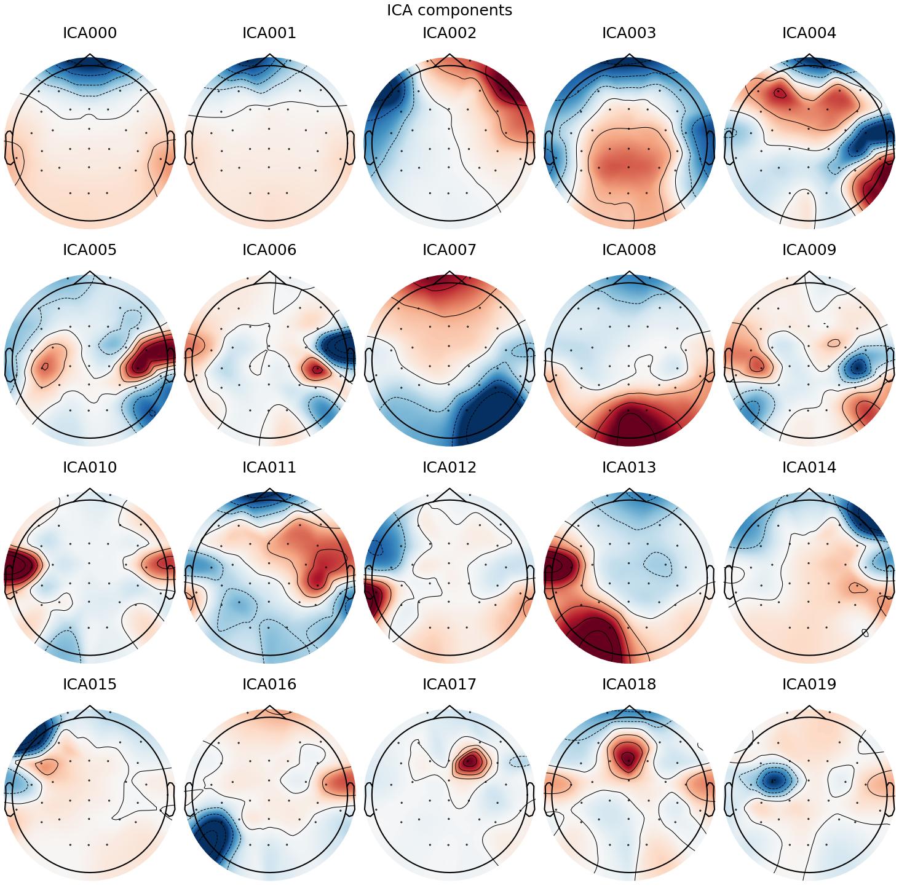
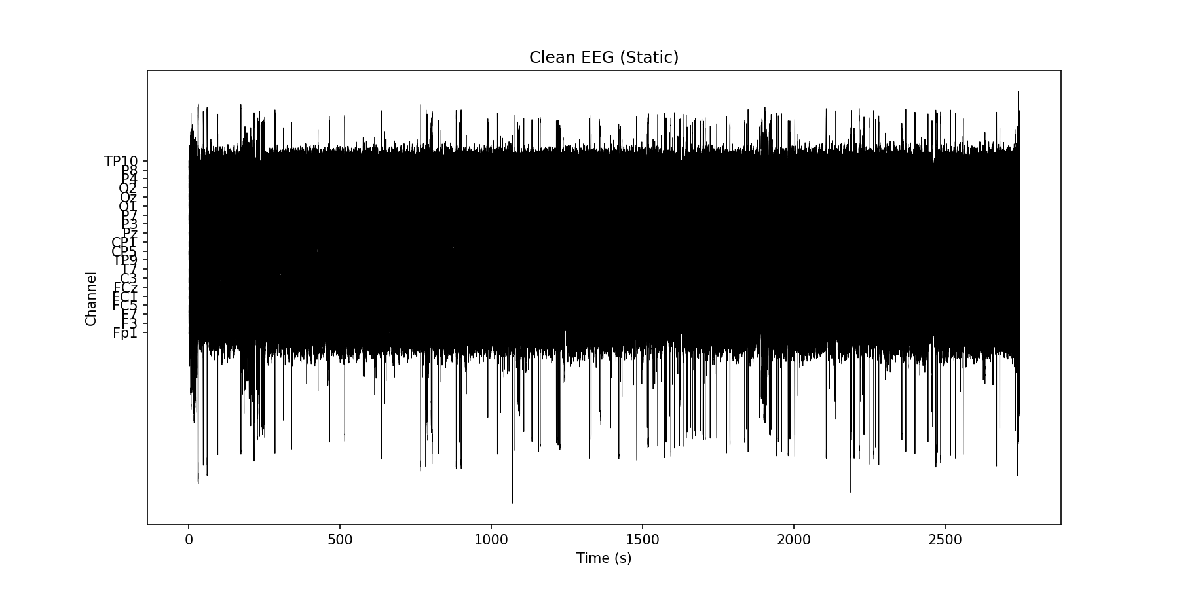
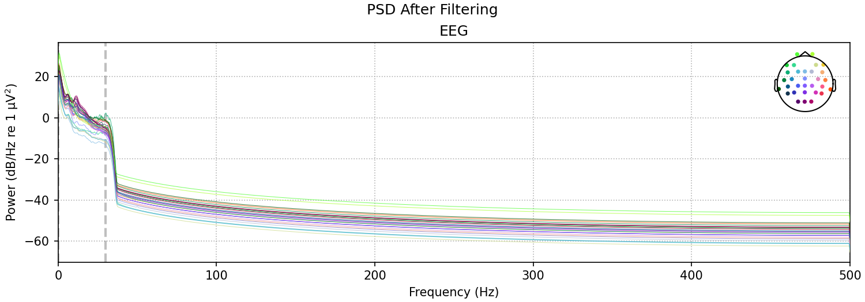
Milestone 4: Team „Pandaas“
Members: Adarsh Panda, Abriti Chakraborty, Anushree Rege
Dataset: Average Task Value
Main Research Question
Are we surprised differently, if our visual predictions were created by inferred (that is, internal) information?
1. PSD Before & After filtering
2. ICA topographies
3. Raw vs Clean EEG

Slide 2
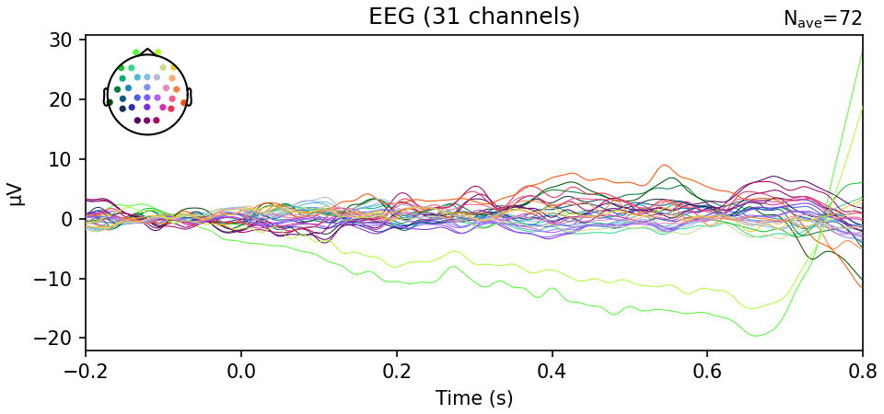

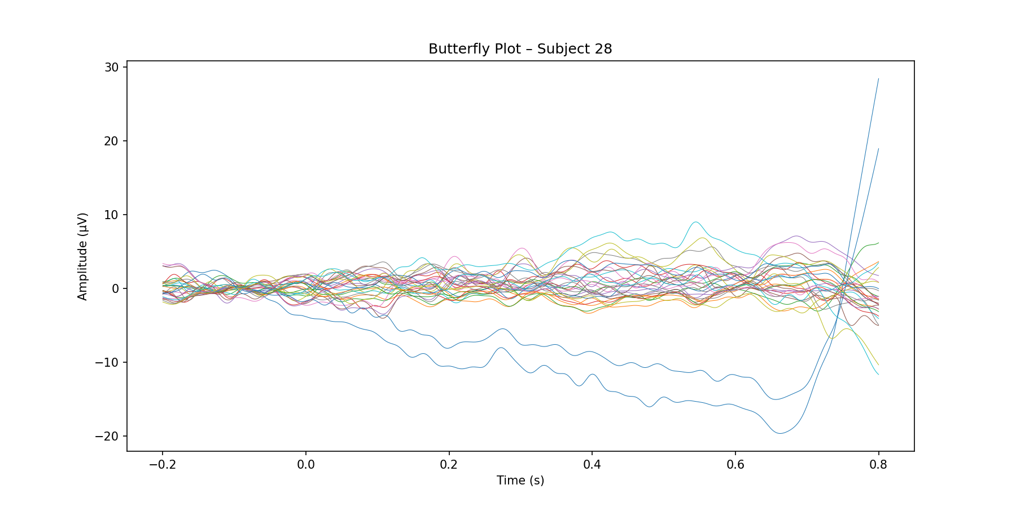
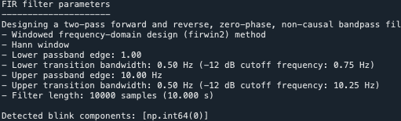
The comparison and checks
4. ERP plot
6. Checking Flat/Nearly dead channels
7. Blink-detection sanity check (Fp1/Fp2 pseudo-EOG)
5. Butterfly plot
We used ICA to detect eye-blink artifacts. Without EOG sensors, the frontal EEG channel Fp1 served as a proxy. One blink-related component was identified and removed before analysis.
CA Component Topographies – Subject 28

