Slide 1
Initialize the weights of a multilayer perceptron network using the genetic algorithm and classify a satellite image with the weight initialized neural network
by
24M0326 Rajash
24M0327 Anuroop

Slide 2
Plan of Action
Feature Extraction
Genetic Algorithm weight initialisation
Data
MLP Classification
Resnet-18
Tournament
Crossover
Mutation

Slide 3
Dataset :
EuroSAT
Public labelled dataset of Sentinel-2 Images
Count of data: 24500
No of classes: 10 - 1 (River class dropped. Too many missclassifications)
Classes: 'AnnualCrop', 'Forest', 'HerbaceousVegetation', 'Highway', 'Industrial',
'Pasture', 'PermanentCrop', 'Residential', 'SeaLake'

Slide 4
MLP
Input
Feature Extractor
64X64X3
Image
Resnet-18
512
64
9
Input Layer
Hidden Layer
Output classes
MLP

Slide 5

Genetic Algorithm weight initialisation
Step -1 Population Initialisation
Individual in Population
Input size * HL1 + HL1 size + HL1 size * outpur size
WM -1
Bias
WM -2
Hyperparameter-1: Population size 100
WM- Weight Matrix
HL- Hidden layer size

Slide 6
Genetic Algorithm weight initialisation
Step -2 Tournament Selection
Compare Fitness
Randomly Select 2
A > B
Winner goes to next gen population set
Done twice for each population choosing iteration
Hyperparameter-2: Tournament size 2
Fitness Function: Accuracy from MLP classification.

Slide 7
Genetic Algorithm weight initialisation
Step -3 Crossover
Step -4 Mutation
Parent genes selected from previous step
Randomly chosen 10% of genes assigned a random number
Crossed from a prandom point in Genes
New Parent
Hyperparameter-3: Mutation rate 0.1

Slide 8
Genetic Algorithm weight initialisation
Step -4 Eliitness
Step -5 Repeat
Top 5 of the population is passed on unhindered to the new generation
Process repeated for 400 generations
Hyperparameter-4: Elitness 5
Hyperparameter-5: Generations 400

Slide 9
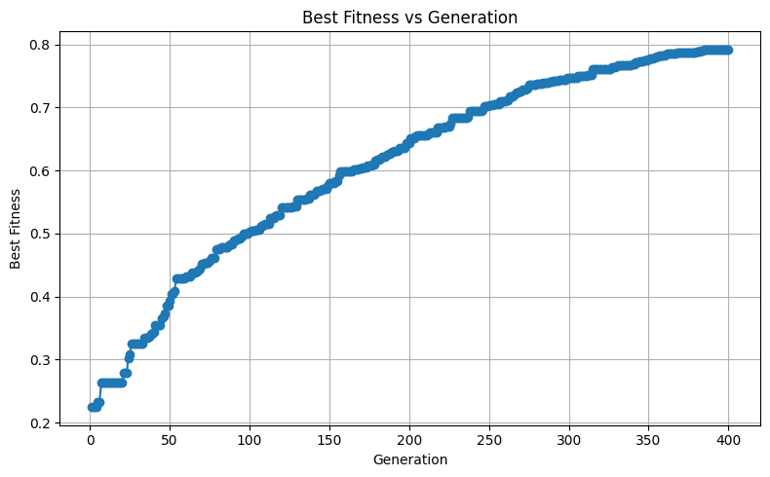
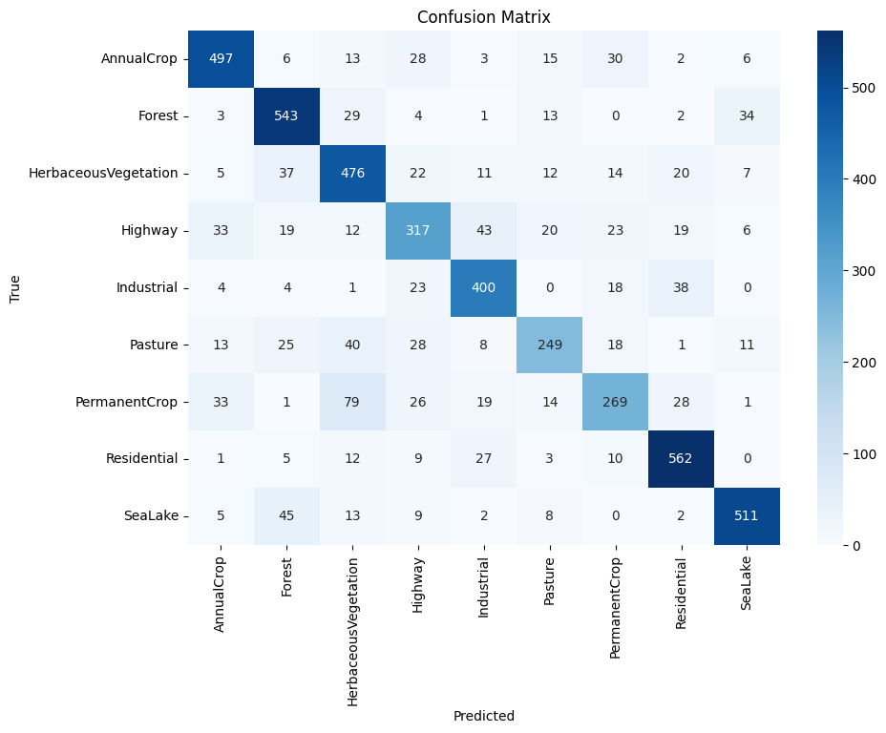
Results
Fitness vs Generation
Best Accuracy : 78.04 % (Testing)

Slide 10
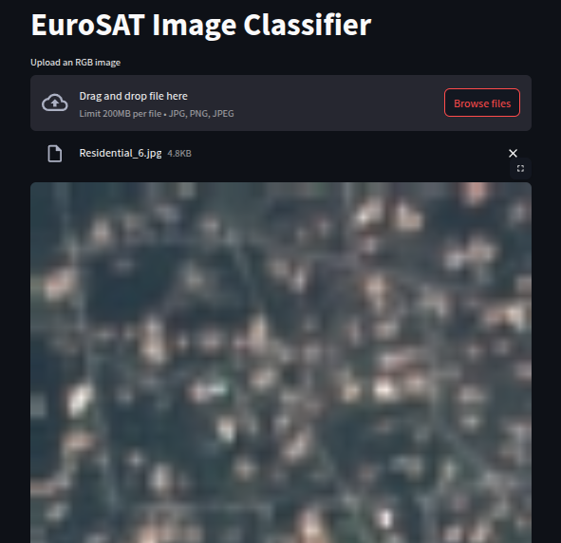
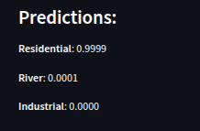
Web Interface
Uplload Image
Shows top 3 predictions

