Slide 1
Python Essentials
One

Slide 2
Python
Interpreted language
dynamically-typed language, which means you don't need to declare variables in it.
Cpython
Conda/Pip – package manager
Comment - #

Slide 3
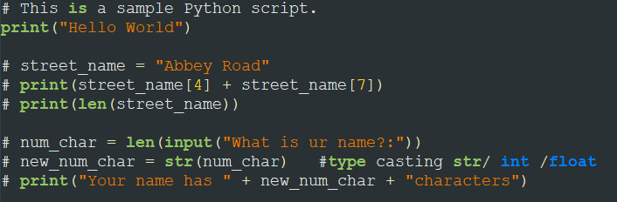

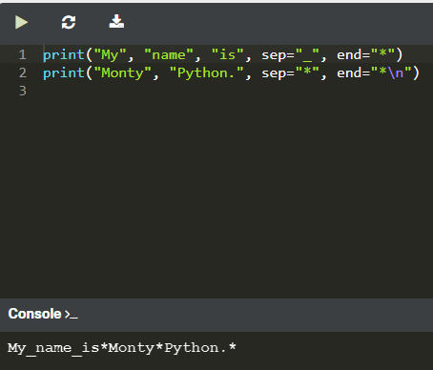
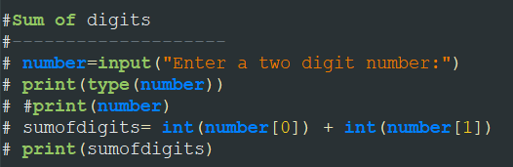
Print [End, Sep] & input & len (Functions) type casting –int(), str (), float()
Notes:
# This is a sample Python script.
print("Hello World")
# street_name = "Abbey Road"
# print(street_name[4] + street_name[7])
# print(len(street_name))
# num_char = len(input("What is ur name?:"))
# new_num_char = str(num_char) #type casting str/ int /float
# print("Your name has " + new_num_char + "characters")
#Sum of digits
#--------------------
# number=input("Enter a two digit number:")
# print(type(number))
# #print(number)
# sumofdigits= int(number[0]) + int(number[1])
# print(sumofdigits)
# PEMDASLR - precednce order ( left to right )
# ()
# **
# * /
# + -
#print(3 * 3 + 3/3 -3) = 7
#print(3 * (3 + 3/3 -3)) = 3
#BMI Calculator
# height=input("Enter your height in m :")
# weight=input("Enter your weight in kg:")
# bmi=float(weight)/float(height) ** 2
# #using fstring
# print (f"Your BMI is: {bmi} ")
# if bmi<=18.5:
# print("You are Under Weight ! ")
# else:
# if bmi <= 25:
# print(" You have a Normal weight !")
# elif bmi <= 30:
# print(" You are Over weight !")
# elif bmi <= 35:
# print(" You are Obese !!")
# else:
# print(" You are Clinically Obese !!")
#life in weeks challenge
# age=int(input("What is your current age ?"))
# yrsleftto90 = 90 - age
# print(f"years to 90 : {yrsleftto90}")
# days = int(yrsleftto90) * 365
# #print (f"Days: {days}")
# weeks = round(float(days/7))
# #print (f"Weeks: {weeks}")
# months = round(weeks/4)
# #print (f"Months: {months}")
#
# print(f"You have {days} days, {weeks} weeks, and {months} months more - Enjoy ur ife")
#
#Day 3 -conditional Logic
#Even or odd
# number=int(input("Enter the number: "))
# check=number%2
# print(check)
# if check == 0:
# print("This is a Even number!!")
# else:
# print("This is a Odd number!!")
#leap year list
# 1804, 1808, 1812, 1816, 1820, 1824, 1828, 1832, 1836, 1840,
# 1844, 1848, 1852, 1856, 1860, 1864, 1868, 1872, 1876, 1880,
# 1884, 1888, 1892, 1896, 1904, 1908, 1912, 1916, 1920, 1924, 1928,
# 1932, 1936, 1940, 1944, 1948, 1952, 1956, 1960, 1964, 1968, 1972,
# 1976, 1980, 1984, 1988, 1992, 1996, 2000, 2004, 2008, 2012, 2016, 2020
#leap year
year=int(input("Enter the year:"))
if year%4 == 0:
if year%100 == 0:
if year % 400 == 0:
print ("leap year")
else:
print("Not a leap year")
else:
print ("Leap year")
else:
print(" Not Leap Year!!")

Slide 4
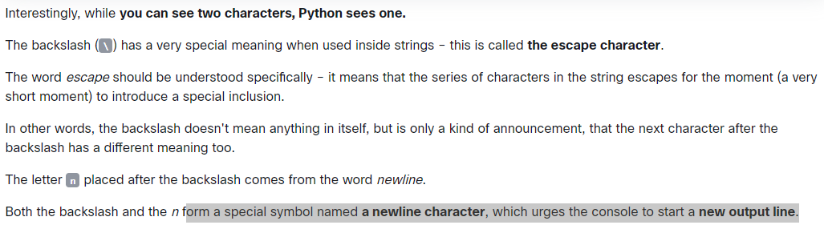
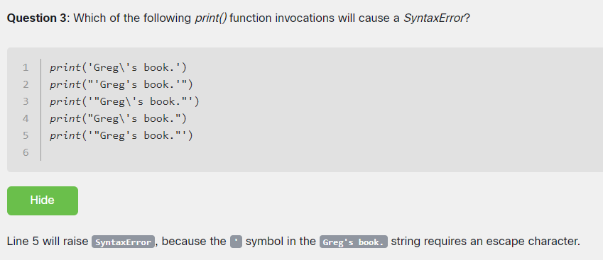
Escape characters ( \ )

Slide 5
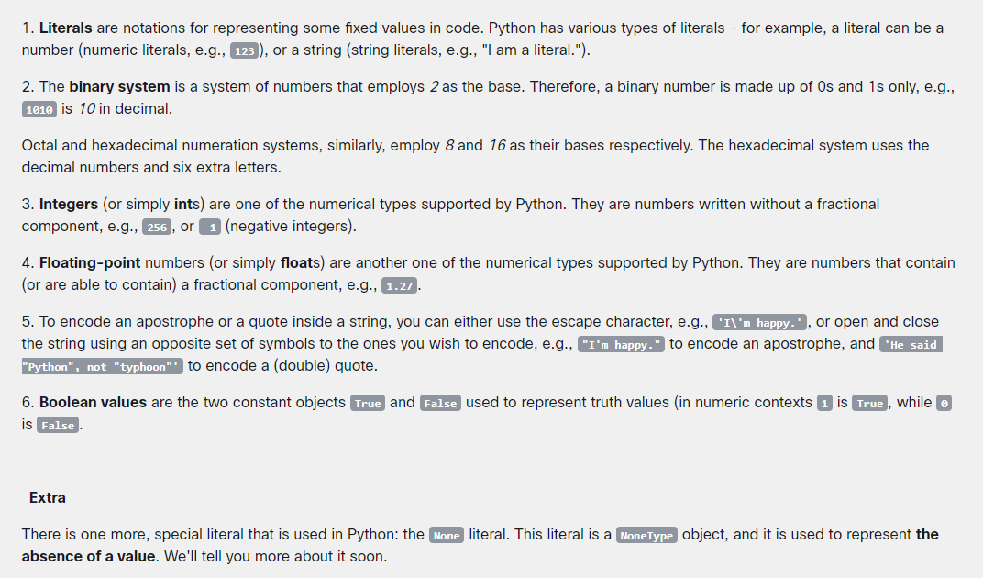
Literals

Slide 6
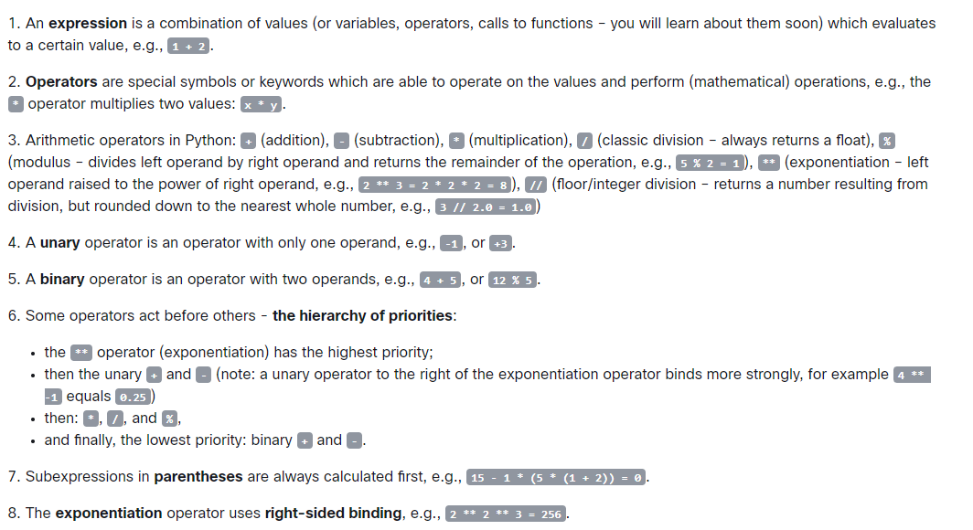
Operators

Slide 7
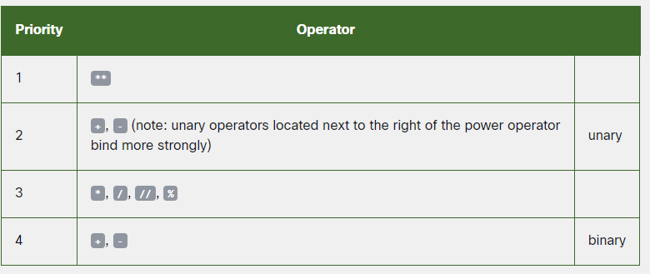
PEMDASLR - precedence order ( left to right )
()
** ( right to left )
* , /
+, -
Notes:
#print(3 * 3 + 3/3 -3) = 7
#print(3 * (3 + 3/3 -3)) = 3

Slide 8
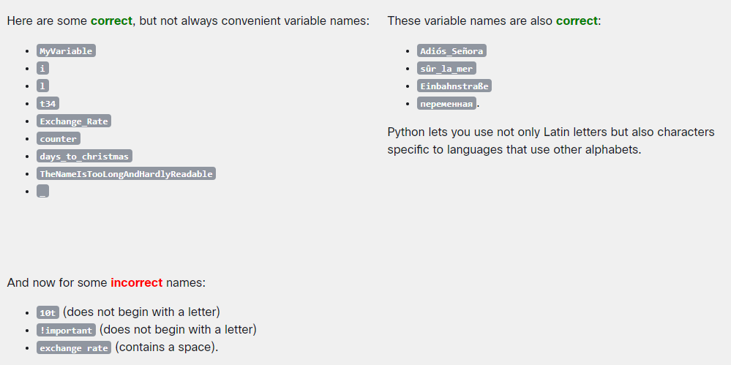
variables

Slide 9
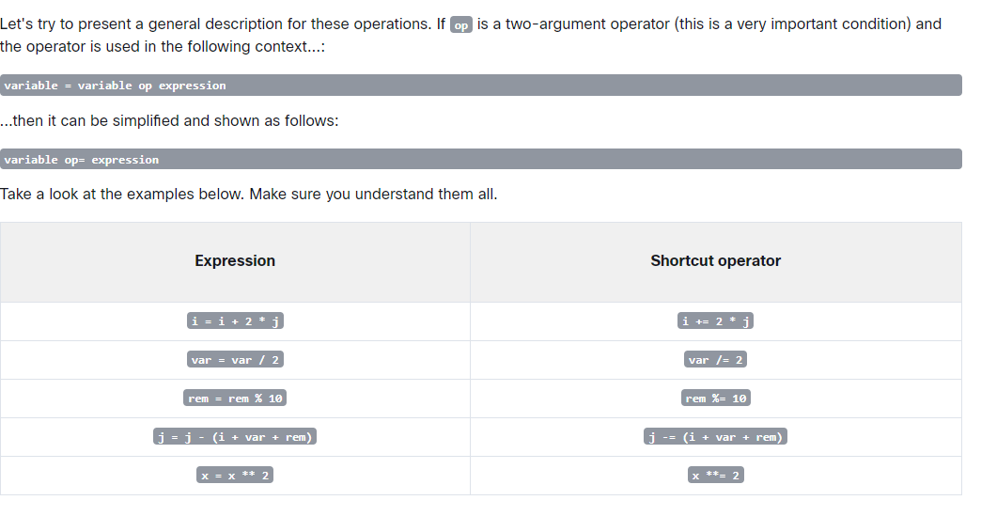

Slide 10
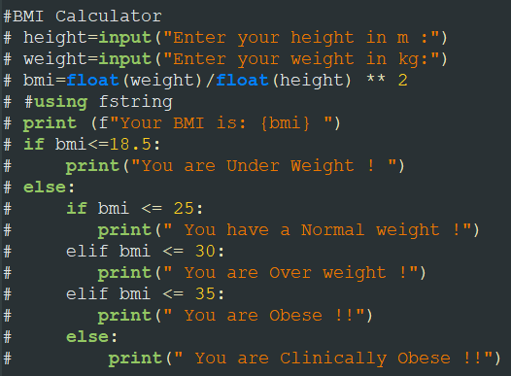
If - elif
Notes:
#BMI Calculator
# height=input("Enter your height in m :")
# weight=input("Enter your weight in kg:")
# bmi=float(weight)/float(height) ** 2
# #using fstring
# print (f"Your BMI is: {bmi} ")
# if bmi<=18.5:
# print("You are Under Weight ! ")
# else:
# if bmi <= 25:
# print(" You have a Normal weight !")
# elif bmi <= 30:
# print(" You are Over weight !")
# elif bmi <= 35:
# print(" You are Obese !!")
# else:
# print(" You are Clinically Obese !!")

Slide 11
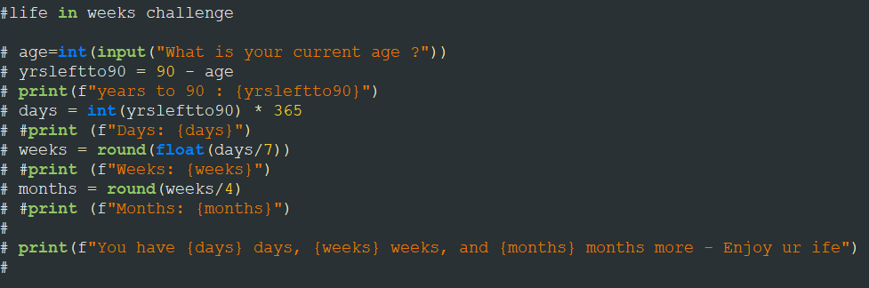
Type casting & round ()
Notes:
#life in weeks challenge
# age=int(input("What is your current age ?"))
# yrsleftto90 = 90 - age
# print(f"years to 90 : {yrsleftto90}")
# days = int(yrsleftto90) * 365
# #print (f"Days: {days}")
# weeks = round(float(days/7))
# #print (f"Weeks: {weeks}")
# months = round(weeks/4)
# #print (f"Months: {months}")
#
# print(f"You have {days} days, {weeks} weeks, and {months} months more - Enjoy ur ife")
#

Slide 12
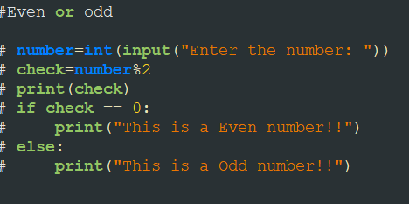
Modulo (%)
Notes:
#Even or odd
# number=int(input("Enter the number: "))
# check=number%2
# print(check)
# if check == 0:
# print("This is a Even number!!")
# else:
# print("This is a Odd number!!")

Slide 13
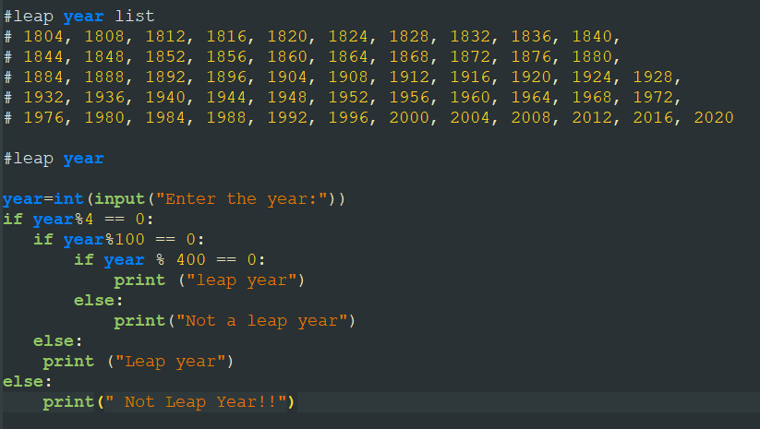
Project 1 : Leap year

Slide 14
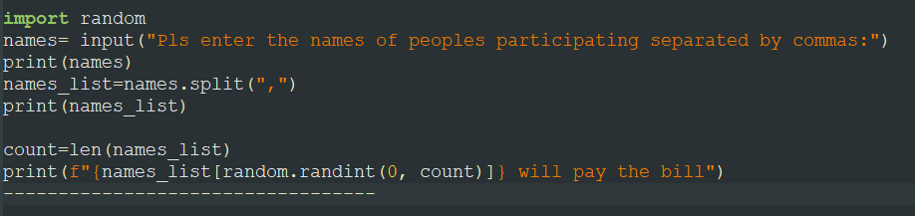
Random ()
Who will pay the bill?

Slide 15
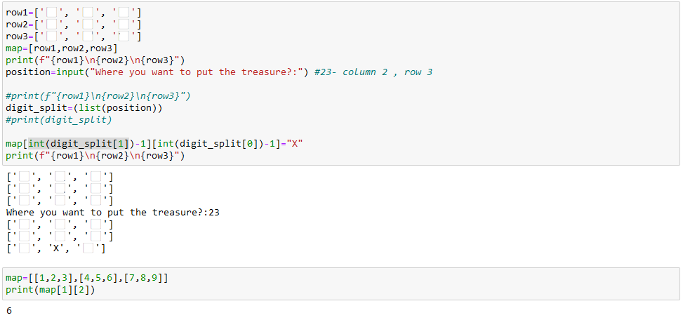
Lists & Nested Lists

Slide 16
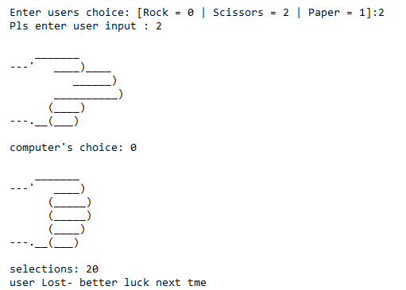
Project 2: Rock Paper Scissors
Notes:
import random
#rock , scissors = 02
#scissors, paper = 21
#paper, rock = 10
rock = '''
_______
---' ____)
(_____)
(_____)
(____)
---.__(___)
'''
paper = '''
_______
---' ____)____
______)
_______)
_______)
---.__________)
'''
scissors = '''
_______
---' ____)____
______)
__________)
(____)
---.__(___)
'''
#------------- user input -----------------------#
user_input = int(input("Enter users choice: [Rock = 0 | Scissors = 2 | Paper = 1]:")) # Enter 0, 1 , 2
print("Pls enter user input :",user_input)
if user_input == 1:
print (paper)
if user_input == 2:
print (scissors)
if user_input == 0:
print (rock)
#------------- Computer input -----------------------#
computer_choice = random.randint(0,2)
print("computer\'s choice:",computer_choice)
if computer_choice == 1:
print (paper)
if computer_choice == 2:
print (scissors)
if computer_choice == 0:
print (rock)
#---------------- Who Wins ---------------------------#
print("selections:",str(user_input) + str(computer_choice))
selections=str(user_input) + str(computer_choice)
if selections[0] == '0' and selections[1] == '2':
print ("user Wins")
elif selections[0] == '1' and selections[1] == '0':
print ("user Wins")
elif selections[0] == '2' and selections[1] == '1':
print ("user Wins")
else:
if selections[0] == selections[1]:
print ("DRAW")
#elif selections[0] == '1' and selections[1] == '1':
#print ("DRAW")
#elif selections[0] == '2' and selections[1] == '2':
# print ("DRAW")
else:
print ("user Lost- better luck next tme ")

Slide 17
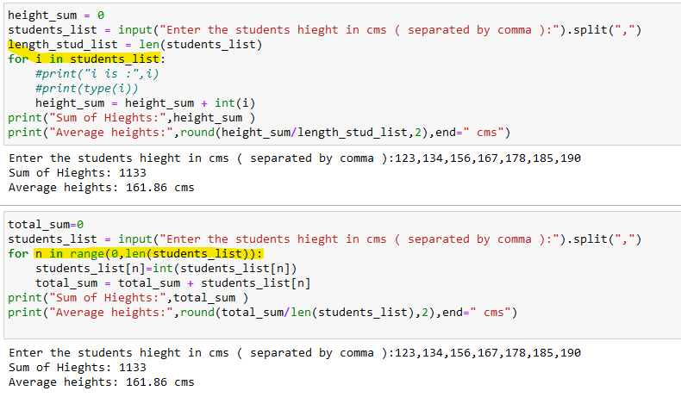
For loop( using list /range )
Notes:
#Average Hieght
#---------------------------------------
#123,134,156,167,178,185,190
#using list traversal directly in FOR
height_sum = 0
students_list = input("Enter the students hieght in cms ( separated by comma ):").split(",")
length_stud_list = len(students_list)
for i in students_list:
#print("i is :",i)
#print(type(i))
height_sum = height_sum + int(i)
print("Sum of Hieghts:",height_sum )
print("Average heights:",round(height_sum/length_stud_list,2),end=" cms")
#using range function
total_sum=0
students_list = input("Enter the students hieght in cms ( separated by comma ):").split(",")
for n in range(0,len(students_list)):
students_list[n]=int(students_list[n])
total_sum = total_sum + students_list[n]
print("Sum of Hieghts:",total_sum )
print("Average heights:",round(total_sum/len(students_list),2),end=" cms")

Slide 18
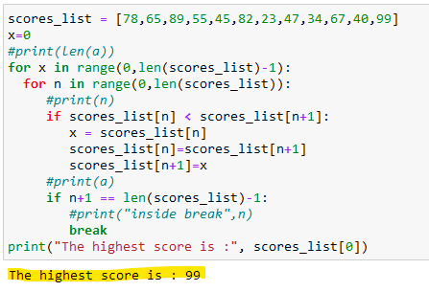
Sort ( using for loop )
RANGE DOESN’T TAKE THE LAST NUMBER
> RANGE(0-10)
> IT WILL TAKE ONLY 1-9
Notes:
scores_list = [78,65,89,55,45,82,23,47,34,67,40,99]
x=0
#print(len(a))
for x in range(0,len(scores_list)-1):
for n in range(0,len(scores_list)):
#print(n)
if scores_list[n] < scores_list[n+1]:
x = scores_list[n]
scores_list[n]=scores_list[n+1]
scores_list[n+1]=x
#print(a)
if n+1 == len(scores_list)-1:
#print("inside break",n)
break
print("The highest score is :", scores_list[0])

Slide 19
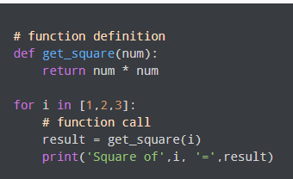

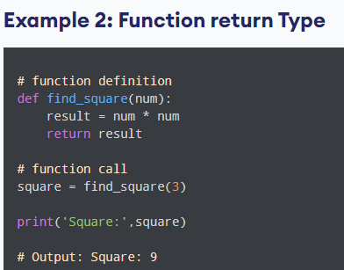
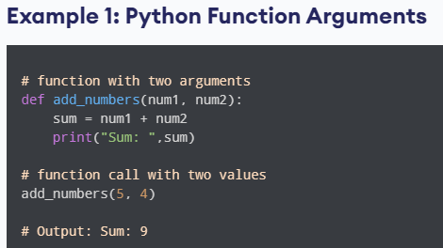
Function(def)
Notes:
https://reeborg.ca/reeborg.html?lang=en&mode=python&menu=worlds%2Fmenus%2Freeborg_intro_en.json&name=Hurdle%201&url=worlds%2Ftutorial_en%2Fhurdle1.json

Slide 20
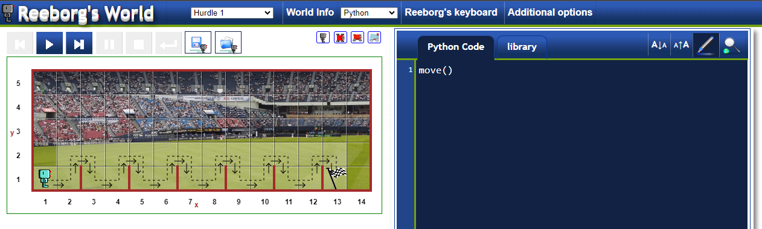
https://reeborg.ca/reeborg.html?lang=en&mode=python&menu=worlds%2Fmenus%2Freeborg_intro_en.json&name=Hurdle%201&url=worlds%2Ftutorial_en%2Fhurdle1.json

Slide 21
Indentation
TAB Vs Space
Space is preferred ( 4 spaces ) – can be set in IDE

Slide 22
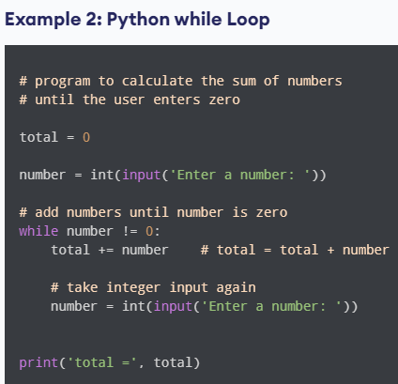

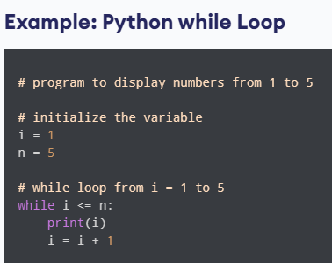
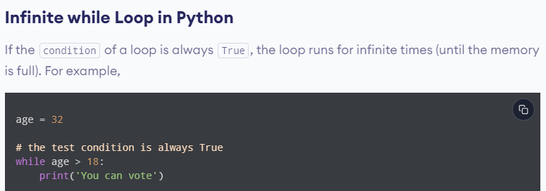
While Loops

Slide 23
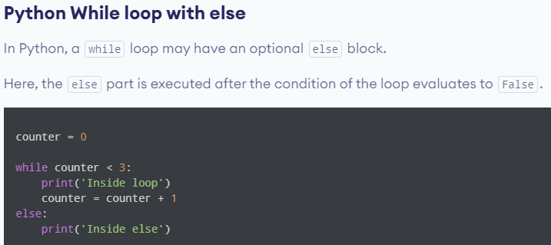
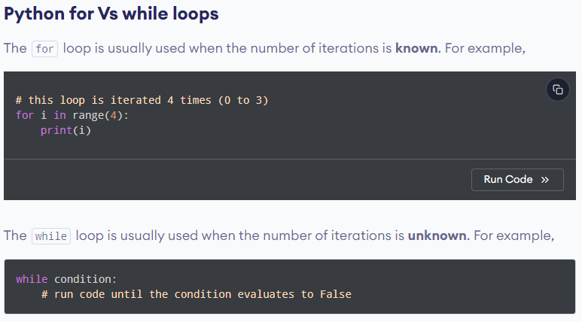

Slide 24
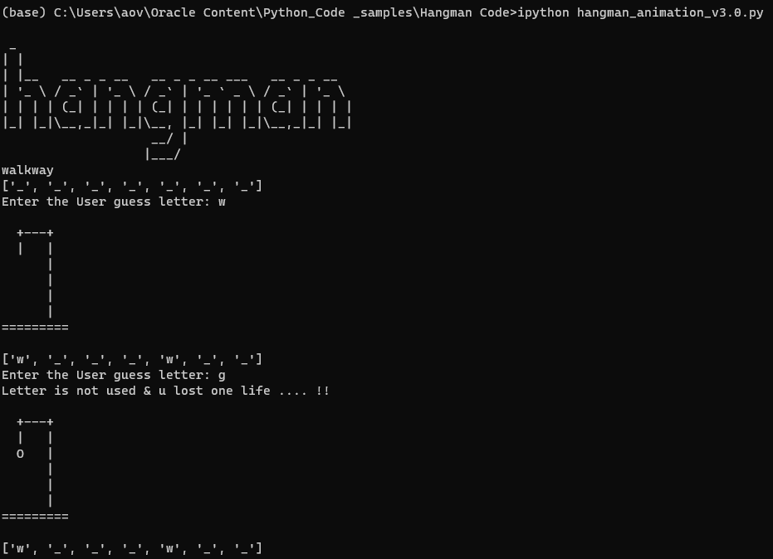
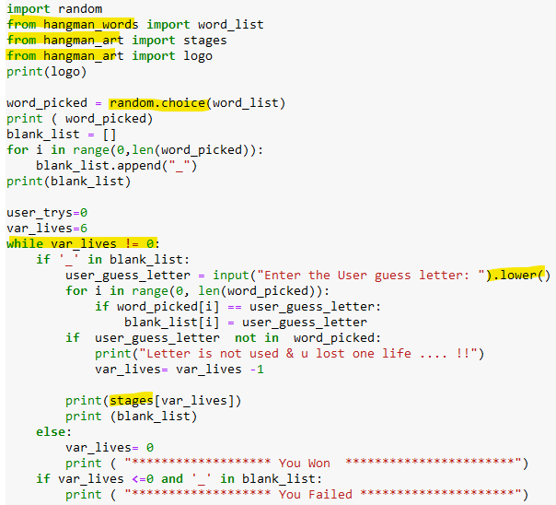
Hangman
Notes:
import random
from hangman_words import word_list
from hangman_art import stages
from hangman_art import logo
print(logo)
word_picked = random.choice(word_list)
print ( word_picked)
blank_list = []
for i in range(0,len(word_picked)):
blank_list.append("_")
print(blank_list)
user_trys=0
var_lives=6
while var_lives != 0:
if '_' in blank_list:
user_guess_letter = input("Enter the User guess letter: ").lower()
for i in range(0, len(word_picked)):
if word_picked[i] == user_guess_letter:
blank_list[i] = user_guess_letter
if user_guess_letter not in word_picked:
print("Letter is not used & u lost one life .... !!")
var_lives= var_lives -1
print(stages[var_lives])
print (blank_list)
else:
var_lives= 0
print ( "******************* You Won ***********************")
if var_lives <=0 and '_' in blank_list:
print ( "******************* You Failed *********************")

Slide 25
Functions – part 2
Parameter vs arguments
Parameter – Is the name of the variable in the function defn
Argument – is the value of the parameter used while calling the function.
Positional parameters – keyword arguments
Ex: greet-with(1,2,3)➔ greet-with(a=1,b=2,c=3)
greet-with (c=3,a=1,b=2)

Slide 26
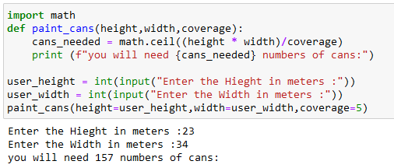
Cans needed ?
Notes:
import math
def paint_cans(height,width,coverage):
cans_needed = math.ceil((height * width)/coverage)
print (f"you will need {cans_needed} paint cans:")
user_height = int(input("Enter the Hieght in meters :"))
user_width = int(input("Enter the Width in meters :"))
paint_cans(height=user_height,width=user_width,coverage=5)

Slide 27
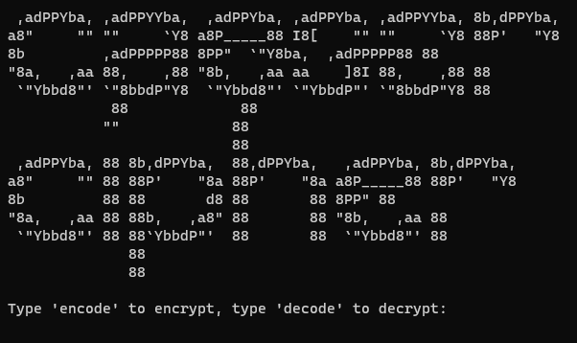
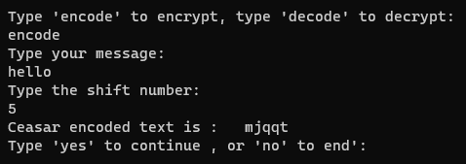
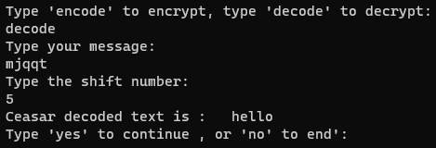
Caesar Cypher
Notes:
# Ceasar Function
# which does both encrypt and decrypt
#-----------------------------------
def ceasar (plain_txt, shift, direction):
ceaser_txt=""
for char in plain_txt:
# Code will handle special characters
if char in alphabet:
index = alphabet.index(char)
#print("index of",char," ",index)
if direction == "encode":
index=index + shift
else:
index=index - shift
#print(alphabet[index])
ceaser_txt += alphabet[index]
else:
ceaser_txt += char
print (f"Ceasar {direction}d text is :" , " " , ceaser_txt)
#Main Block
#-----------
from art import logo
print(logo)
alphabet = ['a', 'b', 'c', 'd', 'e', 'f', 'g', 'h', 'i', 'j', 'k', 'l', 'm', 'n', 'o', 'p', 'q', 'r', 's', 't', 'u',
'v', 'w', 'x', 'y', 'z','!','@','#','$','%','&','*',' ','a', 'b', 'c', 'd', 'e', 'f', 'g', 'h', 'i', 'j', 'k', 'l', 'm', 'n', 'o', 'p',
'q', 'r', 's', 't', 'u', 'v', 'w', 'x', 'y', 'z','!','@','#','$','%','&','*',' ']
yesorno = "yes"
while yesorno == "yes":
direction = input("Type 'encode' to encrypt, type 'decode' to decrypt:\n")
text = input("Type your message:\n").lower()
shift = int(input("Type the shift number:\n"))
# for shift greater than 26
# another to validate saying Shift can be greater than 26
shift = shift % 26
ceasar(text, shift, direction)
yesorno = input("Type 'yes' to continue , or 'no' to end':\n")
if yesorno == "no":
print ("Exited, Good Bye !!! ")
#else:
# continue

Slide 28
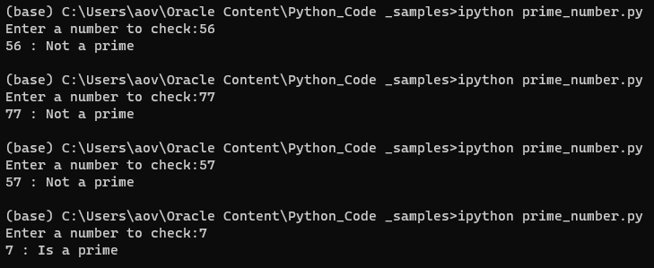
Prime Number
Notes:
#Prime number check
def prime_checker(number):
is_prime="True"
for i in range(2,number):
if number%i == 0:
is_prime="False"
break
if is_prime == "True":
print(number,":", "Is a prime ")
else:
print(number,":", "Not a prime ")
#main
var_number = int(input("Enter a number to check:"))
prime_checker(number=var_number)

Slide 29
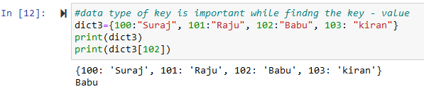
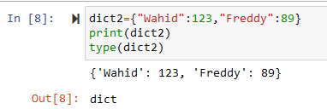



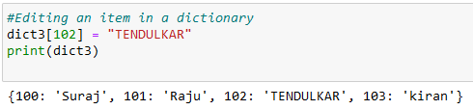
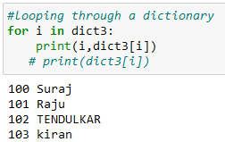
Dictionary
Notes:
#data type of key is important while findng the key - value
dict3={100:"Suraj", 101:"Raju", 102:"Babu", 103: "kiran"}
print(dict3)
print(dict3[102])
#Editing an item in a dictionary
dict3[102] = "TENDULKAR"
print(dict3)
#looping through a dictionary
for i in dict3:
print(i,dict3[i])
# print(dict3[i])

Slide 30
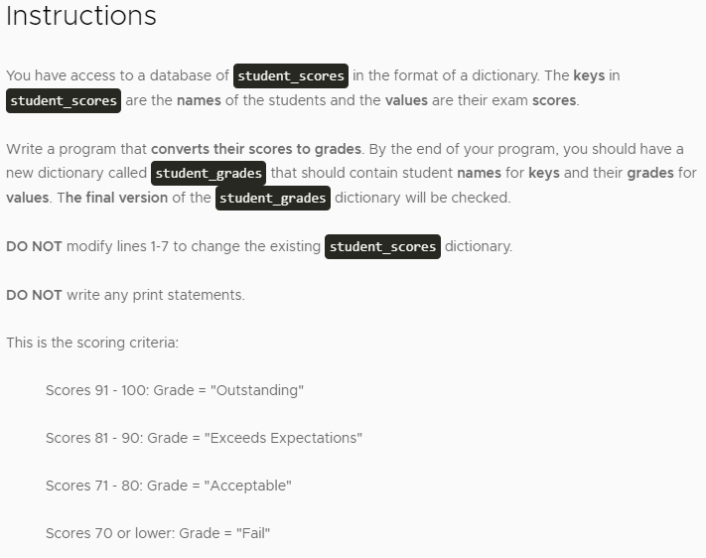
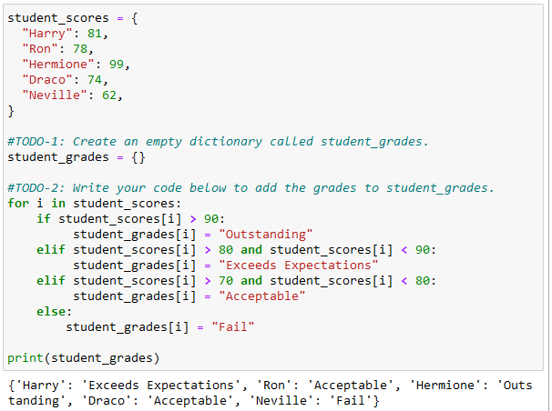
Derive the grades:
Notes:
student_scores = {
"Harry": 81,
"Ron": 78,
"Hermione": 99,
"Draco": 74,
"Neville": 62,
}
#TODO-1: Create an empty dictionary called student_grades.
student_grades = {}
#TODO-2: Write your code below to add the grades to student_grades.
for i in student_scores:
if student_scores[i] > 90:
student_grades[i] = "Outstanding"
elif student_scores[i] > 80 and student_scores[i] < 90:
student_grades[i] = "Exceeds Expectations"
elif student_scores[i] > 70 and student_scores[i] < 80:
student_grades[i] = "Acceptable"
else:
student_grades[i] = "Fail"
print(student_grades)

Slide 31
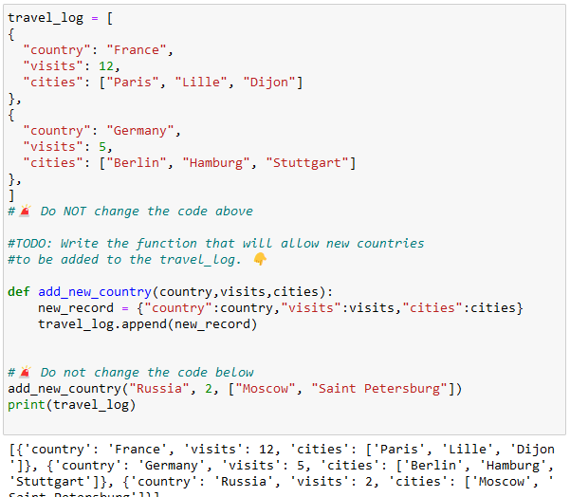
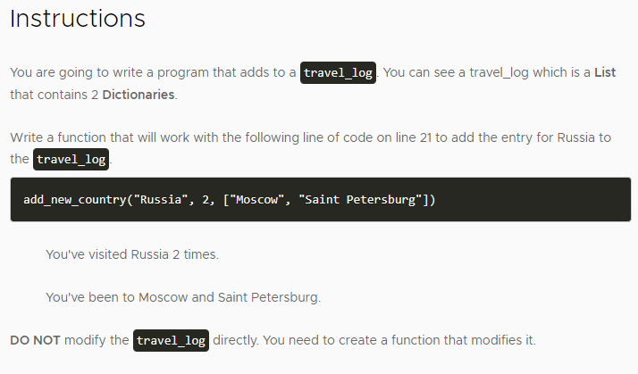
Travel log ( Dictionary In List )
Notes:
travel_log = [
{
"country": "France",
"visits": 12,
"cities": ["Paris", "Lille", "Dijon"]
},
{
"country": "Germany",
"visits": 5,
"cities": ["Berlin", "Hamburg", "Stuttgart"]
},
]
#TODO: Write the function that will allow new countries
#to be added to the travel_log.
def add_new_country(country,visits,cities):
new_record = {"country":country,"visits":visits,"cities":cities}
travel_log.append(new_record)
# Do not change the code below
add_new_country("Russia", 2, ["Moscow", "Saint Petersburg"])
print(travel_log)

Slide 32
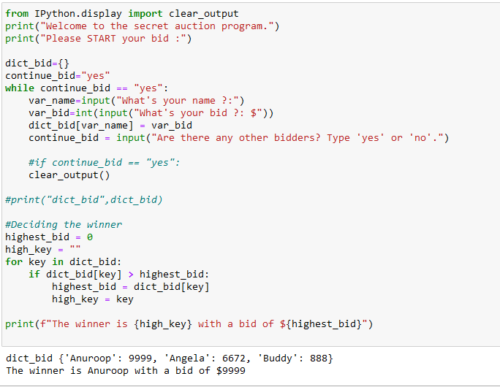
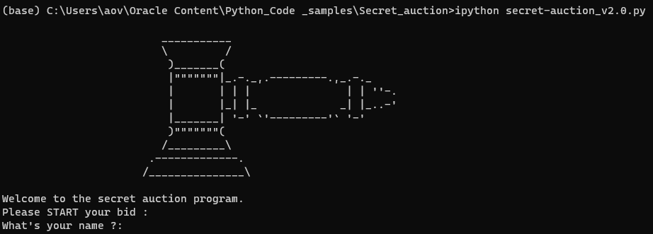
Secret Auction
Notes:
from IPython.display import clear_output
print("Welcome to the secret auction program.")
print("Please START your bid :")
dict_bid={}
continue_bid="yes"
while continue_bid == "yes":
var_name=input("What's your name ?:")
var_bid=int(input("What's your bid ?: $"))
dict_bid[var_name] = var_bid
continue_bid = input("Are there any other bidders? Type 'yes' or 'no'.")
#if continue_bid == "yes":
clear_output()
#print("dict_bid",dict_bid)
#Deciding the winner
highest_bid = 0
high_key = ""
for key in dict_bid:
if dict_bid[key] > highest_bid:
highest_bid = dict_bid[key]
high_key = key
print(f"The winner is {high_key} with a bid of ${highest_bid}")

Slide 33
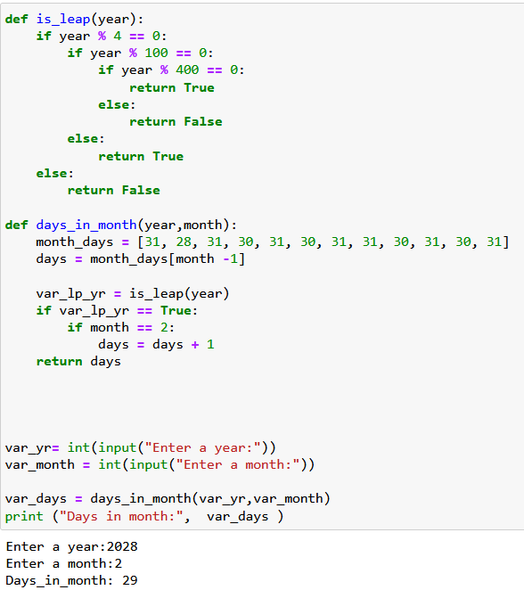
More On Functions ( return )
Notes:
def is_leap(year):
if year % 4 == 0:
if year % 100 == 0:
if year % 400 == 0:
return True
else:
return False
else:
return True
else:
return False
def days_in_month(year,month):
month_days = [31, 28, 31, 30, 31, 30, 31, 31, 30, 31, 30, 31]
days = month_days[month -1]
var_lp_yr = is_leap(year)
if var_lp_yr == True:
if month == 2:
days = days + 1
return days
var_yr= int(input("Enter a year:"))
var_month = int(input("Enter a month:"))
var_days = days_in_month(var_yr,var_month)
print ("Days in month:", var_days )

Slide 34
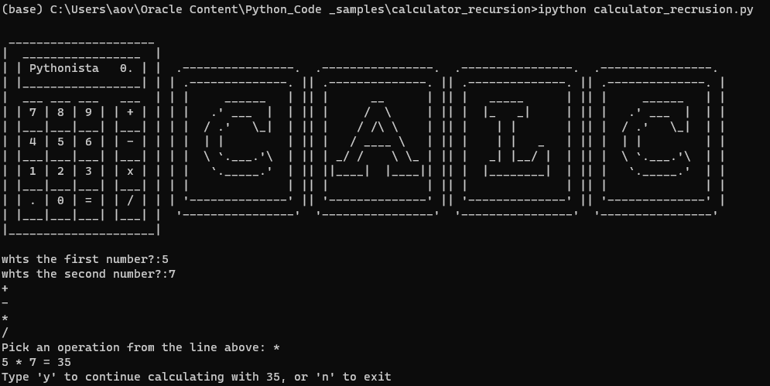
Calculator
Notes:
#calculator - recursion
def add(n1,n2):
return n1+n2
def subtract(n1,n2):
return n1-n2
def multiply(n1,n2):
return n1*n2
def divide(n1,n2):
return n1/n2
# create a dictionary called operations
# keys = + - * /
# values = add subtract multiply divide
dict_operations = {
"+": add,
"-": subtract,
"*": multiply,
"/": divide
}
def calculator():
num1 = int(input("whts the first number?:"))
num2 = int(input("whts the second number?:"))
for symbol in dict_operations:
print(symbol,sep="\n")
operation_symbol = input("Pick an operation from the line above: ")
function = dict_operations[operation_symbol]
answer= function(num1,num2)
print(f"{num1} {operation_symbol} {num2} = {answer}")
#var_continue=input(f"Type 'y' to continue calculating with {answer}, or 'n' to exit")
var_continue="y"
#answer2=answer
while var_continue=="y":
var_continue=input(f"Type 'y' to continue calculating with {answer}, or 'n' to exit")
if var_continue == "n":
calculator()
else:
operation_symbol = input("Pick an operation from the line above: ")
num3 = int(input("whts the next number?:"))
function = dict_operations[operation_symbol]
answer2=answer
answer= function(answer2,num3)
print(f"{answer2} {operation_symbol} {num3} = {answer}")
calculator()

