Slide 1
Walmart Superstore Sales Analysis
Prepared by: Anurudh B. A.

Slide 2
Project Objective
Analyze Walmart Superstore's sales data using Power BI to uncover actionable insights.
Focus on tracking sales, optimizing inventory, regional trends, and customer behavior for strategic decisions.

Slide 3
Tools & Technologies Used
- Power BI (KPIs, Maps, Drilldowns, Dashboards)
- Excel (Data Pre-cleaning and Review)

Slide 4
Project Requirements & Coverage
1. Sales & Revenue Dashboard
2. Inventory Management Dashboard
3. Regional Sales Map
4. Drill-Down Hierarchies

Slide 5
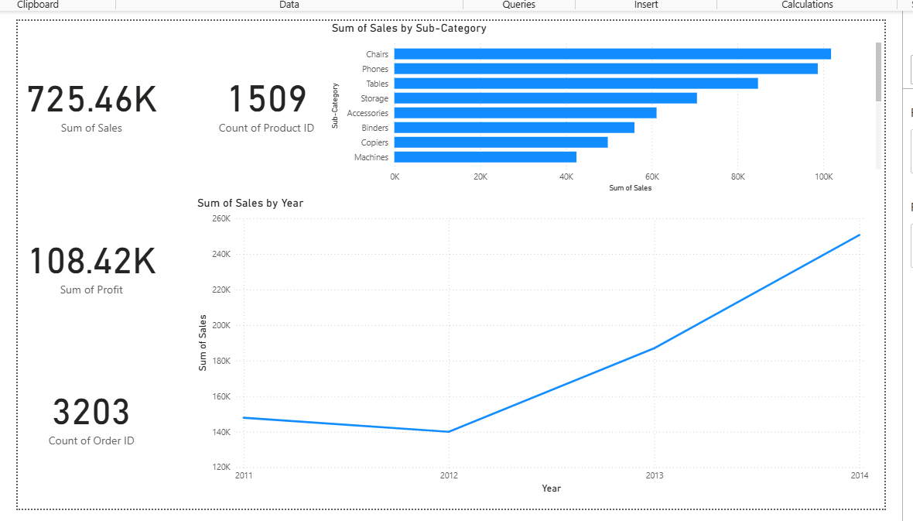
Sales & Revenue Dashboard
Total Sales: ₹725.46K
Profit: ₹108.42K
Orders: 3203
Products: 1509
Top-selling: Chairs, Phones, Tables
Rising trend in sales from 2012 to 2014

Slide 6
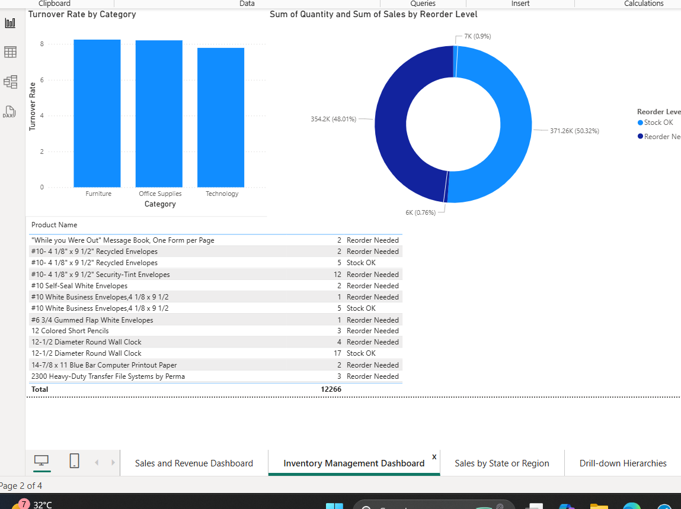
Inventory Management Dashboard
• High turnover in Office Supplies
• 50%+ sales from items needing reorder
• Inventory optimization needed

Slide 7
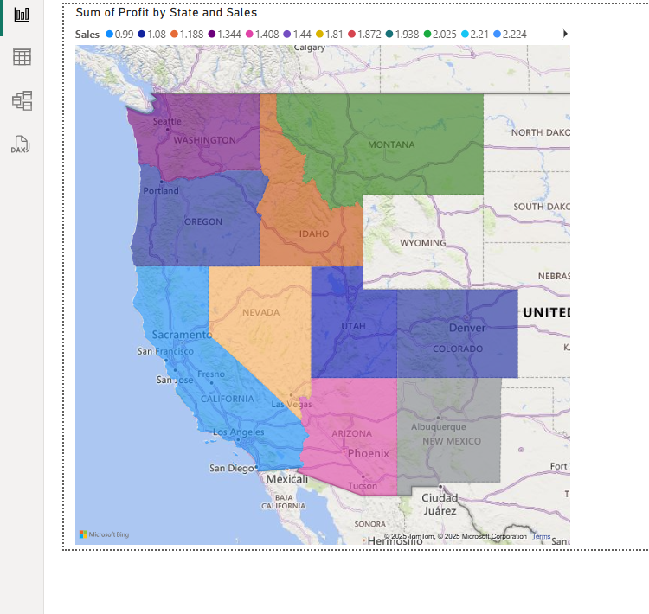
Regional Sales Map
• California, New York, Washington are high profit
• Mid-US states show opportunity areas

Slide 8
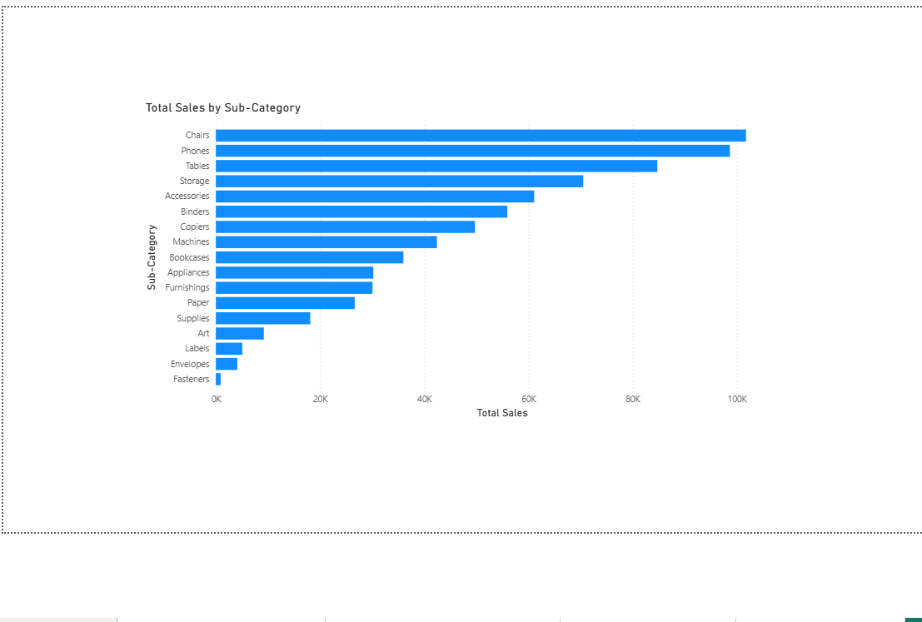
Drill-down Hierarchies
• Navigate from Category > Sub-Category
• Useful for deep-diving into performance

Slide 9
Key Insights
• Chairs & Phones dominate sales
• 20% of products = 80% revenue (Pareto)
• Reorder-needed items indicate demand
• Growth potential in underperforming regions

Slide 10
Recommendations
• Stock fast-moving products more frequently
• Target weaker states with campaigns
• Monitor and automate reorder levels
• Bundle fast & slow products for upsell

Slide 11
Conclusion
This Power BI project reveals deep insights into Walmart's sales trends, inventory health, and customer behavior.
Dashboards created are scalable, dynamic, and ideal for business decision-making.

