Slide 1
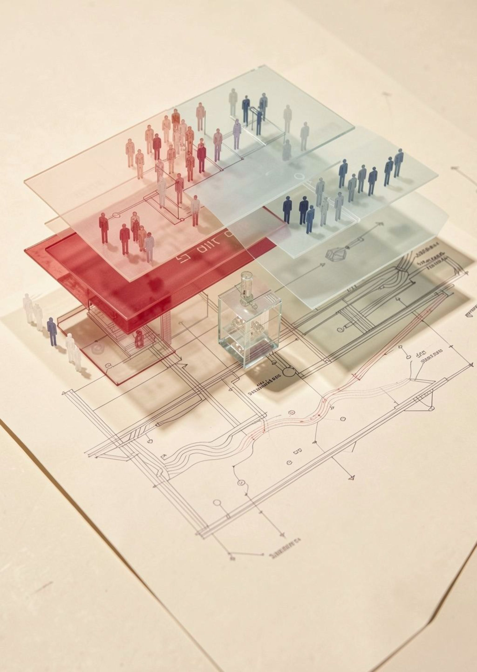
PEOPLE / DATA / DECISIONS
INFORMATION
SECURITY
Protecting data. Preserving trust.
Information security protects the data, systems, and decisions that keep our shared world moving.
Notes:
Open with the idea that security is a condition of trust. The subject is larger than technology: it protects people, information, and the decisions built on them.

Slide 2
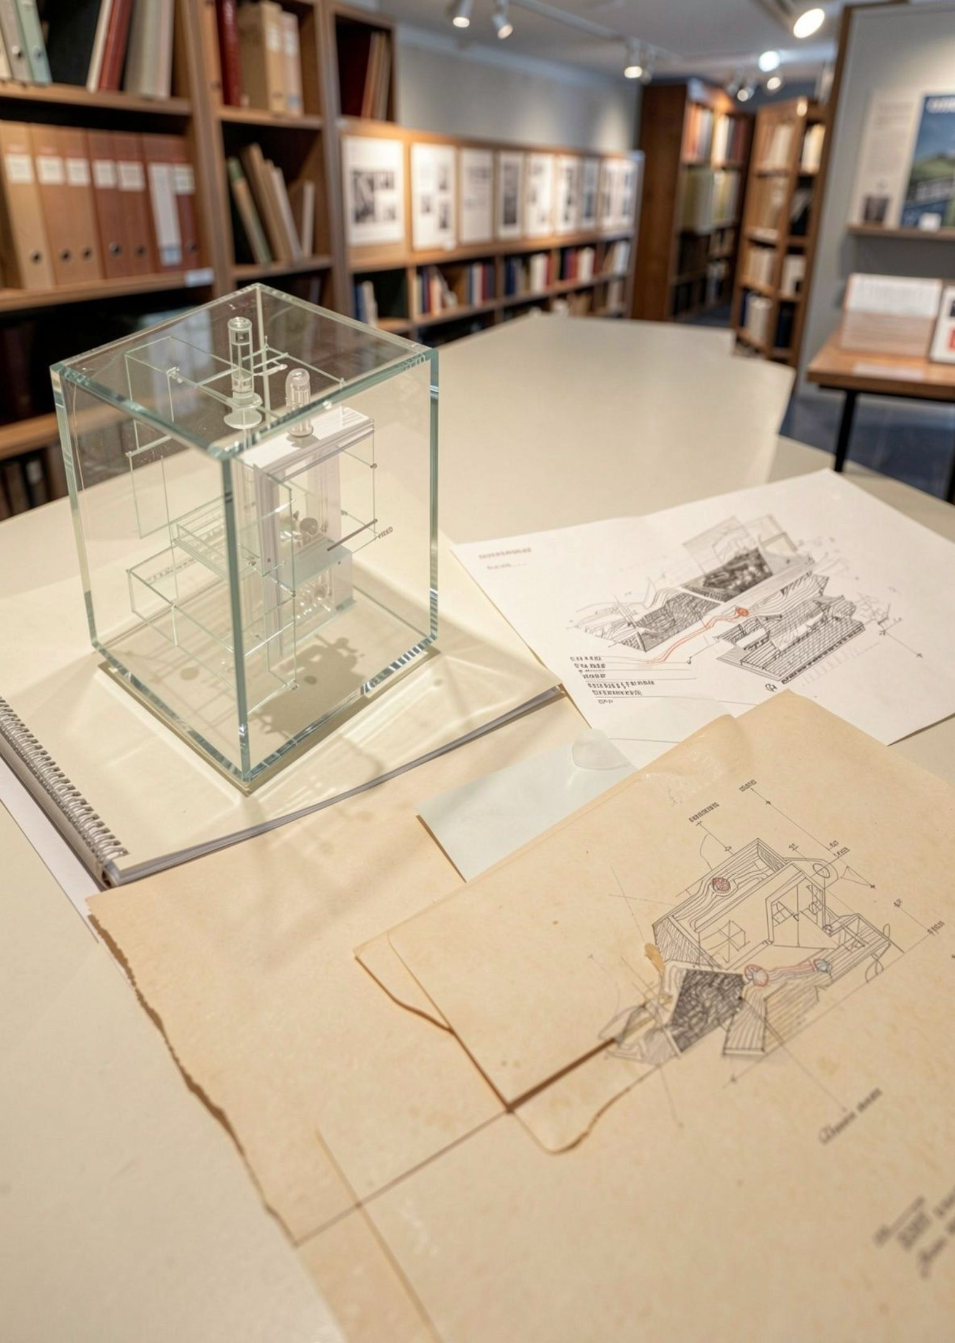
THE OPENING PROMISE
Security begins with a promise
Information security protects the conditions that let people, institutions, and systems rely on one another.
People
Data
Decisions
Students trust a record to represent them fairly.
Researchers trust results to remain accurate.
People trust a payment or message to reach its purpose.
Notes:
Use familiar examples before introducing technical language. A student record, payment, research result, or message is already an information-security story.

Slide 3

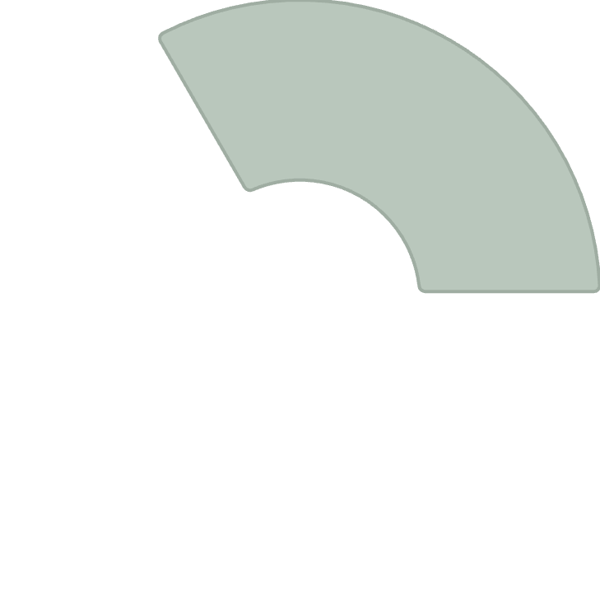
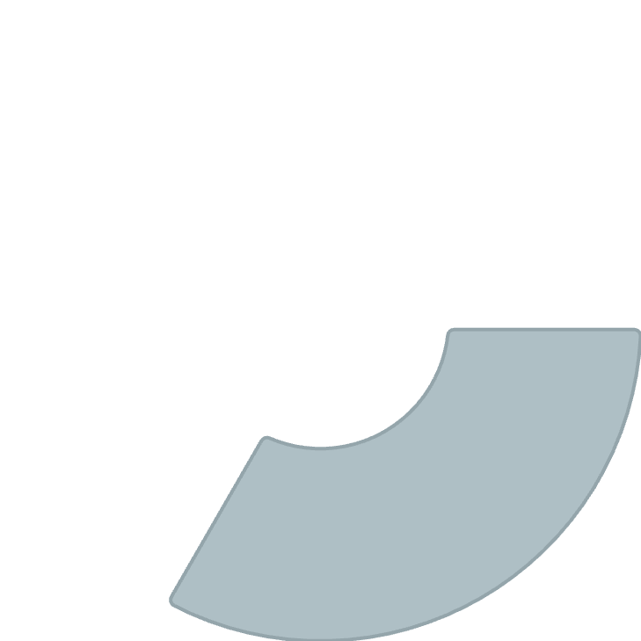
Integrity
THE CORE PILLARS
Three properties make information trustworthy
2
It remains accurate and unaltered.
Confidentiality
Only the right people can see it.
1
Availability
It is there when an authorized person needs it.
3
Information security is not one promise. It is a balanced set of conditions.
A trustworthy system protects all three at once.
Notes:
Introduce the CIA triad as three connected properties, not three isolated definitions. A system can be private but inaccurate, accurate but unavailable, or available to the wrong people.

Slide 4
FOLLOW THE DATA
Every piece of data has a life
Security decisions should follow the data across its full lifecycle.
Create or collect. Ask what is needed and why.
Store and use. Limit access and protect the working copy.
Share or transmit. Send it only through an appropriate path.
Archive or delete. Keep it for a reason, then remove it safely.
The same data may need different safeguards at each stage.
Notes:
Ask learners to name one data item and trace it through all four stages. The right control depends on where the data is and what is happening to it.

Slide 5




WHEN THINGS GO WRONG
Risk is a relationship, not a label
Risk becomes clearer when we connect what matters, what could happen, where protection is weak, and what changes afterward.
Asset
Threat
Vulnerability
Impact
What matters to protect
What could cause harm
Where protection is weak
What changes if the event occurs
Risk grows when a valuable asset meets a plausible threat through a weakness with meaningful impact.
Notes:
Risk is not a permanent label attached to a system. It changes as assets, threats, weaknesses, and impacts change.

Slide 6



HUMAN TO SYSTEM
Identity is the first control point
A secure action starts by connecting the right person to the right permission, at the right time.
Authentication
Authorization
Accountability
Who are you?
What are you allowed to do?
What happened, and can we trace it?
Identity proof → permission → auditable action
Notes:
Distinguish the three questions. Authentication establishes identity. Authorization limits action. Accountability creates a record that can be reviewed later.

Slide 7
ACCESS BY DESIGN
Good access is specific, temporary, and earned
Least privilege means granting only the access needed for the task, then reviewing whether it should continue.
BROAD · STANDING
Separate high-risk actions.
Review permissions over time.
Use strong authentication so a stolen secret does not become a stolen identity.
Everyone can reach the whole system
Permissions remain active after the original task ends.
NARROW · TIME-BOUNDED
One person gets one needed path
Access is earned, scoped to the task, and removed when it is no longer needed.
Notes:
Contrast convenience with control. Broad standing access feels efficient until an account is misused. Specific, temporary access limits the path an error or stolen credential can open.

Slide 8
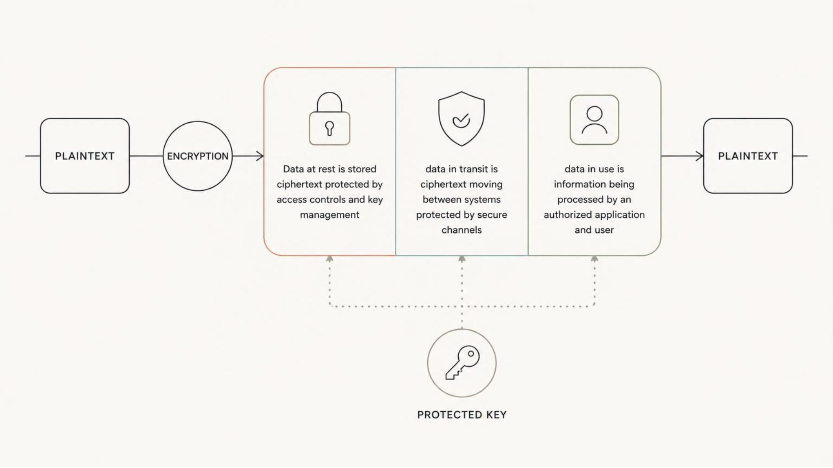
WHO CAN UNDERSTAND IT
Encryption changes who can understand the data
Plaintext becomes ciphertext through an encryption process. A key makes the transformation usable to an authorized party.
Protecting keys matters as much as choosing an algorithm.
Encryption helps across rest, transit, and use. Key protection makes the promise real.
Notes:
Encryption does not make data disappear. It changes who can understand it, and under what conditions. Emphasize that key management is part of the security control.

Slide 9
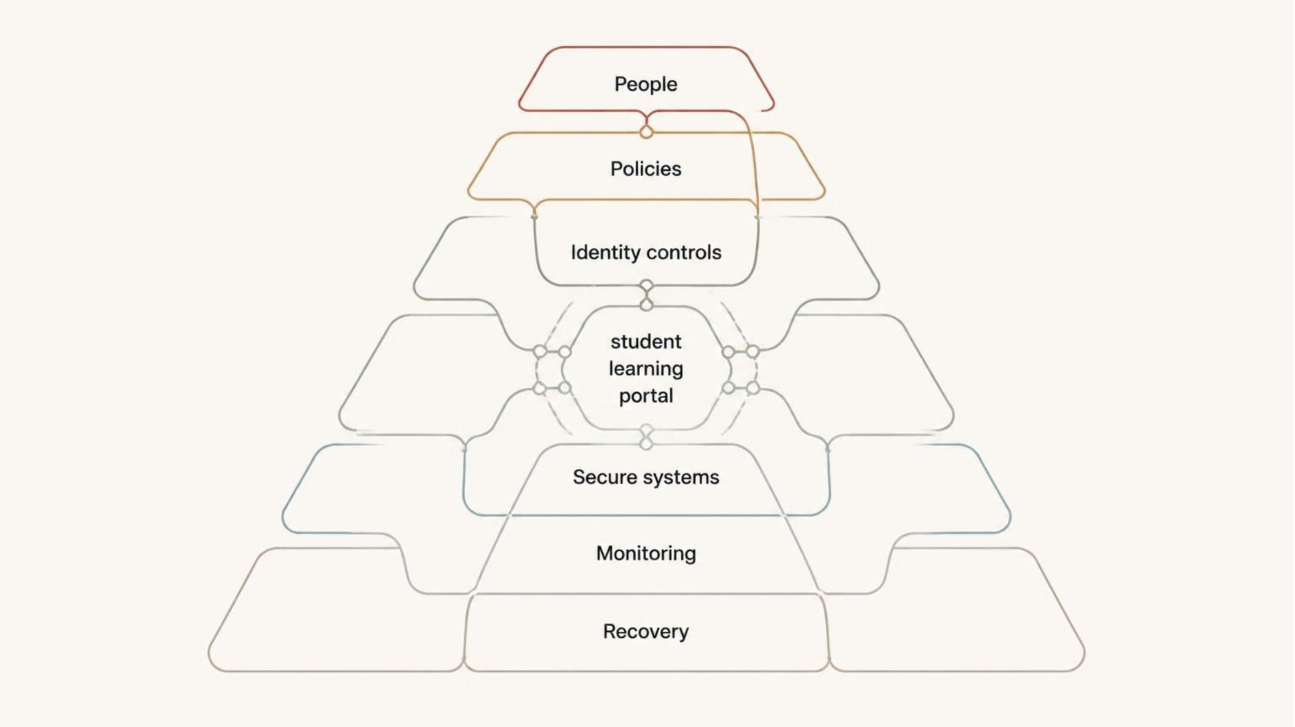
RESILIENCE BY DESIGN
Defense works in layers
No single control is perfect. Resilience comes from overlapping safeguards that can catch, contain, and recover from failure.
People, policies, identity controls, secure systems, monitoring, and recovery reinforce one another.
Notes:
Use the university service as the example. If one layer fails, the others should still slow the problem, reveal it, limit its reach, or help restore service.

Slide 10
THE ORDINARY MOMENT
Most incidents begin with an ordinary moment
A rushed click, reused password, exposed device, misdirected file, or overlooked update can open a path to harm.
Pause
Check
Report
Notice the unusual request or exposed detail.
Use the trusted path before acting.
Make the signal visible early.
Human factors are part of system design, not a reason to blame individuals.
Notes:
Close on a calm, practical message. Security improves when systems make the safe action visible and easy. People are part of the control system, not the scapegoat.

