Slide 1
23CSE452 BUSINESS ANALYTICS
Career Market Intelligence Engine: Salary Prediction and Skill Demand Analytics for Indian Job Postings
Final Project Presentation
Group -3
Ravula Akshith CB.SC.U4CSE23648
V Kireeti CB.SC.U4CSE23057
Mithresh M CB.SC.U4CSE23039
RISHINATH CB.SC.U4CSE23741
R ANUSANTH CB.SC.U4CSE23235
Ms.Rohini Date: 6/11/26
Review 2: Unit 3 advanced analytics (time series forecasting and Text mining) and the interactive
dashboard
01
Notes:
Suggested time: 20 seconds. Replace bracketed prompts with your project evidence. Present actual results only. Target 15 minutes including the live demonstration. Cover the whole project. Review 2 assessment primarily focuses on two Unit 3 methods.

Slide 2
PROJECT OVERVIEW
Business problem and objectives
Business problem: Job seekers, students and recruiters in India cannot tell what a role should pay or which skills to build. Only 12% of scraped Naukri postings state a salary, and skill demand is spread across thousands of descriptions.
Objectives: (1) Predict the annual salary (INR) of a posting with an 80% range that covers at least 80% of unseen employers. (2) Rank 20 skills by demand, search-interest trend and pay association across 10 roles.
Business decision: Which role and skills to target or hire for, and what salary range to negotiate from or offer.
Expected output: A salary band with a confidence guide, an invest / opportunity / hype / avoid skill map, and a personal Skill Gap Advisor, delivered in an interactive dashboard.
02
Notes:
Suggested time: 40 seconds. Replace bracketed prompts with your project evidence. Present actual results only.

Slide 3
UNITS 1 TO 3
UNITS 1 TO 3
Complete project workflow
Complete project workflow
Stage | Your implementation
Unit 1 | Live collection (Naukri API, Google Trends), raw-data inspection, validation (28 of 28 checks pass), cleaning, salary masking, EDA
Unit 2 | Salary band and above/below-median models: Random Forest, TF-IDF + Logistic Regression, and a combined soft vote. Employer-grouped cross-validation plus held-out unseen employers. Feature-group ablation.
Unit 3 | Text mining (skills, clustering, role classification) and time-series analysis (Google Trends momentum, Mann-Kendall test, forecasts versus a naive baseline), plus association rules in the Skill Value Engine
Final application | Nextjs dashboard: salary predictor, model evaluation, dataset validation, and the Skill Gap Advisor page
Stage | Your implementation
Unit 1 | Naukri scrape (Apify): 14,085 postings, 10 roles, 1,358 salaried modelling rows. Validation, preprocessing, EDA.
Unit 2 | 4 models and 2 baselines compared with company-grouped CV; tuned XGBoost with conformalized quantile regression for salary ranges.
Unit 3 | Text Mining (pay-disclosure classifier, topics, skill pay premiums) and Time-Series Analysis (Google Trends, 20 skills).
Final application | Next.js dashboard and Salary Estimator demo; combined demand, interest and pay recommendations.
Completion status: 100% implemented. Four notebooks, saved models and the dashboard are integrated.
Completion status: 100% implemented. Four notebooks, saved models and the dashboard are integrated through shared exports.
03
03
Notes:
Suggested time: 30 seconds. Replace bracketed prompts with your project evidence. Present actual results only.

Slide 4
DATASET ACROSS UNITS 1 TO 3
Overall dataset description
Source and method: Naukri.com postings collected with an Apify scraper, deduplicated by job ID; Google Trends (India, weekly) for 20 skills. All rows are real; no synthetic data.
Final dataset size: 14,085 raw postings x 63 columns (28 kept) → 10,780 role-matched postings (text corpus) → 1,358 salaried postings from 1,017 companies, 190 model inputs.
Coverage: India, 10 roles (Digital Marketing, Graphic Designer, Project Manager, DevOps / Cloud, Data Analyst, Software Engineer, Data Engineer, Product Manager, Business Analyst, Data Scientist), 11 city groups; Trends from Oct 2021 to Oct 2026 (261 weeks).
Unit mapping: Units 1-2 use structured fields and the salary midpoint (1,358 rows). Text mining uses descriptions (10,780) and the salaried subset (1,348). Time series uses weekly Trends; skills link postings to trends in the combined notebook.
04
Notes:
Suggested time: 45 seconds. Replace bracketed prompts with your project evidence. Present actual results only. Document original collection or generation. Pre-built datasets from Kaggle, UCI, GitHub or similar repositories are not permitted under the project requirements.

Slide 5
FINAL PROJECT DATA
Sample dataset and key variables
Job title | Role / seniority | Location | Salary (₹ per year) → band
Salesforce Business Analyst | Business Analyst / Mid | Karnataka | ₹4-8 L → low
Data Scientist | Data Scientist / Mid | Karnataka | ₹10-15 L → medium
Site Reliability Engineer | DevOps / Cloud Engineer / Mid | Telangana | ₹10-20 L → medium
Senior Machine Learning Engineer | Data Scientist / Senior | Karnataka | ₹12-20 L → high
Key variables: role (10 classes), experience min / max (years), seniority and city group (categorical), work mode, 60 skill tags (0/1), description text (TF-IDF → SVD-50). Target: log of salary midpoint (INR per year).
Text subset: 10,780 descriptions. Pay subset: 1,348 salaried postings. Google Trends series (weekly, 20 skills) is joined to postings by skill.
05
Notes:
Suggested time: 35 seconds. Replace bracketed prompts with your project evidence. Present actual results only.

Slide 6
OVERALL VALIDATION FOR UNITS 1 TO 3
Dataset validation and preparation
Check | Finding | Correction / evidence
Missing values and duplicates | Only 12.1% of 14,085 postings state a salary; 7 open-ended ranges; 68 reposts | Unlabelled rows excluded; open-ended and reposts removed; identical descriptions kept once for text (10,780)
Types, ranges and consistency | 34 rows below ₹1 lakh a year (look monthly or open-ended); 11% of texts quote a pay amount | Rows removed (keeping them cuts R² from 0.696 to 0.683); scrubbing quoted pay changes R² by 0.002, so no leakage
Suitability across all units | Role matched for 11,589 postings; largest employer is 1.2% of rows | Company-grouped split (1,101 train / 257 test); Trends: 261 weekly points, no gaps, anchor r ≥ 0.999
Synthetic data, if applicable | None used | Not applicable: all rows are real scraped postings
Final validated dataset: 1,358 salaried postings (1,017 companies) from 14,085 scraped; text corpus 10,780 postings.
06
Notes:
Suggested time: 45 seconds. Replace bracketed prompts with your project evidence. Present actual results only.

Slide 7
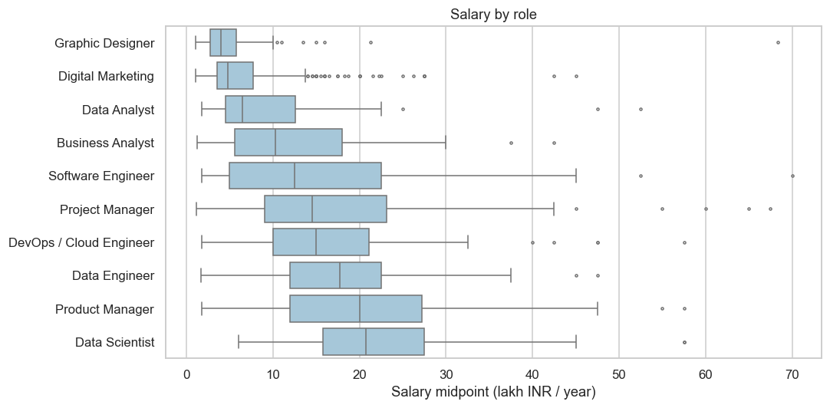
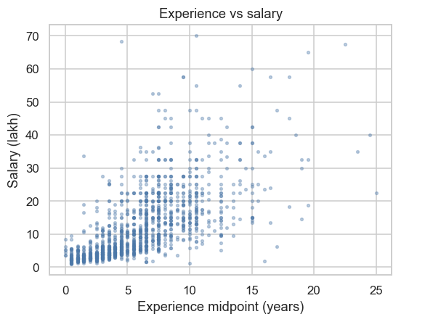
UNIT 1
Exploratory analysis and preprocessing
Key findings: Experience is the strongest signal (correlation 0.71 with log salary). Role spreads pay five-fold: Data Scientist median ₹20.8 L against Graphic Designer ₹4.0 L (overall median ₹9.0 L).
Preparation: Role from title rules; log of salary midpoint; implausible rows and reposts removed; one-hot and scaling inside CV pipelines; 60 skill flags; TF-IDF → SVD-50; split by company.
07
Notes:
Suggested time: 55 seconds. Replace bracketed prompts with your project evidence. Present actual results only. Replace the chart prompt with actual charts. Explain what changed after preprocessing and connect findings to the business objective.

Slide 8
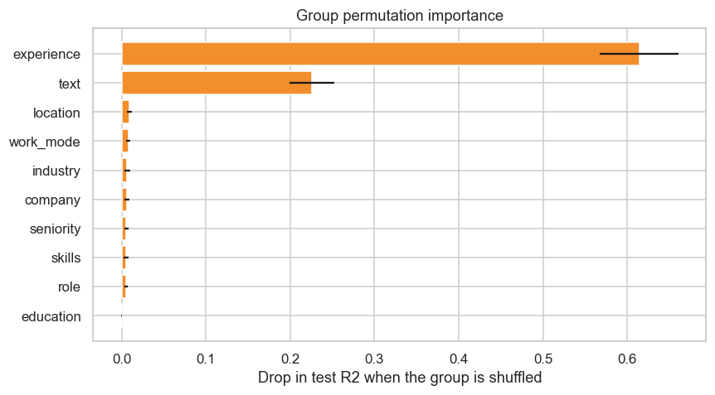
UNIT 2
Predictive modelling and final evaluation
Model | CV MAE (₹ lakh) | CV R² (log salary)
Role median (baseline) | 5.9 | 0.372
Ridge | 4.60 | 0.671
Random forest | 4.51 | 0.671
Stacking (Ridge + RF + XGBoost) | 4.24 | 0.704
Tuned XGBoost (selected) | 4.36 | 0.696
Evaluation setup: log of salary midpoint from 190 inputs; 5-fold CV grouped by company on 1,101 postings. Final test on 257 postings from 204 unseen companies: tuned XGBoost R² 0.767, MAE ₹3.8 L, 60% within 30% (role median: R² 0.335, MAE ₹5.6 L).
Selected model and interpretation: XGBoost is within noise of the stack (fold SD about 0.05) and is a single model. Experience and description text drive predictions (R² drop 0.61 and 0.23, chart). Limitation: senior, high-pay postings are under-predicted.
08
Notes:
Suggested time: 65 seconds. Replace bracketed prompts with your project evidence. Present actual results only. Evaluate predictive models on held-out records from the final validated project dataset. Fit preprocessing only on training data. Compare models on the same test records. Choose task-appropriate metrics.

Slide 9
UNIT 3
Selected advanced analytics methods
Selected method | Business question | Data used
Method 1: Text Mining | What does a description reveal about role and seniority, and which skills carry a pay premium? | 10,780 role-matched descriptions; 1,348 salaried postings; 200-skill vocabulary
Method 2: Time-Series Analysis | Which skills are gaining or losing interest, and can interest be forecast? | Google Trends India, weekly, 20 skills, 261 weeks (SQL anchor)
Selected two methods: Text Mining and Time-Series Analysis.
09
Notes:
Suggested time: 30 seconds. Replace bracketed prompts with your project evidence. Present actual results only.

Slide 10
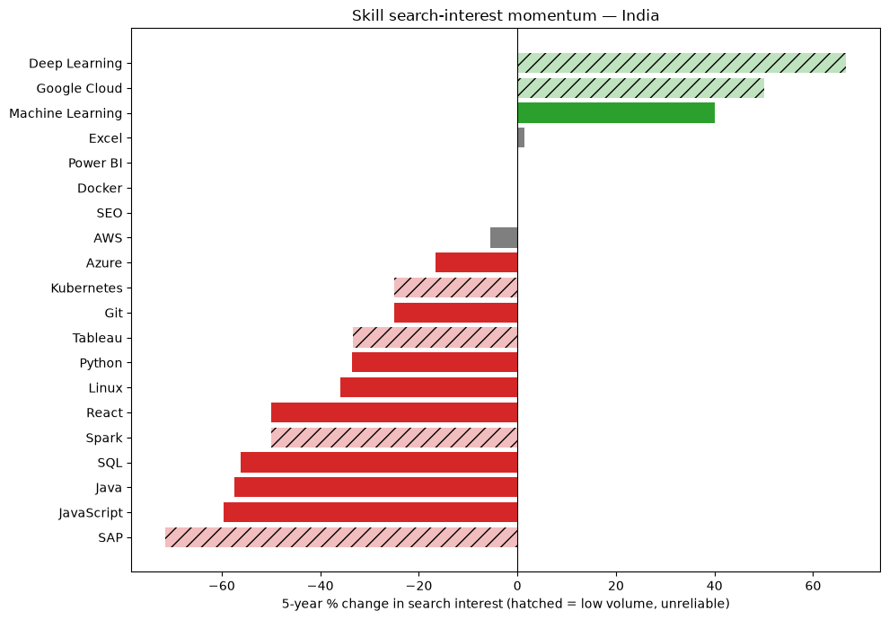
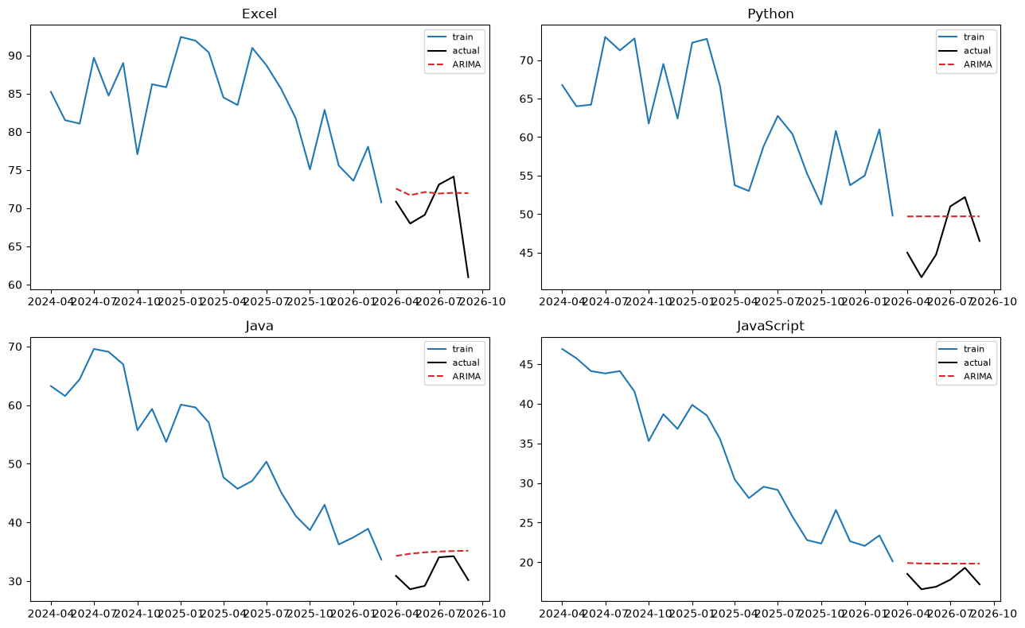
UNIT 3
Method 1 implementation
Selected method: Time-Series Analysis: trend classification, forecasting and a break test on weekly search interest for 20 skills.
Input and preparation: Google Trends India (topic IDs), 261 weeks from Oct 2021 to Oct 2026, rescaled on a shared SQL anchor (batch r ≥ 0.999); weekly to monthly; 14 skills with enough search volume.
Implementation: ±10% rule confirmed by Mann-Kendall and Sen slope; naive, SES, ARIMA(1,1,1) and Holt-Winters in a rolling-origin backtest (7 origins, 3-month horizon); difference-in-differences with randomisation inference; conformal intervals (statsmodels).
Output: Machine Learning is the only reliable riser (+40%). SQL (-56%), Java (-57%), Python (-34%) decline. 11 of 14 labels confirmed. A 3-month forecast is about ±21% wide.
12
Notes:
Suggested time: 45 seconds. Replace bracketed prompts with your project evidence. Present actual results only. For time series, explain frequency and time split. For text, explain cleaning and representation. For association rules, explain transactions and thresholds.

Slide 11
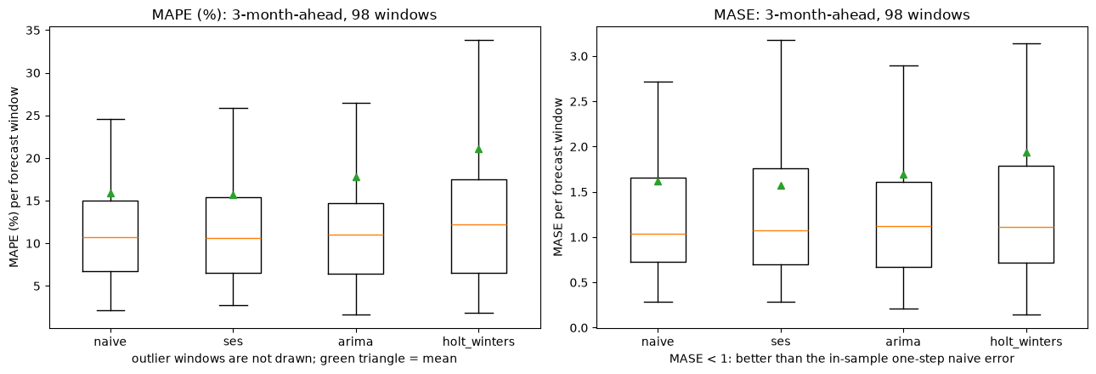
UNIT 3
Method 1 evaluation and comparison
Approach / configuration | Mean MAPE (%) | Median MAPE (%) | MASE vs naive
Simple exponential smoothing | 15.7 | 10.6 | 0.97
ARIMA(1,1,1) | 17.8 | 11.1 | 1.05
Holt-Winters | 21.1 | 12.2 | 1.19
Evaluation data: 14 skills x 7 origins x 3-month horizon = 98 forecast windows, expanding window; Wilcoxon p versus naive between 0.40 and 0.88.
Interpretation: Python and SQL rank among the most in-demand hiring skills yet show falling search interest → mature, assumed baseline skills. Limitation: search interest ≠ hiring demand; 6 low-volume skills excluded; India-only, ~60 monthly points.
13
Notes:
Suggested time: 65 seconds. Replace bracketed prompts with your project evidence. Present actual results only. Compare alternatives within the same task using consistent data and conditions. Forecasting: MAE / RMSE on future held-out periods. Text classification: precision, recall, F1 and confusion matrix on test messages. Association rules: support, confidence and lift on final transaction data. Explain any threshold comparison. Do not compare unrelated tasks directly.

Slide 12
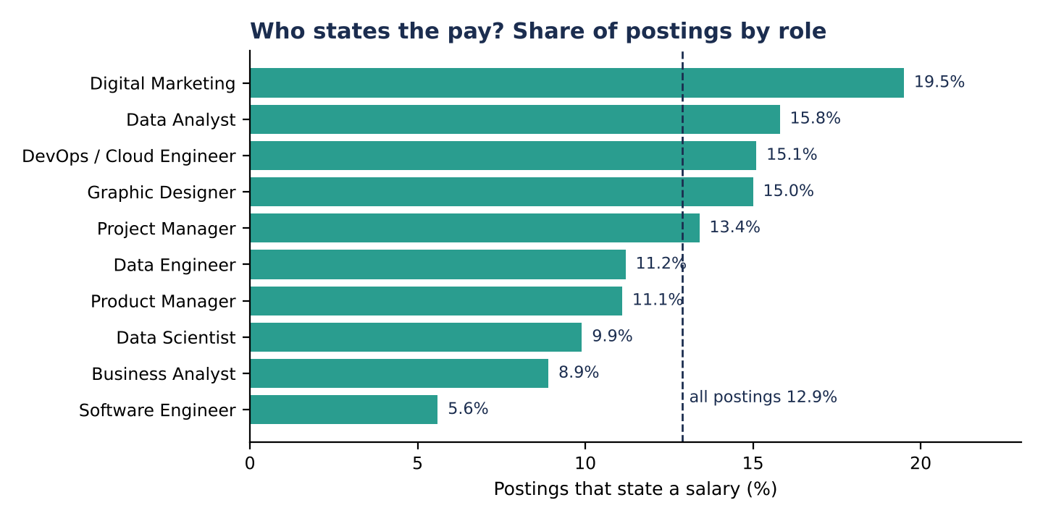
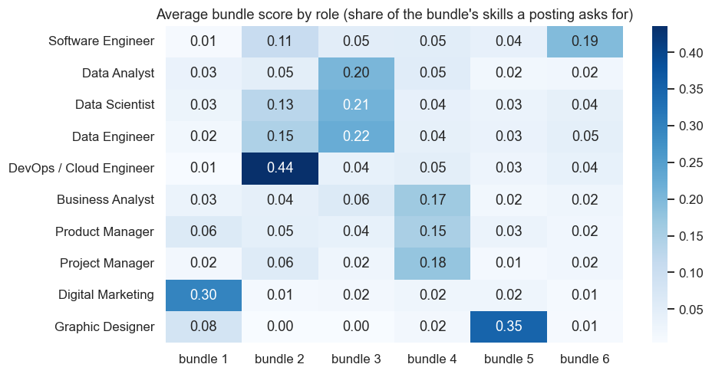
UNIT 3
Method 2 implementation
Selected method: Text Mining: classify whether a posting states its pay from the wording, find skill bundles and topics, and estimate skill pay premiums.
Input and preparation: 10,780 distinct descriptions (median 1,781 characters); 1,389 (12.9%) state a salary. Salary amounts, "CTC" and "LPA" removed so the answer is not given away; 200-skill vocabulary from employer tags and text; TF-IDF features.
Implementation: Disclosure classifier: TF-IDF + logistic regression (best of seven models), 5-fold CV grouped by company, scored by F1 and ROC-AUC because 87% of postings are silent. LDA (K = 8) and NMF topics; Louvain skill bundles; OLS, ridge and double ML premiums with FDR control (Python, scikit-learn).
Output: Disclosure from wording: ROC-AUC 0.87, F1 0.52 (0.55 on held-out companies). Six skill bundles. 15 of 170 skill premiums survive FDR control in regression (8 with double ML; bash and PMP about +26%, performance marketing +23%). Text alone explains R² about 0.54 of pay.
10
Notes:
Suggested time: 45 seconds. Replace bracketed prompts with your project evidence. Present actual results only. For time series, explain
frequency and time split. For text, explain cleaning and representation. For association rules, explain transactions and thresholds.

Slide 13
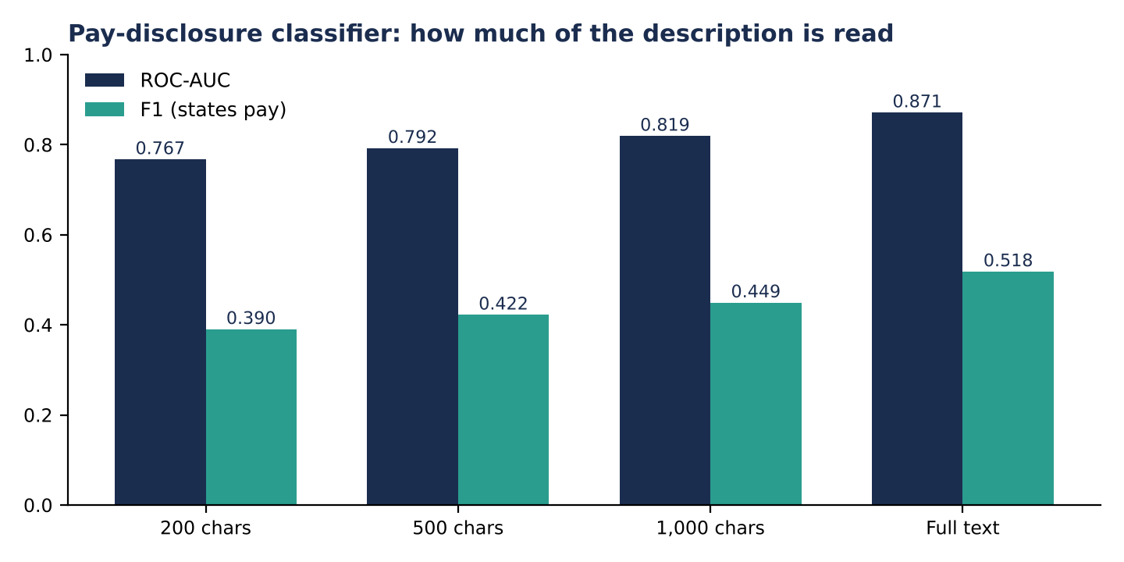
UNIT 3
Method 2 evaluation and comparison
Approach / configuration | F1 (states pay) | ROC-AUC | Reading
Role only (logistic) | 0.253 | 0.593 | role alone is weak
Posting attributes (XGBoost) | 0.435 | 0.819 | structure is weaker than words
First 500 characters of text | 0.422 | 0.792 | cues sit late in the text
Full description (TF-IDF + logistic) | 0.518 | 0.871 | selected
Words + attributes | 0.518 | 0.882 | attributes add almost nothing
Evaluation data: 10,780 postings (1,389 state pay), 5-fold CV grouped by company; held-out companies (2,064 postings): ROC-AUC 0.871, F1 0.552. Premiums use the 1,348 salaried postings.
Interpretation: Wording shows who discloses: advertising vocabulary leans to stating pay (Digital Marketing 19.5%), boilerplate such as "company website" leans to silence. Disclosure is an employer habit: 76.5% of postings come from firms that never state pay. Within a role, silent employers point to pay 3.6% lower (interval -7.2% to +2.4%), so the salary results are not clearly biased. Skill premiums are small and noisy (rank correlation 0.28): use them for direction.
11
Notes:
Suggested time: 65 seconds. Replace bracketed prompts with your project evidence. Present actual results only. Compare alternatives within the same task using consistent data and conditions. Forecasting: MAE / RMSE on future held-out periods. Text classification: precision, recall, F1 and confusion matrix on test messages. Association rules: support, confidence and lift on final transaction data. Explain any threshold comparison. Do not compare unrelated tasks directly.

Slide 14
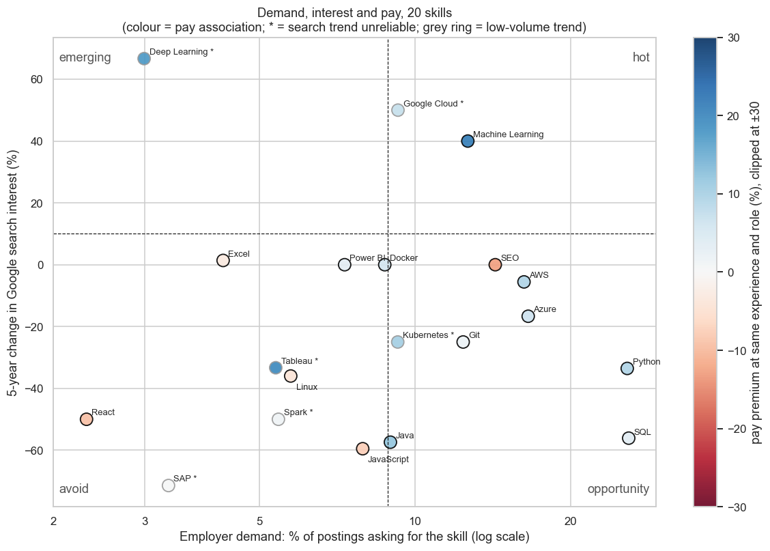
BUSINESS OUTCOMES
Combined insights and recommendations
Evidence from the project | Recommended action | Expected benefit / limitation
Experience and description text drive pay; text alone explains R² about 0.54 | Benchmark offers with the 80% range (for example ₹6-20 L) and state experience clearly in postings | Range is half as wide as a role-median band at 83% coverage; senior high pay is under-predicted
Machine Learning is hot: 12.6% of postings, +40% interest, about +21% pay | Prioritise Machine Learning in learning plans and hiring pipelines | Only skill positive on all three signals; pay link is association, not cause
SQL and Python lead demand (about 26% each) but interest fell 56% and 34%; pay +3% and +9% | Treat them as baseline skills; differentiate with ML, cloud or product skills | Search interest is not hiring; demand is within 10 roles only
Business objective addressed: a realistic salary range and a ranked skill priority list from 10,780 Naukri postings. Only 12% of postings state pay, so results describe pay-disclosing postings.
14
Notes:
Suggested time: 55 seconds. Replace bracketed prompts with your project evidence. Present actual results only.

Slide 15
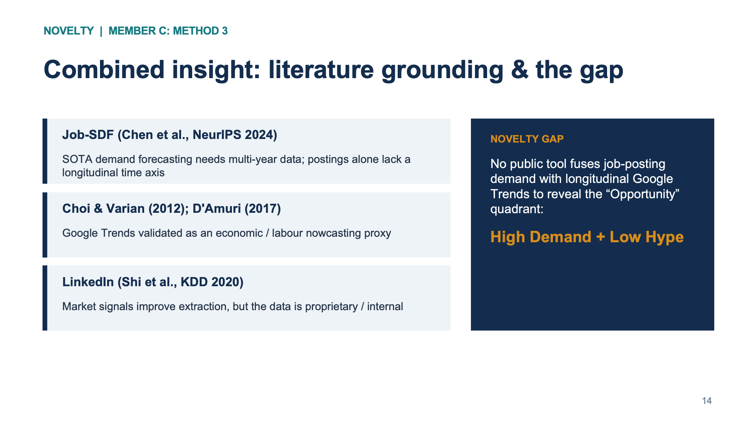

Slide 16
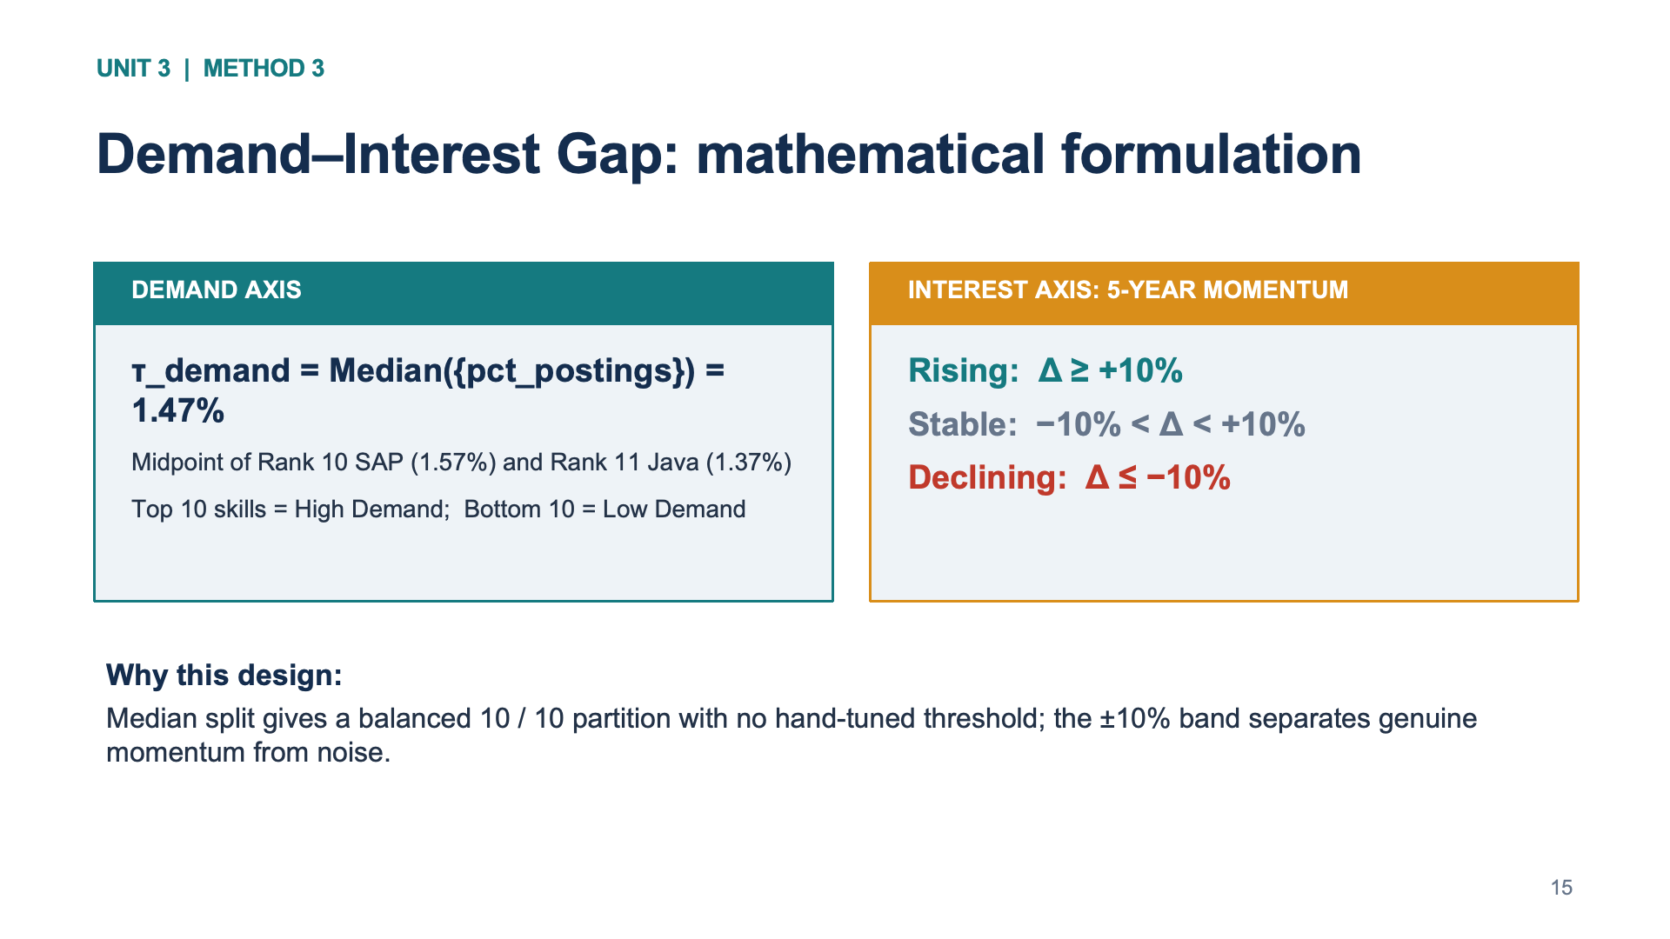

Slide 17
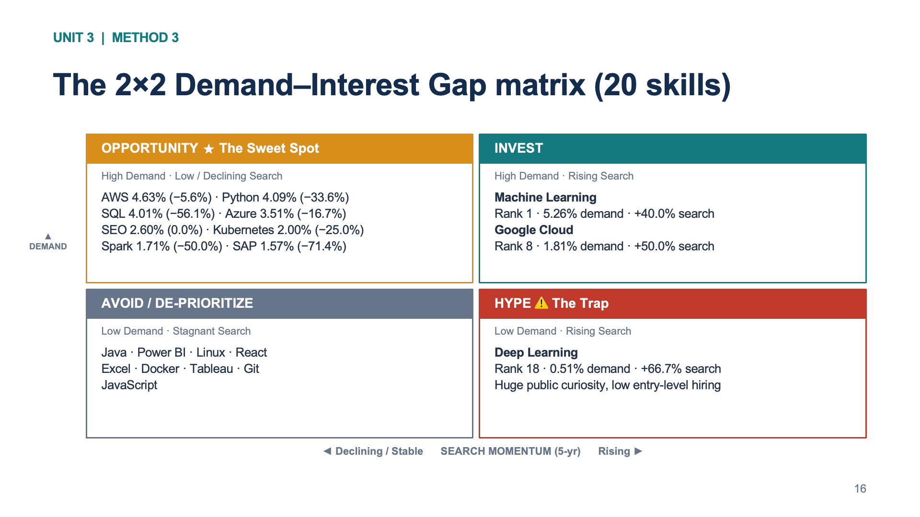

Slide 18
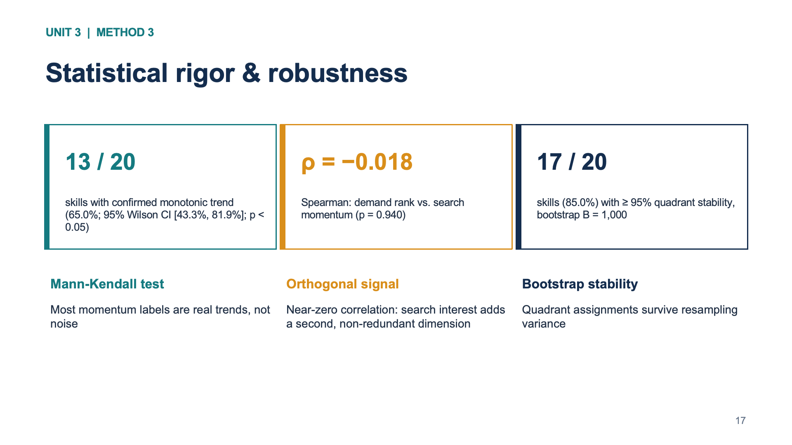

Slide 19
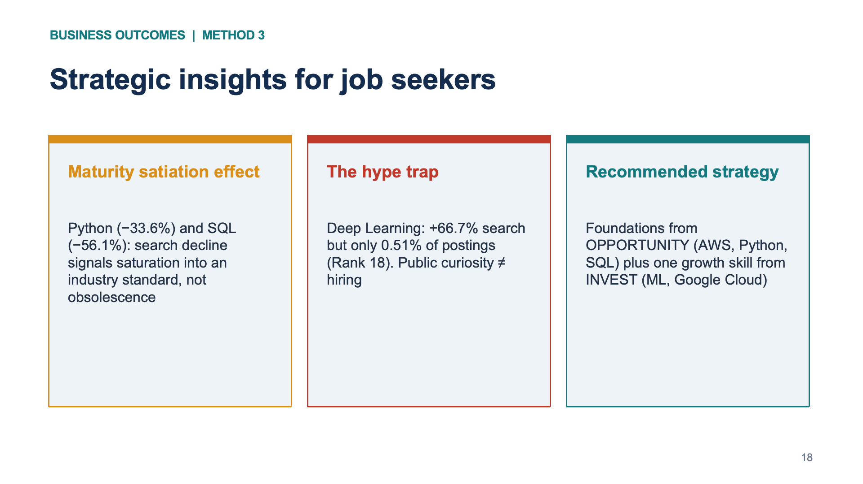


Slide 20
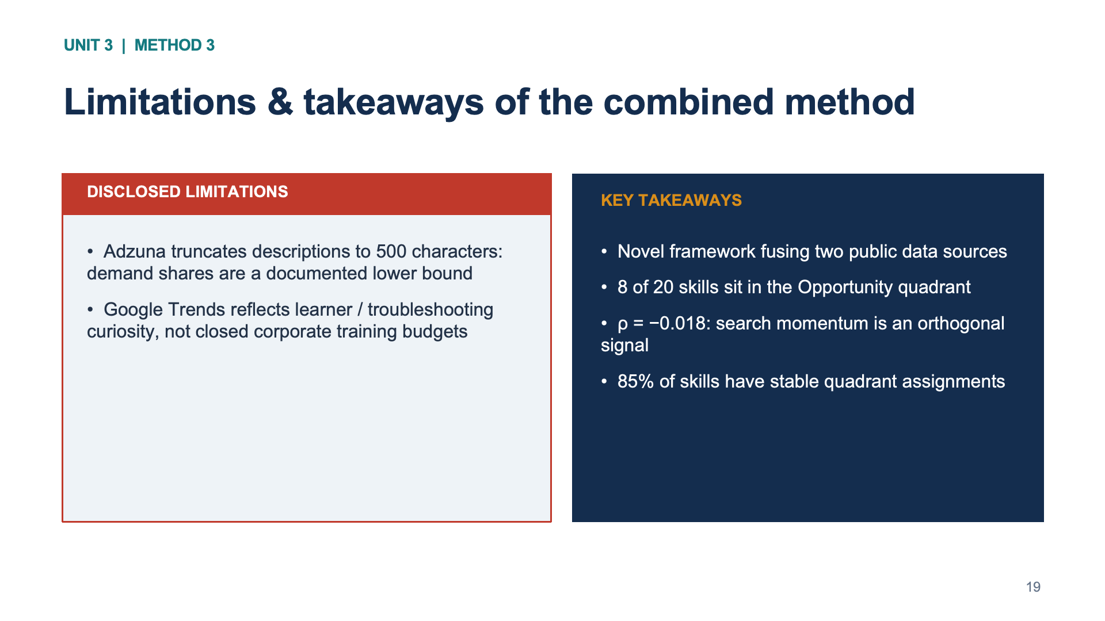

Slide 21
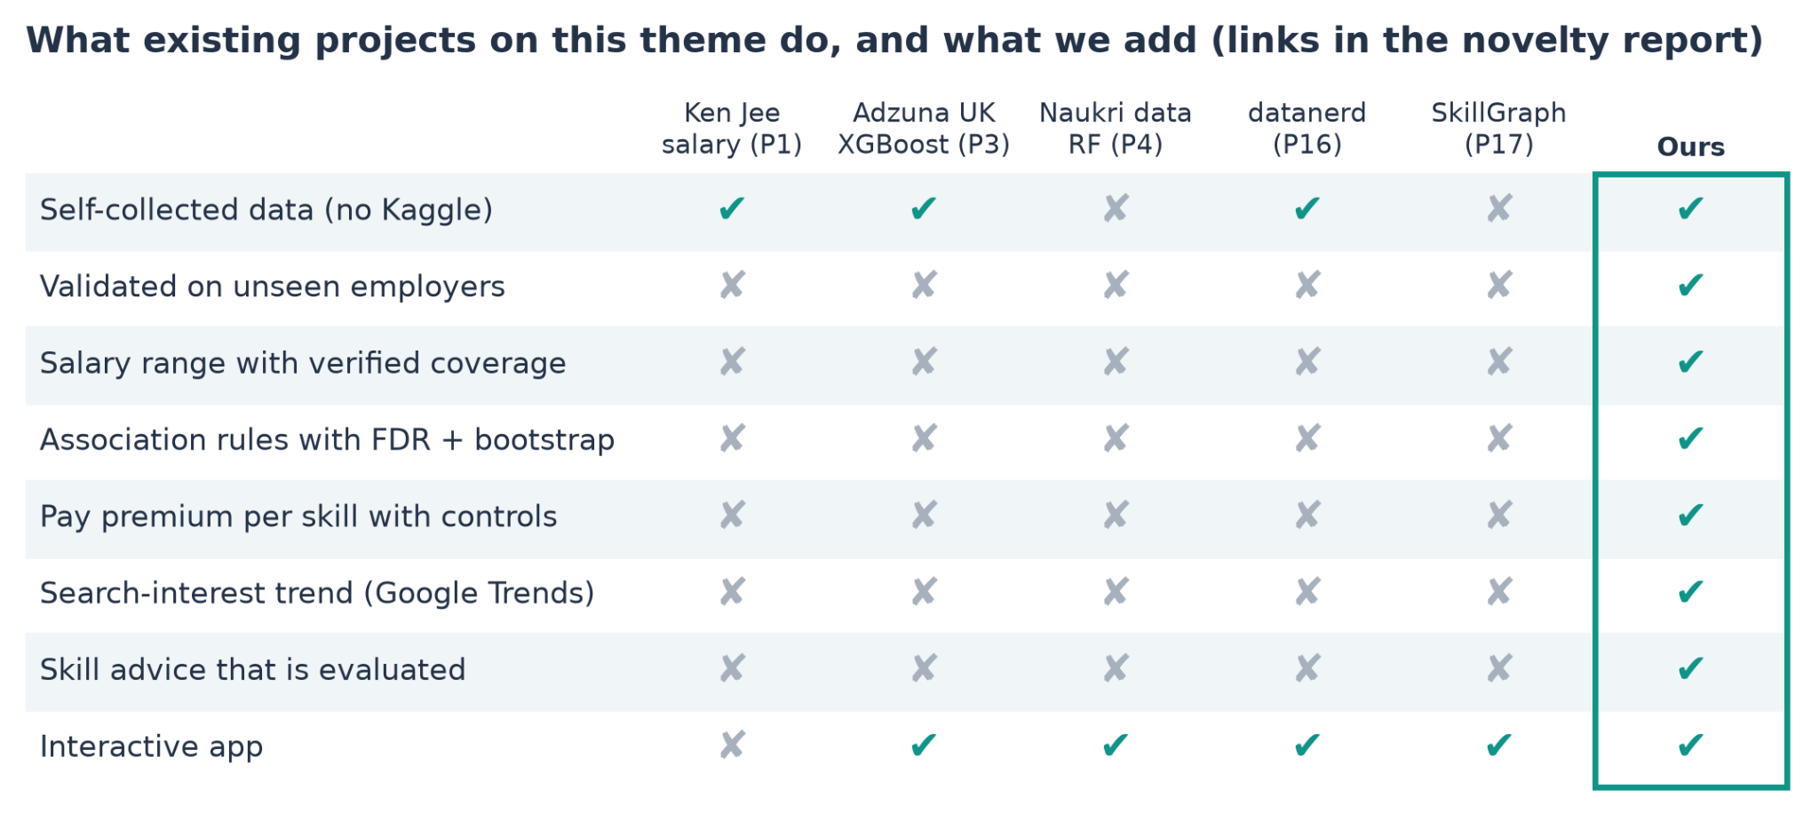
NOVELTY

Slide 22
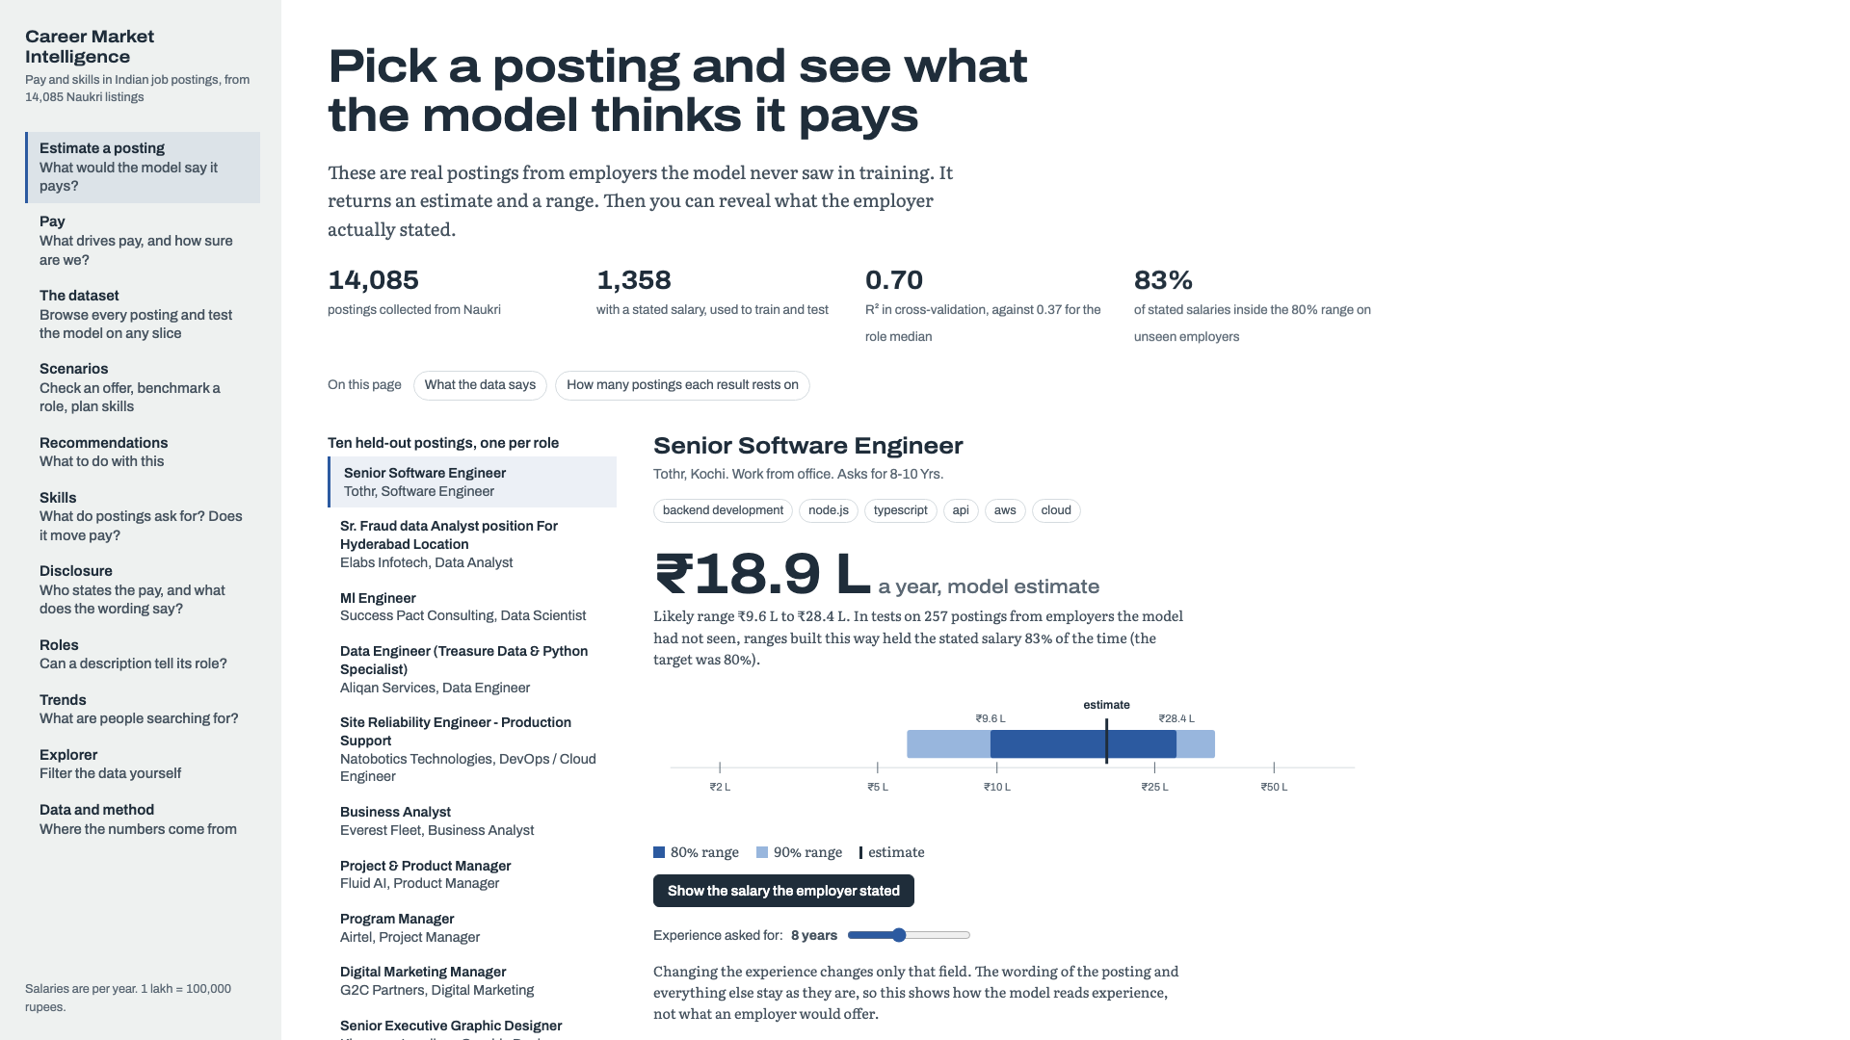
MANDATORY LIVE DEMONSTRATION
MANDATORY LIVE DEMONSTRATION
Interactive dashboard or website
Interactive dashboard or website
Application: Career Market Intelligence dashboard (Next.js), Estimate page. opens at https://career-market-intelligence.vercel.app/
Live demo: pick a held-out posting, read the estimate and 80% range, click "Show the salary the employer stated", then drag the experience slider.
Business scenario: a job seeker checks a ₹8-10 L Senior Software Engineer offer (8-10 years, Kochi). The model estimates ₹18.9 L (80% range ₹9.6-28.4 L), so the offer midpoint (₹9 L) sits just below the range.
15
15
Notes:
Suggested time: 120 seconds. Replace bracketed prompts with your project evidence. Present actual results only. Switch to the working application. Demonstrate meaningful interaction using the final project data and results. Show relevant findings from the complete project. A screenshot supports the presentation but does not replace the live demonstration. Test the application before the panel.

Slide 23
100% PROJECT IMPLEMENTATION
Completion and individual contribution
Team member | Completed responsibility | Evidence / project-board task
RISHINATH CB.SC.U4CSE23741 | Dashboard | https://career-market-intelligence.vercel.app/
Kireeti CB.SC.U4CSE23057 | Text mining | https://github.com/anusanth26/Career-Market-Intelligence/blob/main/notebooks/method1_text_mining.ipynb
R ANUSANTH CB.SC.U4CSE23235 | Time-series Analysis | https://github.com/anusanth26/Career-Market-Intelligence/blob/main/notebooks/method2_time_series.ipynb , reports and outputs
MITHRESH M CB.SC.U4CSE232039 | Combined Results Analysis | https://github.com/anusanth26/Career-Market-Intelligence/blob/main/notebooks/combined_insight.ipynb
Ravula Akshith CB.SC.U4CSE23648 | Review-1 fixes (data inspection, validation, ablation); Skill Value Engine (association rules, salary ranges, pay premium, Skill Value Index, advisor); novelty research (20 projects, 18 papers); integration and final report | notebooks/career_market_intelligence.ipynb, notebooks/skill_value_engine.ipynb, 2_Skill_Gap_Advisor.py, reports
Project board:https://github.com/users/anusanth26/projects/1 Repository / deliverables: https://github.com/anusanth26/Career-Market-Intelligence
16
Notes:
Suggested time: 45 seconds. Replace bracketed prompts with your project evidence. Present actual results only. Delete the fifth member row for a four-member team. Confirm all Units 1–3 components, final evaluation and interactive application are complete. Use activity history and task evidence to support individual contribution.

Slide 24
FINAL PROJECT OUTCOME
Conclusion and limitations
Main outcome: An end-to-end system: a salary estimate with a calibrated 80% range (grouped-CV R² 0.70, 83% test coverage) plus skill demand, trend and pay guidance for 10 roles.
Business value: Seniority, read from experience and description, drives pay. Machine Learning is the one skill hot on demand, interest and pay; SQL and Python are baseline expectations.
Limitations: Only 12% of postings state pay and 1,358 rows are labelled; coverage is lowest for Software Engineer (59%) and Data Scientist (64%); one snapshot; search interest is not demand.
Future scope: Calibrate ranges within role and experience band, label more postings for small roles, and track postings over time to link demand with interest.
17
Notes:
Suggested time: 40 seconds. Replace bracketed prompts with your project evidence. Present actual results only. Core implementation must be complete. Future scope should describe extensions, not unfinished mandatory components. Keep detailed references, additional charts and code explanations in optional backup slides. Reserve panel questions for after the presentation.

