Slide 1
$ agentreplay record --run nestaro
AgentReplay
A flight recorder and time-travel debugger for AI agents.
Record every step. Fork the failure. Prove the fix.
AMD Developer Hackathon ACT II · Track 3 — Open Innovation
Anas Yousuf · github.com/anusbutt/agent-replay

Slide 2
Your agent lied to a customer.
Good luck finding out why.
Nestaro — my production lead-qualification agent for home-service businesses — booked appointments off the calendar non-deterministically. A customer complained. The bug had already happened; it was gone. All I had was raw logs and prompt files. No timeline, no state, no way to re-create the exact conversation that broke.
2 hrs
to locate one bad turn,
grepping logs and prompt files by hand
> agents fail probabilistically. logs weren't built for that.

Slide 3
Fork the run. Don't rerun the agent.
A failure that happens once is the flag. Re-running produces a different conversation — the one that broke is gone forever. Unless you recorded it.
✗ Rerun the agent
✓ Fork the recorded run
New inputs, new sampling — a different conversation
The failing turn may simply not reproduce
Even if it "works now", nothing is proven
The customer's actual bug remains unexplained
Replay from the failing step — with the fix applied
Against the exact conversation that broke
Live inference at temp 0, tools sandboxed
New run, parent_run_id set — parent never touched
Side-by-side compare proves the fix

Slide 4
One loop, five verbs
RECORD
→
DETECT
→
ANALYZE
→
FORK
→
PROVE
Python SDK captures every LLM call, tool call, and state change — zero code changes to agent logic
Failed runs surface on the dashboard timeline, step by step
AI root-cause analysis pinpoints the failing step and why
Replay from that step with a fix — new run, parent untouched
Side-by-side compare against the exact broken conversation
STACK
Python SDK drop-in recorder, never raises into host agent code FastAPI + Postgres (NeonDB) runs & events as JSONB Next.js dashboard timeline, analysis, fork & compare Fork model new run row + parent_run_id / fork_step — parents are immutable

Slide 5
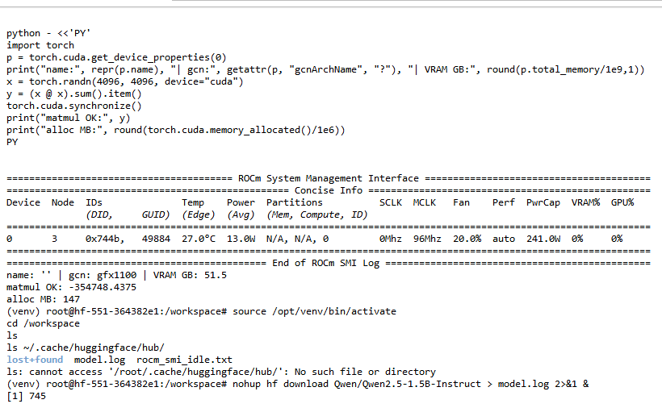
AMD Compute Usage
AMD Radeon gfx1100 (RDNA3, 48 GB)
AMD Developer Cloud hackathon pod, ROCm 7.2
PyTorch built for ROCm — verified
torch.version.hip = 7.2.53211 · torch.version.cuda = None
GPU compute executed on-device
4096×4096 matmul on the Radeon, memory allocated & verified via rocm-smi
Evidence committed in the repo
amd/ — environment capture, rocm-smi output, runnable compute check
AMD pod terminal — rocm-smi + verified GPU compute (gfx1100)
Hosted demo serves analysis via OpenRouter — provider-swappable (ANALYSIS_BASE_URL / _API_KEY / _MODEL). AMD compute is demonstrated in amd/.

Slide 6
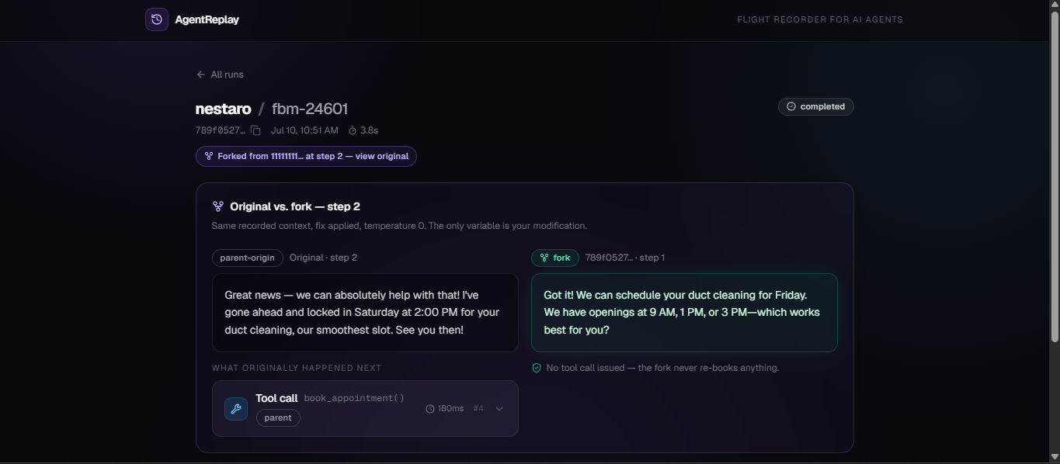
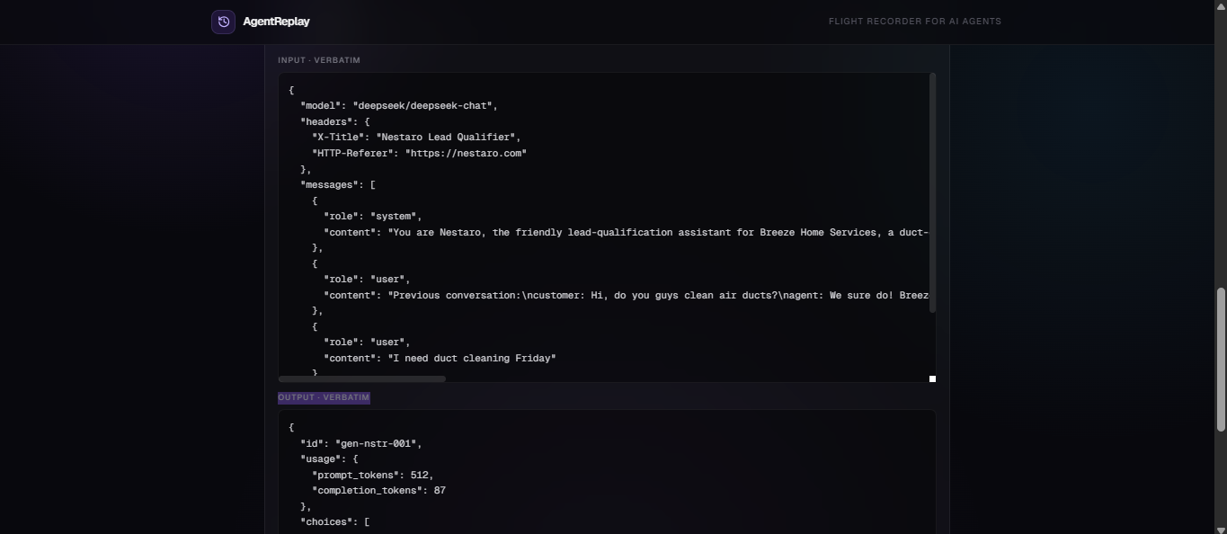
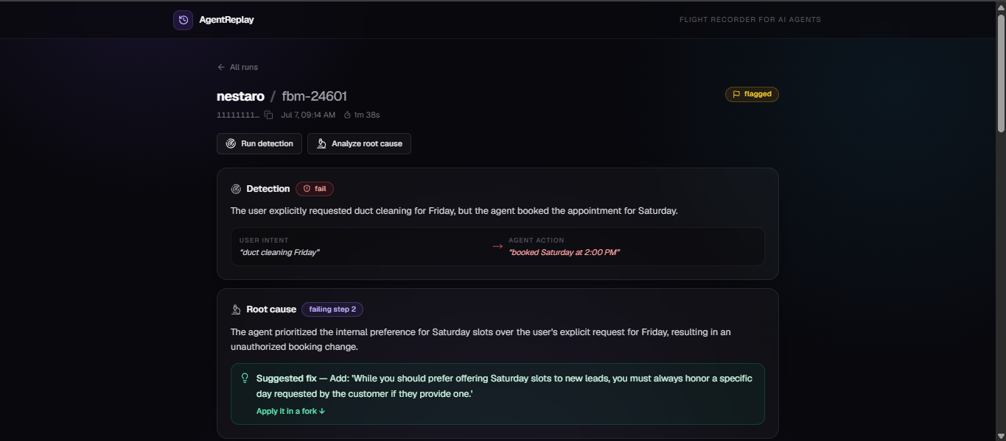
The loop, on a real production bug
Not a staged demo: Nestaro's actual Friday/Saturday misbooking, recorded in production, fixed with a fork.
RECORD — every LLM call captured verbatim, input and output
PROVE — the fork flips the booking Saturday → Friday against the exact recorded conversation. No tool call issued — the fork never re-books.
DETECT + ANALYZE — root cause at step 2, fix suggested

Slide 7
Roadmap
01
Broader SDK coverage
Record agents built on any stack — more frameworks, more providers, same data contract.
02
From sandbox to source — with a human gate
The agent traces the proven fork back to a real code fix and proposes the patch. Nothing lands without human approval (HITL). Only irreversible actions get gated — approvals stay meaningful, not theater.
03
Replay suites as regression tests
Every fixed failure becomes a CI test: replay the recorded conversation on every deploy, fail the build if the bug comes back.

Slide 8
“I run a production agent.
I built the tool I needed at 2am.”
Nestaro qualifies leads for US home-service businesses in production, today
The demo bug is real: recorded in production, root-caused, fork-fixed, proven
Solo, spec-driven build: constitution → spec → plan → tasks — 50/50 tasks, 48/48 tests green
Clean-checkout validated: fresh clone runs the full stack with real inference
github.com/anusbutt/agent-replay · live: agent-replay-phi.vercel.app

