Slide 1
HTML

Slide 2
Objectives
Self Paced Learning
  Getting Started With HTML
    Introducing HTML
    How Web pages work
    Introduction to Tags
    Structure of HTML page
  Creating a Web Page
    Introduction table, tr, td tags.
    Paragraphs and Line breaks
    Headings
    Creating Ordered and Unordered List
  Text Formatting And Alignment
    Boldfaces and Italics
    Font Size, Color and Typeface
    Special Characters
    Using Links and Images

Slide 3
Objectives
Self Paced Learning
  Style Sheet
    Purpose of Style Sheet
    Style Rules
    Attaching Style Sheet
    Defining classes
    Div tag, Span Tag
    Using Span

Slide 4
What is World Wide Web?
The World Wide Web (Web) is a network of information resources. The Web relies on three mechanisms to make these resources readily available to the widest possible audience:
  A uniform naming scheme for locating resources on the Web (e.g., URIs).
  Protocols, for access to named resources over the Web (e.g., HTTP).
  Hypertext, for easy navigation among resources (e.g., HTML).

Slide 5

Introducing HTML
To publish information for global distribution, one needs a universally understood language, a kind of publishing mother tongue that all computers may potentially understand. The publishing language used by the World Wide Web is HTML (from HyperText Markup Language).
What is HTML
Notes:
History of HTML
Tim Berners-Lee created the original HTML (and associated protocols such as HTTP on a NeXTcube workstation using the NeXTSTEP development environment. At the time, HTML was not a specification, but a collection of loosely defined elements to solve an immediate problem: the communication and dissemination of ongoing research between Berners-Lee and his colleagues. His solution later combined with the emerging international and public internet to garner worldwide attention.
HTML stands for Hypertext Markup Language.
Hypertext
Hypertext most often refers to text on a computer that will lead the user to other, related information on demand. It is an ordinary text that has been dressed up with extra features, such as formatting, images, multimedia, and links to other documents.
Markup is the process of taking ordinary text and adding extra symbols. Each of the symbols used for markup in HTML is a command that tells a browser how to display the text.

Slide 6
Introducing HTML
HTML contains special markers, or tags, which define the style and structure of the page.
What is HTML
Tags are also referred to as elements.

Slide 7
Introducing HTML
Uses of HTML
Publish online documents with headings, texts, tables, lists, photos, etc.
Retrieve online information via hypertexts links.
Design forms for conducting transactions with remote services, for use in searching for information, making reservations, ordering products, etc.
Include spread-sheets, video clips, sound clips, and other applications directly in their documents.

Slide 8
How To Access An Web Page
Click To Proceed With The Steps

Slide 9
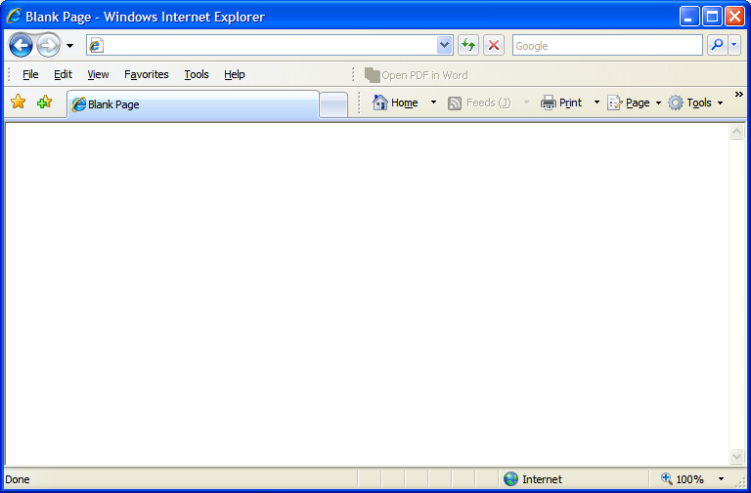
Internet
Web Server
Request
Request
http://www.google.co.in
HTML files
User makes a request
www.google.co.in

Slide 10
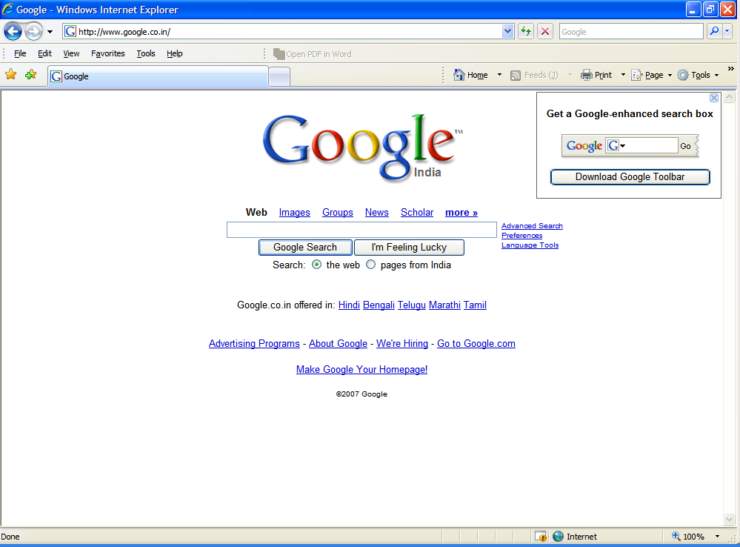
Internet
Web Server
Web Page
Web Page
HTML files
Google page is returned from the Web Server

Slide 12
Introducing HTML
A tag is a reference in an HTML document which describes the style and structure of the document.
What is a Tag
All tag start with < (less than symbol) and end with > (greater than symbol)
Tags which mark a beginning have no / (front slash).
Tags which mark an ending have a / immediately after <, as in </.

Slide 13
Introducing HTML
Example on Tag
Sample Tags
<HTML>, <BODY>, <TITLE>
</HTML>, </BODY>, </TITLE>
Starting tags / elements
Ending tags / elements

Slide 14
Introducing HTML
Explanation of the HTML code
<HTML>
<HEAD>
<TITLE> My Home Page </TITLE>
</HEAD>
<!-- Written by Manas K Sahoo -->
<!-- Created: 30-May-2007 -->
<!-- Organization: -->
<BODY>This is where the text goes.
</BODY>
</HTML>

Slide 15
Introducing HTML
Explanation of the HTML code
<HTML>
<HEAD>
<TITLE> My Home Page </TITLE>
</HEAD>
<!-- Written by Manas K Sahoo -->
<!-- Created: 30-May-2007 -->
<!-- Organization: -->
<BODY>This is where the text goes.
</BODY>
</HTML>
Start of an HTML document.

Slide 16
Introducing HTML
Explanation of the HTML code
<HTML>
<HEAD>
<TITLE> My Home Page </TITLE>
</HEAD>
<!-- Written by Manas K Sahoo -->
<!-- Created: 30-May-2007 -->
<!-- Organization: -->
<BODY>This is where the text goes.
</BODY>
</HTML>
Indicates to the browser that this is an HTML document.

Slide 17
Introducing HTML
Explanation of the HTML code
<HTML>
<HEAD>
<TITLE> My Home Page </TITLE>
</HEAD>
<!-- Written by Manas K Sahoo -->
<!-- Created: 30-May-2007 -->
<!-- Organization: -->
<BODY>This is where the text goes.
</BODY>
</HTML>
HTML document is divided into two sections. 1. <HEAD> …. </HEAD>
Notes:
HTML documents are separated into two sections, the head and the body. The beginning of the head section is marked by the <HEAD> tag, and the end of the head section with the </HEAD> tag.

Slide 18
Introducing HTML
Explanation of the HTML code
<HTML>
<HEAD>
<TITLE> My Home Page </TITLE>
</HEAD>
<!-- Written by Manas K Sahoo -->
<!-- Created: 30-May-2007 -->
<!-- Organization: -->
<BODY>This is where the text goes.
</BODY>
</HTML>
HTML document is divided into two sections. 2. <BODY> …. </BODY>
Notes:
The beginning of the body section is marked by the <BODY> tag, and the end of the body section with the </BODY> tag. The body tag has some attribute like,
1. Text – To change the text color for the whole document.
2. Background : To apply a background image for the document.
3. Link – To specify the link color.
4. Alink – To specify the color for the active link.
5. Vlink – To specify the color for the Visited link.

Slide 19
Introducing HTML
Explanation of the HTML code
<HTML>
<HEAD>
<TITLE> My Home Page </TITLE>
</HEAD>
<!-- Written by Manas K Sahoo -->
<!-- Created: 30-May-2007 -->
<!-- Organization: -->
<BODY>This is where the text goes.
</BODY>
</HTML>
Shows the contents in the browser title bar. Generally placed inside Head tag.
Notes:
The title of the page must be placed within the head section. The beginning of the title is marked by the <TITLE> tag, and the end with the </TITLE> tag. Titles should be short, but descriptive, and limited to one line, so they can fit within the frame of the page.

Slide 20
Introducing HTML
Explanation of the HTML code
<HTML>
<HEAD>
<TITLE> My Home Page </TITLE>
</HEAD>
<!-- Written by Manas K Sahoo -->
<!-- Created: 30-May-2007 -->
<!-- Organization: -->
<BODY>This is where the text goes.
</BODY>
</HTML>
Indicates comment tag. Can be placed anywhere in the document.
Notes:
The comment tag is different from the other tags for the following reasons. It can be placed anywhere in the HTML file; inside the head section, inside the body section, or in between the head and the body. It does not end with a /. It starts with an <!-- and ends with an -->.
It is always a good idea to put comments into your source code. In this simple example the comments state who is the author, the creation date of the document and name of the organization.

Slide 21
Introducing HTML
Explanation of the HTML code
<HTML>
<HEAD>
<TITLE> My Home Page </TITLE>
</HEAD>
<!-- Written by Manas K Sahoo -->
<!-- Created: 30-May-2007 -->
<!-- Organization: -->
<BODY>This is where the text goes.
</BODY>
</HTML>
Signal the end of HTML document.

Slide 22
Introducing HTML
Kinds of Tags
1.
Range / Container tags
They are called so because they cover a range of text.
Example : <HTML>, <HEAD>, <BODY>, <TITLE>
2.
Standalone / Point tags
Those tags which do not need an ending.
Example: <HR>, <BR>
Notes:
<HR> tag is used for drawing a horizontal line. And <BR> tag is used to give a line break. Discussed later in more detail later.

Slide 23
Paragraphs
&
Line Breaks

Slide 24
Line Separators
Tags used for separating one line with other can be classifies as follows:-
  1.
  <P> tag
  2.
  <BR> tag
  3.
  <HR> tag

Slide 25
The <P> Tag
Normally all text in an HTML document is treated like one long paragraph. Indented or blank lines which normally indicate start of paragraphs in text are ignored.
To separate your text into paragraphs use the
The <P> tag forces an end of line and forces a blank line before the next paragraph.
<P>
tag.

Slide 26
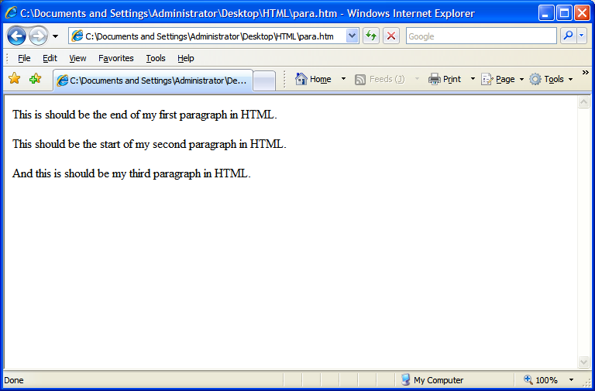
Requirement Analysis

Slide 27
Code Snippet To Fulfill the Requirement
<p>This is should be the end of my first
paragraph in HTML.</p>
<p>This should be the start of my second paragraph in
HTML.</p>
<p>And this is should be my third paragraph in
HTML.</p>

Slide 28
<p> tag forces an end of line and forces a blank line before the next paragraph.
<p>This is should be the end of my first
paragraph in HTML.</p>
<p>This should be the start of my second paragraph in
HTML.</p>
<p>And this is should be my third paragraph in
HTML.</p>

Slide 29
<p> tag forces an end of line and forces a blank line before the next paragraph.
<p>This is should be the end of my first
paragraph in HTML.</p>
<p>This should be the start of my second paragraph in
HTML.</p>
<p>And this is should be my third paragraph in
HTML.</p>
Ends the paragraph tag.

Slide 30
The <BR> Tag
Used to control the line breaks.
Use single spacing among the lines unlike <p> tag that uses double spacing among the paragraph.
Does not have a closing braces.

Slide 31
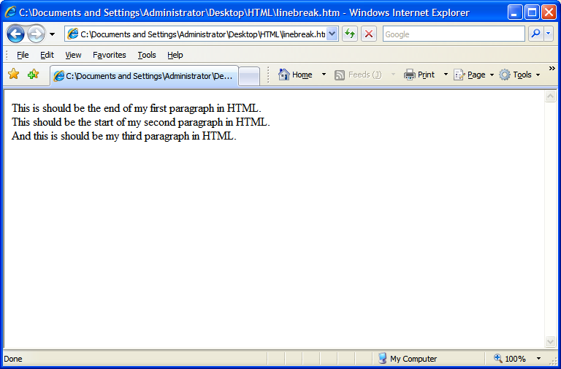
Requirement Analysis

Slide 32
Code Snippet To Fulfill the Requirement
This is should be the end of my first
paragraph in HTML.<br>
This should be the start of my second paragraph in
HTML.<br>
<p>And this is should be my third paragraph in
HTML.<br>

Slide 33
Forces line break with one line spacing between two lines.
This is should be the end of my first
paragraph in HTML.<br>
This should be the start of my second paragraph in
HTML.<br>
<p>And this is should be my third paragraph in
HTML.<br>

Slide 34
The <HR> tag
The <HR> tag draws a horizontal line across the page.
It acts a paragraph break.
There is no need to use the <BR> before or after the <HR> tag.

Slide 35
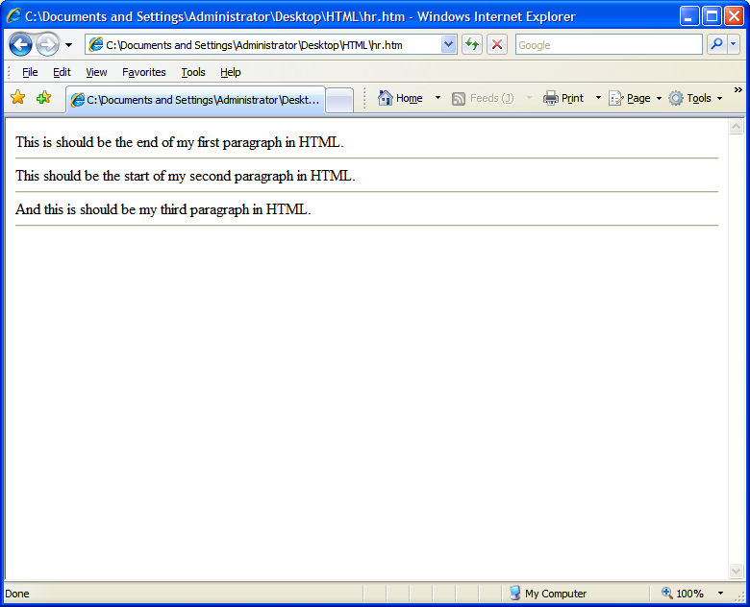
Requirement Analysis

Slide 36
Code Snippet To Fulfill the Requirement
This is should be the end of my first
paragraph in HTML.<hr>
This should be the start of my second paragraph in
HTML.<hr>
And this is should be my third paragraph in
HTML.<hr>

Slide 37
Draws a horizontal line across the page.
This is should be the end of my first
paragraph in HTML.<hr>
This should be the start of my second paragraph in
HTML.<hr>
And this is should be my third paragraph in
HTML.<hr>

Slide 38
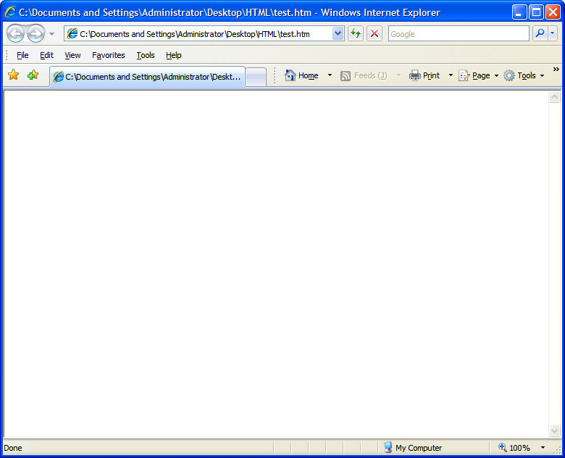
<HR> tag Attributes
  1.
  Color Attribute
How To Use
<hr color=“red”>
<hr color=“blue”>
<hr color=“pink”>

Slide 39
<HR> tag Attributes
  2.
  Width Attribute
How To Use
<hr width=“50%”>
<hr color=“blue” width=“100%”>
<hr width=“500”>
Default alignment of HR is center.
Notes:
Width value without percentage symbol is treated as a pixel value. So, 500 will be treated as 500 pixel.
By default, the horizontal rule starts from center.

Slide 40
<HR> tag Attributes
  3.
  Align Attribute
How To Use
<hr align=“left” width=“50%”>
<hr align=“right” width=“50%”>
<hr align=“center” width=“50%”>

Slide 41
<HR> tag Attributes
  4.
  Size Attribute
How To Use
<hr size=“5”>
<hr size=“3” color=“red”>
<hr align=“center” width=“50%” size=“2”>

Slide 42
The Headings Tags
<Hn>
To add headings in the HTML document use tag where, n represent number from 1 to 6.
Some text here
<H1>
</H1>
<H2>
Some text here
</H2>
<H3>
Some text here
</H3>
<H4>
Some text here
</H4>
<H5>
Some text here
</H5>
<H6>
Some text here
</H6>
Notes:
All the different levels of Headings tag has align as an attribute with “LEFT”, “RIGHT”, “CENTER” as values.

Slide 43
Listing In HTML
A common applications of HTML is to display the list of items.
The most popular types of lists that can be created using HTML are:
  Unordered List
  Ordered List
Notes:
List can also created using Definition List tags.
The definition list tag, or <DL>, can be used to define a definition. It is commonly used to describe items found in a glossary. The definition list is made up of a term, <DT>, and followed by one or more definition descriptions <DD> items.

Slide 44
Unordered List
When the list of contents that you want to display don’t have to follow any sequence then you can use Unordered list.
Each item in the unordered list is indented.
For Example, while creating list of Electronic products, where sequence of occurrence does not matter.
<UL>
tag is used to create a Unordered list.

Slide 45
Unordered List
When the list of contents that you want to display don’t have to follow any sequence then you can use Unordered list.
Each item in the unordered list is indented.
For Example, while creating list of Electronic products, where sequence of occurrence does not matter.
<LI>
tag identifies a item in the list.

Slide 46
Unordered List
Check Out An Example
<HTML>
<BODY>
<H3>List of Electronic Products</H3>
<UL>
<LI>T.V.</LI>
<LI>VCD</LI>
<LI>DVD</LI>
<LI>REFRIGERATOR</LI>
<LI>WASHING MACHINE</LI>
<LI>MICRO OVEN</LI>
</UL>
</BODY>
</HTML>

Slide 47
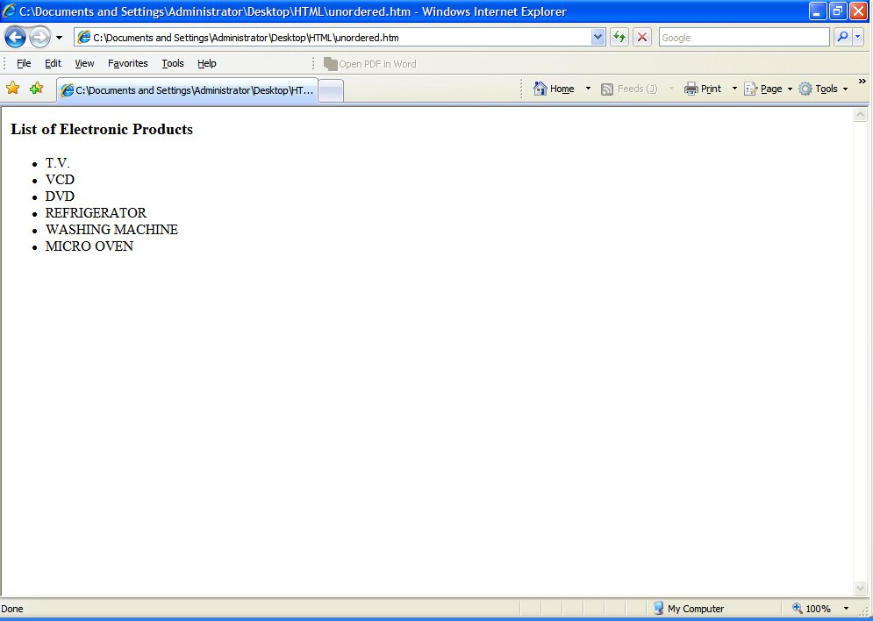
Check Out The
Output

Slide 48
Ordered List
When the list of contents that you want to display have to follow a sequence.
Each item in the ordered list is indented.
For Example, creating a list of students based on their merit.
<OL>
tag is used to create a Ordered list.

Slide 49
Ordered List
Check Out An Example
<HTML>
<BODY>
<H3>List of Fortune 500 Companies – Industry: Computers, Office Equipment Year 2006 Survey </H3>
<OL>
<LI> </LI>
<LI>HP</LI>
<LI>Dell</LI>
<LI>NEC</LI>
<LI>Fujitsu</LI>
<LI>Canon</LI>
</OL>
</BODY>
</HTML>

Slide 50
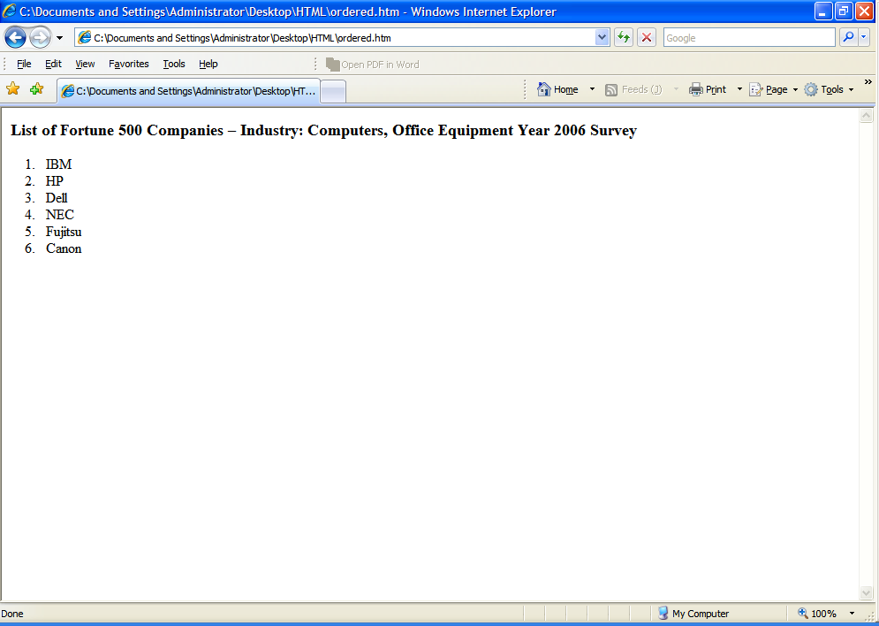
Check Out The
Output

Slide 51
Text Formatting and Alignment

Slide 52
Text Formatting
Character Styles
1.
<PRE> tag
2.
<BLOCKQUOTE> tag
3.
<ADDRESS> tag
4.
Logical Character Highlighting tags
5.
Physical Character Highlighting tags
Notes:
Character style tags are used to give text a different look when displayed by a browser.

Slide 53
Text Formatting (Contd.)
Character Styles
1.
<PRE> tag
It is used to include preformatted text into your HTML document.
Text will appeared exactly as typed including, tabs and returns.

Slide 54
Text Formatting (Contd.)
Character Styles
1.
<PRE> tag
Sample Code
<pre>
This is should be the end of my first paragraph in HTML.
This should be the start of my second
paragraph in HTML.</pre>
And this is should be my third paragraph in HTML.

Slide 55
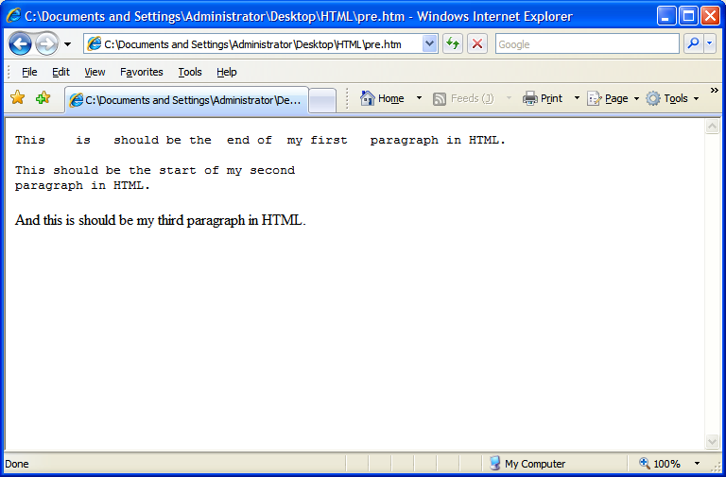
Text Formatting (Contd.)
Character Styles
1.
<PRE> tag
Sample Output

Slide 56
Text Formatting (Contd.)
Character Styles
2.
<BLOCKQUOTE> tag
Used to include indented text in a document.
Both the right and left margin are indented.
Notes:
<BQ></BQ> This element is an alias of the blockquote element.

Slide 57
Text Formatting (Contd.)
Character Styles
2.
<BLOCKQUOTE> tag
Sample Code
Most Popular Quote of Shakespeare :
<BLOCKQUOTE>
To Be, Or Not To Be: That Is The Question
</BLOCKQUOTE>

Slide 58
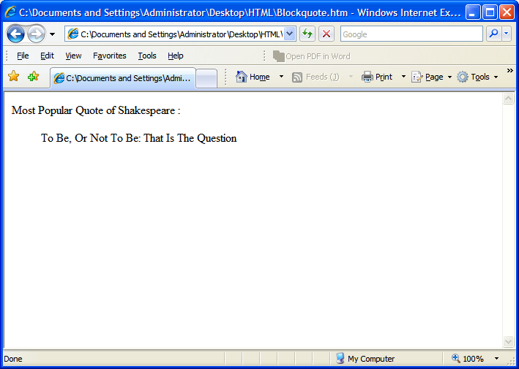
Text Formatting (Contd.)
Character Styles
2.
<BLOCKQUOTE> tag
Sample Output

Slide 59
Text Formatting (Contd.)
Character Styles
3.
<ADDRESS> tag
It defines text that gives an address or other contact information.
It is displayed in italic.
Generally, displayed in the bottom of the page.

Slide 60
Text Formatting (Contd.)
Character Styles
3.
<ADDRESS> tag
Sample Code
stands for International Business Machines.
<hr color=“blue”>
The HeadQuarter is located at:
<ADDRESS>
Armonk, <BR>New York, USA.
</ADDRESS>

Slide 61
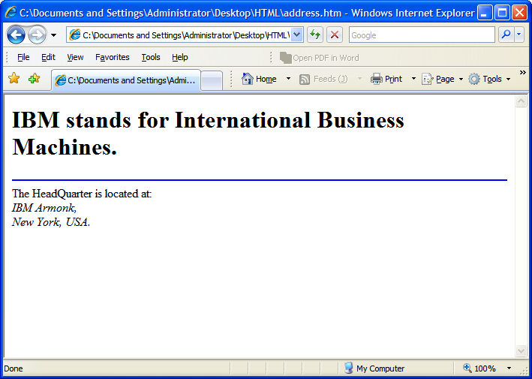
Text Formatting (Contd.)
Character Styles
3.
<ADDRESS> tag
Sample Output

Slide 62
Text Formatting (Contd.)
Character Styles
4.
Logical Character Highlighting tags
Logical Character Highlighters are also known as Idiomatic styles tags.
The purpose of logical tags is to convey the basic semantic meaning of a piece of text rather than the absolute appearance.
It is used to give your text a different look when displayed by browsers.
Browser handle the look and feel of the logical tag.
Notes:
Character styles are displayed differently by different browsers. For example, LYNX (a text-based browser), displays text marked with B, EM, I, and STRONG tags as underlined text, and text marked with SAMP and TT tags as normal text.
It is highly recommended to use logical styles instead of physical styles because the browser handles the display of logical styles and not all browsers support physical styles.

Slide 63
Text Formatting (Contd.)
Character Styles
4.
Logical Character Highlighting tags
Name | Tag | Example
Strong | <STRONG> | This is STRONG text
Emphasis | <EM> | This is EMphasized text
Code | <CODE> | This is CODEd text
Keyboard | <KBD> | This is “KeyBoarD” text
Variable | <VAR> | This is VARiable text
Notes:
Explanation of Each Logical Tags:-
1. Strong Emphasis: <STRONG> indicates strong emphasis, and typically appears in bold. This is preferred over <B> which is a physical tag.
2. Emphasis: <EM> is for emphasizing phrases, and is typically displayed in italics.
3. Code: <CODE> indicates an example of code, typically displayed in a uniform font. CODE is intended for short segments of computer code.
4. Keyboard: <KBD> indicates text typed by a user. It is typically displayed in a font and is commonly used in instructional manuals.
5. Variable: <VAR> indicates a variable, typically displayed in italic.
Some more Logical tags are:-
6. Sample: <SAMP> indicates a sequence of literal characters. It is typically displayed in a uniform font. For example: Use <samp>*.*</samp> to delete every file.
7. Citation: <CITE> is used to indicate the title of a book or other citation. It is typically displayed in italics.

Slide 64
Text Formatting (Contd.)
Character Styles
5.
Physical Character Highlighting tags
Physical Character Highlighters are also known as Typographical styles tags.
It is used to give your text a different look but exacting look.
Not all browsers support physical styles.

Slide 65
Text Formatting (Contd.)
Special Characters
Example
<html>
<body>
<h2><b>&lt;MARQUEE&gt;</b> is used to scroll the enclosing text.</h2>
</body>
</html>

Slide 66
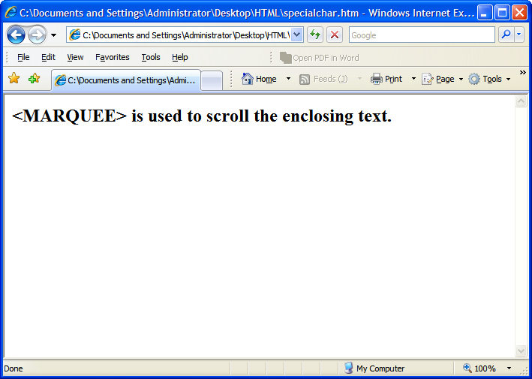
Text Formatting (Contd.)
Special Characters
Output

Slide 67
Using Links
&
Images

Slide 68
Using Links
The Anchor Tag
  HTML uses the <a> (anchor) tag to create a link to another document.
  Attributes of <a>(anchor) tag
    href : is used to address the document to link to, and the words between the open and close of the anchor tag will be displayed as a hyperlink.
    Syntax:
    <a href=”url”>Text to be displayed</a>
Notes:
The <a> tag is used to create an anchor to link from, the href attribute is used to address the document to link to, and the words between the open and close of the anchor tag will be displayed as a hyperlink.

Slide 69
Using Links (Contd.)
  Attributes of <a>(anchor) tag
    target : The target attribute defines where the linked document will be opened.
    Syntax:
    <a href=“http://w3. .com” target=“where to place the document”>Text to be displayed</a>
    name :The name attribute is used to create a named anchor. When using named anchors we can create links that can jump directly into a specific section on a page.
    Syntax
    <a name=“label”>Text to be displayed</a>

Slide 70
Example of a Hyperlink
<html>
<head>
<title>Example of a Hyperlink</title>
<head>
<body>
<a href=“http://w3. .com”> </a>
<a href=“http://w3. .com” target=“_blank”> </a>
---- other information within body tag-------
</body>
</html>
The word will be highlighted , and on clicking the user will be taken to the w3 pages of , the page will be opened on the same window
The word will be highlighted , and on clicking the user will be taken to the w3 pages of , the page will be opened on a new window.
Notes:
HTML Email Tag
Set the href attribute of <a> to the e-mail address, rather than specifying a web URL.
HTML Code:
<a href= "mailto:landk@ .in.com" >Email Example</a>
E-Mail with subject & body of the mail defined.
<a href= "mailto: a@b.com?subject=Feedback Mail&body=This emails from employees" >2nd Email Example</a>

Slide 71
Example of Naming a link and accessing it
<html>
<body>
<a name=“locations”> locations</a>
Kolkata, Bangalore, Hyd, Pune, Chandigarh, Gurgoan
----- other information
----------
<a href=“#locations”> Location In India</a>
</body>
</html>
On Clicking on Location in India you will be linked to the section which has been named as locations
Notes:
Named anchors are often used to create "table of contents" at the beginning of a large document. Each chapter within the document is given a named anchor, and links to each of these anchors are put at the top of the document.

Slide 72
Embedding Images
The image tag
  In Html images are defined by using the <img> tag
  The <img> tag is a open tag ( does not have a </img>)
  Attributes of <img> tag
    src : To display an image on a page, you need to use the src attribute . The value of the src is the url of the image to be displayed
    Syntax
    <img src=“url”>

Slide 73
Embedding images ( contd.)
  Attributes of <img> tag
    alt :The alt attribute is used to define an "alternate text" for an image. The value of the alt attribute is an author-defined text:
    Syntax
    <img src=“url” alt=“user defined text”>
    width & height : the size of the image can be controlled by using the width and height attributes
    Syntax
    <img src=“url” width=“size in pixels” height=“size in pixels”>
Notes:
The "alt" attribute tells the reader what he or she is missing on a page if the browser can't load images. The browser will then display the alternate text instead of the image. It is a good practice to include the "alt" attribute for each image on a page, to improve the display and usefulness of your document for people who have text-only browsers.

Slide 74
Embedding images(contd.)
  Attributes of <img> tag
    align : An image can be aligned with the surrounding text by using the align attribute
    Syntax
    <img src=“url” width=“value in pixels” height=“value in pixels” align=“positon, ie left,right,top bottom…” >
Images can be used as hyperlinks also.
<a href=“http://w3. .com”> <img src=“logo.gif” width=“30 height=“40” ></a>

Slide 75
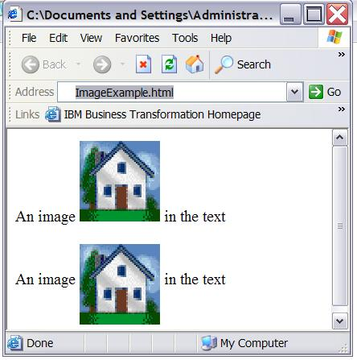
Example of an embedded image
<html>
<body>
<p>
An image
<img src=“home.gif"
align="bottom" width="48" height="48">
in the text
</p>
<p>
An image
<img src ="home.gif"
align="middle" width="48" height="48">
in the text
</p> </body> </html>
Notes:
Image Map
A graphic containing one or more invisible regions, called hotspots, which are associated hyperlinks. Typically, an image map gives site visitors visual cues about the information made available by clicking each part of a picture or graphic. For example, a geographical map could be made into an image map by assigning hotspots to each region of interest on the map.

Slide 76
HTML Table
Table allows to organize and present data in an orderly and concise manner.
Tabular structures were introduced with HTML 3.2.
A table can contains wide variety of information, such as headers, anchors, lists, paragraphs, forms, images, preformatted text and even nested tables.
HTML tables are composed of rows and columns.
Notes:
Prior to HTML 3.2, <PRE> tag were used to create table like structure.

Slide 77
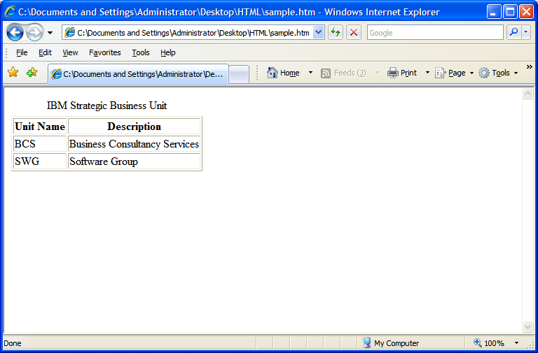
Requirement Analysis

Slide 78
Code Snippet To Fulfill the Requirement
<html>
<body>
<table border=“1”>
<caption> Strategic Business Unit</caption>
<tr>
<th>Unit Name</th>
<th>Description</th>
</tr>
<tr>
<td>BCS</td>
<td>Business Consultancy Services</td>
</tr>
<tr>
<td>SWG</td>
<td>Software Group</td>
</tr>
</table>
</body>
</html>

Slide 79
For starting a table
<html>
<body>
<table border=“1”>
<caption> Strategic Business Unit</caption>
<tr>
<th>Unit Name</th>
<th>Description</th>
</tr>
<tr>
<td>BCS</td>
<td>Business Consultancy Services</td>
</tr>
<tr>
<td>SWG</td>
<td>Software Group</td>
</tr>
</table>
</body>
</html>

Slide 80
It is an attribute of table tag to specify the thickness of the border of the table in pixels.
<html>
<body>
<table border=“1”>
<caption> Strategic Business Unit</caption>
<tr>
<th>Unit Name</th>
<th>Description</th>
</tr>
<tr>
<td>BCS</td>
<td>Business Consultancy Services</td>
</tr>
<tr>
<td>SWG</td>
<td>Software Group</td>
</tr>
</table>
</body>
</html>

Slide 81
Table Border set to 1

Slide 82
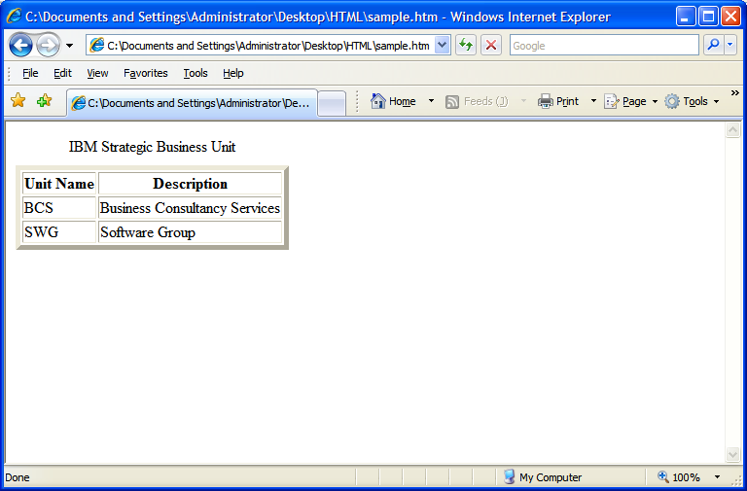
If Table Border set to 5

Slide 83
For starting a table
<html>
<body>
<table border=“1”>
<caption> Strategic Business Unit</caption>
<tr>
<th>Unit Name</th>
<th>Description</th>
</tr>
<tr>
<td>BCS</td>
<td>Business Consultancy Services</td>
</tr>
<tr>
<td>SWG</td>
<td>Software Group</td>
</tr>
</table>
</body>
</html>
For ending a table

Slide 84
For starting a table caption, It is like a title which resides outside the border of the table. It is an optional attribute.
<html>
<body>
<table border=“1”>
<caption> Strategic Business Unit</caption>
<tr>
<th>Unit Name</th>
<th>Description</th>
</tr>
<tr>
<td>BCS</td>
<td>Business Consultancy Services</td>
</tr>
<tr>
<td>SWG</td>
<td>Software Group</td>
</tr>
</table>
</body>
</html>

Slide 85
For starting a table caption, It is like a title which resides outside the border of the table. It is an optional attribute.
<html>
<body>
<table border=“1”>
<caption> Strategic Business Unit</caption>
<tr>
<th>Unit Name</th>
<th>Description</th>
</tr>
<tr>
<td>BCS</td>
<td>Business Consultancy Services</td>
</tr>
<tr>
<td>SWG</td>
<td>Software Group</td>
</tr>
</table>
</body>
</html>
For ending a table caption

Slide 86
Table Caption

Slide 87
For starting a table row
<html>
<body>
<table border=“1”>
<caption> Strategic Business Unit</caption>
<tr>
<th>Unit Name</th>
<th>Description</th>
</tr>
<tr>
<td>BCS</td>
<td>Business Consultancy Services</td>
</tr>
<tr>
<td>SWG</td>
<td>Software Group</td>
</tr>
</table>
</body>
</html>

Slide 88
For starting a table row
<html>
<body>
<table border=“1”>
<caption> Strategic Business Unit</caption>
<tr>
<th>Unit Name</th>
<th>Description</th>
</tr>
<tr>
<td>BCS</td>
<td>Business Consultancy Services</td>
</tr>
<tr>
<td>SWG</td>
<td>Software Group</td>
</tr>
</table>
</body>
</html>
For ending a table row.

Slide 89
Row 1
Row 2

Slide 90
For providing a table heading. By default the header cell will appear in bolder type and the default alignment is center.
<html>
<body>
<table border=“1”>
<caption> Strategic Business Unit</caption>
<tr>
<th>Unit Name</th>
<th>Description</th>
</tr>
<tr>
<td>BCS</td>
<td>Business Consultancy Services</td>
</tr>
<tr>
<td>SWG</td>
<td>Software Group</td>
</tr>
</table>
</body>
</html>

Slide 91
For providing a table heading. By default the header cell will appear in bolder type and the default alignment is center.
<html>
<body>
<table border=“1”>
<caption> Strategic Business Unit</caption>
<tr>
<th>Unit Name</th>
<th>Description</th>
</tr>
<tr>
<td>BCS</td>
<td>Business Consultancy Services</td>
</tr>
<tr>
<td>SWG</td>
<td>Software Group</td>
</tr>
</table>
</body>
</html>
For ending a table heading.

Slide 92
Table Heading

Slide 93
For providing the table data. By default the alignment is left.
<html>
<body>
<table border=“1”>
<caption> Strategic Business Unit</caption>
<tr>
<th>Unit Name</th>
<th>Description</th>
</tr>
<tr>
<td>BCS</td>
<td>Business Consultancy Services</td>
</tr>
<tr>
<td>SWG</td>
<td>Software Group</td>
</tr>
</table>
</body>
</html>

Slide 94
For providing the table data. By default the alignment is left.
<html>
<body>
<table border=“1”>
<caption> Strategic Business Unit</caption>
<tr>
<th>Unit Name</th>
<th>Description</th>
</tr>
<tr>
<td>BCS</td>
<td>Business Consultancy Services</td>
</tr>
<tr>
<td>SWG</td>
<td>Software Group</td>
</tr>
</table>
</body>
</html>
For ending a table data tag.

Slide 95
Table Data

Slide 96
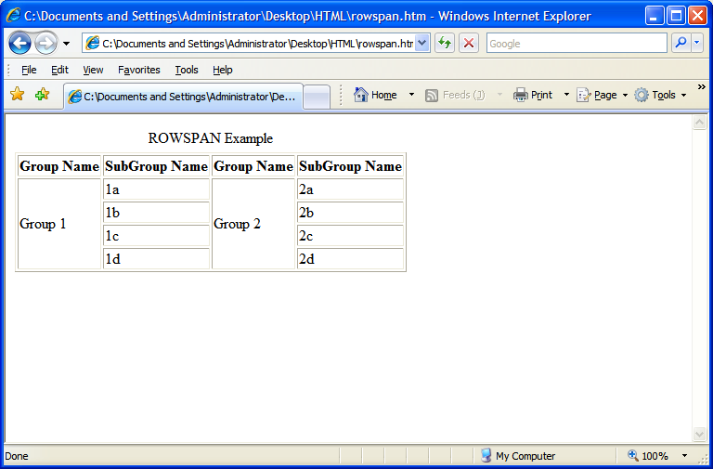
Requirement Analysis

Slide 97
Code Snippet To Fulfill the Requirement
<table border="1">
<caption>ROWSPAN Example</caption>
<tr><th>Group Name</th>
<th>SubGroup Name</th>
<th>Group Name</th>
<th>SubGroup Name</th>
</tr>
<TR>
<td ROWSPAN="4"> Group 1</td> <td>1a</td>
<td ROWSPAN="4"> Group 2</td><td>2a</td>
</tr>
<tr>
<td>1b</td>
<td>2b</td>
</tr>
<tr>
<td>1c</td>
<td>2c</td>
</tr>
<tr>
<td>1d</td>
<td>2d</td>
</tr>
</table>

Slide 98
This attribute is used to span cell more than one row. In this case it will span the 1st column into four rows including the current row.
<table border="1">
<caption>ROWSPAN Example</caption>
<tr><th>Group Name</th>
<th>SubGroup Name</th>
<th>Group Name</th>
<th>SubGroup Name</th>
</tr>
<TR>
<td ROWSPAN="4"> Group 1</td> <td>1a</td>
<td ROWSPAN="4"> Group 2</td><td>2a</td>
</tr>
<tr>
<td>1b</td>
<td>2b</td>
</tr>
<tr>
<td>1c</td>
<td>2c</td>
</tr>
<tr>
<td>1d</td>
<td>2d</td>
</tr>
</table>

Slide 99
This cell is spanned to 4 rows

Slide 100
The 3rd column is spanning more 4 rows including the current row..
<table border="1">
<caption>ROWSPAN Example</caption>
<tr><th>Group Name</th>
<th>SubGroup Name</th>
<th>Group Name</th>
<th>SubGroup Name</th>
</tr>
<TR>
<td ROWSPAN="4"> Group 1</td> <td>1a</td>
<td ROWSPAN="4"> Group 2</td><td>2a</td>
</tr>
<tr>
<td>1b</td>
<td>2b</td>
</tr>
<tr>
<td>1c</td>
<td>2c</td>
</tr>
<tr>
<td>1d</td>
<td>2d</td>
</tr>
</table>

Slide 101
This cell is spanned to 4 rows

Slide 102
Analyzing The Code
<table border="1">
<caption>ROWSPAN Example</caption>

Slide 103
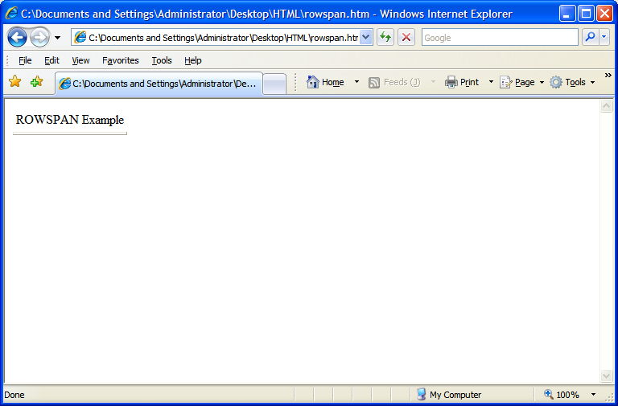

Slide 104
Analyzing The Code
<table border="1">
<caption>ROWSPAN Example</caption>
<tr><th>Group Name</th>
<th>SubGroup Name</th>
<th>Group Name</th>
<th>SubGroup Name</th>
</tr>

Slide 105
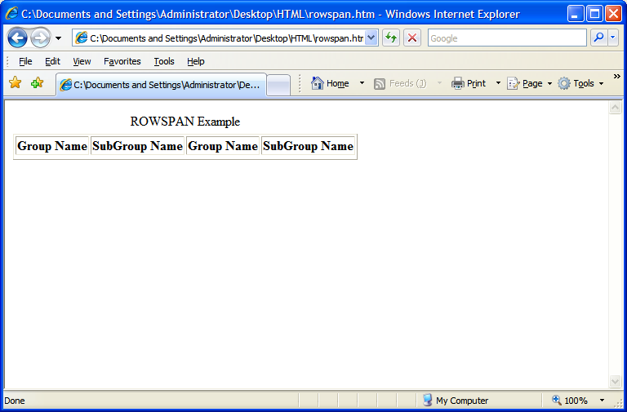

Slide 106
Analyzing The Code
<table border="1">
<caption>ROWSPAN Example</caption>
<tr><th>Group Name</th>
<th>SubGroup Name</th>
<th>Group Name</th>
<th>SubGroup Name</th>
</tr>
<TR>
<td ROWSPAN="4"> Group 1</td> <td>1a</td>
<td ROWSPAN="4"> Group 2</td><td>2a</td>
</tr>

Slide 107
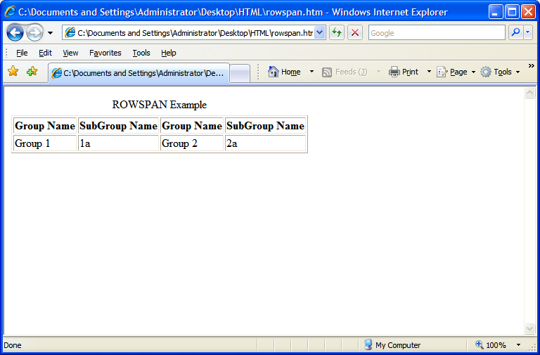

Slide 108
Analyzing The Code
<table border="1">
<caption>ROWSPAN Example</caption>
<tr><th>Group Name</th>
<th>SubGroup Name</th>
<th>Group Name</th>
<th>SubGroup Name</th>
</tr>
<TR>
<td ROWSPAN="4"> Group 1</td> <td>1a</td>
<td ROWSPAN="4"> Group 2</td><td>2a</td>
</tr>
<tr>
<td>1b</td>
<td>2b</td>
</tr>

Slide 109


Slide 110
Analyzing The Code
<table border="1">
<caption>ROWSPAN Example</caption>
<tr><th>Group Name</th>
<th>SubGroup Name</th>
<th>Group Name</th>
<th>SubGroup Name</th>
</tr>
<TR>
<td ROWSPAN="4"> Group 1</td> <td>1a</td>
<td ROWSPAN="4"> Group 2</td><td>2a</td>
</tr>
<tr>
<td>1b</td>
<td>2b</td>
</tr>
<tr>
<td>1c</td>
<td>2c</td>
</tr>

Slide 111
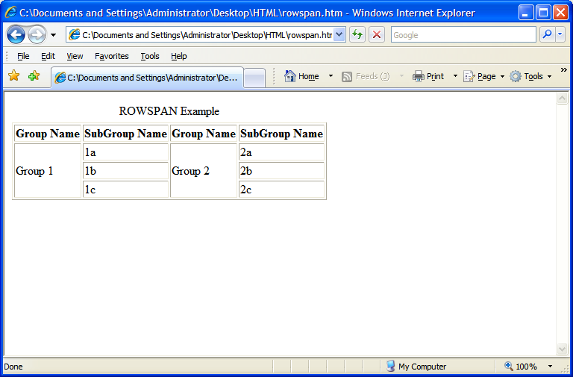

Slide 112
Analyzing The Code
<table border="1">
<caption>ROWSPAN Example</caption>
<tr><th>Group Name</th>
<th>SubGroup Name</th>
<th>Group Name</th>
<th>SubGroup Name</th>
</tr>
<TR>
<td ROWSPAN="4"> Group 1</td> <td>1a</td>
<td ROWSPAN="4"> Group 2</td><td>2a</td>
</tr>
<tr>
<td>1b</td>
<td>2b</td>
</tr>
<tr>
<td>1c</td>
<td>2c</td>
</tr>
<tr>
<td>1d</td>
<td>2d</td>
</tr>
</table>

Slide 114
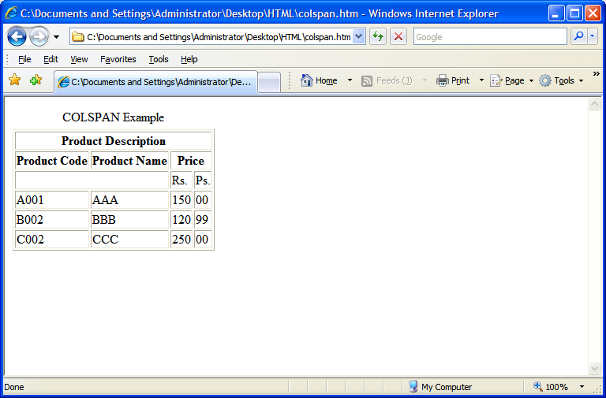
Requirement Analysis
Requirement

Slide 115
Code Snippet To Fulfill the Requirement
<tr>
<td>A001</td><td>AAA</td>
<td>150</td><td>00</td>
</tr>
<tr>
<td>B002</td><td>BBB</td>
<td>120</td><td>99</td>
</tr>
<tr>
<td>C002</td><td>CCC</td>
<td>250</td><td>00</td>
</tr>
</table>
<table border="1">
<caption>COLSPAN Example</caption>
<tr>
<th colspan="5"> Product Description</th>
</tr>
<tr>
<th> Product Code</th>
<th> Product Name</th>
<th colspan="2"> Price</th>
</tr>
<tr>
<td colspan="2">&nbsp;</td><td>Rs.</td><td>Ps.</td>
</tr>

Slide 116
This attribute is used to span cell more than one column. In this case it will span the 1st column into five more nested columns.
<tr>
<td>A001</td><td>AAA</td>
<td>150</td><td>00</td>
</tr>
<tr>
<td>B002</td><td>BBB</td>
<td>120</td><td>99</td>
</tr>
<tr>
<td>C002</td><td>CCC</td>
<td>250</td><td>00</td>
</tr>
</table>
<table border="1">
<caption>COLSPAN Example</caption>
<tr>
<th colspan="5"> Product Description</th>
</tr>
<tr>
<th> Product Code</th>
<th> Product Name</th>
<th colspan="2"> Price</th>
</tr>
<tr>
<td colspan="2">&nbsp;</td><td>Rs.</td><td>Ps.</td>
</tr>

Slide 117

This cell is spanned to 5 columns

Slide 118
It will span the 3rd column into two more nested columns.
<tr>
<td>A001</td><td>AAA</td>
<td>150</td><td>00</td>
</tr>
<tr>
<td>B002</td><td>BBB</td>
<td>120</td><td>99</td>
</tr>
<tr>
<td>C002</td><td>CCC</td>
<td>250</td><td>00</td>
</tr>
</table>
<table border="1">
<caption>COLSPAN Example</caption>
<tr>
<th colspan="5"> Product Description</th>
</tr>
<tr>
<th> Product Code</th>
<th> Product Name</th>
<th colspan="2"> Price</th>
</tr>
<tr>
<td colspan="2">&nbsp;</td><td>Rs.</td><td>Ps.</td>
</tr>

Slide 119
This cell is spanned to 2 columns

Slide 120
It will span the 3rd row 1st column into two columns. In other words, it will merge the 1st two columns of the 3rd row.
<tr>
<td>A001</td><td>AAA</td>
<td>150</td><td>00</td>
</tr>
<tr>
<td>B002</td><td>BBB</td>
<td>120</td><td>99</td>
</tr>
<tr>
<td>C002</td><td>CCC</td>
<td>250</td><td>00</td>
</tr>
</table>
<table border="1">
<caption>COLSPAN Example</caption>
<tr>
<th colspan="5"> Product Description</th>
</tr>
<tr>
<th> Product Code</th>
<th> Product Name</th>
<th colspan="2"> Price</th>
</tr>
<tr>
<td colspan="2">&nbsp;</td><td>Rs.</td><td>Ps.</td>
</tr>

Slide 121
This cell is spanned to 2 columns

Slide 122
Some More Attributes of Table tag
Cellspacing - The CELLSPACING attribute creates a space, or border, of the specified number of pixels, between each cell.
Cellpadding - The CELLPADDING attribute separates text of the cell from the cell border with a padding with the specified number of pixels.
Width - specify the width of the table

Slide 123
USING CELLSPACING ATTRIBUTE
<html>
<body>
<table cellspacing=“25" border="1">
<tr><th>Table Heading 1</th>
<th>Table Heading 2</th>
</tr>
<tr><td>Table Contents 1</td>
<td>Table Contents 2</td>
</tr>
</body>
</html>

Slide 124
USING CELLSPACING ATTRIBUTE
<html>
<body>
<table cellspacing=“25" border="1">
<tr><th>Table Heading 1</th>
<th>Table Heading 2</th>
</tr>
<tr><td>Table Contents 1</td>
<td>Table Contents 2</td>
</tr>
</body>
</html>

Slide 125
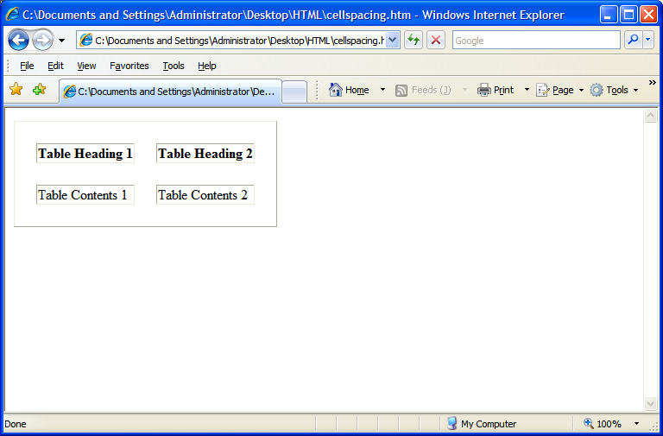
Vertical Cell spacing
Horizontal Cell spacing

Slide 126
USING CELLPADDING ATTRIBUTE
<html>
<body>
<table cellpadding=“25" border="1">
<tr><th>Table Heading 1</th>
<th>Table Heading 2</th>
</tr>
<tr><td>Table Contents 1</td>
<td>Table Contents 2</td>
</tr>
</body>
</html>

Slide 127
USING CELLPADDING ATTRIBUTE
<html>
<body>
<table cellpadding=“25" border="1">
<tr><th>Table Heading 1</th>
<th>Table Heading 2</th>
</tr>
<tr><td>Table Contents 1</td>
<td>Table Contents 2</td>
</tr>
</body>
</html>

Slide 128
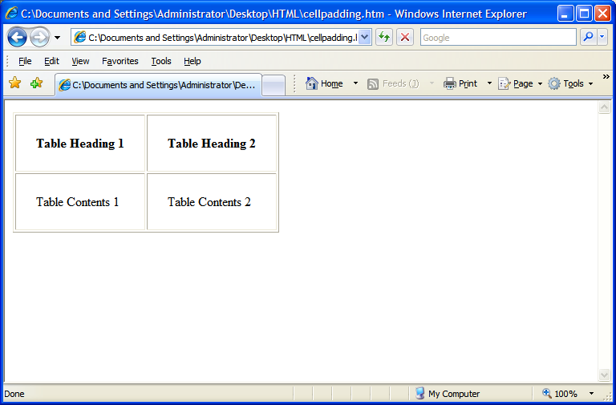
Horizontal Cell padding
Vertical Cell padding

Slide 129
USING WIDTH ATTRIBUTE
<html>
<body>
<table width=“80%" border="1">
<tr><th>Table Heading 1</th>
<th>Table Heading 2</th>
</tr>
<tr><td>Table Contents 1</td>
<td>Table Contents 2</td>
</tr>
</body>
</html>

Slide 130
USING WIDTH ATTRIBUTE
<html>
<body>
<table width=“80%" border="1">
<tr><th>Table Heading 1</th>
<th>Table Heading 2</th>
</tr>
<tr><td>Table Contents 1</td>
<td>Table Contents 2</td>
</tr>
</body>
</html>

Slide 131
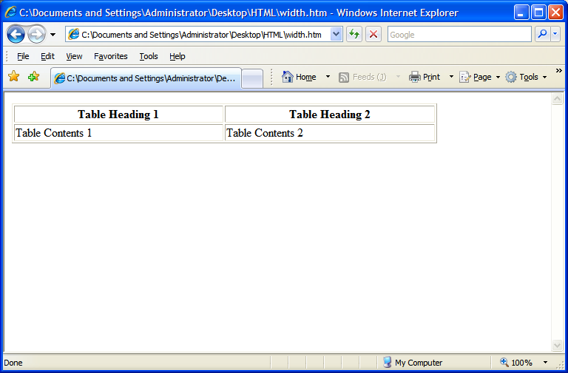
Cell Width

Slide 132
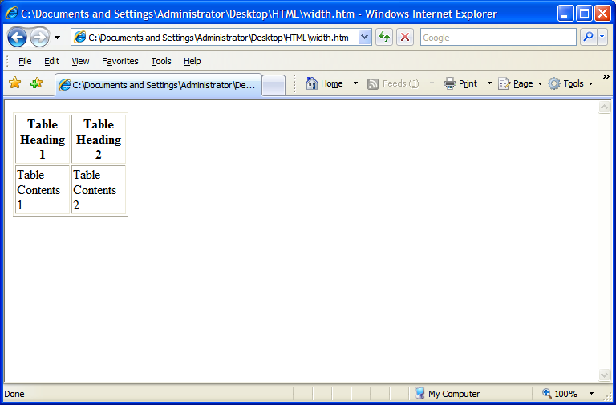
if Cell Width = 20%

Slide 133
Table Alignment Related Attribute
HTML tables can be aligned on the page, and cell content can be aligned within the cell.
  This attribute use to align HORIZONTALLY is
  ALIGN
LEFT
Attribute values are
CENTER
RIGHT
  This attribute use to align VERTICALLY is
  VALIGN
TOP
Attribute values are
MIDDLE
BOTTOM
The blinking attribute value is the default value for VALIGN.
Notes:
Default alignment of the information in the header cell is Center.
Default alignment of a data cell is Left.
VALIGN by default is Middle.

Slide 134
Table Alignment
ALIGN=“left”
ALIGN=“center”
ALIGN=“right”
VALIGN=“top”
Cell1 | Cell2 | Cell3
Cell4 | Cell5 | Cell6
Cell7 | Cell8 | Cell9
VALIGN=“middle”
VALIGN=“bottom”

Slide 135
Web
StyleSheets

Slide 136
Cascading Style Sheet
Web style sheets are a form of separation of presentation and content for web design .
Style sheet can decide the presentation of web pages.
Style sheet takes care of all the layout, fonts, colors and overall look of the site.
Notes:
HTML was originally designed as a simple way of presenting information, with the aesthetics of a web page being far less important than the content (and largely being left up to the web browser). Of course, now that the web has become as popular as it has, the presentation of your content has become almost critical to a site’s success. This, among other things, was why CSS was brought in.

Slide 137

Cascading Style Sheet (contd..)
Principal means of Styling a document using Cascading style sheets are:
Inline style Sheet
Embedded style Sheet
External style Sheet
Notes:
One can use another mechacanisim of styling documents by using Inline Style sheets
An inline style loses many of the advantages of style sheets by mixing content with presentation. Use this method sparingly, such as when a style is to be applied to a single occurrence of an element.
To use inline styles you use the style attribute in the relevant tag. The style attribute can contain any CSS property. The example shows how to change the color and the left margin of a paragraph:
<p style="color: sienna; margin-left: 20px"> This is a paragraph </p>

Slide 138
Benefits of a Cascading Style Sheet
Pages download faster.
Page contains less code, and the pages are shorter and neater.
The look of the site is kept consistent throughout all the pages that work off the same stylesheet.
Updating the design and general site maintenance are made much easier.
Notes:
Well-authored CSS also improves the accessibility of web content, allowing access through myriad devices (handheld PDAs for example) and ensuring that web users with disabilities are still able to receive it. It also eliminates the need for browser-specific hacks and tags, which means your site has a better chance of working across all major browsers.
Initially vaguely intimidating, CSS is a well-designed, elegant language. It is hugely important for the future of web design, and has been pivotal in helping designers move away from the problematic, hack-ridden days of presentational HTML tags like <font>, and allowed us to return to using logical, structural elements which make our sites more accessible.
All that, and there are dozens of powerful extra formatting options and possibilities available through stylesheet commands that are not possible through normal HTML. You’ll see these later on when we get on to things like backgrounds, spacing, layers and borders.

Slide 139

Parts of a Cascading Style Sheet
CSS syntax is made up of three parts:
HTML tag that you wish to change
Selector
The attribute that you wish to change
Property
Each property can take a value
Value

Slide 140
Inline Style Sheet
Inline style sheets are applied by coding style properties and values inside the tags to which they apply.
An inline style sheet can appear inside any tag to directly set its style. All that is required is to enclose the applicable style properties and values inside a quoted style attribute.
Syntax
  <tag style=“property:value [;property:value]…”>

Slide 141
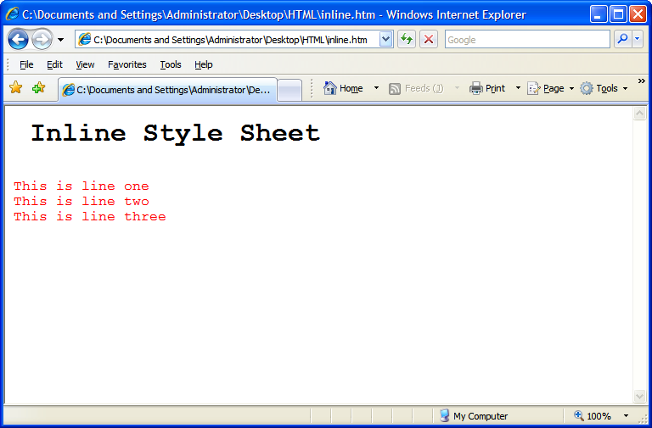
Inline Style Sheet(contd.)
<html>
<body>
<pre>
<h1> Inline Style Sheet</h1>
<p style="font-size: 12pt; color: red">
This is line one
This is line two
This is line three
</p>
</body>
</html>

Slide 142
Embedded Style sheet
Embedded style sheets are used when a unique style is required for a document.
Embedded style are defined in the <head> tag section by using the <style> tag
When a large number of style settings are used on a Web page, there is convenience in packaging the settings together in one place as an embedded style sheet, rather than having them scattered as inline style sheets throughout the document.

Slide 143
Syntax of Style sheet
selector {property: value}
Example
p {color: green}
If the value consist of more than one word the value has to be embedded within quotes.
p {font-family: “sans-serif”}
If more than one property needs to be defined then the properties need to be separated by semi colon.
p {font-family: “sans-serif” ; color: green}

Slide 144
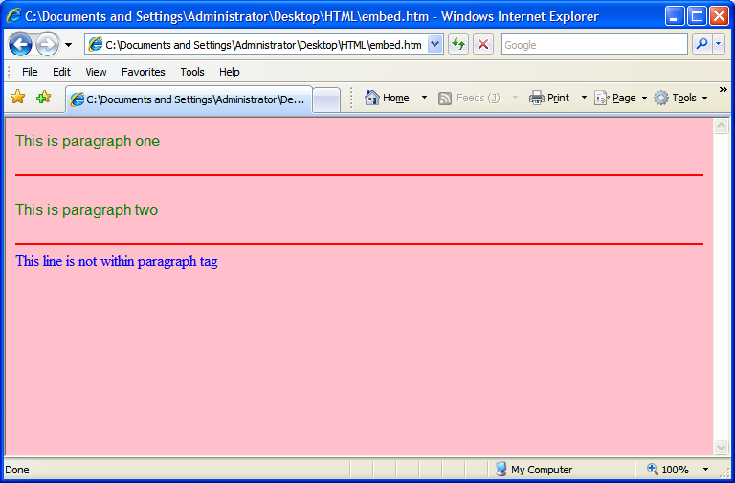
Example of an Embedded Style sheet
<html>
<head>
<style type="text/css">
p {font-family:"sans-serif"; color: green}
hr {color: red}
body {color:blue; background-color:pink}
</style>
</head>
<body>
<p>This is paragraph one</p>
<hr>
<p> This is paragraph two</p>
<hr>
This line is not within paragraph tag
</body>
</html>

Slide 145
External Style Sheet
Internal style sheets are used when a unique style is required for a document.
Internal style are defined in the <head> tag section by using the <style> tag
The different selectors, their properties and values should be defined within the external style sheet.
The external style sheet should be saved within a file, with an extension of .css

Slide 146



External Style sheet
Background is defined
Paragraph font color is
defined
Horizontal color is defined
Requires the background,
Paragraph and horizontal
Rule setting defined
In Mystyle.css
Both the html files uses
<link rel="stylesheet" type="text/css" href=“Mystyle.css" />
FirstPage.html
Requires the background,
Paragraph and horizontal
Rule setting defined
In Mystyle.css
Mystyle.css
SecondPage.html

Slide 147
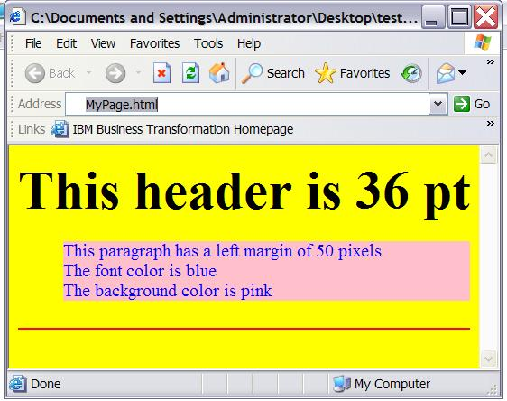
Example of External style sheet
body {background-color: yellow}
h1 {font-size: 36pt}
p {margin-left: 50px; background: pink; color:blue}
hr {color: red}
Mystyle.css
<html>
<head>
<link rel="stylesheet" type="text/css" href="Mystyle.css" />
</head>
<body>
<h1> This header is 36 pt </h1>
<p> This paragraph has a left margin of 50 pixels<br>
The font color is blue<br>
The background color is pink
</p>
<hr>
</body>
</html>
MyPage.html
MyPage.html is using styles
defined in Mystyle.css

Slide 148

Multiple Style sheet
<html>
<head>
<link rel=“stylesheet” type=“text/css” href=“Mystyle.css”>
<style type=“text/css”>
h3 {font-size: 20pt}
</style>
</head>
<body>
<h3> This is a header </h3>
---more text----
</body>
</html>
MyPage.html
h3 { color: red;
text-align: left;
font-size: 8pt }
Mystyle.css
Mypage.html Links to
Mystyle.css
The font size of <h3> is redefined here
What will be the Font size
Of <h3>
8pt or 20 pt??

Slide 149
Multiple Style sheet Continued
        If some properties have been set for the same selector in different style sheets, the values will be inherited from the more specific style sheet .
The HTML will inherit the
Font color and alingment
From Mystyle.css
<html>
<head>
<link rel=“stylesheet” type=“text/css” href=“Mystyle.css”>
<style type=“text/css”>
h3 {font-size: 20pt}
</style>
</head>
<body>
<h3> This is a header </h3>
---more text----
</body>
</html>
MyPage.html
Font Size will be Inherited
From the Internal Style sheet
h3 { color: red;
text-align: left;
font-size: 8pt }
Mystyle.css
Color: Red
Text-align-left
Font-size- 20pt

Slide 150
Some common selectors and attributes
Selector | property
H1,H2,H3….. | font-size,Font-family,font-style , font-weight Color, margin
P | font-size,Font-family,font-style , font-weight Color, Background-color,text-align, margin
HR | color
body | Background-color, font-size,Font-family,font-style , font-weight, margin
Notes:
font-family: sans-serif/courier/times
Font-size: 20pt
Font-style: italuc/bold//regular
Font-weight: (sets the boldness of the font)
Font-weight : 900
The CSS margin properties define the space around elements. It is possible to use negative values to overlap content. The top, right, bottom, and left margin can be changed independently using separate properties. A shorthand margin property can also be used to change all of the margins at once.

Slide 151
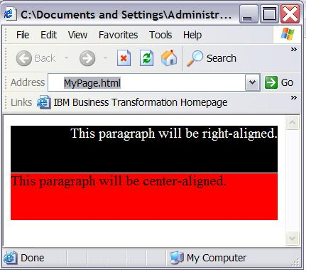
Class Selector
With the class selector you can define different styles for the same type of HTML element.
<html>
<head>
<link rel=“stylesheet” type=“text/css” href=“Mystyle.css”>
</head>
<body>
<p class=“one”>This paragraph is Right aligned </p>
<p class=“two”>This paragraph is Left aligned</p>
</body>
</html>
MyPage.html
p.one {text-align: right; color: white;
background-color: black}
p.two {text-align: left; color: black;
background-color: Red}
Mystyle.css

Slide 152
Uses of <DIV> Tag
1. <DIV> tag is a container for other tags.
2. DIV elements are block elements and work behind
the scenes grouping other tags together.
Some of the attributes of <DIV> tag are:
-> id
-> width
-> height
-> title
-> style
<DIV> tag
Notes:
When HTML first began, web creators only had two choices. A table layout, or frames. The div element provides a 3rd alternative, since a div can contain any/every other type of html element within its beginning and ending tag.
The div tag defines a division or section within an HTML .
span and div are the only elements that carry no innate semantic meaning, besides the logical grouping of the enclosed elements.
div and span differ from each other in one regard. In standard HTML, a div is a block-level element (and so visually isolates a section of a document on the page, in the same way as a paragraph, whereas a span is an inline element (for containing a piece of information inline with the surrounding text).

Slide 153
Uses of <DIV> Tag
<DIV> tag
Example
<div id="menu" align="right">
<a href="">HOME</a> | <a href="">CONTACT</a> | <a href="">ABOUT</a> | <a href="">LINKS</a></div>
<div id="content" align="left" >
<h5>Content Articles</h5>
<p>This paragraph would be your content paragraph with all of your readable material.</p>
<h5 >Content Article Number Two</h5>
<p>Here's another content article right here.</p>
</div>

Slide 154
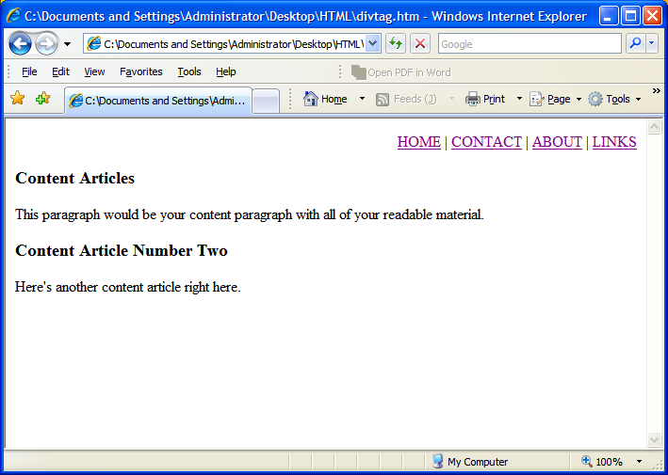
Uses of <DIV> Tag
<DIV> tag
Output

Slide 155
Using <span> in CSS
What is the
Utility of <span> in HTML
SPAN is a inline tag.
It is used to format small chunks of data within another element.
Combining <span> tag with CSS allows us to create custom tags.
Notes:
Do HTML rules cramp your style? Ever wish you could create your own tag what would behave just like you want? Well you can. Combine the SPAN element with CSS rules to create your own custom tags.
What does SPAN do? Nothing. That's the beauty of it. Since it has no defined display, you're free to write your own rules and apply them as you wish.
SPAN is an inline tag, which means that it's used to format small chunks of text inside another element. In contrast, a paragraph tag is a block-level element that can contain a number of inline elements like bold, italics, strong, and SPAN tags.

Slide 156
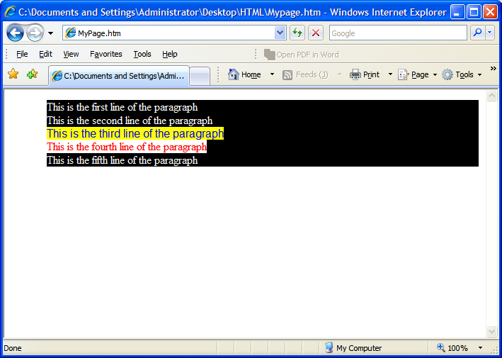
Using <span> in CSS (contd.)
<html>
<head>
<link rel="stylesheet"
type="text/css" href="Mystyle.css" />
</head>
<body>
<p >
This is the first line of the paragraph<br>
This is the second line of the paragraph<br>
<span class="example1">This is the third line of the paragraph<br> </span>
<span class="example2">This is the fourth line of the paragraph<br> </span>
This is the fifth line of the paragraph
</p>
</body>
</html>
MyPage.html
p { color: white ; background-color: black}
.example1 {color:blue ; background-color: yellow ;font-family: "sans-serif"}
.example2 {color:red ; background-color: white ;font-family: times}
Mystyle.css

