Slide 1
Git
A distributed version control system
02-Aug-22

Slide 2
Git History
Came out of Linux development community
Linus Torvalds, 2005
Initial goals:
Speed
Support for non-linear development (thousands of parallel branches)
Fully distributed
Able to handle large projects like Linux efficiently
Notes:
Initial goals were to support development of Linux
2

Slide 3
When I say I hate CVS with a passion, I have to also say that if there are any SVN [Subversion] users in the audience, you might want to leave. Because my hatred of CVS has meant that I see Subversion as being the most pointless project ever started. The slogan of Subversion for a while was "CVS done right", or something like that, and if you start with that kind of slogan, there's nowhere you can go. There is no way to do CVS right.
--Linus Torvalds, as quoted in Wikipedia
3

Slide 4

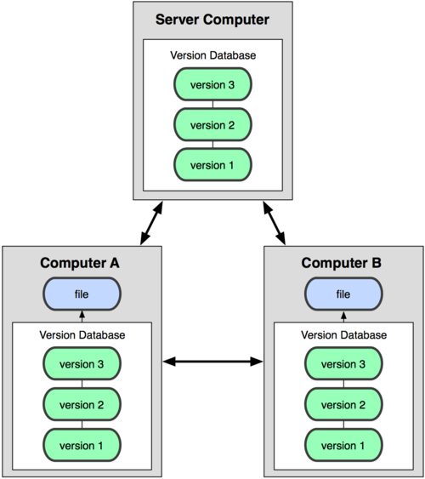
Git uses a distributed model
Centralized Model
Distributed Model
(CVS, Subversion, Perforce)
(Git, Mercurial)
Result: Many operations are local
Notes:
http://git-scm.com/book/en/Getting-Started-About-Version-Control
4

Slide 5
Git uses checksums
In Subversion each modification to the central repo incremented the version # of the overall repo.
How will this numbering scheme work when each user has their own copy of the repo, and commits changes to their local copy of the repo before pushing to the central server?????
Instead, Git generates a unique SHA-1 hash – 40 character string of hex digits, for every commit. Refer to commits by this ID rather than a version number. Often we only see the first 7 characters:
1677b2d Edited first line of readme
258efa7 Added line to readme
0e52da7 Initial commit

Slide 6
Get ready to use Git!
Set the name and email for Git to use when you commit:
$ git config --global user.name “Bugs Bunny”
$ git config --global user.email bugs@gmail.com
You can call git config –list to verify these are set.
These will be set globally for all Git projects you work with.
You can also set variables on a project-only basis by not using the --global flag.
You can also set the editor that is used for writing commit messages: $ git config --global core.editor emacs (it is vim by default)

Slide 7
Create a new javafx quickstart project and call it proClient, proImageshop
mvn archetype:generate -DarchetypeGroupId=org.codehaus.mojo.archetypes -DarchetypeArtifactId=javafx
Assuming you already have either a maven or intellij project.
Make sure you have the .ignore plugin
Select the project view from the project window drop-down
On the main menu, choose VCS | Import into Version Control | Create Git Repository.
By default, IntelliJ IDEA suggests the root of the current project, but select the root if not selected.
Right click the root dir in the project window and select new || .ignore || git.ignore
search for JetBrains and Maven and allow the .gitignore plugin to generate a new .ignore file for you.

Slide 8
Right click root directory from the project window again and select || Git || Add
You will see all the files turn green (except those being ignored which will be muted grey)
Create a remote on bitbucket by going to bitbucket.org
repository | create repository
give the project a name (probably best to give it the same name as the local project).
Go to access management and add:
csgerber, johnhb, davidselvaraj with READ access
click on overview on the left panel
click on the "I have an existing project" drop-down
copy the second line into the clipboard -- the one that looks similar to this:
git remote add origin git@bitbucket.org:csgerber/proclient.git

Slide 9
open a terminal in intelliJ
paste contents of clipboard and press enter.
Test that you did it correctly by typing:
git remote -v
From intelliJ, press Command + K or Ctrl + K
uncheck all checkboxes on right
type your commit message such as "initial commit."
commit || push
make changes to the working directory and always remember if prompted to add files to git, add them.
commit || push as required ad infititum.

Slide 10
Version control systems
Version control is all about managing multiple versions of documents, programs, web sites, etc.
Almost all “real” projects use some kind of version control
Essential for team projects, but also very useful for individual projects
Some well-known version control systems are CVS, Subversion, Mercurial, and Git
CVS and Subversion use a “central” repository; users “check out” files, work on them, and “check them in”
Mercurial and Git treat all repositories as equal
Distributed systems like Mercurial and Git are newer and are gradually replacing centralized systems like CVS and Subversion
10

Slide 11
Why version control?
For working by yourself:
Gives you a “time machine” for going back to earlier versions
Gives you great support for different versions (standalone, web app, etc.) of the same basic project
For working with others:
Greatly simplifies concurrent work, merging changes
Create a portfolio of projects
11

Slide 12
Introduce yourself to Git
Enter these lines (with appropriate changes):
git config --global user.name "John Smith"
git config --global user.email jsmith@seas.upenn.edu
You only need to do this once
If you want to use a different name/email address for a particular project, you can change it for just that project
cd to the project directory
Use the above commands, but leave out the --global
12

Slide 13
Git Resources
At the command line: (where verb = config, add, commit, etc.)
$ git help <verb>
$ git <verb> --help
$ man git-<verb>
Free on-line book: http://git-scm.com/book
Git tutorial: http://schacon.github.com/git/gittutorial.html
Reference page for Git: http://gitref.org/index.html
Git website: http://git-scm.com/
Git for Computer Scientists (http://eagain.net/articles/git-for-computer-scientists/)

Slide 14

A Local Git project has three areas
Unmodified/modified Files
Staged Files
Committed Files
Note: working directory sometimes called the “working tree”, staging area sometimes called the “index”.

Slide 15
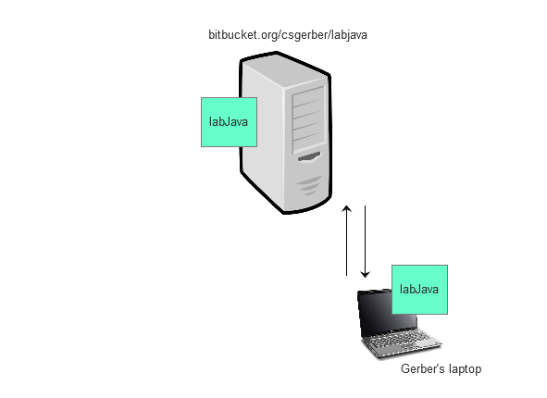
Fork, clone the lab, then create new remote called gerber.
Notes:
15

Slide 16
The difference between a fork and a clone
A fork is NOT a git operation. It is an operation of a Git Web Hosting Service like Bitbucket or Github.
A clone is a git operation. It creates a local copy of the remote repo.
Notes:
16

Slide 17
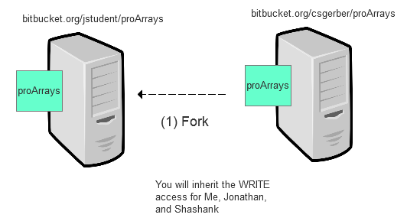
Notes:
17

Slide 18
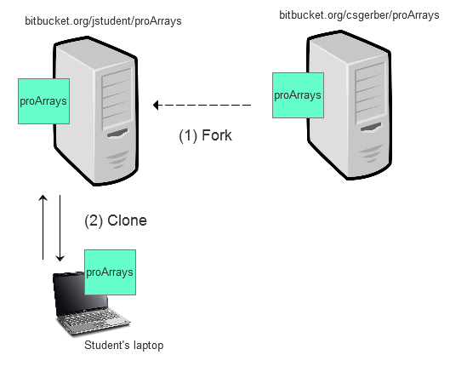
Notes:
18

Slide 19
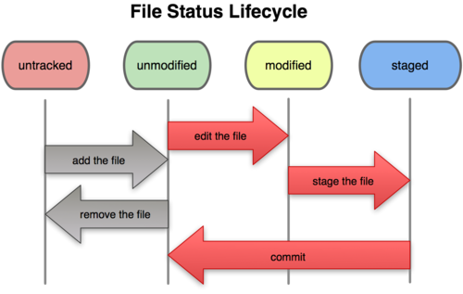
Git file lifecycle

Slide 20
How IntelliJ stages files.
Examine SourceTree versus CLI versus IntelliJ.
IntelliJ defers staging until the last step (Cmd+K or Ctrl+K)
In CLI or SourceTree, you just stage before committing.
Notes:
20

Slide 21
add/reset/commit:
move files from working-dir to stage-dir(aka index)
git add .
git add src/.
git add src/lec01/glab/DigitalToBinary.java
move files from stage-dir(aka index) to working-dir
git reset HEAD .
git reset head src/.
git reset head src/lec01/glab/DigitalToBinary.java
git commit -m “your commit message.”
Notes:
21

Slide 22
Amending:
Every commit is associated with a sha-1 hash. That hash is derived from 1/ the file changes in that commit and 2/ the previous commit.
You can not change any commit unless that commit is at the head. Since no other commits depend on the head, you may safely change the head.
To change the head, use
git commit --amend -m “your message”
git commit --amend --no-edit
Notes:
22

Slide 23
Reverting:
You can roll back a commit (reverse it) by identifying it's sha1 hash like so.
git revert --no-edit 71ac
Notes:
23

Slide 24
Branching:
To list the branches in a project:
git branch
git branch -r
git branch --all
To create a branch:
git checkout -b branchName c39b
git checkout -b branchName
To delete a branch:
git branch -D branchName
To checkout a branch:
git checkout 7afe
git checkout master
Notes:
24

Slide 25
Pushing to remotes:
To see the remotes:
git remote -v
To push to a remote:
git push origin master:master
git push origin master
git push --all
Notes:
25

Slide 26
Pulling from remotes:
To see the remotes:
git remote -v
To pull from a remote:
git pull --all
git pull origin eval
Notes:
26

Slide 27
Show the history of a single file in IntelliJ
How to resolve merge conflicts.
How to force push a branch
How to delete a remote branch
How to do a FFWD merge
Notes:
27

Slide 28
Basic Workflow in IntelliJ
Basic Git workflow:
Modify files in your working directory.
Do a commit, (Cmd+K, or Ctrl+K) which takes the files as they are in the staging area and stores that snapshot permanently to your Git directory.

Slide 29
Create a local copy of a repo
Two common scenarios: (only do one of these)
To clone an already existing repo to your current directory:
$ git clone <url> [local dir name]
This will create a directory named local dir name, containing a working copy of the files from the repo, and a .git directory (used to hold the staging area and your actual repo)
To create a Git repo in your current directory:
$ git init
This will create a .git directory in your current directory.
Then you can commit files in that directory into the repo:
$ git add file1.java
$ git commit –m “initial project version”

Slide 30
Status
To view the status of your files in the working directory and staging area:
$ git status or
$ git status –s
(-s shows a short one line version similar to svn)

Slide 31
Show Diff
To see the Diff between the working directory and the local git repo, press Ctrl+K or Cmd+K. Examine the files and cancel

Slide 32
Searching commits
You can use the filter ominbox to search for a particular commit.
You can sort by Author or date as well.

Slide 33
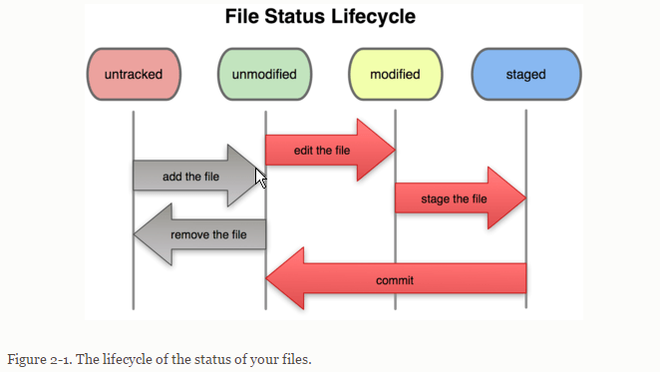

Slide 34
Git color coding for files in IntelliJ
Untracked files are brown (dark orange).
New files are green.
Modified files are blue.
Settled files in repo are black.
Ignored files are muted gray.
Conflicted files are red.

Slide 35
Dealing with untracked files
Dragging a file into your project (not added to git automatically)

Slide 36
Viewing logs (same as log in IntelliJ)
To see a log of all changes in your local repo:
$ git log or
$ git log --oneline (to show a shorter version)
1677b2d Edited first line of readme
258efa7 Added line to readme
0e52da7 Initial commit
git log -5 (to show only the 5 most recent updates, etc.)
Note: changes will be listed by commitID #, (SHA-1 hash)
Note: changes made to the remote repo before the last time you cloned/pulled from it will also be included here

Slide 37
SVN vs. Git
SVN:
central repository approach – the main repository is the only “true” source, only the main repository has the complete file history
Users check out local copies of the current version
Git:
Distributed repository approach – every checkout of the repository is a full fledged repository, complete with history
Greater redundancy and speed
Branching and merging repositories is more heavily used as a result
Notes:
37

Slide 38
Imperative versus Declarative
Imperative: is a style of programming where you program the algorithm with control flow and explicit steps.
Declarative: is a style of programming where you declare what needs be done without concern for the control flow.
Functional programming: is a declarative programming paradigm that treats computation as a series of functions and avoids state and mutable data to facilitate concurrency. “Functional programming has its roots in lambda calculus, a formal system developed in the 1930s to investigate computability, the Entscheidungsproblem, function definition, function application, and recursion. Many functional programming languages can be viewed as elaborations on the lambda calculus”. Wikipedia
See BigDecimalMain

