Slide 1
REST

Slide 2
What is REST ?
REST is a term coined by Roy Fielding to describe an architecture style of networked systems. REST is an acronym standing for REpresentational State Transfer.

Slide 3
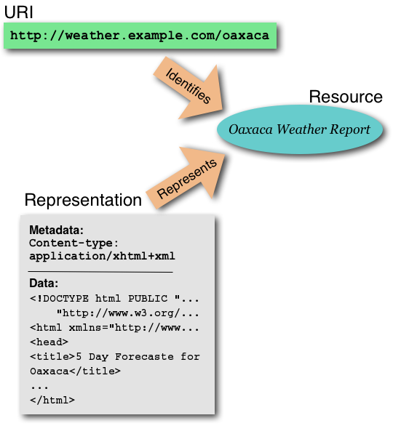
Resource (web server)
URI-Uniform Resource Identifier (or URL)
Web Page (HTML Page)

Slide 4
Two Fundamental Aspects of the REST Design Pattern
Resources Every distinguishable entity is a resource. A resource may be a Web site, an HTML page, an XML document, a Web service, a physical device, etc.
URLs Identify Resources Every resource is uniquely identified by a URL. This is Tim Berners-Lee Web Design, Axiom 0.

Slide 5
Why is it called Representational State Transfer ?
Client
http://weather.example.com/oaxaca
Resource
OaxacaWeather.html

Slide 6
"Representational State Transfer is intended to evoke an image of how a well-designed Web application behaves: a network of web pages (a virtual state-machine), where the user progresses through an application by selecting links (state transitions), resulting in the next page (representing the next state of the application) being transferred to the user and rendered for their use."
Roy Fielding.

Slide 7
REST and HTTP
HTTP 1.1 was designed to conform to REST
Its methods are defined well enough to get work done
Unsurprisingly, HTTP is the most RESTful protocol
But it's possible to apply REST concepts to other protocols and systems

Slide 8
REST - An Architectural Style of Networked System
Utilize the underlying architectural model of the world wide web – rather than inventing your own.
Guiding framework for Web protocol standards.
REST based web services
Online shopping
Search services
Dictionary services

Slide 9
Characteristics of a REST based network
Client-Server: a pull-based interaction style(Client request data from servers as and when needed).
Stateless: each request from client to server must contain all the information necessary to understand the request, and cannot take advantage of any stored context on the server.
Cache: to improve network efficiency, responses must be capable of being labeled as cacheable or non-cacheable.
Uniform interface: all resources are accessed with a generic interface (e.g., HTTP GET, POST, PUT, DELETE).
Named resources - the system is comprised of resources which are named using a URL.
Interconnected resource representations - the representations of the resources are interconnected using URLs, thereby enabling a client to progress from one state to another, and to communicate statelessly to whichever resource it needs on the web.

Slide 10
Web Design, Axiom 0 (Tim Berners-Lee, director of W3C)
Axiom 0: all resources on the Web must be uniquely identified with a URI.
URL1
resource1
URL2
resource2
URL3
resource3

Slide 11
Approach 2: URLs are Cheap! Use Them!
The airline provides several URLs - one URL for premier members, a different URL for frequent flyers, and still another for regular customers.
Premier
Member
Reservation
Service
http://www.kings-air/reservations/premier
client
Premier Members
Frequent
Flyer
Reservation
Service
http://www.kings-air/reservations/frequent-flyer
client
Frequent Flyer Members
Regular
Member
Reservation
Service
http://www.kings-air/reservations/regular
client
Regular Members

Slide 12
This Ain't the REST Design Pattern
Premier
Customer
Representative
Premier Members
Answering
Machine
F.F.
Customer
Representative
Airline Reservation
Frequent Flyer Members
Regular
Customer
Representative
Regular Members
“press 7 to be connected to the Executive club”

Slide 13
This is the REST Design Pattern
Premier
Customer
Representative
1-800-Premier
Premier Members
F.F.
Customer
Representative
1-800-Frequent
Frequent Flyer Members
Regular
Customer
Representative
1-800-Reservation
Regular Members
Numbers are cheap, use them.

Slide 14
This ain't the REST Design Pattern
client
Premier Members
Premier
Customer
Reservation
Web
Service
Determine
Priority
F.F.
Customer
client
Frequent Flyer Members
Regular
Customer
client
Regular Members

Slide 15
This is the REST Design Pattern
Premier
Member
Reservation
Service
http://www.kings-air/reservations/premier
client
Premier Members
Frequent
Flyer
Reservation
Service
http://www.kings-air/reservations/frequent-flyer
client
Frequent Flyer Members
Regular
Member
Reservation
Service
http://www.kings-air/reservations/regular
client
Regular Members
URLs are cheap, use them.

Slide 16
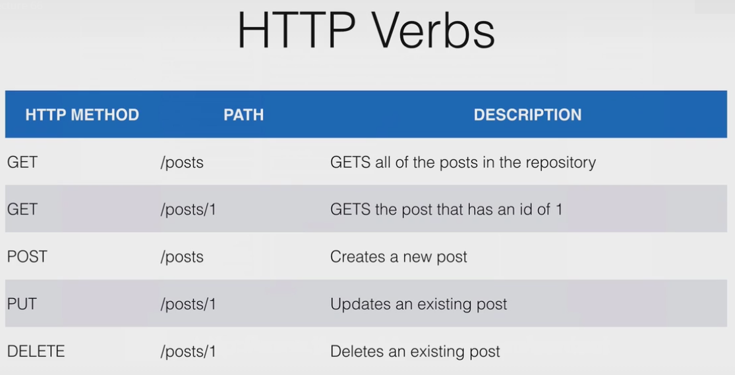

Slide 17
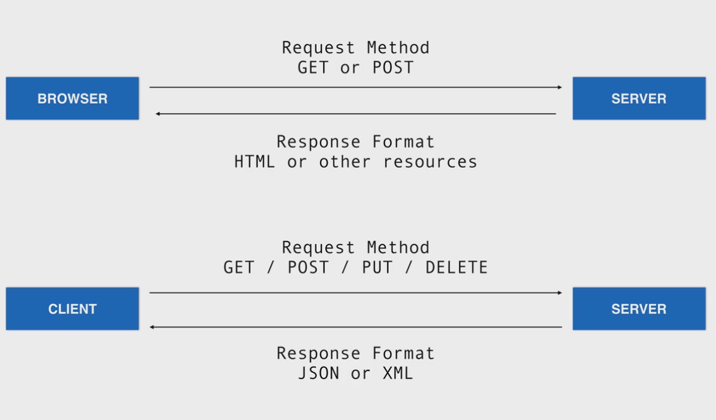

Slide 18
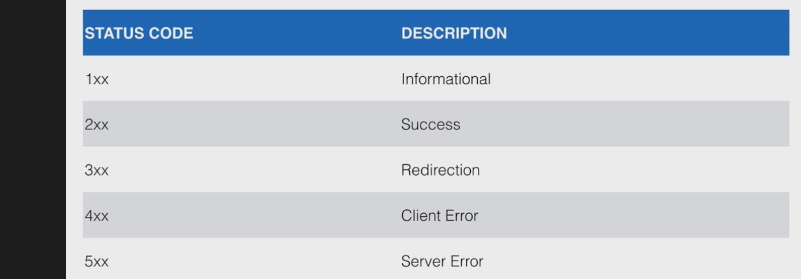
200 ok
404 not found
Etc.

Slide 19
inspect element/network
View amazon.com
Right click | inspect element in chrome
Click network
Examine the response codes

Slide 20
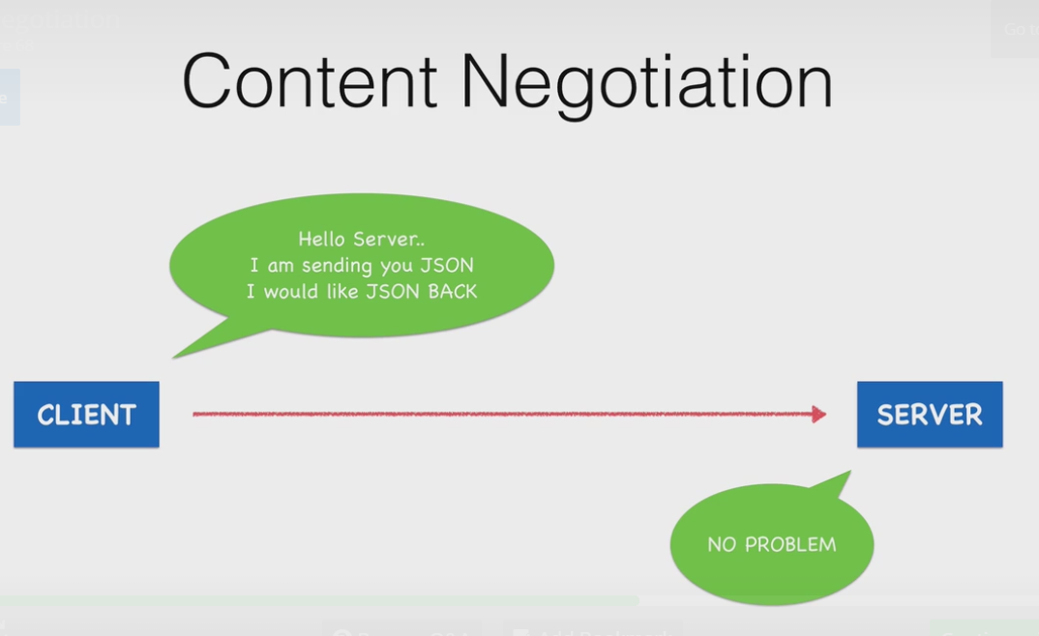
Content Negotiation
Right click | inspect elemernt
Click network

Slide 21
Basic CRUD with REST
Operation | HTTP / REST
Create | PUT / POST
Read (Retrieve) | GET
Update (Modify) | PUT / PATCH
Delete (Destroy) | DELETE

Slide 22

HyperText Transfer Protocol
Used for conversations between web clients and servers
Most of the internet uses HTTP
Supports verbs for GET, PUT, POST, DELETE
Query parameter framework
Notes:
22

Slide 23

Client sends a request
Method
URL
Headers
(sometimes) parameters
(sometimes) body
Server replies with a response
Content
Status
Headers
Use postman and chrome inspect
Notes:
23

Slide 24

Headers
Generally meta-information about the request
For instance: requesting an image in a specific format
Parameters
Limit or describe how you want the resource (searches, filters)
Defines the resource you’re requesting
Notes:
24

Slide 25

Request (client)
Accept: Give me this kind of response. Here’s a list in order of what I’m hoping you’ll send. Accept: text/html,application/xhtml+xml,application/xml
Response (server)
Content-Type: This is the kind of response I’m sending you. Content-Type: text/html; charset=UTF-8
Notes:
25

Slide 26

Part of the URL
Everything after the question mark, delimited by ampersands
http://www.example.com/search_people?this=that&foo=bar
Notes:
26

Slide 27

Chrome browser sends a request to Google
Method: GET
URL: http://www.google.com
Headers:
Accept: text/html,application/xhtml+xml,application/xml;q=0.9,*/*;q=0.8
Accept-Language: en-US,en;q=0.8
Accept-Charset: ISO-8859-1,utf-8;q=0.7,*;q=0.3
Connection: keep-alive
User-Agent: Mozilla/5.0 (Macintosh; Intel Mac OS X 10_7_3) AppleWebKit/535.19 (KHTML, like Gecko) Chrome/18.0.1025.168 Safari/535.19
Accept-Encoding: gzip,deflate,sdch
Cookie: NID=59=EudJ2a15ql8832PCysQA0qchtuvGWMoA7rkp79VpIYAQ8-j42IO17LFudCYNMXm9l6SHcu3YgrGRCdrRCyM468xPZaOek4Pi-AXQ8eARqU1SGYx6y7_9LW-c3HHb-vs2; PREF=ID=994f8de0e8b39a5b:U=237805f1f710dc73:FF=0:TM=1336752507:LM=1336752509:S=W0Hha7x4czdXp51U
Host: www.google.com
Notes:
27

Slide 28

Google sends a response
Headers:
Content-Length: 24716
Content-Encoding: gzip
Set-Cookie: NID=59=F48kbwfwOi-qCHJyrnMSUlDBVxK-ZVKZpq5B5jttt_25IRN4lS-0rQcVttq-dnOIlQzafw1i4HPQAO0RpZ7NuC0WCKWta7SYoekx0--YGf2zIFZ9VXIKS-_UEaOH9iBe; expires=Sat, 10-Nov-2012 21:26:46 GMT; path=/; domain=.google.com; HttpOnly
Expires: -1
Server: gws
X-XSS-Protection: 1; mode=block
Cache-Control: private, max-age=0
X-Frame-Options: SAMEORIGIN
Content-Type: text/html; charset=UTF-8
Date: Fri, 11 May 2012 21:26:46 GMT
Content: A bunch of HTML
Status: 200
Use postman and chrome inspect rest-starter
Notes:
28

Slide 29

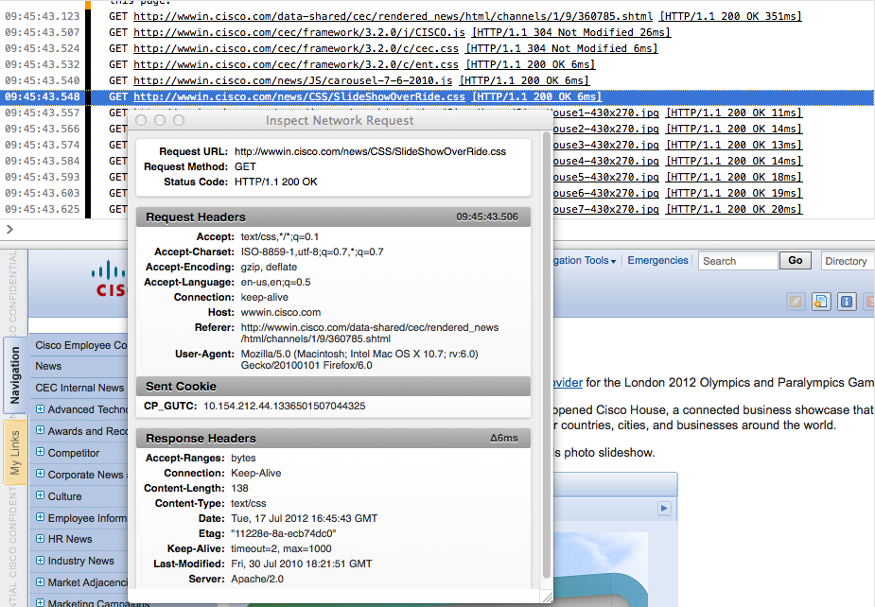
Some browsers provide tools to view HTTP traffic
Chrome is really good at this.
Notes:
29

Slide 30
REST project
rest-starter
8080/posts/
8080/posts/1 or 2
use jsonviewer
chrome://apps/
postman
you can also do a curl:
curl -v http://localhost:8080/
curl -help
See >rest-starter

Slide 31

Uses URL paths to define resources
Create, Read, Update, Delete
POST, GET, PUT, DELETE
Error Codes
HTTP Status Codes
Request parameters
Query parameters
Response types and configuration
Headers
Notes:
31

Slide 32

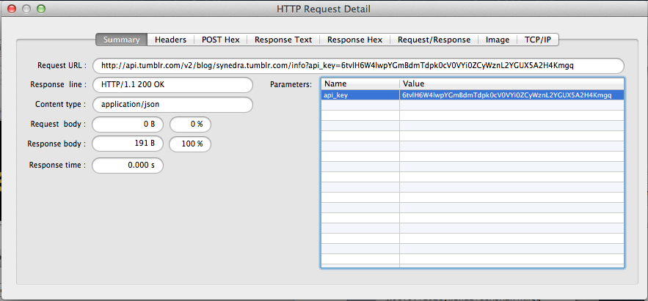
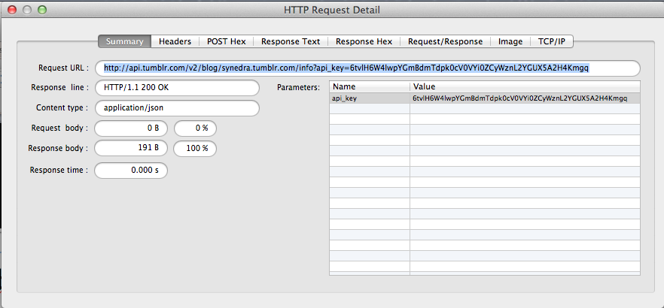
Notes:
32

Slide 33
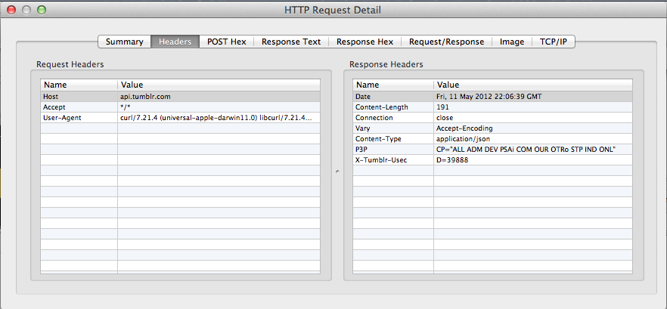
Headers
Notes:
33

Slide 34
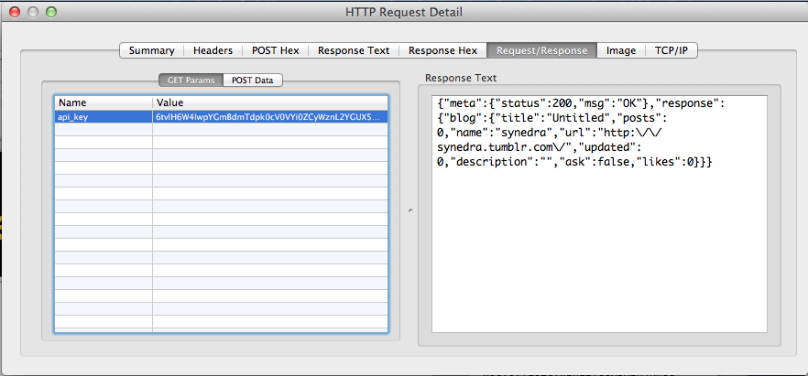
Request/Response
Notes:
34

Slide 35
Four verbs for every noun (the named identifier)
GET to retrieve information
POST to add new information, showing its relation to old information
PUT to update information
DELETE to discard information

Slide 36
Why not just use plain HTML?
Web pages are designed to be understood by people, who care about layout and styling, not just raw data
Every URI could have a human-readable and a machine-processable representation:
Web Services clients ask for the machine-readable one
Browsers ask for the human-readable one

Slide 37
REST style
Client-server
Stateless
Cached
Uniform interface
Layered system (human layer, machine layer)

Slide 38
State
“State” means application/session state
Maintained as part of the content transferred from client to server back to client
Thus any server can potentially continue transaction from the point where it was left off
State is never left in limbo

Slide 39
Transfer of state
Connectors (client, server, cache, resolver, tunnel) are unrelated to sessions
State is maintained by being transferred from clients to servers and back to clients

Slide 40
B2B
B2B systems usually assume that POSTed documents disappear into each partner's internal business systems
Business processes would actually work better if treated like a Web resource
An order is a resource
Shipments and payments are sub-resources
Amazon gets this mostly right

Slide 41
Two kinds of state
Application state is the information necessary to understand the context of an interaction
Authorization and authentication information are examples of application state
Resource state is the kind that the S in REST refers to
The "stateless" constraint means that all messages must include all application state.

Slide 42
Resource state
Changes in resource state are unavoidable
Someone has to POST new resources before others can GET them
REST is about avoiding implicit or unnamed state; resource state is named by URIs
Application state is required by the server to understand how to process a request

Slide 43
Session state
Session state is also application state
If you want a session, you often need smarter clients than a browser
Specialized clients can manage both application and resource state

Slide 44
Sessions
A purchasing client could send a single HTTP request mentioning everything it wanted to purchase in one message
Shopping carts are for people, who have trouble keeping state in their heads

Slide 45
The purpose of statelessness
Prevents partial failures
Allows for substrate independence
Load-balancing
Service interruptions

Slide 46
Another kind of state
Don’t confuse REST state with state-machine state
REST state is the representation of the values of the properties of a resource
State machines fit into REST when the states are expressed as resources with links indicating transitions

Slide 47
The “OOP on the Web” theory
HTTP is just a transport layer between objects
Messages and objects are both opaque
Objects jealously guard their private state

Slide 48
Smash the (private) state
Eliminating private state lets us develop architectures that can scale to larger designs.
REST systems transfer the entire state of the transaction at every state transition
You can pick up where you left off by merely accessing the URI at a later time, regardless of client or server changes.

