Slide 2
Maven

Slide 3
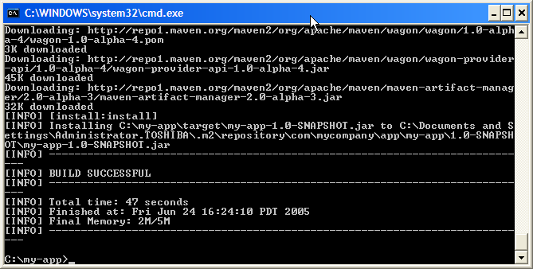
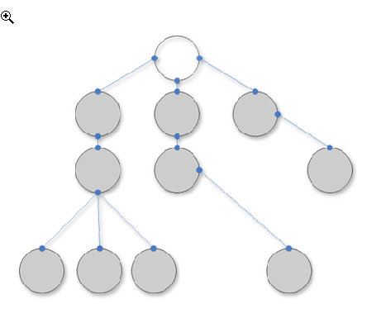
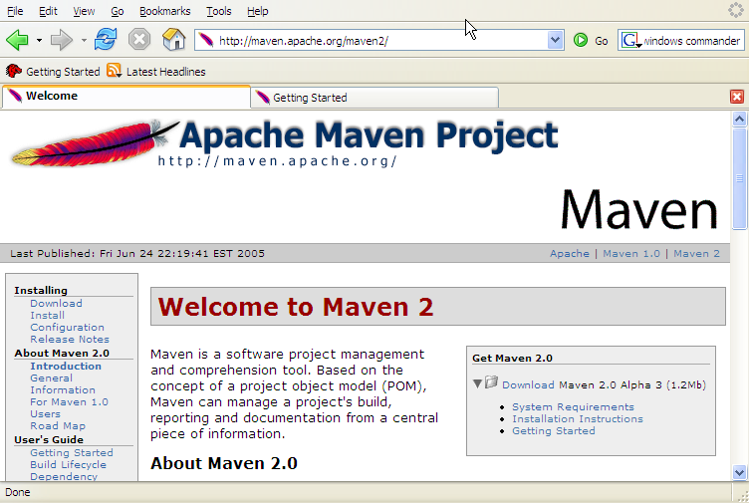
What is Maven?
A build tool
A dependency management tool
A documentation tool
Notes:
3

Slide 4

Maven makes your builds boring…
Building projects should be easy and standardized. You should not be spending a substantial amount of your project time on builds. Builds should just work!
Notes:
4

Slide 5
Benefits of Maven
Portability and Standardization
Fast and easy to set up a powerful build process
Dependency management (automatic downloads)
Project website generation, Javadoc
Continuous Integration Server automatic
Very useful for TDD and testing
Notes:
5

Slide 6
Installation and Setup
Download Maven from http://maven.apache.org/
Unzip the distribution
Create environment variable M2_HOME, which points to Maven directory, e.g. c:\tools\apache-maven-3.1.0
Add Maven’s bin directory to System Variable Path
Ensure JAVA_HOME is set to JDK
Run mvn –version to test install
C:\Users\alina.vasiljeva>mvn -version
Apache Maven 3.1.0 (893ca28a1da9d5f51ac03827af98bb730128f9f2;
2013-06-28 05:15:32+0300)
Maven home: C:\tools\apache-maven-3.1.0\bin\..
Notes:
6

Slide 7
Maven Background
Is a Java build tool
“project management and comprehension tool”
An Apache Project
Mostly sponsored by Sonatype
History
Maven 1 (2003)
Very Ugly
Used in Stack 1
Maven 2 (2005)
Complete rewrite
Not backwards Compatible
Used in Stack 2.0,2.1,2.2,3.0
Maven 3 (2010)
Same as Maven 2 but more stable
Used in Stack 2.3, 3.1

Slide 8
The Maven Mindset
All build systems are essentially the same:
Compile Source code
Link resources and dependencies
Compile and Run Tests
Package Project
Deploy Project
Cleanup
Notes:
8

Slide 9
Other Java Build Tools
Ant (2000)
Granddaddy of Java Build Tools
Scripting in XML
Very flexible
Ant+Ivy (2004)
Ant but with Dependency Management
Gradle (2008)
Attempt to combine Maven structure with Groovy Scripting
Easily extensible

Slide 10
Maven Learning Resources
Maven Homepage
http://maven.apache.org
Reference Documentation for Maven
Reference Documentation for core Plugins
Sonatype Resources
http://www.sonatype.com/resource-center.html
Free Books
Videos

Slide 11
Project Name (GAV)
Maven uniquely identifies a project using:
groupID: Arbitrary project grouping identifier (no spaces or colons)
Usually loosely based on Java package
artfiactId: Arbitrary name of project (no spaces or colons)
version: Version of project
Format {Major}.{Minor}.{Maintanence}
Add ‘-SNAPSHOT ‘ to identify in development
GAV Syntax: groupId:artifactId:version
<?xml version="1.0" encoding="UTF-8"?>
<project>
<modelVersion>4.0.0</modelVersion>
<groupId>org.lds.training</groupId>
<artifactId>maven-training</artifactId>
<version>1.0</version>
</project>
Check version and create a new maven quickstart project from CLI

Slide 12
Maven Conventions
Maven is opinionated about project structure
target: Default work directory
src: All project source files go in this directory
src/main: All sources that go into primary artifact
src/test: All sources contributing to testing project
src/main/java: All java source files
src/main/webapp: All web source files
src/main/resources: All non compiled source files
src/test/java: All java test source files
src/test/resources: All non compiled test source files

Slide 13
Maven Build Lifecycle
A Maven build follow a lifecycle
Default lifecycle
compile
test
package
Install
site
deploy
Notes:
13

Slide 14
Example Maven Goals
To invoke a Maven build you set a lifecycle “goal”
mvn install
Invokes generate* and compile, test, package, integration-test, install
mvn clean
Invokes just clean
mvn clean compile
Clean old builds and execute generate*, compile
mvn compile install
Invokes generate*, compile, test, integration-test, package, install
mvn test clean
Invokes generate*, compile, test then cleans
Notes:
14

Slide 15
Maven and Dependencies
Maven revolutionized Java dependency management
No more checking libraries into version control
Introduced the Maven Repository concept
Established Maven Central
Created a module metadata file (POM)
Introduced concept of transitive dependency
Often include source and javadoc artifacts
Notes:
15

Slide 16
Adding a Dependency
Dependencies consist of:
GAV
Scope: compile, test, provided (default=compile). Provided are those that are provided at runtime by the Server for example.
Type: jar, pom, war, ear, zip (default=jar)
<project>
...
<dependencies>
<dependency>
<groupId>javax.servlet</groupId>
<artifactId>servlet-api</artifactId>
<version>2.5</version>
<scope>provided</scope>
</dependency>
</dependencies>
</project>

Slide 17
Maven Repositories
Dependencies are downloaded from repositories
Via http
Downloaded dependencies are cached in a local repository
Usually found in ${user.home}/.m2/repository
Repository follows a simple directory structure
{groupId}/{artifactId}/{version}/{artifactId}-{version}.jar
groupId ‘.’ is replaced with ‘/’
Maven Central is primary community repo
http://repo1.maven.org/maven2
Check the local system for .m2 dependencies

Slide 18
Proxy Repositories
Proxy (Private) Repositories are useful:
Organizationally cache artifacts
Allow organization some control over dependencies
Combines repositories

Slide 19
Defining a repository
Private repositories are defined in the pom
Repositories can be inherited from parent
Repositories are keyed by id
Downloading snapshots can be controlled
<project>
...
<repositories>
<repository>
<id>lds-main</id>
<name>LDS Main Repo</name>
<url>http://code.lds.org/nexus/content/groups/main-repo</url>
<snapshots>
<enabled>false</enabled>
</snapshots>
</repository>
</repositories>
</project>

Slide 20
Transitive Dependencies
Transitive Dependency Definition:
A dependency that should be included when declaring project itself is a dependency
ProjectA depends on ProjectB
If ProjectC depends on ProjectA then ProjectB is automatically included
Only compile and runtime scopes are transitive
Transitive dependencies are controlled using:
Exclusions
Optional declarations

Slide 21
Dependency Exclusions
Exclusions exclude transitive dependencies
Dependency consumer solution
<project>
...
<dependencies>
<dependency>
<groupId>org.springframework</groupId>
<artifactId>spring-core</artifactId>
<version>3.0.5.RELEASE</version>
<exclusions>
<exclusion>
<groupId>commons-logging</groupId>
<artifactId>commons-logging</artifactId>
</exclusion>
</exclusions>
</dependency>
</dependencies>
</project>

Slide 22
Dependency Management
What do you do when versions collide?
Allow Maven to manage it?
Complex and less predictable
Take control yourself
Manage the version manually
In Java you cannot use both versions
<project>
...
<dependencyManagement>
<dependencies>
<dependency>
<groupId>org.springframework</groupId>
<artifactId>spring-core</artifactId>
<version>3.0.5.RELEASE</version>
</dependency>
</dependencies>
</dependencyManagement>
</project>

Slide 23
Super POM
Convention over configuration. The Super POM is Maven's default POM
All POMs extend the Super POM unless explicitly set
The configuration specified in the Super POM is inherited by the POMs you created for your projects
Super POM snippet can be found here:
http://maven.apache.org/guides/introduction/introduction-to-the-pom.html
Notes:
23

Slide 24
Standard directory organization
Having a common directory layout would allow for users familiar with one Maven project to immediately feel at home in another Maven project.
src/main/java
Application/Library sources
src/main/resources
Application/Library resources
src/main/filters
Resource filter files
src/main/assembly
Assembly descriptors
src/main/config
Configuration files
src/main/webapp
Web application sources
src/test/java
Test sources
src/test/resources
Test resources
src/test/filters
Test resource filter files
src/site
Site
LICENSE.txt
Project's license
README.txt
Project's readme
Notes:
24

Slide 25
Overview of common Goals
validate - validate the project is correct and all necessary information is available
compile - compile the source code of the project
test - test the compiled source code using a suitable unit testing framework. These tests should not require the code be packaged or deployed.
package - take the compiled code and package it in its distributable format, such as a JAR
integration-test - process and deploy the package if necessary into an environment where integration tests can be run
install - install the package into the local repository, for use as a dependency in other projects locally
site – create documentation for the project.
deploy - done in an integration or release environment, copies the final package to the remote repository for sharing with other developers and projects
Notes:
25

Slide 26
Create a new quickstart app and add StringEscapeUtils dependency
Add a dependency
Add a new dependency in pom.xml
<project>
<modelVersion>4.0.0</modelVersion>
<groupId>com.web.music</groupId>
<artifactId>my_project</artifactId>
<packaging>jar</packaging>
<version>1</version>
<name>my_project</name>
<dependencies>
<dependency>
<groupId>log4j</groupId>
<artifactId>log4j</artifactId>
<version>1.2.17</version>
</dependency>
</dependencies>
<build/>
</project>
Notes:
26

Slide 27
Maven console output
C:\Temp\my-app>mvn compile
[INFO] Scanning for projects...
[INFO]
[INFO] ------------------------------------------------------------------------
[INFO] Building my-app 1.0-SNAPSHOT
[INFO] ------------------------------------------------------------------------
...
Downloading: http://repo1.maven.org/maven2/log4j/log4j/1.2.17/log4j-1.2.17.jar
Downloaded: http://repo1.maven.org/maven2/log4j/log4j/1.2.17/log4j-1.2.17.jar (359 KB at 49.4 KB/sec)
[INFO] Not writing settings - defaults suffice
[INFO] Wrote Eclipse project for "my-app" to C:\Temp\my-app.
[INFO]
[INFO] ------------------------------------------------------------------------
[INFO] BUILD SUCCESS
[INFO] ------------------------------------------------------------------------
[INFO] Total time: 9.302s
[INFO] Finished at: Mon Sep 12 19:34:32 EEST 2012
[INFO] Final Memory: 9M/153M
[INFO] ------------------------------------------------------------------------
Notes:
27

Slide 28
Local repository
What does Maven do with all the dependencies?
→ C:\Documents and Settings\<username>\.m2
Advantages: No need to keep anything in the repo other than your own source code, saves space in the repo and rebuild / transfer time
Can download dependencies from a local intranet repo instead of repo1.maven.org, etc
IntelliJ needs to know the path to the local Maven repository. Therefore the classpath variable M2_REPO has to be set:
Java > Build Path > Classpath Variables
Notes:
28

Slide 29
Installing JARs to local repository
Sometimes you need to put some specific JARs in your local repository for use in your builds
The JARs must be placed in the correct place in order for it to be correctly picked up by Maven
To install a JAR in the local repository use the following command:
Now can include
dependency in
pom.xml:
mvn install:install-file -Dfile=<path-to-file> -DgroupId=<group-id> \
-DartifactId=<artifact-id> -Dversion=<version> -Dpackaging=jar
<dependency>
<groupId><group-id></groupId>
<artifactId><artifact-id></artifactId>
<version><version></version>
</dependency>
Notes:
29

Slide 30
run mvn site on jaLabJava
Creating project website
Execute mvn site goal
Maven will start downloading and creating things left and right
Eventually in the \target dir you end up with a \site dir, with an apache-style project website
Javadoc, various reports, and custom content can be added
Notes:
30

Slide 31
Website features
Continuous Integration
Dependencies (JUnit is listed)
Issue Tracking
Mailing Lists
Project License
Project Team
Source Repository
Notes:
31

Slide 32
Using Maven Plugins
Plugins in Maven 2.0 look much like a dependency
For example, configure the Java compiler
to allow
JDK 6.0
sources
...
<build>
<plugins>
<plugin>
<groupId>org.apache.maven.plugins</groupId>
<artifactId>maven-compiler-plugin</artifactId>
<configuration>
<source>1.6</source>
<target>1.6</target>
</configuration>
</plugin>
</plugins>
</build>
...
Notes:
32

Slide 33
Good things about Maven
Standardization
Reuse
Dependency management
Build lifecycle management
Large existing repository
IDE aware
One directory layout
A single way to define dependencies
Setting up a project is really fast
Transitive dependencies
Common build structure
Use of remote repository
Web site generation
Build best practices enforcement
Automated build of application
Works well with distributed teams
All artifacts are versioned and are stored in a repository
Build process is standardized for all projects
A lot of goals are available
It provides quality project information with generated site
Easy to learn and use
Makes the build process much easier at the project level
Promotes modular design of code
Many, many templates!
Notes:
33

Slide 34



Alternatives
There are also alternative build tools
An up-and-coming star in the build world.
Groovy, Ant and Ivy combined.
Ruby Java building with Maven repositories
The agile dependency manager from Apache
http://www.streamhead.com/maven-alternatives/

Slide 35
References
Maven Home
http://maven.apache.org/
Maven Getting Started Guide
http://maven.apache.org/guides/getting-started/index.html
Steps for creating a Maven-based Website
http://www.javaworld.com/javaworld/jw-02-2006/jw-0227-maven_p.html
Maven 3 Plugins Project
http://mojo.codehaus.org/
Notes:
35

Slide 36
Where to install maven?
https://maven.apache.org/guides/getting-started/maven-in-five-minutes.html
why modelVersion in a maven file?
http://stackoverflow.com/questions/19759338/why-modelversion-of-pom-xml-is-necessary-and-always-set-to-4-0-0
mvn archetype:generate -DgroupId=edu.uchicago.gerber.ajava -DartifactId=maven02 -DarchetypeArtifactId=maven-archetype-quickstart -DinteractiveMode=false
StringEscapeUtils
https://maven.apache.org/guides/getting-started/maven-in-five-minutes.html
<p>Hello from Html.</p>
StringEscapeUtils.escapeHtml4(paragraph);
use site to generate documentation
http://books.sonatype.com/mvnref-book/reference/site-generation-sect-custom-descript.html

