Slide 1

BIKE PRICE ANALYSIS: INSIGHTS FROM USED BIKE MARKET DATA

Slide 2
ABOUT ME
I am Yallapragada Anusha.
Passionate about Data Analysis, Python, and Data Visualization.
Skilled in data collection, cleaning, visualization, and analysis.
Eager to apply data-driven insights to solve real-world problems.
Continuously improving skills in web scraping, exploratory data analysis, and predictive modeling.

Slide 3
PREFACE
INTRODUCTION
BUSINESS PROBLEM
OBJECTIVES
WEB SCRAPING
DATASET OVERVIEW
DATA QUALITY ASSESSMENT
DATA CLEANING – DATA PREPROCESSING
HANDLING MISSING VALUES
DATA TRANSFORMATION & FINAL CLEANING
NON VISUALIZATIONS
DATA VISUALIZATIONS
CONCLUSION
EXPERIENCE AND CHALLENGES

Slide 4
INTRODUCTION
The two-wheeler resale market is growing rapidly due to increasing demand for affordable personal transportation.
Online platforms list thousands of used bikes with varying prices, conditions, and specifications.
However, price variation depends on multiple factors such as model year, usage, engine capacity, ownership history, and location.
This project performs Exploratory Data Analysis (EDA) on a used bike dataset to understand pricing patterns and key influencing factors.
Real-world resale data often contains missing values, inconsistent formats, and noise, making preprocessing a critical step before analysis.
By analyzing historical listings, the project aims to uncover market trends and provide data-backed insights into the used bike ecosystem.

Slide 5
BUSINESS PROBLEM
The used two-wheeler resale market lacks standardized pricing, leading to large variations for similar bikes.
Buyers often struggle to assess whether a listed bike price is fair, overpriced, or undervalued.
Sellers rely on intuition rather than data-driven insights, which can result in incorrect pricing and delayed sales.
Resale platforms handle large volumes of listings but lack analytical insights to highlight optimal price ranges.
Inconsistent data formats, missing values, and unstructured information make analysis and decision-making challenging.
Without proper analysis, stakeholders cannot clearly identify the key factors that influence resale value.
This creates uncertainty and inefficiency in the used bike marketplace.

Slide 6
OBJECTIVES
To clean and preprocess real-world used bike listing data.
To analyze price distribution and ownership trends using univariate analysis.
To study relationships between price and factors such as kilometers run, model year, and engine capacity.
To generate actionable insights that support buyers, sellers, and business platforms in decision-making.

Slide 7
WEB SCRAPING
An online used two-wheeler resale platform was selected as the data source.
Browser Developer Tools (Inspect Element) were used to identify relevant HTML tags and page structure.
Python libraries such as Requests and BeautifulSoup were used to send HTTP requests and extract listing data.
Publicly available web pages were fetched and parsed to collect structured information.
The extracted data was consolidated into a single dataset for further processing and analysis.
Exploratory Data Analysis (EDA) was performed to identify pricing patterns, trends, and relationships among features.

Slide 8
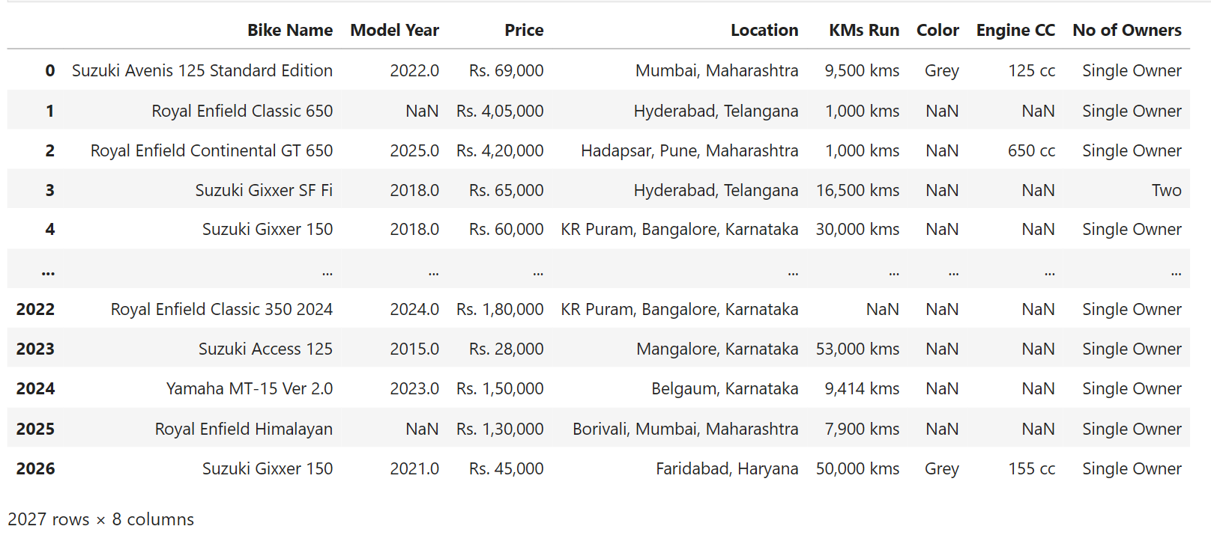
DATASET

Slide 9
DATASET OVERVIEW
The initial dataset consists of 2027 used bike listings with 8 features.
Key attributes include bike name, model year, price, location, kilometers run, engine capacity, color, and ownership details.
The dataset contains a mix of numerical and categorical variables.
Model years range from 1980 to 2026, indicating both old and recent bike listings.
Several columns contained missing values and inconsistent formats, requiring preprocessing.

Slide 10
DATA QUALITY ASSESSMENT
Price, kilometers run, and engine capacity were initially stored as text with units and symbols.
Significant missing values were observed in Color and Engine CC columns.
Minor missing values were found in Model Year, Price, KMs Run, and Ownership columns.
Data types were inconsistent, limiting direct numerical analysis.
DATA CLEANING - PREPROCESSING
Removed currency symbols, commas, and units from numerical columns.
Converted Price, KMs Run into numeric data types.
Invalid or non-numeric values were converted to missing values (NaN).
Standardized ownership labels for consistency (e.g., Single → One Owner).

Slide 11
HANDLING MISSING VALUES
Median imputation was used for Price, KMs Run, and Model Year.
Median was chosen as it is robust to outliers in resale price data.
Categorical missing values were handled using:
Mode imputation for ownership
“Not Mentioned” category for color
“Unknown” category for Engine CC
This approach preserved dataset size and reduced bias.
DATA TRANSFORMATION & FINAL CLEANING
Location column was split into City and State for regional analysis.
State-wise analysis enabled geographical trend identification.
Duplicate records were removed to avoid redundancy.
Final cleaned dataset contains 1980 records with zero missing values.

Slide 12
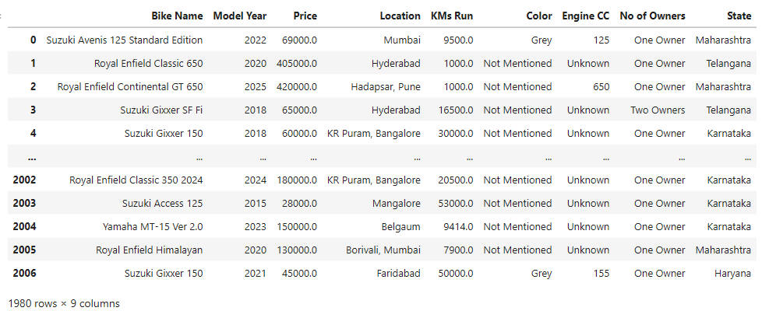

Slide 13
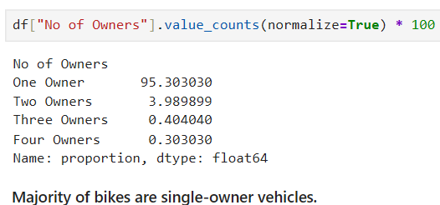
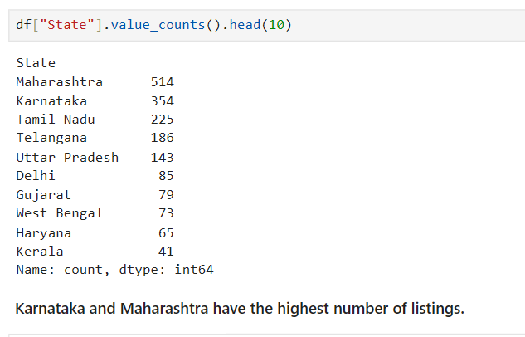
NON-VISUALIZATION
UNIVARIATE ANALYSIS

Slide 14

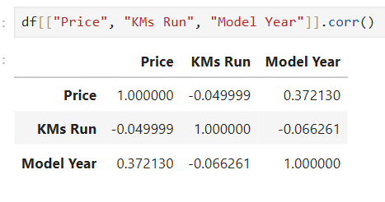
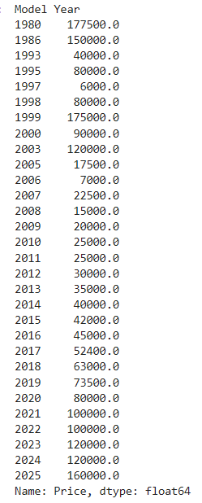
BIVARIATE ANALYSIS
Median price analysis shows that older bikes have highly variable prices due to rarity and condition, while recent bikes (2016–2025) show a clear upward trend in median prices, reflecting the market value of modern models. Using median instead of mean reduces the impact of extreme outliers and provides a more realistic view of typical bike prices for each year.
Price has a positive correlation with model year, indicating that newer and higher-capacity bikes tend to be priced higher. Price shows a weak negative correlation with kilometers run, suggesting that higher usage slightly reduces the price.

Slide 15
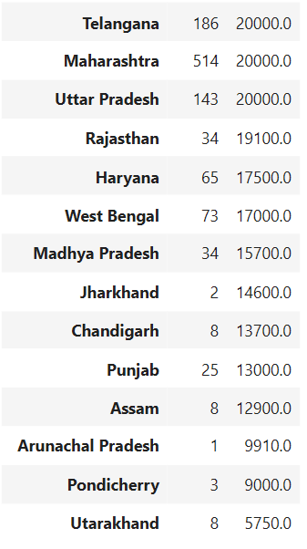
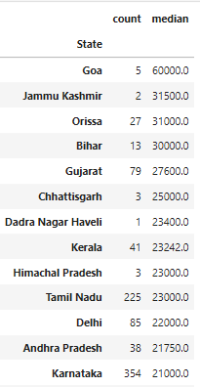
Median kilometers run varies by state, highlighting regional differences in bike usage, condition, and resale potential.

Slide 16
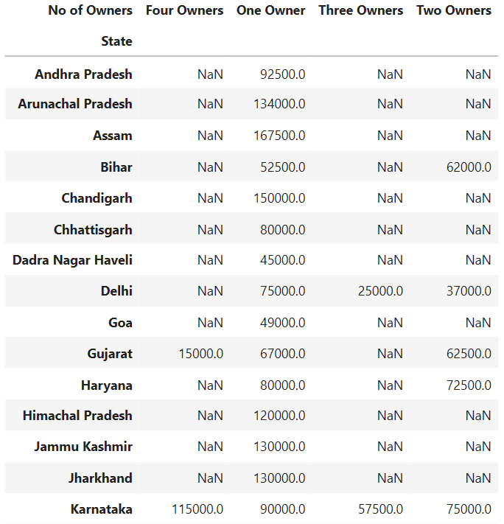
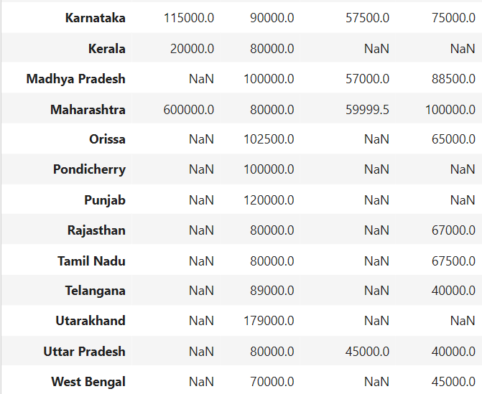
MULTIVARIATE ANALYSIS
Median bike prices vary across states and ownership categories, showing that single-owner bikes generally have higher prices while multi-owner bikes are priced lower.
NaN values indicate the absence of listings for certain state–owner combinations rather than missing or incorrect data.

Slide 17
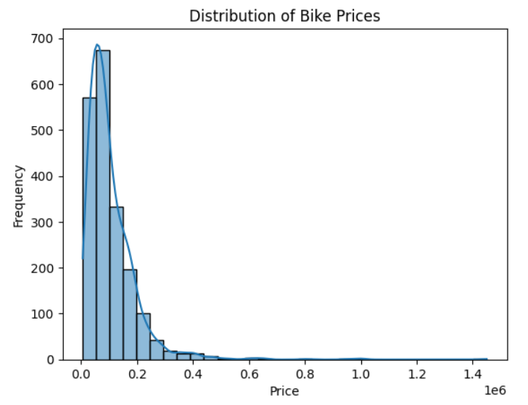
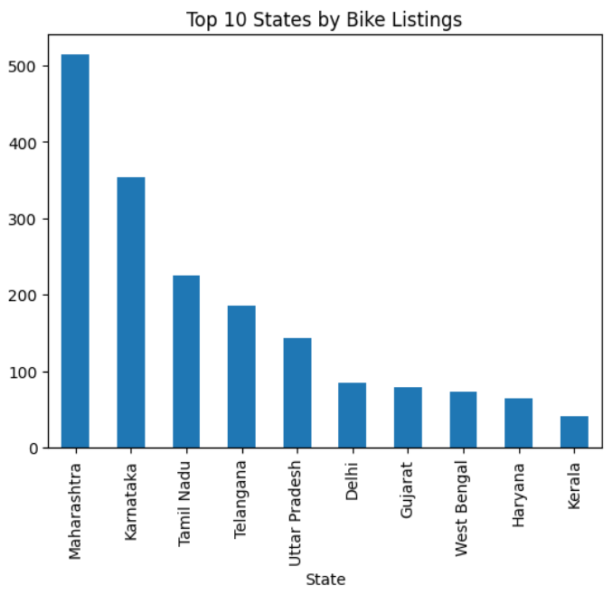
VISUALIZATION
UNIVARIATE ANALYSIS
The bar chart shows that Maharashtra has the highest number of bike listings, followed by Karnataka and Tamil Nadu. This indicates that bike listings are concentrated in a few major states, while other states have comparatively fewer listings.
Most used bikes are priced below ₹2 lakh, indicating a strong concentration in the affordable segment.
A few high-priced bikes create a long right tail, showing that the price distribution is right-skewed due to premium models.

Slide 18
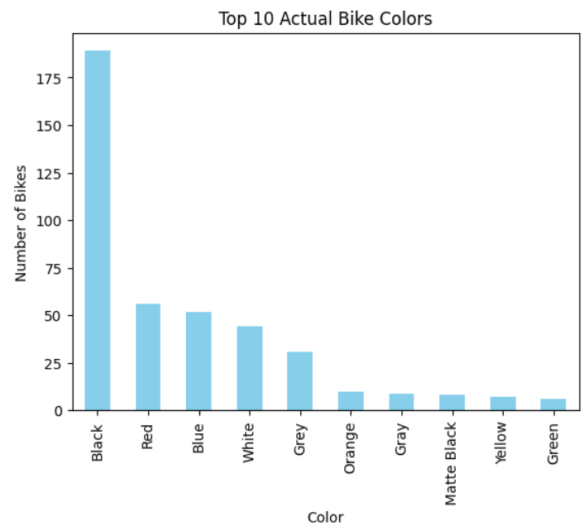
Black is the most common color, dominating the market.
Red, Blue, and White are moderately preferred.
Less frequent colors include Grey, Orange, Green, and Yellow.
Records with missing or unspecified color values were excluded.

Slide 19
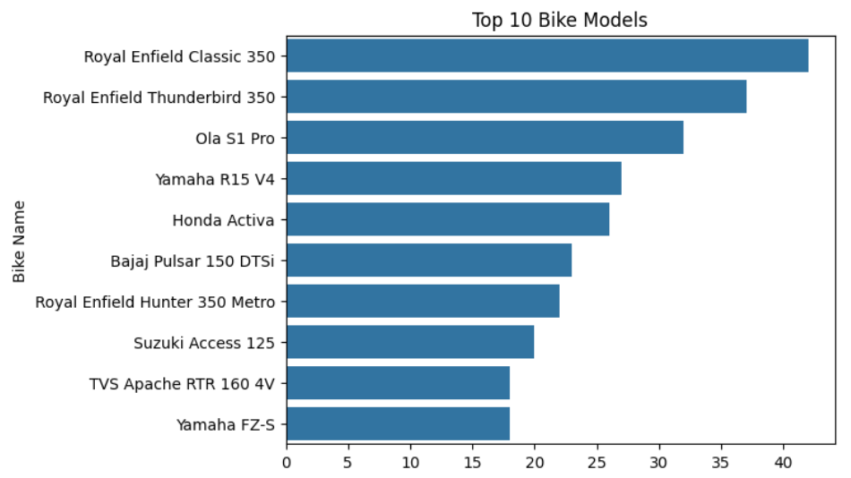
Royal Enfield Classic 350 is the most frequently listed bike, followed by Royal Enfield Thunderbird 350.
Popular commuter and affordable models like Ola S1 Pro, Yamaha R15, Honda Activa, and Bajaj Pulsar 150 are also among the top 10.
This indicates strong resale demand for Royal Enfield bikes and high popularity of mid-range commuter bikes.

Slide 20
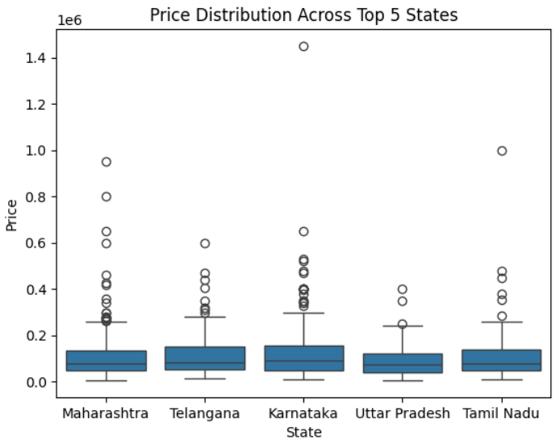
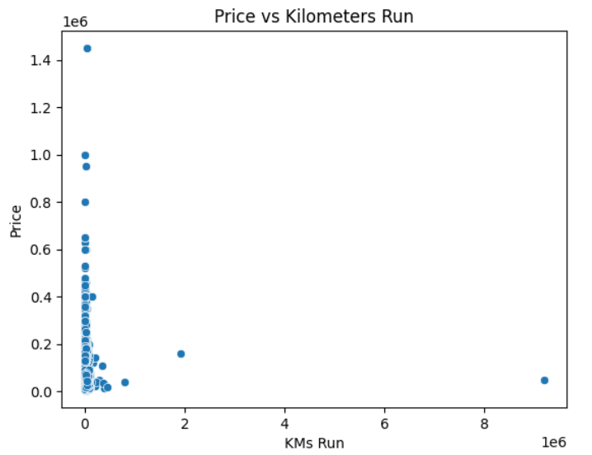
BIVARIATE ANALYSIS
Bike prices are unevenly distributed across states.
States like Karnataka show wider price ranges and extreme outliers, indicating diverse market pricing.
Other states have more compact distributions around the median, showing stable price trends.
There is a negative (inverse) relationship between kilometers run and bike price.
Bikes with lower kirometers run tend to have higher prices, while prices decrease as kilometers increase.
A few outliers exist with unusually high price or mileage.

Slide 21
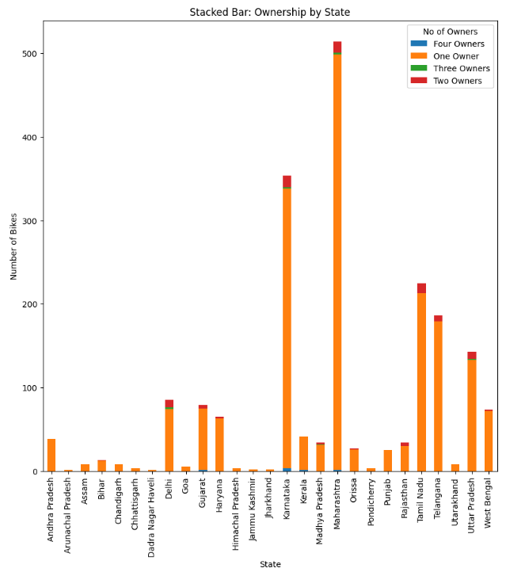
Most bikes across all states are listed as “One Owner”, indicating high resale of relatively new bikes.
Two, Three, and Four Owner bikes are comparatively rare in all states.
States like Maharashtra, Karnataka, and Tamil Nadu have the highest total number of bikes, with the majority being one-owner listings.
This suggests used bikes in popular states are mostly lightly used, making them attractive for resale.

Slide 22
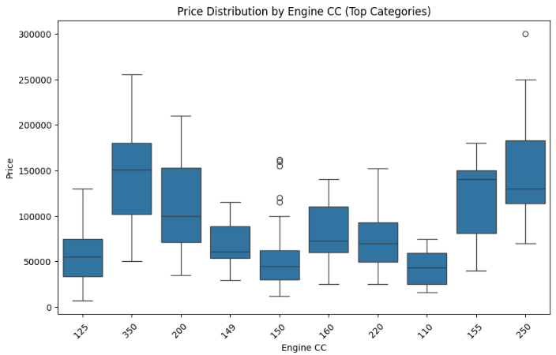
Higher engine CC bikes have higher median prices.
Lower CC bikes are more affordable and price-stable.
Price generally increases with engine capacity.

Slide 23
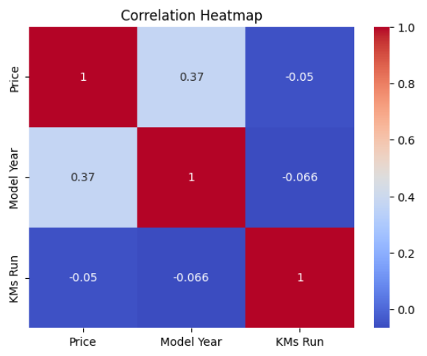
MULTIVARIATE ANALYSIS
Price & Model Year: Moderate positive correlation (0.37), indicating that newer bikes generally have higher prices.
Price & KMs Run: Very weak negative correlation, suggesting mileage has minimal impact on price.
Model Year & KMs Run: Weak negative correlation, showing newer bikes tend to have slightly lower usage.
Bike price is more influenced by model year than by kilometers run.

Slide 24
CONCLUSION
Price trends: Most bikes are priced below ₹2 lakh; higher engine capacity and newer model year generally increase price.
Bike preferences: Black is the most common color; Royal Enfield Classic 350 dominates the market.
Ownership trends: Most bikes are sold by their first owner, with very few multi-owner bikes.
Geographical trends: Prices vary across states, with Karnataka, Maharashtra, and Tamil Nadu showing wider price ranges.
Influencing factors: Engine CC, model year, and brand impact price, but price is a multifactor decision.

Slide 25
EXPERIENCES AND CHALLENGES
Experiences:
Extracted bike listings using Python (BeautifulSoup, Requests) efficiently.
Gained hands-on experience in handling real-world messy datasets.
Performed data cleaning, including removing units, handling missing values, and standardizing text.
Learned to split, transform, and structure data for analysis (e.g., splitting Location into City & State).
Explored trends in price, mileage, engine capacity, and ownership patterns.
Challenges:
Dynamic web pages made scraping multiple listings challenging.
Inconsistent data formats and missing values required careful cleaning.
Numeric columns had special characters and units, needing preprocessing.
Ensuring accuracy and consistency while handling duplicates and irregular entries.
Managing large datasets and maintaining efficiency during scraping and cleaning.

Slide 26

THANK YOU

