Slide 1
Image Encryption Using 4 Out Of 8 Code

Slide 2
OUTLINE OF THE PRESENTATION
Introduction
4 out of 8 code
Generation of carrier image
Encryption
Decryption
Guide
Advantages
Applications
Conclusion
Future work

Slide 3
INTRODUCTION
Image processing
Encryption
Types of encryption

Slide 4
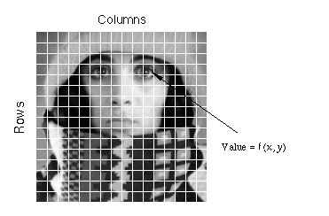
Image processing
Two dimensional function f( x, y),
x & y are spatial co-ordinates
The amplitude of f is called the intensity or gray level
When x, y and f are all finite, discrete quantities; a digital image
Pixel

Slide 5
Encryption :
translation of data into a secret code.
Types of Encryption :
# Symmetric encryption :
uses a single key to encrypt and decrypt the message.
# Asymmetric encryption :
uses two different keys - a public key to encrypt the message, and a private key to decrypt it.

Slide 6
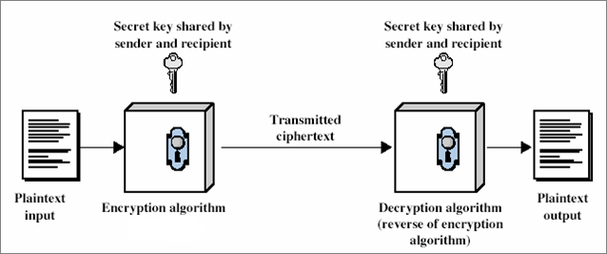
Symmetric encryption

Slide 7
4 OUT OF 8 CODE
A 4 out of 8 code is a byte consisting of equal number of ones and zeroes, provided this byte is a combination of two 2 out of 4 codes.
A 2 out of 4 code is a nibble consisting of equal number of ones and zeroes.

Slide 8
There are 6 possibilities for obtaining a 2 out of 4 code as shown below :
0011
0101
0110
1001
1010
1100

Slide 9
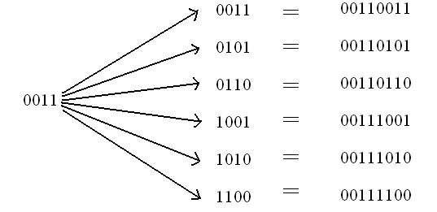
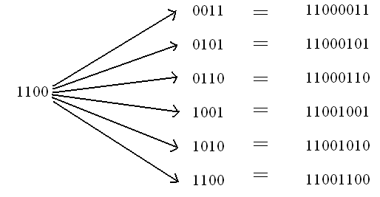
Each of these nibbles is concatenated with all the 6 possibilities of the 2 out of 4 code of the other nibble as shown below :

Slide 10
Look up table
Sl. No. | DEC | BIN | HEX | ALPHA-NUMERIC
1 | 51 | 00110011 | 33 | A,a
2 | 53 | 00110101 | 35 | B,b
3 | 54 | 00110110 | 36 | C,c
4 | 57 | 00111001 | 39 | D,d
5 | 58 | 00111010 | 3A | E,e
6 | 60 | 00111100 | 3C | F,f
7 | 83 | 01010011 | 53 | G,g
8 | 85 | 01010101 | 55 | H,h
9 | 86 | 01010110 | 56 | I,i
10 | 89 | 01011001 | 59 | J,j
11 | 90 | 01011010 | 5A | K,k
12 | 92 | 01011100 | 5C | L,l
13 | 99 | 01100011 | 63 | M,m
14 | 101 | 01100101 | 65 | N,n
15 | 102 | 01100110 | 66 | O,o
16 | 105 | 01101001 | 69 | P,p
17 | 106 | 01101010 | 6A | Q,q
18 | 108 | 01101100 | 6C | R,r

Slide 11
Sl. No. | DEC | BIN | HEX | ALPHA-NUMERIC
19 | 147 | 10010011 | 93 | S,s
20 | 149 | 10010101 | 95 | T,t
21 | 150 | 10010110 | 96 | U,u
22 | 153 | 10011001 | 99 | V,v
23 | 154 | 10011010 | 9A | W,w
24 | 156 | 10011100 | 9C | X,x
25 | 163 | 10100011 | A3 | Y,y
26 | 165 | 10100101 | A5 | Z,z
27 | 166 | 10100110 | A6 | 0
28 | 169 | 10101001 | A9 | 1
29 | 170 | 10101010 | AA | 2
30 | 172 | 10101100 | AC | 3
31 | 195 | 11000011 | C3 | 4
32 | 197 | 11000101 | C5 | 5
33 | 198 | 11000110 | C6 | 6
34 | 201 | 11001001 | C9 | 7
35 | 202 | 11001010 | CA | 8
36 | 204 | 11001100 | CC | 9

Slide 12
GENERATION OF CARRIER IMAGE
A | B | C | D | A | B | C | D
51 | 53 | 54 | 57 | 51 | 53 | 54 | 57
00110011 | 00110101 | 00110110 | 00111001 | 00110011 | 00110101 | 00110110 | 00111001

Slide 13
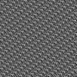

Carrier images
‘digitalelectronicscommunicationsystems’
‘alizee1947’

Slide 14
ENCRYPTION PROCESS
Original image
(mxn)
Carrier image
(mxn)
Encrypted image
(mxn)

Slide 15
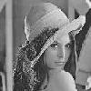
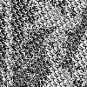
Implementation
ORIGINAL IMAGE
CARRIER IMAGE
ENCRYPTED IMAGE

Slide 16
DECRYPTION PROCESS
Encrypted image
(mxn)
Carrier image
(mxn)
Decrypted image
(mxn)

Slide 17
Implementation
ENCRYPTED IMAGE
CARRIER IMAGE
DECRYPTED IMAGE

Slide 18
Result and discussion
The original image is effectively encrypted using 4 out of 8 code
A strong password can be obtained by selecting alphanumeric values such that their pixel values largely vary from one another. For example, “alizee1947”
The original image from an encrypted image can be obtained only if the correct password is entered
If the password is wrong or even if only half the password is known the original image cannot be obtained

Slide 19
ADVANTAGES
A 4 out of 8 code is any code which can be easily generated and installed on a PC.
The password used may be small enough so that an encrypter can easily remember it.

Slide 20
APPLICATIONS
Secure communication
Secret sharing
Secure electronic mail
Secure computer access

Slide 21
CONCLUSION
A new method for encrypting a grayscale image is developed using 4 out of 8 code with the help of matlab which is more efficient with less or no complexity.

Slide 22
FUTURE WORK
Extension of this work could be the encryption of the color image with the gray scale carrier image and also we can implement the colour carrier image for encrypting the colour image.

Slide 23
Thank you…

