Slide 1
Vulnerability in website
acuforum forums (vulnweb.com)

Slide 2
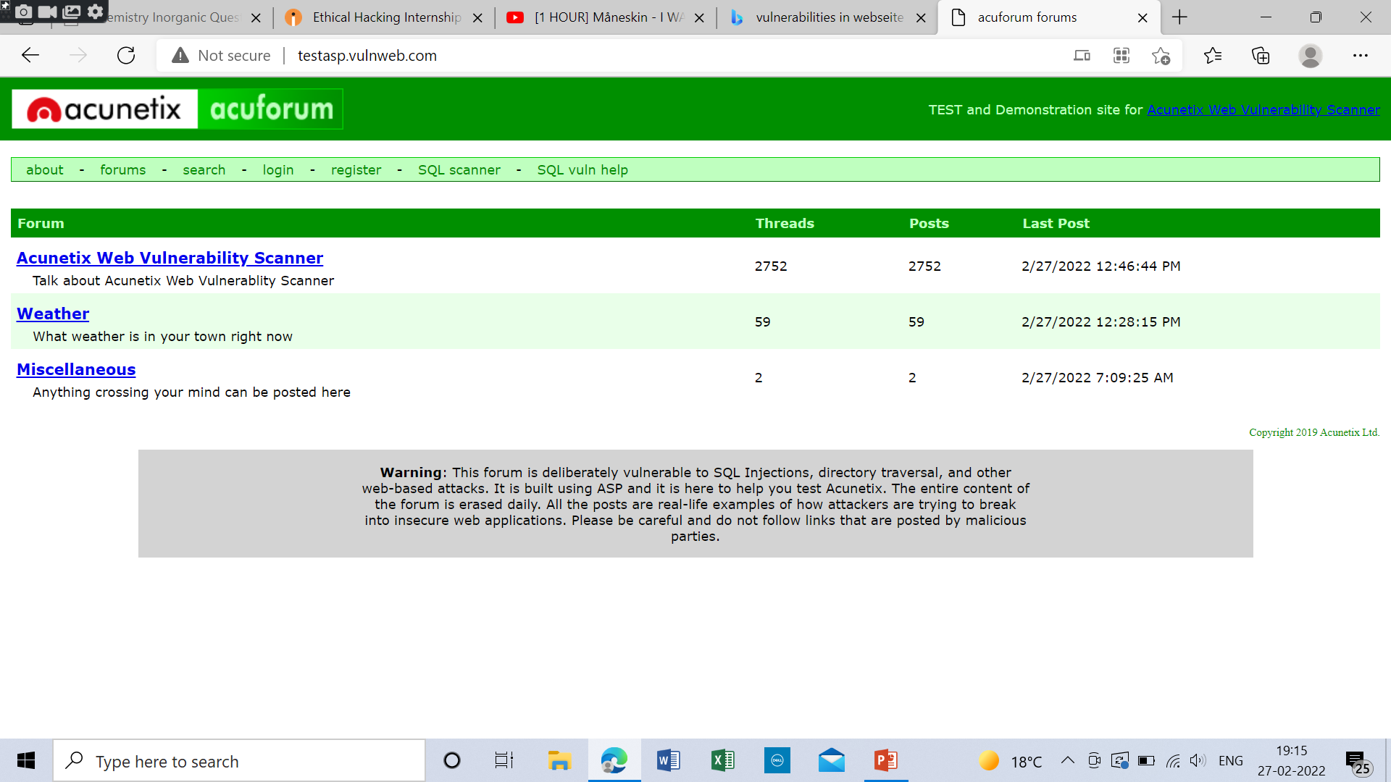
Step 1
: open the web site

Slide 3
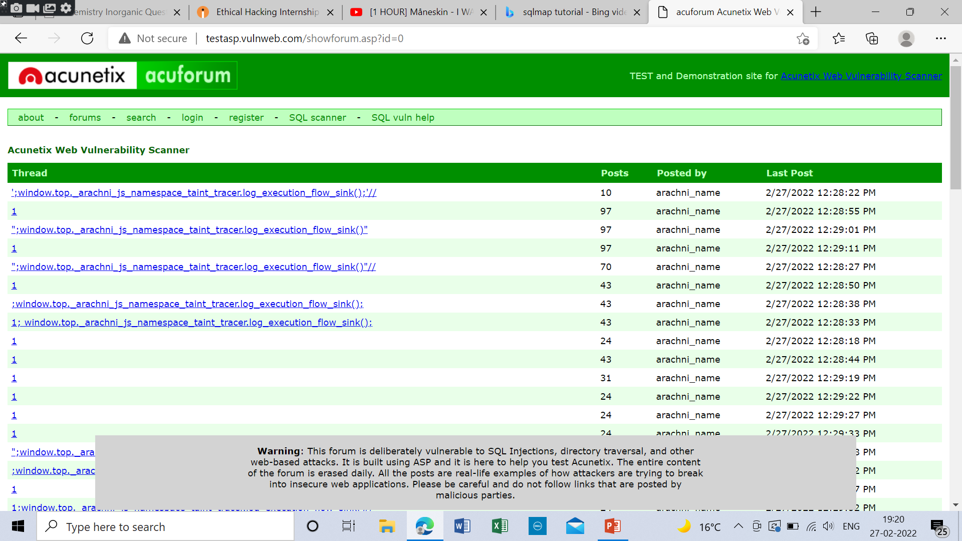
Step2: click on first hyperlink

Slide 4
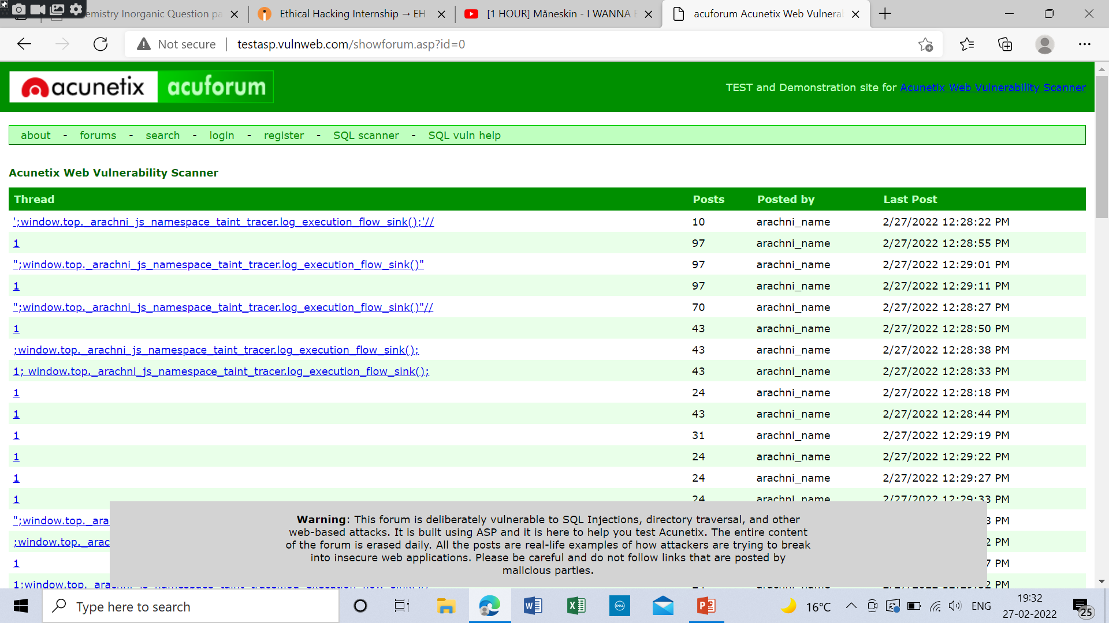
Step 3: copy url and make amendments in source code

Slide 5
Video:the total mb was too large so I attached video separately

