Slide 1

Category Code: C5
Problem Statement Title: Empowering investors with AI-driven strategies
Team Name: 404 Found
Institute Name: Vivekanand Education Society’s Institute of Technology

Slide 2

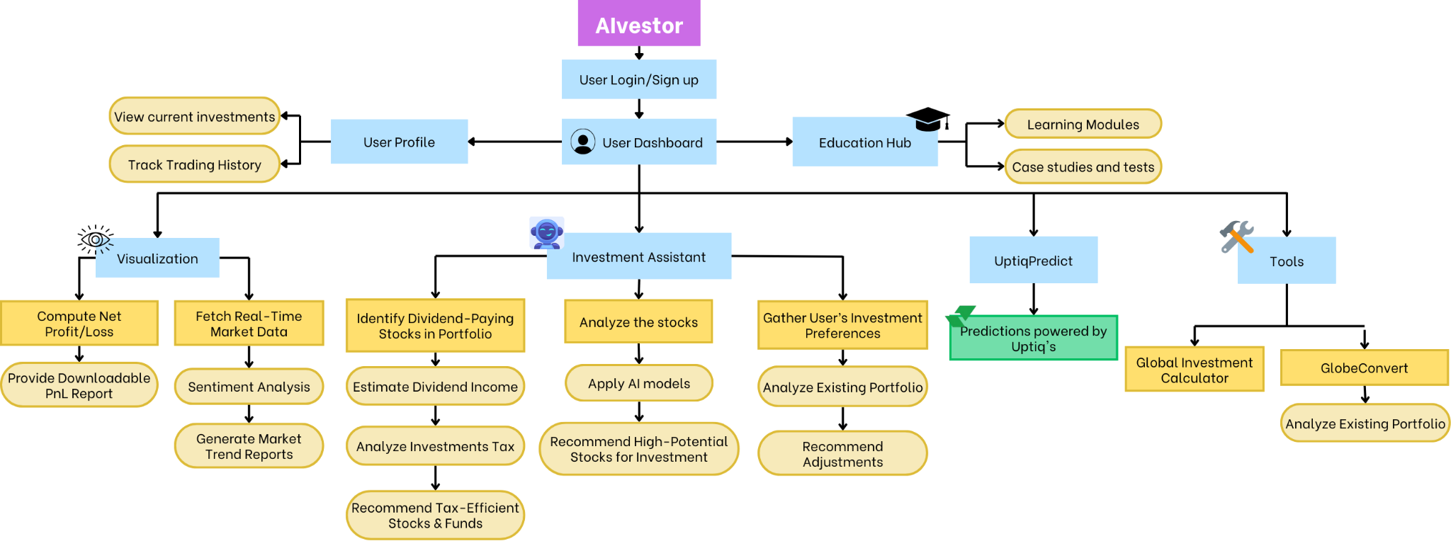
Idea / Approach details (& implemented features)
Problem Statement:
Because of the complexity of markets, the abundance of data, and the lack of individualized insights, investors struggle to make well-informed judgments. Conventional technologies offer static data without sentiment analysis, predictive modeling, or AI-driven flexibility.
Proposed Solution:- The AIvestor AI-Powered Investment Platform
is the suggested remedy; it makes use of AI to
make investment decisions and provide stock market information.
Integration with UptiQ: Leverages historical and real-time market data for accurate insights.
Sentiment analysis and machine learning: Examines past data and market sentiment to make more accurate forecasts.
AI Decision-Making Agents: Automates trading and investment analysis.
AI-driven algorithms are used in predictive analytics to forecast stock patterns.
Portfolio optimization aids users in building and overseeing a variety of investment holdings.
Tailored Stock Suggestions: Makes recommendations for equities according to user preferences and market conditions.
Identification of High-Potential Equity: Identifies cheap stocks with room to expand.

Slide 3
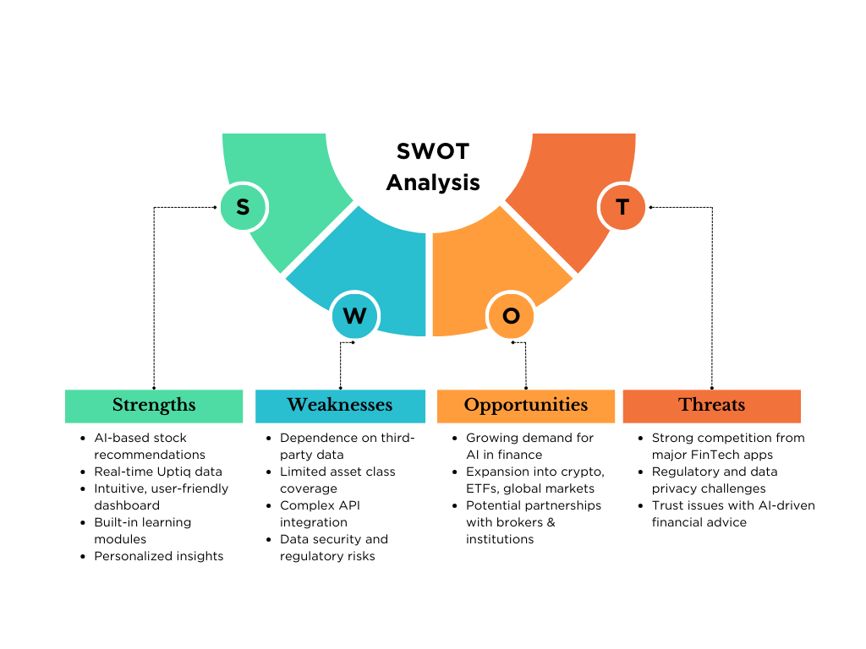
Innovation (Showstopper)
Uptiq Panel : A centralized hub with AI agents for easy access to all Uptiq solutions.
Stock Prediction Sentinel: AI-driven predictions to guide stock investments with precision.
Trend Prediction Agent: Identify market trends early to stay ahead of the curve.
Closing Price Prediction Agent: Forecast stock closing prices for better timing of trades
Visualization & Insights
Real-Time Market Data: Stay ahead with live market updates.
Profit/Loss Tracker: Instantly compute your performance with downloadable reports.
Market Trends: Visualize trends to make data-driven investment decisions.
AI-Powered Investment Assistant
Dividend Stock Finder: Quickly identify stocks with high dividend yields
Tax-Efficient Funds: Get recommendations for tax-optimized fund selections.
Personalized Portfolio Adjustments: Adjust your portfolio based on real-time market changes and personalized goals.

Slide 4



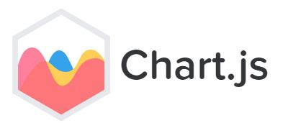

Tech Stack
Frontend :
React.js for building the user interface
Chart.js for interactive data visualizations
Database : Firebase for real-time data storage and authentication
Backend : Flask for creating RESTful APIs and handling server-side logic
Uptiq console for creating advanced AI agents
AIML : NLP,
APIs : Integration with multiple external APIs for market data and other services
Alphavantage
Coingeko
yahoofinance

Slide 5
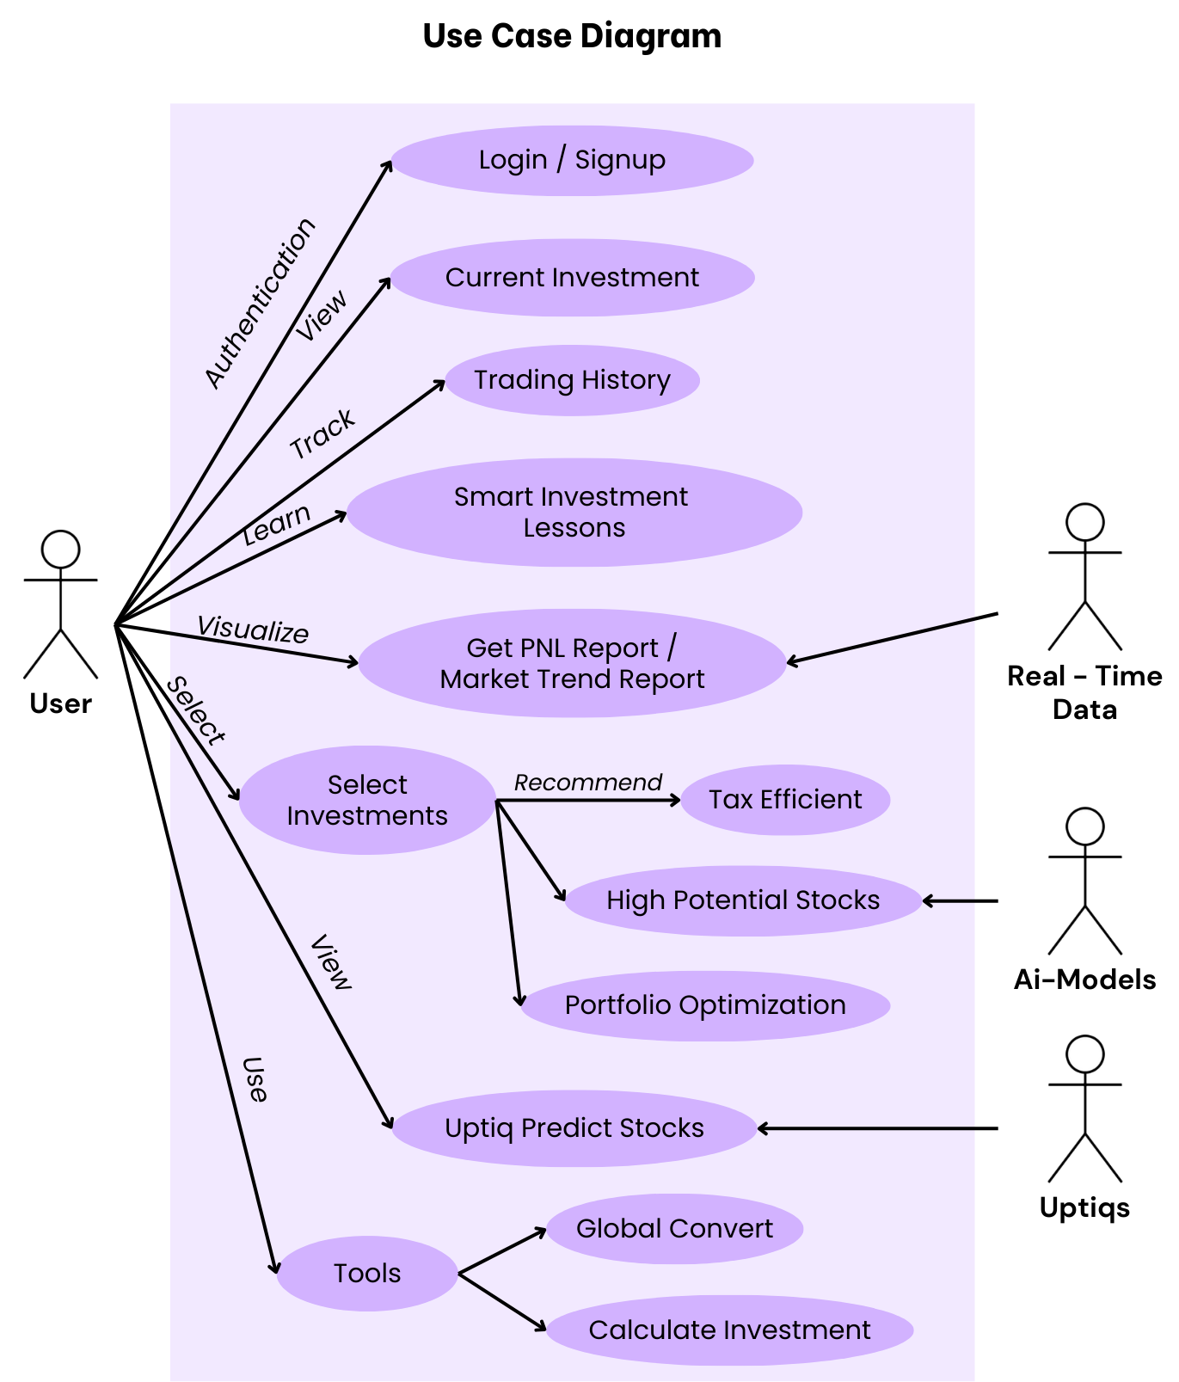
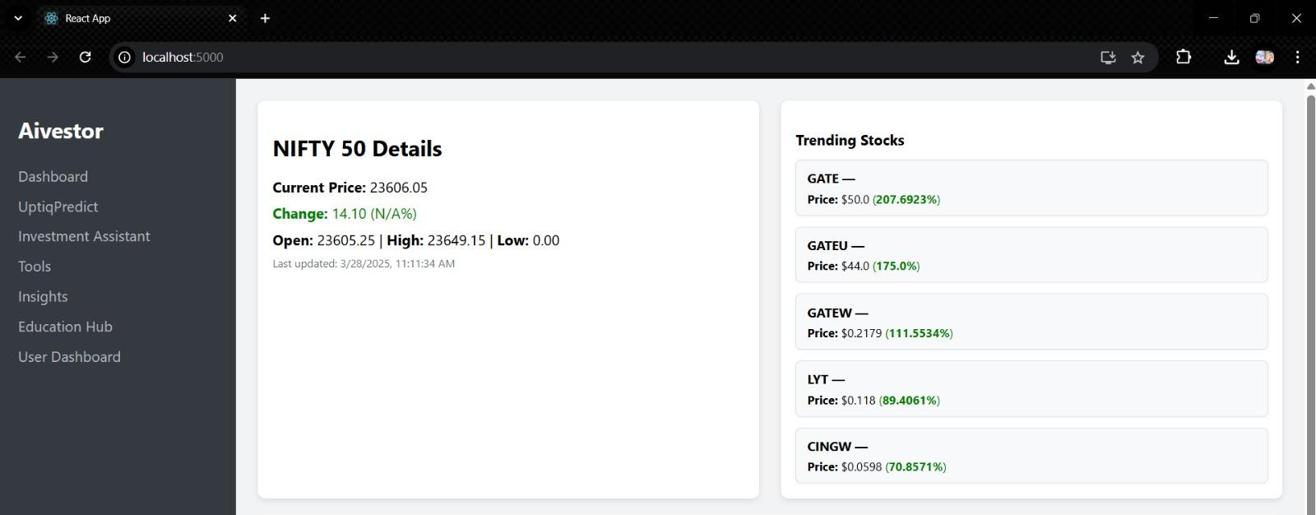
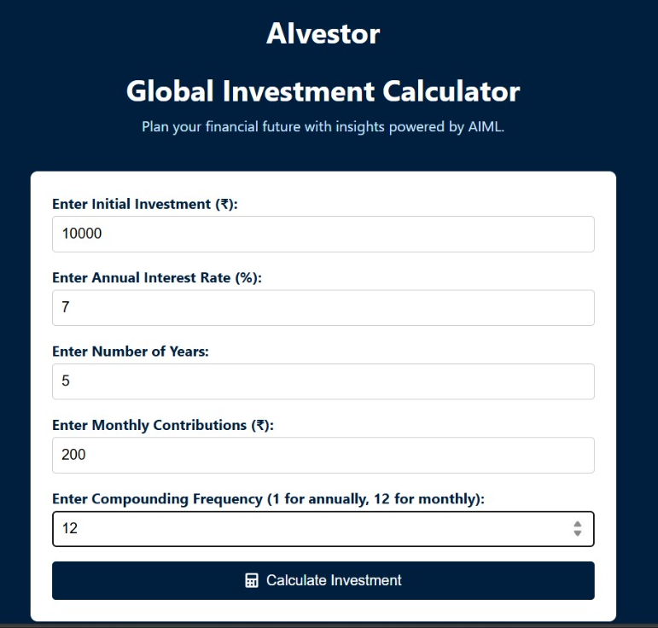
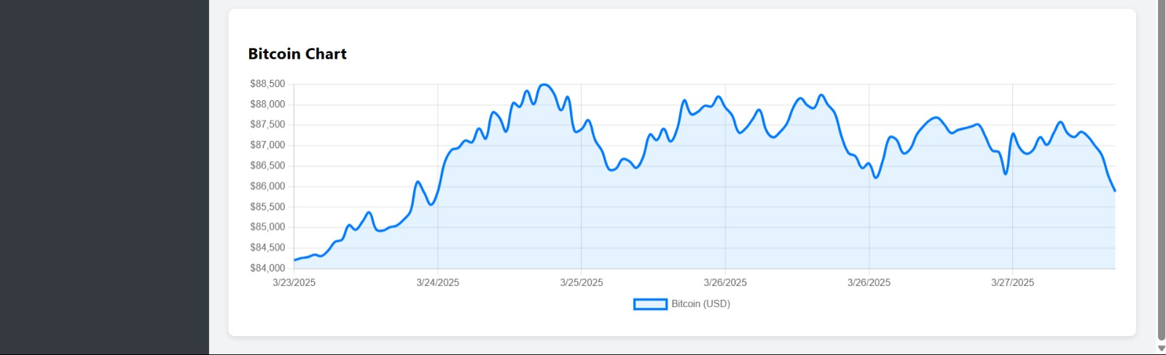

Implementation/Prototype/Use Case Diagram (screenshots)
Implementation Screenshots
Our dashboard is an all-inclusive investment center that shows current market information from live APIs, such as equities, NIFTY indexes, and Bitcoin values. For improved financial insights, it also has a global conversion tool that makes it simple for users to swap between currencies.

Slide 6
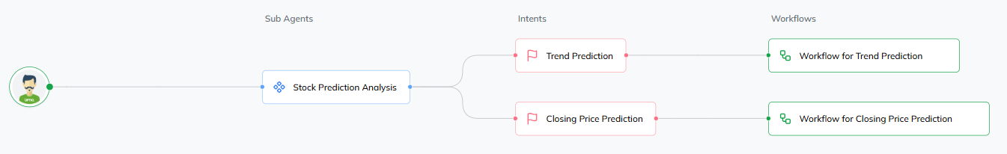
In case of Uptiq category - Your Uptiq Agent (explain in detail)
UptiqPredict is an AI stock market prediction tool that uses advanced algorithms to assist users in predicting closing prices and stock movements. The agent offers useful insights to direct trading and investing decisions by harnessing historical data and financial indicators, ultimately assisting users in navigating the complex dynamics of the stock market.
User Interaction : An investor or analyst looking for stock market predictions communicates with our AI agents.
Sub-Agent: This is the main module in charge of stock data analysis. It interprets user input and routes it to the appropriate prediction models.
Intents : After determining the user's intent, the agent divides it into two main prediction categories:
Trend Prediction: Uses technical indicators and historical patterns to predict whether the stock price will rise or fall.
Closing Price Prediction: Makes use of statistical and machine learning models to forecast the precise closing price of a stock for a specified period of time.

Slide 7
Future Objectives
Enhance AI Models with Uptiq Console
Utilize Uptiq to develop more intelligent and efficient AI models. This will increase precision in trend and price prediction.
Automated P&L Report Generation
Implement auto-generated Profit & Loss statements based on the user's portfolio transactions.
This assists users in tracking their performance and examining returns over time with transparency.
Tax-Optimized Investment Recommendations
Create AI systems that offer investment suggestions aimed at reducing tax liabilities.
It will take into account holding durations, capital gains, and dividend tax strategies.
Investment Learning Hub
Merge all educational materials such as tutorials, quizzes, and market insights into a single module.
This will establish a structured pathway for users to enhance their financial knowledge.

