Slide 1





3D INTERACTIVE MAP
Kolhapur Institute Of Technology, Kolhapur

Slide 2

OUR TEAM
Anusha Patil B44
Pratik Patil B46
Adarsh Gurav B73
Sanket Magdum B77

Slide 3
INTRODUCTION
Our project highlights the tourism and cultural heritage of Kolhapur through an interactive 3D map.
It helps people easily explore places, get accurate information, and connect with the city’s culture.
The platform promotes tourism, ensures accessibility for all, and offers reliable guidance for every visitor.

Slide 4
OBJECTIVES
To develop a 3D map with interactive navigation.
To visualize real-world locations or custom areas in 3D.
To provide clickable details for landmarks or locations.
To enhance learning, tourism, or city planning with 3D visualization.

Slide 5
TECHNICAL ASPECT
  Research Approach:
Studied existing 3D map frameworks and user needs (multilingual, audio support).
Designed and built a prototype focused on Kolhapur city.
For More attraction made a blender animation earth with zoom effects.
  Tools and Technologies:
Mapbox GL JS – for 3D map rendering.
HTML, CSS, JavaScript (react)– for web development.
Audio libraries – to provide multilingual audio support.
Blender – For Earth animation and effects.

Slide 6
WORK DONE TILL NOW
✅ Research on existing 3D map platforms (Google Earth, Mapbox).
✅ Selected framework/library (e.g., Three.js).
✅ Created a basic 3D model / map view.
✅ Implemented basic camera controls (zoom, pan, rotate).
✅ Loaded sample location data.

Slide 7
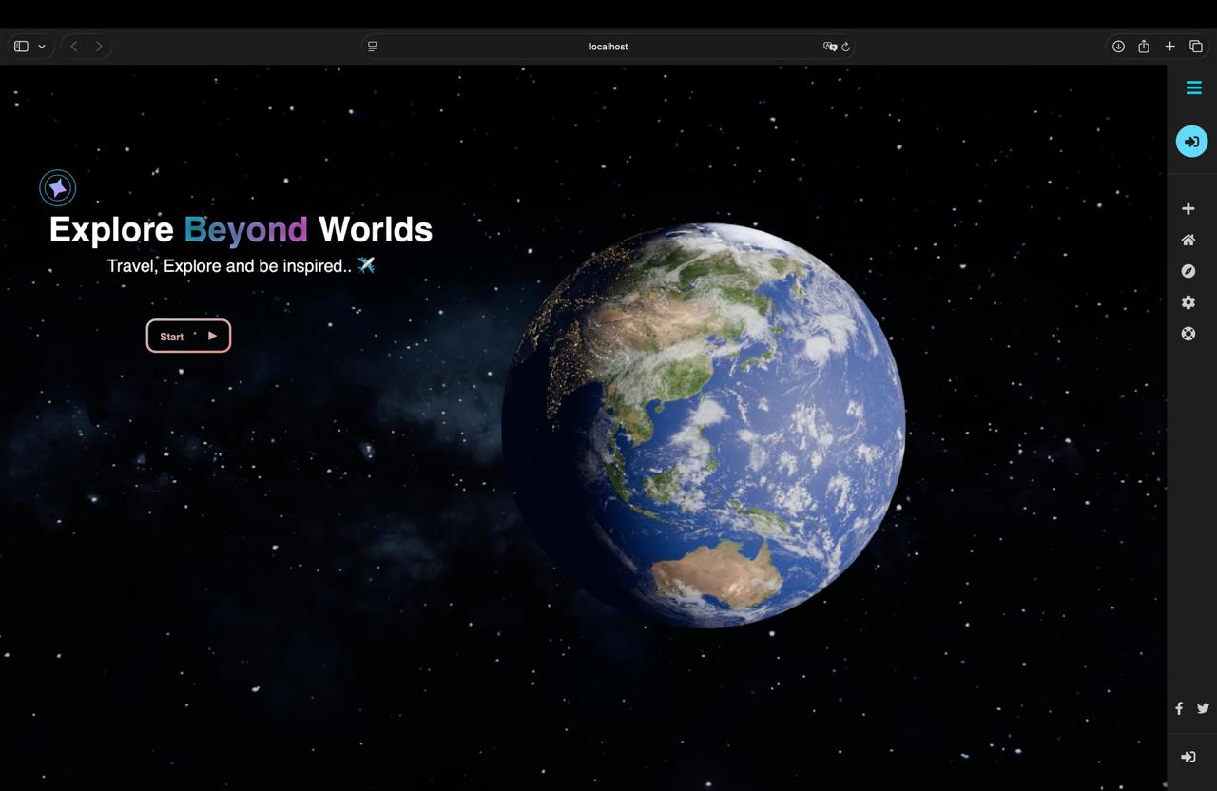
Home Page

Slide 8
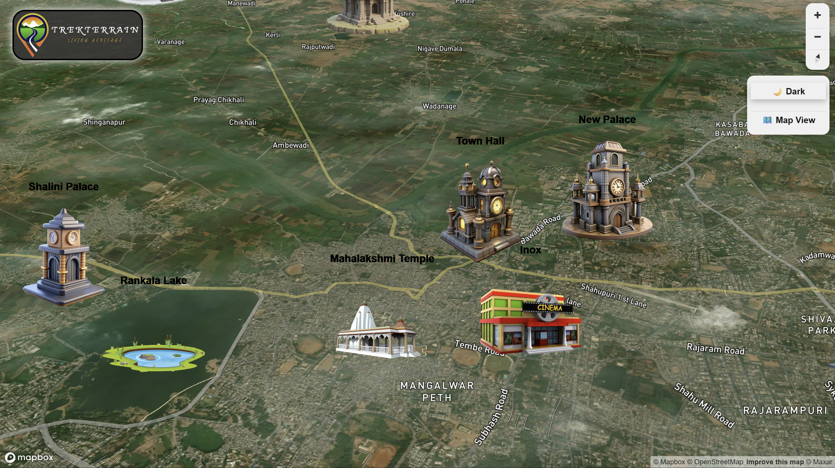
Map

Slide 9
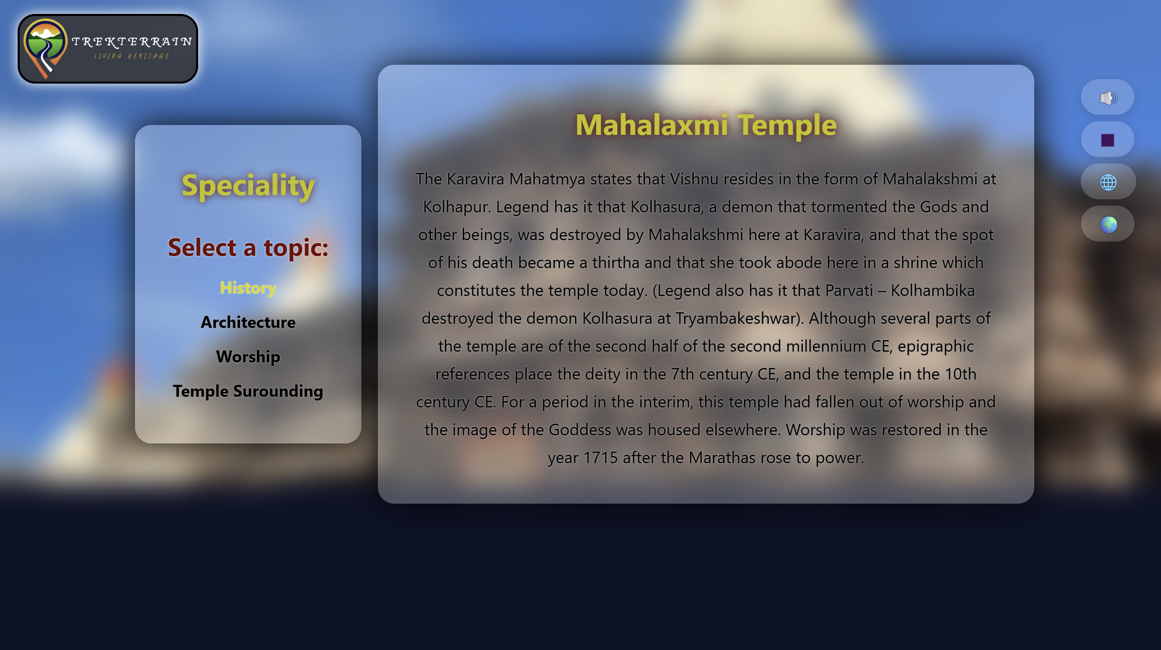
Info.
Page

Slide 10
UNDER PROGRESS
🛠️ Adding interactivity (clickable markers, popups).
🛠️ Integrating real-world map data.
🛠️ Improving map performance and lighting.
🛠️ Designing the user interface (UI) for navigation.

Slide 11
UPCOMING WORK
🔹Creative zoom-in effect for better visualization.
🔹 Include location info pop-ups or 3D landmarks.
🔹 Test responsiveness and user experience.
🔹 Prepare final presentation.
🔹Prepare well managed report and documentation of our project.

Slide 12
CONCLUSION
“So far, we have completed the setup, framework selection, and initial 3D visualization.”
“The upcoming work will focus on interactivity and data integration.”
“We are on track to complete the project as planned.”

Slide 13
THANK
YOU

