Slide 1
Physics-Informed Neural Networks
for Mechanics
Reproduction and Targeted Improvements
Problem Statement: 13 Team No: ______ Section: ______
Faculty: ______________________________
PES University, Electronic City Campus, Bengaluru
______________________
______________________
SRN: ______________
SRN: ______________
Dept. of ______________
Dept. of ______________
Notes:
[Part A · 0:15]
Good morning. We are Team [team number], and our assigned problem statement is number 13: the Stanford CS229 report "Data Driven Solutions and Discoveries in Mechanics Using Physics-Informed Neural Networks" by Zhang, Chen and Yang.
In one line: we rebuilt all three experiments from that paper from scratch, and then implemented and tested two improvements that the authors themselves suggested but never tried.
Emphasis: Say the one-line summary clearly. It tells the panel exactly what to expect.

Slide 2
Outline
1
Problem statement
The assigned paper and our task
6
Finding the gaps
Where the paper's method struggles
2
What is a PINN
How physics enters the loss
7
Fix 1: hard boundary
Exact boundary condition
3
The reference paper
Three mechanics problems
8
Fix 2: adaptive points
RAR plus a control experiment
4
Our implementation
Code, data and evaluation
9
Live demo
Running the code
5
Part 1 results
Reproduction vs the paper
10
Conclusions
Takeaways, limits and next steps
Notes:
[Part A · 0:10]
We start with the problem and a short explanation of physics-informed neural networks, then the paper and our implementation. After that, our Part 1 results, the two gaps we found, our two fixes, a live demo, and conclusions.
Emphasis: Do not read all ten items. One sentence is enough.

Slide 3
The problem statement
Problem Statement 13 — reference: Zhang, Chen & Yang, Stanford CS229 final report
“Data Driven Solutions and Discoveries in Mechanics Using Physics Informed Neural Network”
Can a neural network solve physics problems without a mesh or a labelled dataset, and even discover unknown physical parameters?
GIVEN
FIND
THE DIFFICULTY
The governing equations of three mechanics problems, their boundary and initial conditions, and for one problem only 50 measurements.
The full solution everywhere, without a mesh. For the spring problem, also the unknown damping c and stiffness k.
Mesh-based solvers cannot easily recover unknown parameters, and ordinary neural networks need large labelled datasets we do not have.
Our goal: reproduce all three results faithfully, then test whether the improvements the authors themselves suggested actually make PINNs more accurate.
Notes:
[Part A · 0:35]
The paper asks a simple question: can a neural network solve physics problems without a mesh and without a labelled dataset, and can it even discover unknown physical parameters?
It tests this on three mechanics problems. We are given the governing equations and their boundary and initial conditions, and for one problem only 50 measurements. We have to find the full solution everywhere, and for the spring problem, the unknown damping c and stiffness k.
This is hard for both classical and ordinary ML tools. Finite element solvers need a mesh and cannot easily recover unknown parameters. A normal neural network would need a large labelled dataset, which we do not have.
Our goal was to reproduce all three results faithfully, and then test whether the improvements the authors suggested actually help.
Emphasis: Stress 'no mesh' and 'no labelled dataset'. Those are the two ideas everything else builds on.

Slide 4
What is a physics-informed neural network?
An ordinary neural network whose loss contains the governing equation
Inputs
x, t (random points)
Neural network
tanh MLP, e.g. 5 × 50
Output
p̂(x, t)
Autograd
exact p̂ₜ, p̂ₓₓ
Physics residual
r = p̂ₜ − p̂ₓₓ → 0
Total loss
L = w_{f} L_{f} + w_{b} L_{b} + w_{d} L_{d}
paper Eq. (3.3); weights fixed at 1/4 or 1/2
PHYSICS LOSS
BOUNDARY LOSS
DATA LOSS
Mean squared residual at interior points: does it obey the equation?
Are the boundary and initial conditions satisfied?
Does it match measured data? (inverse problem only)
No mesh, no labelled dataset: training points are random locations, and the equation provides the supervision. tanh is used because the residual needs second derivatives (ReLU's are zero).
Notes:
[Part A · 0:50]
A PINN is an ordinary fully connected network. It takes x and t as input and outputs the physical quantity, for example the pore pressure p.
What makes it physics-informed is the loss. PyTorch's automatic differentiation gives the exact derivatives of the output with respect to the inputs, such as p_t and p_xx. We substitute those into the equation and get a residual, which should be zero everywhere.
The loss has three parts. L_f is the mean squared residual at random interior points: does the network obey the physics? L_b checks the boundary and initial conditions. L_d checks measured data, when we have any. They are weighted and added, and training drives all three towards zero.
So there is no mesh and no labelled dataset: the equation itself provides the supervision. We use tanh activations rather than ReLU because we need second derivatives, and ReLU's second derivative is zero almost everywhere.
Emphasis: Point at each box of the diagram as you name it. Make sure 'autograd gives exact derivatives' is clear.

Slide 5
The reference paper: three mechanics problems
Two forward problems (find the solution) and one inverse problem (find the parameters)
PROBLEM 1 · FORWARD
PROBLEM 2 · FORWARD
PROBLEM 3 · INVERSE
1D soil consolidation
2D steady heat conduction
Damped spring-mass
pₜ = pₓₓ on (0,1) × (0, 0.5]
Drained top p = 0, sealed base pₓ = 0, p = 1 at t = 0
Output multiplied by x: top condition exact
Reference: exact series solution
5 × 50 net · 500 / 250 / 125 points
Tₓₓ + Tᵧᵧ + 1 = 0 on [−1, 1]²
T = 0 on all four edges (soft penalty)
No closed-form solution
Reference: finite element (deal.II)
4 × 50 net · 1500 / 500 points
u″ + c u′ + k u = 0, u(0) = 1, u′(0) = 1
Find c and k from 50 observations
True c = 0.4, k = 4
Paper: c = 0.40125, k = 3.99332
3 × 32 net · Adam only, 100k epochs
Training recipe: Glorot initialisation, Adam (50k epochs, lr 1e-3 or 5e-4) then L-BFGS until convergence, fixed loss weights, about 10,000 test points per problem.
Notes:
[Part A · 0:40]
Problem 1 is soil consolidation. When a load is placed on wet soil, the water pressure inside slowly drains out through the top. It is a diffusion equation. The paper non-dimensionalises it so every quantity is of order one, and multiplies the network output by x, so the drained-top condition p = 0 at x = 0 holds automatically. An exact series solution exists, so we can compare against it.
Problem 2 is steady heat conduction on a square plate with a constant heat source and edges held at zero. There is no closed-form solution, so the paper compares against a finite element solution.
Problem 3 turns the question around. It is a damped spring where we observe 50 displacement values and must discover c and k. The true values are 0.4 and 4, and the paper reports 0.401 and 3.993.
All problems are trained with Adam first and then L-BFGS, with fixed loss weights.
Emphasis: Forward vs inverse is the key distinction. Problems 1 and 2 are forward; problem 3 is inverse.

Slide 6
Our implementation
Written from scratch in PyTorch, with every setting from the paper
pinn-mechanics/
src/
model.py network
trainer.py Adam → L-BFGS
references.py true answers
plotting.py · utils.py
experiments/
consolidation.py heat.py
spring_inverse.py
heat_improved.py Fix 1
consolidation_rar.py Fix 2
run_all.py · run_part2.py
results/ README.md
DATA · NO DOWNLOAD NEEDED
Training points are random locations in each domain, drawn with a fixed seed. For the inverse problem, 50 synthetic observations come from the exact solution with c = 0.4, k = 4.
REFERENCE SOLUTIONS
Exact series (consolidation) and exact formula (spring). For heat, our own finite-difference solver on a 201 × 201 grid, checked to about 4 × 10⁻⁶ by grid refinement.
EVALUATION
Relative L2 error on about 10,000 test points, max and boundary error, PDE test residual, identified c and k. Fixed seeds give bit-identical reruns.
Notes:
[Part A · 0:35]
We implemented everything from scratch in PyTorch. The src folder holds the shared pieces: the network, the Adam-then-L-BFGS trainer, the reference solutions and the plotting code. Each experiment is one script, and two runner scripts reproduce everything.
There is no dataset to download. Training points are random locations in each domain, drawn with a fixed seed. For reference answers we use the exact solutions for problems 1 and 3. For heat, we wrote our own finite-difference solver on a 201 by 201 grid and checked that it converges to about 4 times 10 to the minus 6, far smaller than the errors we measure.
We report the relative L2 error on about ten thousand test points, the maximum and boundary errors, the PDE residual on test points, and the identified c and k. Because the seeds are fixed, re-running gives bit-identical numbers, and we verified that twice.
Emphasis: Mention that every paper setting was reproduced, and that results are exactly reproducible.

Slide 7
Part 1: the paper, reproduced
All three problems at the paper's full settings, compared with the paper's reported results
Problem | Metric | Paper | Ours | Agreement
1. Consolidation | Relative L2 error | “perfect match” | 1.29 % | Yes: largest error near the origin, as in the paper
2. Heat | Relative L2 error | consistent with FEM | 0.90 % | Yes: largest error on the boundary, as in the paper
 | Max error | ≈ 5 × 10⁻³ (Fig. 3) | 1.2 × 10⁻² | Close: paper also forced T > 0 (method not given)
3. Spring | Damping c (true 0.4) | 0.40125 | 0.4115 | Yes: 2.9 % from the true value
 | Stiffness k (true 4) | 3.99332 | 3.9904 | Yes: 0.24 % from the true value
1.29 %
0.90 %
0.24 %
2.9 %
consolidation error
heat error
error in k
error in c
Notes:
[Part A · 0:40]
All three results reproduce. Consolidation: 1.3 percent relative error, with the largest error near the origin, exactly as the paper describes. Heat: 0.9 percent error, and the error is largest along the boundary, again as in the paper. Spring: k within 0.24 percent and c within 2.9 percent of the true values.
Small differences from the paper are normal, because the random points and the framework are different, and each one has a known cause. For example, the paper says it forced the temperature to stay positive but never explains how. We did not, which explains part of our larger heat max error.
And c converges more slowly than k. k sets the oscillation frequency, so a wrong k shifts every peak and gives a strong gradient. c only changes how fast the oscillations die out, so its gradient is weaker.
Emphasis: Do not claim an exact match. Say 'reproduced, with small explained differences'.

Slide 8
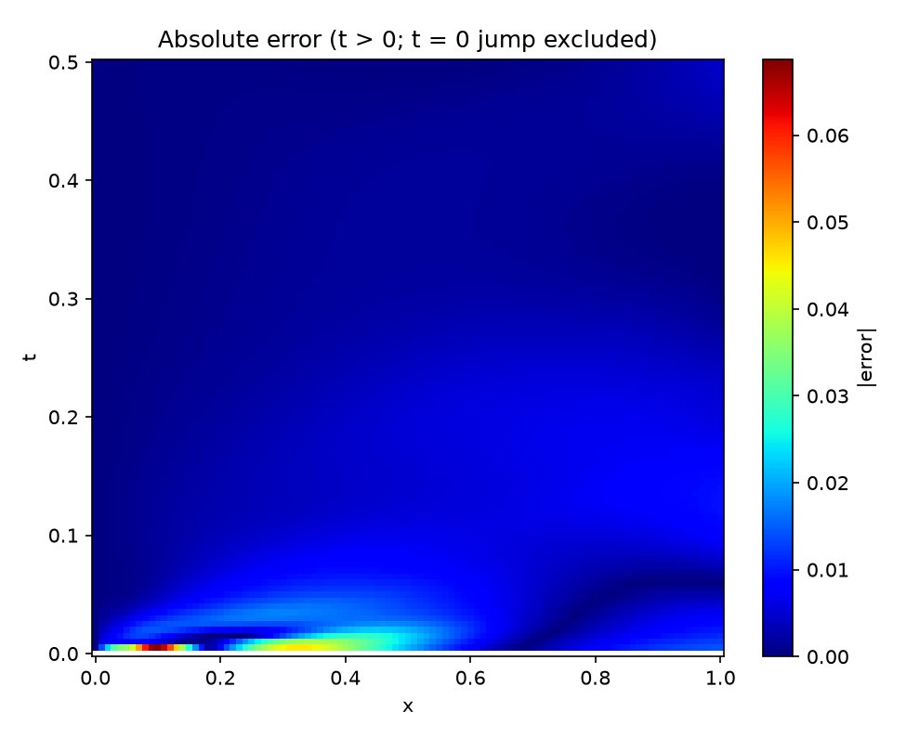
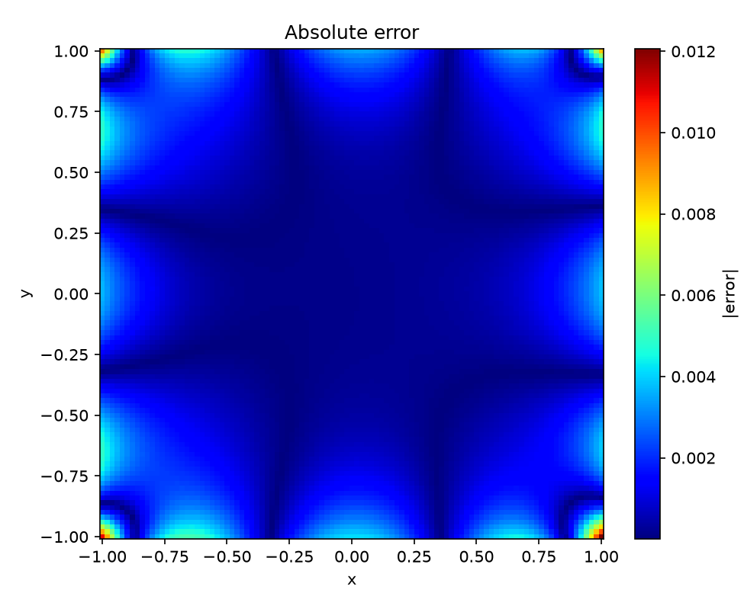
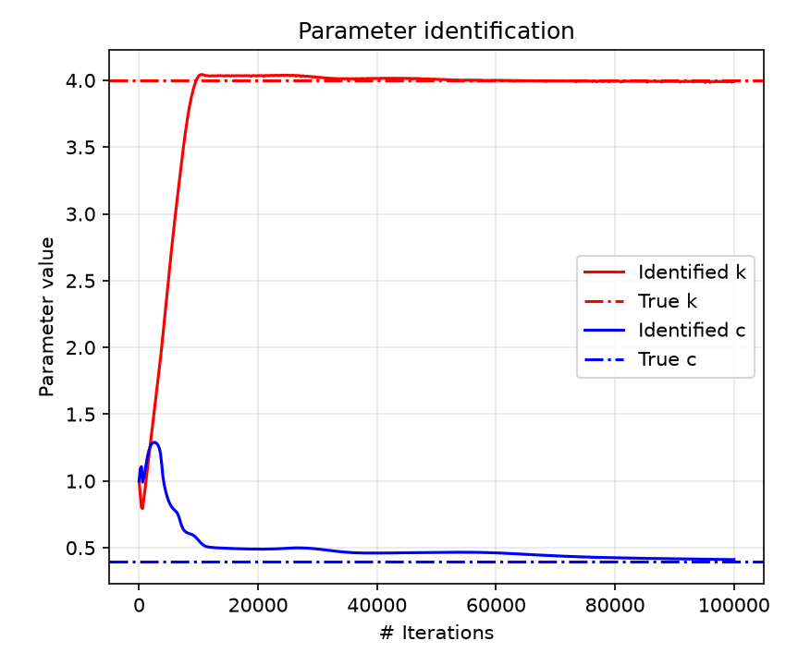
Part 1: where the errors are
Our figures, from the final full run
Consolidation
Heat conduction
Spring (inverse)
Error is concentrated in a thin strip near t = 0, where the solution changes sharply.
Error is largest along the edges and corners, where the boundary condition is only a soft penalty.
k locks onto 4 within about 10,000 iterations; c approaches 0.4 slowly.
Notes:
[Part A · 0:20]
Left: consolidation, with the error concentrated in a thin strip near t = 0. Middle: heat, bright along the edges and in the corners. Right: c and k converging to the dashed true values. k locks in by about 10,000 iterations, while c settles slowly.
These two weak spots, the edges and the early-time strip, are where Part 2 begins. My teammate will now explain how we improved them.
Emphasis: This is the handover. Point at the edges in the heat map and the strip in the consolidation map before handing over.

Slide 9
Finding the gaps: the paper names both
Our novelty comes from the paper's own text, measured in our own reproduction
GAP 1 · HEAT PROBLEM
GAP 2 · CONSOLIDATION PROBLEM
Soft boundary condition
Fixed, uniform training points
Paper §4.2: “The largest absolute error happens near the Dirichlet boundary because Eq. (4.7) is not regarded as a hard constraint.”
Suggested fix: multiply the output by a function that vanishes on the boundary. Not implemented.
Our run: mean boundary error 3.0 × 10⁻³, worst at the corners.
Paper §5 (future work): “develop some training points selection strategy similar to the adaptive re-meshing.”
500 random points are too sparse in the thin layer near t = 0. Not implemented.
Our run: PDE test residual 18.7, driven by that layer.
Our contribution: implement and test both suggestions, keeping the network, seed and training budget identical to Part 1, and add a control experiment so the comparison is fair.
Notes:
[Part B · 0:45]
We did not invent these weaknesses; the paper points to both. In section 4.2 it says the largest heat error is near the boundary because the boundary condition is not a hard constraint, and it suggests multiplying the output by a function that vanishes on the boundary. It never implements that.
In its conclusion it suggests a training-point selection strategy similar to adaptive re-meshing. It never implements that either.
Our reproduction measures both problems: a mean boundary error of 3 times 10 to the minus 3 for heat, and a PDE test residual of 18.7 for consolidation, coming from the thin layer near t = 0 where 500 random points are too sparse.
So our novelty is to implement and test both suggestions, keeping the network, seed and training budget identical to Part 1 so the comparison is fair.
Emphasis: This is where the novelty comes from. Say clearly that the ideas come from the paper's own text, and our contribution is implementing, measuring and honestly evaluating them.

Slide 10
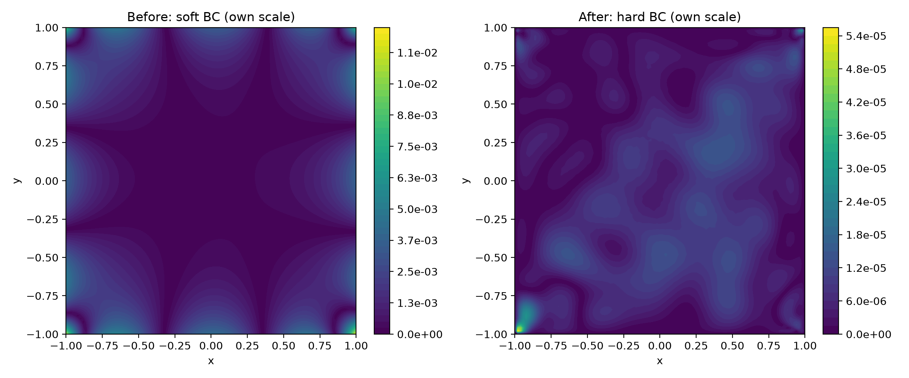
Fix 1: a hard boundary condition
Heat conduction: build T = 0 on the edges into the network itself
T̂(x, y) = (1 − x²)(1 − y²) · NN(x, y)
The factor is exactly zero on all four edges, so T = 0 on the boundary for any network weights
The boundary loss is removed: the loss is the PDE residual only
Same network, 1,500 points, seed and Adam 50k + L-BFGS as Part 1
Error maps, each on its own colour scale: left 0 to 1.2 × 10⁻², right 0 to 5.5 × 10⁻⁵
≈220×
0
14 → 4,019
Why so large? One loss term instead of two competing ones, so L-BFGS keeps converging instead of stalling.
lower error: 0.90 % → 0.004 %
boundary error (exact)
L-BFGS iterations before stopping
Notes:
[Part B · 1:00]
Fix 1 builds the boundary condition into the network itself. We multiply the output by (1 minus x squared) times (1 minus y squared). That factor is exactly zero on all four edges, so the temperature is zero on the boundary no matter what the network learns. The boundary loss disappears, and only the physics residual remains.
The results: relative error drops from 0.9 percent to 0.004 percent, about 220 times lower, and the boundary error is exactly zero. On the right, before and after, each on its own colour scale: the soft-BC error sits on the edges, while the hard-BC error is more than 200 times smaller and spread evenly.
Why such a large effect? With a soft boundary condition, two loss terms compete, and L-BFGS stopped after just 14 iterations. With a single loss term, L-BFGS kept improving for 4,019 iterations. Both runs used the same schedule, so the comparison is fair, but the gain comes from an easier optimisation problem, not from the envelope alone.
Emphasis: The '14 versus 4,019 L-BFGS iterations' explanation is what makes this slide strong. Do not say 'the envelope alone made it 220 times better'.

Slide 11
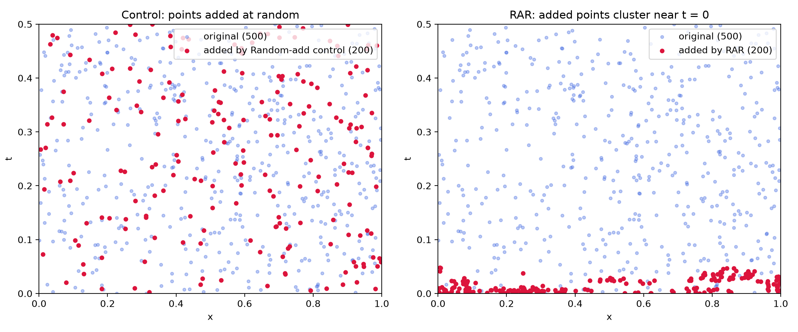
Fix 2: residual-based adaptive refinement (RAR)
Consolidation: put extra training points where the physics is violated most · RAR from Lu et al., DeepXDE (paper ref. [24])
1 Train
10,000 Adam epochs
2 Sample
5,000 random candidates
3 Score
PDE residual r² at each
4 Add
the 40 worst to training
× 5 cycles
then L-BFGS
CONTROL EXPERIMENT
Same everything, random picks
Same 5-cycle schedule and the same 200 extra points (500 → 700)
Points chosen at random instead of by residual
Separates where the points go from how many there are
Worst candidate squared residual (RAR): 3,700 after cycle 1, 0.035 after cycle 3
Red = the 200 added points. Left: random control. Right: RAR clusters them along t ≈ 0.
Notes:
[Part B · 0:45]
Fix 2 changes where the network trains. We use Residual-based Adaptive Refinement, RAR, from the DeepXDE paper, which is reference 24 in our own assigned paper.
Train for 10,000 epochs. Sample 5,000 random candidate points and compute the PDE residual at each. Add the 40 worst to the training set. Repeat 5 times, then finish with L-BFGS. The total budget equals Part 1.
On the right, the red points show where the extra points ended up. RAR packed them along t near zero, exactly the hard region, while the random control spreads them everywhere. After cycle 1 the worst candidate's squared residual was 3,700; after cycle 3 it was only 0.035.
And importantly, we also ran that control: the same schedule and the same 200 extra points, but chosen at random. That separates 'where the points go' from 'how many points there are'.
Emphasis: Cite DeepXDE out loud. Explain the control experiment carefully; it is the most scientific part of the project.

Slide 12
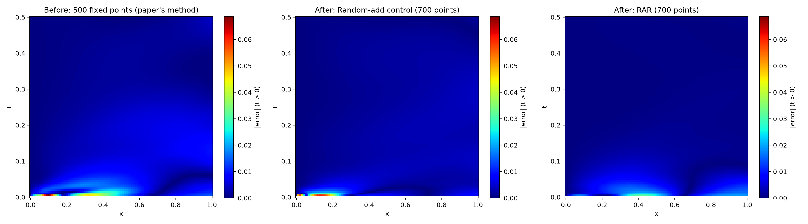
Fix 2: results, with the control
Three runs on the same machine, same seed and same training budget
Metric | Baseline: 500 fixed | Random +200 | RAR +200
Relative L2 error | 1.29 % | 0.84 % | 0.79 %
Max error (t > 0) | 0.069 | 0.060 | 0.032
PDE test residual | 18.7 | 99.0 | 0.11
The honest reading
RAR's own gain is the worst case: max error halved versus random points, residual in the hard region 99 → 0.11.
Average error improves almost as much with random points: that part comes from the extra points and the cycled schedule.
Error maps on one colour scale (0 to 0.069): baseline · random control · RAR
Notes:
[Part B · 0:55]
Three runs on the same machine. Relative error: 1.29 percent for the baseline, 0.84 percent for random points, 0.79 percent for RAR. Maximum error after t = 0: 0.069, 0.060 and 0.032, so RAR roughly halves the worst case compared with random points. PDE test residual: 18.7, 99 for random, and 0.11 for RAR.
In the maps, the bright strip near t = 0 fades with RAR.
The honest reading: the average error improves almost as much with random points, so that part comes from the extra points and the cycled schedule. RAR's own contribution is the worst-case error and the residual in the hard region. Without the control, we would have over-claimed.
One more detail: the loss curves spike every 10,000 iterations. That is when new points are added and Adam restarts, so the loss jumps briefly and then recovers.
Emphasis: Deliver the 'honest reading' sentence slowly. Panels reward this kind of careful claim.

Slide 13
Live demo
Saved models load in seconds; one short live training run
# Part 1: reproduction
python experiments/heat.py --load --show
python experiments/spring_inverse.py --epochs 5000 --show
# Part 2: improvements
python experiments/heat_improved.py --load --show
python experiments/consolidation_rar.py --load --show
# Reproduce everything (about 1 to 2 h on CPU)
python run_all.py
python run_part2.py
WHAT TO WATCH
Heat: error bright on the edges
Spring: c and k printed as they move towards 0.4 and 4
Fix 1: edge error gone
Fix 2: points cluster near t = 0
BEFORE THE REVIEW
Back up the results folder: the live spring run overwrites results/spring_inverse
Keep the figures open as a fallback
Notes:
[Part A + B · 1:30]
Part A presenter: First, the reproduction. This loads the saved heat model and shows the result in seconds, without retraining. [run heat --load --show] Note the errors along the edges.
Now a short live training run of the inverse problem, 5,000 epochs, about half a minute. Watch c and k printed in the terminal moving towards 0.4 and 4. [run spring_inverse --epochs 5000 --show] With only 5,000 epochs it is not fully converged; the full run takes 100,000.
Part B presenter: Now Fix 1. [run heat_improved --load --show] The same problem, the edge errors are gone, and the comparison figure shows the before and after.
And Fix 2. [run consolidation_rar --load --show] Here are the RAR points clustered near t = 0, and the before/after error map.
Emphasis: Before the review: copy the results folder to a backup, because the live spring run overwrites results/spring_inverse. Have the figures open in another window as a fallback.

Slide 14
Conclusions
WHAT WE SHOWED
LIMITATIONS AND NEXT STEPS
All three paper results reproduced: errors about 1 %, c and k within 3 %
Hard boundary: heat error about 220× lower, boundary exact
RAR: worst-case consolidation error halved, residual in the hard layer 18.7 → 0.11
A control experiment keeps the claims honest
Single seed; numbers vary slightly between machines
Paper's output constraints (0 ≤ p ≤ 1, T > 0) not implemented
Part of the hard-BC gain comes from better L-BFGS convergence
Next: multi-seed averages, hard initial condition for consolidation, coupled poromechanics (paper Eq. 5.1 to 5.2)
In PINNs, how you impose the constraints and where you place the training points matter as much as the network itself.
Notes:
[Part B · 0:40]
To conclude: we reproduced all three results of the paper, with errors around 1 percent and c and k within 3 percent. The hard boundary condition cut the heat error about 220 times and made the boundary exact. RAR halved the worst-case consolidation error and reduced the residual in the hard region from 18.7 to 0.11, and the control experiment kept our claims honest.
Limitations: we report a single seed, numbers vary slightly between machines, we did not implement the paper's output constraints, and part of the hard-BC gain comes from better L-BFGS convergence.
Next steps would be multi-seed averages, a hard constraint for the consolidation initial condition, and the coupled poromechanics equations the paper names as future work.
Emphasis: End on the one-line takeaway in the bottom box.

Slide 15
References
[1] Q. Zhang, Y. Chen, Z. Yang. Data Driven Solutions and Discoveries in Mechanics Using Physics Informed Neural Network. Stanford CS229 final report. (assigned paper)
[2] M. Raissi, P. Perdikaris, G. E. Karniadakis. Physics-informed neural networks: a deep learning framework for solving forward and inverse problems involving nonlinear PDEs. J. Comput. Phys. 378 (2019) 686–707.
[3] L. Lu, X. Meng, Z. Mao, G. E. Karniadakis. DeepXDE: a deep learning library for solving differential equations. arXiv:1907.04502 (2019). (source of RAR; ref. [24] of [1])
[4] J. Berg, K. Nyström. A unified deep artificial neural network approach to partial differential equations in complex geometries. Neurocomputing 317 (2018). (distance-function idea; ref. [3] of [1])
[5] D. P. Kingma, J. Ba. Adam: a method for stochastic optimization. arXiv:1412.6980 (2014).
[6] R. H. Byrd, P. Lu, J. Nocedal, C. Zhu. A limited memory algorithm for bound constrained optimization. SIAM J. Sci. Comput. 16 (1995) 1190–1208.
[7] A. Paszke et al. PyTorch: an imperative style, high-performance deep learning library. NeurIPS 2019.
Notes:
[Part B · 0:05]
These are our references. The two most important are the assigned paper and the DeepXDE paper that introduced RAR.
Emphasis: Do not read the list.

Slide 16
Thank you
Questions welcome
Faculty: ______________________
_____________________ · ______________________
PES University, Electronic City Campus, Bengaluru
Notes:
[Part B · 0:10]
Thank you. We are happy to take your questions.
Emphasis: Both presenters stand ready for Q&A. Either can answer any question.

