Slide 1
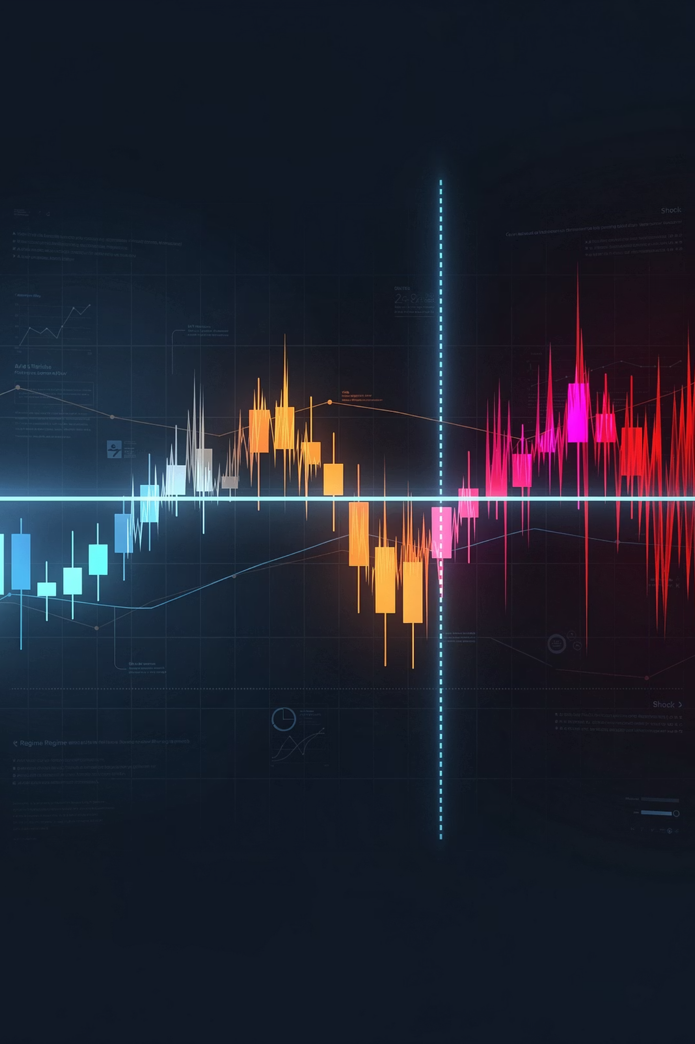
ShiftGuard: Event-Aware Distribution Shift Detection, Attribution, and Human-in-the-Loop Adaptation for Non-Stationary Forex Markets
CS 6140 Machine Learning · Northeastern University
Forex: one of the most liquid markets — yet volatile and regime-dependent
Feature–return relationships shift after macro shocks, policy events, sentiment changes
Static models degrade — detection, explanation, and adaptation are required
Goal: shift detection + attribution + adaptive response, not just prediction

Slide 2

Why This Project Matters
Applied ML systems fail silently when the world changes
Prior work studies drift adaptation, SHAP, and HITL separately
ShiftGuard connects them into one operational pipeline
Core contribution: system integration under non-stationarity
Drift Detection
Human Review
Explainability

Slide 3
Methods Overview
End-to-end pipeline — each stage feeds the next
Fully reproducible: python src/run_all_phases.py --clean
Results come from the complete regeneration path, not manual steps
Raw Data
Monitored Model
SHAP Attribution
Retrain + Trade
1
2
3
4
5
6
7
8
Feature Engineering
Shift Detection
HITL Review
Evaluation

Slide 4

Data Sources and Instruments -
EURUSD · GBPJPY · XAUUSD
Price series: 4H OHLCV bars, Jan 2015 – Apr 2026 · sources: Dukascopy, Yahoo Finance
~18,000 processed rows per pair after warm-up and preprocessing
Price Bars
Market Sentiment
Rates & Yields
Macro Calendars

Slide 5
Feature Engineering
4 feature groups engineered per pair — designed to capture distinct market dynamics
Feature counts: EURUSD 70 · GBPJPY 70 · XAUUSD 76
XAUUSD has 6 additional gold-specific sentiment factors
Macro and sentiment sources merged by date, forward-filled across intraday bars
Technical
Volatility
MAs, MACD, RSI, ADX, ATR, Keltner channels, Williams %R, CCI, ROC, momentum
Garman-Klass, Parkinson, rolling std, vol-of-vol, volatility ratios, drawdown
Macro / Event
Sentiment / Cross-Asset
Rate differentials, yield spreads, yield curve, event surprise, days to next event, NFP/CPI flags
VIX, DXY, S&P500 return, oil return, rolling correlations, news volume spikes, gold factors

Slide 6


Baselines and Complexity Checks
Technical baseline: rule-based RSI/MACD, no learned model, no shift awareness
ML Direction baseline: always-on XGBoost — learned model, no shift-aware control
Higher-complexity models (stacked ensemble) explored — did not solve drift or reproducibility
Complexity alone was not the answer — system design was
Technical Baseline
ML Direction Baseline
Higher-Complexity Models
✓ Uses RSI/MACD signals, rule-based entry
✓ Uses XGBoost predictions, directional trading
✓ Uses Stacked ensemble, sequence models
✗ Missing Learned model, shift detection, attribution, adaptive response
✗ Missing Shift detection, attribution, HITL review, adaptive response
✗ Missing Explanation quality, reproducibility and rerun speed

Slide 7
Main Monitored Model
XGBRegressor predicting next 4H log return — 70/15/15 chronological split
5-fold TimeSeriesSplit tuning with MAE objective
Chosen for: predictive strength, TreeSHAP compatibility, rerun speed
Pair-specific hyperparameters — not one copied config for all instruments
EURUSD ✓ Strongest
GBPJPY · Moderate
XAUUSD ⚠ Hardest
MAE: 0.001141
MAE: 0.001621
MAE: 0.003483
Dir. Accuracy: 59.52%
Dir. Accuracy: 52.63%
Dir. Accuracy: 51.37%
depth 5 · lr 0.05
depth 3 · lr 0.01
depth 5 · strong regularization

Slide 8
Shift Detection Engine
Markets shift for known and unknown reasons — one detector is not enough
Scheduled: KS test + MMD on 60-bar pre/post windows around macro events
Unexpected: ADWIN (δ=0.002) on non-calendar days — flash moves, geopolitical events
Performance: DDM on directional error stream — catches model degradation directly
Scheduled Shifts
Unexpected Shifts
Performance Drift
KS Test + MMD
ADWIN · δ=0.002
DDM on error stream
60-bar pre/post windows
Adaptive windowing
Warning + drift thresholds
High-impact macro events
Non-calendar disruptions
Model degradation detection
All three feed into → Shift Event Queue → SHAP Attribution → HITL Review

Slide 9
SHAP Attribution Layer
Understanding the 'why' behind market shifts requires attributing model predictions to specific feature groups. Our SHAP attribution layer highlights the dominant drivers for each currency pair.
TreeSHAP explains post-shift samples and Feature contributions aggregated into 4 interpretable groups. Attribution patterns differed sharply by pair
Technical
Volatility
Macro
Sentiment
MAs, momentum, MACD, RSI
ATR, Garman-Klass,
vol-of-vol
Rate differentials, yield spreads, NFP/CPI
VIX, DXY, news volume, cross-asset
EURUSD
GBPJPY
XAUUSD
Technical dominant
31/31 shifts
(Sched: 26 · Unexp: 5 · Perf: 0)
Sentiment dominant
27/27
(Sched: 7 · Unexp: 19 · Perf: 1)
Mixed (Sentiment + Technical)
34/50 sentiment, 16/50 technical
(Sched: 27 · Unexp: 23 · Perf: 0)

Slide 10



HITL Review: Dashboard and Human Oversight
Dashboard with 4 analytic views: Overview · P&L Simulator · Price & Regimes · Shift Detection
Human input is most valuable when evidence is interpretable and review is lightweight
Benchmark runs used auto-confirmed decisions for full reproducibility ,manual override still supported
Shift Flagged
Detection engine raises event (Scheduled / Unexpected / Performance)
Dashboard Review
Analyst inspects SHAP attribution, confirms or rejects
Decision Logged
Approved shifts enter retraining queue; rejected shifts discarded

Slide 11
Selective Retraining and Adaptive Trading
Retraining Policies
No Retrain
Full Retrain
Window Retrain
baseline, no update
retrain on all available data
30-day local window only
Weighted Retrain
Adaptive Retrain
recent data emphasized
policy selected from shift type + dominant SHAP group
Adaptive Trading Posture
Technical Dominant
Macro / Sentiment
Volatility / Unexpected
➡️ Follow-through posture
➡️ Event-aware participation
➡️ Defensive posture

Slide 12






Evaluation Framework
Metrics span: prediction, drift counts, attribution, recovery, trading quality, portfolio outcomes
Statistical validation: paired t-tests between technical baseline and ShiftGuard on overlapping trades
Prediction
Detection
MAE, RMSE, directional accuracy, precision, recall, F1
1
Counts of scheduled, unexpected, and performance shifts
2
Portfolio
6
Attribution
Combined profit and ending balance across all 3 pairs
Dominant feature group patterns across shifts
3
Trading
5
Retraining
4
Win rate, profit factor, cumulative return, market participation
Post-shift MAE, recovery bars, % recovered

Slide 13

Five Experiments
Trading Comparison — Technical vs. ML Direction vs. ShiftGuard · win rate, profit factor, cumulative return, participation
Fixed-Capital / Portfolio — $10k per pair · 1:20 leverage · transaction costs · 30% tax · ending balance
Selective Retraining — 5 policies post-shift · MAE recovery · recovery bars · % recovered
Walk-Forward Robustness — expanding-window refit from 2021 · 48 refit windows per pair
Ablation Study — system-level (Table 3) + adaptation policy (Table 7)

Slide 14
Retraining and Walk Forward Robustness
Best retraining policy was pair-dependent — no single policy wins everywhere
XAUUSD showed the clearest gain — most non-stationary pair benefits most from repeated refits
Pair
Holdout MAE
Post-shift Retrain MAE
Holdout Dir Acc
WF Dir Acc
WF MAE
Recovery
EURUSD
Full Retrain
0.001141
0.001173
59.34%
60.87%
0.001122
85.7%
GBPJPY
Full or Adaptive
0.001621
0.001643
52.45%
53.10%
0.001636
85.7%
XAUUSD
Weighted Retrain
0.003483
0.004148
51.34%
55.84%
0.002632
84.6%

Slide 15
Key Results — Trading and Portfolio Outcomes
EURUSD: ShiftGuard win rate 58.45% vs ML 56.68%, profit factor 2.14 vs 1.80 — at only 28% participation vs 100%
Selective participation = fewer but more confident trades
Statistical significance: p < 0.003 (EURUSD) · p < 0.00005 (GBPJPY) · p < 10⁻⁶ (XAUUSD)
Portfolio Outcomes
$10,000 per pair · $30,000 portfolio capital ·
$103,515
$125,028
$196,080
3 months
6 months
1 year

Slide 16
Analysis — What the Pipeline Added
Technical baseline = no learned model, no shift-aware control
ML Direction baseline = learned model only — no detection, attribution, or adaptive response
ShiftGuard = learned model + detection + attribution + review + adaptive response
Full pipeline mattered more than raw forecasting accuracy
XAUUSD: hardest to predict, strongest downstream gains — regime awareness > raw accuracy
Pair
Technical Win Rate
ML Direction Win Rate
ShiftGuard Win Rate
ShiftGuard Trades
ShiftGuard Profit Factor
EURUSD
50.9%
54.0%
58.5%
27.9%
2.14
GBPJPY
50.9%
51.9%
59.1%
39.4%
1.99
XAUUSD
50.1%
49.6%
58.0%
40.7%
1.89
Across the 2021-2026 evaluation window, ShiftGuard achieved the highest win rate on all three pairs while trading only 27.9-40.7% of bars, showing that regime filtering improved trade quality over both technical rules and always-on ML.

Slide 17
Conclusion and Future Work
Takeaways
Future Work
ShiftGuard worked best as a shift-aware decision system — not just a predictor
Shift-aware filtering improved trading quality, especially on GBPJPY and XAUUSD
Profit and ending balance matter alongside accuracy — selective participation wins
Walk-forward evaluation strengthened robustness — directional accuracy improved on all 3 pairs
Core contribution: system integration — detection + attribution + review + adaptive response
Learned retraining policy — select strategy from shift type + SHAP group + recovery history
Stronger feedback loop — validate human overrides before feeding back into retraining
Stress tests — dynamic transaction costs, realistic slippage
Online adaptation — continuous ingestion, real-time drift monitoring, live shift alerts
Live deployment — move from historical analysis to ongoing adaptation framework

Slide 18
Team Roles Summary
Anusha Ravi Kumar
Sohan Mahesh
Disha Manubhai Patel
Feature engineering and dataset construction
Monitored model and baseline development (XGBoost pipeline)
Dashboard and HITL review layer
Pipeline integration and report polishing
Shift detection pipeline (scheduled, unexpected, performance drift)
SHAP attribution and shift interpretation
Selective retraining and adaptive trading response
End-to-end pipeline integration and experiment interpretation
Data acquisition and curation (forex, macro, sentiment, event context)
Evaluation setup and metric generation
Reference paper identification for ablation framing
Presentation preparation

Slide 19
Thank You
Questions?

