Slide 1

Seasonal Agriculture Performance Analysis
AYYALASOMAYAJULA VENKATA SAI ANUSHA
BHARAT INSTITUTE OF ENGINEERING AND TECHNOLOGY
STU65102e816d8331695559297

Slide 2

PROBLEM STATEMENT
Agricultural activities are influenced by seasonal variations in environmental conditions, farming practices, resource availability and market conditions.
As a result, agricultural performance may differ from one season to another. However, raw agricultural data does not clearly explain how agricultural performance changes across seasons or what patterns can be observed in different seasonal conditions. The problem is to analyze the given agricultural dataset and investigate seasonal differences in agricultural performance by identifying meaningful patterns, trends, relationships and variations within the available data

Slide 3
PROJECT DESCRIPTION
APPROACH
• Analyze 4,000 farm records across Kharif, Rabi and Zaid seasons.
• Clean missing rainfall and soil-moisture values and reconstruct missing yield using production and farm area.
• Compare seasons, crops, states/districts, irrigation methods, resource use and disease/pest risk.
• Use correlations, visualizations and statistical tests to identify important patterns.
• Summarize findings and recommendations for evidence-based seasonal planning.

Slide 4

WHO ARE THE END USERS?
Farmers
Agri planners
Researchers
Season planning
Resource allocation
Pattern discovery
Use performance and resource insights
Compare seasons and irrigation methods
Study seasonal and regional variation
Extension officers
Policy makers
Advisory support
Evidence-based planning
Translate findings into local guidance
Identify areas needing attention

Slide 5

TECHNOLOGY USED
Python
Pandas + NumPy
Matplotlib + Seaborn
Core analysis
Data handling
Visualization
Jupyter / Colab
Cleaning and aggregation
Charts and heatmaps
SciPy
Excel + Colab
Statistics
Input & execution
ANOVA, Kruskal–Wallis, Pearson
Dataset and notebook

Slide 6
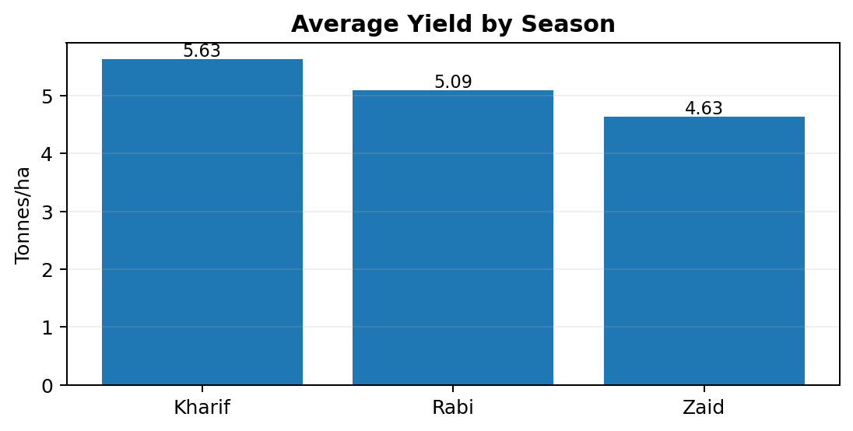
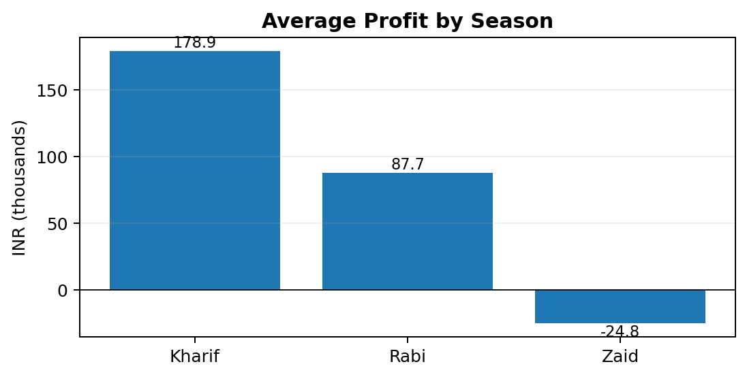
RESULTS
Dataset
Seasons
Best average yield
Best average profit
4,000
Kharif
Kharif
Kharif
28 columns
Rabi 1,627 • Zaid 594
5.63 tonnes/ha
₹178,915 per farm
Kharif records the highest average yield.
Zaid shows negative average profit in the dataset.

Slide 7
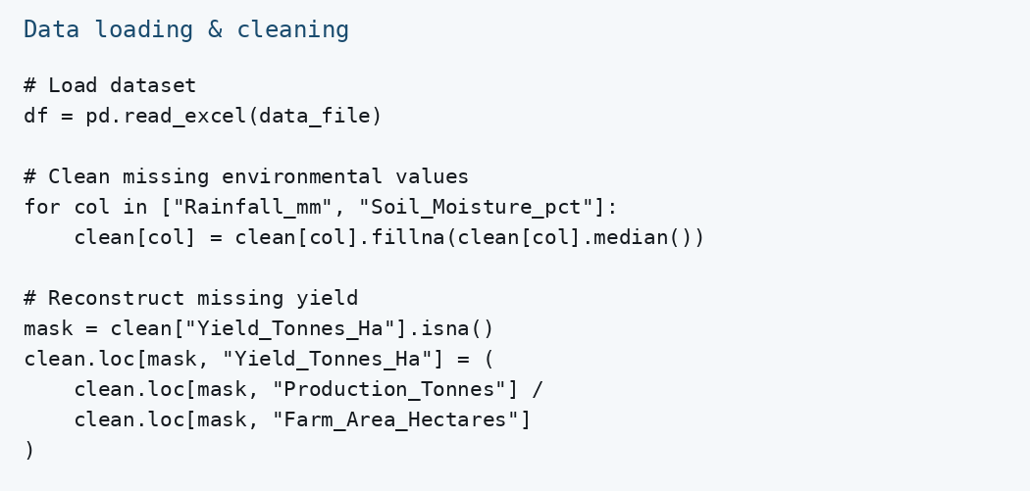
RESULTS — DATA CLEANING
Notebook code used for dataset loading and required cleaning steps.
Missing rainfall
Missing soil moisture
Missing yield
48 cells
40 cells
32 cells
Median filled
Median filled
Reconstructed

Slide 8
RESULTS — SEASON & CROP ANALYSIS
Season-wise aggregation and visual comparison.

Slide 9
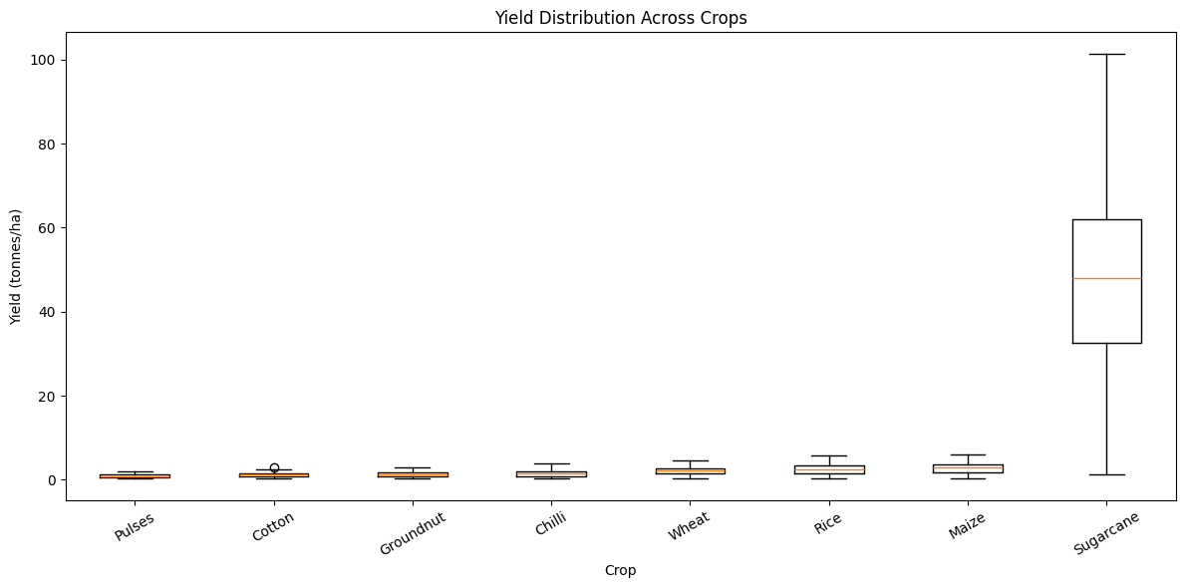
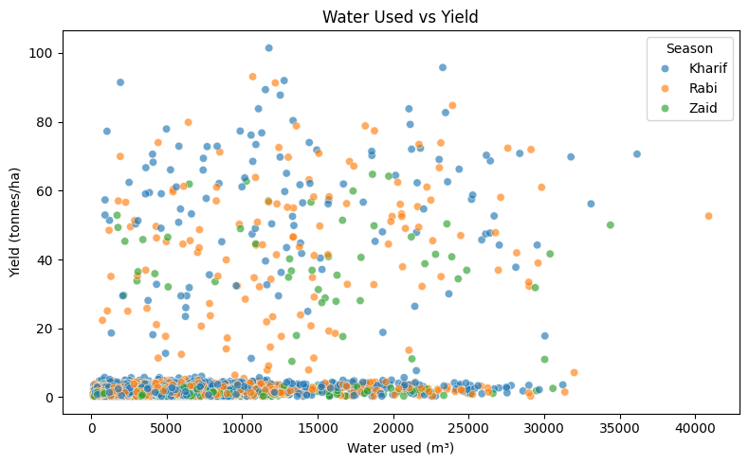
RESULTS — CORRELATION & STATISTICS
• Water used had the strongest positive correlation with yield (r ≈ 0.39).
• Kruskal–Wallis detected significant seasonal differences for yield and profit (p < 0.001).
• ANOVA detected a significant seasonal difference for profit, but not yield.

Slide 10
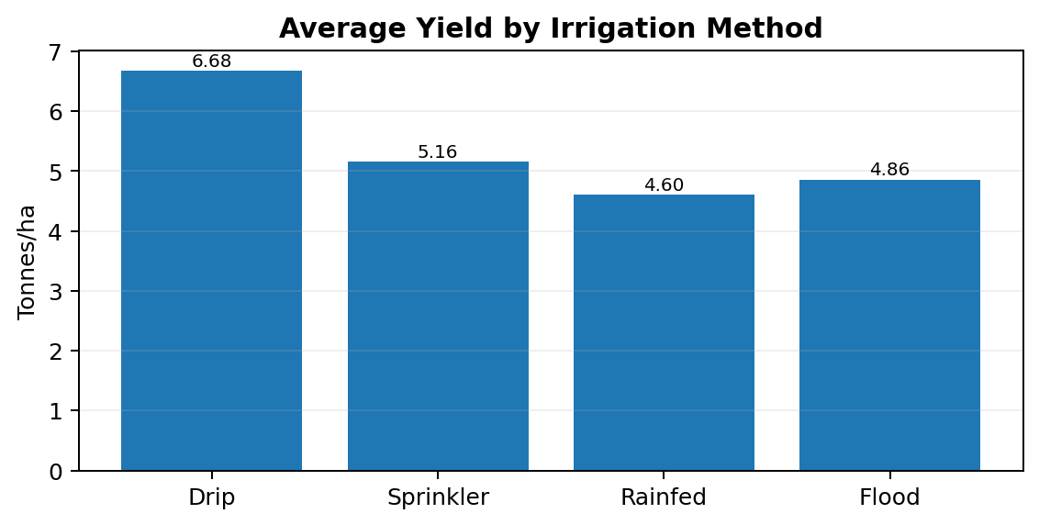
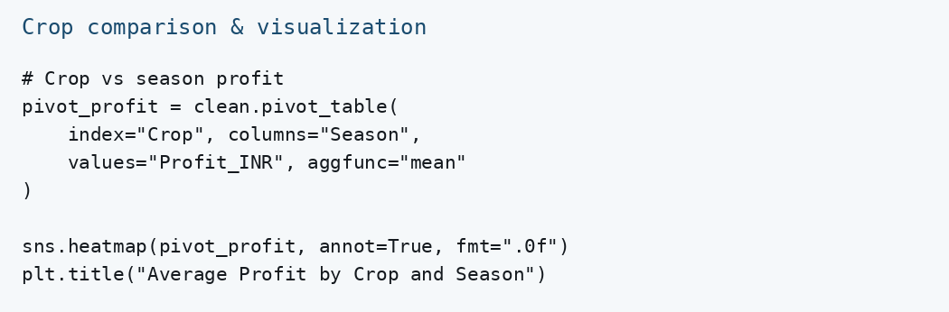
RESULTS — IRRIGATION & REGIONAL ANALYSIS
• Drip: highest average yield (6.68 t/ha) and profit (₹219,626).
• Rainfed: highest average water-efficiency value (7.56 t/1,000 m³).
• Analysis also compared 8 states, 10 districts and 8 crops.

Slide 11
FUTURE SCOPE
• Add more years of data to study long-term seasonal trends.
• Include richer weather and soil datasets for deeper environmental analysis.
• Build predictive models for yield and profit forecasting.
• Develop an interactive dashboard for farmers and agricultural planners.
• Validate findings with local agronomic knowledge and real-world field data.

Slide 12
GITHUB LINK
https://github.com/anusha2403/Seasonal-Agriculture-Performance-Analysis

Slide 13

VOIS COURSE COMPLETION CERTIFICATE

Slide 14
THANK YOU

