Slide 1





YOURSTORY | snowflake | H2S
CoCo CLI
GCC Edition
Team Name : Data Unifiers
Team Leader Name : Anil Kumar Yelleti
Team Size : 2
Problem Statement : Customer360 AI — AI-Powered Customer Intelligence & Next Best Action for Insurance: Unifying structured & unstructured data with Snowflake Cortex to analyze sentiment, explain churn risk, and deliver personalized retention actions.

Slide 2
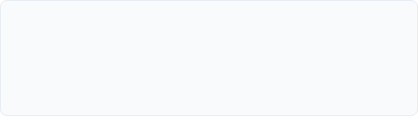

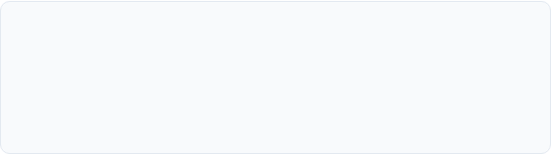


YOURSTORY | snowflake | H2S
GCC Edition
Problem Brief & Pain Points
fragmented customer signals
actionable next-best action
explainable risk assessment
Siloed Touchpoints
Reactive Churn Prevention
Insurers struggle with customer data fragmented across policy admin, claims, billing logs, and unstructured call transcripts with no unified health view.
Retention teams react to customer cancellation after it occurs, missing critical early-warning indicators trapped inside interaction sentiment.
Black-Box Risk Models
Target Persona & Impact
Relationship managers lack transparent, explainable churn scores. They need clear evidence backing why a customer is at risk rather than an arbitrary score.
Built for Relationship Managers, Retention Leads, & Support Supervisors to convert multi-channel data into instant, AI-guided Next Best Actions.

Slide 3




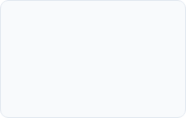
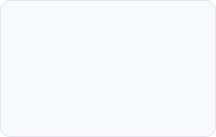



YOURSTORY | snowflake | H2S
GCC Edition
Solution Architecture & Core Modules
1. UNIFY
2. UNDERSTAND
3. PREDICT
4. RECOMMEND
5. ACT
Data + Transcripts
Cortex Sentiment
9-Signal Churn Model
Next Best Action
Personalized Outreach
Executive Dashboard
Customer 360
Ask Customer 360
Action Center
Analytics
Portfolio KPIs, AI Executive Insights, priority work queues.
Explainable risk drivers, NBA recommendation, timeline.
Natural language Q&A backed by Cortex COMPLETE.
Operational queue filterable by risk, segment & trigger.
Segment risk breakdown, sentiment trends & distribution.

Slide 4




YOURSTORY | snowflake | H2S
GCC Edition
Architecture & Snowflake Cortex Stack
Streamlit Application Layer
Interactive UI: Dashboard, 360 View, NL Q&A, Action Center
Intelligence Layer
CORTEX.COMPLETE
CORTEX.COMPLETE
CORTEX.COMPLETE
llama3.1-70b: Summaries, Q&A, Scripts
FN_TRANSCRIPT_INTELLIGENCE + FN_ASK_CUSTOMER_360
FN_CUSTOMER_AI_SUMMARY + FN_GENERATE_COMMUNICATION
Snowflake Data Cloud: 5 Source Tables + 3 Dynamic Tables (10-min auto-refresh)

Slide 5

YOURSTORY | snowflake | H2S
GCC Edition
Comprehensive Data Model & Schema
Table Entity | Row Count | Description & Key Attributes | Relational Schema
CUSTOMERS | 500 | Demographics, segment, CLV, status, overall health score | 1 : Many Policies / Interactions
POLICIES | ~780 | Auto, Home, Life, Health lines, premium, renewal dates | 1 : Many Claims
CLAIMS | ~700 | Claim severity, processing status, payout amounts, open flags | Mapped to Policies
CUSTOMER_INTERACTIONS | ~2,400 | Multi-channel touchpoints with sentiment scores & escalation status | 1 : 1 Call Transcripts
CALL_TRANSCRIPTS | ~1,100 | Realistic multi-turn conversation text for deep sentiment analysis | Mapped to Interactions
CUSTOMER_360_VIEW | 500 | Unified customer view with 9-signal churn risk scoring, health score | Dynamic Table (10-min refresh)
CHURN_SIGNALS_EXPLAINED | 500 | Explainable churn drivers per customer with signal levels | Dynamic Table (10-min refresh)
NEXT_BEST_ACTION | 407 | Prioritized retention recommendations with suggested channel | Dynamic Table (10-min refresh)
Data Governance Note: Synthetic data with 100% programmatically generated records. 3 Dynamic Tables (CUSTOMER_360_VIEW, CHURN_SIGNALS_EXPLAINED, NEXT_BEST_ACTION) auto-refresh every 10 minutes with pre-computed churn scores for instant app performance. Synthetic data structured with 100% programmatically generated records ensuring strict privacy while mirroring real-world relational insurance complexities.

Slide 6

YOURSTORY | snowflake | H2S
GCC Edition
Explainable 9-Signal Churn Risk Model
Risk Signal | Max Points | Data Source & Trigger Condition | Category
Negative Sentiment / Cancellation Intent | 40 pts | Cortex sentiment scores + transcript explicit intent detection | Sentiment / Intent
Complaint & Unresolved Issues | 25 pts | Frequent complaint interactions + unresolved/escalated status | Service Experience
Open / Delayed Claims | 15 pts | Claims currently pending or exceeding 30-day resolution SLA | Claims Operations
Payment Issues & Renewal Proximity | 20 pts | Late/overdue payment status + policy renewal within 30 days | Financial & Contract
Transparent AI: Every risk score (0-100) clearly separates verifiable data facts from LLM interpretation, building agent trust.

Slide 7


YOURSTORY | snowflake | H2S
GCC Edition
Next Best Action Engine & Personalization
11 Deterministic Action Rules
AI Communication Generator
Escalate Claim: Open high-value claim + complaints
Cortex COMPLETE generates tailored, context-aware draft communications instantly:
Retention Outreach: High CLV + cancellation intent
Phone Scripts: Empathy-first talking points for agents
Renewal Retention: Cancellation intent + renewal near
Email Drafts: Formal, personalized resolution proposals
Payment Assistance: Overdue status + multiple policies
SMS Messages: Short, actionable reminder notifications
Service Recovery: Multiple unresolved interactions

Slide 8


YOURSTORY | snowflake | H2S
GCC Edition
Golden Demo Walkthrough: Emily Mitchell (CUST-0340)
Featured Customer Profile
7-Step Guided Judge Flow
Customer: Emily Mitchell (Premium Segment)
Executive Dashboard → View top-risk queue
Customer Lifetime Value: ~$53,000
Select Emily Mitchell → Inspect risk drivers
Churn Risk: HIGH (83 / 100 Risk, 10 Health)
Transcript Intelligence → See verbatim intent
Triggers: ~$35K claim under review + 4 cancellation calls + overdue Life policy payment
AI Summary → Generate 360 relationship analysis
Communication Panel → Create phone script
Ask Customer 360 → Query NL risk reasons

Slide 9




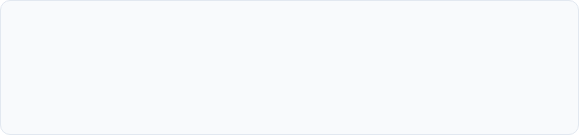
YOURSTORY | snowflake | H2S
GCC Edition
Measurable Impact & Production Readiness
100%
9
11
< 10s
Snowflake Native Stack
Explainable Risk Signals
Automated Next Best Actions
End-to-End LLM Synthesis
Business Outcomes
Enterprise Safeguards
Proactive Retention: Intercepts churn weeks before renewal dates.
Human-in-the-Loop: AI outputs are presented as drafts for agent review.
Agent Efficiency: Pre-drafted scripts reduce prep time from 20m to seconds.
Zero Data Leakage: Runs entirely inside Snowflake security boundary.

Slide 10

YOURSTORY | snowflake | H2S
GCC Edition
THANK YOU
Customer360 AI — Snowflake Cortex Hackathon
GitHub Repository https://github.com/anusha522/customer360-ai-snowflake
Live Snowflake Streamlit Application https://app.snowflake.com/trsaclg-xp36877/#/streamlit-apps/CUSTOMER_360_DB.C360.CUSTOMER360_AI
Demo Access Credentials
Account: TRSACLG-XP36877 | Username: DEMO_VIEWER | Password: Customer360Demo!2026
Role: CUSTOMER360_VIEWER | Warehouse: COMPUTE_WH | Read-only access to all 5 app pages
Powered by Snowflake Cortex AI & Streamlit | Team Data Unifiers

Slide 11

Image Sources
https://photos.peopleimages.com/picture/202309/2810998-data-internet-and-futuristic-background-wave-with-blue-connection-abstract-and-technology-illustration-for-big-data-ai-or-a-network-or-stream-of-communication-science-or-music.-blockchain-cloud-fit_400_400.jpg
Source: peopleimages.com

