Slide 1
CurrencyX:
A Comprehensive Currency Converter Solution

Slide 2
Problem Statement
The objective of this project is to develop a currency converter program using Python that allows users to quickly and accurately convert between different currencies.

Slide 3
Flow of the project
Start
User Interface
User Input
Fetch Currency Data
Convert Currency
Display Currency

Slide 4
Technology Stack
Programming Language: Python-3.10
Frontend Framework: Tkinter
Backend: API Integration
API: Exchangerate
Development Tools : IDE, Sublime
Version Control : Git & Github

Slide 5
Features Of The Project
Real-time Currency Conversion
User-friendly Interface
Support for Multiple Currencies
Conversion Accuracy
Cross-Platform Compatibility
Lightweight and Fast
Clear and Informative Results

Slide 6
Differences from Existing Converters
The existing currency conversion solutions often lack user-friendly interfaces, real-time exchange rates, or support for a wide range of currencies.
This project aims to address these limitations and provide a reliable and efficient currency conversion tool.

Slide 7
Advantages
Ease and Convenience
Accurate and Reliable Results
Time and Effort Savings
Global Currency Support
User-Friendly Interface
Open Source and Extensibility

Slide 8
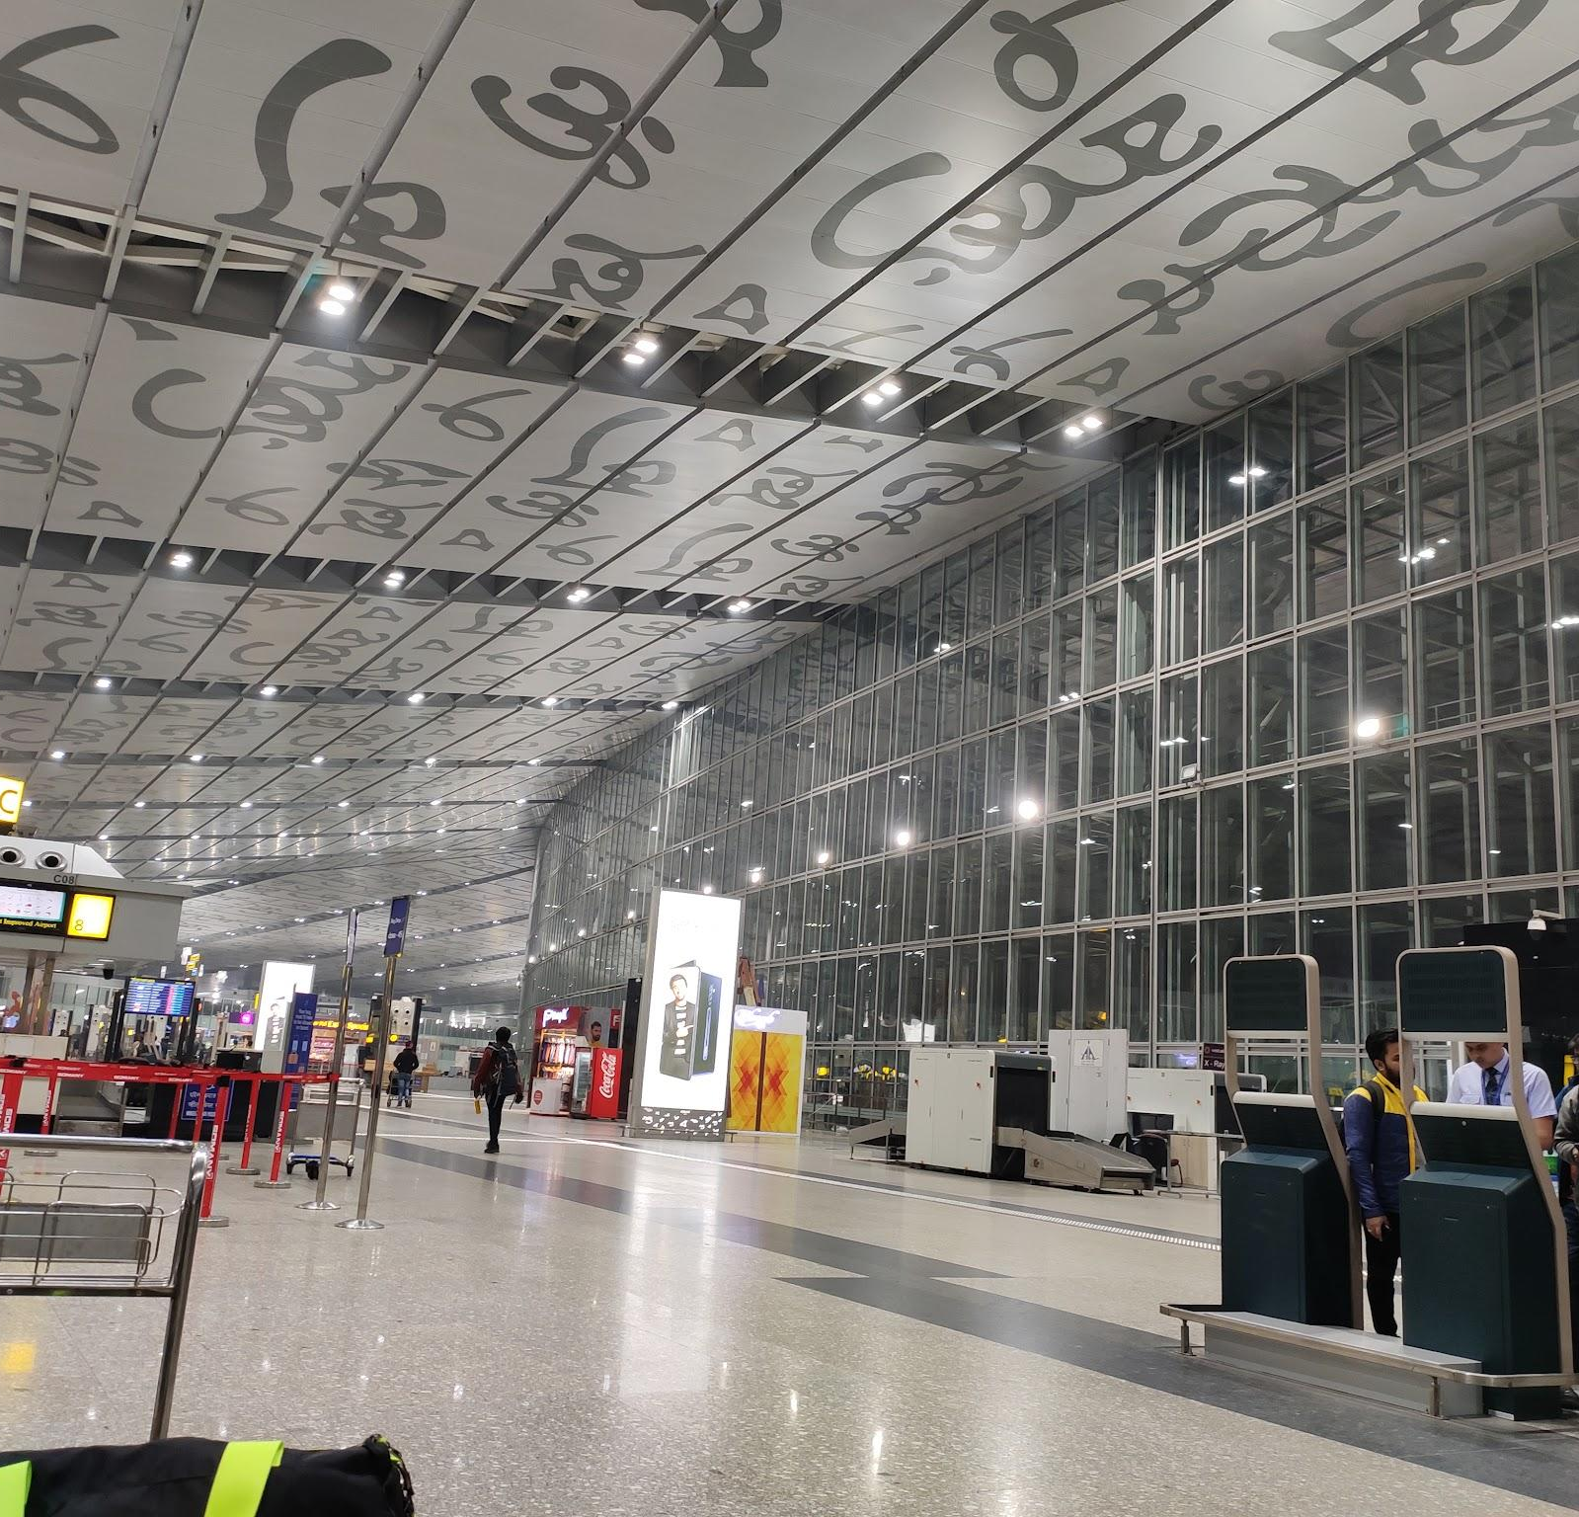

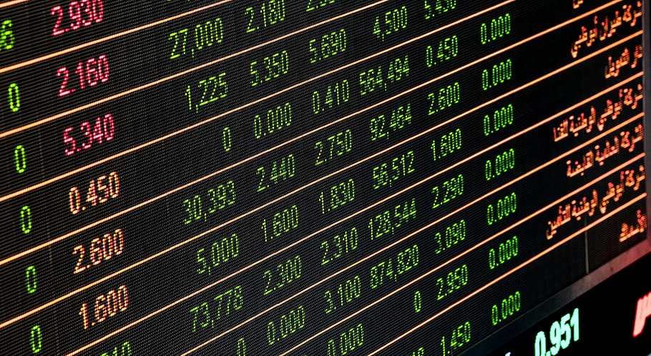
Use Cases
Where we can use this?
International Travelers
E-Commerce Shoppers
Traders and Investors
International Businesses
Students and Researchers

Slide 9
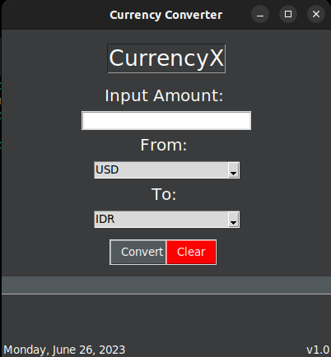
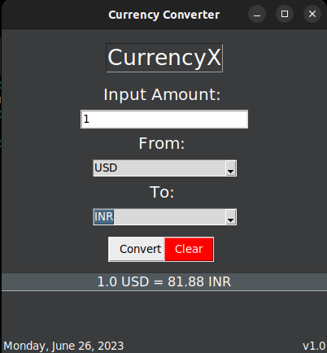
Preview of the User Interface

Slide 10
Conclusion
Overall, the currency converter project is a comprehensive and versatile solution that empowers users with accurate currency conversions, historical data analysis, and a seamless user experience.
Source Code : https://github.com/anusha6380/CurrencyX

Slide 11
Thank You
Presented By
-

