Slide 1


Consumer Goods Ad-hoc Insights
-presented by Anusha Talari

Slide 2
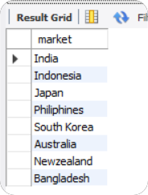
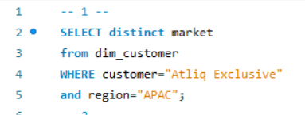
AD-HOC Request-1
Provide the list of markets in which customer "AtliQ Exclusive" operates its business in the “APAC” region
SQL Query
Output

Slide 3
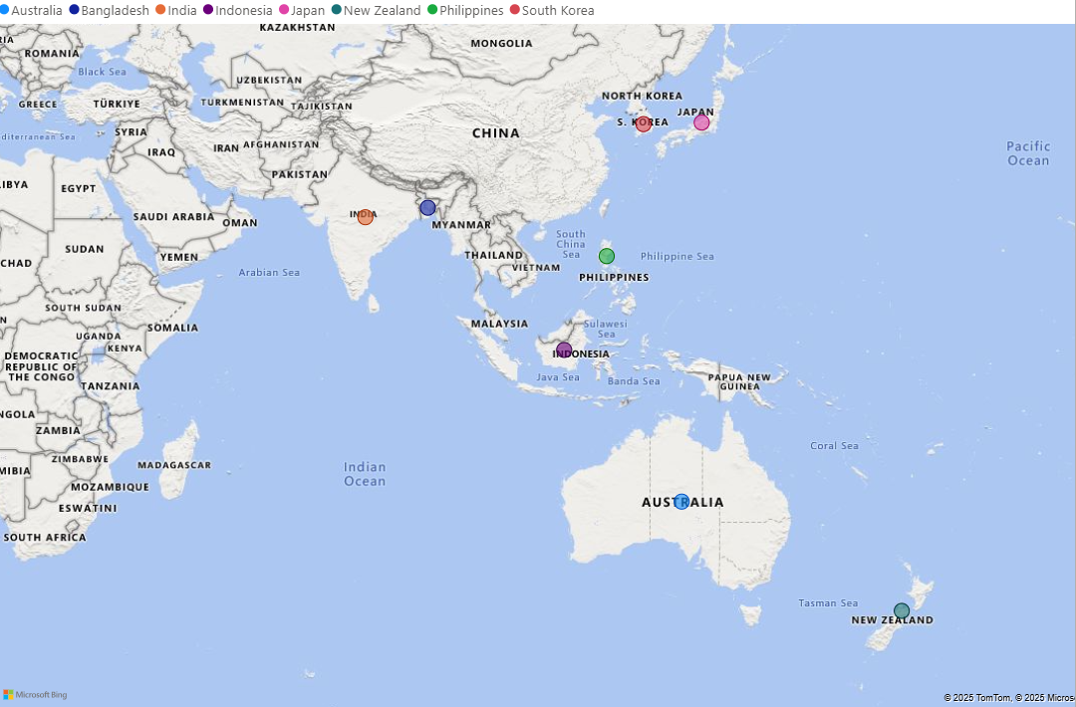
Visual and Insights
Atliq companies have a strong presence in the APAC region,
covering both emerging markets like India, Indonesia, and Bangladesh and developed economies like Japan, South Korea, and Australia.
This strategic mix helps balance high-growth opportunities with stable revenue streams.
The company can leverage technological advancements in developed markets and tap into rising consumer demand in emerging economies.

Slide 4
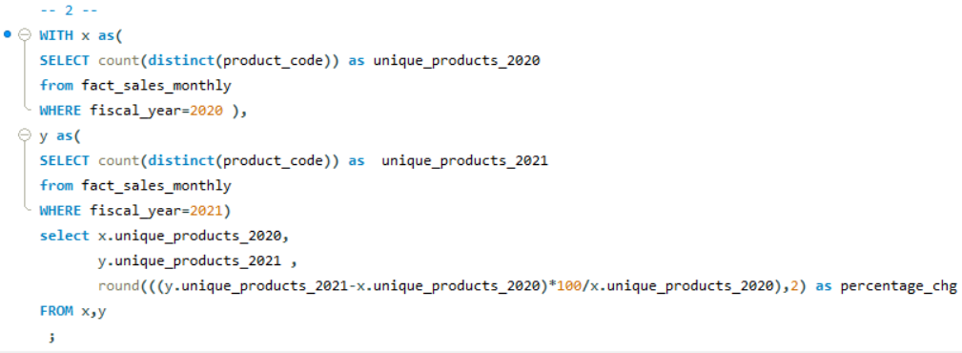

AD-HOC Request-2
What is the percentage of unique product increase in 2021 vs. 2020? The final output contains these fields, unique_products_2020 unique_products_2021 percentage_chg
SQL Query
Output

Slide 5
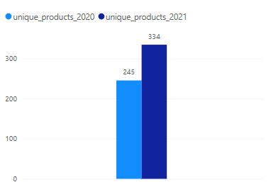
Visual and Insights
Unique products surged by 36.3% from 245 to 334 in 2021, signifying robust expansion. This implies rising demand, market progression, or an enhanced product strategy.

Slide 6
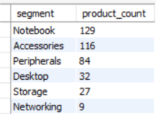
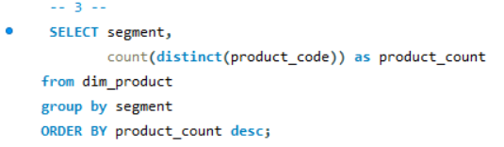
AD-HOC Request-3
Provide a report with all the unique product counts for each segment and sort them in descending order of product counts. The final output contains 2 fields, segment product_count
SQL Query
Output

Slide 7
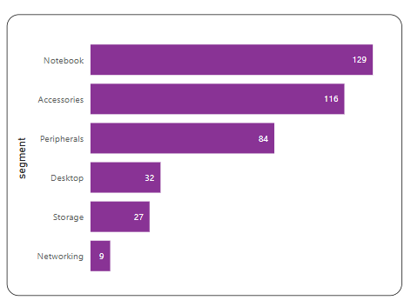
Visual and Insights
Notebooks and accessories are lead sales, indicating strong manufacturing demand. Storage and networking lag, suggesting potential market saturation or niche focus.
Focusing on high-performing categories while improving weaker segments could optimize sales and strategy.
Notebooks, accessories, and peripherals make up 83% of the total manufactured products.

Slide 8
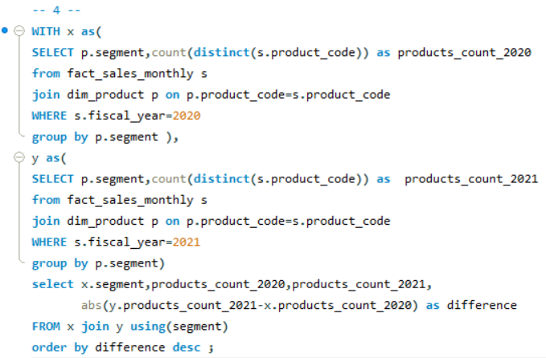
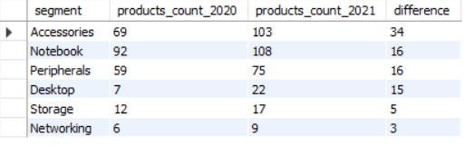
AD-HOC Request-4
Follow-up: Which segment had the most increase in unique products in 2021 vs 2020? The final output contains these fields, segment product_count_2020 product_count_2021 difference
SQL Query
Output

Slide 9
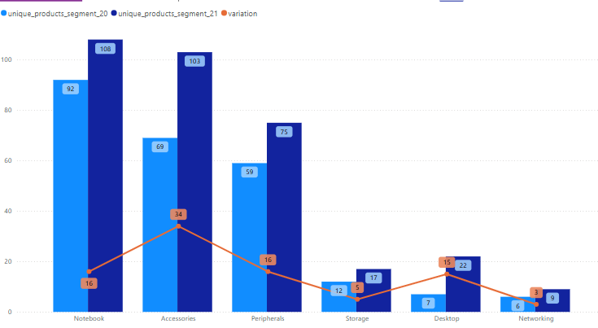
Visual and Insights
Notebook +17% and Accessories +49% are the
highest contributors to growth, indicating strong customer demand.
Storage and Networking show minimal variation, indicating potential stagnation.
The business should explore new product innovations,
competitive pricing, or targeted promotions to boost
these categories.

Slide 10
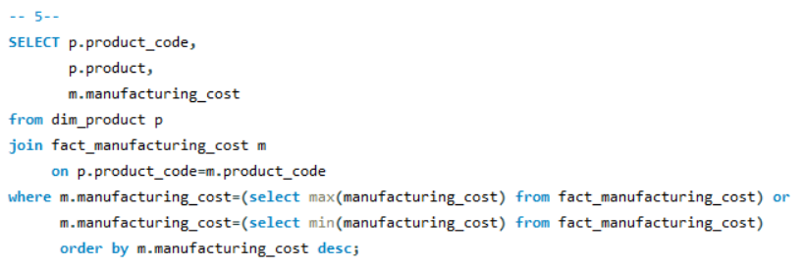

AD-HOC Request-5
Get the products that have the highest and lowest manufacturing costs.The final output should contain these fields, product_code product manufacturing_cost
SQL Query
Output

Slide 11
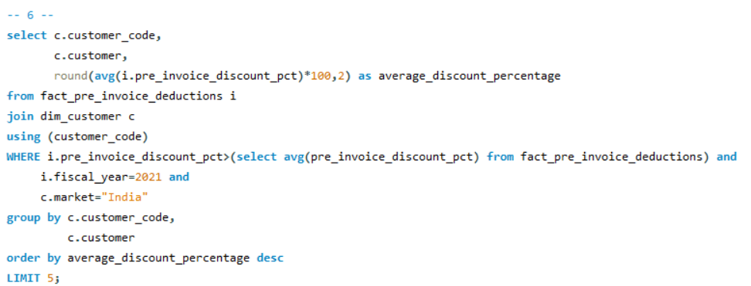
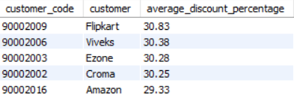
AD-HOC Request-6
Generate a report which contains the top 5 customers who received an average high pre_invoice_discount_pct for the fiscal year 2021 and in the Indian market. The final output contains these fields, customer_code,customer , average_discount_percentage
SQL Query
Output

Slide 12
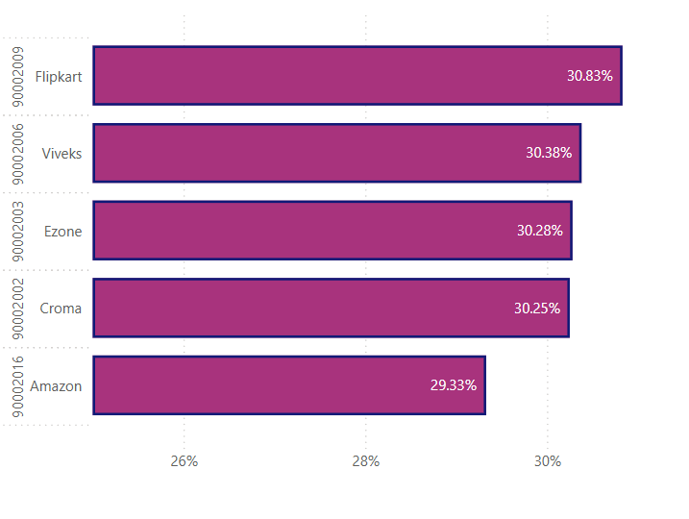
Visual and Insights
Flipkart offers the highest average pre-invoice discount (30.83%), but the difference across retailers is minimal (just 1.5% between Flipkart and Amazon).
All top 5 retailers are offering around 30% discounts, meaning they rely heavily on price-based strategies to attract customers.
Amazon, despite being a dominant player, is offering the lowest average discount.
This could mean they focus more on customer loyalty programs, subscription benefits (Amazon Prime), and exclusive deals, rather than direct discounts.

Slide 13
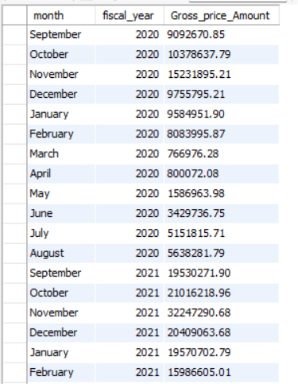
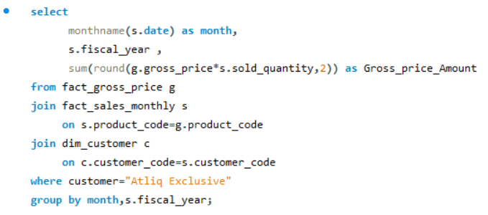
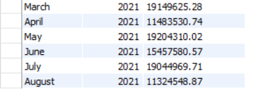
AD-HOC Request-7
Get the complete report of the Gross sales amount for the customer “Atliq Exclusive” for each month. This analysis helps to get an idea of low and high-performing months and make strategic decisions. The final report contains these columns: Month, Year, Gross sales Amount
SQL Query
Output

Slide 14
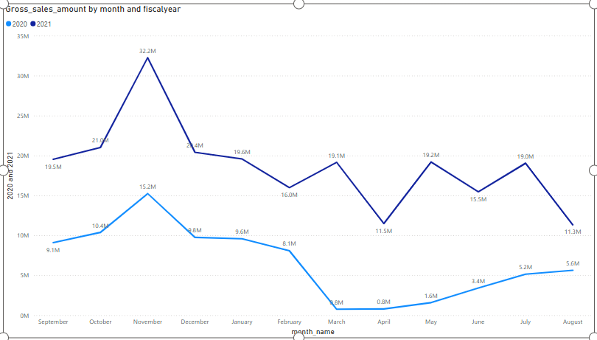
Visual and Insights
In both 2020 and 2021, sales peaked in November, suggesting a seasonal impact
This could be due to holiday shopping, promotions, or end-of-year demand surges.
Sales dropped from March to August because of COVID-19. But now, things are looking up. Sales have been going up and are even better than they were in 2020.

Slide 15
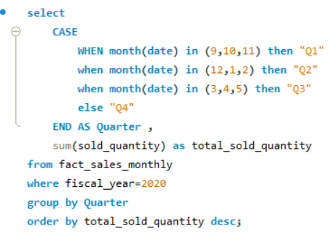
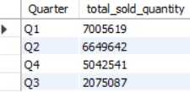
AD-HOC Request-8
In which quarter of 2020, get the maximum total_sold_quantity? The final output contains these fields sorted by the total_sold_quantity, Quarter total_sold_quantity _mln
SQL Query
Output

Slide 16
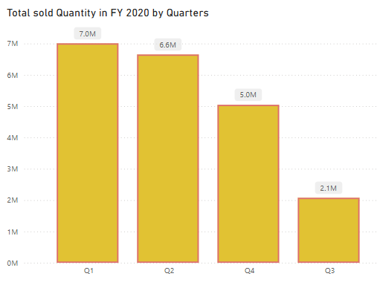
Visual and Insights
Q1 contributed 33.82% of the total sales in 2020.
The Highest total quantity is in Q1 with 7,005,619 units
This could indicate strong demand at the beginning of the year, possibly due to seasonal trends, promotions, or new product launches.
The data suggests that Q1 and Q2 were the peak
sales periods, while Q3 experienced a major slump.

Slide 17
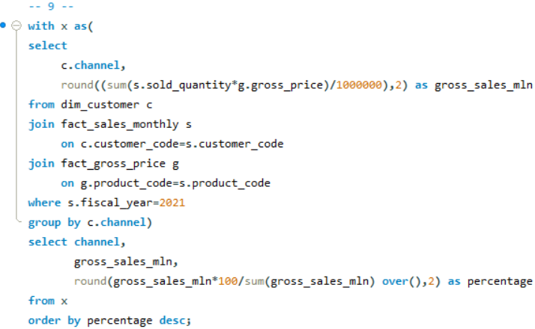

AD-HOC Request-9
Which channel helped to bring more gross sales in the fiscal year 2021 and the percentage of contribution? The final output contains these fields, channel gross_sales_mln percentage
SQL Query
Output

Slide 18
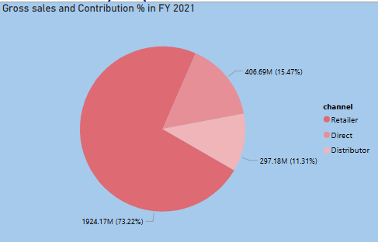
Visual and Insights
The Retail channel contributed 73.22% (1924.17M) of total sales,
making it the primary revenue driver.
This indicates strong dependence on retail distribution for business
growth.
Distributor and Direct channels together contribute 26.78%, showing
potential for expansion, particularly in direct sales .
Increasing the Direct sales share could improve profitability by reducing
dependency on third-party retailers and intermediaries.

Slide 19
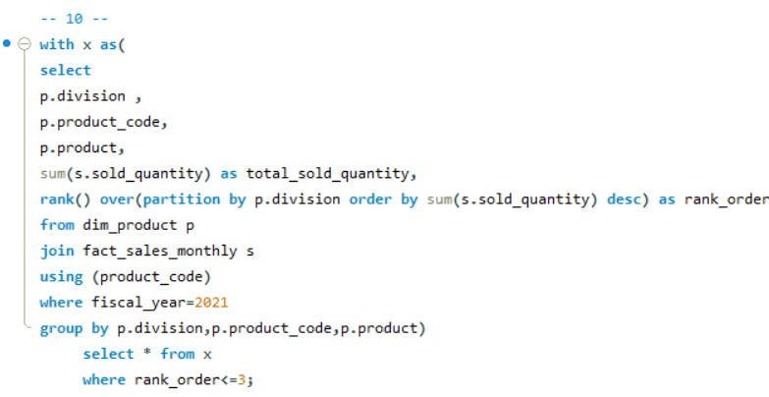
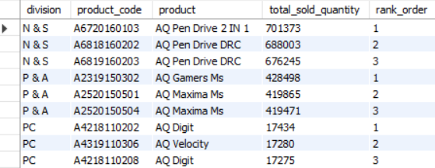
AD-HOC Request-10
Get the Top 3 products in each division that have a high total_sold_quantity in the fiscal_year 2021? The final output contains these fields, division ,product_code ,product ,total_sold_quantity,rank_order
SQL Query
Output

Slide 20
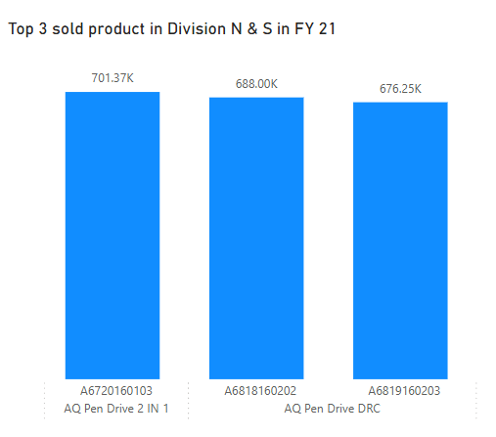
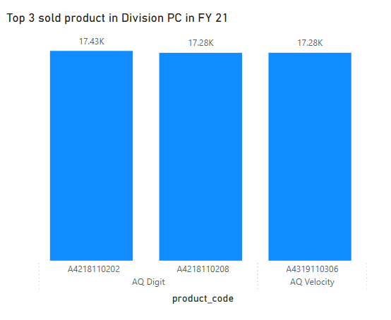
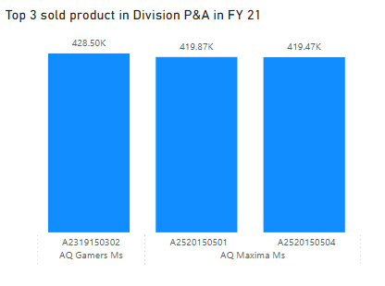
Visual and Insights

Slide 21
Thank You

