Slide 1
Counts
Electrons
Pions
E_{cal}/P
# of Photo-electrons, N_{cer}

Slide 2
δ ( % )
W (GeV/c²)

Slide 3
ΔY (cm)
ΔX (cm)

Slide 4
Counts
Δ_{p}

Slide 5
The Physics Asymmetries, A_{p}
Q² (GeV/c)²

Slide 6
The Physics Asymmetries, A_{p}
Q² (GeV/c)²

Slide 7
The Physics Asymmetries, A_{p}
Invariant Mass, W (GeV/c²)

Slide 8
The Phy. Asym., A_{p}
Invariant Mass, W (GeV/c²)

Slide 9
The Phy. Asym., A_{p}
Invariant Mass, W (GeV/c²)

Slide 10
The Relative Dilution Factor
Invariant Mass, W (GeV/c²)

Slide 11
The Relative Dil. Fac.
Invariant Mass, W (GeV/c²)

Slide 12
The Relative Dil. Fac.
Invariant Mass, W (GeV/c²)

Slide 13
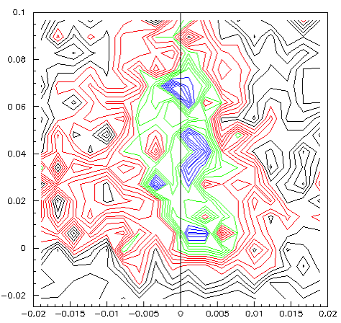
θ_{tar} (Deg.)
Δ_{P} (%)

Slide 14
ΔY (cm)
Y_{BETA} (cm)

Slide 15
θ_{tar} (rad)
θ_{tar} (rad)

