Slide 1
KODURU ANUSHA
Final Project
<number>

Slide 2

Keylogger and Security
3/21/2024 Annual Review
<number>

Slide 3


AGENDA
Problem Statement
Project Overview
Who Are The End Users
Solution And Value Proposition
Wow in Your Solution
ModelingWire Frames
Outputs
Results
Project Links

Slide 4

Problem Statement
In today’s digital world, it is more complex to provide such parameters that are filled with networks and devices. It is challenging for organizations to prevent the inside attack where employees exploit their access to data and at the same time, track and manage employees’ performance. Likewise, the issues of detection and prevention of unauthorized access are still major challenges. Current available approaches of keylogging however prove to be inadequate due to their intrusive nature, usability challenges and lack of an efficient security system.
Solution : Based on these challenges, Keylogger Monitoring Tool is able to overcome these challenges by having a secure and efficient method of logging keystrokes and preserving data security for IT administrators, security experts, and parents.

Slide 5

Project- Overview
The Keylogger Monitoring Tool has been developed specifically to solve numerous problems of modern security and productivity in the modern world. It addresses companies struggling with internal security breaches, anxious parents who want to monitor their children’s internet activity, and organizations in need of protection from unauthorized access.
Key Features :
Security Enhancement: To help the executives protect their privacy and information security, the tool provides a safe way of recording keystrokes to prevent data leaks, sabotage, and unauthorized access within the company.
Parental Control: Parents are able to oversee and regulate their children’s usage of the computers, and steer clear of improper conducts online.
User-Friendly Interface: The tool aims to remove traditional keylogging solutions by focusing on convenient browsing without loss of security or capabilities.
<number>

Slide 6

WHO ARE THE END USERS?
Organizations and IT Administrators
- Security Professionals
- IT Administrators
Parents and Guardians
Individual Users
<number>

Slide 7

SOLUTION AND ITS VALUE PROPOSITION
Virtual Private Network (VPN) : Encrypts internet connection and protect your keystrokes from being intercepted while typing online.
Secure Operating Systems : Choosing a secure OS that prioritizes security features and regular updates can help mitigate the risk of keyloggers and other malware.
Biometric Authentication : Fingerprint scanners or facial recognition for authentication adds an extra layer of security, making it harder for keyloggers to compromise your credentials.
Security Awareness : Awareness about phishing scams, social engineering tactics, and safe computing practices can help.
Regular Software Updates : Keeping the OS, Antivirus software, web browsers, and other applications up to date helps to protect against keyloggers attacks.
<number>

Slide 8

THE WOW IN SOLUTION
Two-Factor Authentication : Implement two-step verification to add an extra layer of security beyond passwords, thwarting keyloggers from compromising your accounts.
Secure Operating System : Opt for secure operating systems with built-in protections against malware, ensuring robust defense mechanisms against keylogging threats.
VPN Usage : Encrypt the internet connection with a VPN to shield the keystrokes from interception, especially on public or unsecured networks.
Biometric Authentication : Enhance security with biometric authentication methods
Comprehensive Protection : Integrates multiple strategies to provide layered defense against keyloggers and other cyber threats.
<number>

Slide 9
MODELLING
Install required python libraries in command prompt like,
1. pip install pynput 2. pip install json
Initialization of keylogger : Set up the main GUI window. Initialize global variables for key logging.
Capturing of keystrokes : Start capturing key events when the "Start" button is pressed. Log key press and release events.
Data Logging into text files : update text and Json log files with captured key events.
Stop Logging : Stop capturing key events when the "Stop" button is pressed.
<number>

Slide 10
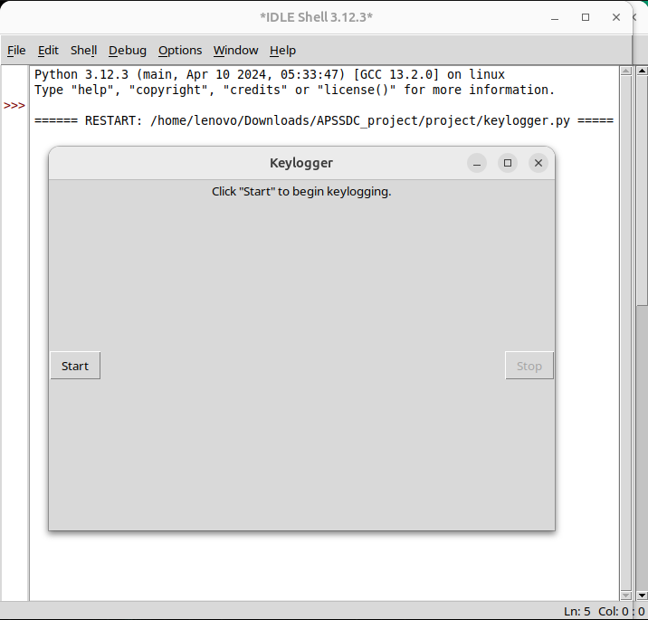
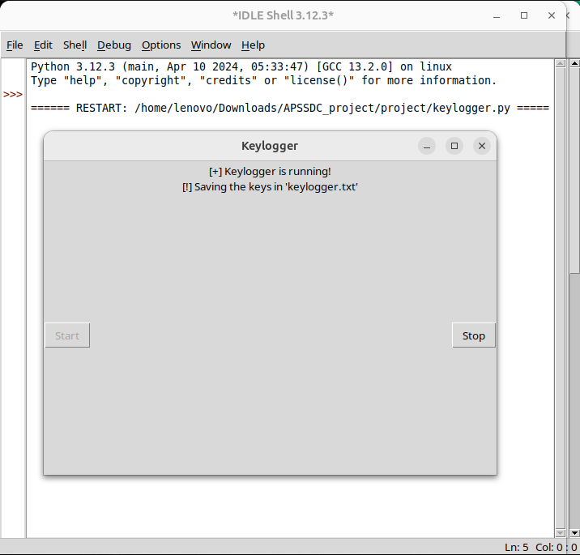
START STOP
<number>

Slide 11
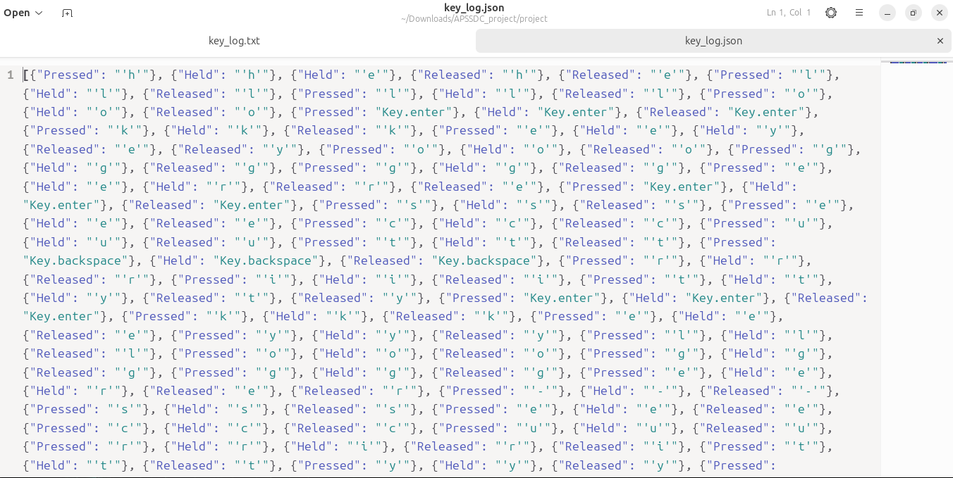

RESULTS
key_log.txt key_log.json
<number>

Slide 12
Github Link :
https://github.com/anusha9059/Keylogger_security_project
<number>

