Slide 1

E-Commerce
Whether an online company should invest more on mobile apps or website?

Slide 2
1.1 Introduction:
*Python:
Python is one of the most widely used high level programming language .
It was initially designed by Guido Van Rossum in 1991 and later developed by Python Software Foundation.
Some of the reasons for using this as high level programming language is
-open source
-easy to learn
-exception handling
*Machine Learning:
It is an application of artificial intelligence (AI) that provides systems the ability to automatically learn and improve from experience without being explicitly programmed.
It consists of two models that is regression and classification.

Slide 3
1.2 Objective Of Research
The Objective of research project summarizes
that an E-commerce company should invest on application or on Website.

Slide 4
1.3 Problem Statement
The dataset consists of several parameters out of which we need to predict whether which parameter affects the yearly amount spent by a customer and in this project by doing exploratory data analysis and implementing algorithm we will find a solution to this problem.

Slide 5
2.Review of Literature
Firms across the globe have adopted e-commerce (EC) in their operations
and have reaped benefits thereof. While firms in technologically developed countries
like US and UK has deployed EC to its advantage, whereas firms in developing coun-
tries like India failed to follow the suit

Slide 6
With the advent of Internet and its commercialization since 1994 [28, 29] a new medium of commerce popularly known as ‘E-Commerce (EC)’ rapidly emerged in the modern global economy. E-commerce can be defined as “the use of the Internet and other networking technologies for conducting business transactions” .

Slide 7
-Mobile Website:
The other fortunate thing about the mobile website is that they are constantly available by anybody on the web: you don’t need to download a site, as you do with a eCommerce app, to look through your items and products.
Likewise, now that mobile sites have turned into the standard, with most online business stages, it’s quite simple and not very costly to have a website for mobile use.

Slide 8
-Mobile Apps:
Mobile applications are designed in a way which makes it simpler and more helpful being used compared to someother mobile solutions. Mobile applications are significantly quicker than mobile sites. When clients download your application, all the content is introduced on their mobile phone. Hence, clients can operate their
e-commerce application without an internet connection (offline apps/database sync apps) in their phones to see your products.

Slide 9
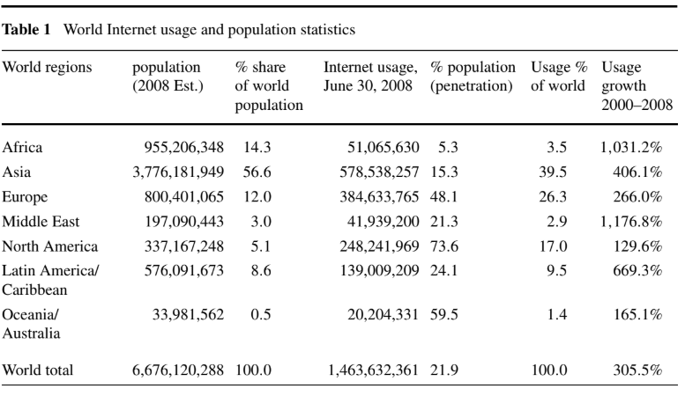

Slide 10
3.Data Collection
We have collected this Dataset from
KAGGLE.COM

Slide 11
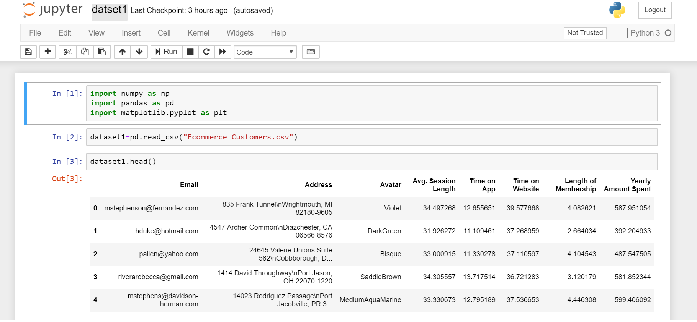
4.Methodology
4.1 :Exploratory Data Analysis
4.1.1: Figures and Tables and Data Modelling
Data1-

Slide 12
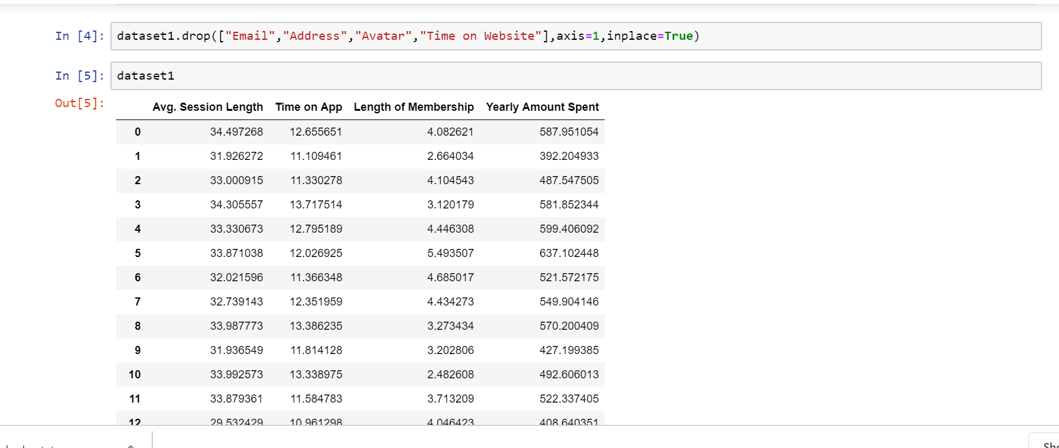

Slide 13
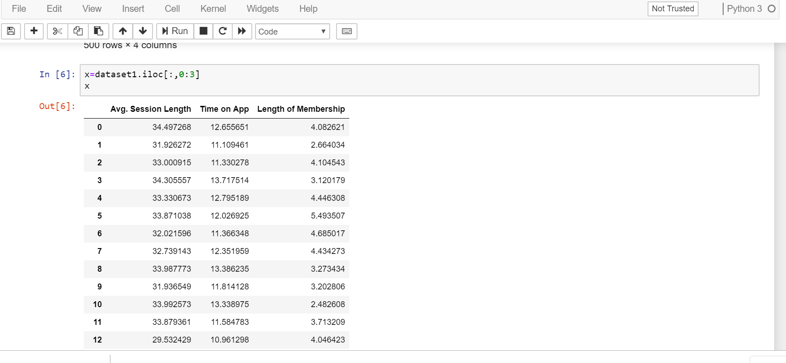

Slide 14
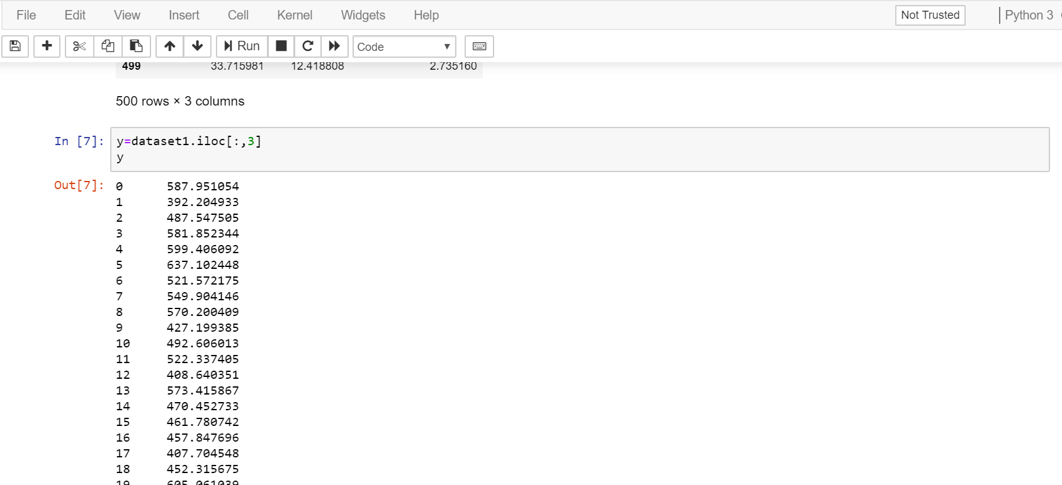

Slide 15
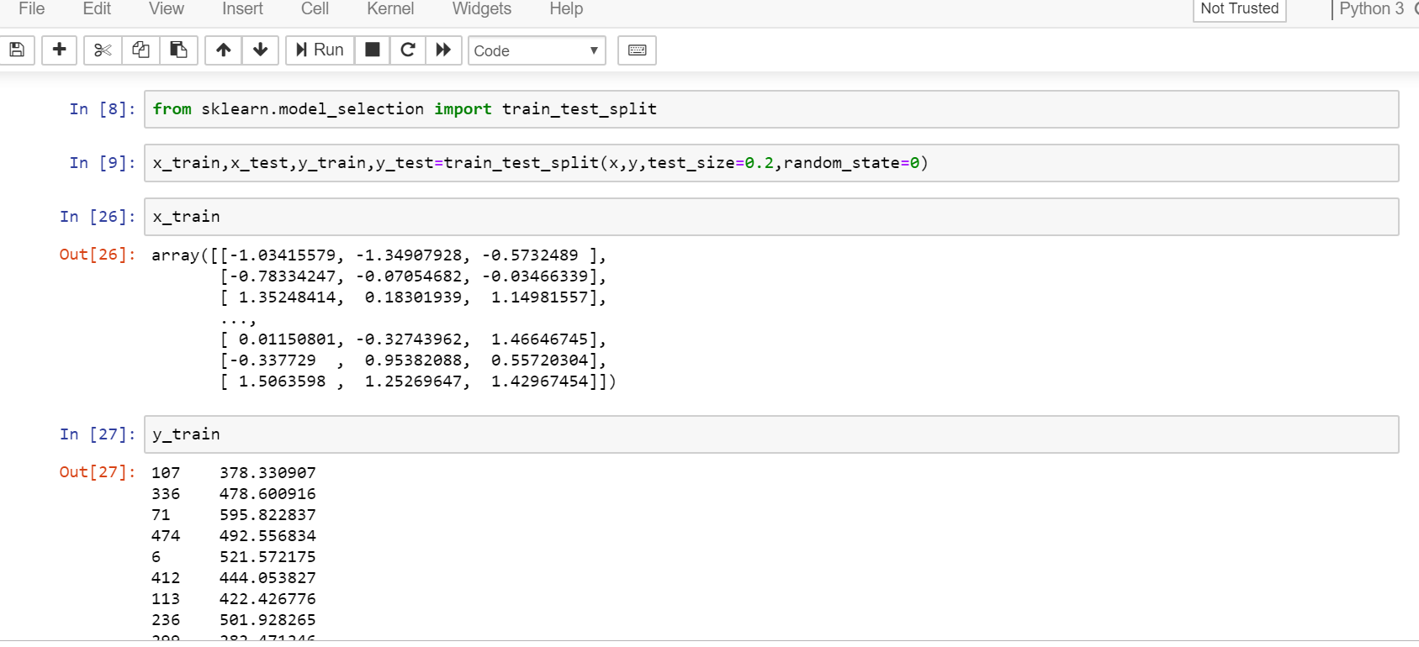

Slide 16
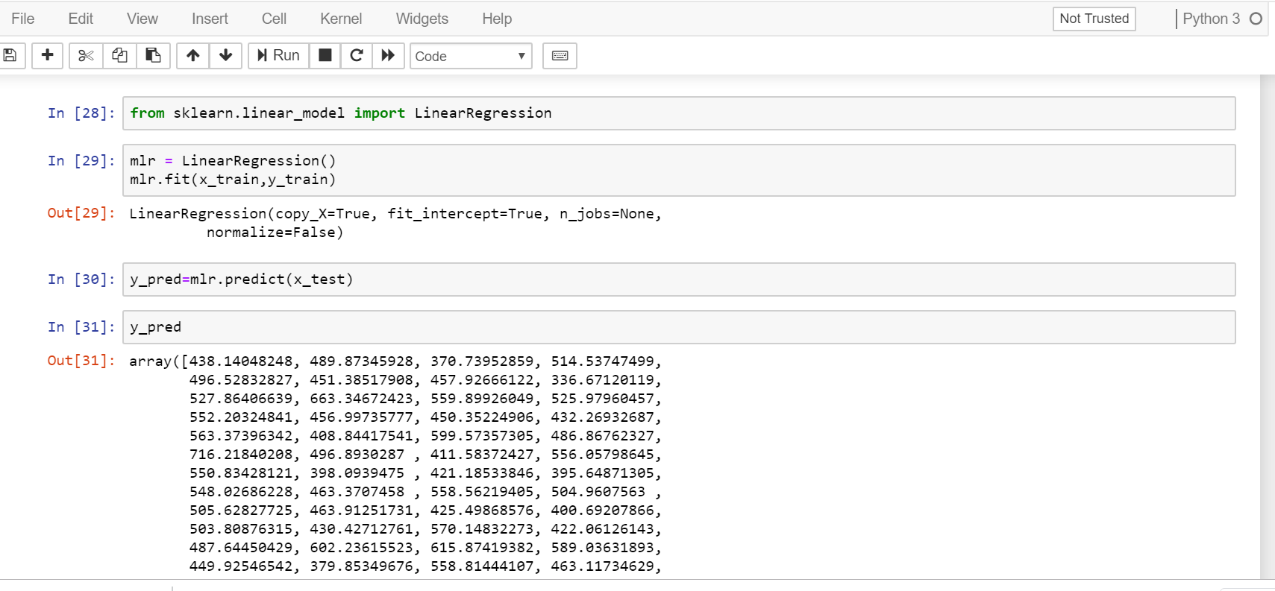

Slide 17
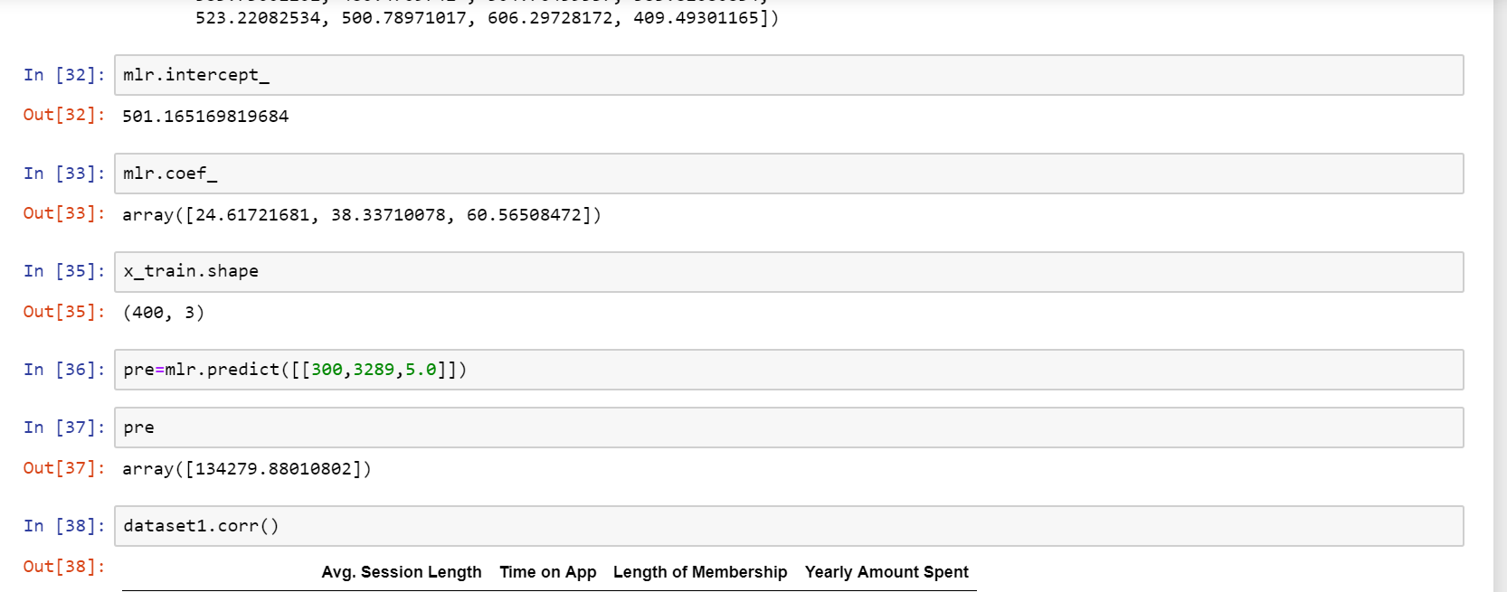

Slide 18
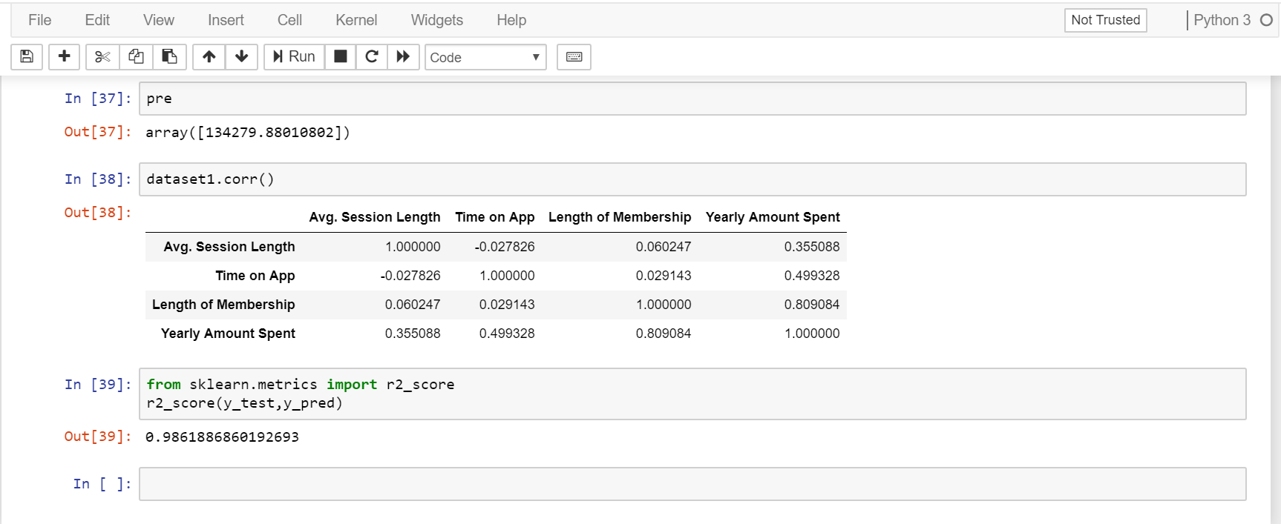

Slide 19
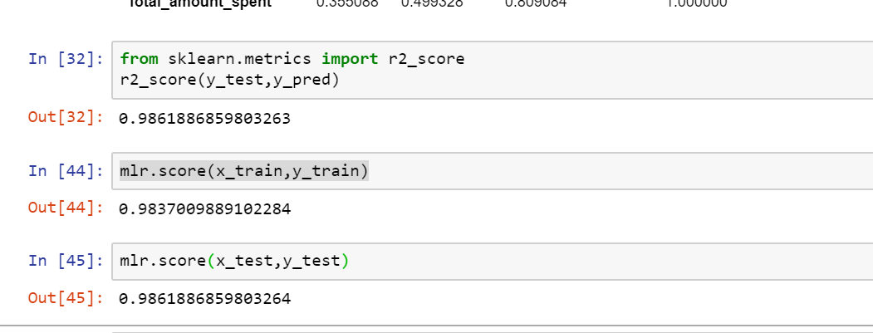

Slide 20
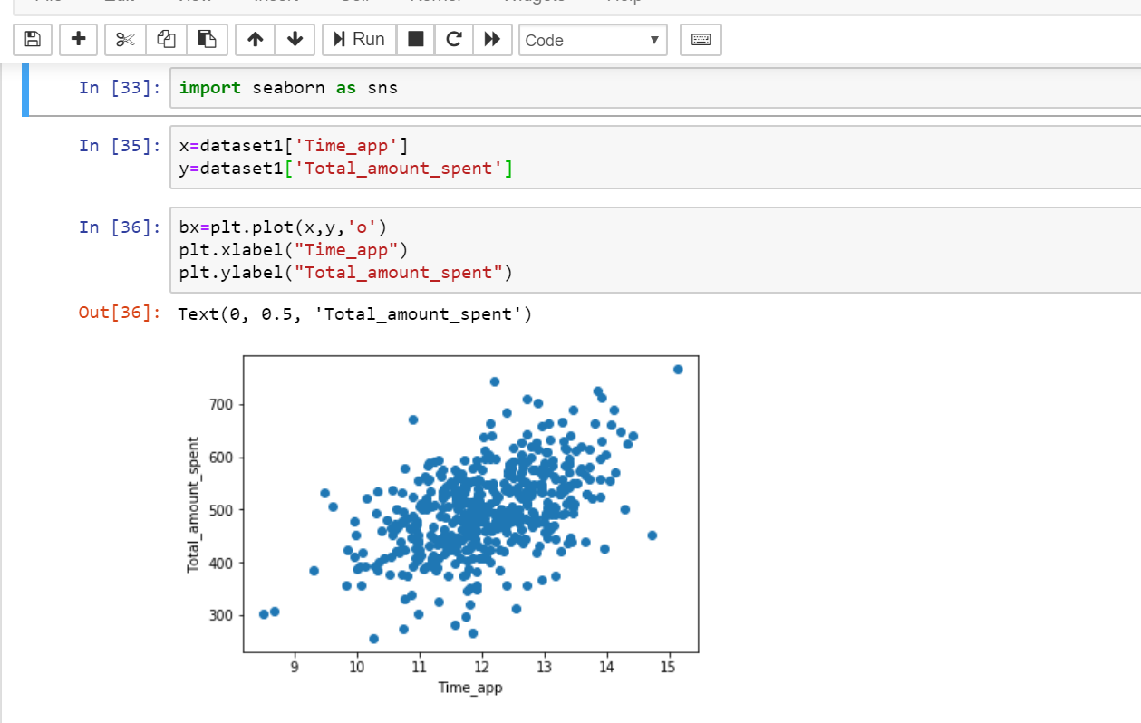

Slide 21
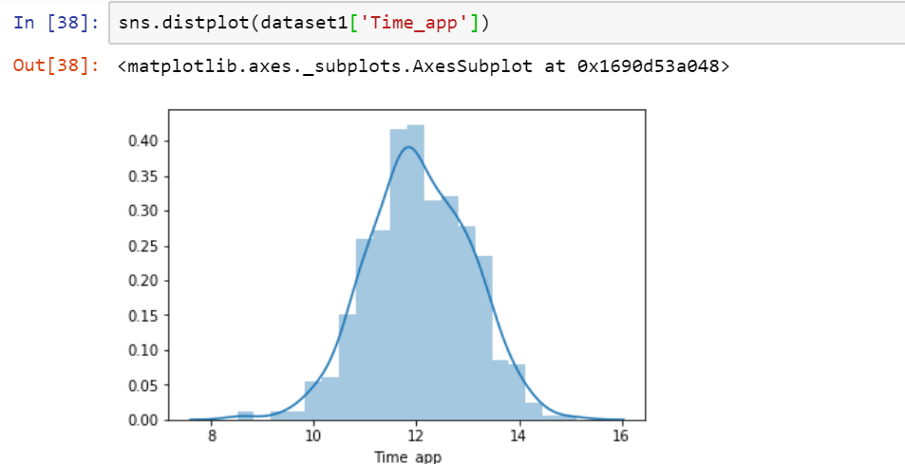

Slide 22
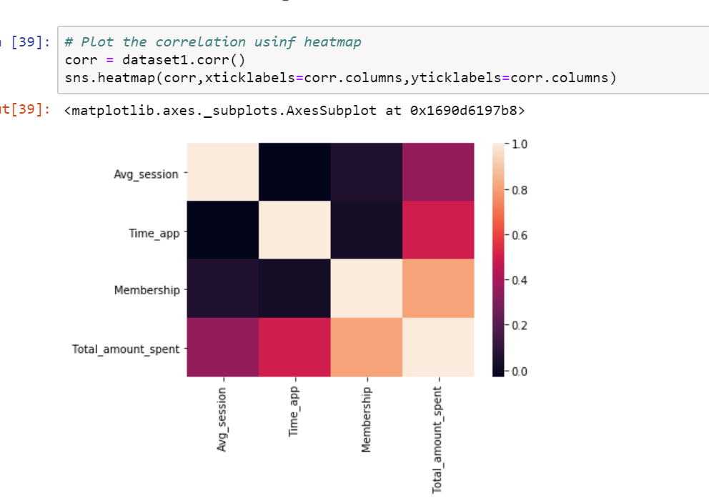

Slide 23
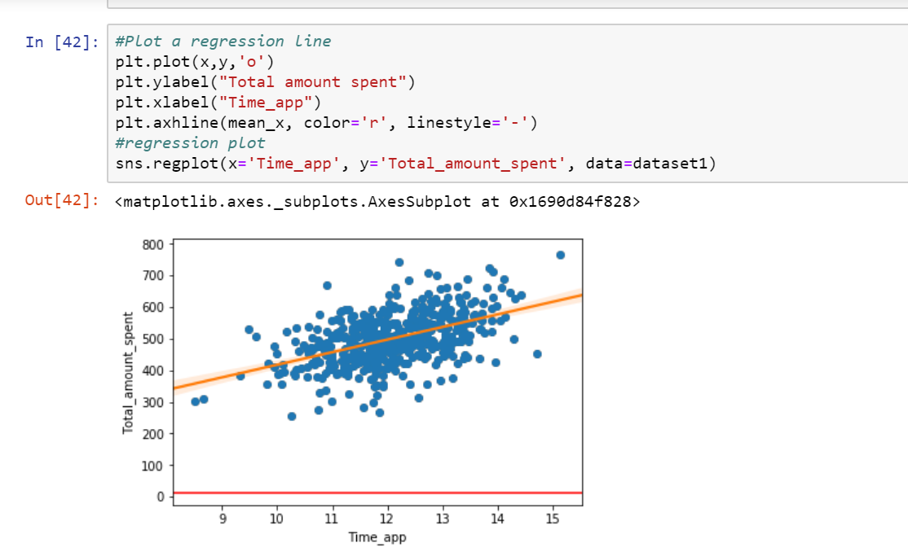

Slide 24
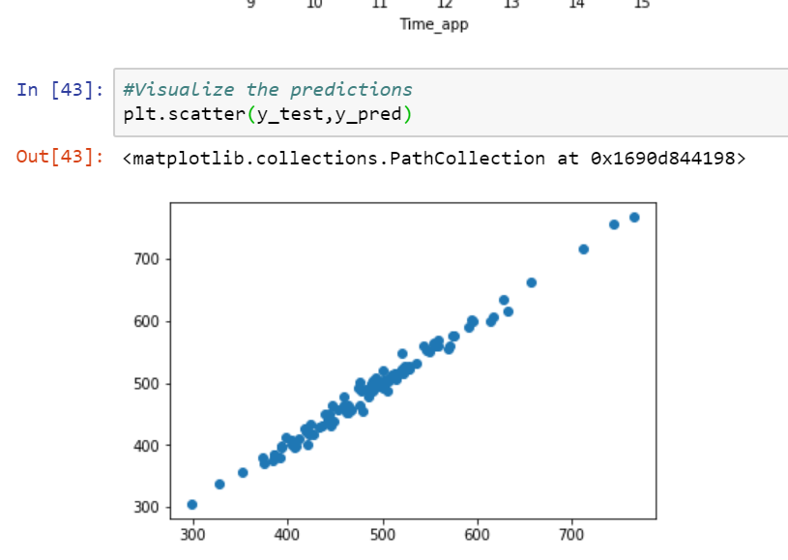

Slide 25
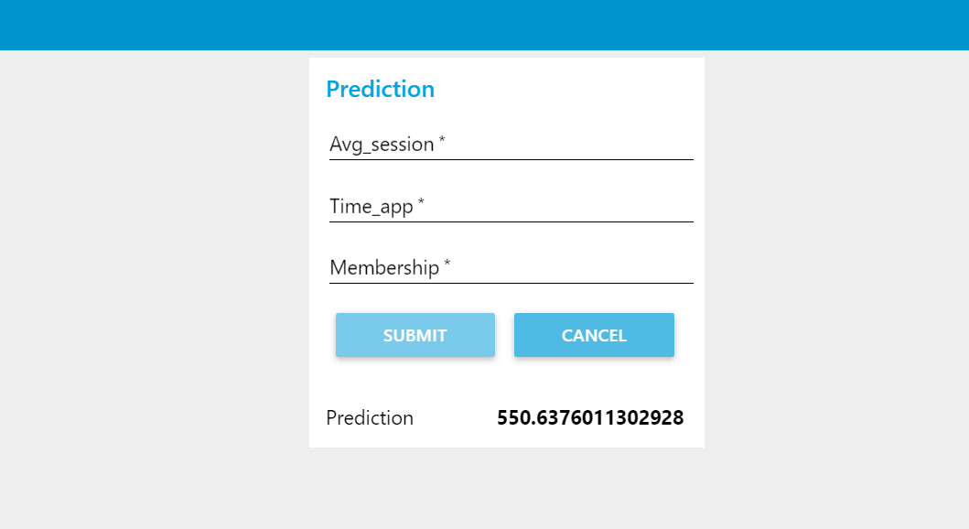

Slide 26
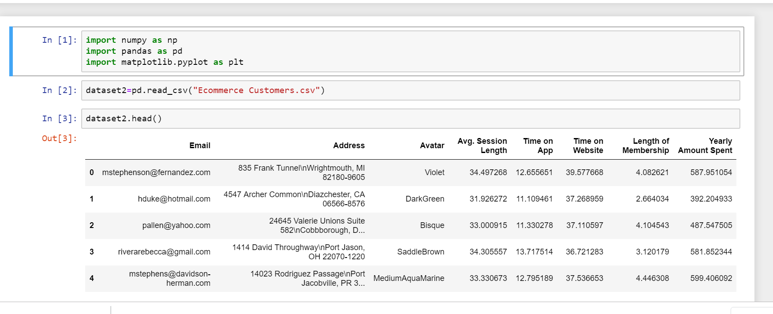
Data2-

Slide 27
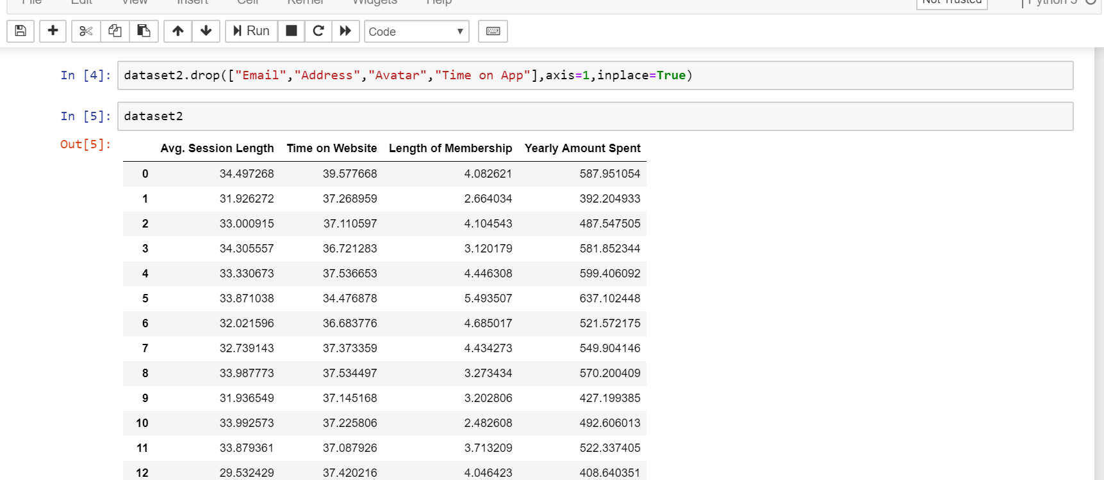

Slide 28
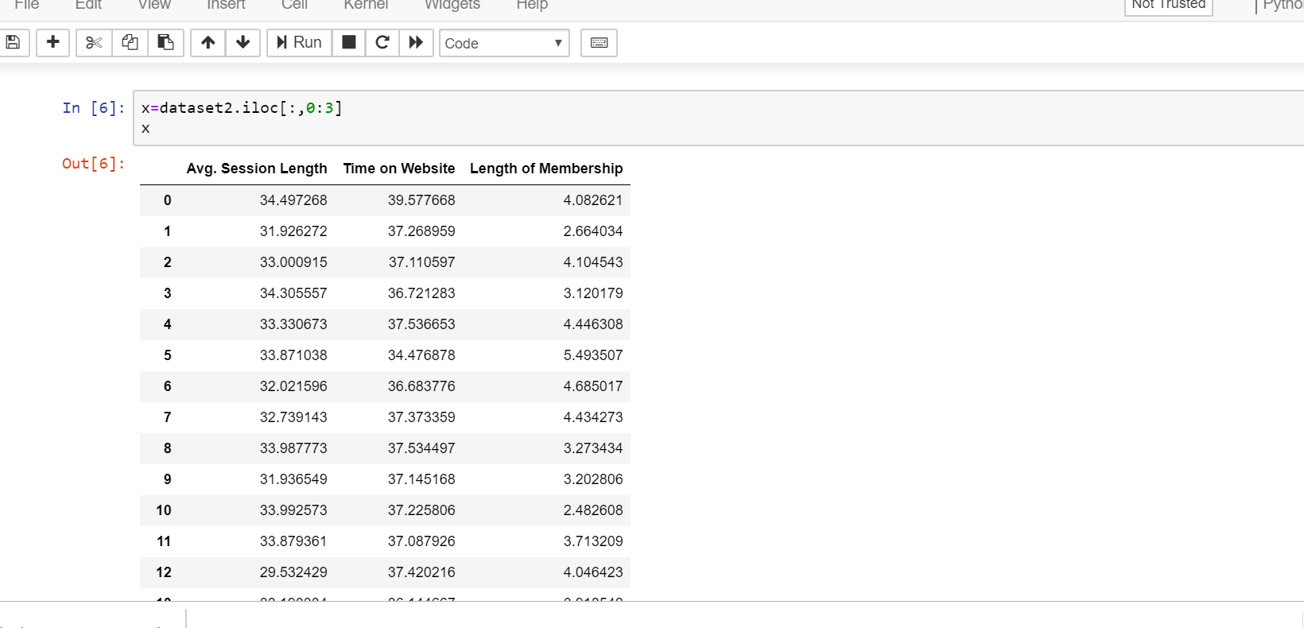

Slide 29
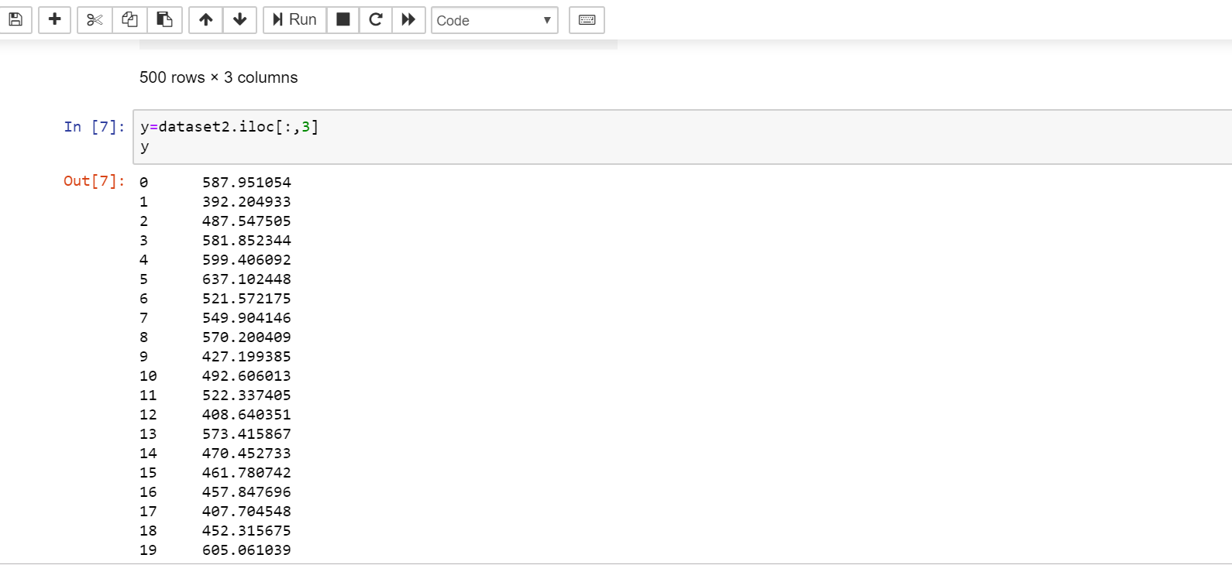

Slide 30
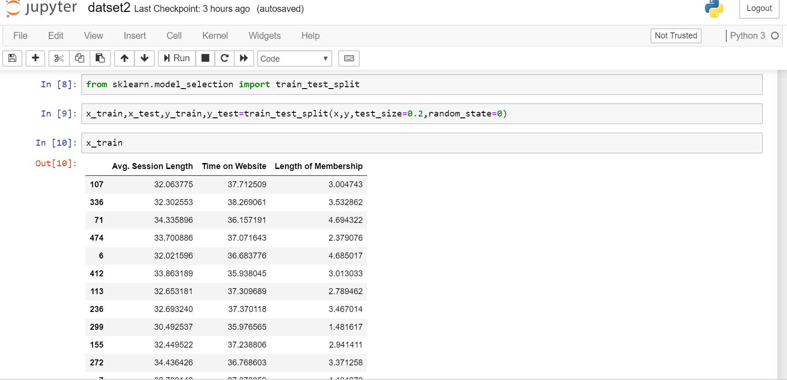

Slide 31
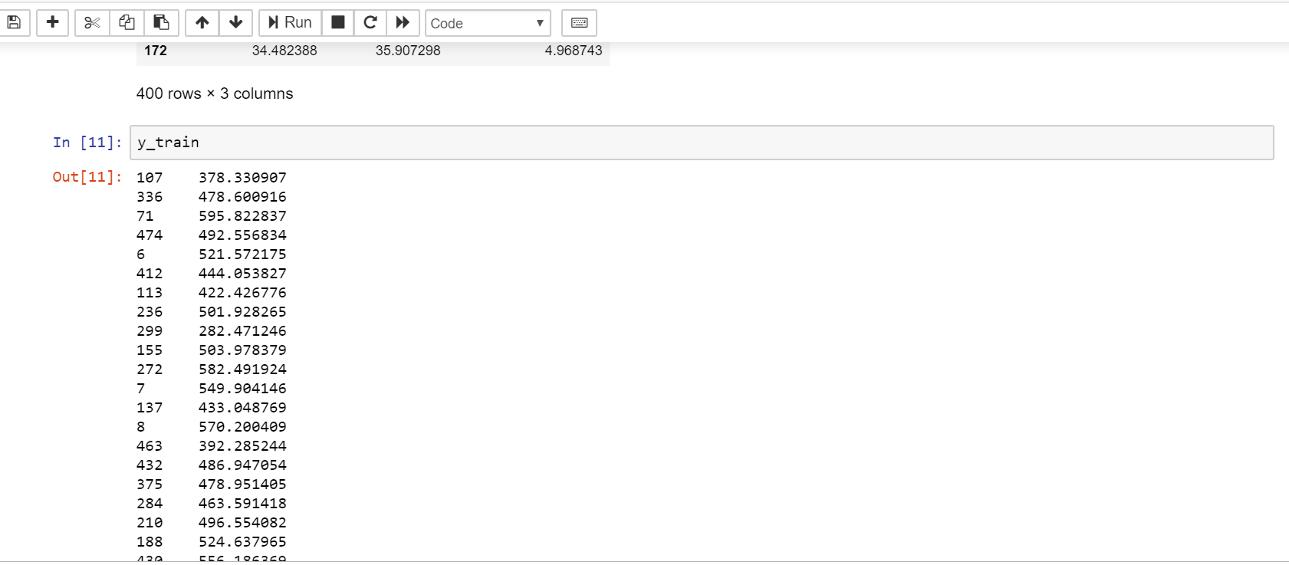

Slide 32
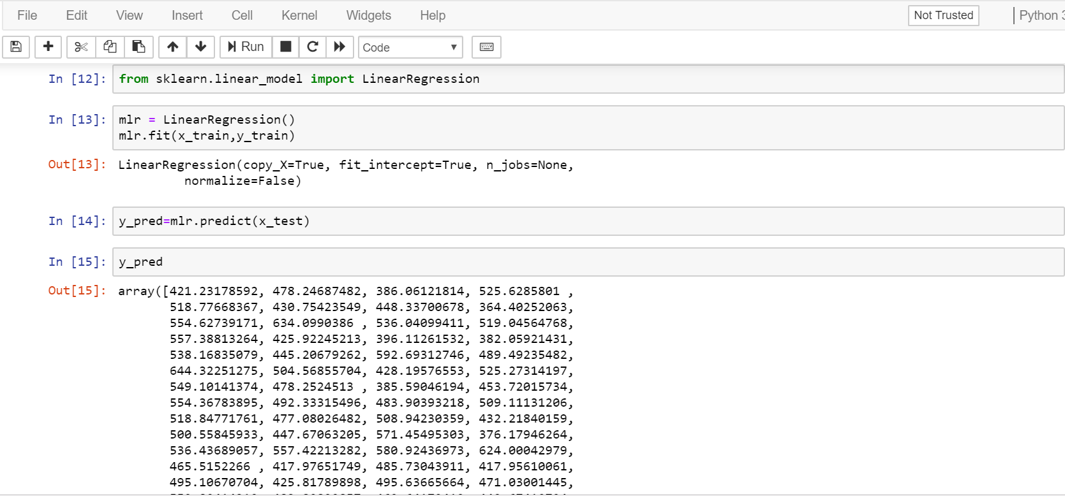

Slide 33
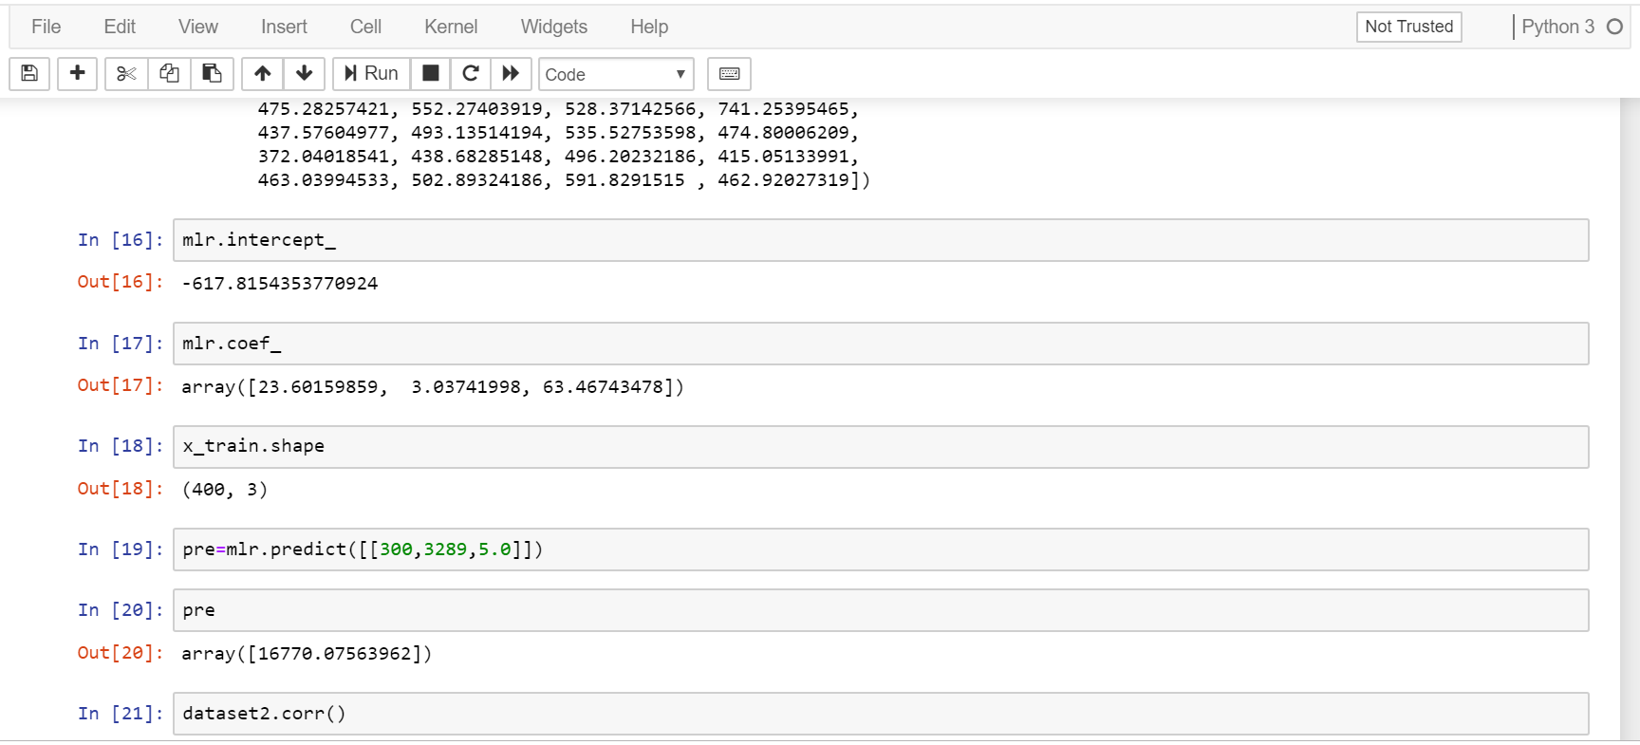

Slide 34
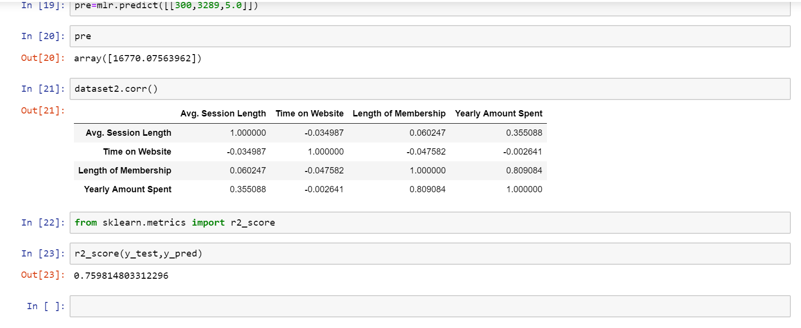

Slide 35
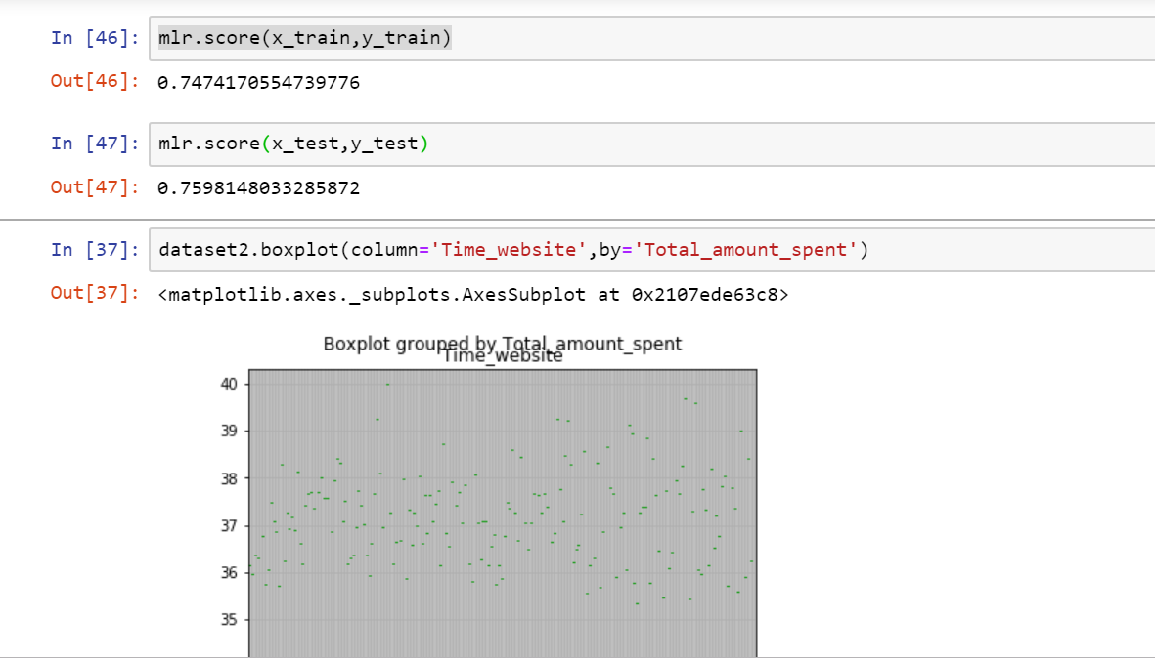

Slide 36
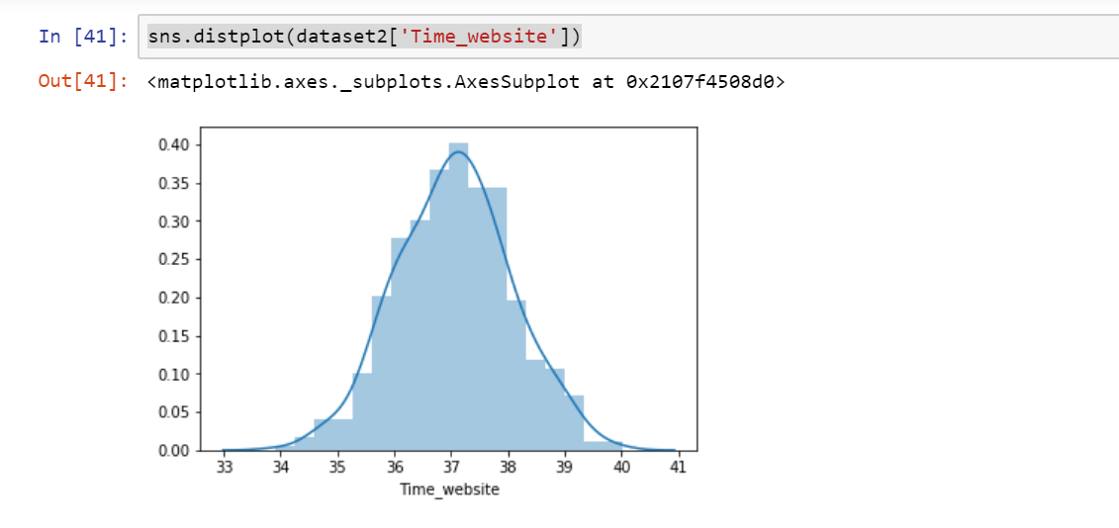

Slide 37
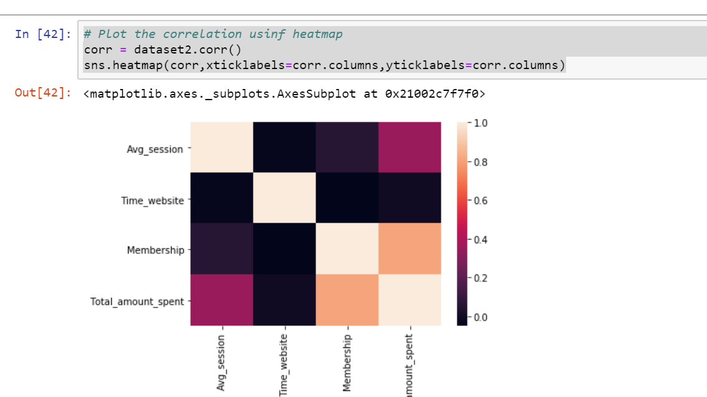

Slide 38
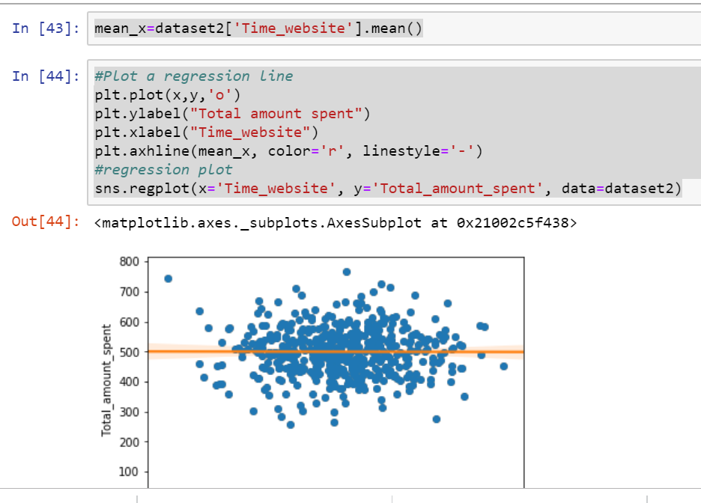

Slide 39
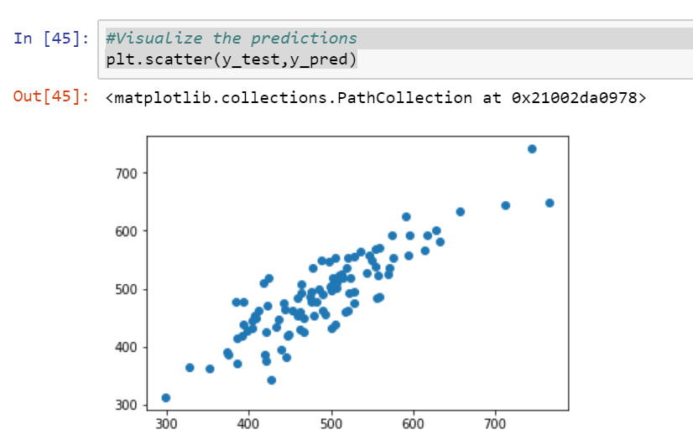

Slide 40
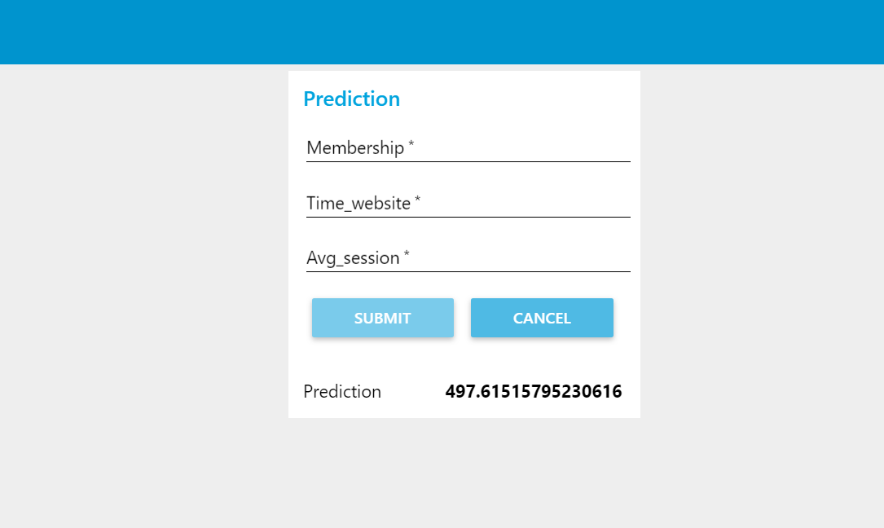

Slide 41
5.Findings and Suggestions: we have splitted the dataset in two models(model 1 and 2)where input is average session time,length of membership,time on application and time on website,And the output is Yearly amount spent by a customer in purchasing products.
The future updations can be made on the prediction based on the changing input/output .The suggestions that can be made on this dataset is that the e-commerce company can invest in both as the R-squared value is high for both the data,But the best model with 98% accuracy I s the model1 where the time spent on application for purchasing a product is less and the profit is more.

Slide 42
6.Conclusion:
Based on this dataset we can predict and suggest that the e-commerce company should invest in application.

Slide 43
Made by:
R.Vaishnavi
Samreen Sultana
Chitla Venkata Trinadh
V. Ahlada Sai
Anusha Narayan
THANKYOU

