Slide 1
IBM University Engagement Project Submission
“Exploring the Power of Agentic AI with IBM Granite and LangFlow”

Slide 2

Project Tile – AI Agent for Digital Financial Literacy
Domain of Project – Finance
Student Name | Recent Passport Photo | Email ID | Mobile number [WhatsApp]
[Redacted] |  | [Redacted] | [Redacted]

Slide 3
Problem Statement : AI-powered Digital Financial Literacy Agent
The Challenge: Digital financial tools are expanding rapidly, but many users struggle to understand and navigate essential financial practices like using UPI safely, avoiding online scams, managing budgets, and understanding loan interest rates. Reliable financial information is often scattered across complex government portals, banking websites, and educational platforms. Without accessible, personalized, and culturally inclusive guidance in local languages, individuals risk financial fraud and lack the confidence to participate fully in digital finance.
The Objective: Build an AI-powered Digital Financial Literacy Agent that retrieves reliable content to help users navigate financial tools, protect against fraud, and build confidence through personalized, multilingual guidance.
Core Requirements / Features:
  Multilingual Support: Enable users from diverse linguistic backgrounds to interact and ask questions in their preferred language (e.g., “How do I send money via UPI?” or “What is a safe interest rate for a loan?”).
  Financial RAG Retrieval: Fetch verified content regarding UPI usage, scam prevention, budgeting, and personal finance management from trusted government and banking platforms.
  Fraud Protection & Advisory: Educate users on identifying phishing links, fake customer care numbers, and safe digital transaction habits.
  Multi-Agent System:
    Financial Knowledge Agent (retrieves facts on banking and schemes via RAG).
    Scam Prevention & Security Agent (analyzes texts/scenarios for potential fraud risks).
    Budgeting & Advisory Agent (provides personalized savings and loan guidance).
  Interactive Dashboard: Visualize financial literacy progress, budgeting tips, and scam alerts.

Slide 4
Proposed Solution -
Proposed Solution: AI-powered Digital Financial Literacy Agent
The proposed solution is an AI-powered Digital Financial Literacy Agent built using Python, Streamlit, IBM watsonx.ai, and Granite Models to provide accessible, personalized, and culturally inclusive financial guidance. The system tackles challenges in digital adoption, scam awareness, and personal finance through a modular, custom-coded architecture.
At its core, the solution utilizes a Retrieval-Augmented Generation (RAG) pipeline to fetch reliable guidelines from trusted sources such as RBI, NPCI, and government financial portals. This data is embedded and stored in a vector database, allowing Granite models to retrieve and summarize rules on UPI, interest rates, and budgeting
The system comprises specialized components: a retrieval engine handles policy and tool queries, an analysis module detects online scam patterns, and an advisory interface assists with personal finance management. Streamlit powers the interactive frontend interface, while watsonx.ai ensures enterprise-grade model deployment, embeddings, and governance

Slide 5
Technology Used
Python: Core programming language used for building the application logic, data ingestion, and RAG pipeline.
Streamlit: For building the interactive, clean, and user-friendly web application interface.
IBM Granite Model : ( ibm-granite-3-2-8b or Granite-4.0-8B-Instruct)For natural language understanding, complex financial reasoning, scam evaluation, and multilingual personalization.
IBM Cloud: Provides a secure, scalable, and reliable infrastructure environment for deploying the Digital Financial Literacy Agent.
RAG (Retrieval-Augmented Generation): To fetch accurate real-world data from banking and regulatory sources before generating responses, ensuring trustworthiness.
IBM watsonx.ai: For model deployment, vector embeddings, and robust AI governance.
Vector Database (FAISS / Chroma): For fast, efficient RAG-based retrieval of financial regulations, scam alerts, and educational articles.

Slide 6
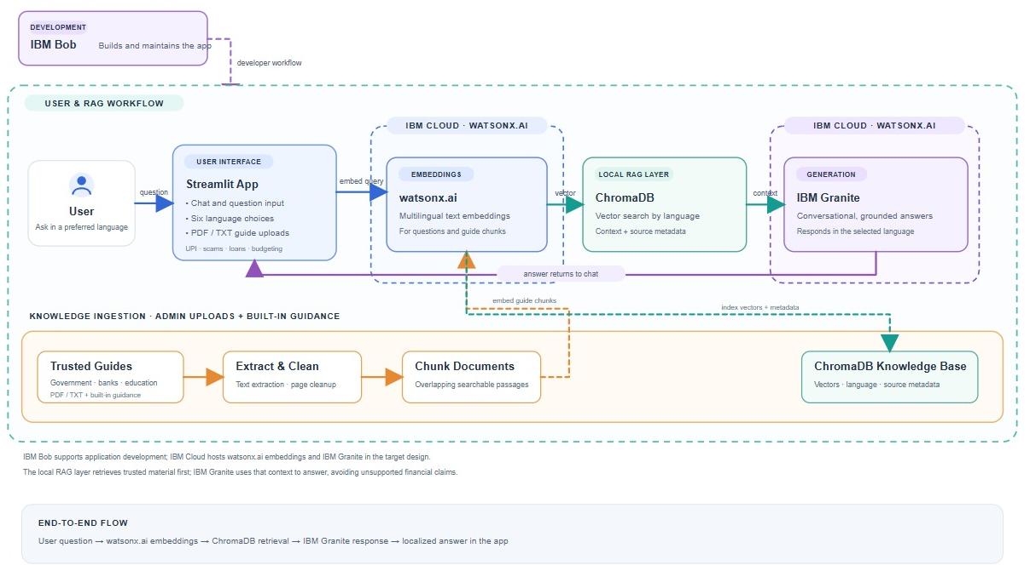
Architecture blueprint

Slide 7

Role of Agentic AI in the solution
Role of Agentic AI in : AI-powered Digital Financial Literacy Agent
Agentic AI elevates the Digital Financial Literacy Agent from a static chatbot into an autonomous, proactive financial mentor:
Autonomous Intent Routing: Dynamically evaluates whether a user inquiry requires step-by-step technical execution (like UPI setup), scam risk verification (analyzing suspicious text messages), or budgeting advice, routing it to the appropriate context.
Proactive Guardrails & Verification: Cross-references user queries against verified regulatory data via RAG to ensure that no incorrect or high-risk financial advice is ever delivered.
Context Adaptation & Personalization: Adjusts explanation depth, tone, and regional language nuances based on user interactions, ensuring financial concepts are easily digested by diverse demographic groups.

Slide 8
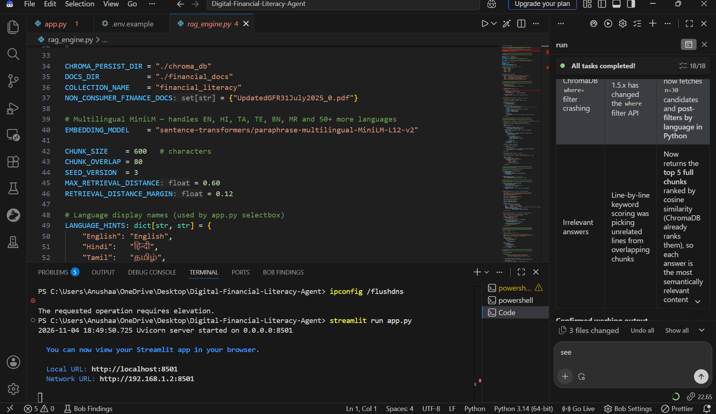
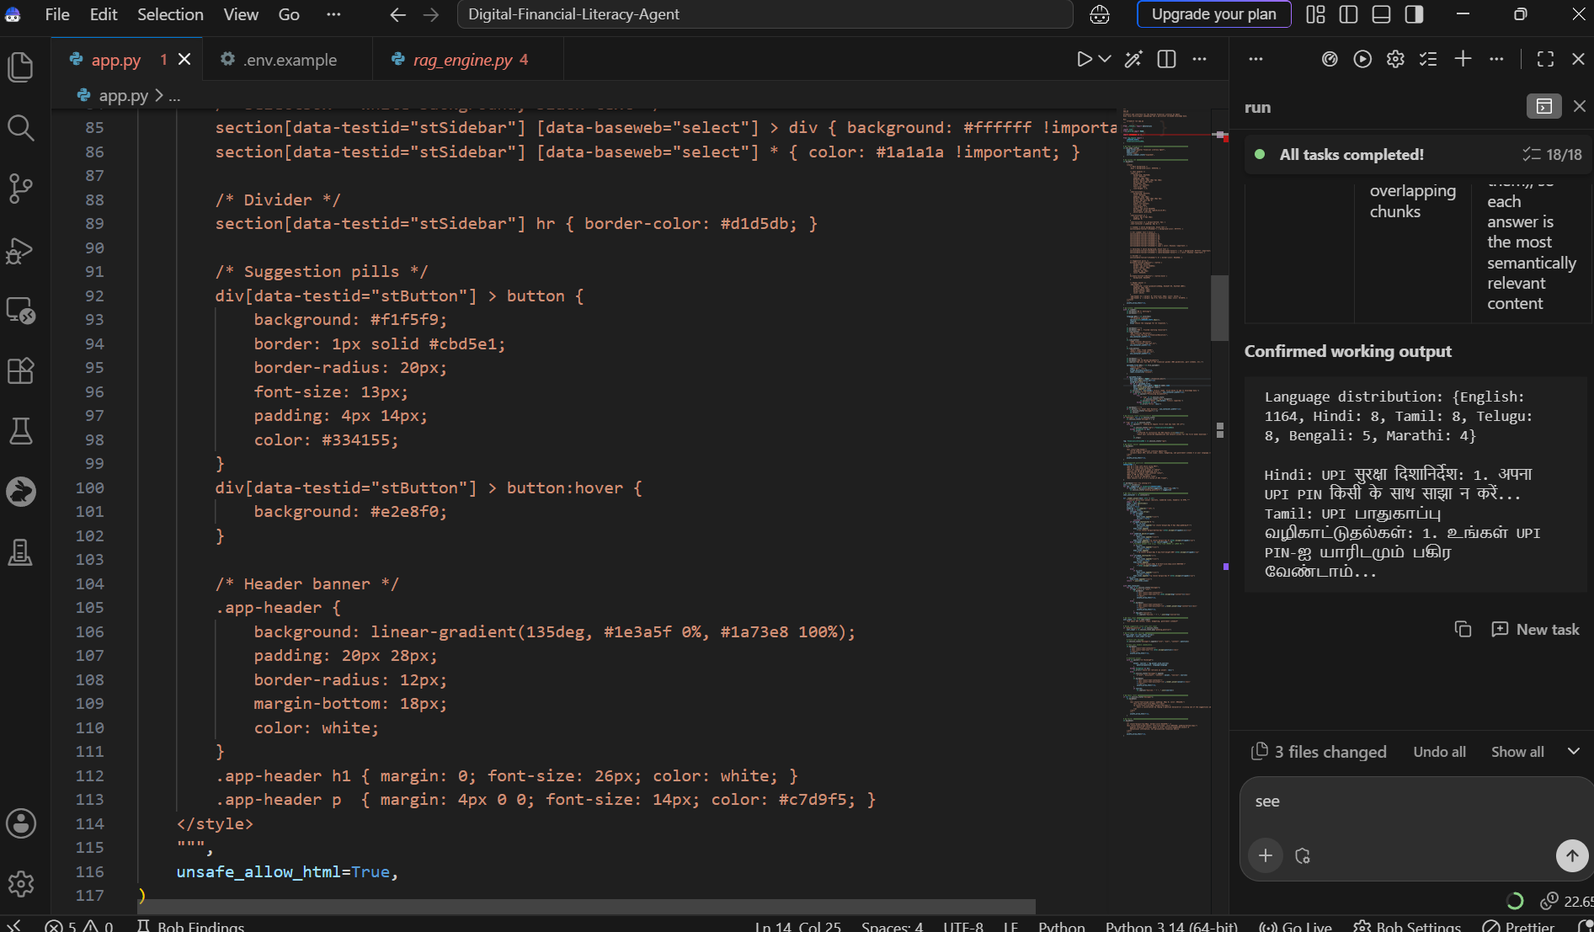
Snapshots
·
·
·

Slide 9
Novelty and Uniqueness
Zero-Hallucination Grounding via RAG: Unlike generic financial chatbots that risk making up banking rules, every output is strictly tethered to verified RBI, NPCI, and government educational repositories.
Interactive Scam Risk Evaluation: Features a specialized scanning mechanism where users can paste suspicious links, messages, or offers to receive an instant security risk assessment.
Native Language Simplification: Translates complex legal and banking jargon into simple, culturally inclusive terminology across multiple regional languages.
Enterprise-Grade Governance: Built on IBM watsonx.ai with secure governance parameters ensuring data privacy and compliant model deployment.

Slide 10
Git Hub Link
https://github.com/anushaaj/Financial-literacy-Agent
·
·
·

Slide 11
Future Scope
Integration with Real-Time Banking APIs & Cybercrime Feeds: Connect directly with official cybercrime reporting portals and live threat feeds to instantly flag newly emerging online banking scams and fake customer care numbers.
Voice-First Regional Language Support: Expand the Streamlit application to include speech-to-text and text-to-speech capabilities, enabling low-literacy users or rural populations to interact naturally using voice commands in their regional languages.
Offline-First Mobile Web Deployment: Optimize the application for progressive web app (PWA) architecture or lightweight mobile wrappers so users in low-connectivity areas can access basic financial literacy guides offline.
·
·
·

Slide 12
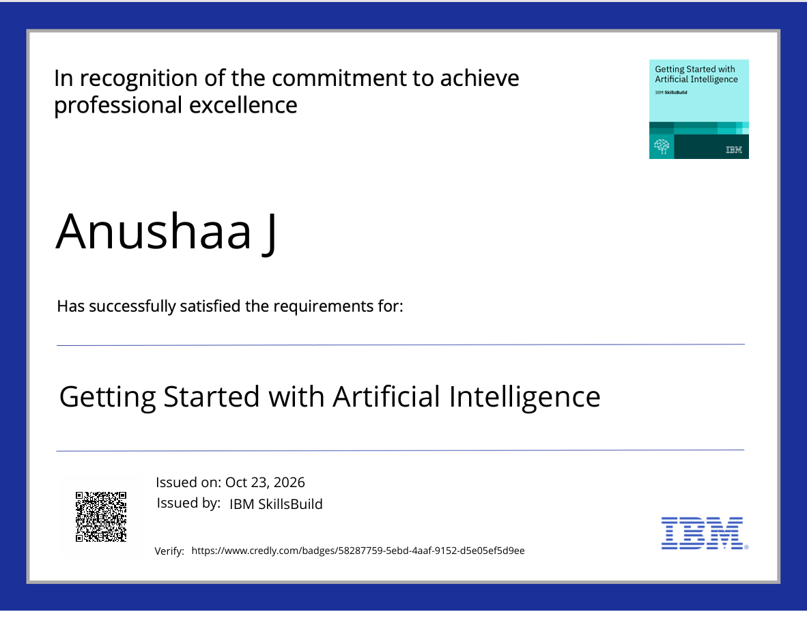
Certificates Earned:

Slide 13

Certificates Earned:​

Slide 14


