Slide 1
Did We Choose Right?
The Career Prospects of a Data Scientist
The Job Prospect Skeptics:
Anusha Aligeti, Sakshat Darne, Ramyakoumudi Kaveri, Harry Leeser,
Keshin Mehta, Siddharth Shankar, Annie Zhuang

Slide 2
Order of Operations
Project Introduction
Our Data
Data Cleaning
Our Analysis
Our Conclusions
Trying to Predict Our Future Salaries
Wrap-Up

Slide 3
What are we looking to do?
Key question: Is the Data Industry stable with substantial salaries?
2 Datasets: Data Scientist Salaries & Global Layoff Data
Objective: Analyze the 2 datasets to seek insights on our major choice.

Slide 4
Our Data
Data Scientist Salaries
# of Rows: 3755
Relevant Columns: job_title, salary_in_usd, employee_residence, and etc.
From Kaggle.com
Global Layoffs Data
# of Rows: 2738
Relevant Columns: Industry, Percentage (percentage of total employees laid off), Date, Laid_Off_Count, and etc.
From Kaggle.com

Slide 5
Data Cleaning and Preparation Process
Our Process
Exploratory Data Analysis
Check for duplicates and null or missing values
Remove duplicates and interpolate missing data
Screen for outliers and, if found, decide whether or not to exclude them

Slide 6
Addressing Missing Data
Layoffs Dataset
Significant amount of missing data in three variables
Interpolated missing data values with the daily average for the missing datapoint
If no daily average, forward fill and backfill the data as required

Slide 7
Adding Useful Country Information
Both datasets reference countries, but using different classifications (name and ISO 2-letter code)
Plotly Express uses a third method (ISO 3-letter code)
We used a third dataset from Datahub.io to add the ISO 3-letter codes to both datasets

Slide 8
We’ve Got Data…Now What?

Slide 9
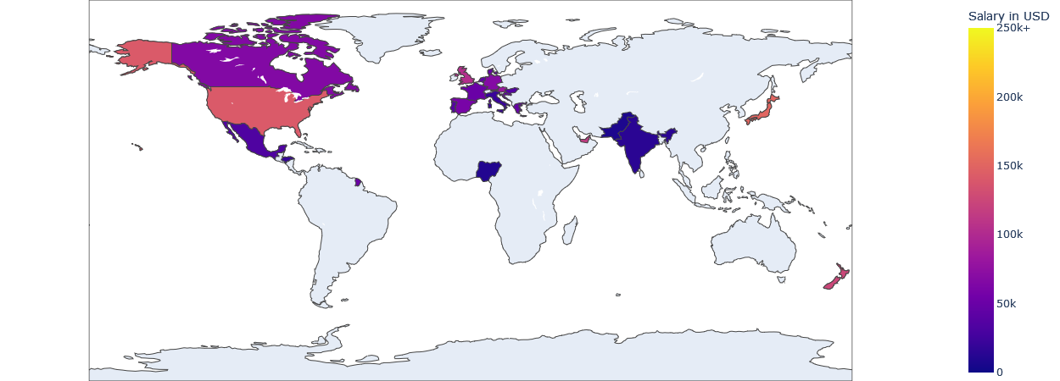
Average Data Scientist Salaries in 2020

Slide 10
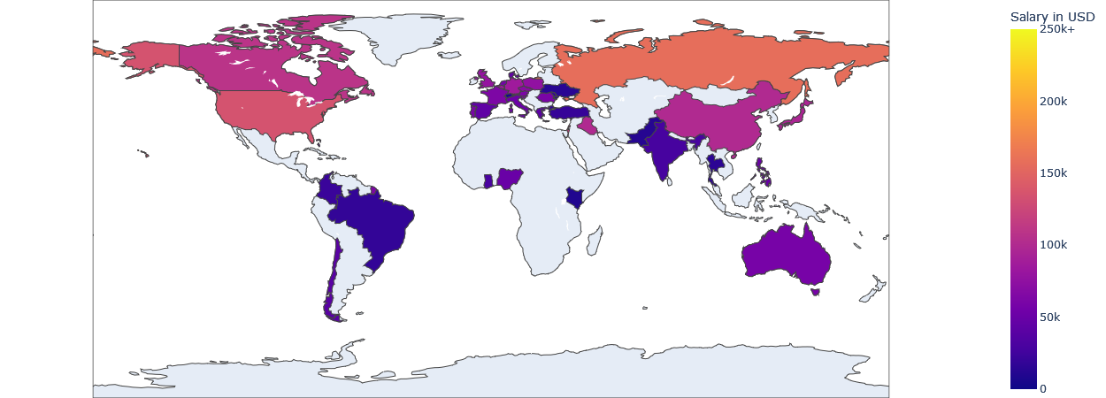
Average Data Scientist Salaries in 2021

Slide 11
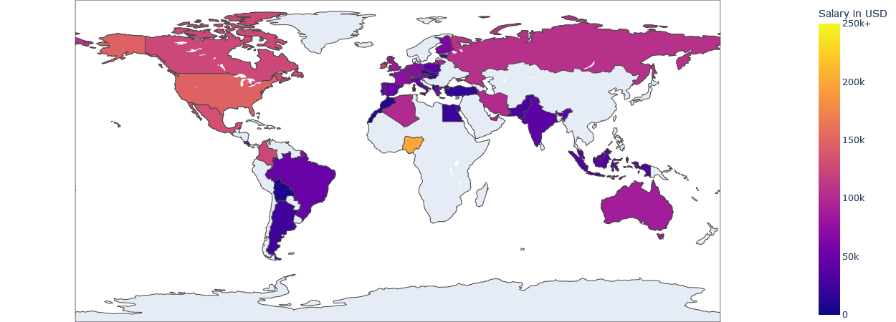
Average Data Scientist Salaries in 2022

Slide 12
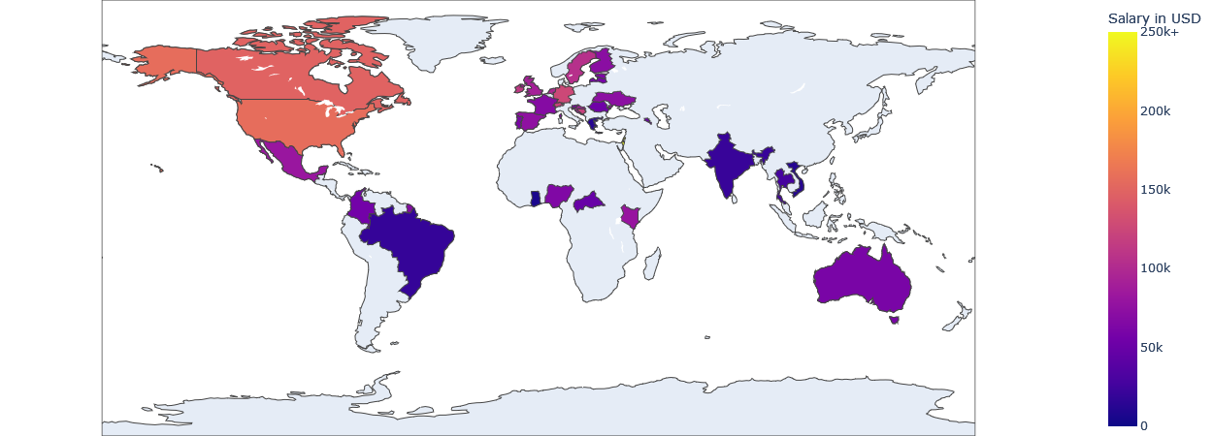
Average Data Scientist Salaries in 2023

Slide 13
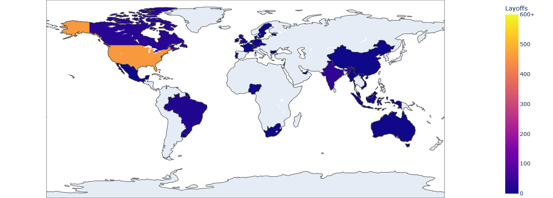
Layoffs Announced in 2020

Slide 14
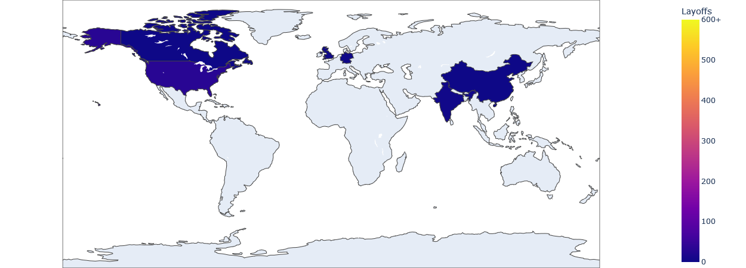
Layoffs Announced in 2021

Slide 15
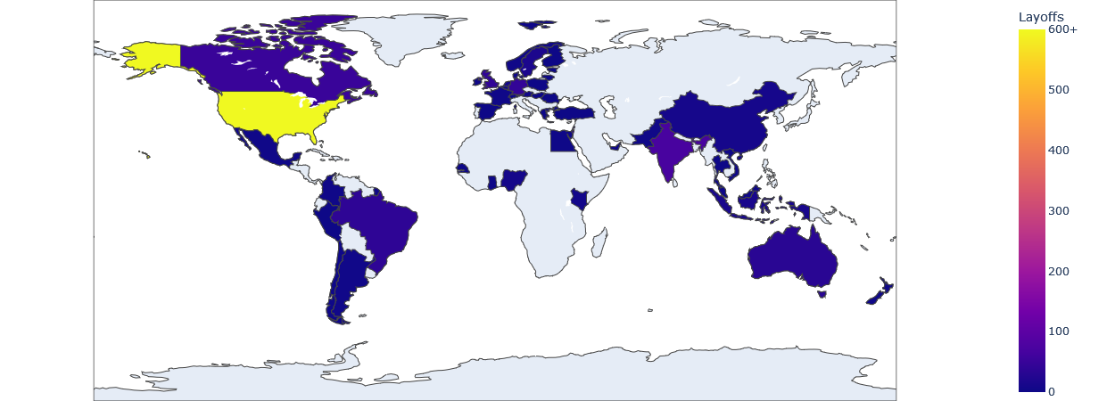
Layoffs Announced in 2022

Slide 16
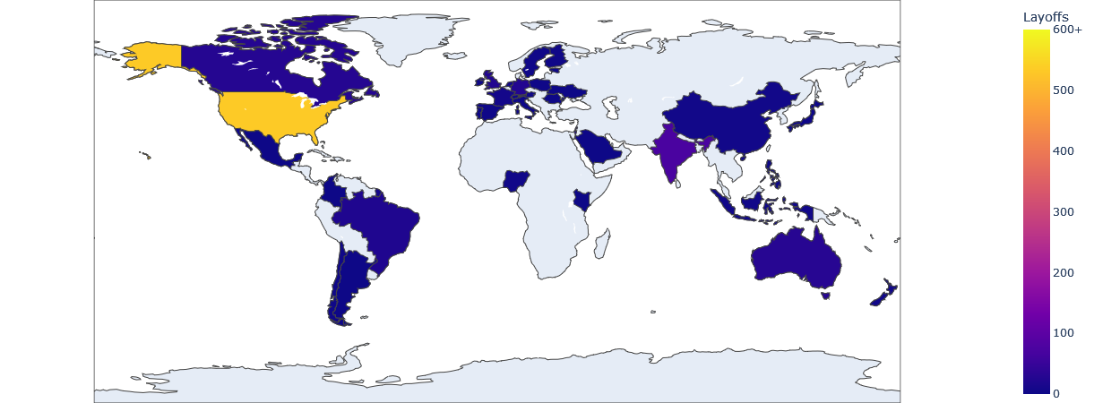
Layoffs Announced in 2023

Slide 17
Did we all choose well?

Slide 18
Yes!
Data science salaries are increasing
Salary growth appears to be inversely related to the size and frequency of large layoffs
There are certain industries that are less stable, but are industries, like the data industry, that are more stable for anyone prioritizing job security
There are data science jobs around the world

Slide 19
One last question:
Can we predict our future salary?

Slide 20
Correlation Analysis and Feature Engineering
Categorical variable transformation: Quantifiable exploration of feature relationships through label encoding.
Correlation Heatmap: Quickly identify key redundancies and patterns potentially shaping Data Science salary trends.
Feature Engineering: Created interaction terms (e.g., SE x FT) to capture nuanced relationships.
Weighted importance assigned, enhancing the model's ability to predict Data Science salary trends based on employment type and experience level interactions.

Slide 21
Machine Learning Regression Models
Linear Regression
Explore how input features linearly relate to fluctuations in Data Science salaries
Easily interpretable and Ideal for identifying direct and proportional impacts
Random Forest Regression
Explores potential non-linear relationships between salary and employer/employee factors.
Nuanced relationships gives a more comprehensive understanding of diverse factors impacting Salaries

Slide 22
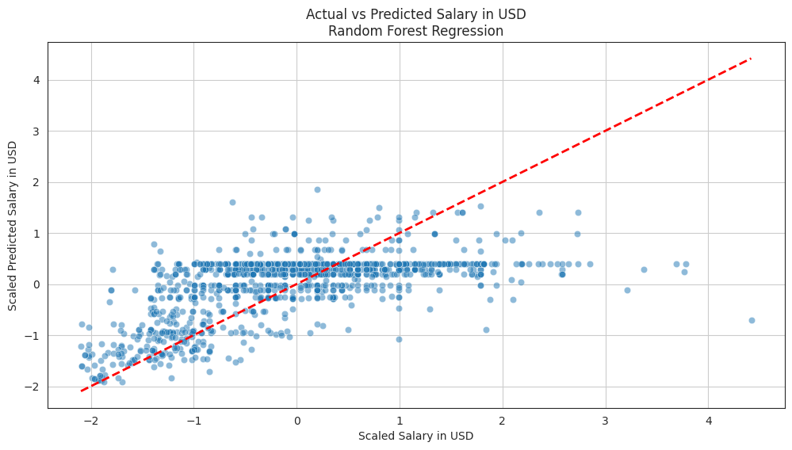
Model
Accuracy

Slide 23
Final Thoughts
Congratulations! You chose a good career path!
We can’t tell you exactly what salary to expect when you graduate
Data scientist salaries are purely based on easy to quantify factors
Soft skills are important (we need to tell stories)

Slide 24
References:
Data Science Salaries 2023 Dataset, https://www.kaggle.com/datasets/arnabchaki/data-science-salaries-2023
Layoffs Dataset 2023, https://www.kaggle.com/datasets/theakhilb/layoffs-data-2022
Country Code Dataset, https://datahub.io/core/country-codes
How the pandemic boosted working from home - U.S. News & World Report. (n.d.). https://www.usnews.com/news/health-news/articles/2023-05-18/how-the-covid-pandemic-impacted-working-from-home
Taylor, B., & Davis, J. (2023, December 1). Tech company layoffs: The Covid Tech Bubble bursts. InformationWeek. https://www.informationweek.com/it-leadership/tech-company-layoffs-the-covid-tech-bubble-bursts-sep-14#close-modal

