Slide 1
Recap through exercise --
X x₁ : {Block, Jeevan, Cinema, Old, Agra}
x₂ : {House, Jeevan, Vihar, Delhi}
Y x₃ : {Block, Jeevan, Cinema, Agra}
x₄ : {Building, Ravi, Vihar, New, Delhi}
x₅ : {Block, Jeevan, Vihar, New, Delhi}
x₆ : {Mandir, Ravi, Vihar, Delhi}

Slide 2
Inverted Index
X x₁ : {Block, Jeevan, Cinema, Old, Agra}
x₂ : {House, Jeevan, Vihar, Delhi}
Y x₃ : {Block, Jeevan, Cinema, Agra}
x₄ : {Building, Ravi, Vihar, New, Delhi}
x₅ : {Block, Jeevan, Vihar, New, Delhi}
x₆ : {Mandir, Ravi, Vihar, Delhi}
x₁: {Block, Jeevan, Cinema, Old, Agra}
What will be the candidate set?
Candidate set: {3, 5}+{3, 5}+{3}+{3}
IDX(S)
Token | DID
Agra | 3
Block | 3, 5
Cinema | 3
Delhi | 4, 5, 6
Jeevan | 3, 5
Mandir | 6
New | 4, 5
Ravi | 4, 6
Vihar | 4, 5, 6
2

Slide 3
X x₁ : {Block, Jeevan, Cinema, Old, Agra}
x₂ : {House, Jeevan, Vihar, Delhi}
Y x₃ : {Block, Jeevan, Cinema, Agra}
x₄ : {Building, Ravi, Vihar, New, Delhi}
x₅ : {Block, Jeevan, Vihar, New, Delhi}
x₆ : {Mandir, Ravi, Vihar, Delhi}
Size Filtering
Given a string xεX, only strings y such that |x|/t ≥ |y| ≥ |x|*t
Consider x₁={Block, Jeevan, Cinema, Old, Agra}, suppose t=0.9
What will be the candidate set?
If yεY matches x, we must have
  5/0.9 = 5.5 ≥ |y| ≥ 5* 0.9 = 4.5
  Candidate set C= x_{4,} x₅
IDX(S)
Token | DID
Agra | 3
Block | 3, 4, 5
Cinema | 3
Delhi | 4, 5, 6
Jeevan | 3, 5
Mandir | 6
New | 4, 5
Ravi | 4, 6
Vihar | 4, 5, 6

Slide 4
Prefix Filtering
  if |x ⋂ y| ≥ k ➔ any subset x’ ⊆ x of size at least |x| - (k – 1) must overlap y
Consider matching using O(x,y) ≥ 3
x₁={Block, Jeevan, Cinema, Old, Agra}
What would be the candidate set?
Prefix x₁’ = {Block, Jeevan, Cinema},
Use inverted index to find the candidate set C={x₃, x₅} which contain at least one token in x₁’.
X x₁ : {Block, Jeevan, Cinema, Old, Agra}
x₂ : {House, Jeevan, Vihar, Delhi}
Y x₃ : {Block, Jeevan, Cinema, Agra}
x₄ : {Building, Ravi, Vihar, New, Delhi}
x₅ : {Block, Jeevan, Vihar, New, Delhi}
x₆ : {Mandir, Ravi, Vihar, Delhi}

Slide 5
Prefix-Inverted Index
Token | ID List | TF | Order
Agra | 1, 3 | 2 | 5
Block | 1, 3, 5 | 3 | 9
Building | 4 | 1 | 1
Cinema | 1, 3 | 2 | 6
Delhi | 2, 4, 5, 6 | 4 | 10
House | 2 | 1 | 2
Jeevan | 1, 2, 3, 5 | 4 | 11
Mandir | 6 | 1 | 3
New | 4, 5 | 2 | 7
Old | 1 | 1 | 4
Ravi | 4, 6 | 2 | 8
Vihar | 2, 4, 5, 6 | 4 | 12
X x₁ : {Block, Jeevan, Cinema, Old, Agra}
x₂ : {House, Jeevan, Vihar, Delhi}
Y x₃ : {Block, Jeevan, Cinema, Agra}
x₄ : {Building, Ravi, Vihar, New, Delhi}
x₅ : {Block, Jeevan, Vihar, New, Delhi}
x₆ : {Mandir, Ravi, Vihar, Delhi}
Order:
Building < House < Mandir < Old < Agra < Cinema < New < Ravi < Block < Delhi < Jeevan < Vihar

Slide 6
Order: x₁ : {Block, Jeevan, Cinema, Old, Agra}
Building < House < Mandir < Old < Agra < Cinema < New < Ravi < Block < Delhi < Jeevan < Vihar
Algorithm
  reorder terms in each x ε X and y ε Y in increasing order of their frequencies
  for each y εY , create y’, the prefix of size |y| - (k – 1) of y
  build an inverted index over all prefixes y’
  for each x ε X, create x’, the prefix of size |x| - (k – 1) of x, then use above index to find all y such that x’ overlaps with y’
Prefix Inverted Index for Y
O(x,y) ≥3 Prefix(x)=|x|-(3-1)=|x|-2
Token | DID
Agra | 3
Cinema | 3
Delhi | 5
Mandir | 6
New | 4, 5
Ravi | 4, 6
What would be the candidate set?
X x₁ : {Old, Agra, Cinema, Block, Jeevan}
x₂ : {House, Delhi, Jeevan, Vihar}
Y x₃ : {Cinema, Agra, Block, Jeevan}
x₄ : {Building, New, Ravi, Delhi, Vihar}
x₅ : {New, Block, Delhi, Jeevan, Vihar,}
x₆ : {Mandir, Ravi, Delhi, Vihar}
Candidate Set C for x₁={Old, Agra, Cinema, Block, Jeevan} is {x₃}.

Slide 7
Position Index
x₁={Old, Agra, Cinema, Block, Jeevan}
x₃ : {Cinema, Agra, Block, Jeevan}
O(x,y) >4
Estimation of max overlap = overlap in prefixes + min of unseen tokens = 2 + min(2, 2) = 4 > k (false)
➔ No need to compute sim(x₁, x₃) !

Slide 8
Cleansing Composite Attributes with
Ripple Down Rules
(Composite Entity (Description) Normalization (and Cleansing) into DB Schema)

Slide 9
BRIDGE FROM PREVIOUS TOPIC
From matching records to cleansing attributes
PREVIOUS LECTURE: FIND CANDIDATES
TODAY: RESOLVE A TTRIBUTE MEANINGS
X: {Block, Jeevan, Cinema, Old, Agra}
Y: x3={Block, Jeevan, Cinema, Agra}
Use token inverted indexes, size bounds, prefix and position filtering to reduce pair comparisons.
Find candidate duplicates first; then parse each messy address into House, Block, Road, Area, City and PIN.
I-344, Sarojni Ngr, N Delhi, 23
344, Block I, Sarojini Nagar, New Delhi, 110023
Matching does NOT determine field boundaries or canonical names.
Question: could two addresses have high token overlap yet be different houses?
YES — field semantics matter.
Notes:
Refined from uploaded Week-8 slides 1–7. These slides are a bridge, not a second full similarity-search lecture.

Slide 10
A concrete integration problem
PRODUCT FEEDS
POSTAL ADDRESS FEEDS
“SPEED STK FRESH”
“DRY IDEA GEL POWDR FRSH 2.25OZ A P”
“HP 15s 8GB RAM 512GB SSD”
“I-344 Sarojni Ngr N Delhi 23”
“344 Block I Sarojini Nagar New Delhi 110023”
ELEMENTISATION / PARSING
STANDARDISATION + VALIDATION
Identify raw spans and assign fields.
“FRSH” → [Variant: FRSH]
“2.25OZ” → [Size: 2.25OZ]
“N Delhi” → [City: N Delhi]
Convert extracted spans to canonical values.
FRSH → Fresh
2.25OZ → 2.25 oz
N Delhi → New Delhi
Validate consistency; preserve evidence.
Heterogeneous raw text
Typed, validated attributes
Integrated entities
Without normalization: joins miss, deduplication fails, analytics group aliases as distinct values.

Slide 11
Understanding dirty data
Why dictionaries alone do not solve the problem

Slide 12
Sources of difficulty: six failure modes
Failure
Example
Why hard
Abbreviation
STK; FRSH; N Delhi
Many aliases, domain-dependent
Ambiguous token
St John St
Saint vs Street
Omitted field
SPEED STK FRESH
Size absent; cannot hallucinate
Token order
344 Block I / Block I-344
Flexible grammar
Typos / spacing
Sarojni
Alias and segmentation issues
Overloaded number
8GB RAM; 512GB SSD
Same unit, different semantics

Slide 13
Product descriptions → extracted fields
Raw source
Parsed concept 1
Parsed concept 2
SPEED STK FRESH
Brand / line: Speed Stick
Variant: Fresh; size unknown
DRY IDEA GEL POWDR FRSH 2.25OZ A P
Brand: Dry Idea; form: Gel/Powder
Size: 2.25 oz; AP: antiperspirant
SURE 2.6OZ UNSCNT INV SLD
Brand: Sure; form: Solid
Unscented; Invisible; 2.6 oz
GILLETTE CLWV GEL TWNPK DEO 6OZ
Brand: Gillette; form: Gel
Twin pack; deodorant; 6 oz
CVS MEN DEOD REG 325ml
Brand: CVS; gender: Men
Deodorant; Regular; 325 mL
Treat ambiguous tokens as unresolved until context/dictionary support exists.

Slide 14
Postal addresses: Indian variants
Variant spellings, partial postal codes, and non-identical field boundaries
THREE RECORDS THAT MAY REFER TO ONE LOCATION
1. I-344 | Sarojini Nagar | N Delhi | 23
2. 344 Block I | Sarojni Ngr | New Delhi | 110023
3. 344 Block I Near Navyug School S Ngr NDelhi23
EXPECTED PROCESSING
Extract block/door + landmark + area + city + postal code → standardise aliases → validate locality, PIN and house identity.
Do not assume “23” uniquely determines 110023 without geographic evidence.
IIA · COMPOSITE ATTRIBUTE NORMALISATION
12

Slide 15
Why address standardisation fails: three original cases
SPELLING + ABBREVIATIONS
I-344 | Sarojini Nagar | N Delhi | 23
344 Block I | Sarojni Ngr | New Delhi | 110023
MULTIPLE FIELD BOUNDARIES
13B | Link Road | Versova | Mumbai
Block B-13 | Bandra Versova Link Rd. | Versova | Mumbai
OMITTED / REORDERED FIELDS
123 | IIITD Campus | Okhla Phase 3 | New Delhi | 20
123 Block-C | IIIT Delhi | Industrial Area | Okhala Phase III | New Delhi | 110020
These are candidate variants, NOT automatically identical locations. Normalize → validate → entity-match.
Notes:
Source: uploaded Week-8 slide 9. Ambiguity is deliberate: strings that look similar may refer to different premises.

Slide 16
Pipeline: where each component fits
Source description
Tokenisation
Lexicon / aliases
Pattern generator
RDR inference
Canonicalisation
Validation
Raw string
Spans + units
Candidate tags
Sequence features
Field labels
Typed values
Confidence / flags
RAW ADDRESSES
SIGNATURE CLUSTERS
SYNONYM DISCOVERY
I-344 / Sarojni Ngr
Retrieve likely variants
Sarojni ↔ Sarojini
LOOKUP ENRICHMENT
RDR FIELD LABELLING
STANDARDIZED OUTPUT
Area, road, city aliases
Assign context-specific tags
Structured typed record
Supporting resources:
  curated dictionaries locale rules
  cornerstone cases regression tests
  Data provenance

Slide 17
Clustering Based Approach
I-344 Sarojini Nagar N Delhi 23
344 I Block Sarojni Ngr New Delhi110023
344 Block I Near Navyug School S Ngr NDelhi23
Raw Addresses
J Block 12 Sarojini Nagar NDelhi 110023 55 Y Mandir Lane S N New Delhi 23
1
Signature Based Clustering
Elementization : Extracting structured elements like door number, building name, street name, city, etc. from an address record.
“344 Block-C Aruna Asaf Ali Rd Sarojini Nagar New Delhi Delhi 110070” House Number Street Area City State Pin
Standardization : Transform non-standard keywords (Rd, Rod…) to standard keywords (Road).
C₁
C₂ C_{n}
Identify Synonymous Terms
Sarojini Nagar | Sarojani Nagar | Sarojni Ngr; N Delhi | New Delhi
2
3
Standardize Clusters
C₁ C₂ C_{n}
4
Merge Clusters
5
Add new words to Tables
Enriched Classification Tables
Enriched Lookup Tables
I-344 Near Navyug School Sarojini Nagar New Delhi 110023 I-344 Near Navyug School Sarojini Nagar New Delhi 110023 I-344 Near Navyug School Sarojini Nagar New Delhi 110023
RDR for Writing Rules
Matching Engine
J Block 12 Sarojini Nagar New Delhi 110023
55 Y Mandir Lane Sarojini Nagar New Delhi 110023
Standardized Addresses
Cleaned Addresses

Slide 18
Home Assignment – 2 marks (Due Date: October 19, 2026)
Select the addresses from any metro city/state from the electoral data (from Election Commission website or any other source) [the cardinality of Address column should not be less than 10M], and build a look-up dictionary for all variants of Road Type (Rd, St, Street, Road, Path, Marg, Lane,…).
Marks will be given based on your prompt, data size, and running the reviewed (generated) code on the address data, and building the look-up table/dictionary. You need to highlight where you have made the changes in the LLM generated code.

Slide 19
Lexicons and pattern mining
From messy tokens to robust candidate predicates

Slide 20
Feature extraction before RDR
Surface + shape
Dictionary matches
Contextual signals
Higher-order signals
H171 → alpha+digits
110020 → six digits
2.25OZ → number+unit
Road / Rd / Marg
Apartments / Towers
New Delhi / Bengaluru
Previous token = “Flat”
Next token = “RAM”
Country = India
Detected City=Delhi
Product category=laptop
Street begins after house no.
Important: longest-phrase dictionary lookup before single-token tagging helps preserve “New Delhi”, “Dry Idea”, “Saki Naka”.

Slide 21
PATTERN MINING
Your sub-pattern notation
SYMBOL DICTIONARY
ENCODE DESCRIPTIONS
B = building-type marker
T = street-type marker
A = area / town
C = city / district
S = state
P = PIN
^ = numeric token
+ = currently unknown token
127 Mahima Towers Mahatma Gandhi Road Calcutta
→ ^+B++TC
344 Block-C Aruna Asaf Ali Rd Sarojini Nagar New Delhi Delhi 110070
→ symbolic stream; multiword recognition and tokenisation policy must be specified.
Purpose: mine recurring local contexts.

Slide 22
Sub-pattern Mining
Input: Indian Address Text file, Database Schema, Classification and Lookup Tables, Input Pattern (P)
Output: Sub-patterns that will assist in writing the rules
Approach:
Assume we would like to normalize each address(address database schema) into
ADDRESS(Floor#, House#, Building_Name, Landmark, Street_Name, Street_Type, Area, City, State, PIN) B T A C S P
Convert each address into a pattern using Classification and Lookup Tables
    Street, Road, Avenue, Marg, Nagar, Phase are street type markers represented by T
    Building, Towers, Bunglow are building type markers represented by B
    Tables for Area/Town (A), City/District (C), State (S), PIN (P)
    + represents unknown word, ^ represents numeric token
  127 Mahima Towers Mahatma Gandhi Road Calcutta → ^+B++TC
  344 Block-C Aruna Asaf Ali Rd Sarojini Nagar New Delhi Delhi 110070 → ^++++T+ACSP
  123 IIIT Delhi Okhala Phase-3 New Delhi 110020
                → ^+SACP
Find a sub-pattern for writing the rules
Rules size will be very large… so need some method to manage such large rules.

Slide 23
From pattern frequency to a decision rule
^ + B + + T C
Candidate predicate
Expert tests
Observed repeated address pattern
IF token ε ROAD_DICT
Correct / exception?
Why not directly replace the pattern with a rule?
Because “Road” could be part of a landmark, a building name or a street type depending on context.
IIA · COMPOSITE ATTRIBUTE NORMALISATION
21

Slide 24
Ripple Down Rules
Maintain knowledge by appending contextual exceptions

Slide 25
Ripple Down Rules (RDR) – Managing Rules
Knowledge acquisition methodology: the human expert’s knowledge is acquired based on the current context and is added incrementally
Rule Tree: In its simplest version, each node is a rule and has two child nodes (except, else) depending on whether the rule is satisfied or not
Rules are added or modified when the expert system incorrectly classifies a case or fails to classify a case
The case which prompted the addition of this rule and the set of cases this rule classified correctly are stored for reference.

Slide 26
Ripple-Down Rules
if condition then conclusion [because case] except
if ....
else if ...
For example:
if (a and b) then c except a and b => c
if d then e a and b and d => e
else if (f and g) then h f and g => h
Default rule:
If true then normal
Rule 1: when an exception If (a and b) then c is added
If true then normal except
If (a and b) then c
Rule 2: when an exception If (f and g) then h is added
If true then normal except
If (a and b) then c
else if (f and g) then h
Rule 3: when another exception If (a, b and d) then e is added
If true then normal except
If (a and b) then c except
if d then e
else if (f and g) then h
If a rule fires, but produces an incorrect conclusion, we add an except branch
=> If a rule fails to fire, we add an else branch
Ordinary if-then-else statement
if (a and b) then
if d then e
else c
else if (f and g) then h

Slide 27
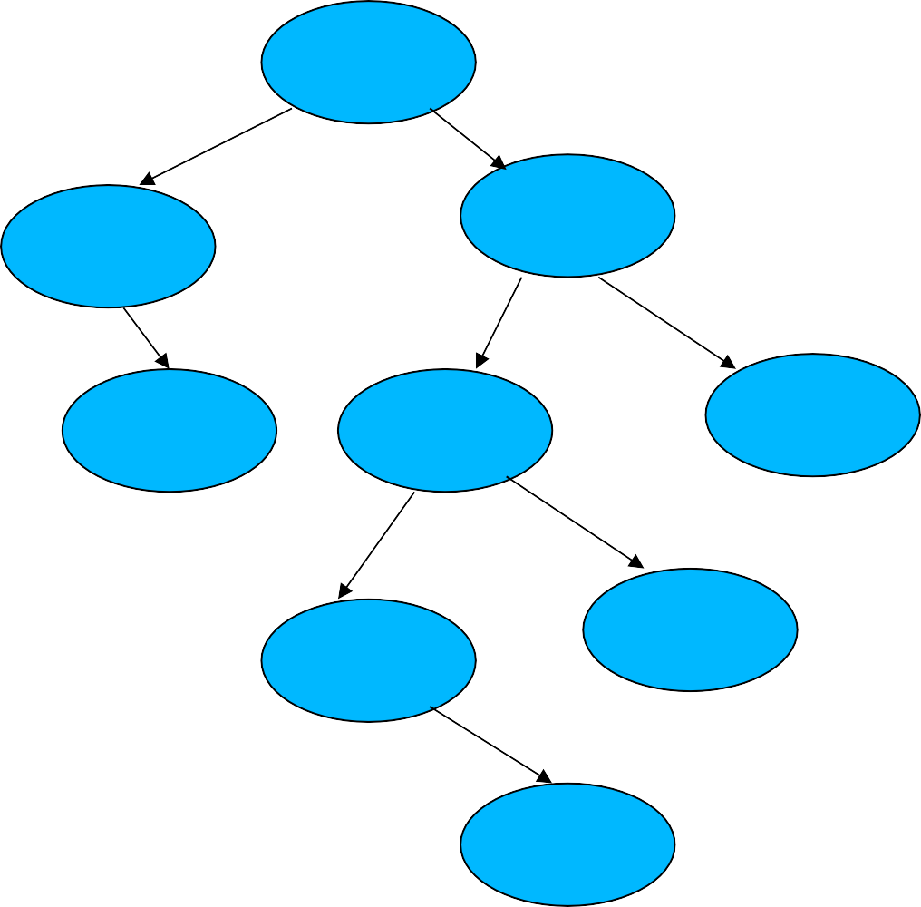
Knowledge acquisition process in RDR
If the rule in a node is true, the rule in the node connected by
TRUE branch is also tested.
#S
True
False
The conclusion of the parent is returned only if the rule on the TRUE branch does not satisfy the case.
#R|S
#+|+
True
True
False
#+|+|+
#K|S
#K|R|S
If a rule is not satisfied for a case, the child rule with a FALSE link is tested.
True
False
#R|K|S
#K|**|S
If the case satisfies the child rule, its conclusion takes precedence over the conclusion of the parent rule.
True
#K|+|+|S

Slide 28
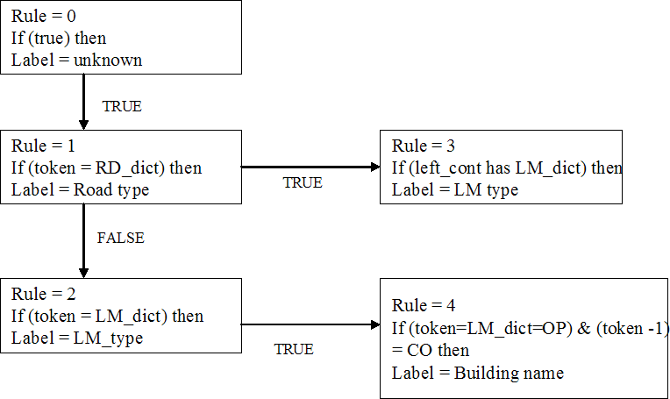
Rule organization in RDR framework
For Rule 1, if the current token is in road dictionary, do not declare it as a road type immediately, but perform step 2. If the current token is not in road dictionary, go to Step 3.
Check if the left context of this token has a landmark type. If yes, declare the token as part of landmark rather than as a road type, else road type.
Check Rule 2, .. and so on.

Slide 29

RDR Tree – a summary
Each Node will have Three steps
A True Branch to look for more specific or elaborate set of actions you want to take
If a more specific case is not executed then existing generic action is taken
A False case to look at alternate patterns
#S
True
False
#R|S
#+|+
True
True
False
#+|+|+
#K|S
#K|R|S
Each Node entered is being traced and noted in Rule order Execution
True
False
This will help trace for a given address which particular case is breaking
It guides the person to add a new rule to its false branch
#R|K|S
#K|**|S
True
#K|+|+|S
Expect large number of rules (in hundreds/thousands)
Rules are organized in the form of a taxonomy
Order rules within each node based on the generality of a rule
Annotate rules with examples to make it clear how they will work

Slide 30


H171 Valecha Apartments Saki Naka Mumbai
If contained in
If contained in dictionary of Area types
If contained in dictionary of districts
If contains a no. and left is null
If token to right is of building type
If right token is of Area Type
N
N
dictionary of building types
N
N
N
Y
Y
Y
Y
Y
Y
Classified!
Classified!
Classified!
Classified!
Classified!
Classified!
Door No.
Building Name
Building Type
Area Name
Area Type
District
What if query = “H171 Valecha Apartments Sakinaka Mumbai”

Slide 31

H171 Valecha Apartments Sakinaka Mumbai
If contains a no. and left is null
If contained in dictionary of building types
If contained in dictionary of Area types
If contained in dictionary of districts
N
If token to right is of building type
N
N
If right token is of Area Type
N
N
Y
Y
Y
Y
Y
Y
Classified!
Classified!
Classified!
Classified!
Classified!
Classified!
Prompt : Sakinaka not classified as Area name or Type.
Suggestion: Add a rule
Door No.
Building Name
Building Type
Area Name
Area Type
District

Slide 32

H171 Valecha Apartments Sakinaka Mumbai
Door No.
Building Name
Building Type
Area Name
Area Type
District
If contained in dictionary of building types
If contained in dictionary of Area types
If contained in dictionary of districts
If contains a no. and left is null
If token to right is of building type
If right token is of Area Type
N
N
N
N
Y
Y
Y
N
Y
Y
N
Classified!
Classified!
Classified!
Classified!
Classified!
If last 4 characters belong to Area Type
Y
Y
Classified!

