Slide 1
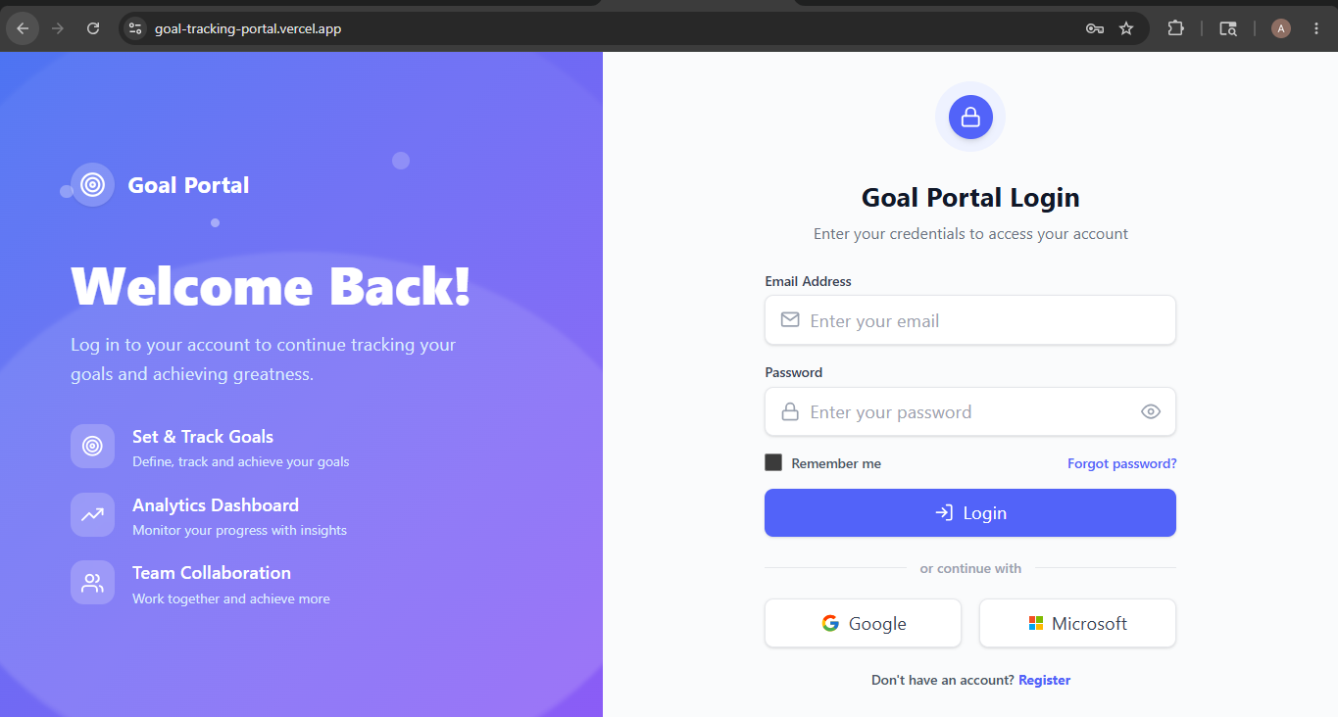
Goal Tracking Portal
Enterprise Goal Management &
KPI Tracking System

Slide 2
Problem Statement
• Organizations still rely on spreadsheets for goal tracking.
• No centralized approval & KPI monitoring workflow.
• Performance reviews become manual and time-consuming.
• Lack of analytics, audit logs and transparency.

Slide 3
Detailed System Architecture
React Frontend (Vercel Hosting)
Express.js API (Node Backend)
Prisma ORM
PostgreSQL DB
Employee → Create Goals → Manager Approval → Quarterly Check-ins → Analytics → Admin Audit Logs

Slide 4
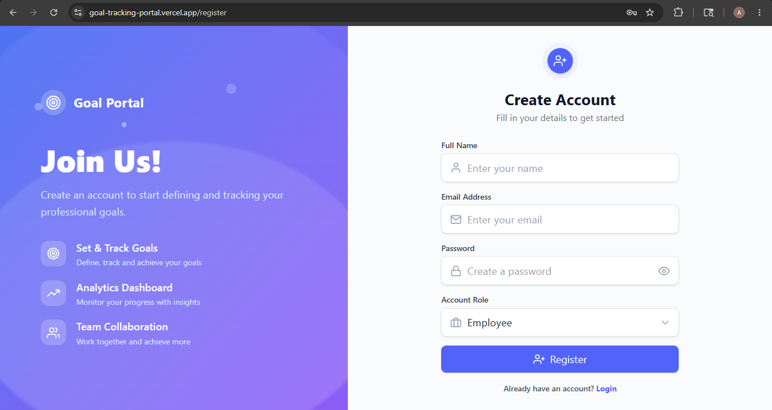
Key Features Implemented
✓ JWT Authentication & Authorization
✓ Role-Based Dashboards (Employee / Manager / Admin)
✓ Goal Creation & KPI Tracking
✓ Manager Approval / Rejection Workflow
✓ Quarterly Performance Check-ins
✓ Analytics Dashboard with Charts
✓ CSV Export Reports
✓ Audit Logging & Goal Unlocking

Slide 5
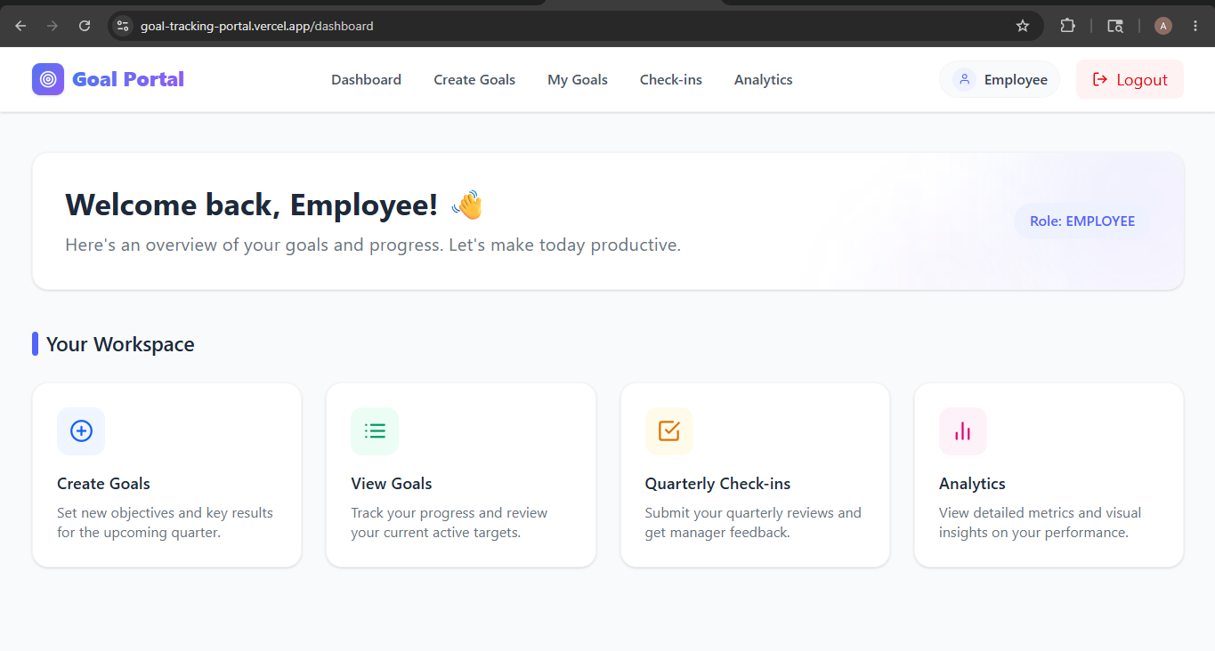
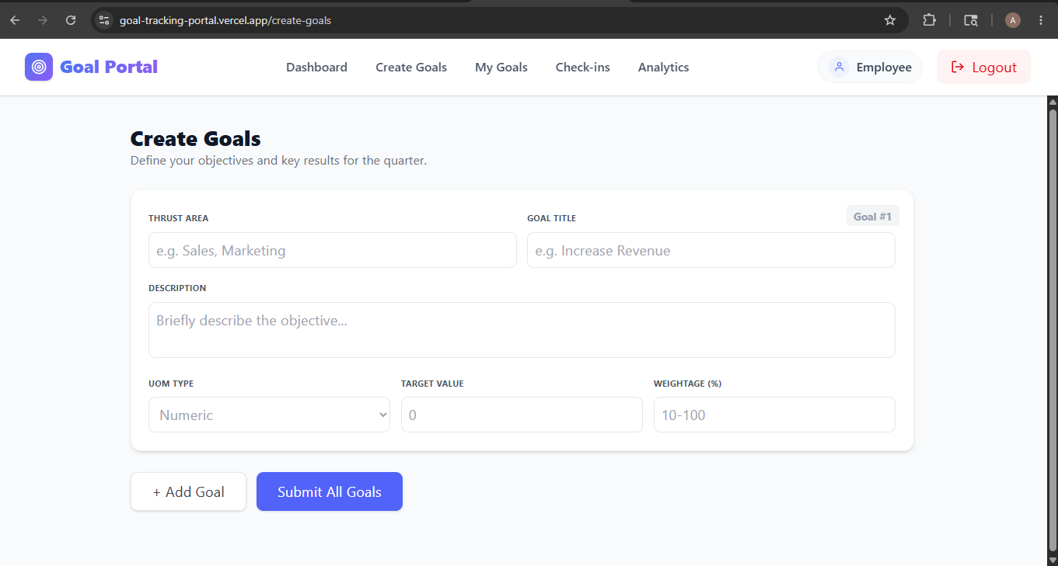
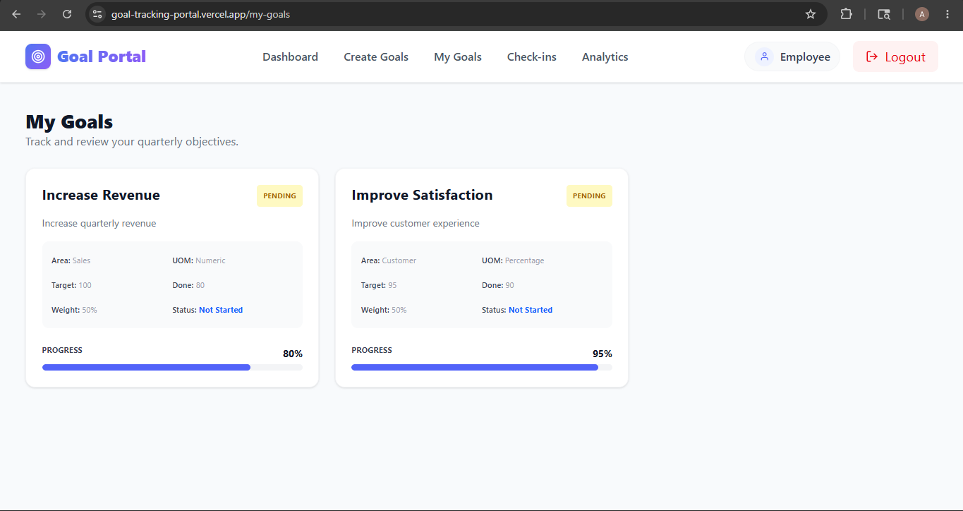
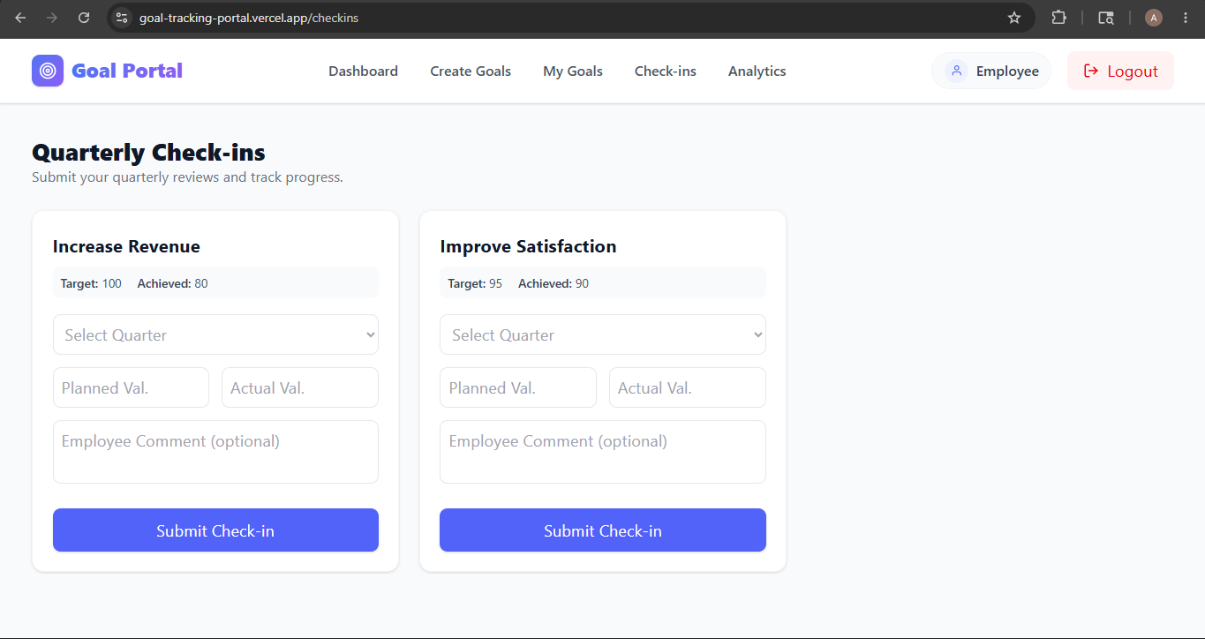
Project Screenshots & Feature Walkthrough

Slide 6
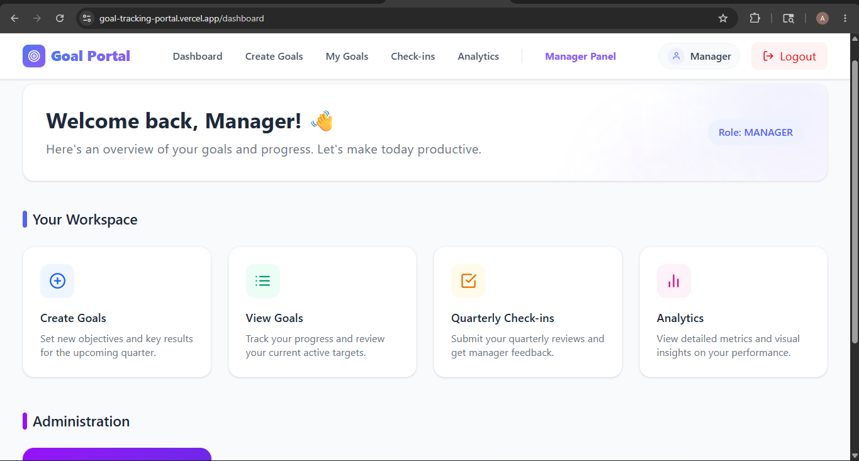
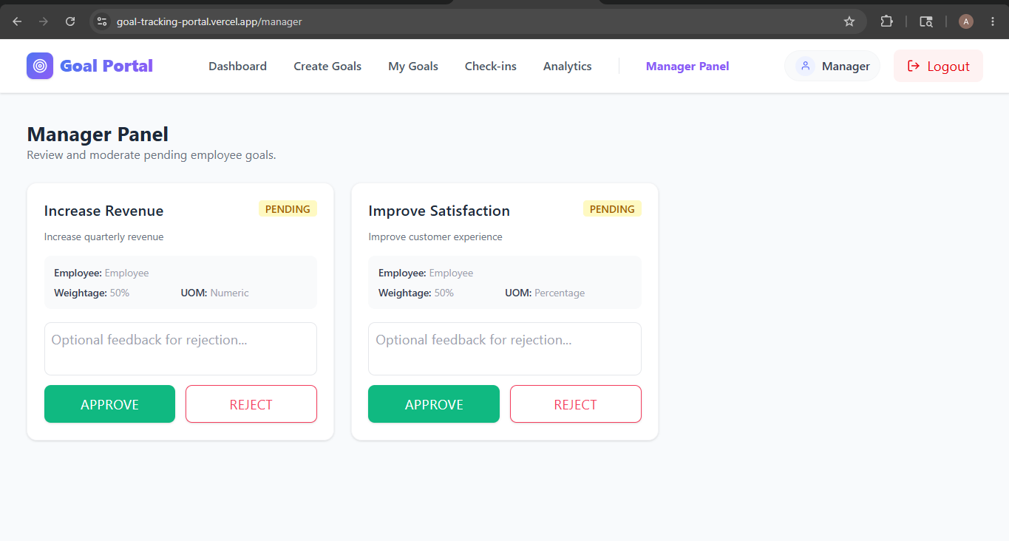

Slide 7
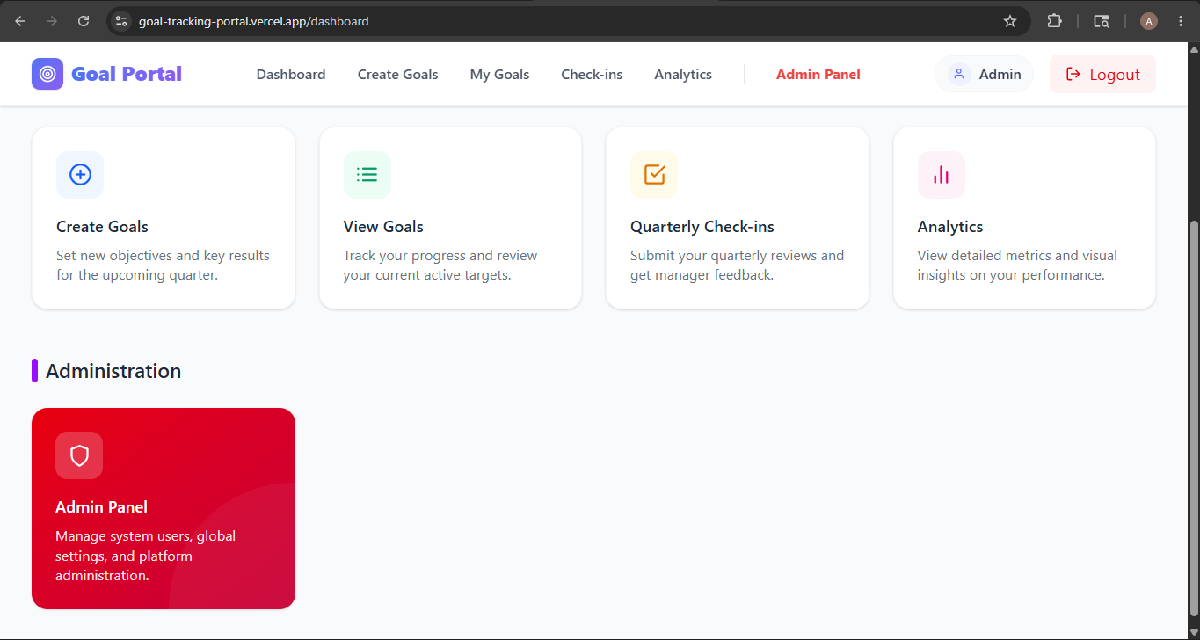

Slide 8
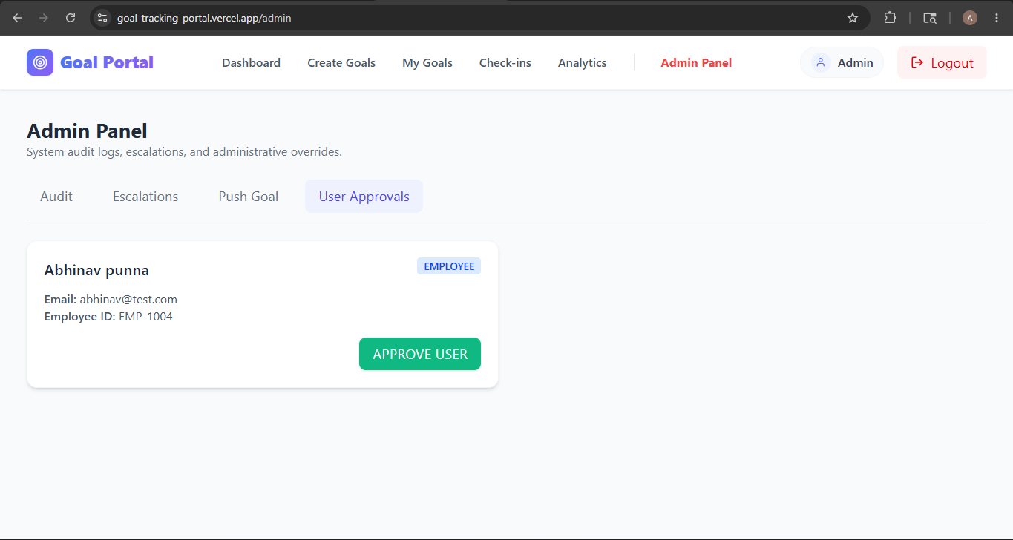

Slide 9
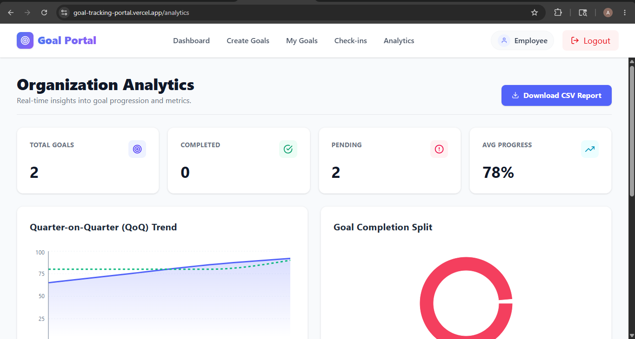

Slide 10
Technology Stack
Frontend
React.js, Tailwind CSS
Backend
Node.js, Express.js
Database
PostgreSQL
ORM
Prisma
Authentication
JWT + bcrypt
Deployment
Vercel + Render

Slide 11
📊 Employee Analytics Filtering
✓ Admins & Managers can filter analytics employee-wise
✓ Dynamic dropdown selector using Employee IDs
✓ KPI cards refresh automatically in real-time
✓ Charts update instantly based on selected employee
✓ Improves visibility for performance monitoring
✓ Enterprise-grade analytics experience
ADMIN
↓
Select Employee
↓
Filter Goals
↓
Refresh KPI Charts
↓
View Insights
Goal Tracking Portal • AtomQuest Hackathon 1.0 • Anusha Anchalia

Slide 12
✨ AI Goal Refiner
• Added AI-powered SMART Goal enhancement workflow.
• Users can click 'Enhance with AI' while creating goals.
• Transforms raw goals into professional SMART objectives.
• Simulated LLM response with realistic 1.5-second delay.
• Improves usability and enterprise-grade experience.

Slide 13
🔐 Security & Identity Workflow
• Implemented role-based authentication and authorization.
• Unique employee identity badges (EMP-XXXX) generated dynamically.
• Pending approval workflow for newly registered users.
• Admin approval dashboard added for identity governance.
• Secure JWT authentication with bcrypt password hashing.

Slide 14
⚡ Advanced Enterprise Features
• Rule-based escalation engine using node-cron.
• Automated escalation for missed approvals/check-ins.
• Real-time analytics dashboard using Recharts.
• Immutable audit logging for governance and transparency.
• CSV export reporting for enterprise reviews.

Slide 15
Project Deployment & Repository
👩‍💻 Developer: Anusha Anchalia
🚀 Project Type: Solo Hackathon Project
🌐 Frontend: https://goal-tracking-portal.vercel.app
📦 Backend: https://goal-tracking-portal.onrender.com/
🔗 GitHub: https://github.com/anushaanchalia/goal-tracking-portal

Slide 16
Thank You!
Goal Tracking Portal

