Slide 1


Title: Web Scraping and Exploratory Data Analysis of Ambition _ Box

Slide 2

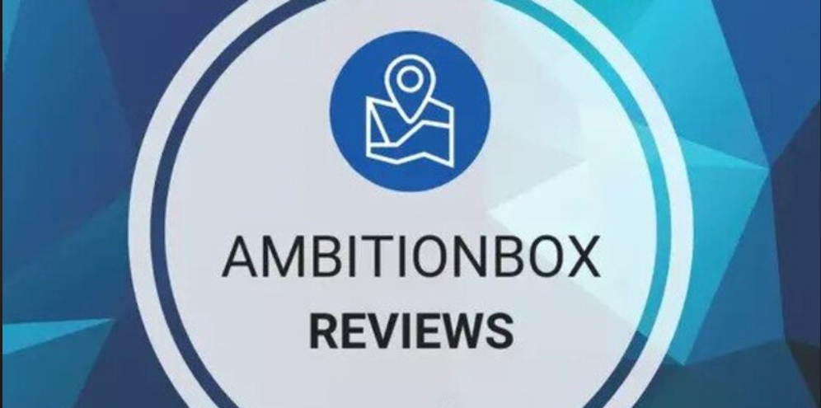
Introduction:
Ambition Box is an Indian career platform that helps job seekers research companies salaries , Interview experiences , and employee reviews
Founded :in 2015 by Mayank Mishra and Saurabh Tyagi in India
Acquired by : Naukri.com (info Edge India Ltd.) in 2016- the same parent company that owns popular job portals like Naukri.com , Jeevansathi , and 99acres.
Intially , Ambition_Box Started as a company and interview review site where users could anonymously share their experiences with employers.

Slide 3

Objectives:
Enhance Transparency in the job Market.
Help Job Seekers Make Informed Career Decisions.
Simplify interview Preparation
Provide Accurate Salary Insights
Improve Employer Branding

Slide 4
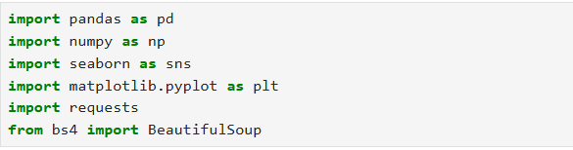
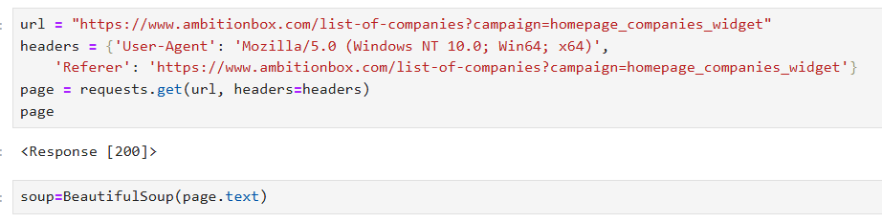
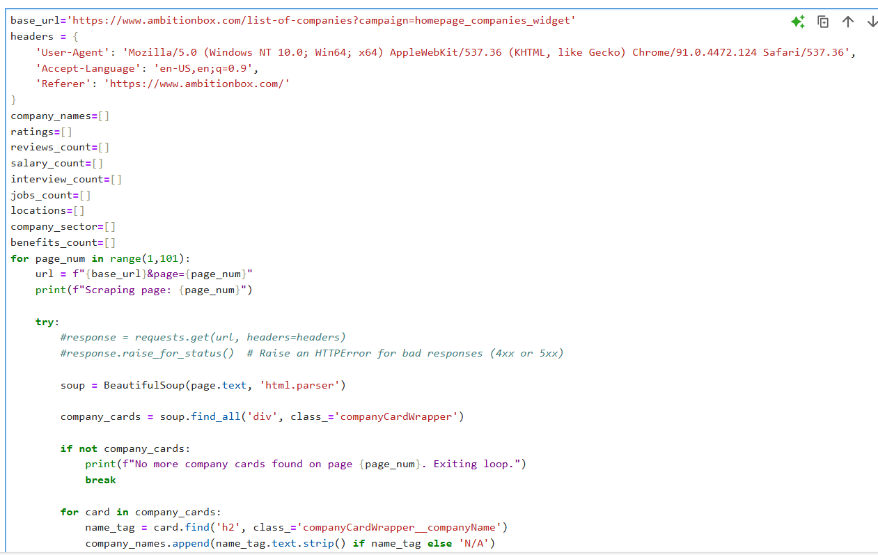
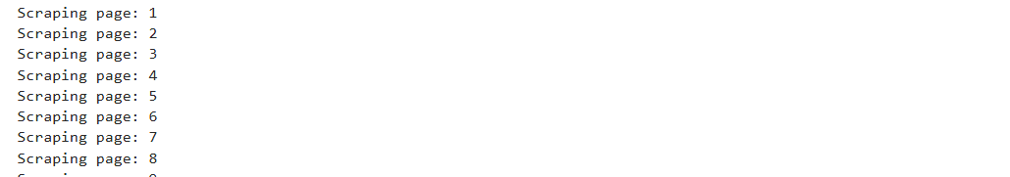
Web Scraping:
Ambition Box is the official website was selected as the main data source
Used browser developer tools (Inspect Element) to identify relevant HTML elements in match data pages
Used BeautifulSoup and Requests libraries in Python to extract structured data from the web pages
Cleaned and consolidated scraped data for further analysis and visualization.

Slide 5






Tools Used:

Slide 6
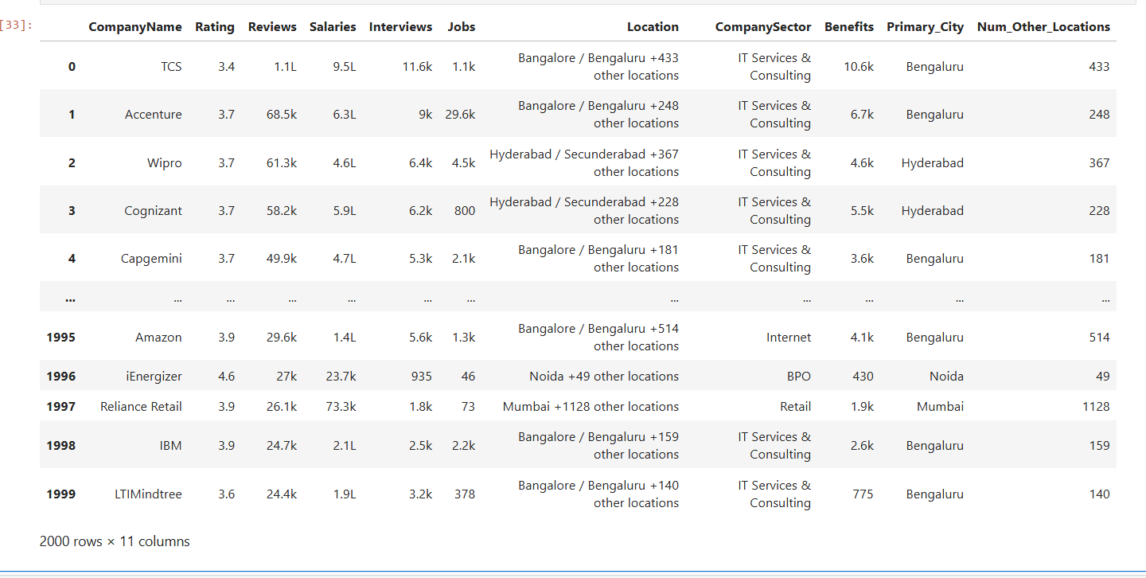
Data Cleaning Steps:
Load the Dataset
Import the dataset into python Using Pandas(pd.read_csv())
Checked the basic structure using df.info() and df.head().
Checking for missing Values
Used df.isnull().sum() to identify missing or null values in each column.
Founded no missing values in any column
Remove Duplicates
Checked for duplicates rows using df.duplicated().sum().

Slide 7
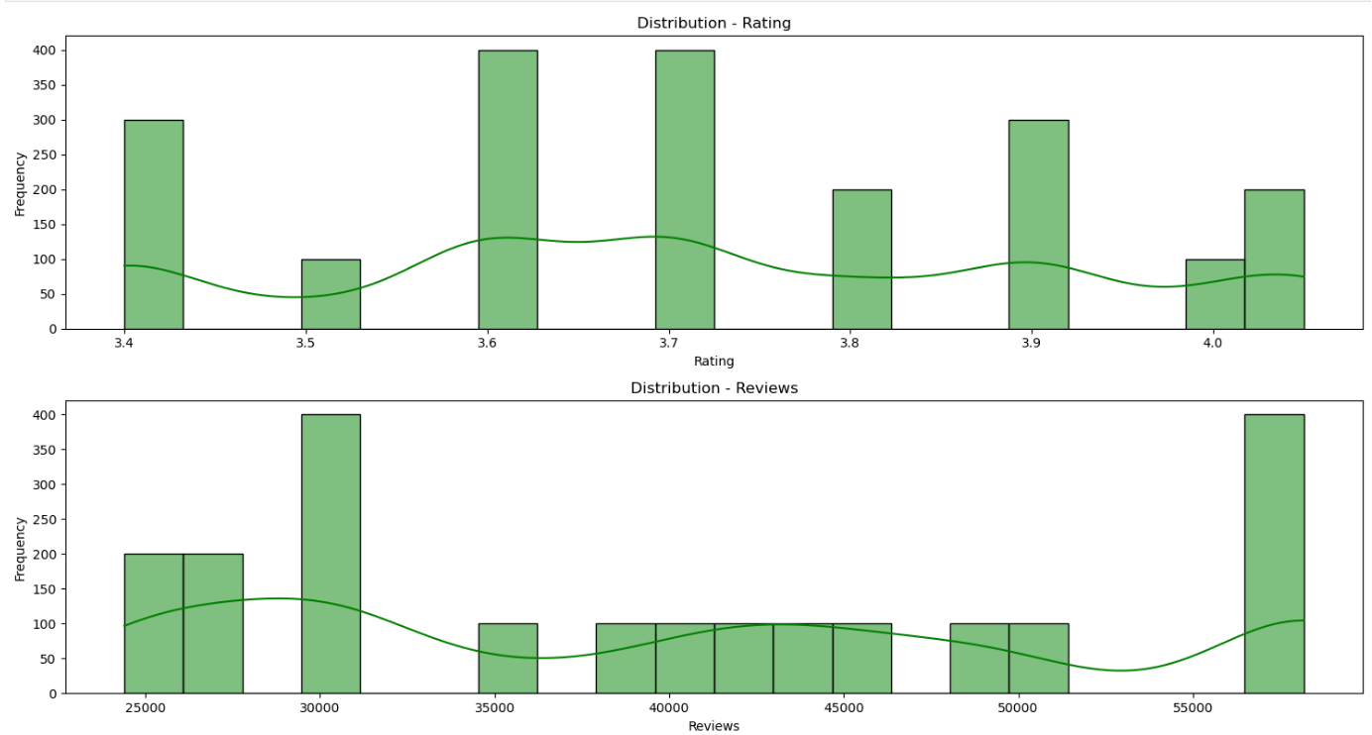
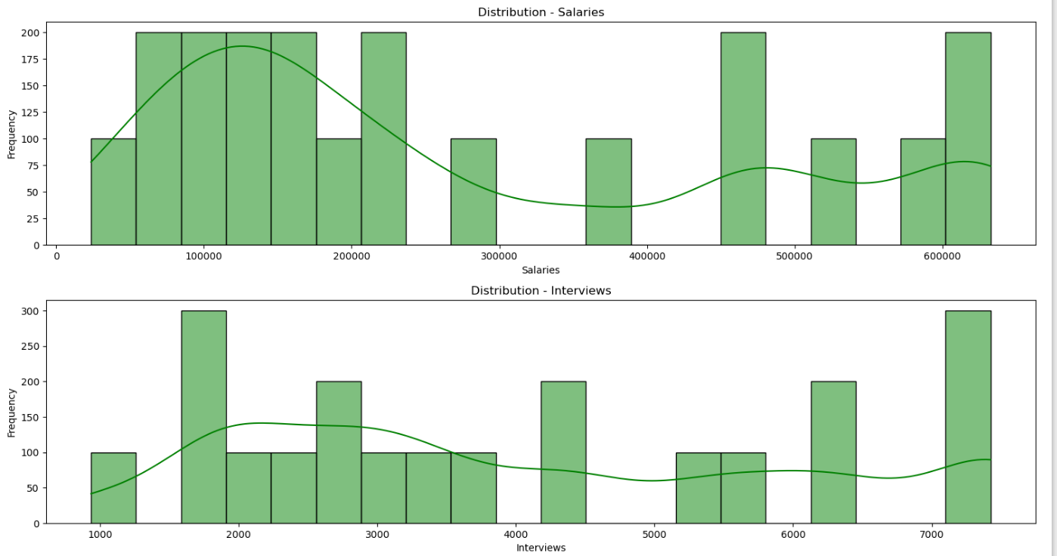
Data Visualization:
Distribution with KDE-Rating- Most of the ratings are concentrated at 3.7 i.e 3.7 is the most common rating given* The ratings are between 3.4-4.0* Ratings 3.5 are less frequent.
Distribution with KDE-Reviews- The distribution ranges from 25k to 55k reviews , Here the Distribution is right skewed,
A significant spike near 55k reviews that means
Popular companies has high review counts
Distribution with KDE-Salaries – Most companies have salaries in the range of 100k-450k and very few companies show high salaries , The Distribution is Right Skewed
Distribution with KDE-Interviews- Many Companies have 2k-3k interview count , Larger companies record higher interviews showing greater candidate intrest size.

Slide 8
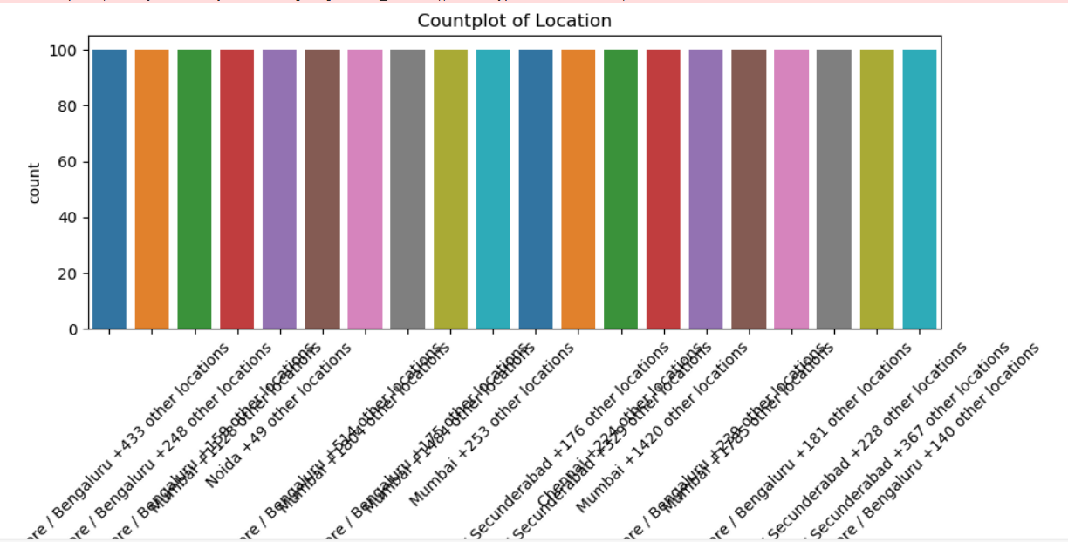
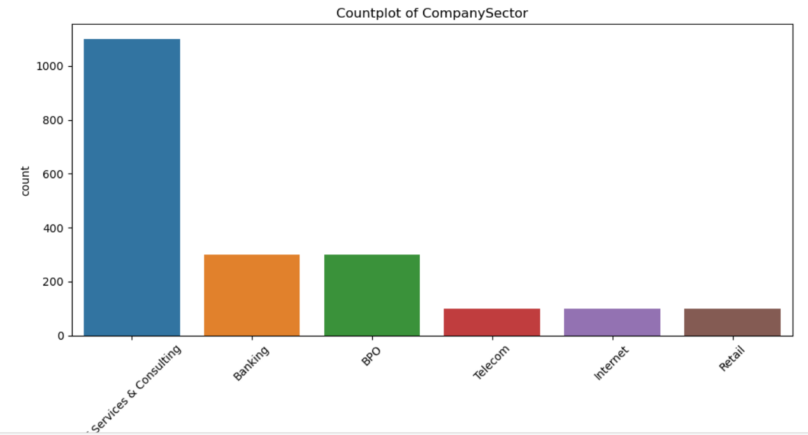
Data Visualization:
Each bar represents a unique location e.g, Bengaluru+433 other locations
The Height of each bar shows how many rows in dataset have that location
The y-axis is labeled “count”-That’s the number of occurrences
The x-axis lists all the location names . Since there are many and they’re long,The labels are rotated for readability
All bars appear to be of qual height, meaning each location has approximately the same number of entries in your dataset
This dataset is imbalanced-one category(IT Service & Consulting)has significantly more data than others
This could affect analysis later if you’re comparing ratings ,salaries ,etc , by sector-because one group will dominate.
You might consider grouping smaller sectors or taking samples to balance your data if needed.

Slide 9
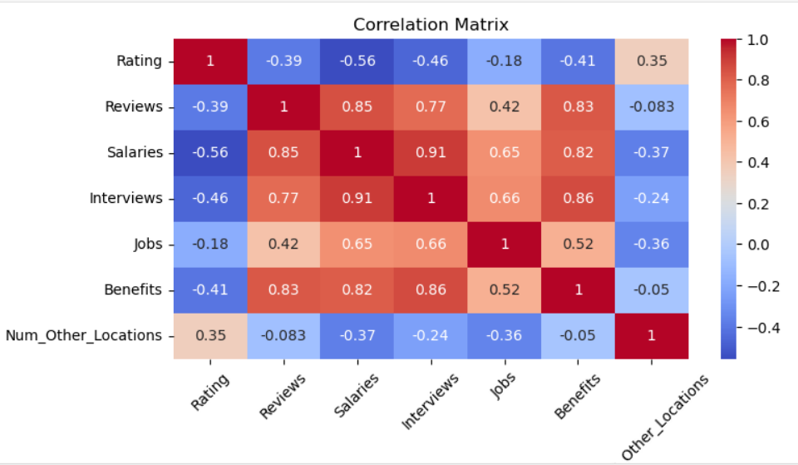
Data Visualization:
The correlation heatmap shows the variable such as Salaries , Reviews , Interviews, and Benefits are strongly interrelated-Indicating These features tend to increase together as company activity grows.
On the other hand , Ratings have a moderate negative relationship with most of these factors , suggesting the more popular companies don’t always score higher in employee satisfaction
Number of other Locations has little impact on most company performance or employee-related metrics.
More reviews are associated with more salary benefits information-active companies tend to have rich employee data overall.

Slide 10
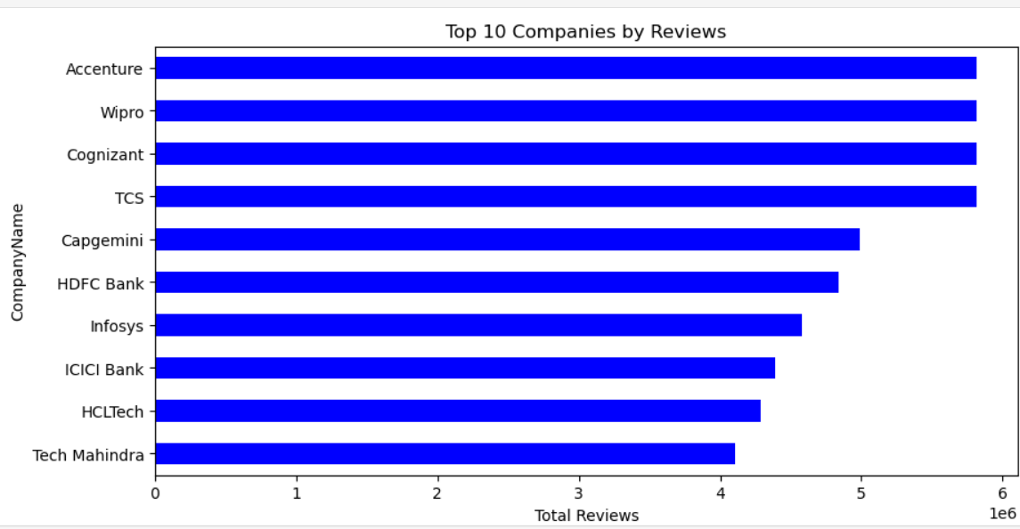
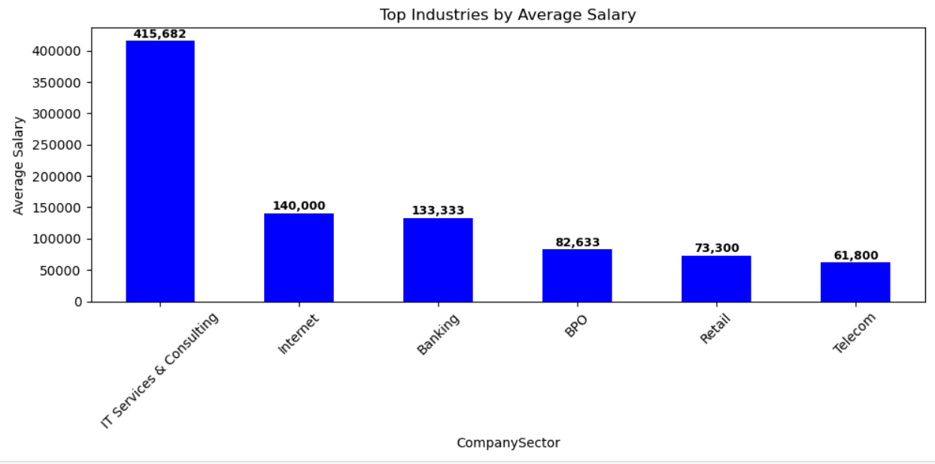
Data Visualization:
Accenture ,Wipro ,Cognizant , and TCS have the highest number of reviews, each close to 5.8-5.9 million.
Capgemini, HDFC Bank, and Infosys have slightly fewer , around 4.5-5 million reviews
ICICI Bank, HCLtech, and Tech Mahindra have the lowest among the top 10,roughly 4-4.3 million reviews.
It Services & Consulting offers the highest average salary by a large margin over 4 lakh.
Internet and banking sectors follow next with around 1.3-1.4 lakh average salaries.
BPO, Retail and Telecom industries have lower average salaries,ranging from 60k -83k.

Slide 11
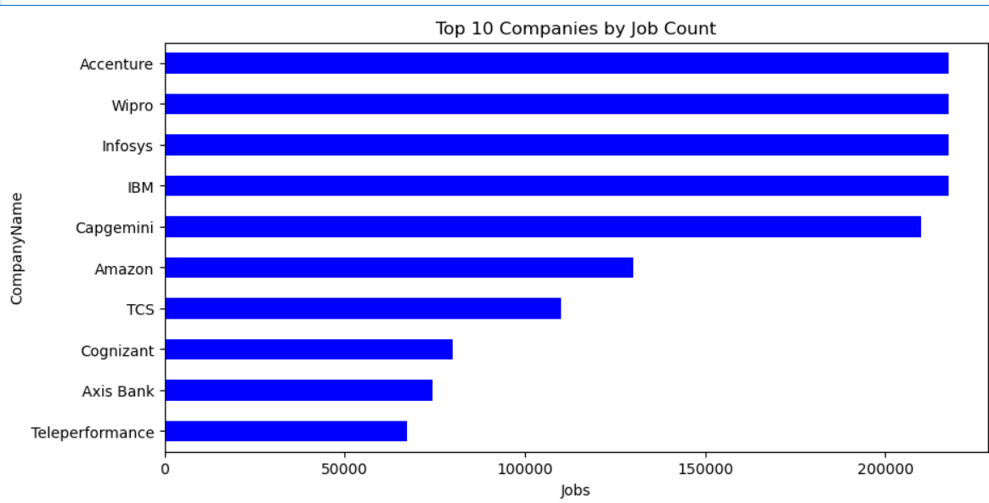
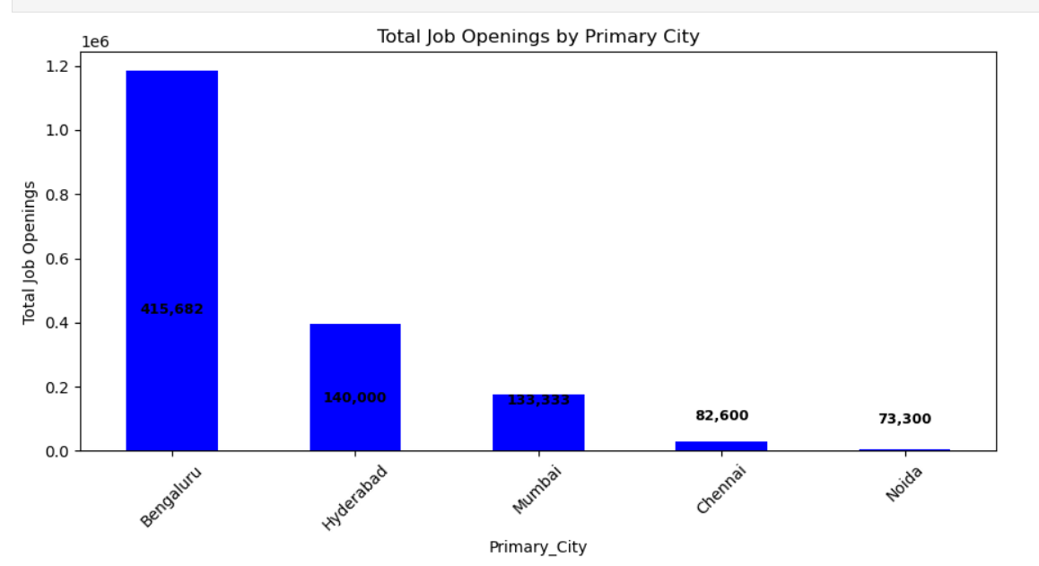
Data Visualization:
Accenture, Wipro,Infosys,and IBM have the highest job counts, each close to or above200,000 job openings.
Capgemini also show a large number of jobs ,slightly below the top 4
Amazon and TCS are in the mid-range,suggesting significant but comparatively fewer opportunities.
Cognizant,Axis Bank, and Teleperformance have fewer openings but still make it to the top 10 list
Bengaluru has the highest number of job openings-nearly 1.2 million far more than any other city.
Hyderabad and Mumbai follow with moderate job openings,around 400k and 130k respectively.
Chennai and Noida have relatively fewer jobs,below 100k

Slide 12
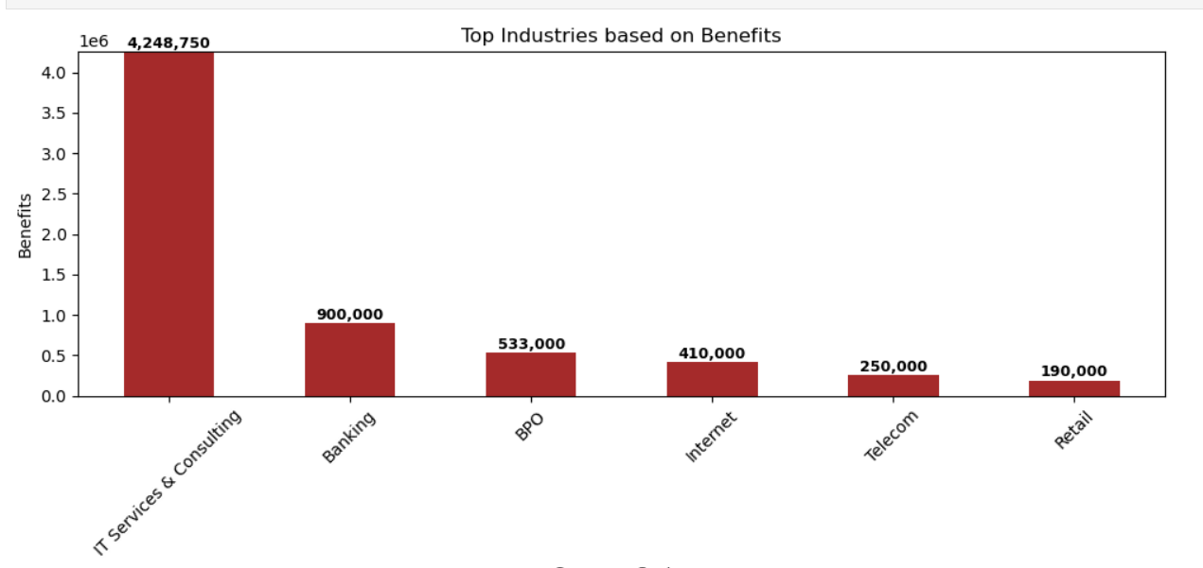
Data Visualization:
IT Service &Consulting clearly leads with Highest benefits(4.25 million)-far ahead of all other industries.
Banking comes second with 900k,followed by BPO and Internet sectors.
Telecom and Retail have the lowest benefit values, under 300k.
The difference between IT Service & Consulting and other industries is very largr showing it provides significantly better benefits to employees.

Slide 13
Conclusion:
The Ambition_Box Web Scraping Project successfully extracted real-time data about companies, including ratings, reviews, salaries, jobs, and benefits.
After data cleaning and analysis, useful insights were obtained about top companies, popular sectors, and job trends.
The project demonstrates how web scraping and data analysis can help in understanding market patterns and employee preferences.
It highlights the importance of automation in collecting large amounts of data efficiently.
Overall, this project shows how data-driven insights can support career decisions and business strategy.
h

Slide 14
Challenges – Web Scraping & Data Analysis:
Inconsistent webpage structures across seasons.
Missing or mismatched match details.
Handling duplicate and unclean data.
Overcoming request blocks and slow scraping.
Choosing the most meaningful visuals for insights.

Slide 15


