Slide 1
Project
Team No:6
Ecommerce website for Watches
By:
Anusha Hosamani
Hima Thirumulswamy
Prathiksha Nataraja
Sirisha Jujare

Slide 2
Problem statement
Creating a website for watches using spring MVC.
We can create account, add to cart and order operations.

Slide 3
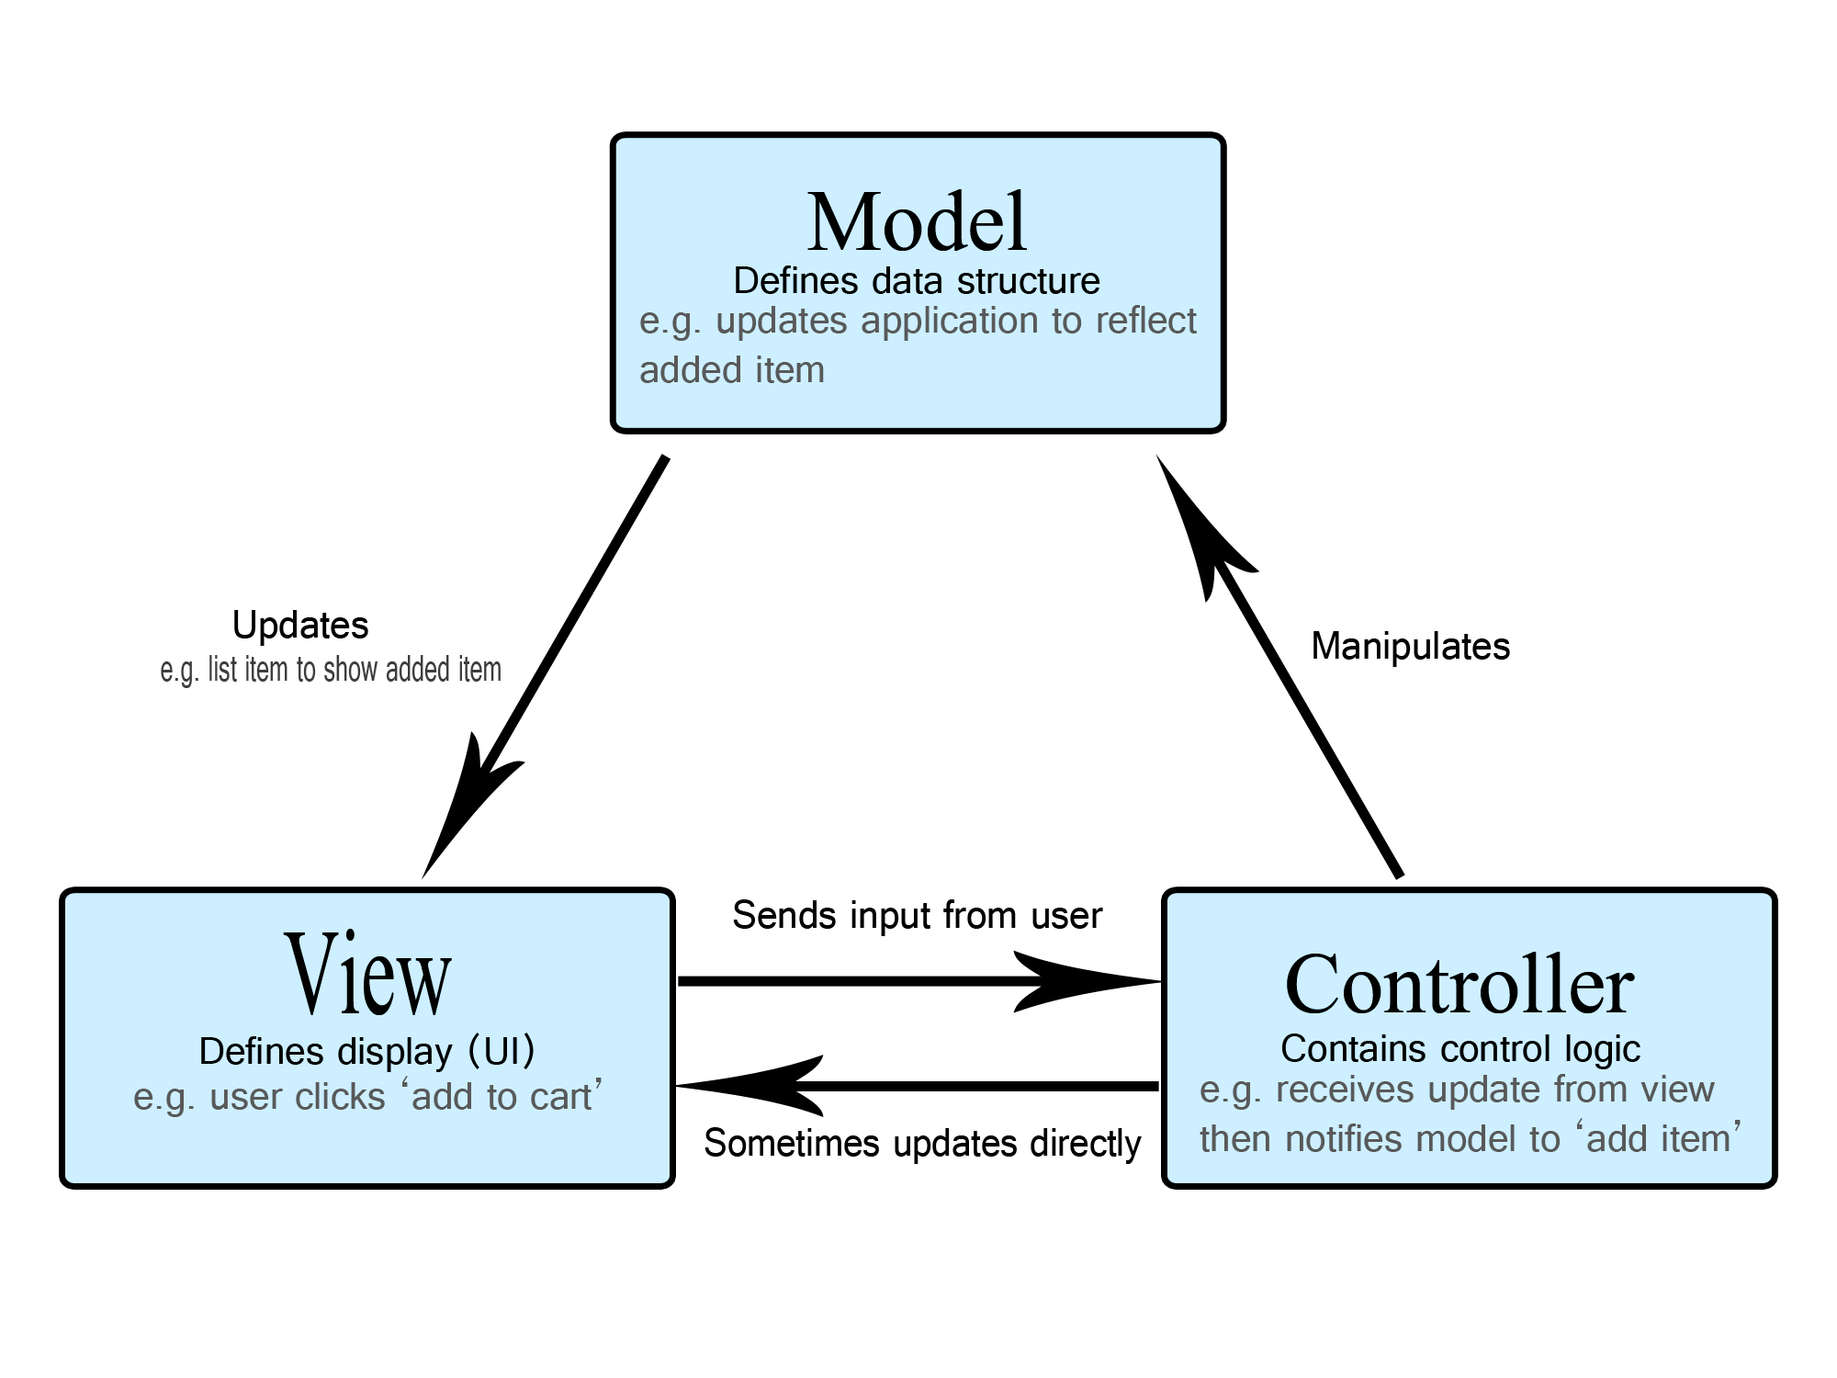
Design

Slide 4
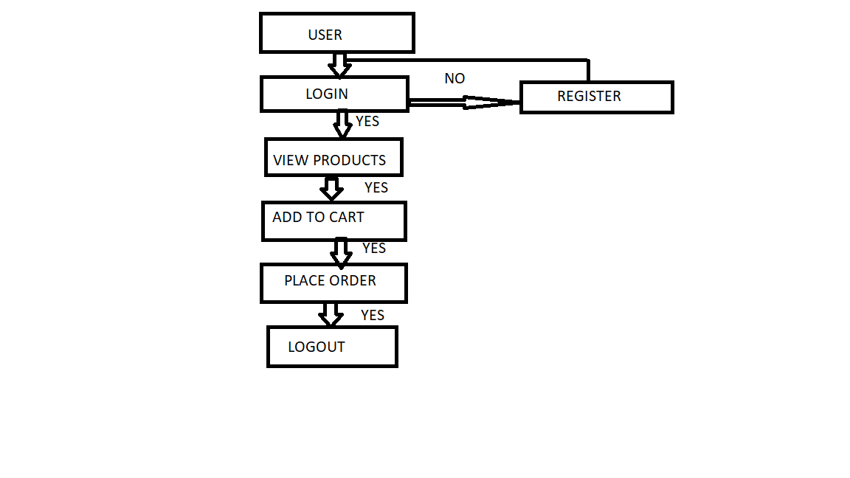
FLOW DIAGRAM

Slide 5
Technologies used
Spring boot framework
Spring MVC
Database-MySQL
JAVA SCRIPT
CSS

Slide 6
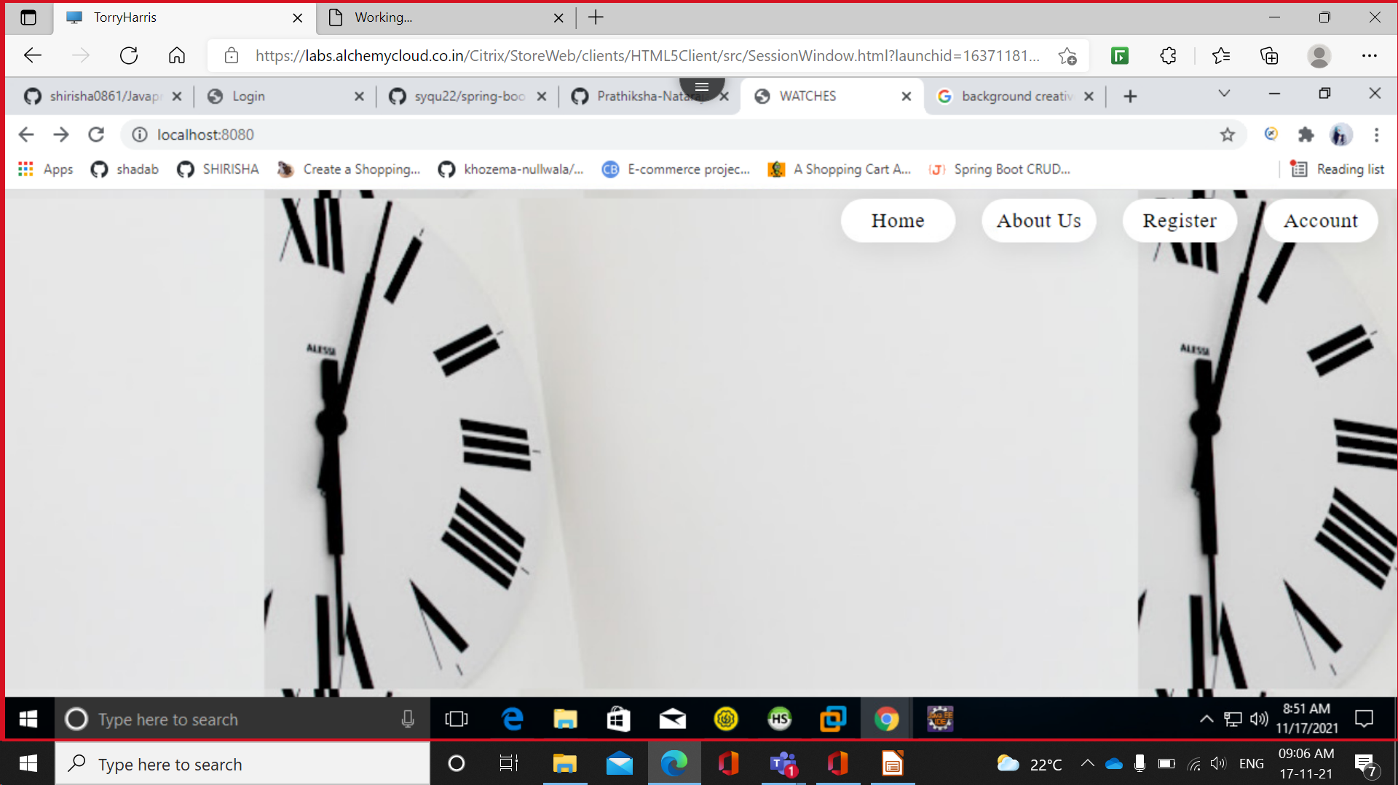
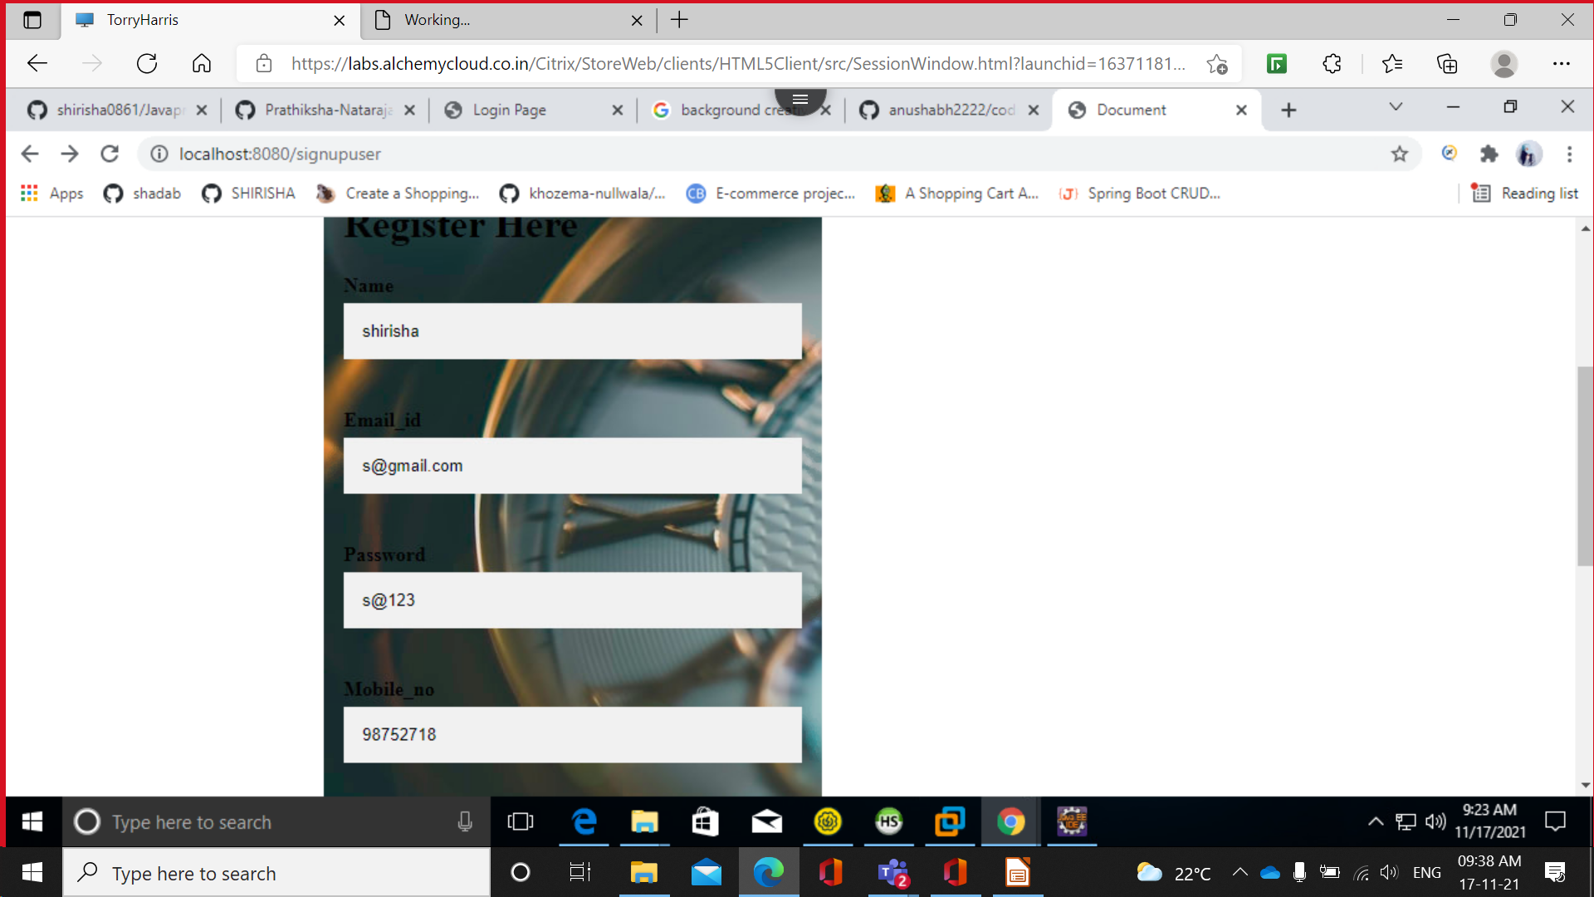
Screenshots:

Slide 7
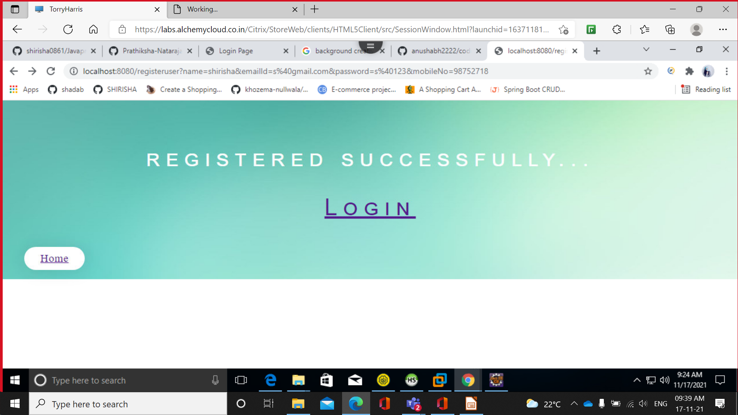
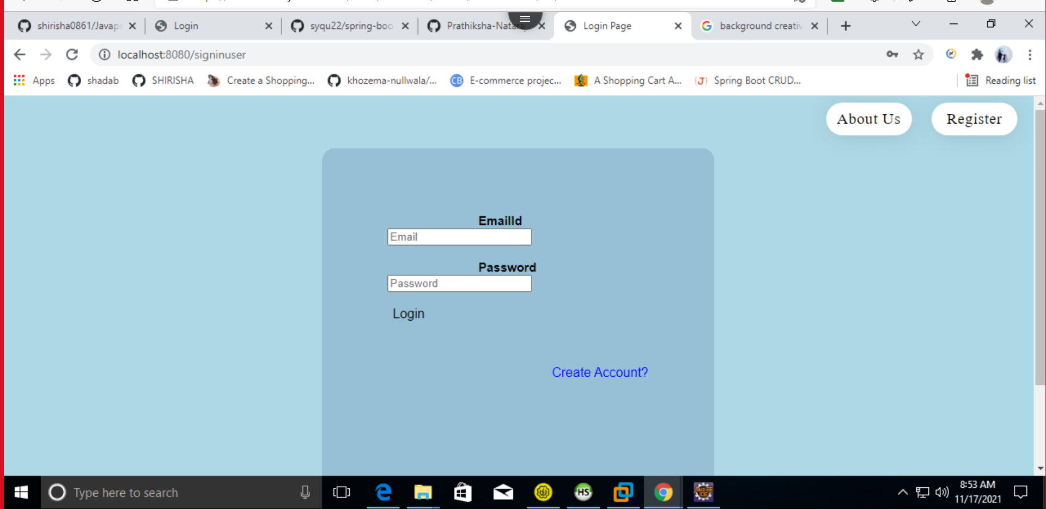
Screenshot

Slide 8
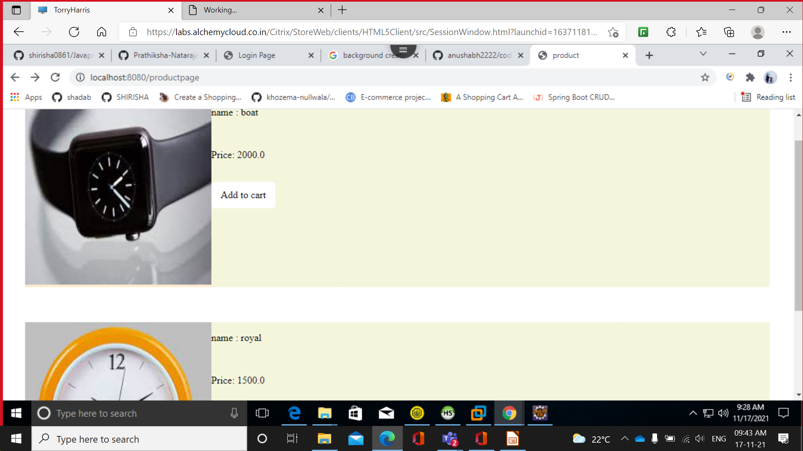
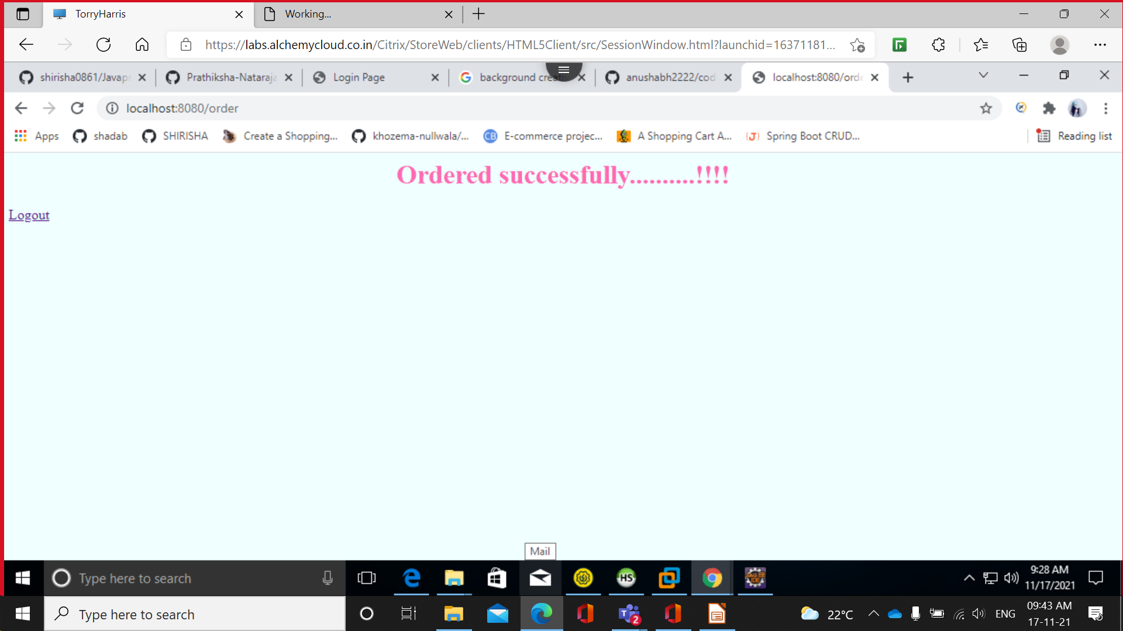
SCREENSHOT

Slide 9
Thank You...

