Slide 1

Web Test Automation with Selenium WebDriver Using C#.Net

Slide 2
Why Automation
Why Testing:
To confirm if the product works as expected and as per specifications.
Why Automation:
Automated testing reducing the time & resources to run repetitive tests.
Advantages of Automation:
- Faster & Efficient
- Accurate & Reusable
4. Why Selenium Web Driver:
It is an open source tool which is widely supported by the community
Platform independent and supporting multiple browsers.
All popular programming languages can used with it.

Slide 3
What is needed for automation ?
1) Any Object-oriented programming language
Ex: Java, C#, Python etc.,
2) Microsoft Visual Studio[Integrated development environment] is a software application that provides comprehensive features to computer programmers for software development. It consists of source code editor, build automation tools for compiling source code into binary code and debugger for locating and fixing errors in the code.
Selenium WebDriver - Automation tool for Web applications in different browsers, supporting many programming languages.
4) Web Element - is just the reference to that element within the DOM. It is Selenium 's way of representing a DOM element.
Ex: Text field, Radio button, Dropdown, Login buttons etc.,

Slide 4
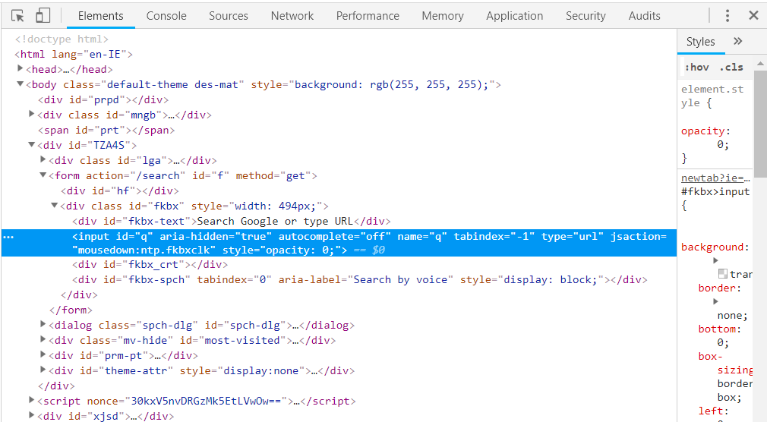
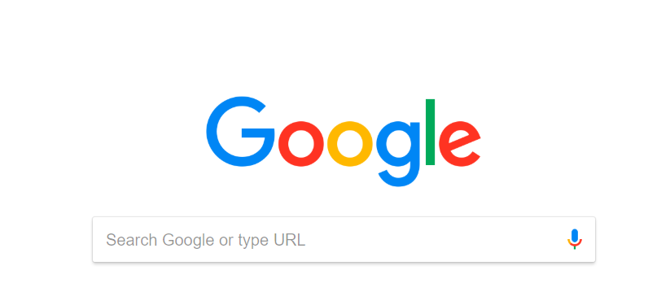
DOM & Web Elements
Document Object Model (DOM)
DOM in simple terms, is an interface which defines the logical structure of a web page and the way in which web page is accessed and manipulated. It includes how the HTML/XHTML/XML is formatted.
A DOM element is something like a DIV, HTML, BODY element on a page.

Slide 5
Locating Web Elements
USING CHROME BROWSER
Google Chrome has its own developer tools, that can be used to identify and locate web elements on the web page.
Open Google. Press F12 to launch the tool. In Elements Tab it displays all the HTML Properties belonging to the current web page.
You can also launch developer tools by right-clicking anywhere within the web page and by selecting “Inspect element”.
USING FIREFOX BROWSER
Similarly, Firefox browser also has something called as Firefox Developer Tools to identify web elements.
Open Firefox Browser. Press F12 to launch the tool. In Inspector Tab it displays all the HTML Properties belonging to the current web page.
You can also launch developer tools by right-clicking anywhere within the web page and by selecting “Inspect element ”.

Slide 6
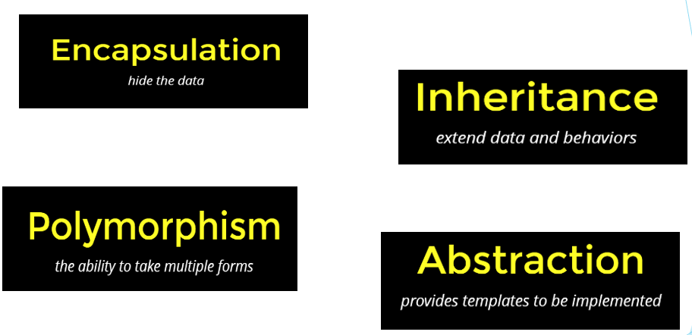
Object Oriented Programming (OOP) - Principles

Slide 7
C#.Net Installation
.NET is a developer platform made up of tools, programming languages (c# ,f# , VB), and libraries for building many different types of applications.
.NET Framework is the original implementation of .NET. It supports running websites, services, desktop apps, and more on Windows.
.NET Core is a cross-platform implementation for running websites, services, and console apps on Windows, Linux, and macOS.
Go to https://visualstudio.microsoft.com/vs/.
Mouse Hover on Download Visual Studio Button
Click on Community 2019 ( Community is free while the professional version is not free, Community version can be used by developers individually or a smaller sized Team up to 5 persons or less. But the professional Version Can be used by group of 5 to 25 persons and it has Enterprise support)
Run the exe
Select Asp.Net, .Net framework 4.8 Developers Tools and click on install

Slide 8
Sample C#.Net Project
HOW TO CREATE SIMPLE PROJECT
Open Visual Studio →Create New Project->Next-->Class Library (.NET Framework)→Next
Project Name (eg Sample)
Location (Workspace Location)
Solution Name (eg Basics)
A Solution can have multiple Projects.
Properties →AssemblyInfo.cs (AssemblyInfo.cs) contains information about your assembly, like name, description, version, etc.
References → These are the Default Libraries comes with project.
Default class →Dummy class for you to get started
HOW TO CREATE A CLASS IN A PROJECT
Project (right click)>New-->Class > ClassName (Note:Starts with capital and cannot be a c# key word )

Slide 9
C# Basics For Automation
Namespace in C#
A namespace is designed for providing a way to keep one set of names separate from another. The class names declared in one namespace does not conflict with the same class names declared in another.
. Usually Project name is taken as Namespace by Default.
1) Class in C# :
syntax:
Public class Demo
{
}
2) Access specifiers
Public→any were
Protected→within a package and outside the package through inheritance
Default→within a package
Private→ within a class

Slide 10
C# Basics For Automation – Cont…
3) Data types
a) Primitive data types
int, float, double, string, char, Boolean, var
b) User defined data types
Demo, Sample
4) Arrays
Collection of elements of same datatypes.
Variable stores only one element where as array stores collection of elements
syntax:
string[] name={“Test”,”QA”,”Automation”};
5) Creating an Object in : An object is an representation of a class.
syntax
Demo d=new Demo();

Slide 11
C# Basics For Automation – Cont…
TO RUN THE PROJECT RIGHT CLICK ON THE PROJECT→PROPERTIES→OUTPUT TYPE→ WINDOWS APPLICATION
6) Non static Functions without return type
function with no return type.
syntax:
public void functionName()
{
}
To create object for non Static methods class
syntax:
Demo d1=new Demo();
7) Non Static function with return type:
syntax:
public datatypename functionName()
{
return datatype
}

Slide 12
VERSION CONTROL
Importance of Version Control
To secure your code
To work in a Team
Who did what and when
Can go back to any pervious work to any point in time

Slide 13
GIT
Create A GIT Account
Google →github (github.com/join)→ enter your email and Password → Create account
Install Source Tree Desktop application
Google → Source Tree (https://www.sourcetreeapp.com/) → Download for windows → run the exe file → Select Git → login to Git-> Grant Access → Next

Slide 14
GIT
Get Started
Create a repository in GitHub → clone the repo with source tree → create a
folder in your local machine → select that folder and click on clone→ if cloned
successfully you should see Reame.md file from Git into the your local machine folder.
Important concepts in Source Tree
Commit → To Commit code into your repository
Push → To push your code into your repository
Pull → To get the Latest Master from the repository

Slide 15
GIT
Fetch→ To get all the Tags.
Branch→ To create an other branch from the master.
Take any of your project and place it in your local folder→ it will be reflected in
SourceTree→ Stage All→ Commit message → click on commit → push → if you
refresh your Git your code will be there
To get the code from master→ fetch→ pull →rebase

Slide 16
GIT
Working With Branches
Branch→ Branch Name→ Create Branch →You can see the branch created
Make Changes To the Code → stage it → Commit→ push → In Bitbucket when you click on branches you should see your branch → create → click on close check box→ create pull request → merge
Navigate to source tree →switch to master →fetch →pull

Slide 17


