Slide 1
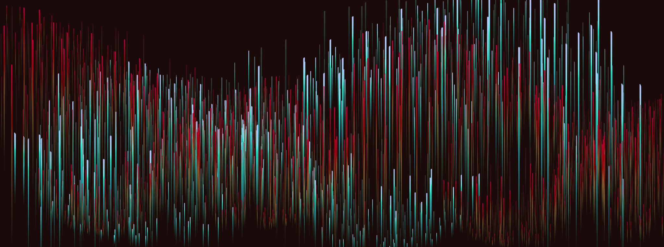
SPEECH EMOTION RECOGNITION USING ML
INFO 7390
Anusha Das
NUID: 002985875

Slide 2
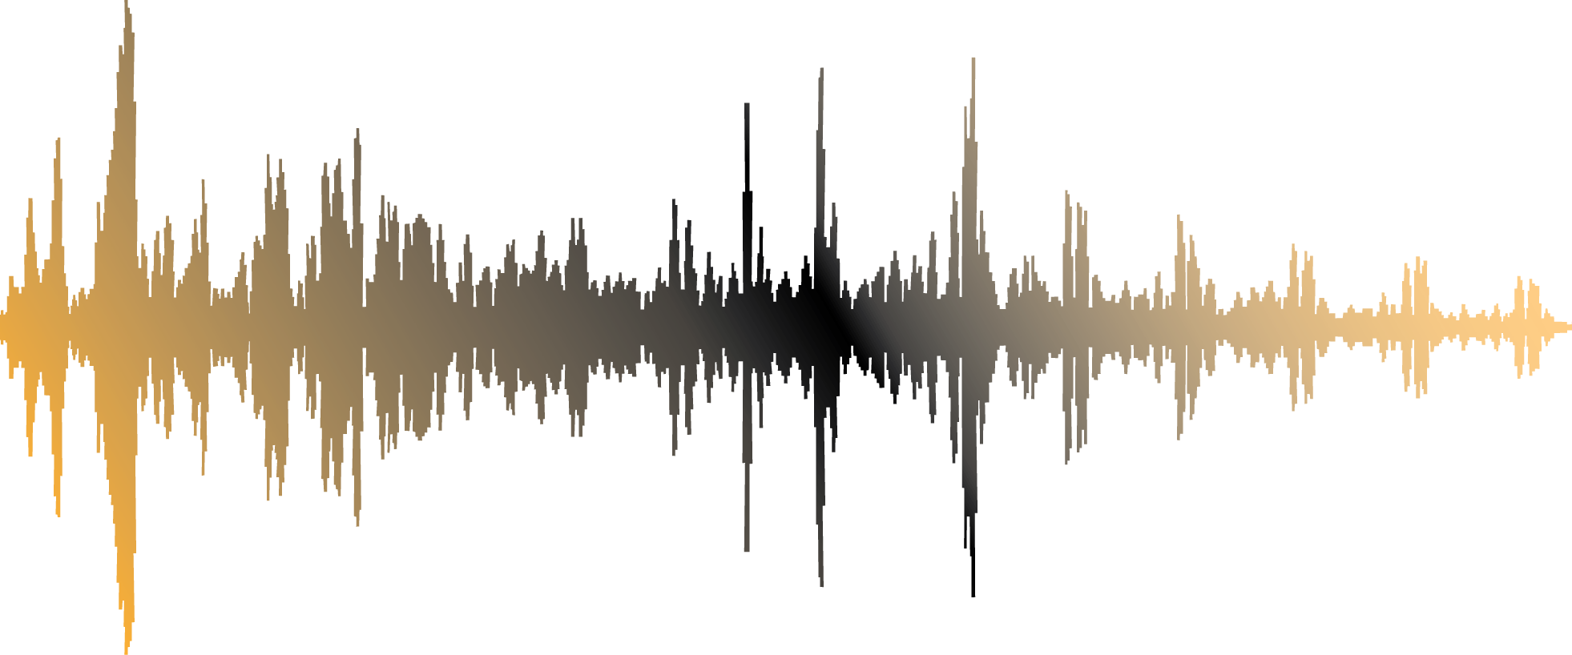
Introduction
Grasping human interactions requires an understanding of emotions. Researchers are working to develop systems that may, at the very least, simulate the human ability to recognize emotions expressed through facial expressions, tone changes when speaking, and other means. One of these domains is Speech Emotion Recognition (SER). We want to create an autonomous emotion recognition system using deep learning and machine learning methods.

Slide 3
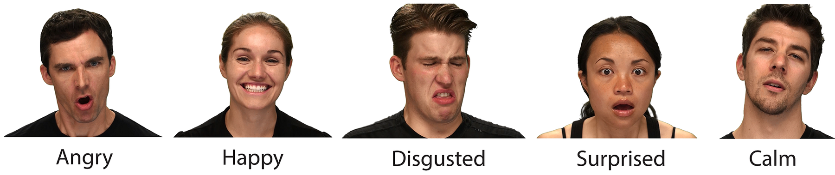
Dataset Used
The goal of this project is to detect the emotions produced by the speaker while he or she is speaking. Speech generated in a condition of fear, rage, or delight, for example, becomes loud and quick, with a greater and wider range of pitch, but speech produced in a state of grief or exhaustion is slow and low-pitched. The goal of the presented models is to identify only the emotion in the audio recording that has a higher value. To have a machine classify feelings, various ways have been tried, such as computer vision or text analytics. Our goal in this project is to use pure audio data while considering MFCC.
Goals
1440 speech files
recordings of 24 professional actors (Male & Female)
Emotions including neutral, calm, happy, sad, angry, fearful, surprise, and disgust.
Ryerson Audio-Visual Database of Emotional Speech and Song (RAVDESS) dataset

Slide 4
Methodology & Packages
Packages
Scikit-learn
Librosa
Tensorflow
The classification model proposed based on
machine learning
deep learning
The project tested 3 models:
convolutional neural networks (CNN)
Multilayer Perceptron classifier (MLP)
support vector machine (SVM) classifier
Feature extracted: Mel-frequency cepstral coefficients (MFCC)

Slide 5
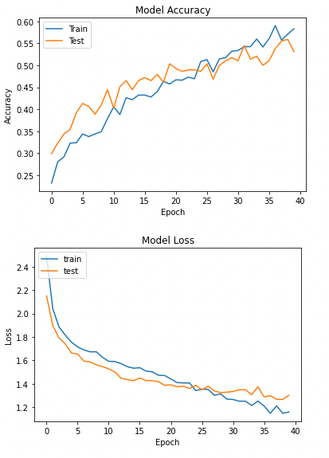
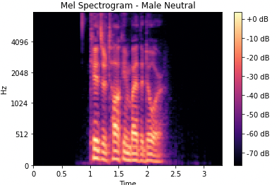
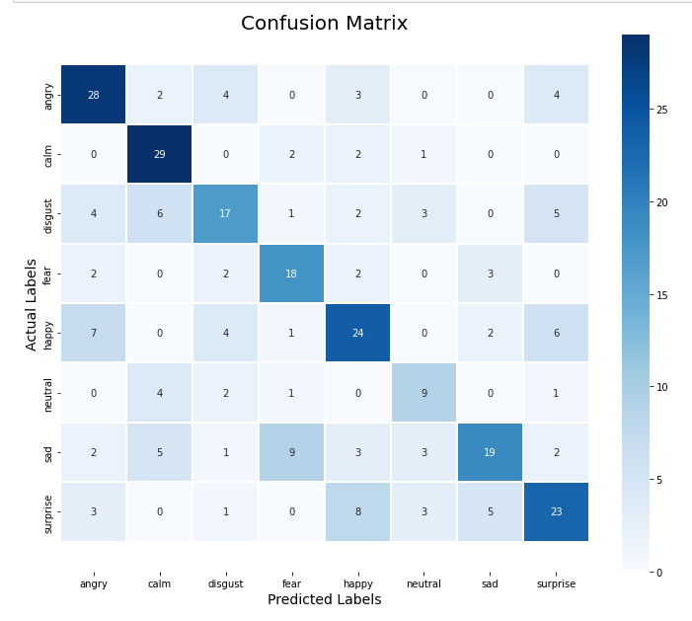
Results
Model | Accuracy
1D-CNN | 53%
1D-CNN(Data Augmentation) | 54%
MLP Classifier | 45%
SVM Classifier | 58%

Slide 6
Conclusion
In this project, we presented an architecture based on deep neural networks for the classification of emotions using audio recordings from the Ryerson Audio-Visual Database of Emotional Speech and Song (RAVDESS).The model has been trained to classify seven different emotions (neutral, calm, happy, sad, angry, fearful, disgust, surprised) and obtained the best performances on the Angry class (0.79) and worst on the Neutral class (0.31).The best classification has been performed by SVM and 1D-CNN Model after Data Augmentation with the highest accuracy of 58%
Further Improvement
More data can be collected to increase model accuracy and performance on all emotion classes.
Applying other data augmentation methods
Using more robust methods such as Transfer learning – ResNet50, or VGG19

Slide 7
Thank you!

