Slide 1
Deepfake Detection with ResNet18
and adversarial robustness (FGSM / PGD)
Section D Capstone | Anusha Dayal | 2430010333 | B.Tech CSE (Data Science), MUJ

Slide 2
Problem and goal
Deepfakes are cheap to make and hard to spot by eye
Goal: frame-level real vs fake classifier on FaceForensics++ frames
Second goal: test whether the detector survives adversarial attacks
Innovation: PGD adversarial training as a defense

Slide 3
Approach
Data: FF++ frames, split 70/15/15 by source video, 224x224 full frames
Model: ImageNet-pretrained ResNet18, final layer replaced with 2 classes (11.18M params)
Training: Adam lr 1e-4, batch 32, 10 epochs, flip + colour-jitter augmentation
Also supported: EfficientNet-B0, ViT-B/16 (same train.py)
Evaluation: accuracy, macro P/R/F1, ROC-AUC, FGSM and PGD sweeps

Slide 4
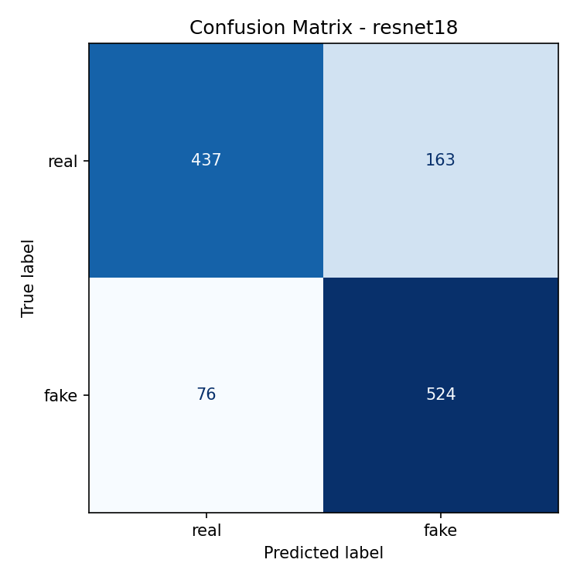
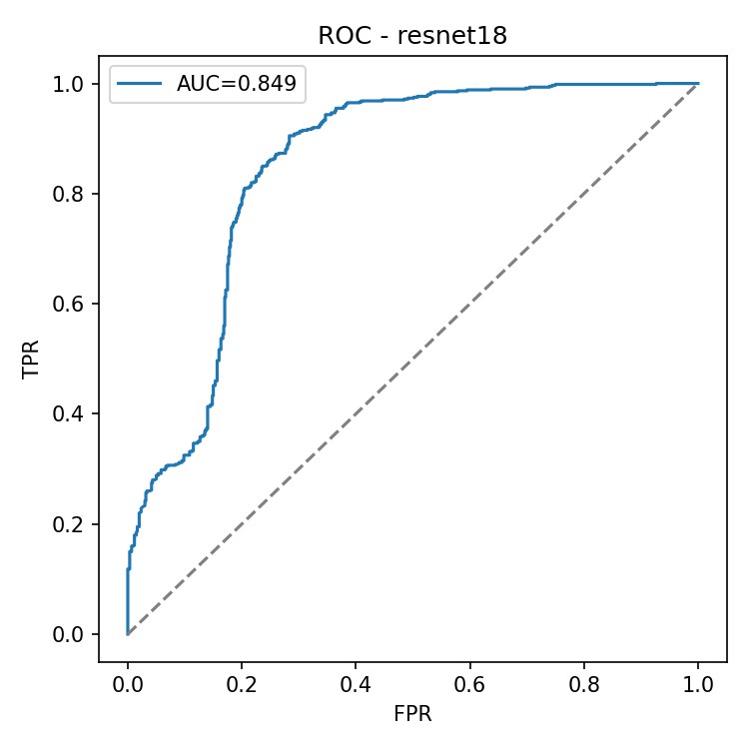
Clean results (1,200 test frames)
80.1%
accuracy
AUC 0.849
F1 (macro) 80.0%
Fake recall 87.3% vs real recall 72.8%: the model over-flags real frames (163 false positives vs 76 misses).

Slide 5
Attack finding: accuracy collapses
Undefended model falls to ~0% at eps 0.01 (~2.6/255)
FGSM rising at large eps is single-step overshoot, not robustness
Literature agrees: undefended detectors hit 0-8% under PGD
Numbers to be re-run on the current checkpoint

Slide 6
Innovation: PGD adversarial training
Each batch: craft PGD examples (eps 0.01, 3 steps) with model in eval mode
Train on 50% clean + 50% adversarial samples
Command: python src/train.py --arch resnet18 --adv --name resnet18_adv
Reference: AFSL (2024) lifts Xception from 7.3% to 81.7% under PGD10
Expected cost: some clean accuracy and ~4x training time
Result table: filled after resnet18_adv run

Slide 7
Limits and next steps
Limits: one dataset, full frames, small test set, narrow attack suite
Resolve earlier-run (92.6%) vs current-run (80.1%) mismatch; check split leakage
Next: train resnet18_adv, add face crops, cross-dataset test (Celeb-DF), AutoAttack
Compared against 6 papers (FF++, AFSL, SBI, Effort, ...): see literature xlsx

