Slide 1
Clustering update

Slide 2
Aim
Create clusters with customer which exhibit similar behaviours
Each cluster will have one model
Clusters can be used to infer behaviour for different customers in the clusters

Slide 3
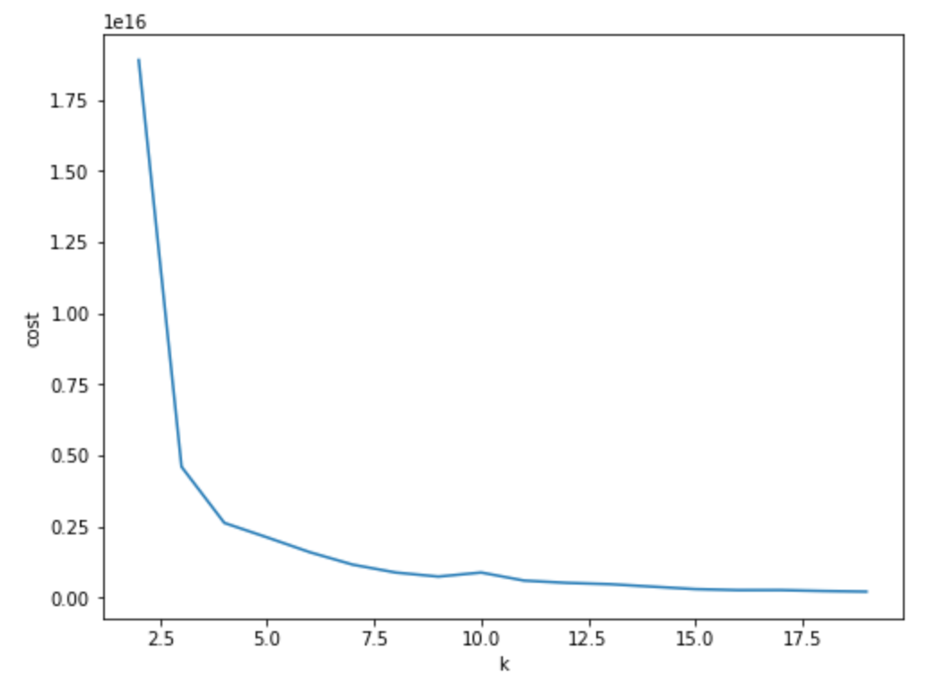
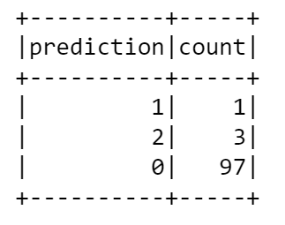
Cluster customer based on timeseries
K-means & bisecting K-means
Elbow curve indicates ~3 clusters
Silhouette distance is close to 1
However, 99% of customers are put in 1 cluster
Regardless of:
the number of clusters
the length of the timeseries
the number of customers included

Slide 4
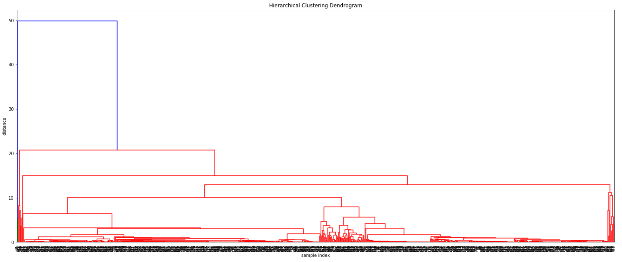
Cluster customer based on timeseries
Hierarchical clusters
From 8 clusters onwards we get two distinct large clusters ( >5 customers)
From 15 clusters onwards we get three distinct large clusters ( >5 customers)
Dendrogram → also confirms many outliers
Silhouette distances are 0.05 and 0.004 respectively

Slide 5
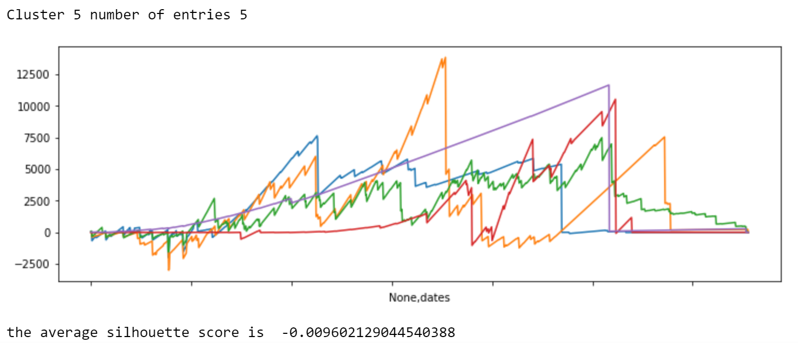
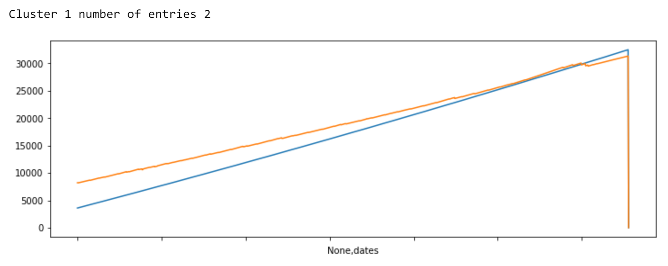
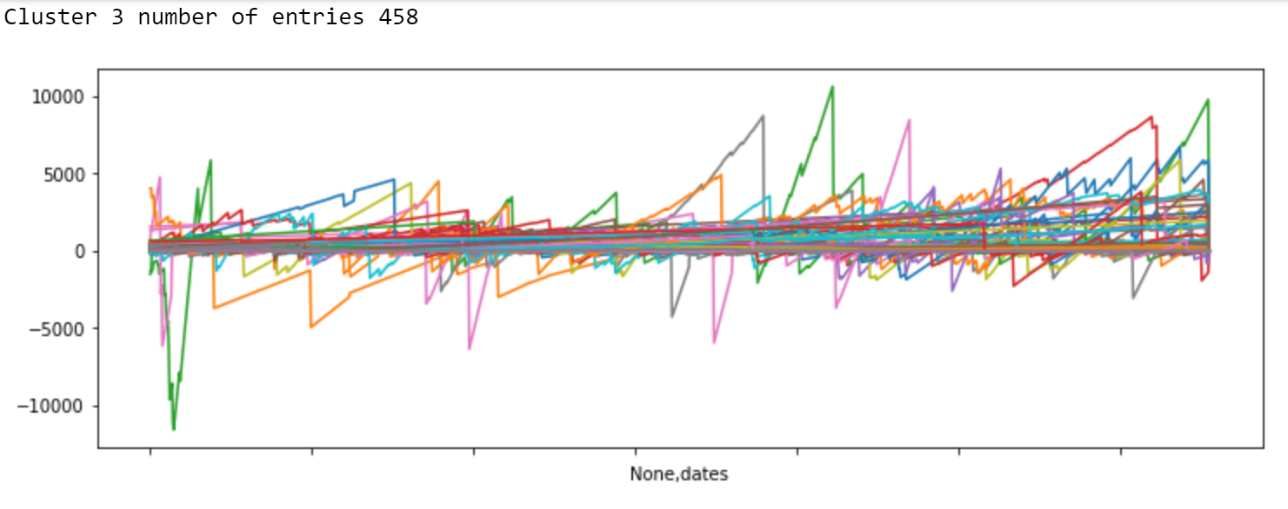
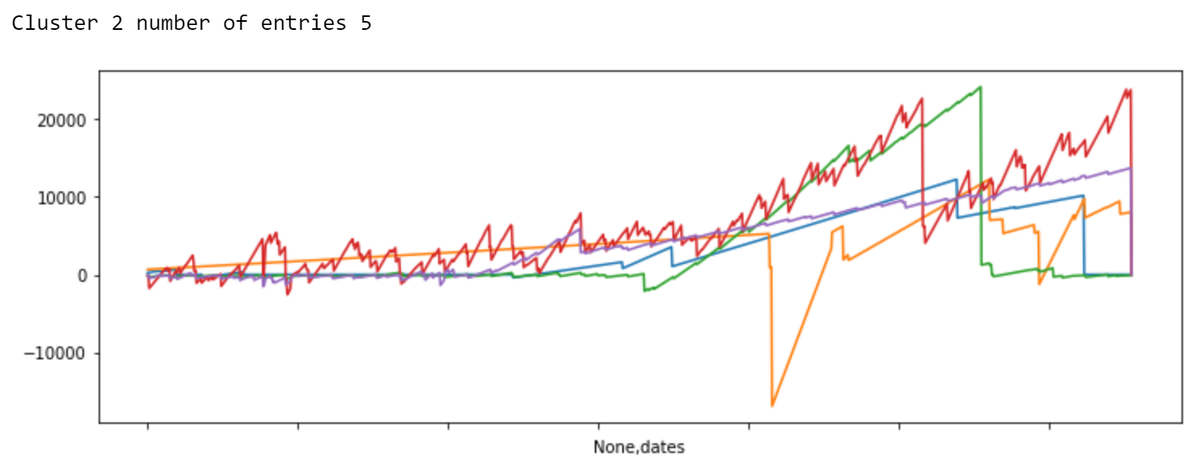
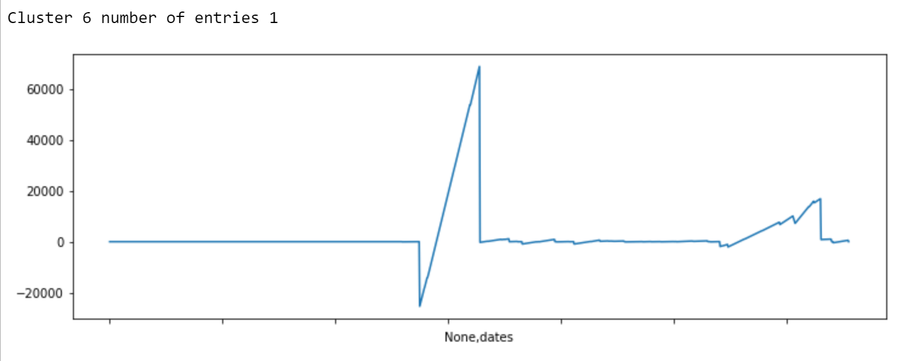
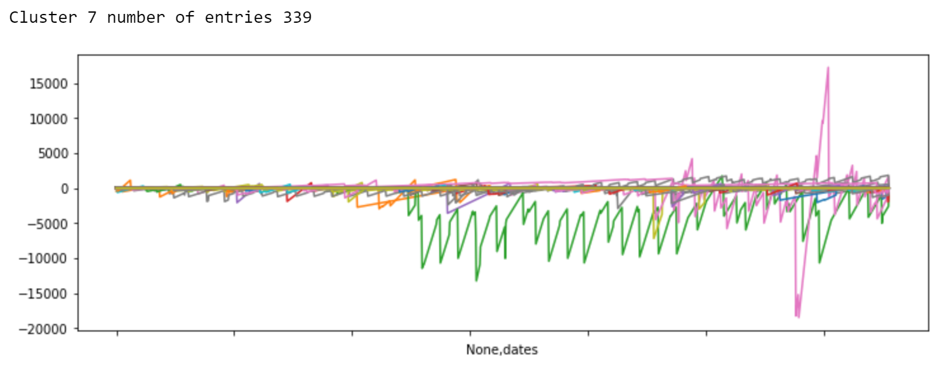
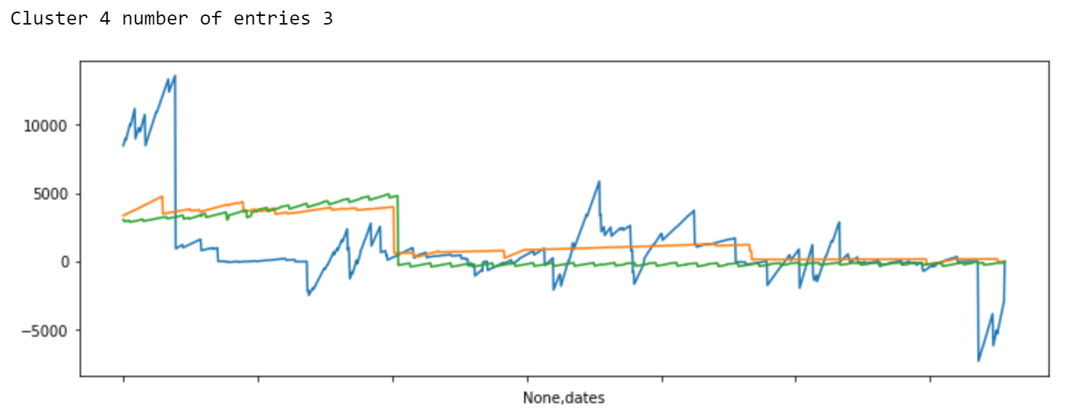
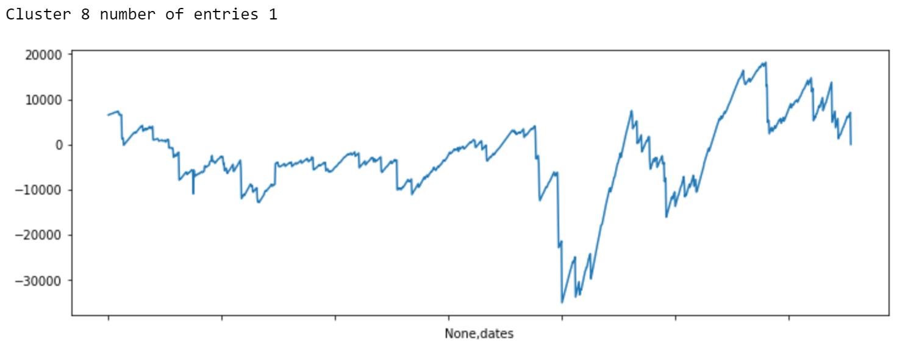
Cluster plots

Slide 6
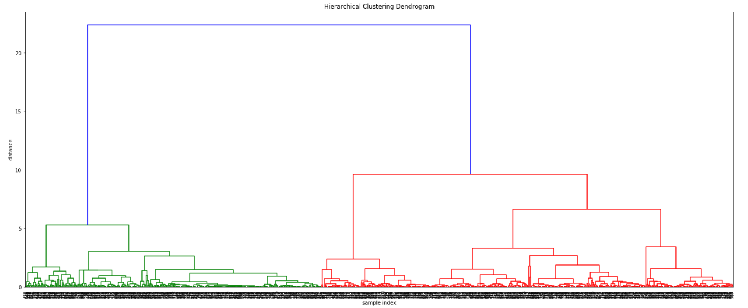
Customer clusters based on timeseries features
Hierarchical clustering
Timeseries features:
Timeseries statistics, linear least square regression statistics, fft statistics
Dendrogram to inspect data for outliers and number of clusters
2 clusters & no outliers as a first indication

Slide 7
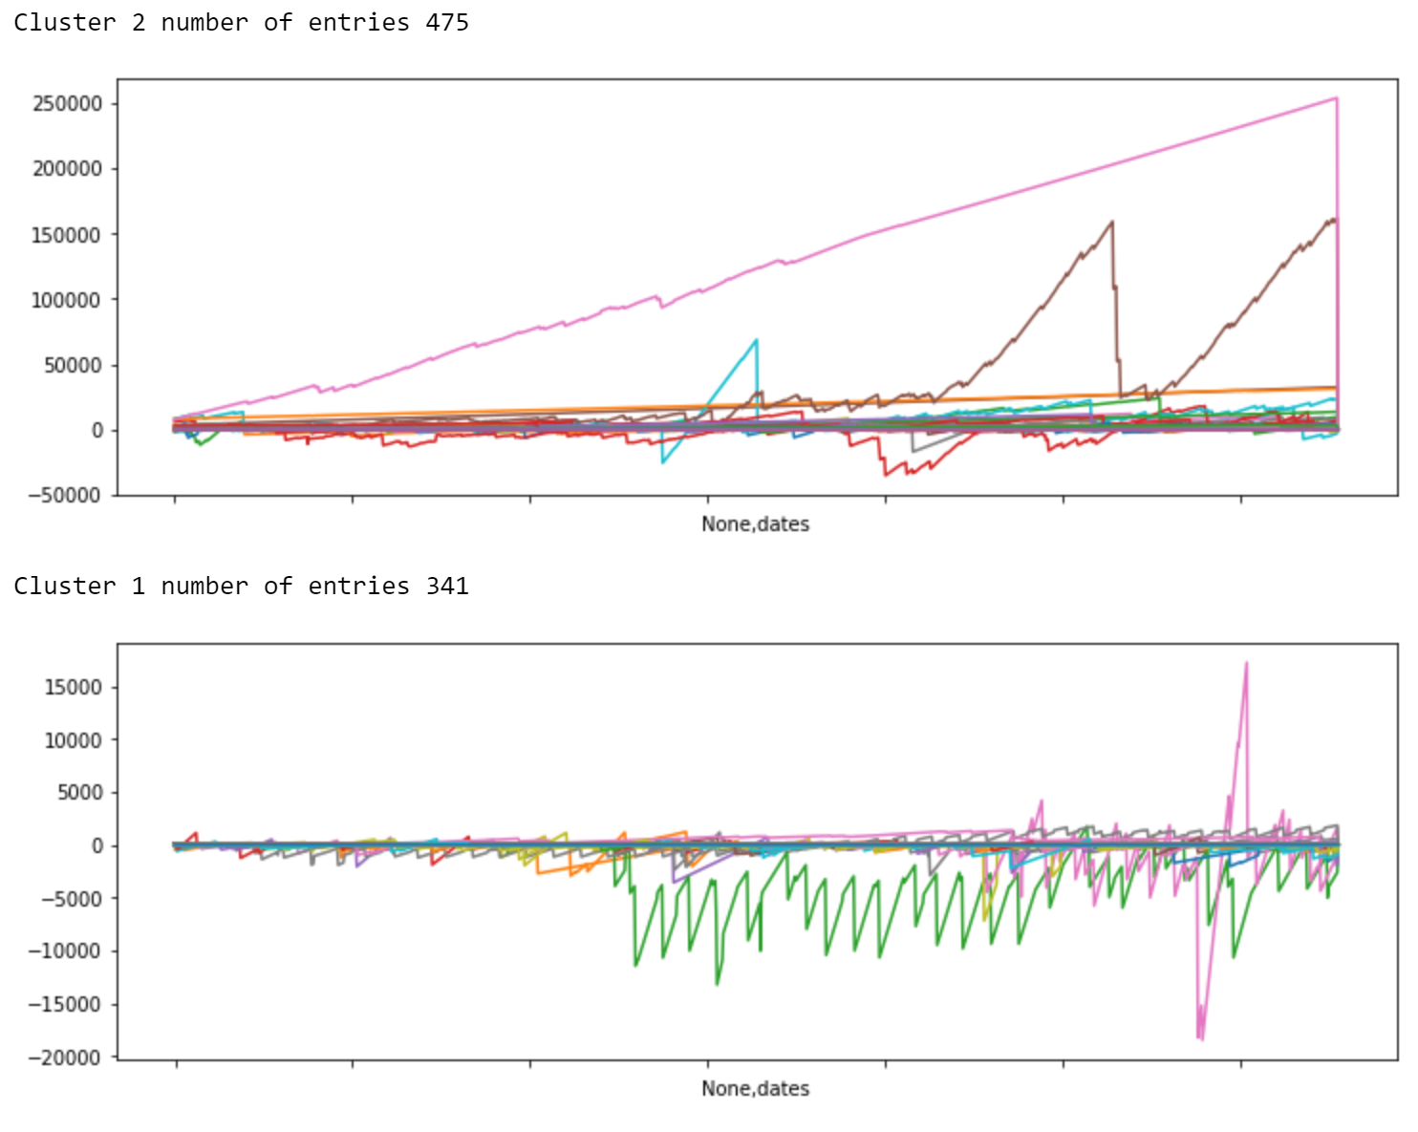
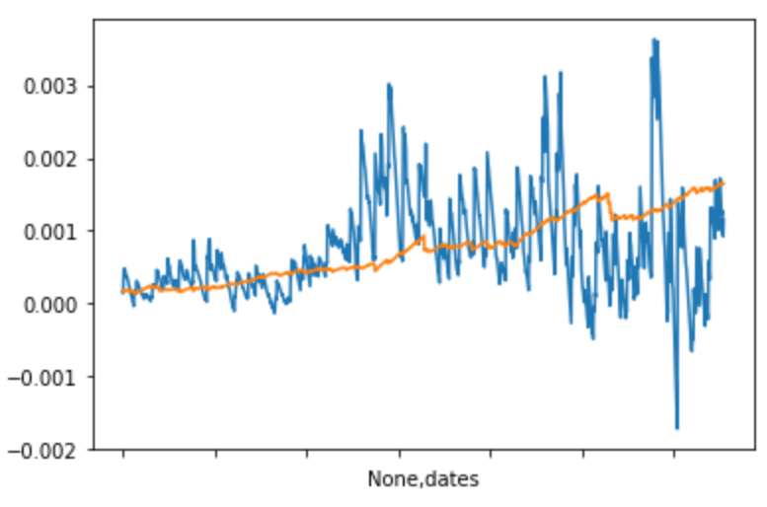
Cluster plots
Cluster 2 has the relatively ‘stable’ customers which seem to pay late generally.
Cluster 1 has customers who seem to have more regular interactions with GE and pay more regularly as well.
Note: silhouette distance for clusters is negative → more effort necessary to optimise?

Slide 8
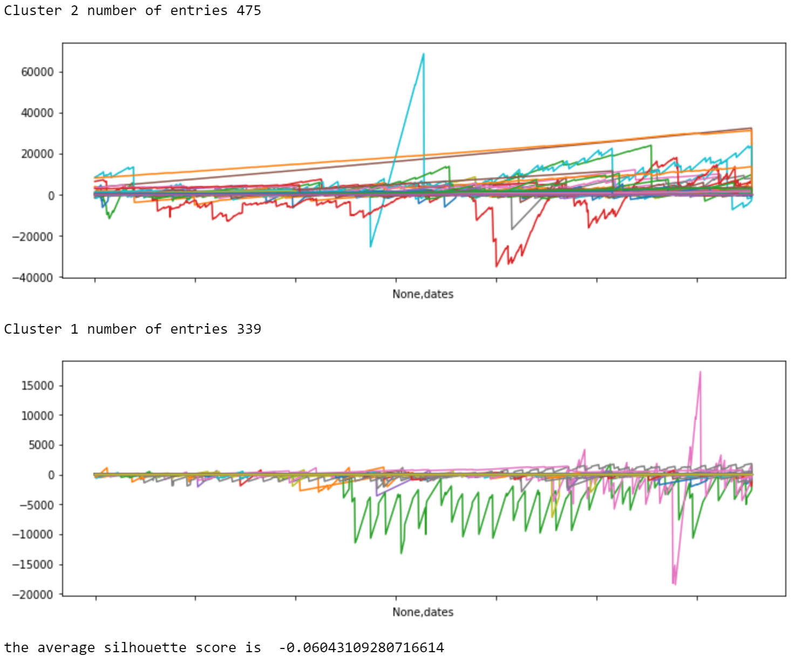
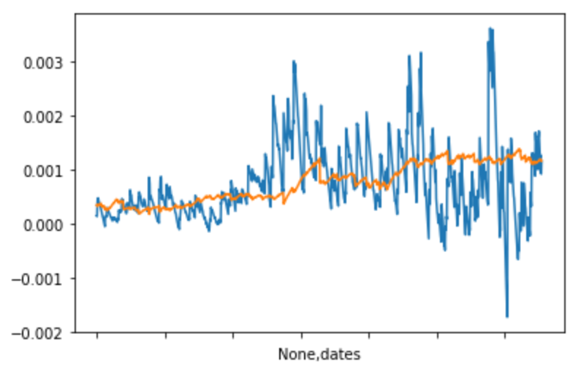
Cluster plots without clear outliers

Slide 9
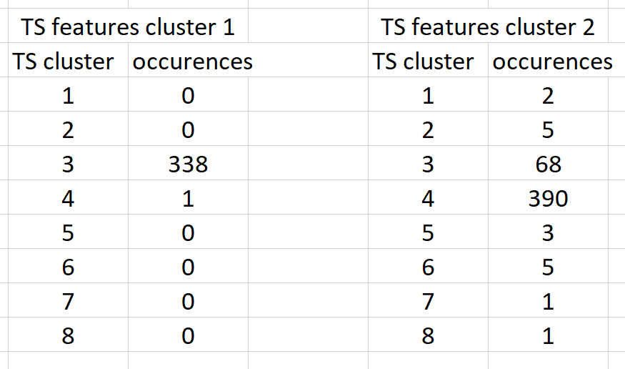
Comparing method 2 & 3
From the below note:
Clusters calculated using hierarchical clustering with only the timeseries and with the timeseries features have a large overlap

