Slide 1
Keras LSTM
Time series Analysis for each customer

Slide 2
Customer
Prepare data:
Charge the format of input data to model as convolution layer requires data to be in 3D format i.e ( samples/rows, timesteps, features/lags)
Create lags: Lags remove increasing trend in data and make data stationary
Transform time series into a supervised learning problem: organization of data into X and Y where the observation at the previous time step is used as an input/X to forecast the observation at the current time (Y)
Rescale the data to values between -1 and 1 to meet the default hyperbolic tangent activation function of the LSTM model.
A batch size of 1 is used for making one-step forecasts

Slide 4
Model
Convolution layer : extract new features
model.add(Conv1D(filters=24,batch_size=1,padding="same",activation='relu',dilation_rate=1, input_shape=(1,3),data_format='channels_first’))
Maxpooling: Max pooling is the application of a moving window across input space, where the maximum value within that window is the output.
model.add(MaxPooling1D(pool_size=3,strides=3, padding="same"))
Dropout= 0.2 (20% input nodes dropped)
ignoring neuron during the training phase which are chosen at random
Notes:
Why drop-to avoid overfitting

Slide 5
LSTM
model.add(LSTM(units=num_neurons,
batch_input_shape=batch_input_shape, return_sequences=False,# as we only want last hidden output
stateful=True)) # states gets updated each batch size
model.compile(loss='mean_absolute_error', optimizer='adam’)
# adam optimiser is an extension of stochastic gradient descent
Splitting data
For each Customer data before 2018 is Train dataset and 2018 data is Test dataset

Slide 6
Predictions of 1015193 on test data

Slide 7
Sample test Experiment on 2 data models
1st Model:
Create one model
Train the model on all train datasets of customers and testing against their corresponding test sets
2nd Model:
Create n models for n customers
Train model on each customer train set and validate against their test set

Slide 8
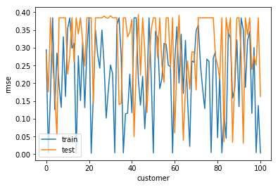
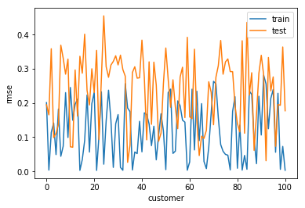
Results on 100 Customers scaled values
Model 1
Model 2

Slide 9
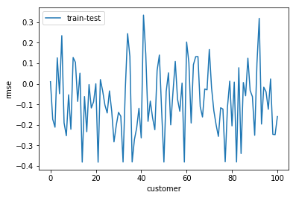
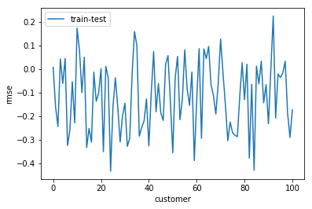
Peak -ve values -> we are overfitting train data
Peak +ve values -> we are underfitting train data
Values around zero are best fit models
Model 1
Model 2

Slide 10
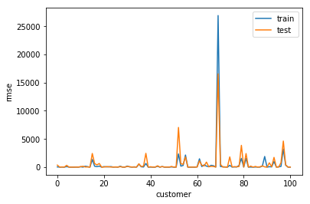
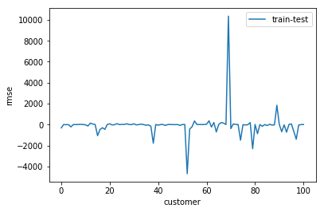
100 Customers actual values

Slide 11
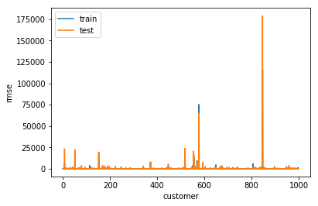
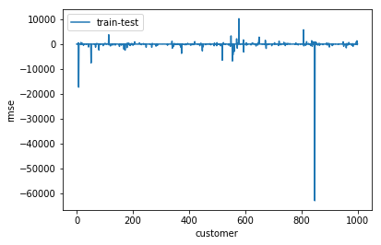
1000 customers actual values

